Slide 1
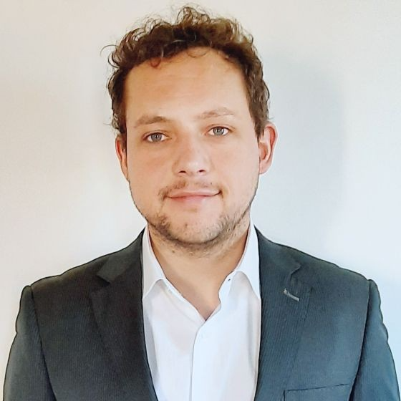
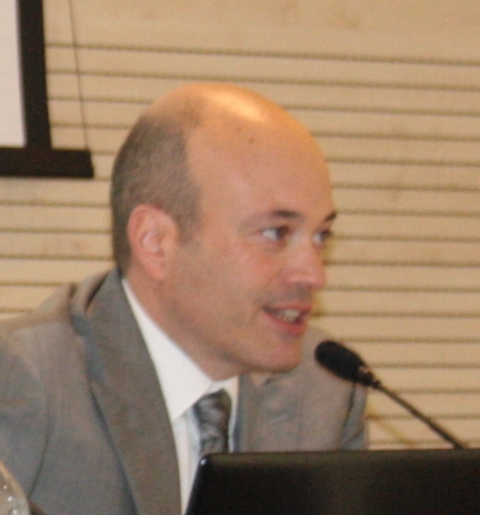
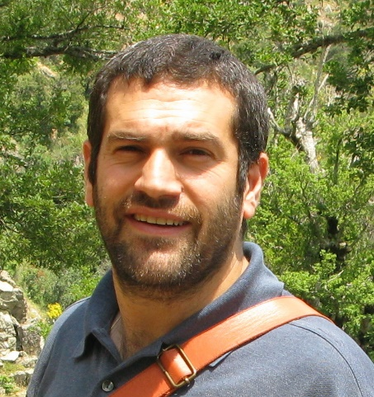
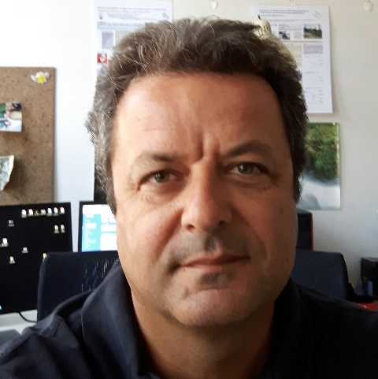
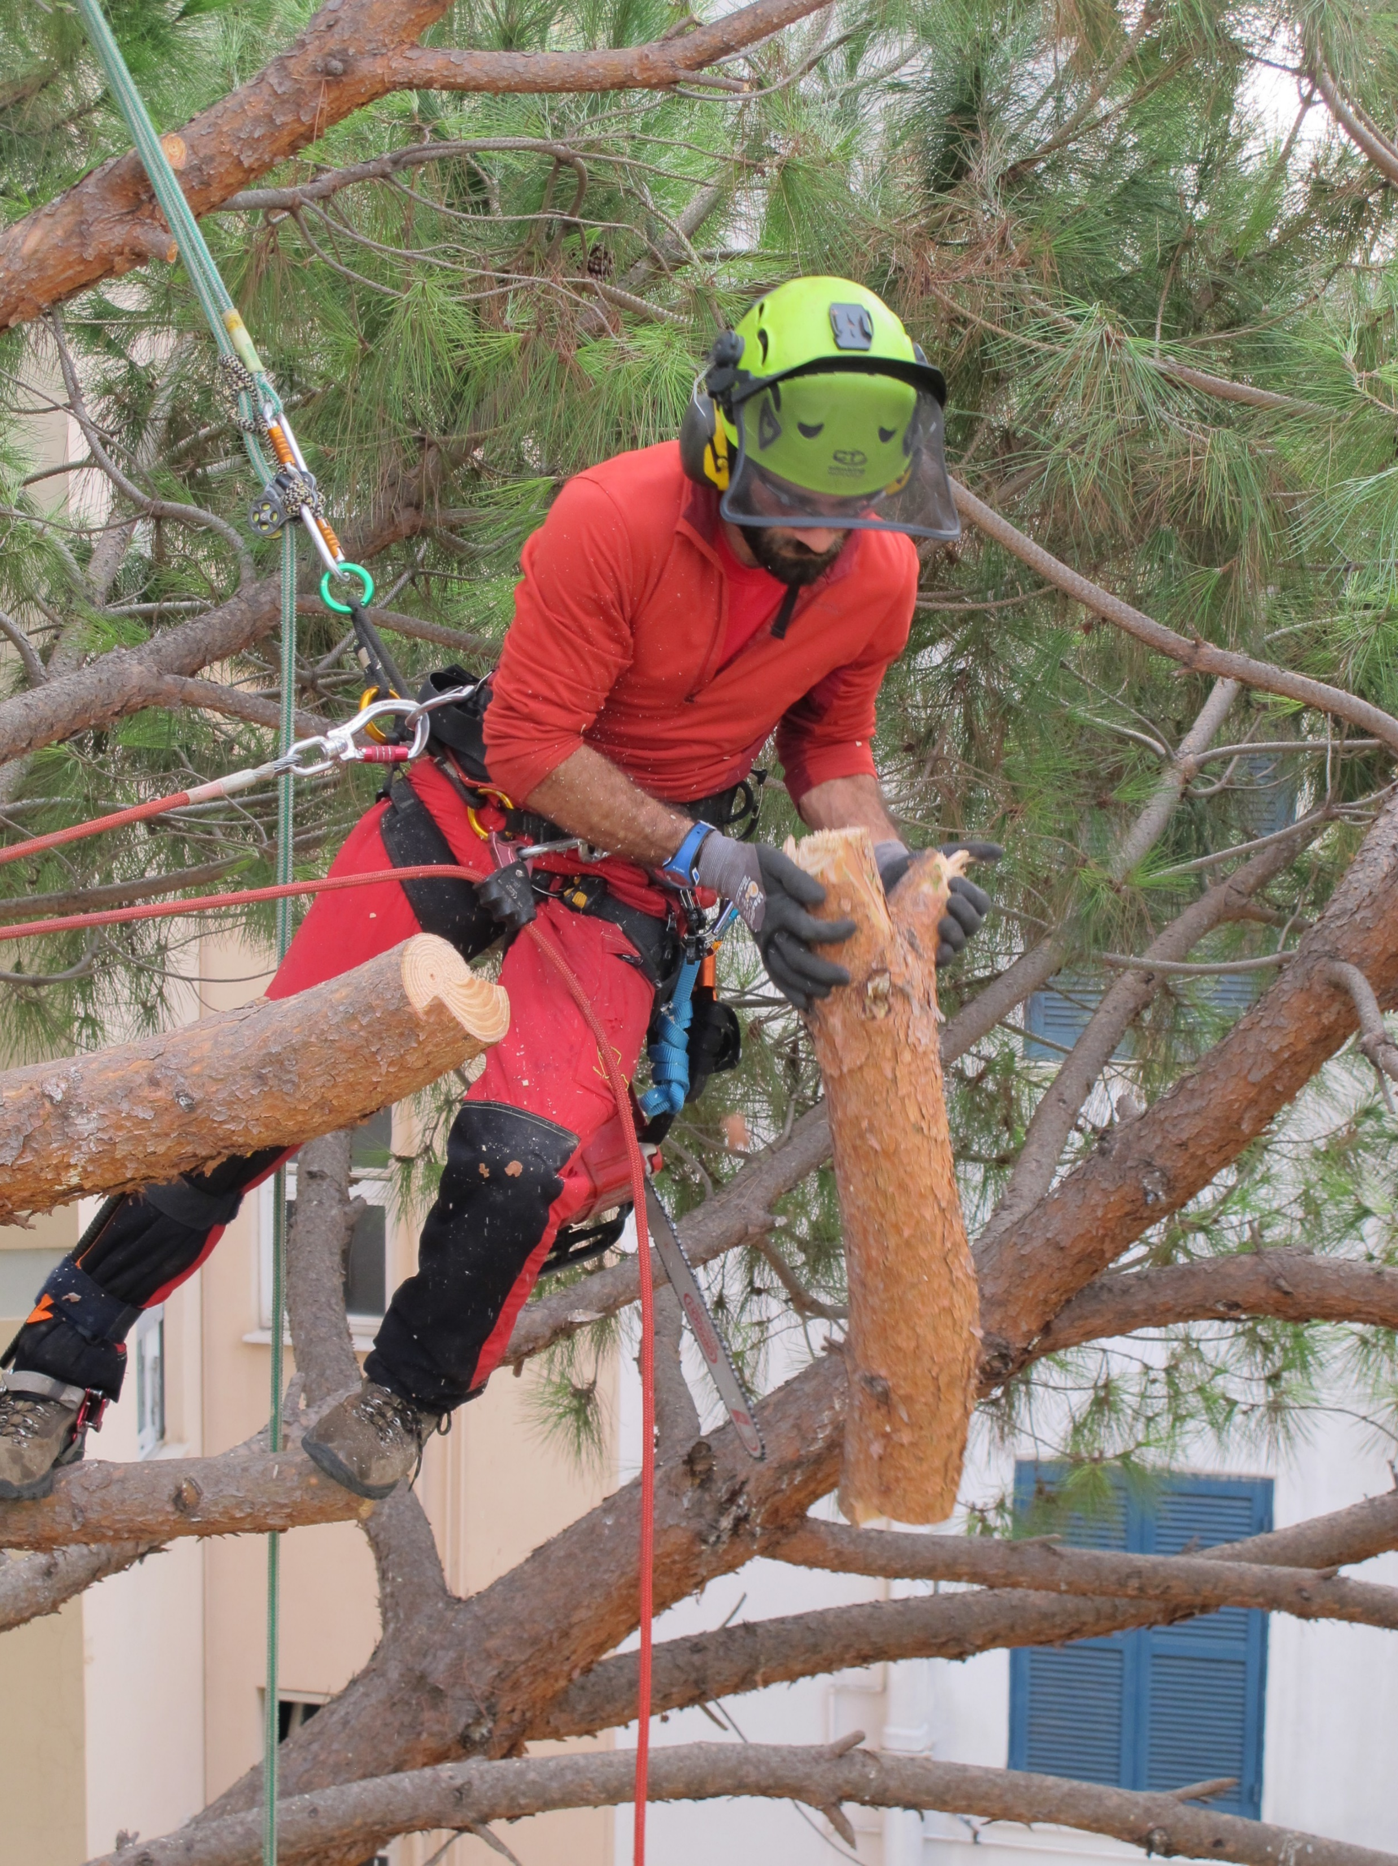
A survey on rope-based ascending techniques and materials of professional arborists in Italy
Leonardo Bianchini¹
Massimo Cecchini¹
Pietro Gallo²
Marcello Biocca²
¹Tuscia University – Department of Agriculture and Forestry Science (UNITUS-DAFNE)
²CREA Centro Ingegneria e Trasformazioni Agroalimentari

Slide 2
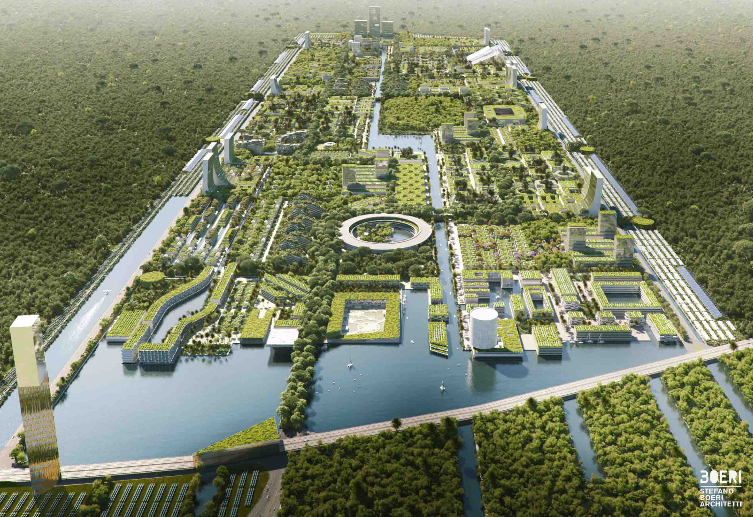
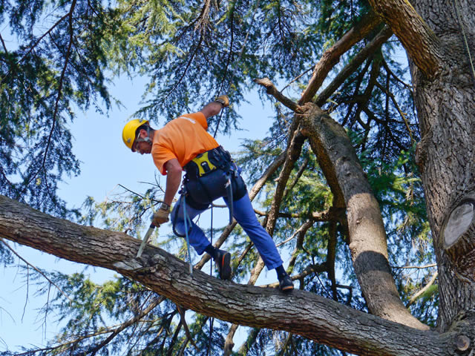
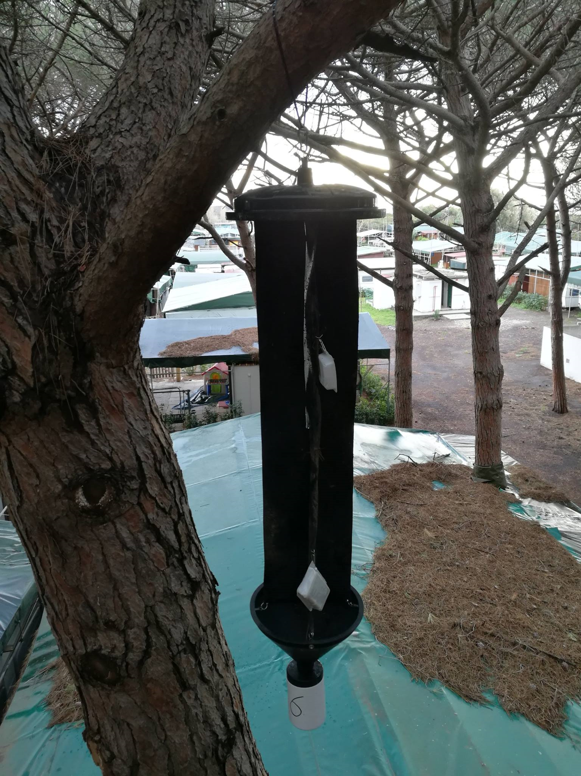
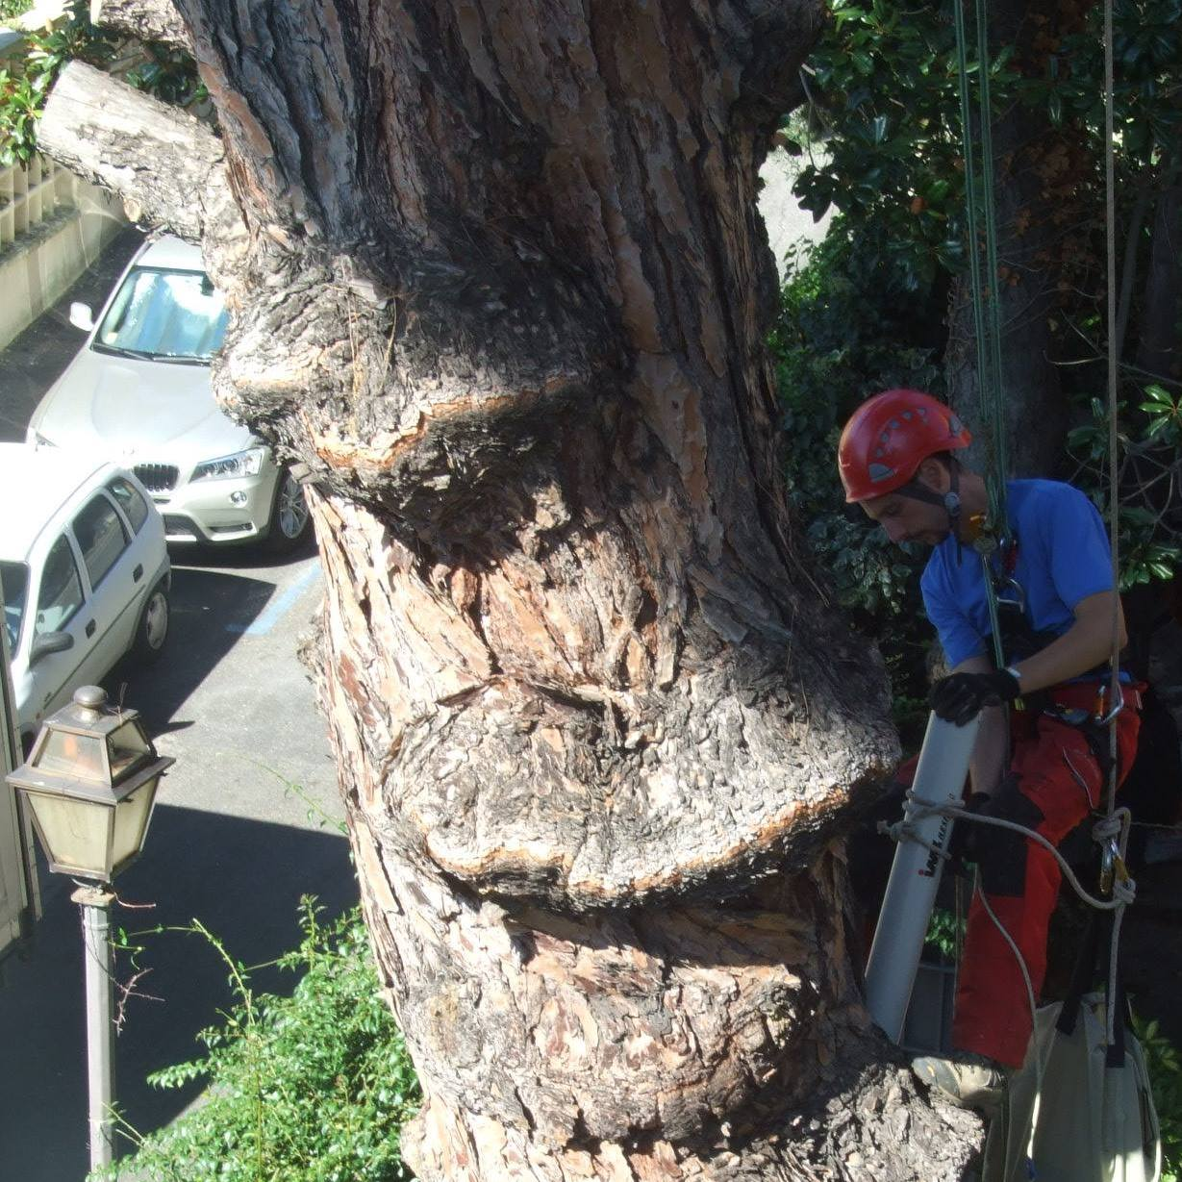
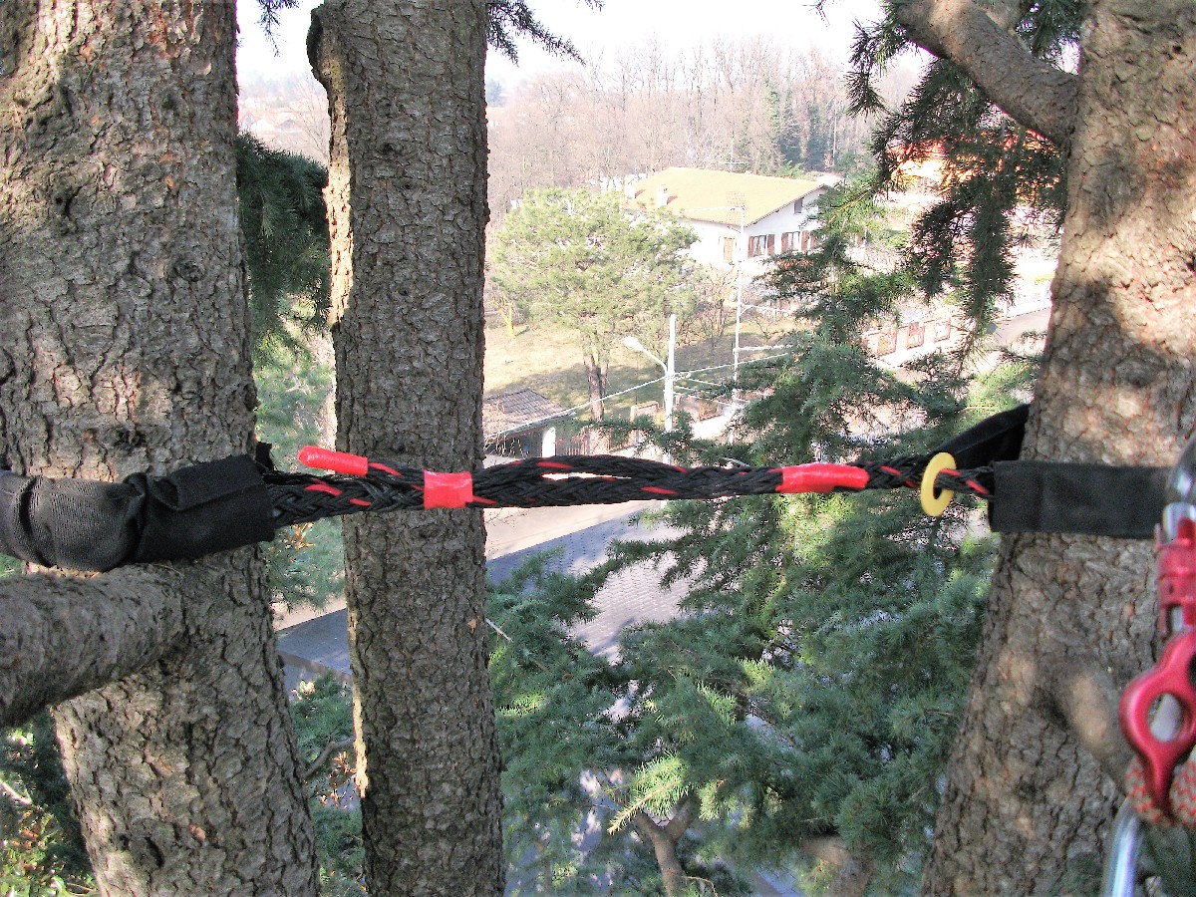
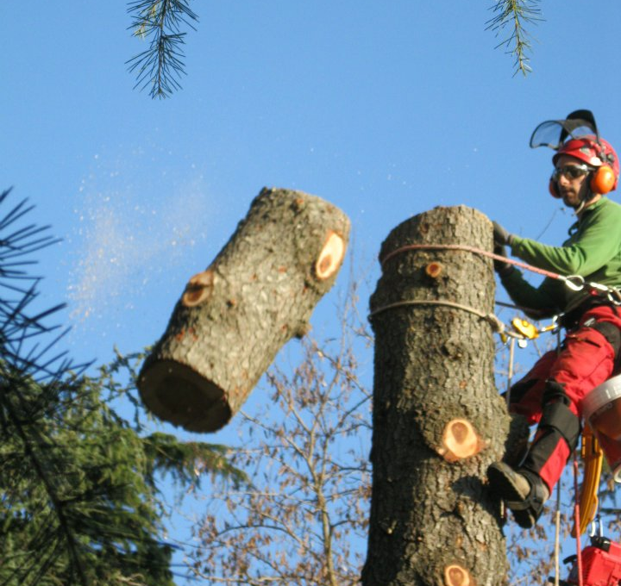
Introduction
Urban forestry and green areas are increasingly important but require workforce and professionality to manage trees.
Tree-climbing (rope-based access methods):
pruning,
felling of trees,
cabling,
phytosanitary inspections,
others.
Advantages:
targeted and selective interventions on tree branches,
reaching internal portions of the canopy,
accessing to trees located in confined areas where machinery cannot enter.
The scientific literature about the technical and economic evaluation of maintenance operation performed by tree-climbing appears rather poor.

Slide 3
Methods
Questionnaire
objective contents
Close-ended structure
subjective content
five-point Likert scale
Questionnaire sections
personal data
formation
safety
work organization
opinions
48 questions
86 operators
In this paper we analyze technical information related to 26 answers

Slide 4
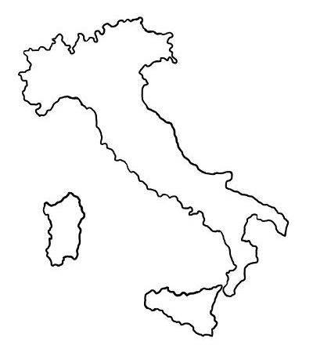
Results
The participants
Geographical work areas
All males
North Eastern 21%
Age: 62.8% were less than 40 years
North Western 31%
Level of education:
59% high school diploma,
17% Master degree or post graduate degree, i.e. PhD
Central 40%
South and Islands 8%
The degree of education significantly differs (p-value = 0.01242 Pearson’s Chi-squared test) according to area of work
Working positions
were freelance (44%),
company owners (34%),
employee (17%),
contractor (2%)
member of cooperative (2%).

Slide 5
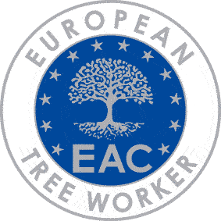
Results
Professional training
Compulsory course: specific module on rope work on trees
Art.116 - annex XXI D.Lgs. 81/08.
8 out of 86 (9.3%) did not attend the course
The other courses
basic courses for Health & safety Manager (Directive 89/391/EEC) (68.6%),
mobile aerial platforms (64%),
chainsaw (59.3%),
first rescue (51.2%)
anti-fire (39.5%),
supervisor (36.0%),
gardener (14.0%).
Other qualification courses
other courses related to the profession (40.7%),
voluntary certification courses (European Tree Worker - ETW) (32.6%).

Slide 6
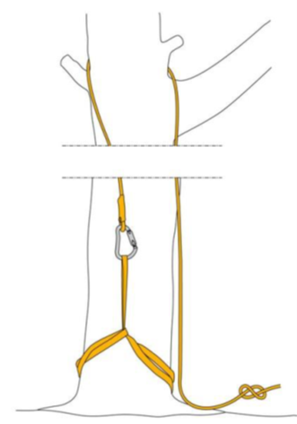
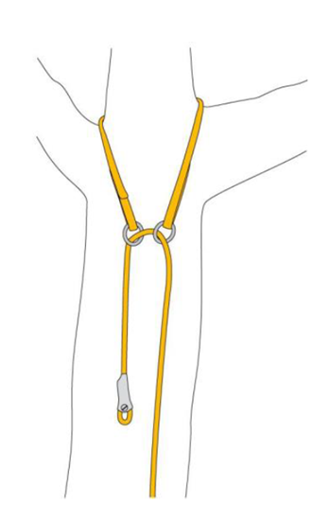
Results
Techniques
Single Rope Technique (SRT) 70%
Doubled Rope Technique (DdRT)17%
DdRT with handled rope clamp and prusik 8%
Climbing spike and adjustable lanyard 5%

Slide 7
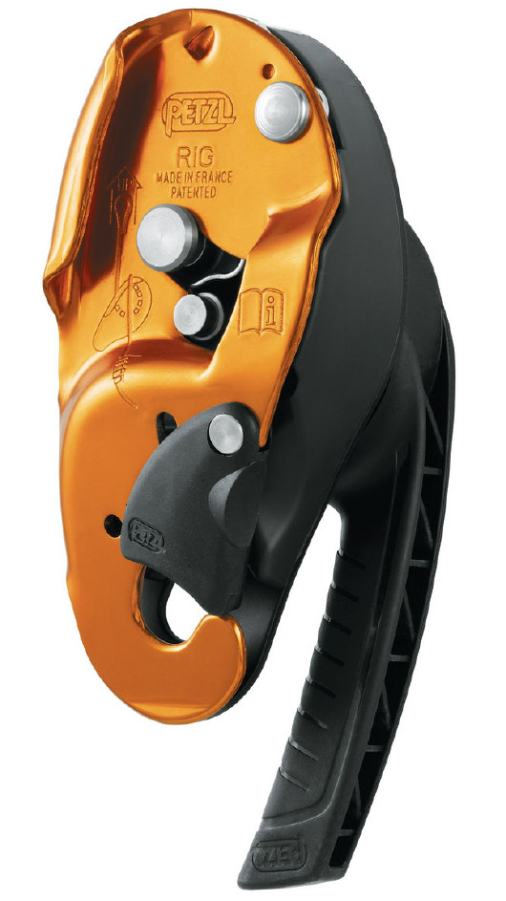
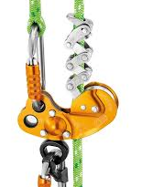
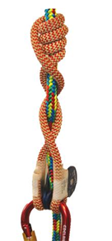
Results
Mechanical descenders or friction hitches
Mechanical descender
Zig zag 71.8%
Rig 30.8%
Friction hitches
Valdotain tresse 58.3%
Blake’s hitch 45.8%

Slide 8
Conclusions
The sector is characterized by a high level of operator education, training and a high degree of technological innovation both in terms of techniques and tools and equipment.
We have compared the results with a previous survey carried out by Mazzocchi in 2017.
A reduction of self-employed workers was observed (44% versus 63%).
An increase in employers and employees (respectively 34% and 17% against 20% and 5%).
An increase in the use of mechanical descenders (ZigZag 71.8%) which in the past was around 31%.
A change was observed is the increase in the number of operators having got voluntary ETW certification, which increase from 27% to 32.6%,
An increase in the use SRT techniques is clearly preferred (70% versus 50%).

Slide 9
Conclusions
In the present study, technical and work conditions of professional arborists operating in tree care and maintenance were indagated by means of a survey carried out at national level.
The role of the professional arborist has gone beyond being only a pruner, as training and continuing specialization allow operators to provide tree management services from many domains.
However, further in-depth studies are desirable to improve productivity and safety of this type of emerging work dedicated to the correct management of urban green areas.

Slide 10
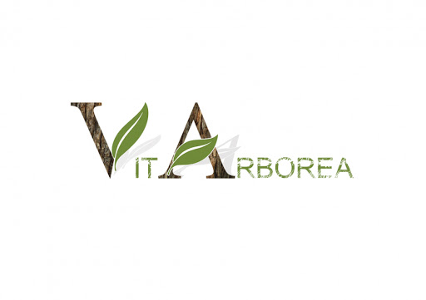
Acknowledgements
The authors are grateful to the professional arborists of the following companies who have contributed to the development of the questionnaire
Ecologistica Srl (Viterbo)
UTM Soc. Coop. (Oriolo Romano, VT)
Vitarborea (Palombara Sabina, RM)
l.bianchini@unitus.it

