Slide 1
MODELLING OF ELEVATED TEMPERATURE PERFORMANCE OF ADHESIVES USED IN CROSS LAMINATED TIMBER: AN APPLICATION OF ANSYS MECHANICAL 2020 R1 STRUCTURAL ANALYSIS SOFTWARE
Presented by:
Ivan Moses Okuni
Supervised by:
Tracy Ellen Bradford
TRANSFORMING LIVES SINCE 1828

Slide 2
Outline
Introduction
Methodology
Results and Analysis
Conclusion
Future Research
A mass timber building in London, UK

Slide 3
Introduction
Increasing use of CLT from 610,000 cubic meters in 2015 to 821,270 cubic meters in 2019 in Europe for building construction
CLT traps approximately 1500 kilograms of carbon dioxide per ton
CLT combustibility and flammability limits its use
While under fire CLT undergoes charring and delamination
1% reduction in moisture content influences CLT’s structural properties by between 2% to 6%
CLT is produced by bonding wood lamellas together with wood glue
CLT is used as wall panels, flooring panels, roofing slabs, and so on
Cross Laminated Timber (CLT) Slab

Slide 4
Problem Statement
Difficulty in accurately modelling adhesive influence in structural performance of CLT
Lack of available knowledge on the heat performance of adhesives
Shortfalls with small scale tests or large-scale tests
Robustness of numerical tools, especially ANSYS software

Slide 5
Objectives
To determine the influence of the adhesive layer on thermal behaviour of CLT
To model the thermal behaviour of solid wood
To determine the mechanical properties of wood adhesives, especially loss in the adhesive bond strength due to rise in temperature

Slide 6
Methodology
Introduction and Materials
Table 1: Properties of wood used in Finite Element Analysis (FEA)
Parameter | Douglas Fir (DF) | Southern Yellow Pine (SYP) | Spruce Pine Fir (SPF)
E_{L} (MPa) | 14740 | 13530 | 9790
E_{T} (MPa) | 737 | 1055.34 | 577.61
E_{R} (MPa) | 1002.32 | 1528.89 | 1253.12
V_{LR} | 0.292 | 0.328 | 0.422
V_{LT} | 0.449 | 0.292 | 0.462
V_{RT} | 0.390 | 0.382 | 0.53
G_{LR} (MPa) | 943.36 | 1109.46 | 1213.96
G_{LT} (MPa) | 1149.72 | 1095.93 | 1174.8
G_{RT} (MPa) | 103.18 | 175.89 | 97.9
Thermal Conductivity, W/(m°C) | 1.01 | 1.12 | 0.90
Figure 1: Geometry of the specimen used by Zelinka

Slide 7
Methodology
Introduction and Materials Cont’d
Table 2: Coefficient of Thermal Expansion of DF, SYP & SPF
Species | Radial (10⁻⁶ in/in/ ºF) | Tangential (10⁻⁶ in/in/ ºF) | Parallel (10⁻⁶ in/in/ ºF)
Douglas Fir - South | 14 | 19 | 1.9
Southern Yellow Pine | 15 | 20 | 2.0
Spruce Pine Fir | 13 | 18 | 1.8
Figure 2: Geometry for solid wood used in thermal analysis
Table 3:Properties of wood adhesives
Elastic Properties | Melamine Formaldehyde (MF) | Phenol Resorcinol Formaldehyde (PRF) | Polyurethane (PUR)
Young’s Modulus (MPa) | 3200 | 3540 | 559
Possion’s Ratio | 0.33 | 0.443 | 0.351
Coefficient of thermal expansion (CTE) (/ºF,K) | 60 x 10⁻⁶ | 68 x 10⁻⁶ | 200 x 10⁻⁶
Thermal Conductivity (W/m.K) | 0.5 | 0.146 | 0.209
Figure 3: Geometry for wood with a glued lap joint

Slide 8
Methodology
Introduction and Materials Cont’d
Table 4: Temperatures and Heat Flux used in the Simulations
Temperature | 20 ºC, 100 ºC, 140 ºC, 180 ºC, 220 ºC, and 260 ºC
Heat Flux | 10020 W.m⁻²
Heat | 5.65 W
convective heat transfer coefficient | 2.5 x 10⁻⁶ W/(mm².K)
Eurocode 5 Equation (Eq1) | $$T=T_{i}+\left(T_{p}−T_{i}\right){\left(1−\frac{x}{a}\right)}^{2}$$
Thermal Conductivity Equation (Eq4) | $$T_{out}=T_{in}−\dot{Q^{′′}\frac{dx}{k}}$$
Figure 5: ANSYS set up for tensile test of wood
Figure 4: Specimen Dimensions for Analytical Calculations
Figure 6: ANSYS set up for tensile test of Adhesive

Slide 9
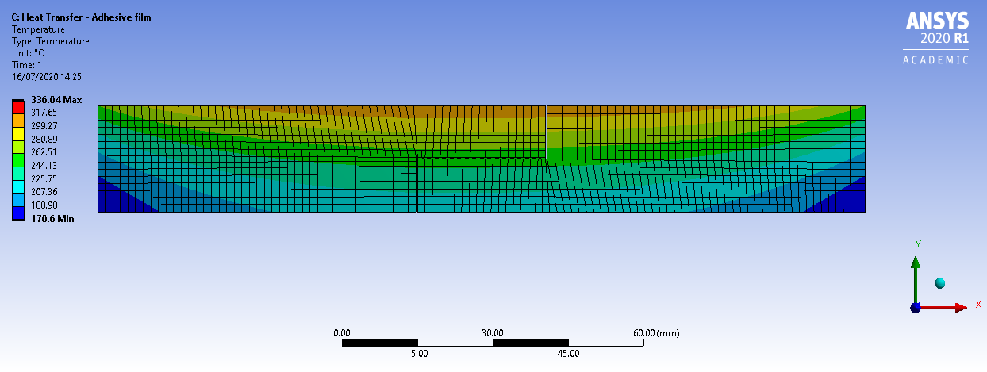
RESULTS AND ANALYSIS Steady State Thermal Model
Figure 7: Temperature distribution in solid wood (DF)
Figure 9: Temperature distribution in a composite of DF and MF
Figure 8: Temperature distribution in a composite of DF and PRF
Figure 10: Temperature distribution in a composite of DF and PUR
Notes:
From steady state thermal simulations, the adhesive layer lies in the region between 10.2 to 10.5 mm, which is within the green region. For solid wood specimen, the green region lies between temperatures of about 238 to 256 ºC, for wood bonded with PRF, the green region lies between temperatures of 244 to 263ºC, for wood bonded with MF, the green region lies between temperatures of 244 to 262 ºC and finally for solid wood bonded with PUR the green region lies between temperatures of 244 to 262 ºC.

Slide 10
RESULTS AND ANALYSIS Analytical Model
Table 5: Summary of Analytical Results
Material | Heat Flux (W/m²) | Thermal conductivity (Wm⁻¹K⁻¹) | T_{B} ( ºC) | T_{C} (ºC)
Eurocode 5 Equation (Eq1)
Solid Wood - DF |  |  | 175 | 172
Thermal Conductivity Equation (Eq4)
Solid Wood - DF | 10020 | 1.01 | 235 | 232
Adhesive layer - PRF | 10020 | 0.146 | 235 | 214
Adhesive layer - MF | 10020 | 0.5 | 235 | 229
Adhesive layer - PUR | 10020 | 0.209 | 235 | 220
Notes:
From steady state thermal simulations, the adhesive layer lies in the region between 10.2 to 10.5 mm, which is within the green region. For solid wood specimen, the green region lies between temperatures of about 238 to 256 ºC, for wood bonded with PRF, the green region lies between temperatures of 244 to 263ºC, for wood bonded with MF, the green region lies between temperatures of 244 to 262 ºC and finally for solid wood bonded with PUR the green region lies between temperatures of 244 to 262 ºC.

Slide 11
RESULTS AND ANALYSIS Thermal - Structural Behaviour of Wood
Table 6: Douglas Fir (DF)
Temperature (ºC) | Stress (MPa) | Strain (mm/mm)
20 | 102 | 0.0278
100 | 83.7 | 0.0198
140 | 74.4 | 0.0159
180 | 65.1 | 0.0120
220 | 55.8 | 0.00805
260 | 46.5 | 0.00724
Table 7: Southern Yellow Pine (SYP)
Temperature (ºC) | Stress (MPa) | Strain (mm/mm)
20 | 106 | 0.0261
100 | 85.7 | 0.0186
140 | 75.6 | 0.0149
180 | 65.4 | 0.0112
220 | 55.3 | 0.00783
260 | 45.1 | 0.00709
Table 8: Spruce Pine Fir (SPF)
Temperature (ºC) | Stress (MPa) | Strain (mm/mm)
20 | 82.7 | 0.0349
100 | 66.7 | 0.0252
140 | 58.7 | 0.0204
180 | 50.6 | 0.0155
220 | 42.6 | 0.0107
260 | 34.5 | 0.00764
Notes:
From steady state thermal simulations, the adhesive layer lies in the region between 10.2 to 10.5 mm, which is within the green region. For solid wood specimen, the green region lies between temperatures of about 238 to 256 ºC, for wood bonded with PRF, the green region lies between temperatures of 244 to 263ºC, for wood bonded with MF, the green region lies between temperatures of 244 to 262 ºC and finally for solid wood bonded with PUR the green region lies between temperatures of 244 to 262 ºC.

Slide 12
RESULTS AND ANALYSIS Thermal - Structural Behaviour of Adhesives
Table 9: PRF Adhesive
Temperature (ºC) | Stress (MPa) | Strain (mm/mm)
20 | 132 | 0.0696
100 | 107 | 0.0524
140 | 94.2 | 0.0439
180 | 81.6 | 0.0354
220 | 68.9 | 0.0270
260 | 56.1 | 0.0186
Table 10: MF Adhesive
Temperature (ºC) | Stress (MPa) | Strain (mm/mm)
20 | 128 | 0.0525
100 | 104 | 0.0400
140 | 92.2 | 0.0337
180 | 80.1 | 0.0275
220 | 68.0 | 0.0214
260 | 55.8 | 0.0153
Table 11: PUR Adhesive
Temperature (ºC) | Stress (MPa) | Strain (mm/mm)
20 | 116 | 0.152
100 | 94.3 | 0.114
140 | 83.5 | 0.0949
180 | 72.8 | 0.0762
220 | 62.0 | 0.0580
260 | 51.2 | 0.0407
Notes:
From steady state thermal simulations, the adhesive layer lies in the region between 10.2 to 10.5 mm, which is within the green region. For solid wood specimen, the green region lies between temperatures of about 238 to 256 ºC, for wood bonded with PRF, the green region lies between temperatures of 244 to 263ºC, for wood bonded with MF, the green region lies between temperatures of 244 to 262 ºC and finally for solid wood bonded with PUR the green region lies between temperatures of 244 to 262 ºC.

Slide 13
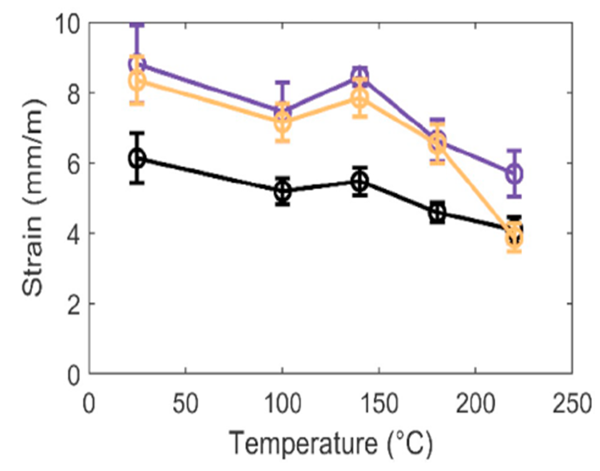
RESULTS AND ANALYSIS Results from Zelinka’s Experiment
STRESS VS TEMPERATURE FOR SOLID WOOD
ERROR GRAPH OF STRESS VS TEMPERATURE FOR ADHESIVES
STRAIN VS TEMPERATURE FOR SOLID WOOD
Notes:
From steady state thermal simulations, the adhesive layer lies in the region between 10.2 to 10.5 mm, which is within the green region. For solid wood specimen, the green region lies between temperatures of about 238 to 256 ºC, for wood bonded with PRF, the green region lies between temperatures of 244 to 263ºC, for wood bonded with MF, the green region lies between temperatures of 244 to 262 ºC and finally for solid wood bonded with PUR the green region lies between temperatures of 244 to 262 ºC.

Slide 14
Conclusion
The thermal properties of glued timber are the same as for solid timber
Wood adhesives have a significant influence on the structural properties of CLT
The stresses and strains of wood species decreased with increase in temperature
The stresses and strains of wood adhesives reduced with increase in temperature
PRF and MF are better structural adhesives than PUR

Slide 15
Future Research
There needs to be a study of assemblies rather than rectangular slabs and for higher temperatures and perhaps defects such as ducting also need more study
There needs to be an extensive study on CLT with more than two glue layers

Slide 16
References
Zelinka, S. L., Sullivan, K., Pei, S., Ottum, N., Bechle, N. J., Rammer, D. R., & Hasburgh, L. E. (2019). Small scale tests on the performance of adhesives used in cross laminated timber (CLT) at elevated temperatures. International Journal of Adhesion and Adhesives, 95, 102436. https://doi.org/10.1016/j.ijadhadh.2019.102436
Bartlett, A.I., Hadden, R.M. & Bisby, L.A. (2019). A Review of Factors Affecting the Burning Behaviour of Wood for Application to Tall Timber Construction. Fire Technology 55, 1–49. https://doi.org/10.1007/s10694-018-0787-y
Wood handbook (1999): wood as an engineering material. Madison, WI : USDA Forest Service, Forest Products Laboratory. General technical report FPL; GTR-113: Pages 4.1-4.45.
Klippel, M. (2014). Fire safety of bonded structural timber elements. ETH Zürich. Available at: http://hdl.handle.net/20.500.11850/94679
Frihart CR. (2005). Handbook of wood chemistry and wood composites. In: Rowell Roger M, editor. Wood adhesion and adhesives. Boca Raton, Florida: CRC press. p.215–78.
Stoeckel, F., Konnerth, J. and Gindl-Altmutter, W. (2013). Mechanical properties of adhesives for bonding wood—A review. (International Journal of Adhesion and Adhesives, 45). https://doi.org/10.1016/j.ijadhadh.2013.03.013
Charles A. Harper (2002). Handbook of Plastics, Elastomers, and Composites, Fourth Edition (McGRAW-HILL).
Sun, G., & Zhang, Z. (2001). Mechanical properties of melamine-formaldehyde microcapsules. Journal of Microencapsulation, 18(5), 593 - 602.
Thompson, M. K., & Thompson, J. M. (2017). ANSYS Mechanical APDL for Finite Element Analysis. Elsevier Inc.
Kosky, P., Balmer, R., Keat, W. and Wise, G. (2013). Exploring Engineering (Third Edition). Elsevier/AP.

