Slide 1
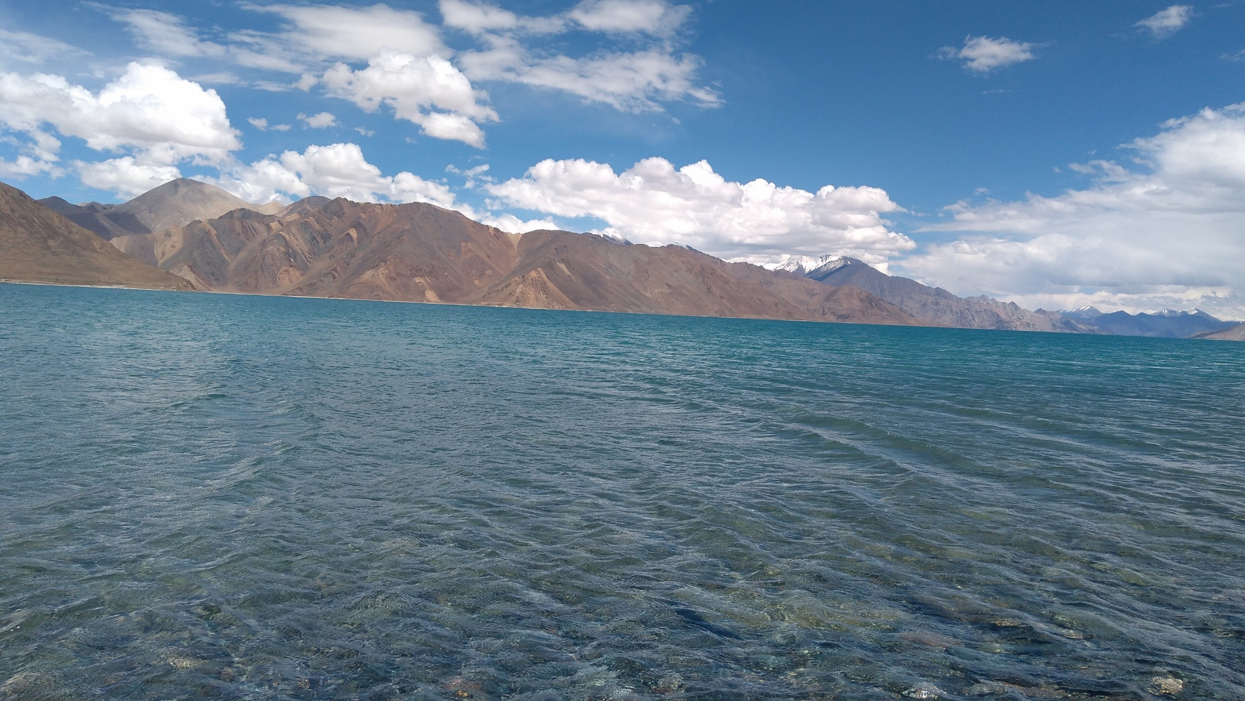
Dr. Suhail A. Lone
Project Scientist
DEPARTMENT OF EARTH SCIENCES
UNIVERSITY OF KASHMIR
HAZARATBAL SRINAGAR
Jammu and Kashmir (INDIA)
Stable water isotopic evidence for the moisture source and composition of surface runoff in Ladakh, upper Indus river basin (UIRB)
Field Photograph: 2018
Pangong Lake

Slide 2
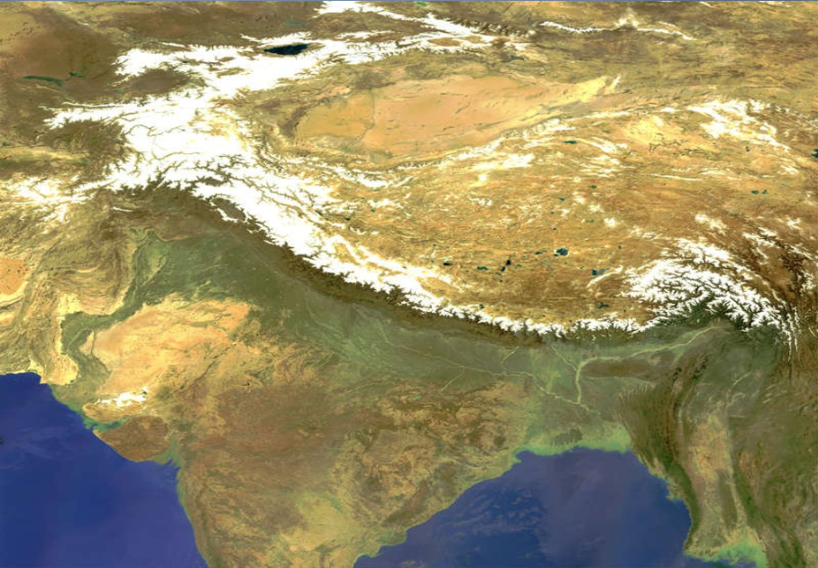
Himalayan Cryosphere
More than 1/6 of worlds population depends on snow and glacier fed rivers.
Known as Water Tower of Asia
Largest body of glaciers outside of polar regions, occupy 17% of mountain area (IPCC, 2007) hence also know as Third pole.
5000 glaciers in Himalayan-Hindu-Kush region with an area of 35,110 km².
1800 glaciers in J&K, cover an area of 997 km^{2.}
Satellite image of Himalayan Cryosphere

Slide 3
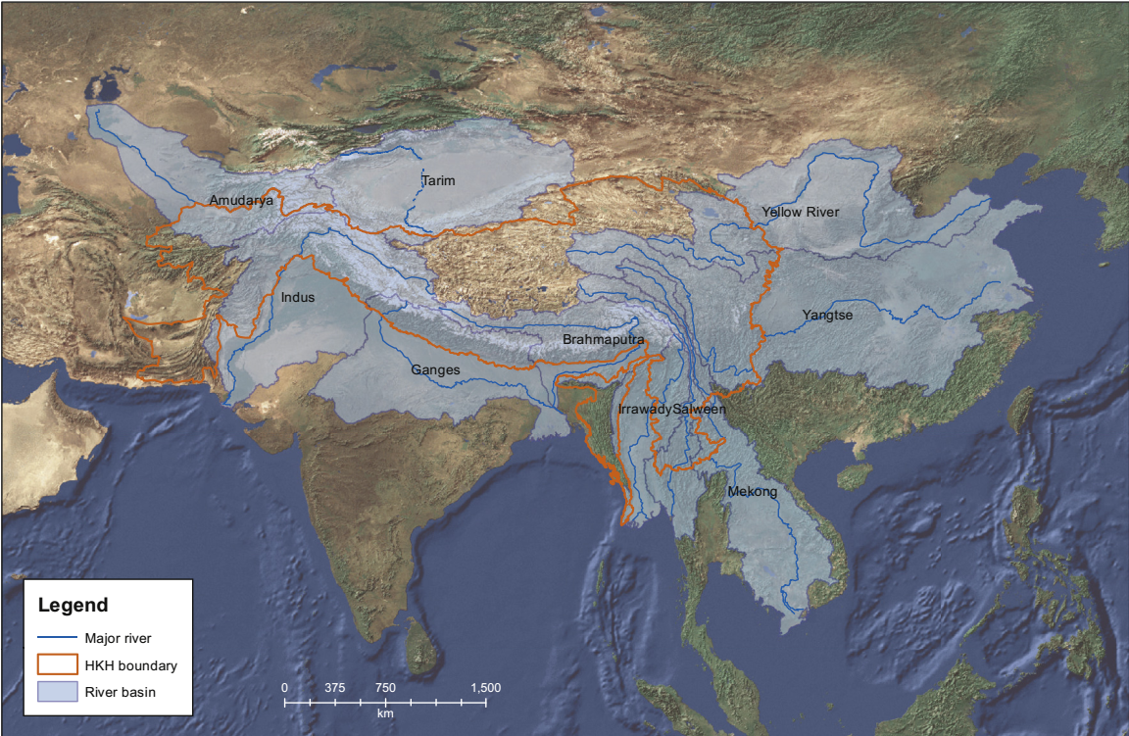
Significance
These Glacier/Snow fed rivers supply fresh water to 500 million in Himalayas-Hindu-Kush region and 250 million people in China (IPCC,2007)
Drinking Purposes
Agriculture
Hydropower generation
Shrinking cryosphere?????
Concern among the people
Climate Change: everybody's cup of tea

Slide 4
Study Area
Area: 59942 sq. kms
Elevations: 2500 a,msl in Drass to > 5000 m a,msl in Leh
Climate: Cold arid climate annual precipitation of about 115 mm (Weather station Leh)
Temperature: 14ºC in summer to -8ºC in winter (Weather station Leh)

Slide 5
Upper Indus river basin Ladakh
Long-term temperature and precipitation trends
IMD and NOAA
Source: Lone et al., 2019

Slide 6
Variation of δ¹⁸O and δ²H in precipitation
LMWL-Precipitation
(Monthly & Seasonal)
δ¹⁸O vs. air temperature, precipitation amount & d-excess
δ¹⁸O vs. Altitude

Slide 7
The stable water isotopic value of precipitation abruptly drops at all the precipitation sites in August, without considerable variation in the ambient temperature and precipitation amount signifying the alteration in moisture source.

Slide 8
NCEP/NCAR (National centre for environmental prediction/National centre for atmospheric research:
Westerly wind dominant from the October to May.
southwest monsoons dominant from June to September.

Slide 9
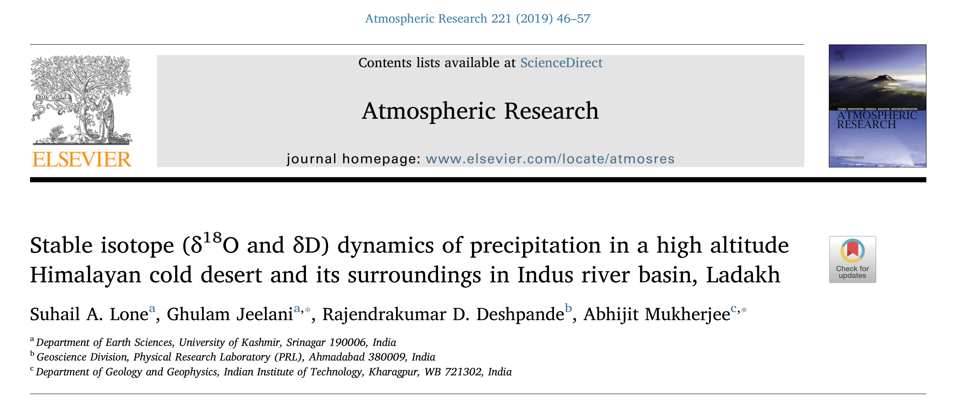
HYSPLIT Model
1000
1500
2000

Slide 10
Stable isotopic variation (δ¹⁸O and δ²H) in glacier melt
Machoi and Galdar glaciers exhibit low isotopic values: δ¹⁸O or / δ²H -10.4 to -12‰ and -73 to -74‰, than Parachik, Drung-Durung and Khardung glaciers (Avg:: δ¹⁸O or / δ²H -13.6 to -16.8‰ and -95 to -110‰).
Isotope altitude gradient (-0.27 ‰ and -2 ‰) for δ¹⁸O and δ²H.
δ¹⁸O and δ²H v/s altitude in glacier melt
Temporal variation in glacier melt

Slide 11
Stable isotopic variation (δ¹⁸O and δ²H) in snowpacks:
Snowpack samples taken from the winter-accumulated snowpacks along various transects in all the basins ranged from −15.38 to−11.48 ‰ (S.D.: 1.6) and −112.76 to −70.28 ‰ (S.D.: 12.2) with an average values of −94.05‰ and −13.43‰.
The estimated isotope altitude gradient of snowpack samples varied from −0.24 to −0.42 ‰ and −2.4 to −3.9‰ for δ¹⁸O and δ²H.
δ¹⁸O and δ²H v/s altitude in glacier melt
Temporal variation in glacier melt

Slide 12
Stable isotopic variation (δ¹⁸O and δ²H) in Stream water
δ¹⁸O & δ²H variation in stream water in different rivers of upper Indus basin
Temporal variation of δ¹⁸O & δ²H in stream water in different rivers of upper Indus basin

Slide 13
Relation between LMWL & GMWL
The slope of all stream water is higher than LMWL but lower than GMWL.
Dras river: δ²H=7.6(±0.8)˟δ¹⁸O+23(±3.2) R²=0.98
Suru river: δ²H=8.6(±0.6)˟δ¹⁸O+18(±2.8) R²=0.95
Shyok river:δ²H=9.6(±0.4)˟δ¹⁸O+16(±2.1) R²=0.81
Nubra river:δ²H=8.2(±0.7)˟δ¹⁸O+14(±3.3) R²=0.93
Indus river:δ²H=7.7(±0.3)˟δ¹⁸O+13(±2.2) R²=0.86

Slide 14
Contribution from rain, snow, glacier melt and groundwater to regional hydrology:

Slide 15
Contribution from rain, glacier melt, snowmelt and groundwater in (%):
Rivers | Spring |  |  |  | Summer |  |  |  | Autumn
 | r | sn | gm | gw | r | sn | gm | gw | r | sn | gm | gw
Dras | 12±0.2 | 41±1.2 | 30±1.4 | 18±0.8 | 22±0.9 | 36±1.6 | 31±1.7 | 11±0.1 | 18±0.8 | 25±1.1 | 41±2.1 | 16±0.2
Suru | 14±0.4 | 39±1.9 | 32±1.1 | 15±0.2 | 19±0.7 | 33±1.9 | 26±1.5 | 12±1.1 | 10±0.1 | 21±0.6 | 49±2.7 | 20±0.5
Indus | 20±0.4 | 37±2.1 | 27±0.6 | 16±0.6 | 24±0.7 | 36±1.2 | 23±0.7 | 17±0.3 | 22±0.8 | 25±0.9 | 37±1.1 | 16±0.7
Nubra | 17±1.1 | 41±1.9 | 27±0.8 | 15±0.5 | 22±0.9 | 37±1.8 | 29±1.7 | 12±0.3 | 16±0.5 | 31±0.6 | 41±2.3 | 12±0.5
Shyok | 18±0.9 | 39±1.8 | 24±0.4 | 19±0.3 | 21±0.7 | 33±1.7 | 33±1.9 | 13±0.1 | 16±0.8 | 28±0.8 | 46±2.6 | 10±0.2
The contribution of rain, snow, glacier melt and groundwater to stream flow in different rivers of Ladakh (UIRB) with uncertainty

Slide 16
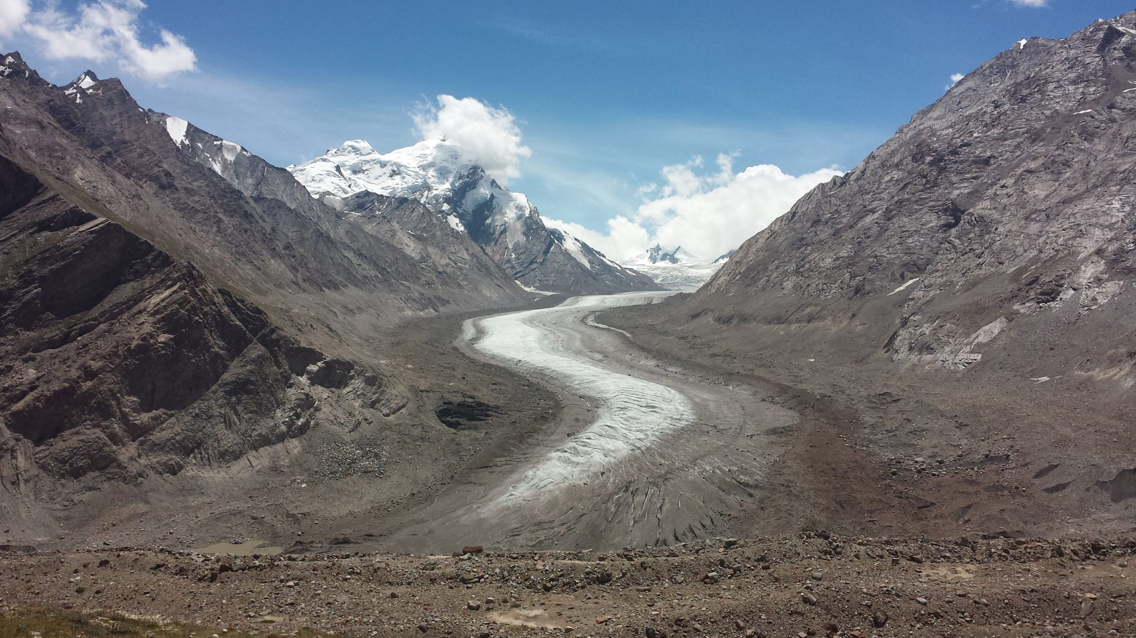
Thank You
Thank You
Field photograph: 2018
Drang-Drung Glacier

