Slide 1





Antitumor and osteogenic activity of bisphosphonate-based Organic Salts and Ionic Liquids
Miguel M. Santos ^{1,}*, Sónia Teixeira ², Maria H. Fernandes ², J. C. Rodrigues ³, Luís C. Branco ¹
¹ LAQV-REQUIMTE, Departamento de Química, Faculdade de Ciências e Tecnologia, Universidade Nova de Lisboa, Caparica, Portugal
² Faculdade de Medicina Dentária, Universidade do Porto, Porto, Portugal
³ Escola Superior de Saúde do Instituto Politécnico do Porto, Porto, Portugal
* Corresponding author: miguelmsantos@fct.unl.pt

Slide 2
Antitumor and osteogenic activity of bisphosphonate-based Organic Salts and Ionic Liquids
Bioavailability
Zoledronate-OSILs
Polymorphism
Alendronate-OSILs
Toxicity to healthy cells
Etidronate-OSILs
Antitumor activity
Lung
Osteoclastogenesis
Breast
Osteoblastogenesis
Bone
Notes:
rfpedsuhgsdkjfgh

Slide 3
Abstract: Osteoclast-mediated bone loss disorders are chronically treated with bisphosphonates (BPs). In addition, they have recently shown potential antitumor activity. However, BPs suffer from several drawbacks such as polymorphism and low bioavailability which are related with the common side effects (e.g. muscle, joint and bone pain, numbness) associated with these drugs. Thus, there is a need to develop new ways to increase BPs’ bioavailability while reducing toxicity.
Active Principle Ingredients as Organic Salts and Ionic Liquids (API-OSILs) has been one of the focus of our group over the last years. The combination of drugs as anions or cations with biocompatible organic counter ions has proven to be an innovative approach to tackle drug polymorphism as well as to improve water solubility, permeability and corresponding bioavailability and biological activity.
In this communication, we report the preparation of anionic etidronate, alendronate and zoledronate-based BP-OSILs in quantitative yields. The polymorphic profile of the prepared BP-OSILs and their solubility in water and biological fluids, as well as toxicity towards human healthy and lung, breast and bone cancer cell lines will be presented. Finally, the effect of etidronate-OSILs on osteoblast- and osteoclastogenesis will also be disclosed.
Keywords: API-OSILs; Antitumor; Bioavailability; Bisphosphonates; Osteogenesis.

Slide 4
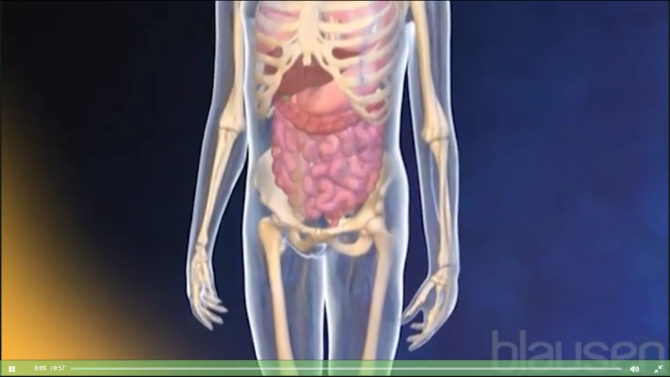
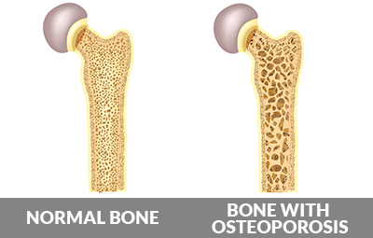
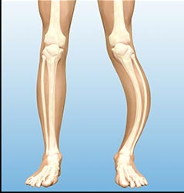
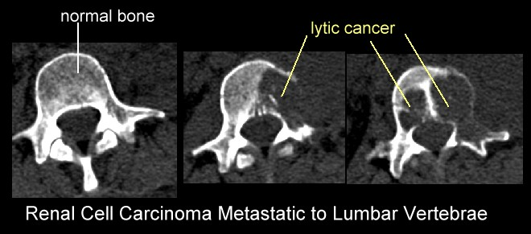
Osteoclasts
H⁺ erode hydroxyapatite
Cathepsin K
Proteases
Introduction
Osteoblasts
Collagen type 1
Hydroxyapatite
Osteoporosis Paget’s disease Bone osteolytic metastases

Slide 5
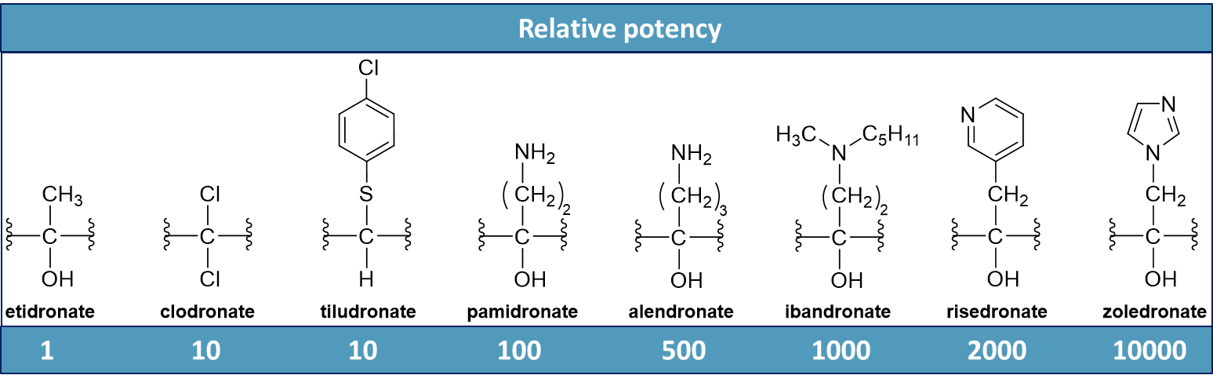
Anti-bone resorption drugs
Resistant to hydrolysis
Ability to functionalize
Enhanced affinity for calcium from hydroxyapatite
Inhibit bone resorption

Slide 6
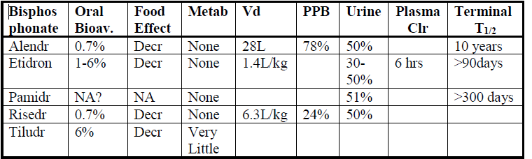
Pharmacokinetics
Organic Salts and Ionic Liquids
from Bisphosphonates
Common side effects
- muscle, joint and bone pain
- muscle spasms
- numbness
Polymorphic profile
Different crystalline forms with distinct pharmacological effects

Slide 7
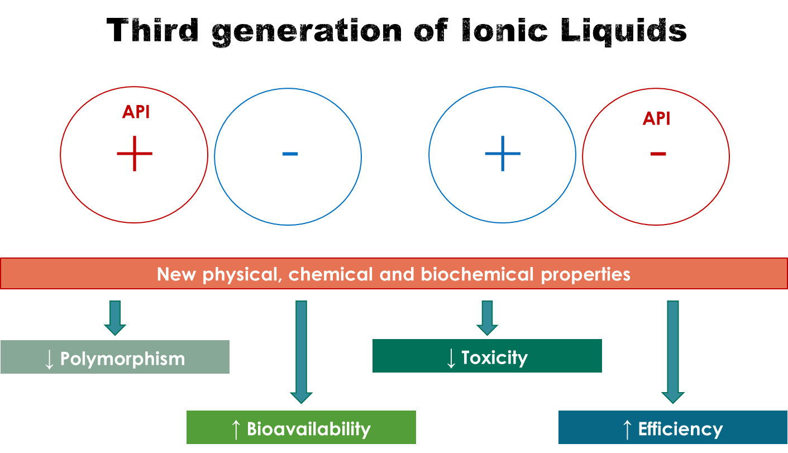
L. C. Branco, et al. Annual Rev. Chem. Biom. Eng. 2014, 5, 527
M. M. Santos and L. C. Branco, Pharmaceutics 2020, 12, 909

Slide 8
Methodology
Chem. Sci., submitted
Pharmaceutics 2020, 12, 293
ChemMedChem 2019, 14, 1767
NMR
FTIR
EA
DSC

Slide 9
¹H NMR spectroscopy

Slide 10
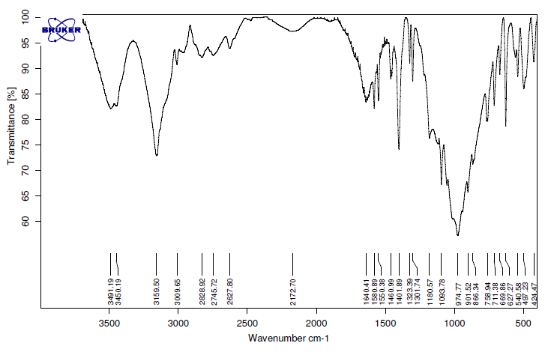
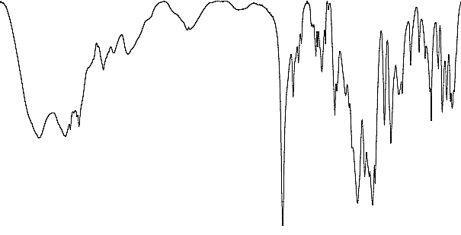
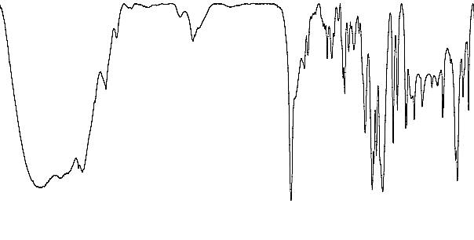
O=P–O-H
P=O / P–OH

Slide 11
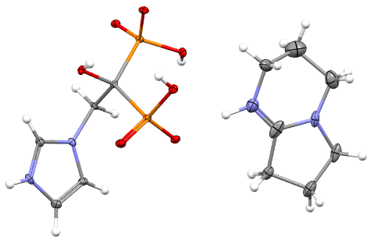
Salt | Physical state | T_{m} /°C | T_{c} /°C | T_{g} /°C
ETI | White solid | 199.0 | - | -
[TMGH][ETI] | White solid | 166.6;189.9 | - | 38.5
[TMGH]₂[ETI] | Colorless paste | - | - | -
[DBNH][ETI] | White solid | 195.2 | - | 27.7
[DBNH]₂[ETI] | Colorless paste | - | - | 0.68
Na[ALN] | White solid | 259.3 | - | -
[TMGH][ALN] | White solid | 48.1;162.7 | 107.1* | -
[TMGH]₂[ALN] | Colorless paste | - | - | 97.5
[DBNH][ALN] | White solid | 130.3;133.2 | - | -
[DBNH]₂[ALN] | Colorless paste | - | - | 45.7
[C₂OHMIM][ALN] | Colorless paste | - | - | 64.5
[C₂OHMIM]₂[ALN] | White solid | 153.0 | - | 46.3
[Ch][ALN] | White solid | 141.2 | - | 74.9
[Ch]₂[ALN] | Colorless paste | - | - | 63.8
ZOL | White solid | 214.0; 230.0 | - | -
[TMGH][ZOL] | White solid | 225.3 | - | -
[TMGH]₂[ZOL] | Colorless paste | - | - | 12.4
[DBNH][ZOL] | White solid | 208.7 | - | 45.7
[DBNH]₂[ZOL] | Colorless paste | - | - | 15.1
[Ch][ZOL] | White solid | 220.4 | - | 78.4
[Ch]₂[ZOL] | White paste | 18.6 | 13.2 | -
[EMIM][ZOL] | White solid | 198.0 | - | 29.5
[EMIM]₂[ZOL] | Colorless paste | - | - | 31.7
[C₂OHMIM][ZOL] | White solid | 143.8;195.9 | 170.1* | 57.3
[C₂OHMIM]₂[ZOL] | Colorless paste | - | - | 10.8
[C₃OMIM][ZOL] | White solid | 125.9;185.0 | 139.8* | 45.7
[C₃OMIM]₂[ZOL] | Colorless paste | - | - | 3.4
c
[DBNH][Zol]
one cationic DBN unit and one zwitterionic Zol entity bearing two anionic phosphonate groups and one cationic imidazolium moiety.
11 monoanionic solid salts and 1 RTIL
Lower T_{m} than parent drugs
7 non-polymorphic
11 dianionic RTILs and 1 salt
* Cold crystallization

Slide 12
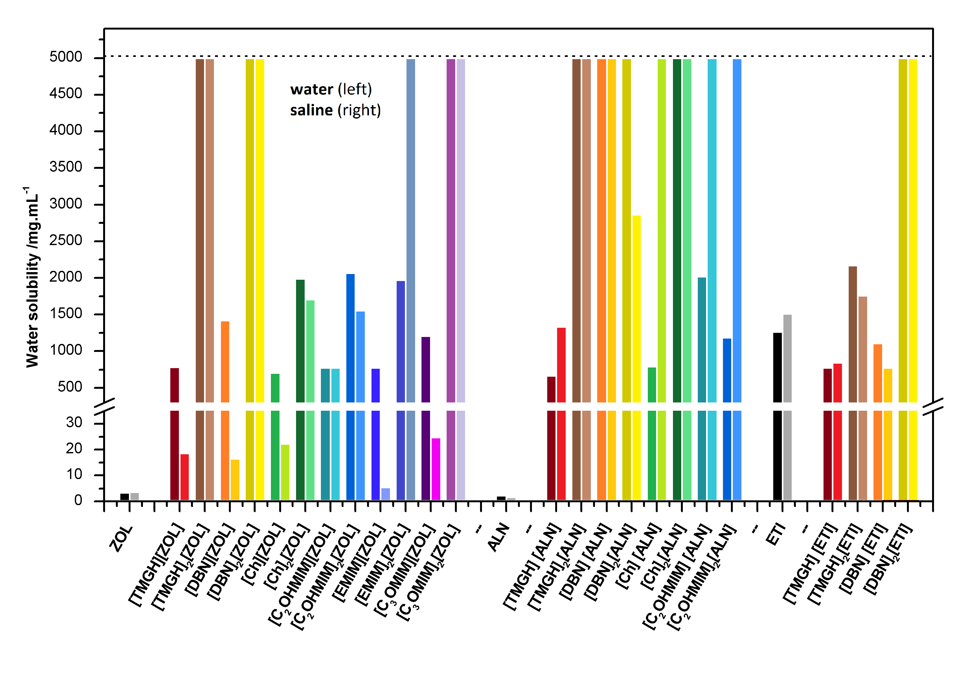
Solubility studies
BP-OSILs >>> BPs
dianions > monoanions
ALN-OSILs > ZOL-OSILs ≈ ETI-ILs
19 compounds are fully soluble

Slide 13
%
IC₅₀ /mM
Compound | Fibroblasts | T47D | MG63 | A549
Pactitaxel | 1.91×10⁻⁵ | 6.46×10⁻⁶ | 8.19×10⁻⁶ | 4.08×10⁻⁶
ETI | 15.6 | 48.9 | 61.1 | -
[TMGH][ETI] | n.d. | 2.7×10⁻⁷ | 1.6 | -
[TMGH]₂[ETI] | 1.4×10⁻³ | 9.1×10⁻⁴ | 12.0 | -
[DBNH][ETI] | 11.4 | 9.3×10⁻⁴ | 2.0×10⁻³ | -
[DBNH]₂[ETI] | 18.6 | n.d. | 2.0×10⁻³ | -
ALN | 3.17×10⁻² | 4.09×10⁻³ | 5.55×10⁻⁴ | 8.10×10⁻³
[TMGH][ALN] | 7.19×10⁻³ | 8.23×10⁻³ | 9.23×10⁻³ | 2.54×10⁻³
[TMGH]₂[ALN] | 1.11×10⁻³ | 3.16×10⁻⁵ | 7.11×10⁻⁵ | 5.14×10⁻⁴
[DBNH][ALN] | 7.20×10⁻² | n.d. | n.d. | 6.14
[DBNH]₂[ALN] | 6.01×10⁻⁵ | n.d. | 1.02 | 3.12×10⁻²
[Ch][ALN] | 1.87×10⁻¹ | 3.14 | 4.10×10⁻¹ | 6.66×10⁻²
[Ch]₂[ALN] | 4.92×10⁻³ | 2.64×10⁻³ | 1.01×10⁻² | 5.41×10⁻³
[C₂OHMIM][ALN] | 2.19 | 5.92×10⁻³ | 5.16×10⁻⁵ | 2.10×10⁻⁶
[C₂OHMIM]₂[ALN] | 4.07×10⁻⁴ | 3.28×10⁻⁶ | 7.84×10⁻⁵ | n.d.
ZOL | 2.43×10⁻³ | n.d. | 5.74×10⁻⁴ | -
[TMGH][ZOL] | n.d. | n.d. | n.d. | -
[TMGH]₂[ZOL] | 1.02×10⁻³ | 6.87×10⁻³ | 6.97 | -
[DBNH][ZOL] | 2.50 | 1.98×10⁻¹ | 1.65×10⁻³ | -
[DBNH]₂[ZOL] | 5.96×10⁻⁷ | 1.25×10⁻⁷ | n.d. | -
[Ch][ZOL] | 3.98×10⁻³ | 6.15×10⁻⁴ | 1.51×10⁻⁷ | -
[Ch]₂[ZOL] | 1.46×10⁻⁷ | 1.69×10⁻⁴ | 2.10×10⁻² | -
[C₂OHMIM][ZOL] | n.d. | 1.84×10⁻² | 5.60×10⁻⁴ | -
[C₂OHMIM]₂[Zol] | 1.58×10⁻⁷ | 1.48×10⁻⁷ | 5.58×10⁻⁵ | -
[EMIM][ZOL] | 4.97×10⁻² | 2.11×10⁻³ | n.d. | -
[EMIM]₂[ZOL] | 17.8 | 3.82×10⁻² | 5.01×10⁻⁴ | -
[C₃OMIM][ZOL] | 14.7 | 2.01 | 12.3 | -
[C₃OMIM]₂[ZOL] | 9.71×10⁻⁵ | 8.02×10⁻³ | 3.27×10⁻⁷ | -
[TMGH][ETI] | n.d. | 2.7×10⁻⁷
[DBNH][ETI] | 11.4 | 9.3×10⁻⁴ | 2.0×10⁻³
[DBNH]₂[ETI] | 18.6 |  | 2.0×10⁻³
%
[Ch][ALN] | 1.87×10⁻¹ |  |  | 6.66×10⁻²
[C₂OHMIM][ALN] | 2.19 | 5.92×10⁻³ | 5.16×10⁻⁵ | 2.10×10⁻⁶
[TMGH][ZOL] | n.d.
[DBNH][ZOL] | 2.50 |  | 1.65×10⁻³
[Ch][ZOL] | 3.98×10⁻³ | 6.15×10⁻⁴ | 1.51×10⁻⁷
[C₂OHMIM][ZOL] | n.d. | 1.84×10⁻² | 5.60×10⁻⁴
[EMIM][ZOL] | 4.97×10⁻² | 2.11×10⁻³
[EMIM]₂[ZOL] | 17.8 | 3.82×10⁻² | 5.01×10⁻⁴
[C₃OMIM][ZOL] | 14.7

Slide 14
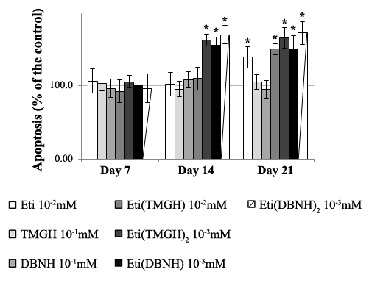
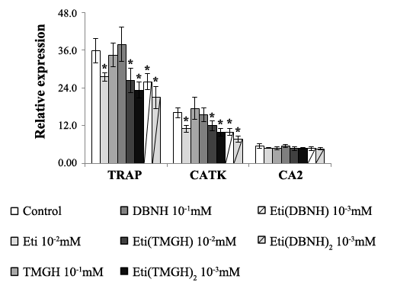
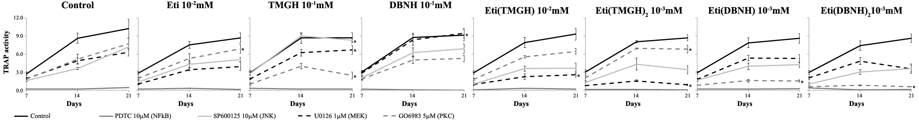
Modulation of osteoclastogenesis
Peripheral Blood Mononuclear Cells (PBMC) as precursors of osteoclasts
❶ Apoptosis quantification (caspase-3 activity) ❷ Gene expression
❸ Intracellular signalling pathways
All [ETI]-OSILs (primarily dianionic) promote higher apoptosis than ETI
All [ETI]-OSILs (primarily dianionic) downregulate expression of TRAP (Tartrate-Resistant Alkalyne Phosphatase) and CatK (Cathepsin K)
Control
ETI 10⁻² mM
[TMGH]Cl 10⁻¹ mM
[DBNH]Cl 10⁻¹ mM
[TMGH][ETI] 10⁻² mM
[TMGH]₂[ETI] 10⁻³ mM
[DBNH][ETI] 10⁻³ mM
[DBNH]₂[ETI] 10⁻³ mM
MEK pathway
PKC pathway

Slide 15
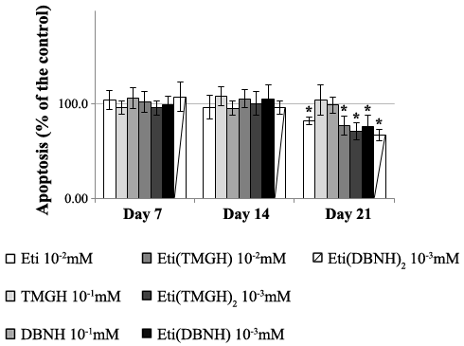
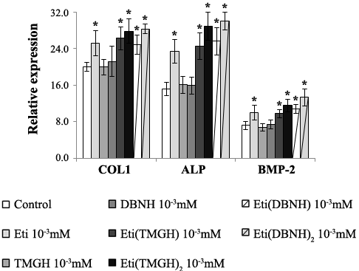
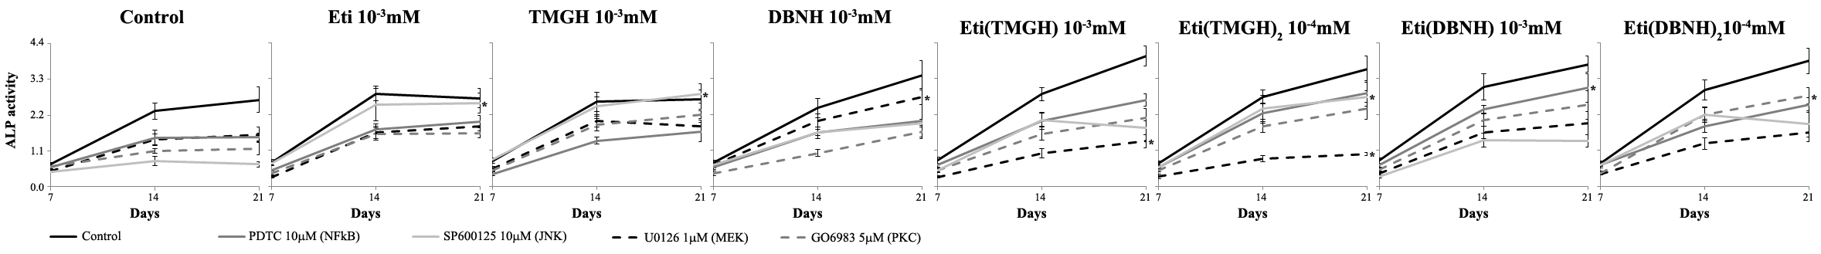
Modulation of osteoblastogenesis
Human Mesenchymal Stem Cells (HMSC) as precursors of osteoblasts
❶ Apoptosis quantification (caspase-3 activity) ❷ Gene expression
❸ Intracellular signalling pathways
Inhibition of apoptosis is higher with [ETI]-OSILs (primarily dianionic) than ETI
All [ETI]-OSILs (primarily dianionic) overexpress COL1 (collagen type 1), ALP (alkalyne phosphatase) and BMP-2 (bone morphogenetic protein-2)
Control
ETI 10⁻³ mM
[TMGH]Cl 10⁻³ mM
[DBNH]Cl 10⁻³ mM
[TMGH][ETI] 10⁻³ mM
[TMGH]₂[ETI] 10⁻⁴ mM
[DBNH][ETI] 10⁻³ mM
[DBNH]₂[ETI] 10⁻⁴ mM
NFkB and JNK pathway
JNK and PKC pathway

Slide 16

Conclusions
24 new Organic Salts and Ionic Liquids from etidronic, alendronic and zoledronic acids in quantitative yields
Sustainable and green Amberlyst resin-based method
Monoanionic are salts and dianionic are RTILs
Characterization by NMR (¹H, ¹³C), FTIR, DSC, elemental analysis and single crystal XRD (for [DBNH][ZOL])
Tunability of water solubility and thermal properties according to the cation and degree of ionization
Decrease of systemic toxicity and enhancement of antitumor activity as low as nanomolar scale
[ETI]-based OSILs display higher anti-osteoclast and pro-osteoblast activity than ETI and protonated superbases
Osteoclastogenesis is inhibited through the MEK ([TMGH]) and PKC ([DBNH]) pathways
Osteoblastogenesis is enhanced through the NFkB ([TMGH]), PKC ([DBNH]) and JNK (both)
New avenue for modulation of bone metabolism associated with bone cancer cells, particularly when increased bone resorption is present.

Slide 17




\
Acknowledgments
Synthesis
Luís C. Branco (LAQV@REQUIMTE, FCT-NOVA)
CHARM group @ FCT-NOVA
Bone metabolism and cytotoxicity studies
Sónia Teixeira (FMD-UPorto)
M. H. Fernandes (FMD-UPorto)
João Costa-Rodrigues (ESS-IPPorto)
DSC facilities
Madalena Dionísio (LAQV@REQUIMTE, FCT-NOVA)
DESignBIOtechHealth (Norte-01-0145-FEDER-000024)
PTDC/QUI-QOR/32406/2017
RECI/BBBBQB/0230/2012
PEst-C/LA0006/2013
PTDC/CTM/103664/2008
IF/0041/2013/CP1161/CT005 (LCBranco)
Associate Laboratory for Green Chemistry LAQV (UID/QUI/50006/2020)

