Slide 1


Development of a novel class of brain penetrant ligands endowed with high affinity and selectivity for
dopamine D4 receptors
Pegi Pavletić ^{1,}*, Fabio Del Bello ¹, Alessandro Piergentili ¹, and Wilma Quaglia ¹
¹School of Pharmacy, Medicinal Chemistry Unit,
University of Camerino, Via S. Agostino 1, 62032 Camerino, Italy
* Corresponding author: pegi.pavletic@unicam.it

Slide 2
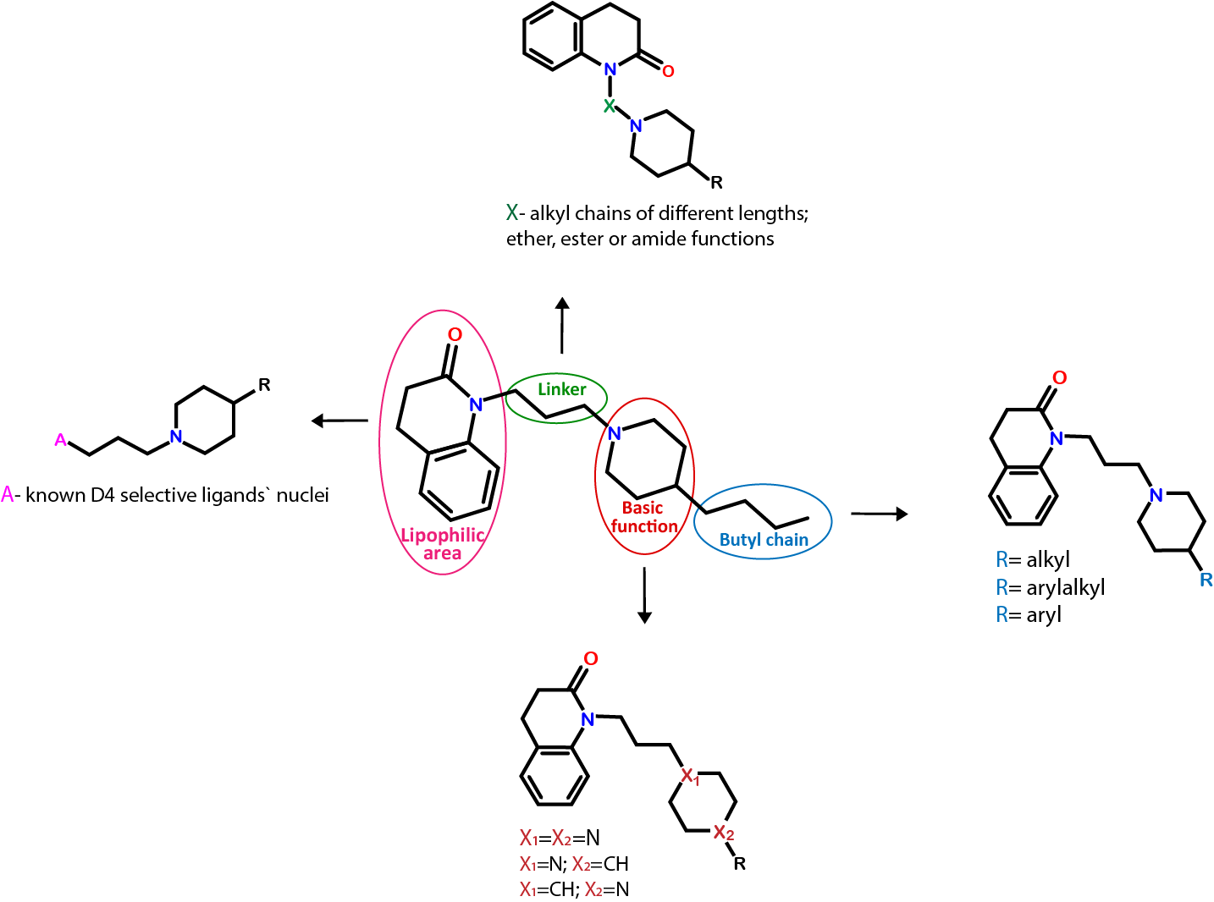
Development of a novel class of brain penetrant ligands endowed with high affinity and selectivity for dopamine D4 receptors
Graphical Abstract
77-LH-28-1

Slide 3
Abstract
Dopamine is a catecholamine neurotransmitter involved in a variety of physiological functions, through interaction with five different G-protein-coupled receptors (D1-D5). Among dopamine receptors, the D4R subtype has recently emerged as a potential target for the treatment of eating disorders, drug addiction and cancer. Classical D4R ligands are characterized by a common pharmacophore, consisting of a lipophilic moiety linked by a spacer to a piperidine or piperazine basic function and an aromatic terminal. It has been demonstrated that the known M1 muscarinic bitopic agonist 77-LH-28-1 also behaved as a potent D4R ligand and showed an unexpected D4 selectivity over D2 and D3 subtypes. The structure of 77-LH-28-1 differs from other known selective D4R ligands (characterized by the presence of a substituted aromatic group at position 4 of the piperidine ring) by having a butyl aliphatic chain. Since 77-LH-28-1 is the first example of a D4R selective ligand with a unique structural feature, an extensive structure-activity relationship study has been undertaken to evaluate the importance of the butyl aliphatic chain for the interaction with D4R. From a preliminary study, potent, selective and brain penetrant D4R antagonists were identified. The results prompted us to further investigation of 77-LH-28-1 structure and D4R selectivity.
Keywords: D4R, dopamine, 77-LH-28-1

Slide 4
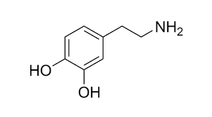
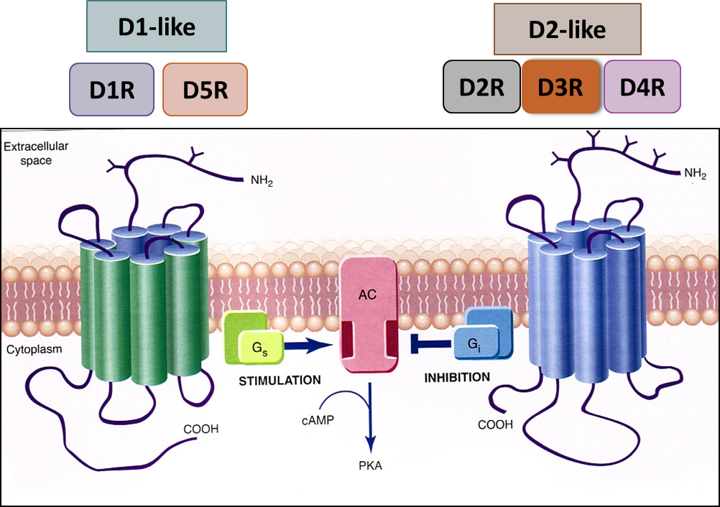
Introduction
DOPAMINE
Catecholamine neurotransmitter involved in physiological functions in the central and peripheral nervous systems
Interacts with five different G-protein-coupled receptors (GPCRs), namely D1-D5 receptors (D1R-D5R)
Divided into D1-like and D2-like subfamilies on the basis of sequence similarity and signal transduction properties (Figure 1)
a) D1-like subfamily: - D1R and D5R subtypes
b) D2-like subfamily: -D2R, D3R, and D4R subtypes
DOPAMINE
RECEPTORS
Figure 1. Depiction of D1- like and D2- like dopamine receptor subfamilies

Slide 5
Introduction
D4R
D4R subtype is encoded by DRD4 gene
Located in the frontal cortex, amygdala, hippocampus, globus pallidus, substantia nigra pars compacta and thalamus; and at the periphery in retina, kidney, adrenal glands, sympathetic ganglia, blood vessels, heart and gastrointestinal tract
Potential target for the treatment of widespread diseases: addiction, eating disorders, Parkinson’s disease and cancer
Given the limitations of current drugs, innovative treatments that improve efficacy and safety are an urgent need!
Compounds belonging to different chemotypes, including aryl-linked piperazines, amide-linked piperazines, piperidines, morpholines and imidazolines, have been reported as selective D4R ligands (Figure 2)
Figure 2. Depiction of different chemotypes of selective D4R ligands

Slide 6
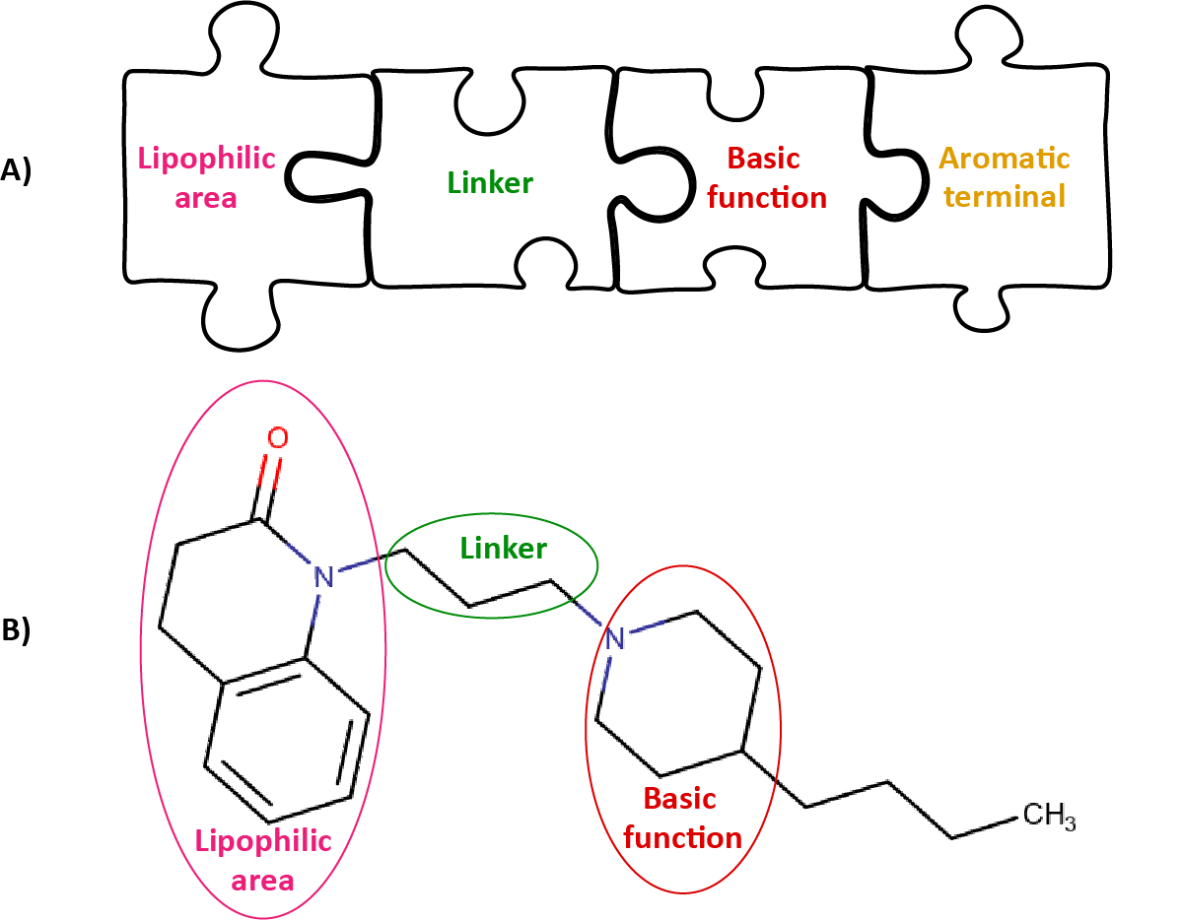
Introduction
77-LH-28-1
Known as M1 muscarinic bitopic agonist
We demonstrated that it also behaves as a potent and selective D4R ligand
77-LH-28-1 structure fits all the features of the pharmacophoric model proposed for the classical selective D4R ligands and consisting of a lipophilic moiety linked by a spacer to a basic function and an aromatic terminal (Figure 3A), except for the presence of a butyl chain instead of the aromatic terminal (Figure 3B)
77-LH-28-1 → model for synthesis of novel D4R molecules
Compound |  | pK_{i}
 | D2R | D3R | D4R | D4/D2 | D4/D3
77-LH-28-1 | 6.17±0.16 | 6.21±0.13 | 9.01±0.04 | 691 | 631
No aromatic terminal!
77-LH-28-1
Figure 3A) General pharmacophoric model deduced from the structures of classic dopamine D4R drugs.
Figure 3B) Chemical structure of 77-LH-28-1, fitting all the features of the pharmacophore except for the aromatic terminal, which is replaced by a butyl chain.
Del Bello F. et al. J Med Chem. 2018, 61:3712

Slide 7
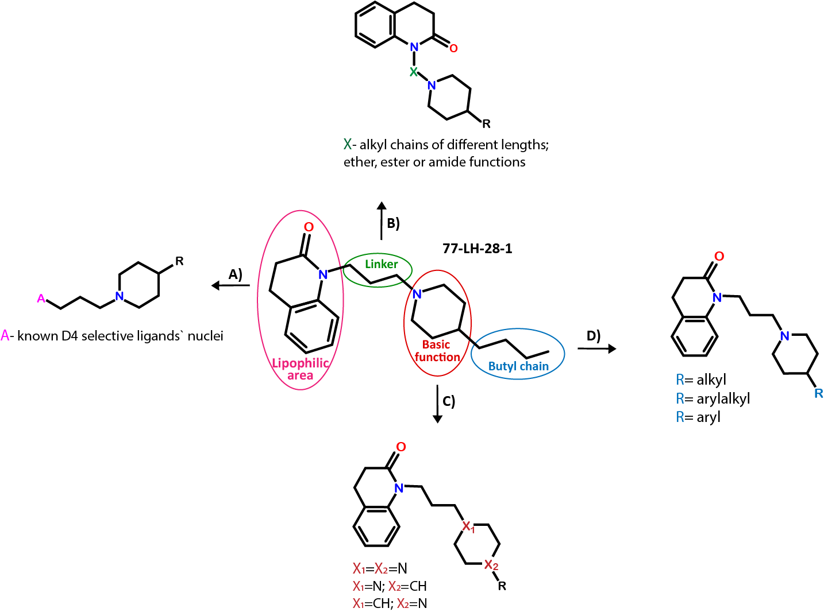
Introduction
AIM OF THE STUDY
Synthesis and biological evaluation of new 77-LH-28-1 analogues, to better understand the structural features required for the selective interaction with D₄R.
The following modifications have been performed:
The quinolinone lipophilic portion has been replaced by other moieties, based on known D4-selective ligands (Figure 4A)
Propyl linker has been replaced by chains of different lengths and nature to assess the role of the distance between the basic function and the quinolinone moiety (Figure 4B)
Piperidine has been replaced by a piperazine nucleus, which proved to be suitable for high affinity D4R ligands (Figure 4C)
77-LH-28-1 butyl chain has been replaced by different alkyl, arylalkyl and aryl groups (Figure 4D)
Figure 4. Modifications to the structure of 77-LH-28-1. A) Modifications of the lipophilic area; B) Modifications of the linker; C) Modifications of the basic function; D) Modifications of the n-butyl terminal.

Slide 8
Results and discussion
FIRST SERIES OF COMPOUNDS

Slide 9
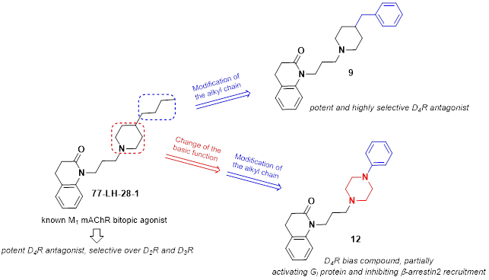
Results and discussion
MOST INTERESTING RESULTS FROM THE STUDY OF THE FIRST SERIES OF COMPOUNDS
From the study of the first series of compounds it emerges that the aliphatic chain of 77-LH-28-1 can be successfully replaced by an aryl or arylalkyl chain without affecting high D4R affinity and selectivity over D2R and D3R subtypes (compounds 9 and 12) (Figure 5)
Compound 9 behaves as a potent D4R antagonist and, unlike 77-LH-28-1, as a weak partial antagonist at M₁ muscarinic receptor. It shows very high D4R affinity and selectivity over the other D2-like subtypes and over M₁-M₅ muscarinic receptors.
Piperazine ring causes a sharp decrease in affinity, except for the N-phenyl derivative 12, which shows high affinity for D4R and selectivity over D2R and D3R, M₁-M₅ subtypes and other selected off-targets, namely α_{1a}, α_{1b,} α_{1d}-, β₁- and β₂-adrenoceptors, σ₁ receptor, dopamine and serotonin transporters (DAT and SERT)
Figure 5. Modifications to structure of 77-LH-28-1 that resulted in synthesis of compounds 9 and 12

Slide 10
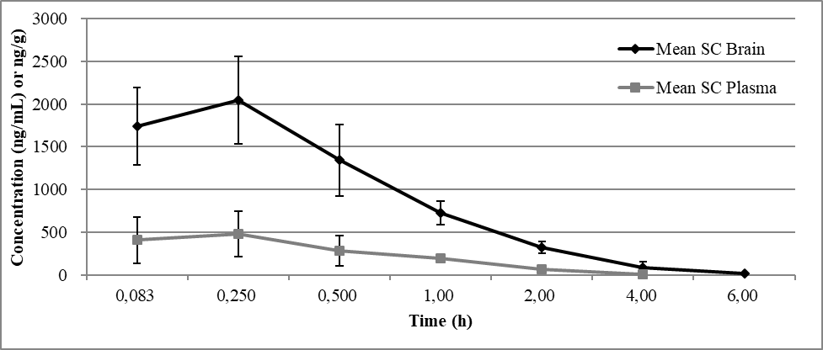
Results and discussion
MOST INTERESTING RESULTS FROM THE STUDY OF THE FIRST SERIES OF COMPOUNDS
Interestingly, in in vivo pharmacokinetic studies, a relevant brain penetration characterizes compound 12 (Figure 6)
From functional studies, 12 shows a biased behavior, potently and partially activating Gi protein and inhibiting β-arrestin2 recruitment (Table 1)
Future studies with 12 might reveal mechanistically related behaviors and the interplay between G-protein- and β-arrestin-mediated signaling in D4R-related physiological effects
Figure 6. Plot of mean concentration with standard devations of 12 in plasma and brain after subcutaneous administration (3 mg/kg).
Table 1. Potency Values (Expressed as pEC₅₀ or pIC₅₀) and Efficacy Values of 12 and Dopamine for D4R Expressed in HEK293T Cells.

Slide 11
Results and discussion
Due to its interesting biological profile, 12 has been selected as a model for the synthesis of analogues, to define extensive SARs for this class of potent and selective D4R ligands (Figure 7)
Before engaging in the synthesis of a new series of derivatives, a preliminar in silico analysis was performed on the selected compounds P1-P7, to collect useful infomation on the structural requirements for an optimal interaction with D4R
P1-P7
Figure 7. Compound 12 (left) as a model for the synthesis of ligands P1-P7 (right)

Slide 12
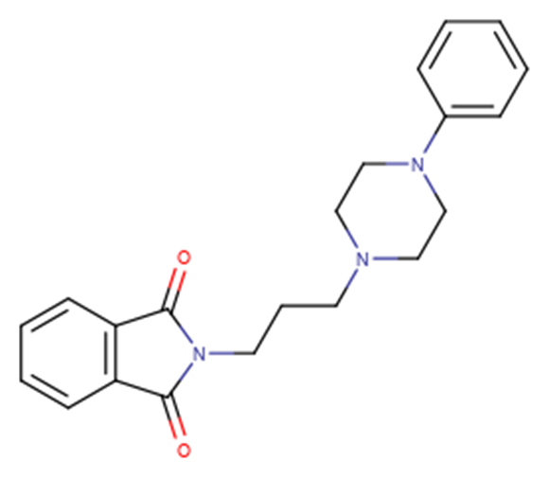
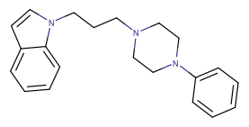
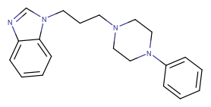
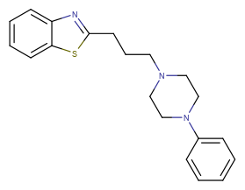
Results and discussion
Table 2. Structure and characteristics of D4R ligands P1- P4
Name | Structure | M.W. / g/mol
P1 |  | 349,43
P2 |  | 319,44
P3 |  | 320,43
P4 |  | 337,48

Slide 13
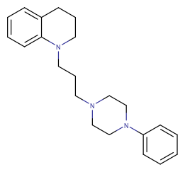
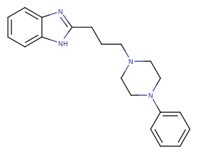
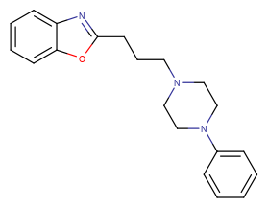
Results and discussion
Table 3. Structure and characteristics of D4R ligands P5- P7
Name | Structure | M.W. / g/mol
P5 |  | 335,49
P6 |  | 320,43
P7 |  | 321,42

Slide 14
Results and discussion
IN SILICO ANALYSIS
3D models of the compounds P1- P7 were created using Avogadro program, and were stabilized using MMFF94s force field
Structure of the human D4R in complex with the antipsychotic drug Nemonapride (PDB ID: 5WIU) was used for docking analysis (program: AutoDock Vina)
5WIU D4R crystal structure is a monomer in which mutations in a form of cytochrome b562 (UniProtKB - P0ABE7) originating from Escherichia Coli were introduced at the positions 238, 333 and 337
For the purpose of analysis of compounds P1-P7, all water and phospholipid molecules are removed from the surroundings of the D4R
We tried to determine how successfully can the newly sythesized compounds bind to the D4R in a simulation, in order to take the next steps in the synthesis of D4R antagonists

Slide 15
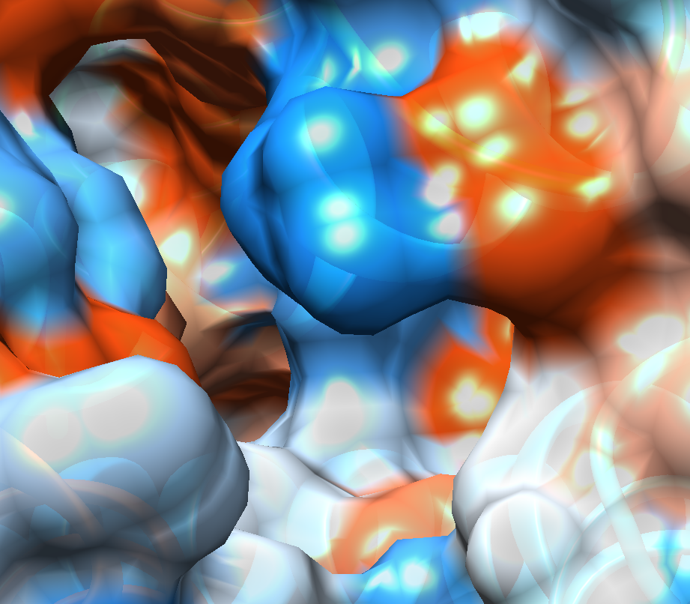
Results and discussion
IN SILICO ANALYSIS
To better understand the binding of P1-P7, we have analyzed the properties of the D4R orthosteric binding pocket (OBP) and the extended binding pocket (EBP)
Figure 8. depicts the hydrophobicity surface of both the OBP and the EBP. EBP is highly hydrophobic, due to close presence of VAL 87, PHE 91 and MET 112 surrounding the pocket. Slightly hydrophilic and neutral surfaces can be found on the transition to the OBP.
OBP is predominantly neutral, with the exception of three polar regions (ARG 186, ASP 115, HIS 414) dividing it from the EBP (Figure 8, arrows) and lateral hydrophobic surface caused by VAL 116
OBP
EBP
Figure 8. Orthosteric binding pocket (OBP) and extended binding pocket (EBP) colored by hydrophobicity: brown surfaces are non-polar (hydrophobic), and blue surfaces are polar (hydrophilic). Arrows show polar areas between OBP and EBP

Slide 16
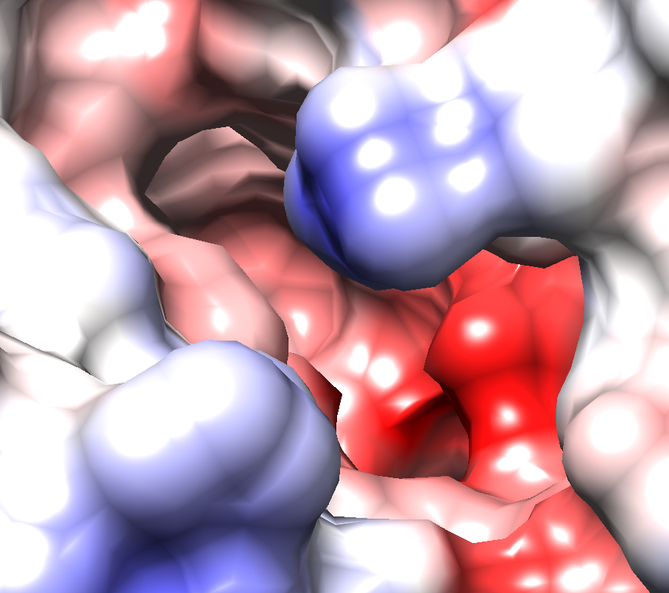
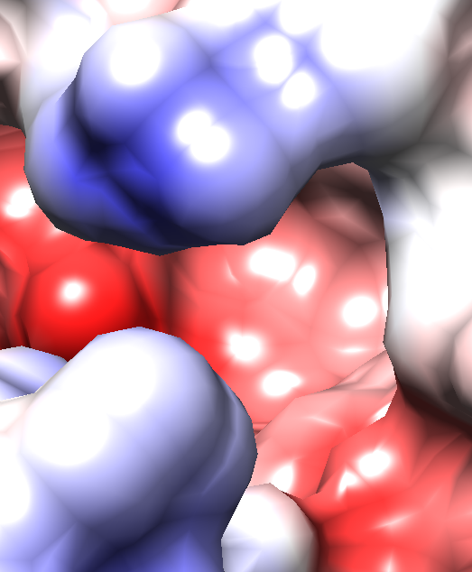
Results and discussion
IN SILICO ANALYSIS
Coulombic surface coloring indicates that the OBP is slightly negatively charged, except the surface of positive charge on the crossing to EBP due to ARG 186 in the chain ending and negative charge caused by ASP 115 on the internal crossing to EBP (Figure 9A)
EBP is slightly negatively charged throughout the entire surface (Figure 9B)
A)
B)
Figure 9. Coulombic surface coloring of the orthosteric binding pocket is shown in the picture A) and of the extended binding pocket in the picture B). Red surface presents negative charge while the blue surface represents positive charge. Arrow indicates the same structure shown in both pictures, for space orientation.

Slide 17
Results and discussion
IDENTIFIED DESIRABLE LIGAND PROPERTIES
High D4R selectivity
Molecular weight below 500 Da
Blood Brain Barrier penetration
Ability of forming stable H-bonds within OBP
Penetration into the EBP and forming hydrophobic interactions - desirable, not necessary!

Slide 18
Results and discussion
Table 4. Docking results for compounds P1-P7
Name | Nr. of conformations in extended pocket | Nr. of conformations establishing H-bonds | Highest number of H-bonds per conformation | Score value | RMSD l.b. | Aminoacid that forms H-bond
P1 | 9 | 3 | 1 | -9,1 | 2,142 | ASP 115
P2 | 9 | 1 | 1 | -8,5 | 2,241 | HIS 414
P3 | 9 | 2 | 1 | -9,0 | 1,429 | ASP 115
P4 | 9 | 7 | 2 | -9,8 | 0,0 | TYR 438, ASP 115
P5 | 9 | 1 | 1 | -9,9 | 1,091 | ASP 115
P6 | 9 | 7 | 3 | -9,9 | 0,00 | ASP 115
P7 | 9 | 1 | 2 | -8,3 | 6,373 | ARG 186

Slide 19
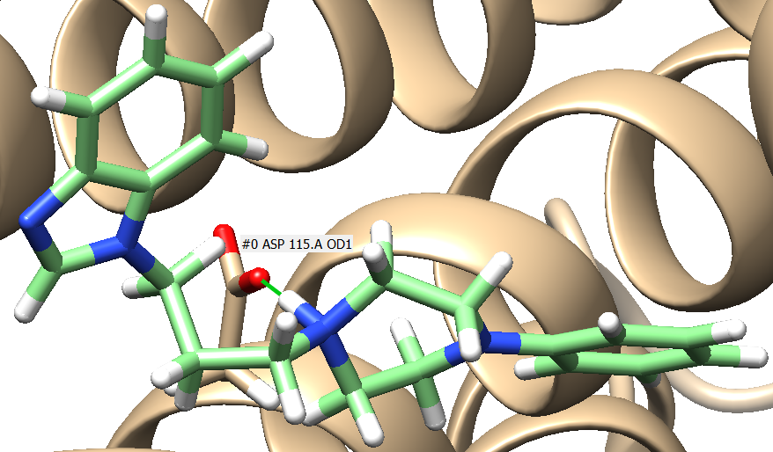
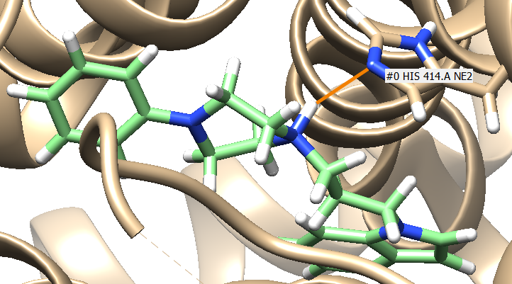
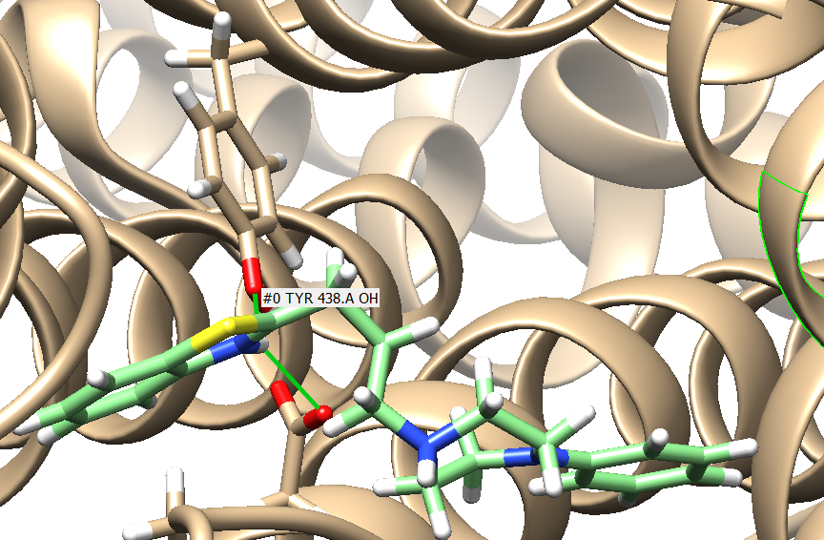
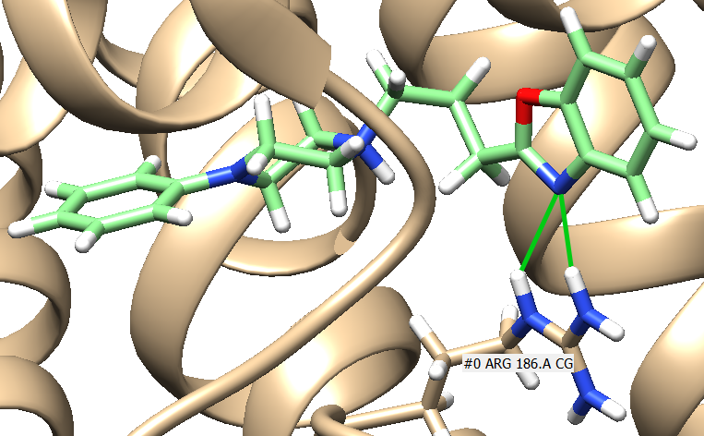
Results and discussion
Hydrogen bonds in the orthosteric pocket
P1, P3, P5, P6 bounded to ASP 115 in the chain A of D4R (Figure 10A)
P2 bound to HIS 414 in the chain A of D4R (Figure 10B)
P4 bound to ASP 115 and TYR 438 in the chain A of D4R (Figure 10C)
P7 bound to ARG 186 in chain A of D4R (Figure 10D)
P3, P4, P5, P6 and P7 produce stable bonds, while P1, P2 show unstable H-bonds present at slightly different distances than expected for H-bonds (2,6-3,1 Å)
A)
A)
B)
C)
D)
Figure 10 A) H-bond between P1 ligand and ASP 115 of the D4R; B) H-bond between P2 ligand and HIS 414 of the DRD4; C) H-bonds between the P4 ligand and TYR 438 and ASP 115 of the DRD4; picture D) 2 H-bond between ligand P7 and ARG 186 of the DRD4.

Slide 20
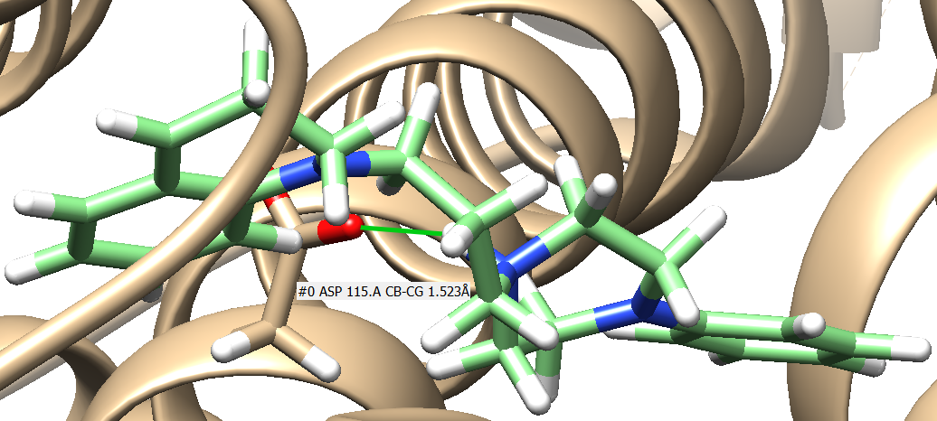
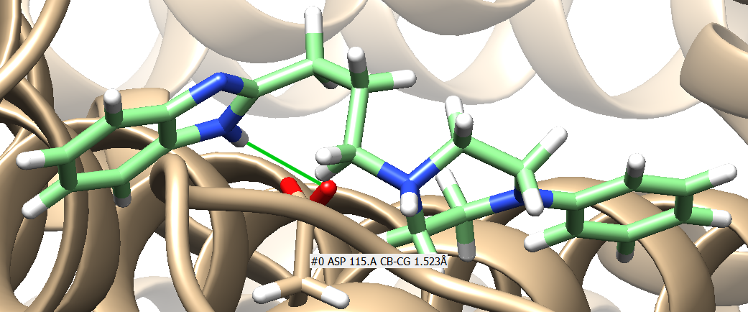
Results and discussion
HYDROGEN BONDS IN THE ORTHOSTERIC POCKET
Most compounds for which multiple conformations were calculated during docking show secondary binding possibility to HIS 414, like in the case of P2
Most stable H-bonds are formed between the negatively charged ASP 115 and nitrogen bound hydrogens in either piperazine (P1, P3, P5) or lipophilic area of the molecule (P4, P6), examples of which are shown in Figure 11
A)
B)
A)
C)
Figure 11A) H-bond between hidrogen bound to piperazine nitrogen of the P3 ligand and ASP 115 of the D4R; B) H-bond between hidrogen bound to piperazine nitrogen of the P5 ligand and ASP 115 of the DRD4; C) H-bond between the hidrogen bound to the benzoimidazole of the P6 ligand and ASP 115 of the DRD4

Slide 21
Conclusions
Considering the renewed interest garnered by D4R, recently emerged as a potential therapeutic target for diseases such as cancer, drug addiction, as well as Parkinson’s disease, in which D4R antagonists can attenuate L-DOPA-induced dyskinesias, the selective D4R compounds 9 and 12 might help to better clarify the role played by this subtype in the above disorders and are good candidates for further evaluation in in vivo animal models for D4R-mediated pathologies
12 shows a biased behavior, potently and partially activating Gi protein and inhibiting β-arrestin2 recruitment- due to this specificity, 12 makes an interesting model for future drug design and synthesis!

Slide 22
Conclusions
In silico analysis of the D4R provided insight into the potential target structure of the novel drugs: lipophilic area of the molecule must bind within the orthosteric pocket, while the basic function probably serves to orient or additionally bind the molecule to the polar aminoacids of the DRD4 receptors
Hydrophobic interactions within the EBP might additionally help in ligand binding to the receptor, which is in line with the previously reported data for aromatic groups (Wang S et al., Science 2017).
P7 exhibited 2 H-bonds between benzoxazole nitrogen and the ARG186 in the protein chain ending, which is very flexible, so this result can be disregarded taking into consideration that AutoDock Vina cannot take into consideration the flexibility of proteins.
Molecules of water and their impact on ligand- binding were not assessed in this research and could provide additional insight into binding of the ligand to D4R
P7
P7

Slide 23





Acknowledgments
Dr. Amy H. Newman
Dr. Alessandro Bonifazi
Dr. Hideaki Yano
Dr. Rosanna Matucci
Dr. Stefano Fontana
Dr. Valerio Mammoli
This work was supported by grants from the University of Camerino (Fondo di Ateneo per la Ricerca 2019)

