Slide 1
Induction of mitochondrial-mediated apoptosis by methanol extract of Cajanus cajan
Olajumoke O.Alao ^{1,}* and Olufunso O.Olorunsogo ²
¹ Department of Biochemistry, Lead City University, Ibadan
² Laboratories for Biomembrane Research and Biotechnology, Biochemistry Department, College of Medicine, University of Ibadan, Ibadan, Nigeria.
*olajualao@yahoo.co.uk

Slide 2
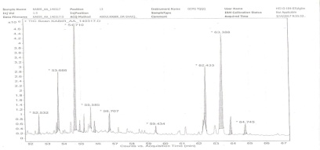
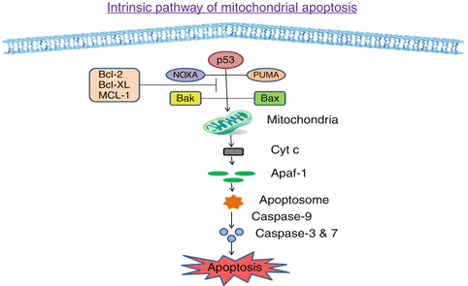
Graphical Abstract
GC-MS analysis
Cajanus cajan leaves
Hexadecanoic acid methyl ester, oleic acid, cis-α-bisabolene, octadecenoic acid methyl ester, tetradecanoic acid ,β-bisabolene and β-curcumene

Slide 3
Abstract
Attention has recently focused on mitochondrial-mediated apoptosis as a signaling pathway that is disrupted during carcinogenesis. The chemopreventive effects of dietary phytochemicals can be explored in order to combat conditions emanating from dysregulation of mitochondria-mediated apoptosis. Cajanus cajan is a medicinal plant common in Nigeria for the traditional treatment of jaundice, measles, dysentery and breast tumours. This study aims to investigate the effects of Cajanus cajan on mitochondrial-mediated apoptosis. Male Wistar rats (150±2.00 g) were assigned into groups and orally treated with corn oil (control), 100 and 200 mg/kg methanol extract of Cajanus cajan once daily for thirty consecutive days. The mitochondrial membrane permeability transition pore, were determined spectrophotometrically. Caspase 3, caspase 9 and cytochrome C release were determined by immunohistochemistry. Cajanus cajan induced pore opening and caspase 3, caspase 9 and cytochrome C were activated significantly. Chemical compounds identified by GCMS include Hexadecanoic acid methyl ester, oleic acid, cis-α-bisabolene, octadecenoic acid methyl ester, tetradecanoic acid, β-bisabolene and β-curcumene. Cajanus cajan can be used in the management of conditions associated with dysregulation of apoptosis.
Keywords ; Apoptosis ; Cajanus cajan ; mitochondrial membrane permeability transition pore ;

Slide 4
Introduction
Medicinal plants have long been used in folk medicine for therapeutic purposes (Zhang et al., 2012 )
Many drugs have been introduced into international market through validation of the claims of these traditional medicines (Allison et al, 2001)
Several studies have shown that patronage of medicinal plants as an alternative to synthetic drugs has increased, because they are cheap, affordable and cases of resistance are unlikely (Bussman, 2002)

Slide 5
The primary role of mitochondria in healthy cells is to generate ATP for normal cell function (Abrahams et al.,1994)
However, the opening of a large conductance channel, the mitochondrial membrane permeability transition pore converts the mitochondria from a life-supporting to a death promoting organelle (Lockshin and Zakeri, 2001)
Mitochondrial membrane permeability transition (MMPT) pore opening is a point of no return for apoptosis to take place ( Fulda, 2010)

Slide 6
Figure 1; The Intrinsic and extrinsic pathways of Apoptosis( Zou et al., 1999)

Slide 7
Apoptosis is a genetically regulated process for the destruction of unwanted cells. It is a crucial phenomenom that is vital for different biological processes and its dysregulation is implicated in disease conditions such as heart reperfusion injury, hyperplasia and cancer (Lockshin and Zakeri 2001)
It is characterised by specific morphological and biochemical changes in dying cells such as condensation of cytoplasm, chromatin condensation, nuclear fragmentation, formation of membrane apoptotic bodies and engulfment of the dying cells by phagocytes (Kerr et al.,1972, Rodriguez et al., 2009, Kroemer et al., 2009)

Slide 8
Figure 2; Apoptosis ( Rode , 2008)

Slide 9
Since apoptosis is downregulated in hyperplasia and cancer, the MMPT pore acts as a promising target for pharmacological interventions in the management of conditons involving dysregulation of apoptosis (Wong, 2011)
The MMPT pore is a sudden increase in the permeability of inner mitochondrial membrane in response to a noxious stimulus such as oxidative stress, Ca²⁺ overload, hypoxia and cytotoxic drugs ( McCommins and Baines, 2012)
This opening causes depolarisation of the IMM, swelling of the matrix space, rupture of the OMM which results in activation of caspases and release of cytochrome C (Kinnally and Antonsson, 2007)

Slide 10
Many naturally occuring compounds have been found to induce pore opening and can be used in the chemoprevention of cancer (Martin, 2006)
Scientific reports have shown that Cucurmin, lycopene and ECCG have been found to induce pore opening (Jana, 2004)
Berberine, α bisabol, betunilic acid, cucurmin and resveratol have been tested and found to be effective in tumour cell line an in vivo in preclinical animal. (Martin, 2006)

Slide 11
Plate 1; The leaves of Cajanus cajans

Slide 12
Cajanus cajan commonly known as pigeon pea is a medicinal plant that is widespread Africa. The seeds are high protein content and it is consumed in many developing countries (Burkhill, 1978)
It has been used traditionally in African folk medicine for treating liver and stomach disorders, anaemia, dysentery, measles, jaundice and tumours (Kong et al., 2009, Grover et al. , 2002)

Slide 13
There is paucity of information on the effects Cajanus cajan on mitochondrial membrane permeability transition pore, activation of caspases and cytochrome c release
It is on this premise that we investigated the effects of the extract of Cajanus cajan leaves on these apoptotic markers
The present study therefore evaluated the effect of methanol extract of Cajanus cajan on mitochondrial–mediated apoptosis

Slide 14
Materials and methods
Cajanus cajan leaves was soaked in methanol for 72 hours and concentrated using rotary evaporator to obtain the methanol extract of Cajanus cajan (MECC)
Mitochondrial membrane permeability transition was monitored according to the method of Lapidus and Sokolove 1993, by measuring the decreases in absorbance at 540n
Immunohistochemical staining of caspase 3, caspase 9 and cytochrome c were assessed by the method of Chakravarthi et al., (2010)
The gas chromatography–mass spectrometry (GC-MS) analysis of the extract was performed using an Agilent (USA) 6980N Network GC System

Slide 15
Figure 1; Effects of MECC on MMPT pore in the absence of calcium. NTA- No triggering agent (without calcium), TA- Triggering agent (with calcium), MECC - methanol extracts of Cajanus cajan
Results and discussion

Slide 16
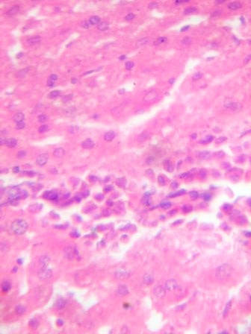
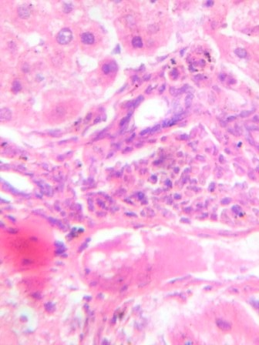
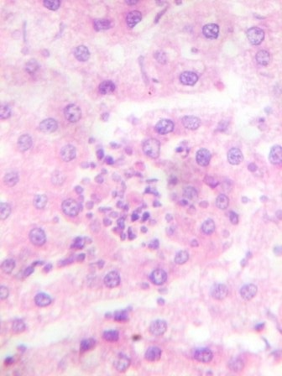
A
B
C
X400
Figure 3 A: Control with no visible lesion.
B: .Rats were administered 100mg/kg of MECC. There is infilitration by inflammatory cells (blue arrow)
C: Rats were administered 200mg/kg of MECC. .There is infilteration by inflammatory cells (Blue arrow)

Slide 17
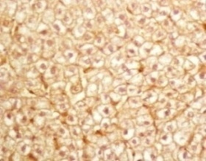
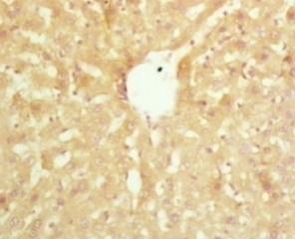
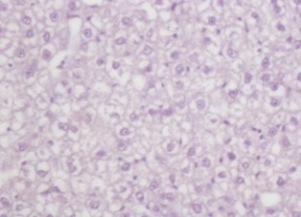
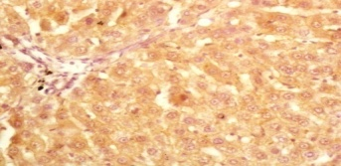
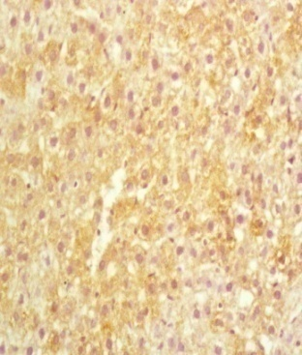
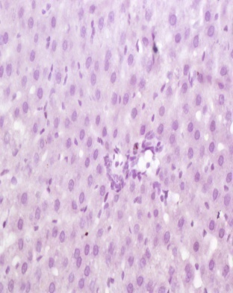
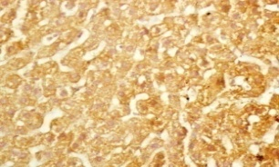
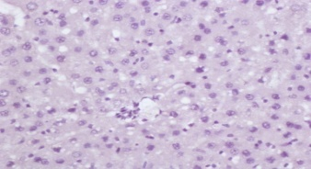
Figure 4: Immunohistochemical expression of Cytochrome c, caspase3 and caspase in the control , 100mg/kg MECC treated group and 200mg/kg MECC treated group.

Slide 18
Chemical compounds identified by GC-MS include : Hexadecanoic acid methyl ester, oleic acid, cis-α-bisabolene, octadecenoic acid methyl ester, tetradecanoic acid ,β-bisabolene and β-curcumene

Slide 19
Conclusions
These findings suggests that Cajanus cajan induced mitochondrial-mediated apoptosis via the induction of mitochondrial membrane permeability transition and therefore could be useful in chemoprevention in conditions associated with downregulated apoptosis

Slide 20
References
Burkhill H M.Tropical Africa, 2nd Ed Vol 1 families A-D. Royal Botanic Gardens, Kew, Richmond, UK 1978
Kerr, JF, Wyllie, AH and Currie, AR Apoptosis: a basic physiological phenomenom with wide ranging implications in tissue kinetics. Brit J Cancer 1972;26(4):239-57
Lapidus RG, Sokolove PM. Spermine Inhibition of the permeability transition of isolated rat liver mitochondria: An investigation of mechanisms. Biochem. Biophys. J. 1993;64:246-253
Martin KR. Targeting apoptosis with dietary bioactive agents. Exp Biol Med 2006; 231: 117-129
Reitman, S., Frankel, S., (1957) Amer. J. Clin. Path. 28 : 56

Slide 21
Acknowledgments

Slide 22
THANK YOU FOR LISTENING

