Slide 1
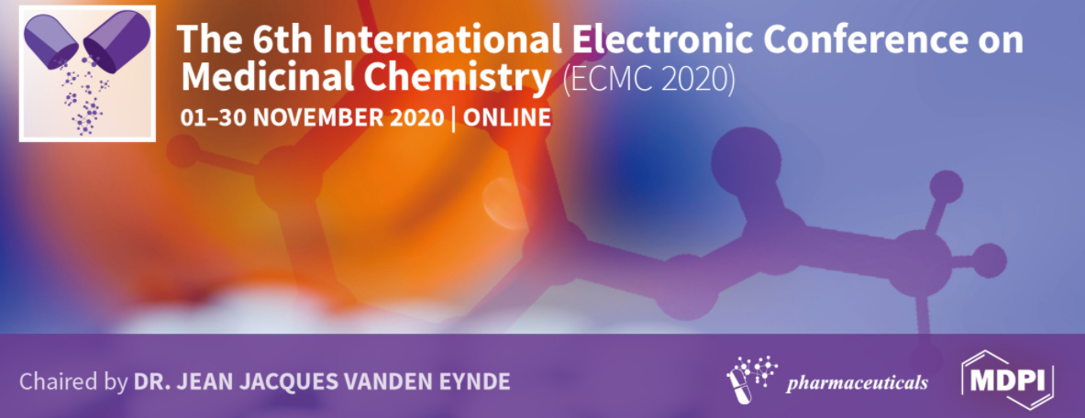
Advanced preclinical studies in Canine Leishmaniasis drug development.
Cintya Perdomo ª, Elena Aguilera ^{b}, Ileana Corvo ª, Paula Faral-Tello ^{c}, Elva Serna ^{d}, Carlos Robello ^{c, e}, Shane R. Wilkinson ^{f}, Gloria Yaluff ^{d}, Guzmán Alvarez ª,*
aLaboratorio de Moléculas Bioactivas, Universidad de la República, CENUR Litoral Norte, 60000 Paysandú, Uruguay.
bGrupo de Química Medicinal-Laboratorio de Química Orgánica, Facultad de Ciencias, Universidad de la República, Montevideo, C.P. 11400, Uruguay.
cUnidad de Biología Molecular, Institut Pasteur de Montevideo, Montevideo, C.P. 11400, Uruguay.
dDepartamento de Medicina Tropical, Instituto de Investigaciones en Ciencias de la Salud, Universidad Nacional de Asunción, San Lorenzo, C.P. 2169., Paraguay.
eDepartamento de Bioquímica, Facultad de Medicina, Universidad de la República, Montevideo, Uruguay.
fQueen Mary Pre-Clinical Drug Discovery Group, School of Biological and Chemical Sciences, Queen Mary University of London, London, United Kingdom.
*Corresponding author. Laboratorio de Moléculas Bioactivas, CENUR Litoral Norte, Universidad de la República, Ruta 3 (km 363), Paysandú, C.P. 60000, Uruguay. E-mail address: guzmanalvarezlqo@gmail.com (G. Alvarez).

Slide 2
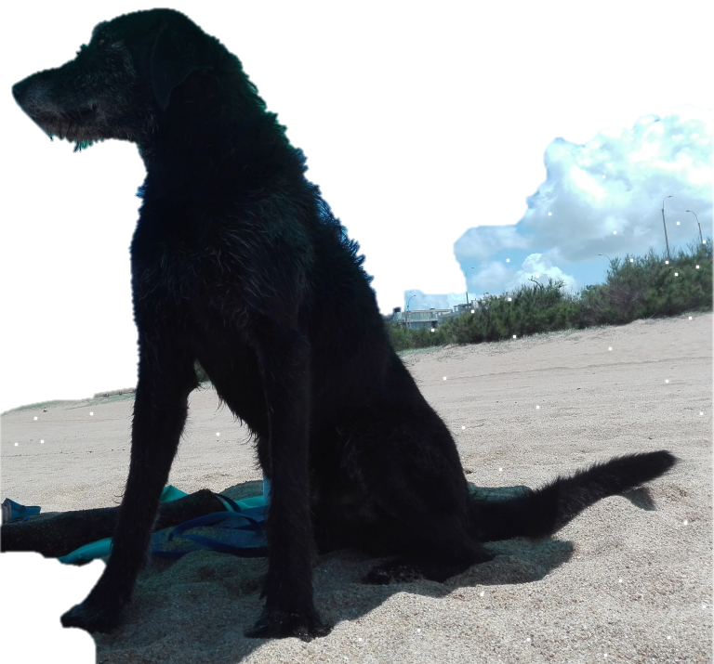
GRAPHICAL ABSTRACT
Stop dog culling

Slide 3
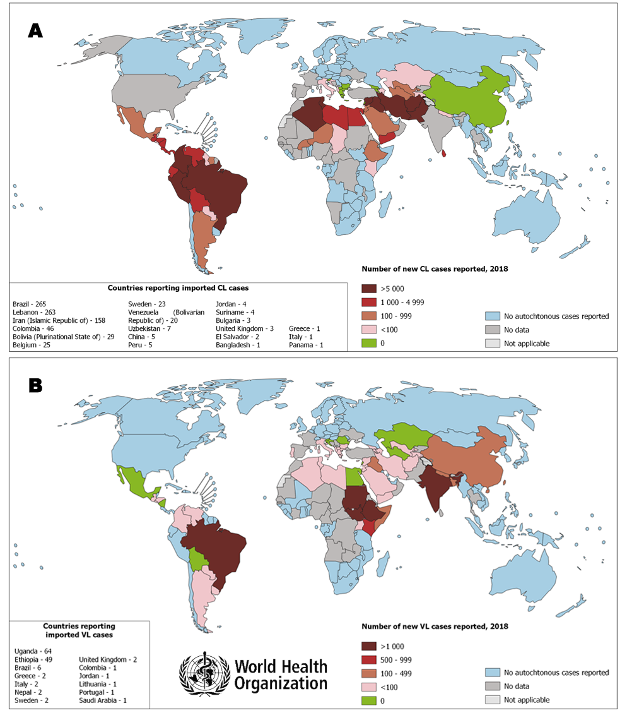
Canine Leishmaniasis have not :
A robust diagnostic method,
A efficient vaccine
A efficient drug
The control of the vector is not easy, it cannot be controlled by insecticides.
It is a zoonotic disease, when the first case of canine leishmaniasis arrive, few years later arrives the human cases.

Slide 4
A dog culling strategy is not supportable along the time for several reasons:
no reliable body of scientific evidence supports the effectiveness for disease control,
2) alternative reservoir hosts may play a role in maintaining the life cycle of L. infantum, like foxes, hares, armadillos, wild boars, cats and rabbits.
3) culled dogs are rapidly replaced with young dogs that are often more susceptible to primary infection.
4) serologic diagnostic tools often used for screening dogs as part of a culling program have limitations in terms of sensitivity and specificity.
5) dog culling is not a cost-effective, valid alternative from a socioeconomic perspective (e.g., drugs for euthanasia) to government institutions.
Then, the use of dog culling as a strategy to reduce the incidence of Visceral Leishmaniasis in humans cannot be justified and should no longer be used
it is successfully used for outbreak controls in short terms of time.

Slide 5

Low cost drug development
Because there is a neglected disease, and also because is for veterinary use.
Then we are looking for low cost and easy production compounds:
THIAZOLIDENE HYDRAZINES and CURCUMINOIDS

Slide 6
29 hydrazines were characterized against Leishmania spp, selected from our background in T. cruzi.
Only 3 were active (CI50 <10uM) against T. cruzi, T. brucei and Leishmania spp.
Only one was active in Leishmania infantum isolated from the last outbreak of canine leishmaniasis.

Slide 7
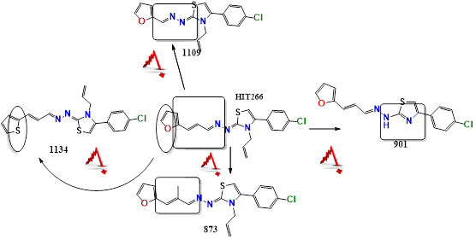
Structure-Activity analysis. Interpretation of the possible pharmacophore.

Slide 8
14 curcuminoids were characterized against Leishmania spp, selected from our background in T. cruzi.
Only 2 were active (CI50 <10uM) against T. cruzi, T. brucei and Leishmania spp.
And also active in Leishmania infantum isolated from the last outbreak of canine leishmaniasis.

Slide 10
Pharmacokinetic background

Slide 11
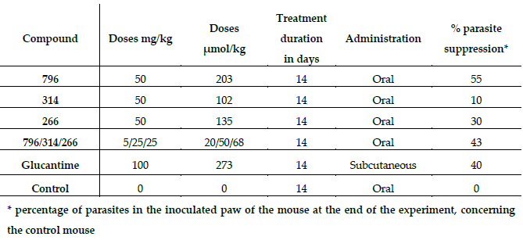
PROOF OF CONCEPT
In vivo test in the murine cutaneous leishmaniasis model for the lead compounds.

Slide 12
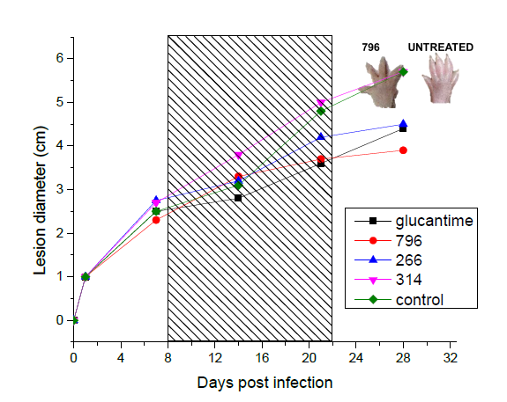
Weekly evolution of the diameter of the infected paw of mice.

Slide 13
Conclusions
Of the 50 compounds evaluated from our chemical collection, we conclude that 3 of the leading compounds (796, 266, 314), were found to have good antiparasitic activity in different species of trypanosomatids. Furthermore, these molecules have low nonspecific cytotoxic effects and did not show genotoxic or mutagenic effects. In addition to these encouraging results, they are safe, showing 100% survival in the acute toxicity model in vivo.
Compound 796 was the most promising compound with effective control of the Leishmania parasite infection in vivo. Also, the synergic effect was observed between the two chemical groups (curcuminoids and thiazolidene hydrazines). Taken together, the results obtained encourage us to continue with the clinical phase of experimentation in dogs of our leading compounds.

Slide 14






Funding: This research was funded by CSIC (Comisión Sectorial de Investigación Científica) I+D 2016 program number ID435 (grant).
Acknowledgments:

