Slide 1
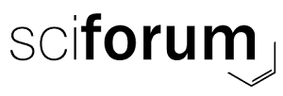
Long-term Sensitivity Analysis of Palmer Drought Severity Index (PDSI) Through Uncertainty and Error Estimation from Plant Productivity and Biophysical Parameters
Ghosh et al., 2020
Subhasis Ghosh ^{1*}, Subhajit Bandopadhyay ² and Dany A. Cotrina Sánchez ³
¹Department of Geography; Visva-Bharati University, Santiniketan, West Bengal, India;
²Department of Ecology and Environmental Protection; Poznan University of Life Sciences; Piatkowska 94; 60-649 Poznan; Poland;
³ Instituto de Investigación para el Desarrollo Sustentable de Ceja de Selva (INDES-CES) de la Universidad Nacional Toribio Rodríguez de Mendoza de Amazonas; Perú;
*Presented by: Subhasis Ghosh
Email- mail.subhasis@yahoo.com
Presented at the 1st International Electronic Conference on Forests
15–30 November 2020 Available online: https://sciforum.net/conference/IECF2020

Slide 2
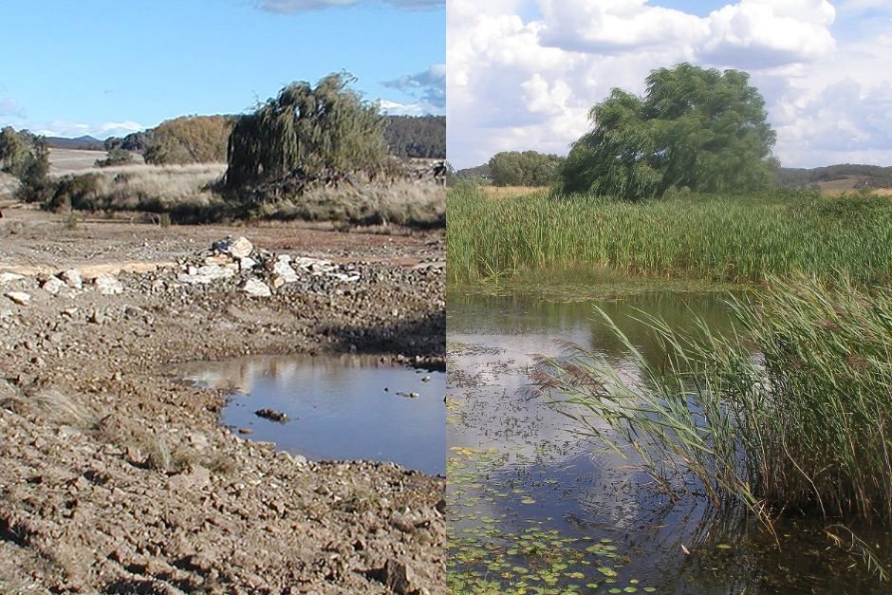
What is drought ?
Ghosh et al., 2020
Drought is the dryness condition of the environment that creates ecological stress due to lack of precipitation and shortages in water supply for plant growth.
Hence, vegetative condition is an ideal indicator of the level of atmospheric droughtiness.
Stressed vegetation
Better (More alive) vegetation condition
Water Shortage
Adequate Water Supply to support vegetation growth
Drought Condition
Regular Condition
Image Courtesy: abc.net.au

Slide 3
What is PDSI ?
Ghosh et al., 2020
The Palmer Drought Severity Index (PDSI) is one of the most effective, well-acknowledged, and widely used drought severity index that particularly determines the long-term drought conditions over the forest and other terrestrial ecosystems.
The PDSI is based on the demand and supply concept of the water balance model, taking consideration not only precipitation deficit but also includes local temperature and soil moisture anomalies to assess relative dryness.
The index was developed by Wayne Palmer in 1965 that uses readily available temperature and precipitation data as well as the locally available water content of the soil to estimate relative dryness.
This standardized drought index that generally spans -10 (extremely dry) to +10 (extremely wet), however maps of operational agencies like NOAA typically show a range of -4 (extremely dry) to +4 (extremely wet).
It has been reasonably successful at quantifying long-term drought, as it uses local temperature and rainfall data and a physical water balance model for estimation.
It can also capture the basic effect of global warming on drought through changes in potential evapotranspiration. Monthly PDSI values do not capture droughts on time scales less than about 12 months.
PDSI does not consider human impacts on the water balance, such as irrigation.

Slide 4
What is the need for this study?
Ghosh et al., 2020
Several studies were already conducted on the application of PDSI, however, the sensitivity of PDSI has not been explored yet over a humid-subtropical forest ecosystem based on-
1. Productivity (i.e. Gross Primary Productivity or GPP)
2. Biophysical parameters (i.e. biomass- Leaf Area Index or LAI, Enhanced Vegetation Index or EVI; greenness content- Normalized Difference Vegetation Index or NDVI),
3. Absorbed solar radiation by the plants (i.e. fraction of Absorbed Solar Radiation or fAPAR)
It was also observed that most of the existing literatures on drought severity preferred to use productivity, net photosynthesis (GPP, NPP) [1-6] or NDVI or Near-Infrared (NIR) based vegetation indices [7-12] for long-term drought condition assessments without testing the other vegetation parameters.
Hence, a true sensitivity analysis of all important vegetation parameters like GPP, NDVI, EVI, LAI, fAPAR was necessary to find out the most complimentary and effective PDSI indicator that shows the actual water deficit induced stress conditions over the vegetative areas of a sub-tropical humid ecosystem.

Slide 5
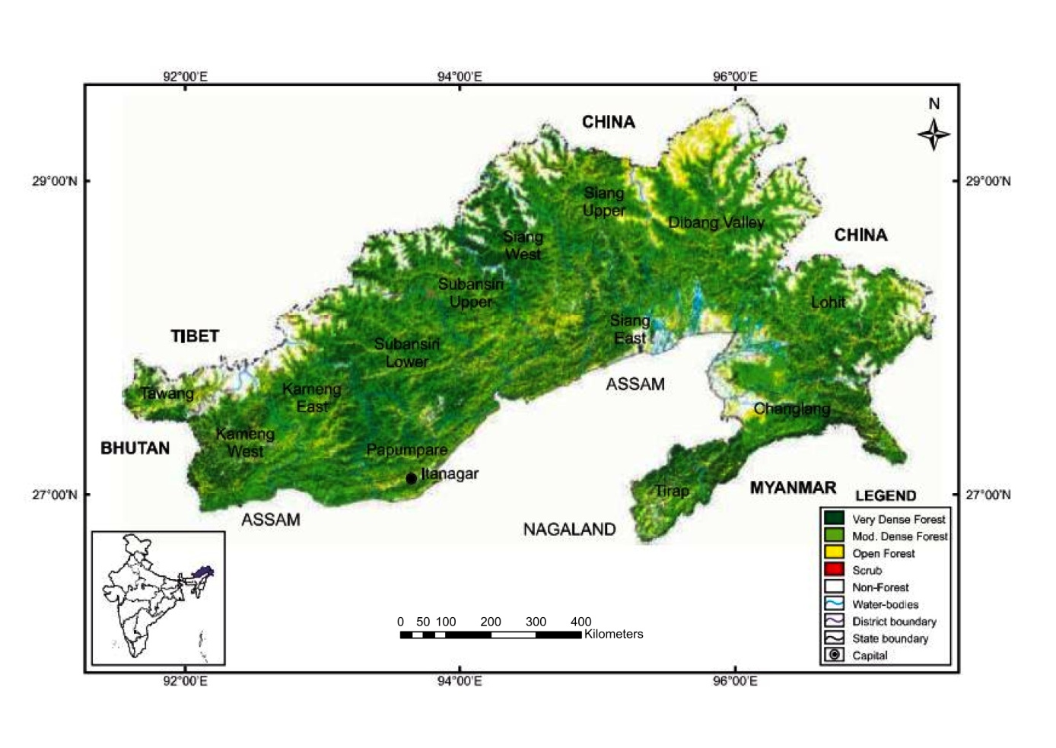
Study Area
Ghosh et al., 2020
The study was carried out over the humid-subtropical forest region of Arunachal Pradesh, India.
The study area is enriched with the second largest forest cover spreading over 79.63% of the total geographical area of the state.
This north-eastern state lies at the eastern Himalayan region of the country coordinated between 26°28’ N to 29°30’ N latitude and 91°30’ E to 97°30’ E longitude, and shares international boundaries with Bhutan in the west, China to the north and north-east, and Myanmar to the east.
The climate varies from temperate in the northern part and warm humid in the southern part having annual rainfall ranging between 2000 mm to 8000 mm and the annual temperature from <0°C to 31°C.
Source: India State of Forest Report 2019, Forest Survey of India, Ministry of Environment, Forest & Climate Change, Govt. of India

Slide 6
Methodological Framework
Ghosh et al., 2020
Data Collection
PDSI
Vegetation Parameters
(Using MODIS Terra Sensor data)
GPP (MOD17)- 8-day
NDVI (MOD13Q1)- 8-Day
EVI (MOD13Q1)- 8-Day
LAI (MOD15A2H)- 16-Day
fAPAR (MOD15A2H)- 8-Day
Development of Mean Monthly Products
Sensitivity Analysis
Pearson’s Correlation (r)
Error Estimation (SEE)
Uncertainty Analysis (RMSE)
Compilation of Results and Long-Term Analysis

Slide 7
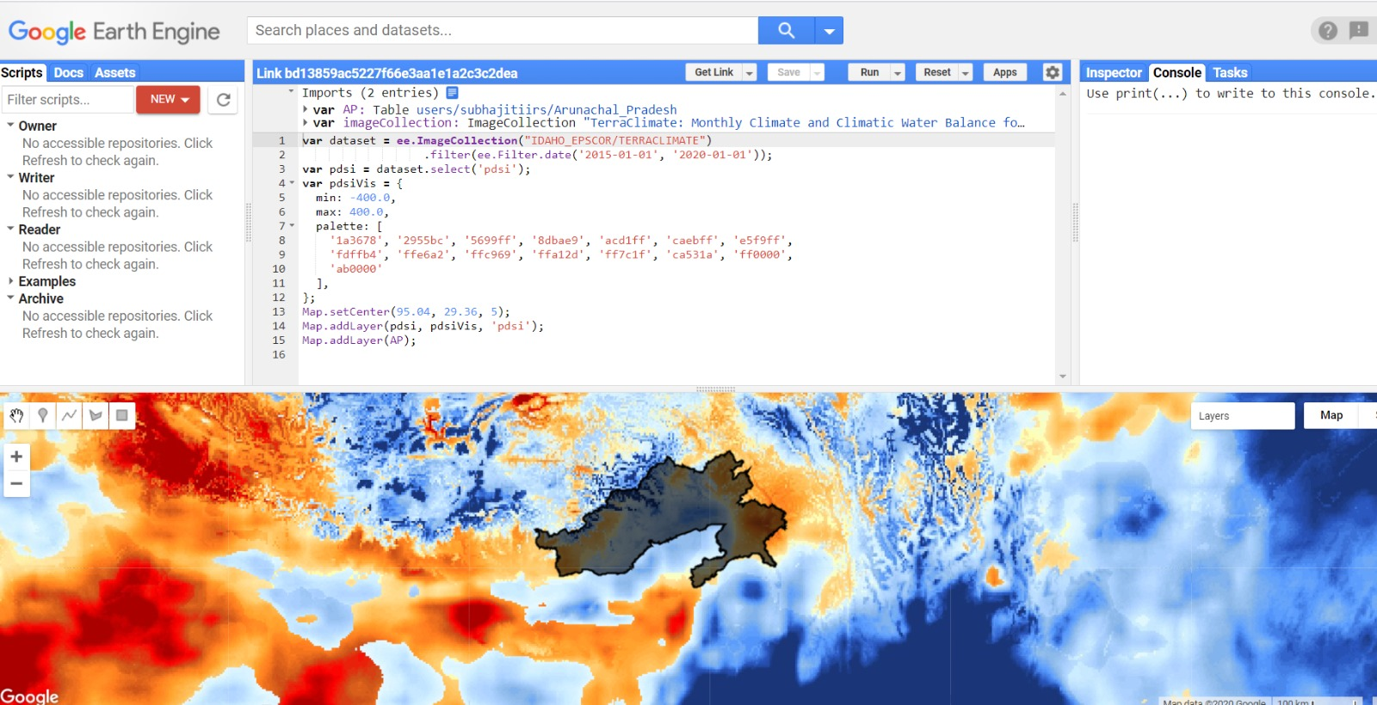
Extraction of PDSI Information
Ghosh et al., 2020
The monthly PDSI data for the year 2015-2019 has been obtained from the TerraClimate products developed by the University of Idaho, USA using Google Earth Engine that provide monthly climate and climatic water balance for global terrestrial surfaces.

Slide 8
Development of Vegetation Parameters
Ghosh et al., 2020
Gross Primary Productivity or GPP is the rate at which chemical energy (typically expressed as carbon biomass or organic substances) is created by primary producers through capturing solar energy in a given unit of area and time during photosynthesis.
LAI (LAI = leaf area / ground area, m² / m²) typically characterizes plant canopies.
EVI is highly responsive to plant physiognomy. EVI also indicates the water balance and atmospheric doughtiness of leaves that are the major eco-physiological parts of a plant that interact with the atmosphere. The formula used for computing EVI is-
$$EVI=G×\frac{(NIR−RED)}{(NIR+C1×RED−C2×BLUE+L)}$$
Where, NIR/red/blue are atmospherically-corrected or partially atmosphere corrected (Rayleigh and Ozone absorption) surface reflectance, L is the canopy background adjustment that addresses non-linear, differential NIR and red radiant transfer through a canopy, and C1, C2 are the coefficients of the aerosol resistance term, which uses the blue band to correct for aerosol influences in the red band. The coefficients adopted in the MODIS-EVI algorithm are; L=1, C1 = 6, C2 = 7.5, and G (gain factor) = 2.5.
The NDVI ($NDVI=NIR−RED/NIR+RED$) is a widely used greenness (chlorophyll content) indicator of vegetation, which is often used to assess the water deficit induced stress levels on plants.
fAPAR is one of the essential climate variables recognized by the UN Global Climate Observing System (GCOS) that has great potential to monitor and assess the drought impacts on vegetation. fAPAR monitors the greenness and health of vegetation by quantifying the fraction of the solar radiation absorbed by alive leaves for the photosynthesis activity.

Slide 9
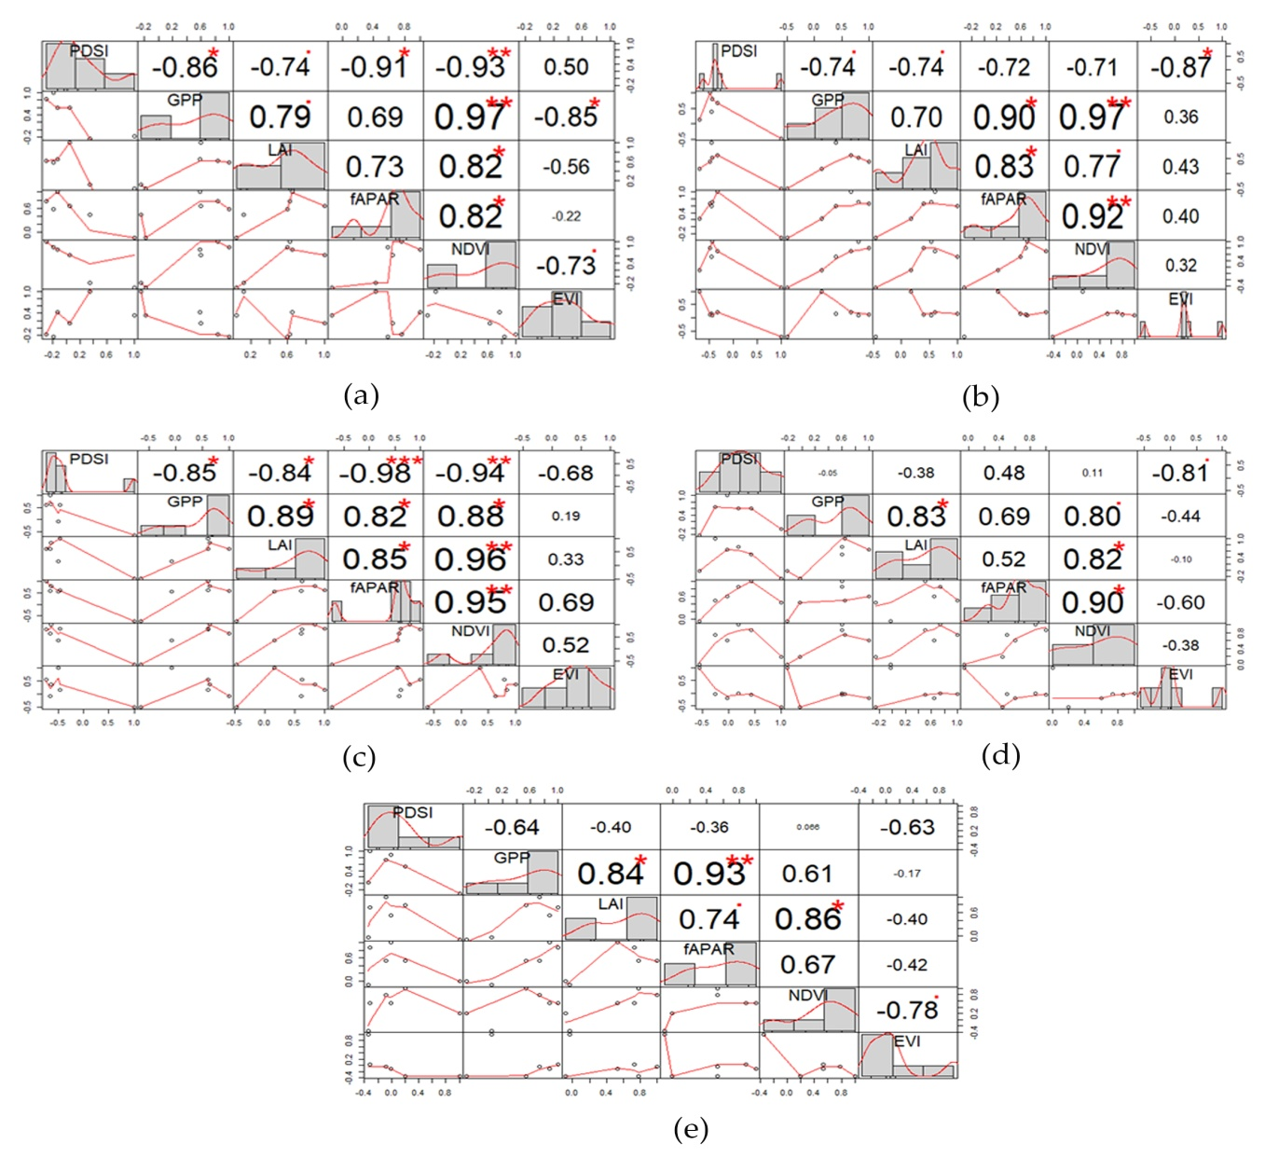
Results
Ghosh et al., 2020
Pearson Correlation
2015
2016
2017
2018
EVI shows the most promising long-term agreement with PDSI
2019

Slide 10
Error Estimation Analysis (Standard Error of the Estimates)
Ghosh et al., 2020
YEAR | PDSI-GPP | PDSI-LAI | PDSI- fAPAR | PDSI-NDVI | PDSI-EVI
2019 | 70.10047 | 11.23408 | 16.35537 | 0.22529 | 0.07128
2018 | 85.00281 | 14.707568 | 14.64304 | 0.26018 | 0.07962
2017 | 84.30856 | 14.99181 | 9.07160 | 0.18792 | 0.12114
2016 | 105.98472 | 18.01153 | 18.11280 | 0.21312 | 0.07426
2015 | 97.12000 | 12.47910 | 16.85542 | 0.21665 | 0.11117
EVI continuously managed to show least estimated standard error values for all five years, clearly indicating the highest level of long-term sensitivity with PDSI.
Though, NDVI also gave values very near to EVI.

Slide 11
Uncertainty Analysis (RMSE)
Ghosh et al., 2020
RMSE in %
Both EVI and NDVI showed the least uncertainties compared to the other vegetation parameters in respect to PDSI for all five years.
The RMSE values for both NDVI and EVI were found to be ranging from 2.39% to 3.01% during 2015-2018, which is overall the lowest among the others.
However, in 2019, NDVI showed slightly less RMSE values than EVI, but in that year, it was fAPAR that actually showed the optimum condition to PDSI with a RMSE 1.89%.
Overall, The estimated uncertainty (RMSE) between PDSI and EVI, and PDSI and NDVI were found to be 1% - 2% lower compared to the others, showing better sensitivity than the other four vegetation parameters in a long term context.

Slide 12
Compilation of the outcomes of correlation, error estimation, and uncertainty analysis
Ghosh et al., 2020
Parameters | 2015 |  |  | 2016 |  |  | 2017 |  |  | 2018 |  |  | 2019
 | r | SEE | RMSE (%) | r | SEE | RMSE (%) | r | SEE | RMSE (%) | r | SEE | RMSE (%) | r | SEE | RMSE (%)
GPP | -0.86 | 97.12 | 4.73 | -0.74 | 105.98 | 4.55 | -0.85 | 84.3 | 4.89 | -0.05 | 85 | 3.95 | -0.64 | 70.1 | 3.86
LAI | -0.74 | 12.47 | 3.45 | -0.74 | 18.01 | 3.09 | -0.84 | 14.99 | 3.23 | -0.38 | 14.7 | 2.79 | -0.4 | 11.23 | 1.89
fAPAR | -0.91 | 16.85 | 3.7 | -0.72 | 18.11 | 3.31 | -0.98 | 9.07 | 3.56 | 0.48 | 14.64 | 3.09 | -0.36 | 16.35 | 1.89
NDVI | -0.93 | 0.21 | 3.01 | -0.71 | 0.21 | 2.63 | -0.94 | 0.18 | 2.82 | 0.11 | 0.26 | 2.39 | 0.066 | 0.22 | 2.32
EVI | 0.5 | 0.11 | 3.01 | -0.87 | 0.07 | 2.63 | -0.68 | 0.12 | 2.82 | -0.81 | 0.07 | 2.39 | -0.63 | 0.07 | 2.58
Analysis | Overall most sensitive parameters
Pearson’s Correlation | EVI
Error Estimation | EVI
Uncertainty | NDVI, EVI
EVI overall showed the best result in all of the statistical testing measurements, and NDVI took the next place for showing second best result in both Error Estimation and Uncertainty Analysis.

Slide 13
Conclusion
Ghosh et al., 2020
Based on the long-term analysis from this experimental study over the sub-tropical forest region of the Arunachal Pradesh state of India, it was observed that EVI was the most sensitive parameter to PDSI in a long-term observation
We found that EVI is the simple, effective, and most complementary indicator (among vegetation parameters) for assessing PDSI over forest regions of a tropical ecosystem. Besides, EVI can also be used as a promising tool for effective evaluation of the long-term drought impacts on forest ecosystem that indicates the actual water deficit induced stress conditions.
EVI can also act as a direct proxy of the actual drought condition of the region. Similarly, after EVI, NDVI can be considered as the next promising sensitive indicator that is highly responsive to PDSI.
The authors assumed that this study will support sustainable forest management practices and drought monitoring under climate change scenarios for tropical ecosystems.

Slide 14
Acknowledgement
Ghosh et al., 2020
Analyses of the data were supported by the Polish National Research Centre (NCN) within the Project Sun Induced florescence and photosynthesis of peatland vegetation response to stress caused by water deficits and increased temperature under conditions of climate manipulation experiment (No. 2016/21/B/ST10/02271). We also sincerely appreciate the anonymous reviewers and members of the editorial team for their valuable comments and suggestions.

Slide 15
References
Ghosh et al., 2020
1. Graw, V.; Ghazaryan, G.; Dall, K.; Gómez, A.D.; Abdel-Hamid, A.; Jordaan, A.; Piroska, R.; Post, J.; Szarzynski, J.; Walz, Y.; et al. Drought dynamics and vegetation productivity in different land management systems of Eastern Cape, South Africa-A remote sensing perspective. Sustain. 2017, 9, doi:10.3390/su9101728.
2. Wang, H.; He, B.; Zhang, Y.; Huang, L.; Chen, Z.; Liu, J. Response of ecosystem productivity to dry/wet conditions indicated by different drought indices. Sci. Total Environ. 2018, 612, 347–357, doi:10.1016/j.scitotenv.2017.08.212.
3. Xie, X.; Li, A.; Tan, J.; Lei, G.; Jin, H.; Zhang, Z. Uncertainty analysis of multiple global GPP datasets in characterizing the lagged effect of drought on photosynthesis. Ecol. Indic. 2020, 113, 106224, doi:10.1016/j.ecolind.2020.106224.
4. Ciais, P.; Reichstein, M.; Viovy, N.; Granier, A.; Ogée, J.; Allard, V.; Aubinet, M.; Buchmann, N.; Bernhofer, C.; Carrara, A.; et al. Europe-wide reduction in primary productivity caused by the heat and drought in 2003. Nature 2005, 437, 529–533, doi:10.1038/nature03972.
5. He, M.; Kimball, J.S.; Running, S.; Ballantyne, A.; Guan, K.; Huemmrich, F. Satellite detection of soil moisture related water stress impacts on ecosystem productivity using the MODIS-based photochemical reflectance index. Remote Sens. Environ. 2016, 186, 173–183, doi:10.1016/j.rse.2016.08.019.
6. Yu, Z.; Wang, J.; Liu, S.; Rentch, J.S.; Sun, P.; Lu, C. Global gross primary productivity and water use efficiency changes under drought stress. Environ. Res. Lett. 2017, 12, doi:10.1088/1748-9326/aa5258.
7. Diodato, N.; Bellocchi, G. Modelling vegetation greenness responses to climate variability in a Mediterranean terrestrial ecosystem. Environ. Monit. Assess. 2008, 143, 147–159, doi:10.1007/s10661-007-9964-z.
8. Gu, Y.; Hunt, E.; Wardlow, B.; Basara, J.B.; Brown, J.F.; Verdin, J.P. Evaluation of MODIS NDVI and NDWI for vegetation drought monitoring using Oklahoma Mesonet soil moisture data. Geophys. Res. Lett. 2008, 35, L22401, doi:10.1029/2008GL035772.
9. Peters, A.J.; Walter-Shea, E.A.; Ji, L.; Viña, A.; Hayes, M.; Svoboda, M.D. Drought monitoring with NDVI-based Standardized Vegetation Index. Photogramm. Eng. Remote Sensing 2002, 68, 71–75.
10. Rousta, I.; Olafsson, H.; Moniruzzaman, M.; Zhang, H.; Liou, Y.A.; Mushore, T.D.; Gupta, A. Impacts of drought on vegetation assessed by vegetation indices and meteorological factors in Afghanistan. Remote Sens. 2020, 12, doi:10.3390/RS12152433.
11. Wang, P.X.; Wan, Z. ming; Gong, J. ya; Li, X. wen; Di, W.J. Advances in drought monitoring by using remotely sensed normalized difference vegetation index and land surface temperature products. Adv. Earth Sci.
12. Chen, W.; Xiao, Q.; Sheng, Y. Application of the Anomaly Vegetation Index to Monitoring Heavy Drought in 1992. J. Remote Sens. 1994, 9, 106–112.

Slide 16
Ghosh et al., 2020
THANK YOU
If you have any question, please feel free to contact the
corresponding authors at:
Subhajit Bandopadhyay : subhajit.bandopadhyay@up.poznan.pl
Subhasis Ghosh: mail.subhasis@yahoo.com

