Slide 1
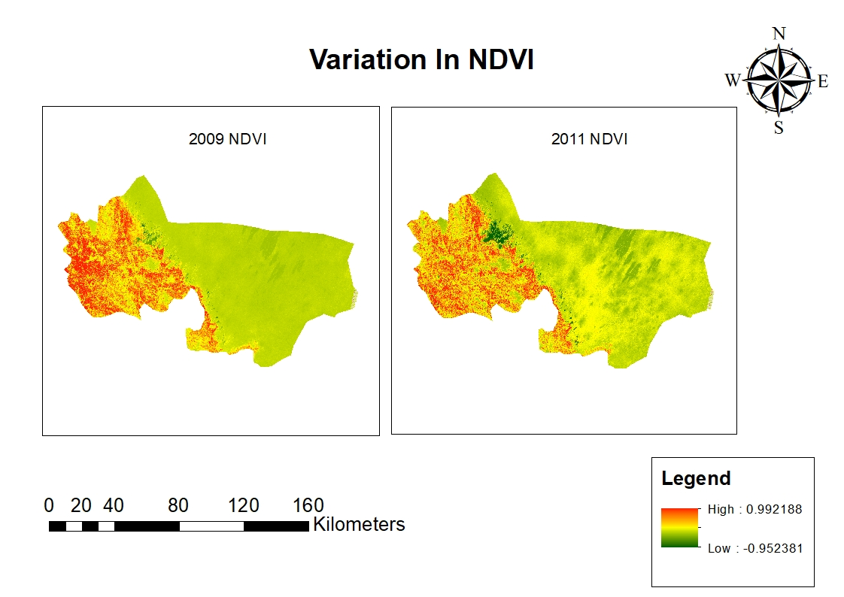
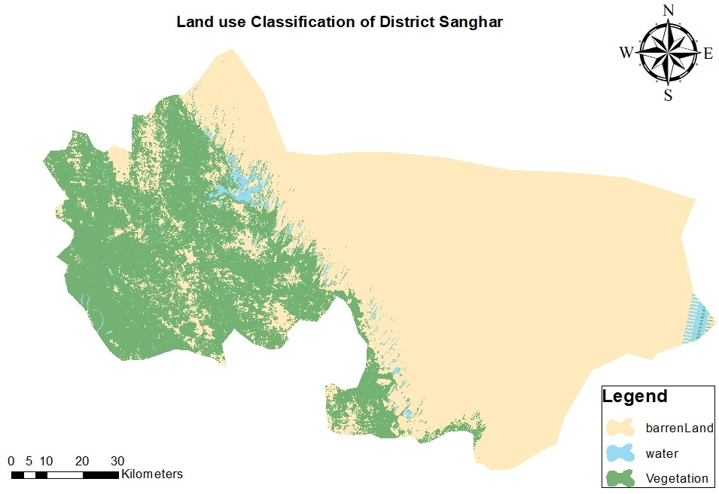
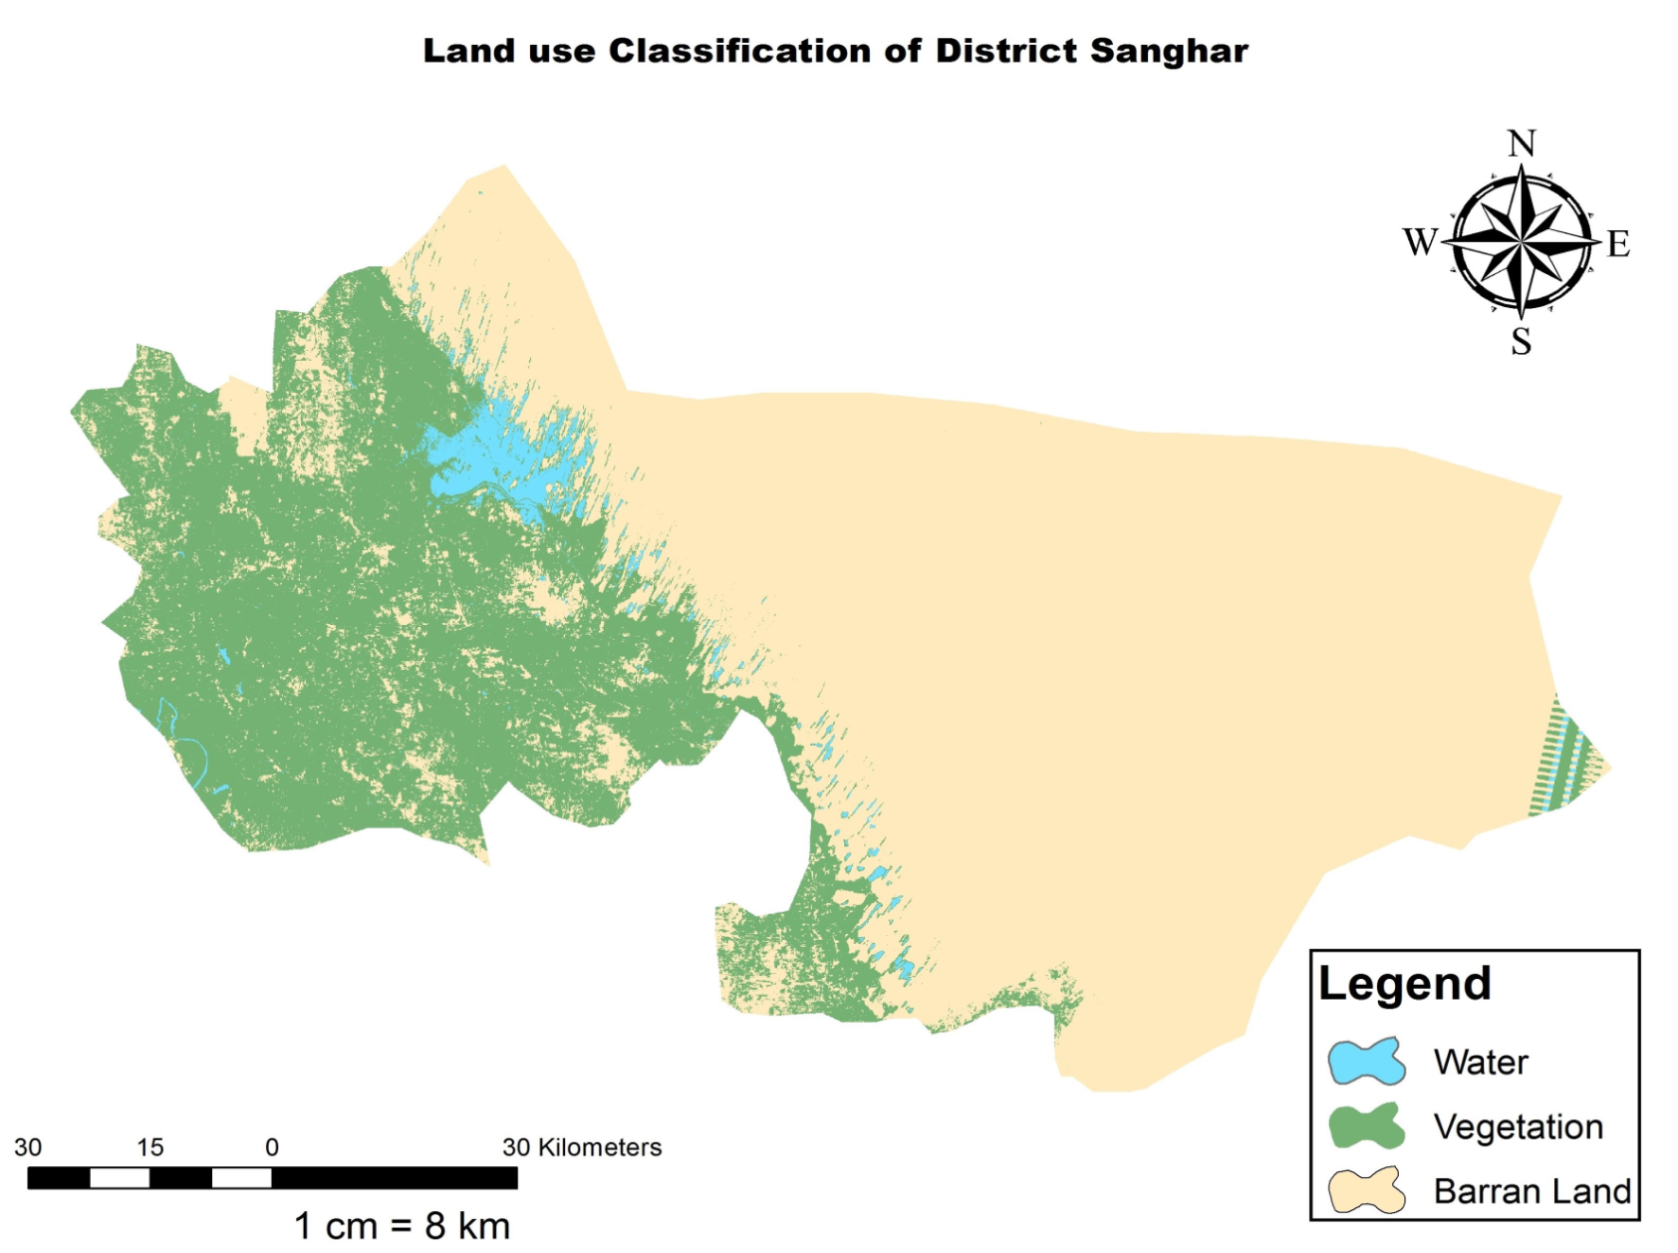
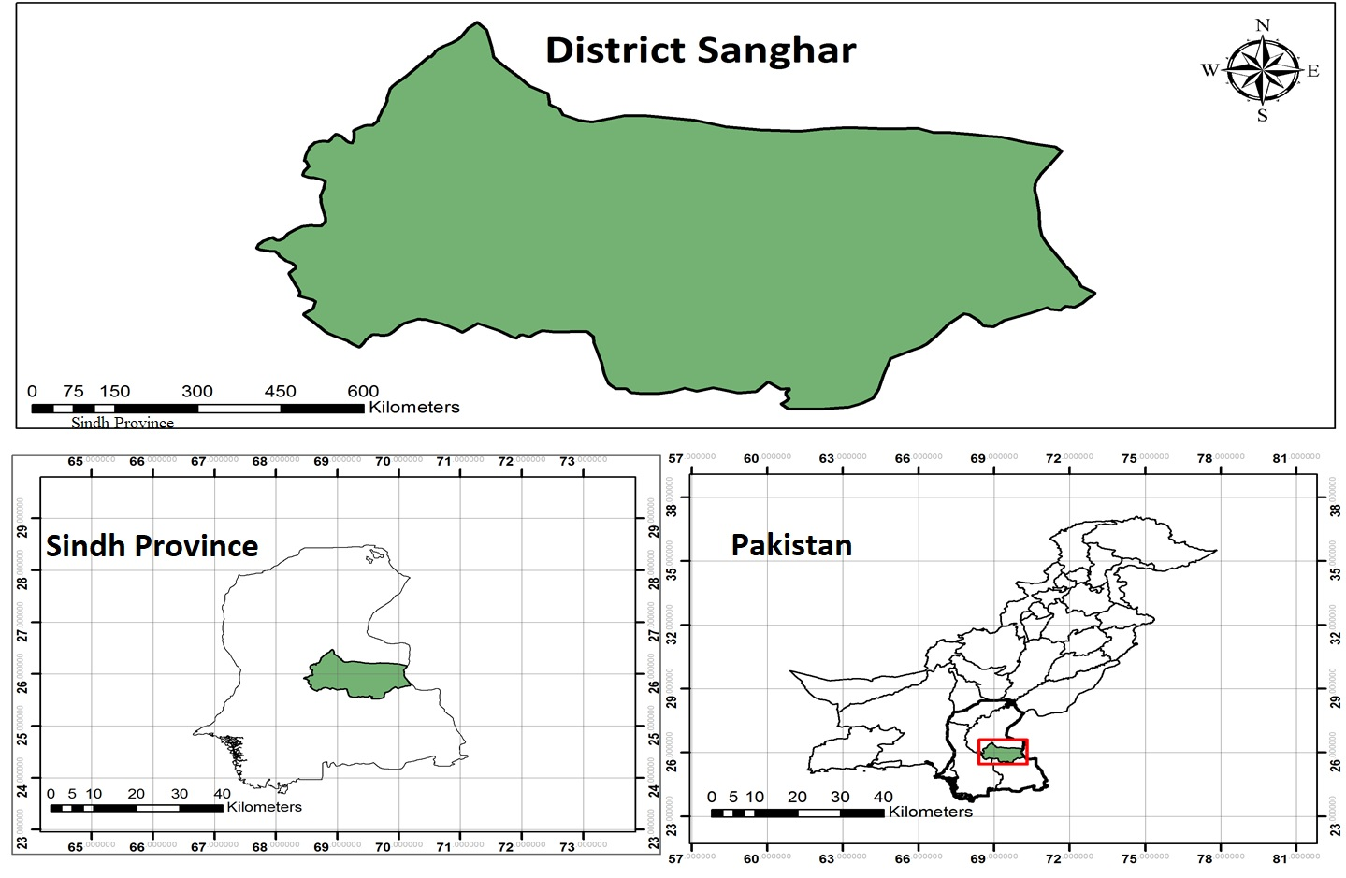
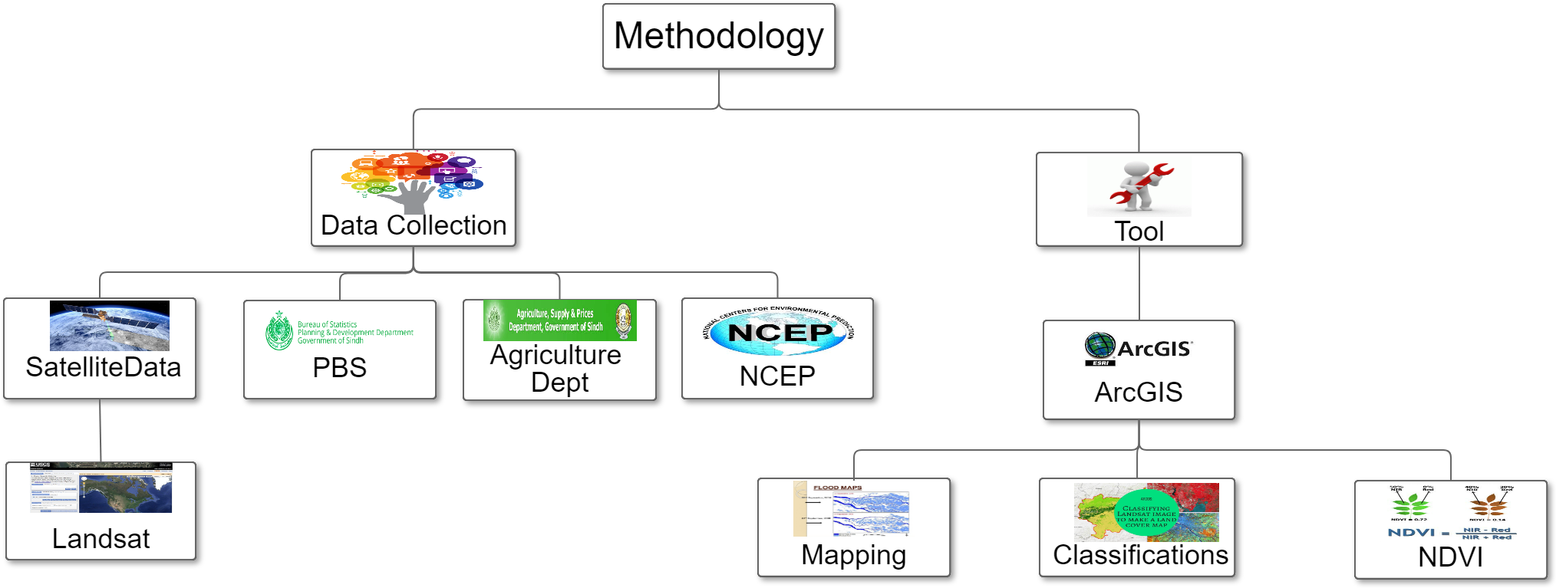
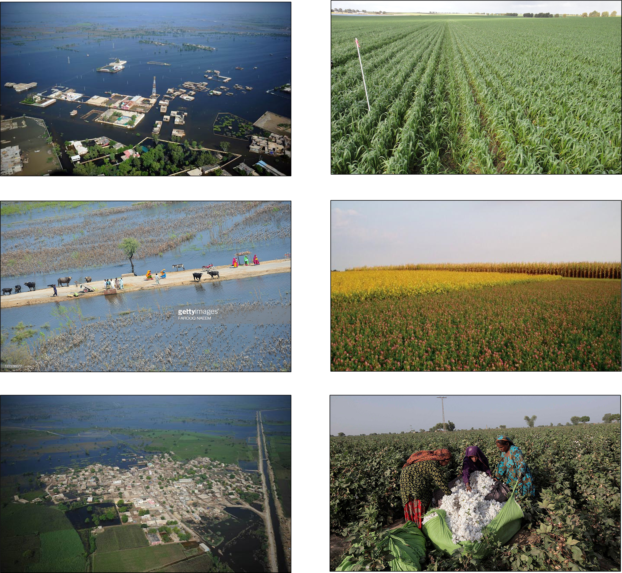
IMPACT OF FLOODS ON VEGETATION COVER
IN THE SANGHAR DISTRICT
Zenobia Talpur, Talal Naseer, Abdul Rafiue and Arjumand Zaidi
US-Pakistan Center for Advanced Studies in Water
Mehran University of Engineering and Technology
ABSTRACT
This study aims to assess the impact of 2010-2011 flash floods on the crop production of Sanghar—an eastern district of Sindh. The population of almost two million is mainly dependent on agriculture. Cotton, sugarcane, and wheat are the main cash crops of the district. In 2010-2011 Sanghar was hit by flash floods after heavy rainfall. These floods adversely affected the crops standing at that time. However, on the other hand, they increased the fertility of agriculture lands. Satellite images, precipitation data, and geographical information system (GIS) tools were used to quantify floods' effects by mapping pre- and post-flood vegetation cover. Supervised classification was applied on Landsat images from 2009 to 2013 to extract vegetation area. The temporal analysis unveils a significant increase in the vegetation cover in the post-flood years. Furthermore, the comparison between pre-and post-flood crop production data collected from the Pakistan Bureau of Statistics also validated the study results by revealing an increase in crop production.
INTRODUCTION
Sanghar, is an eastern district of Sindh, the population of district is mainly dependent on agriculture. Cotton, sugarcane, and wheat are the chief cash crops of the district. In 2010-2011, the area was subjected to flash floods due to heavy rainfall. Floods may adversely affect the economy by destroying standing crops, but on the other hand, they increase the fertility of the agriculture land. This study aims to quantify the effect of floods on the vegetation cover of the barren land. After analyzing through geospatial tools, it was found that the vegetation cover has increased to a significant extent.
RESULTS
OBJECTIVES
To map floods extent of 2010 and 2011 in the Sanghar district situated on the left bank of the River Indus.
To calculate change in the vegetation cover before and after the floods.
Classification of District Sanghar
STUDY AREA
2009 & 2011
METHODOLOGY FRAMEWORK
LIMITATION
The image of 2012 is not used in our research because of the excessive cloud cover.
CONCLUSION
According to Pakistan Met Department’s report of 2012, massive floods have inundated major areas of vegetation cover where crops were ready to harvest, and the flash flood of 2011 damaged all the crops.
Although crops were severely affected during the flood, soon after the flood, an increase in the vegetative cover presented a positive impact of the disaster.
The study results also validated the report and showed a significant increase in the vegetation cover after the flooding years.
DURING FLOOD AFTER FLOOD
Source:
( PHOTO: REUTERS), The Express Tribune .(Farooq NAEEM), PHOTO by AFP), Dawn News
ACKNOWLEDGMENT
We are thankful to Mr. Mashooq Leghari, Deputy Director of the Agricultural Department of Sanghar, for providing us the required data used in this study.
REFERENCES
Disaster Risk Management Plan District Sanghar, Government of Sindh
http://www.pdma.gos.pk/new/Preparedness/DRM_Plan/Sanghar.pdf
2. Government of Sindh Rehabilitation Department, “Sindh provincial
monsoon/floods contingency plan 2011 (DRAFT VERSION 1.0)." undated.
http://pdma.gos.pk/new/docs/download/13sindhcontigencyplan.pdf
A. Rehman, L. Jingdong, Y. Du, R. Khatoon, S. A. Wagan, and S. K. J. E. D. E. Nisar, "Flood disaster in Pakistan and its impact on agriculture growth (a review)," vol. 6, no. 23, pp. 39-42, 2016.
GOP, "Annual flood report 2011," Government of Pakistan, Ministry of
Water and Power.
http://mowr.gov.pk/wp content/uploads/2018/06/Annual-Flood-Report-2011.pdf

