Slide 1


Hydro-energy suitability of the rivers regarding their hydrological and hydrogeological characteristics
Bojan Đurin^{1*}, Lucija Plantak ², Dragana Dogančić², Nikola Kranjčić²
University North, Department Of Civil Engineering, Varaždin, Croatia;
bojan.durin@unin.hr
University Of Zagreb, Faculty Of Geotechnical Engineering, Varaždin, Croatia;
lucija.plantak@gfv.unizg.hr, dragana.dogancic@gfv.unizg.hr,
nikola.kranjcic@gfv.unizg.hr

Slide 2
Introduction
Energy consumption is rapidly growing from year to year and the public and decision makers have realized the importance of switching to clean and renewable energy sources.
hydropower plants, including small-scale hydropower plants, produce the majority of the energy deemed as renewable.
Unlike large-scale hydropower plants, mini and micro hydropower plants, if carefully planned and managed, tend to cause no environmental damage and can be considered perfectly safe for the environment.
Also, micro and mini hydropower plants are nature-friendly, cheaper in comparison to large hydro power plants, and can be installed at almost any water course.

Slide 3
Small rivers and water coursers, with their changeable velocities and torrential characteristics, can pose a challenge when planning for an installation of mini or micro hydropower plants.
Key input parameters for sizing of micro and mini hydropower plants will be provided with research and analysis of hydrological and hydrogeological properties of the rivers.
One of the basic parameters for hydropower potential of rivers are daily average flows.
In light of that, thorough analysis of the time series of average daily flows of water course will be carried out, not just as mentioned input parameter, but also for further elaboration of the project.
Other key information for reliable analysis and sizing of the hydropower plant model is hydrogeological characterization of the medium underlying the riverbed.

Slide 4
Methodology
First part is Rescaled Adjusted Partial Sums (RAPS) method, while the second part is hydrogeological analysis of the analyzed location, in order to obtain the comprehensive view of the topic.
RAPS is a well-known method based on a visual determination of a subseries from original series of data. By using the average value and standard deviations of the observed time series, RAPS values provide insight into the parts, where occurrence of the trends, data grouping, fluctuations and similar appearances during the time:
Methodology presented in the paper gives reliable projection of the hydro-energy potential of analyzed locations, which could be very useful for investors, as well as for the designers of hydro power plants.

Slide 5
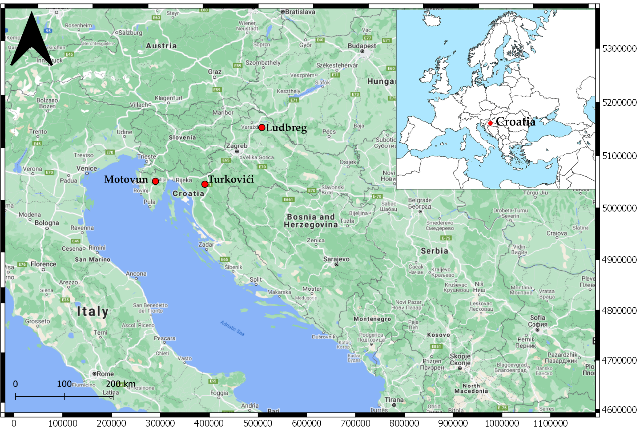
Case study
HYDROLOGICAL (LIMNIGRAPH) STATIONS WHERE TIME SERIES OF THE AVERAGE DAILY FLOW WERE TAKEN ARE LUDBREG (BEDNJA), TURKOVIĆI (GORNJA DOBRA) AND MOTOVUN (MIRNA).
Notes:
Each of the rivers flows through different geological, i.e. hydrogeological media, which definitely has an impact on the hydrological characteristics of the observed rivers. Bednja flows through the intergranular media, Gornja Dobra through karst, while Mirna flows through the flysch (marl) media. This consequently has an impact on the hydro-energy potential of the rivers

Slide 6
Results and discussion
RAPS diagrams for the flows measured at the measuring stations on the rivers Bednja, Gornja Dobra and Mirna for analysed period of 20 years, from 1999 to the 2018.
General conclusion is that all three rivers have torrential characteristics, which could be seen from the hydrograms.
Precipitation causes a very fast rising of the hydrograms after minimum one day after the precipitation ends, and very short lag of the alighting.
Also, during summer periods, i.e. middle of each observed year, in most of the cases it could be concluded that flows are the smallest in comparison to the entire year.
years with smallest flows, 2011 and 2012, are common for all analyzed rivers.

Slide 7
Table 1. Statistical parameters of the average daily flows for river Bednja, Gornja Dobra and Mirna
River | Average (m³/s) | Standard deviation (m³/s) | Minimum (m³/s) | Maximum (m³/s)
Bednja | 6,171 | 9,980 | 0,431 | 116,000
Gornja Dobra | 11,727 | 15,414 | 0,627 | 171,000
Mirna | 5,559 | 9,909 | 0,061 | 89,800

Slide 8
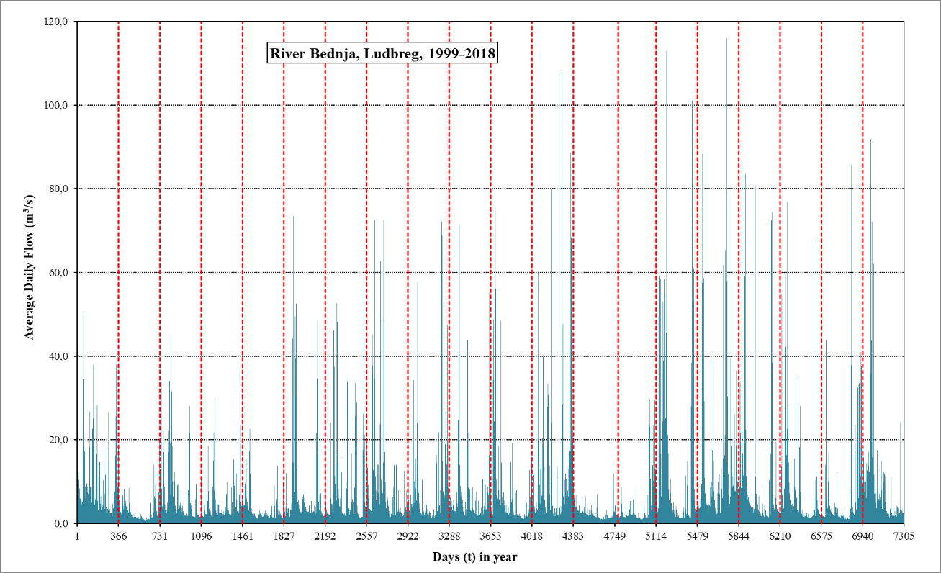

Slide 9

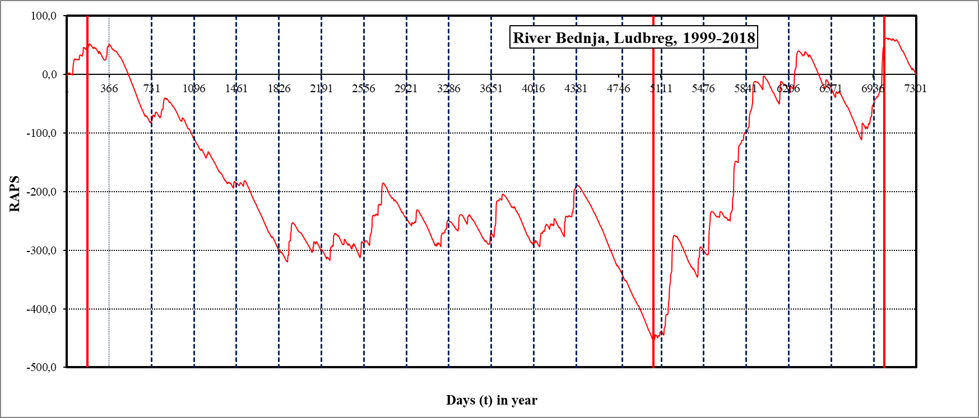
Notes:
Analysis of the RAPS diagram for the river Bednja establishes four subperiods. First one is from middle of 1999 year, second from middle of 1999 year till end of 2012 year, third from end of 2012 year till beginning of 2018 year, and last one from beginning of the 2018 year and extends further (fourth subserie). Second subperiod divides period of the conditionally speaking ”low flows” compared with third subperiod with ”high flows” years.

Slide 11

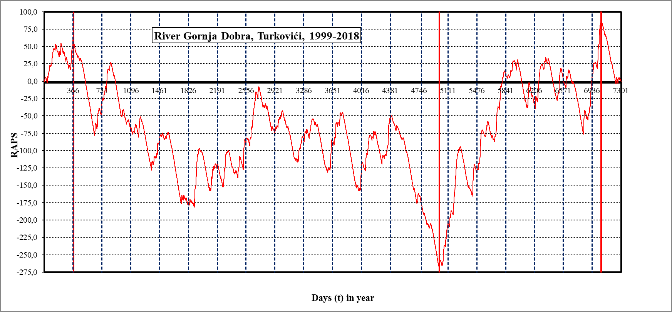
Notes:
Figure 5 shows a bigger number of the subseries. Analysis of the RAPS diagram for the river Gornja Dobra assert four subperiods. First one is until the end of 1999 year, second from end of 1999 till end of 2012, third from end of 2012 till beginning of 2018, and last one from beginning of the 2018 year and extends further. RAPS diagrams for Gornja Dobra and Bednja also shows four subseries as Bednja, but there are no complete overlapping. Joint parts are beginning of the subdivision during years 1999 and 2018. This implies on the regional climate change. Other subdivisions are not so easy for explain. Such could be a consequence of a regulation work on the rivers, or maybe local climate changes, which are particular for the analyzed area(s).

Slide 12
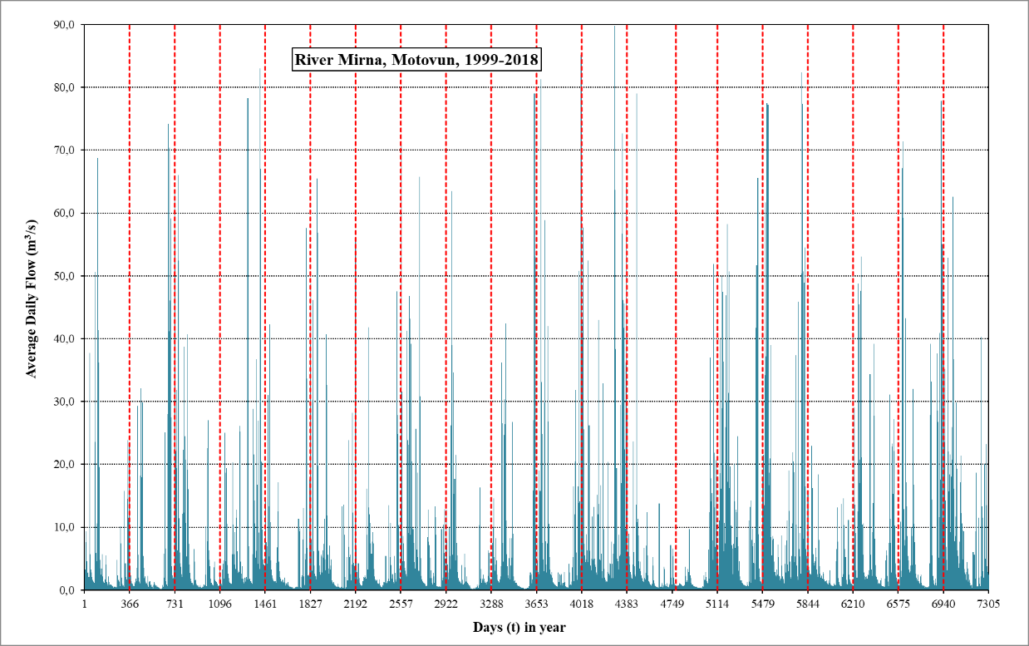

Slide 13
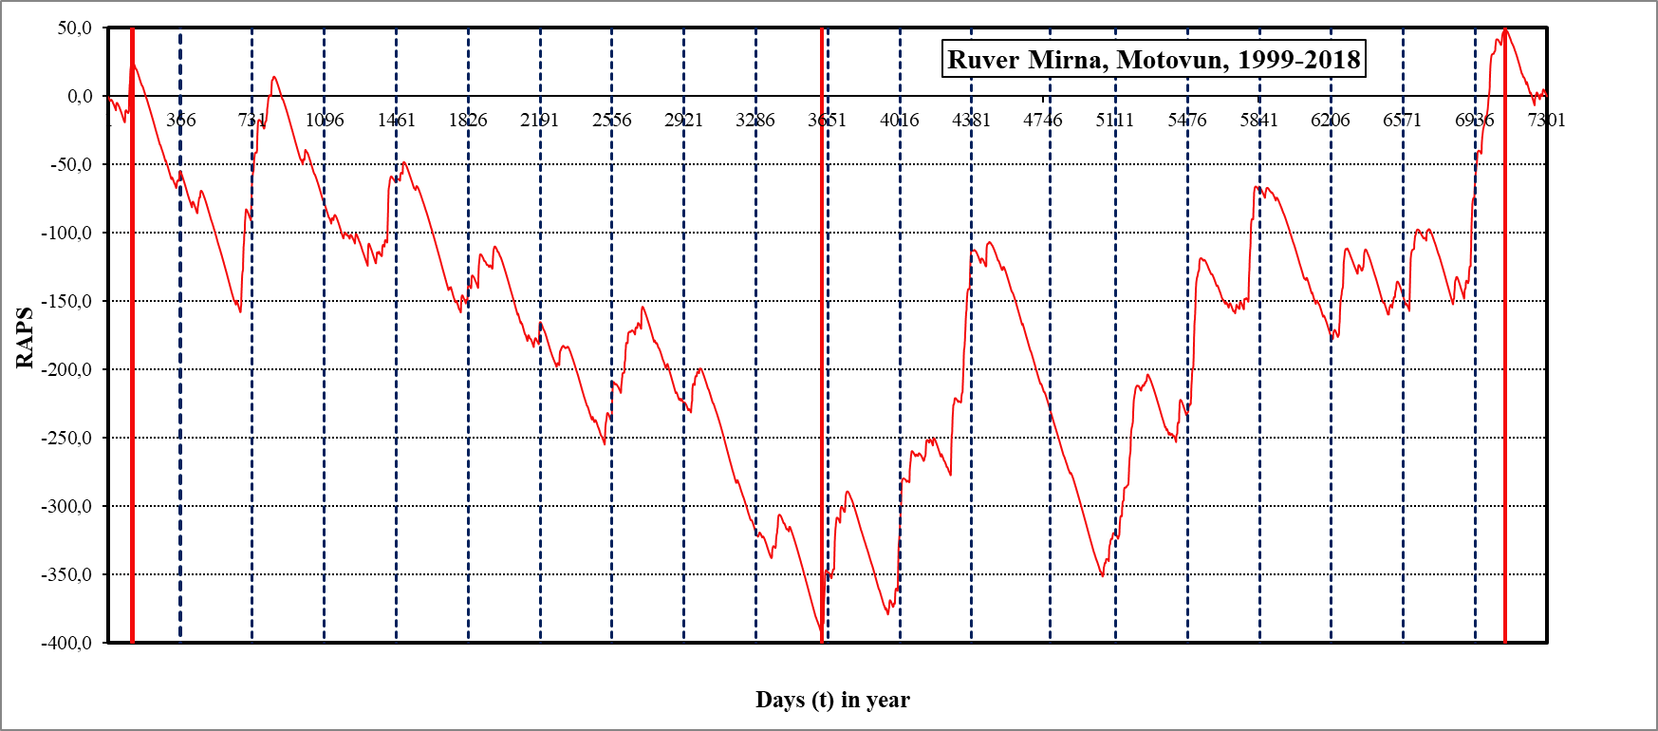
Notes:
For river Mirna, analysis of the RAPS also asserts four subperiods. First one is from beginning of 1999 year, second from beginning of 1999 year till end of 2008 year, third from end of 2008 year till beginning of 2018 year, and last one from beginning of the 2018 year and extends further.

Slide 14
Discussion
Regarding hydro-energy potential, such analysis indicates that in case of occurrence of the subseries within original time serie of the flow, attention should be focused on these parts of the analyzed time periods.
Specifically, in analyzed cases, periods from year 2018 are interested because there are present irregularities, which affect average daily flow series. Calculation of the flow required for sizing of the hydropower plants should be focused on those values in such subseries.
This surely depends about duration of the available time series (10, 20 or longer), because RAPS calculation will not show same division of the given time serie.

Slide 15
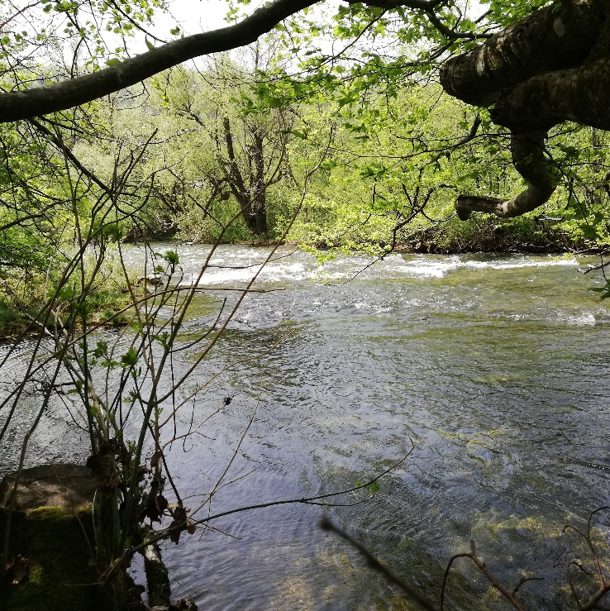
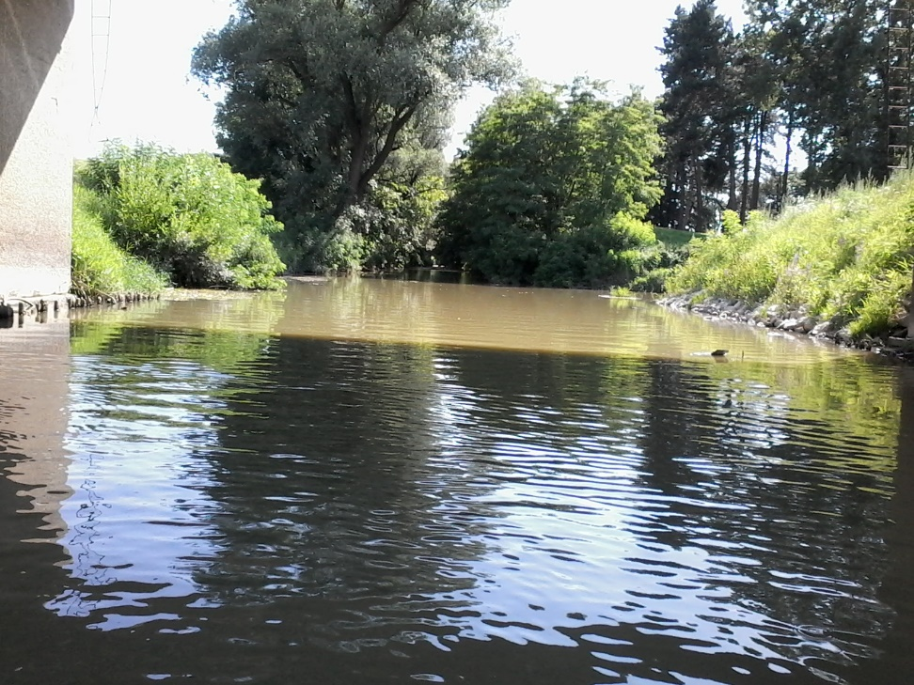
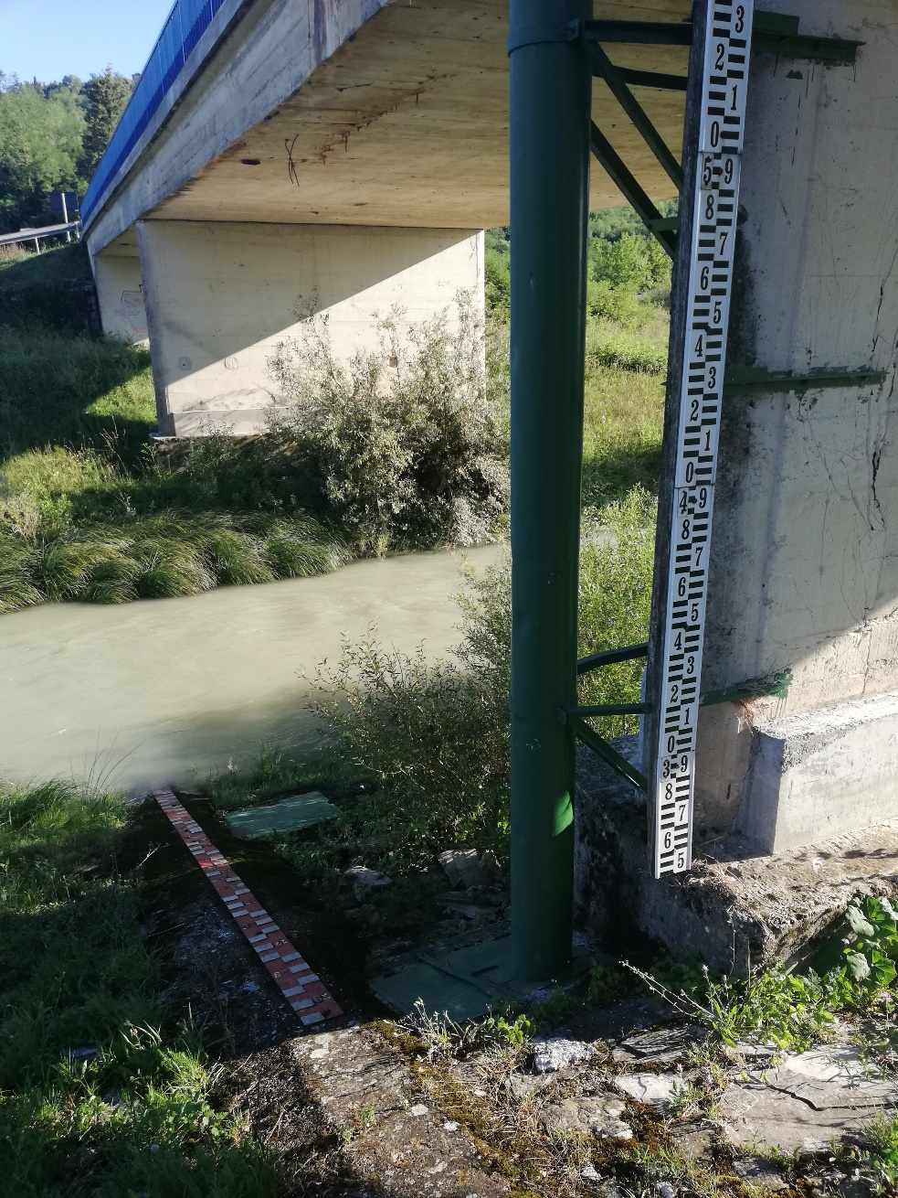
View at the measuring station Ludbreg on river Bednja
View at the measuring station Motovun on river Mirna
View at the measuring station Turkovići on river Gornja Dobra
Notes:
From Table 1, it could be seen that River Gornja Dobra has biggest deviation of the averaged daily flow, compared with the Bednja and Mirna. Such is explained by the characteristics of the river bed. Gornja Dobra firstly flows through the clastites. After this flows through the dolomite rocks, where flow losses are small due to the lack of caverns and abysses [14]. Such formations are formed in the limestone. Dolomites are mostly impermeable and in the karst they represent a barrier to the passage of water.

Slide 16
conclusion
regime of the water flow by application the RAPS analysis of the average daily flow series, together with review of the hydrogeological characteristics.
All analyzed rivers have potential for building of the small hydropower plants.
Detailed analysis, i.e. extension of the research will include analysis of the other measuring stations on the analyzed rivers and establishing of the functional connections between flows measured on several measuring stations.
field measurement and prospection on the potential locations, where installation of the hydropower plants is possible, and where data does not exist, everything with regards on the hydrogeologcal properties.
Numerical analysis should include RAPS analysis of the precipitation time series, as well as of each particular time serie of the average daily flow in order to obtain complete picture of the analyzed area.

Slide 17

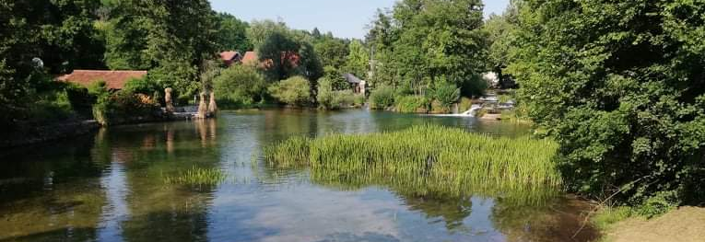
Thank you!

