Slide 1
Landscape pattern effects on surface runoff: Assessment using a hydrologic model in the Fuhe River Basin of Poyang Lake Watershed
The 5th International Electronic Conference on Water Sciences (ECWS-5)
Session E. Integrated Modelling of the Interactions between Water and the Ecosphere
Jianzhong Lu^{1,} *, Qingqing Yan², Hongzhi Wang², and Xiaoling Chen¹
1. State Key Laboratory of Information of Engineering in Surveying, Mapping and Remote Sensing, Wuhan University, Wuhan 430079, China.
2. School of Urban and Environment Sciences, Central China Normal University, Wuhan 430079, China
* Tel.: (+86)27-68778755, Email: lujzhong@whu.edu.cn
Nov. 16-30, 2020

Slide 2
Outline
1.
Introduction
2.
Study area and data
3.
Method
4.
Results and discussion
5.
Conclusion

Slide 3
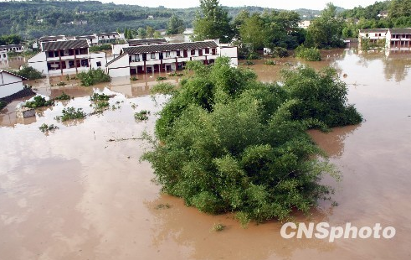
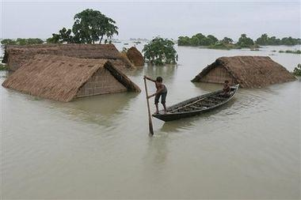
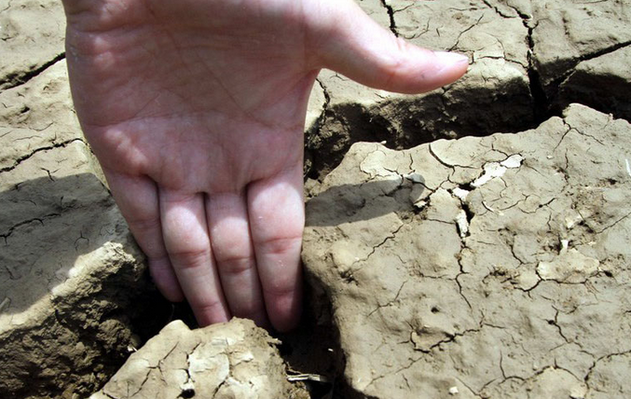
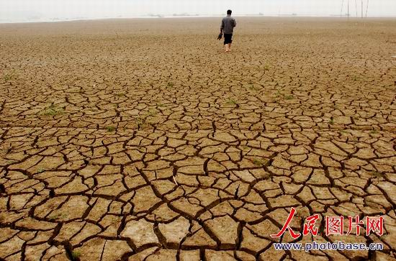
Introduction
With the development of social economics recently, human activities intensively change the landscape, which significantly impacts the water cycle in the watershed.
It will lead to water problems such as water pollution, water redundancy and shortage.

Slide 4
Introduction
Impact assessment of landscape change on surface runoff in watershed will provide
Knowledge for water resources management
Information of Best Management Practices for land development
Regulation of water cycle under regional landscape changes
River discharge for drought and flood prediction

Slide 5
Study area and data
Fuhe River basin (FRB) in Poyang Lake watershed
  Poyang Lake is the large freshwater lake in China.
  Fuhe River is one of the five major tributaries of Poyang Lake, and its drainage area is the second largest basin in Poyang lake watershed with area 16493 km²
  There are four ground-based meteorological stations named Guangchang, Nancheng, Zhangshu, and Guixi within and around the basin.
  The Lijiadu hydrological station measures discharge of the basin.

Slide 6
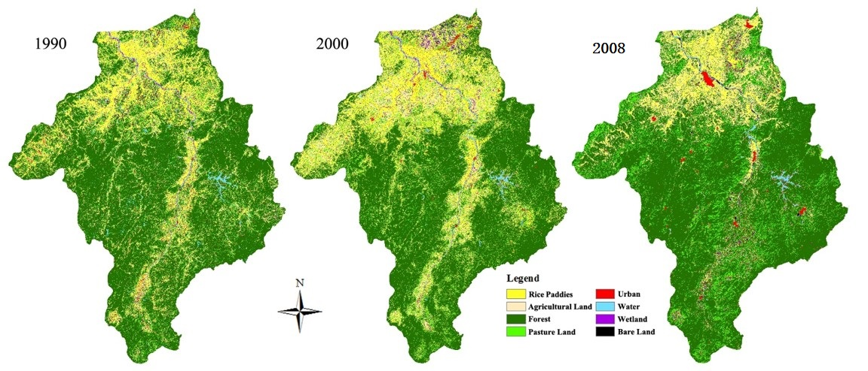
Study area and data
Data processing
  Land use and cover change
    Supervised classification method is applied to the satellite images, including Landsat TM images in 1990, Landsat ETM+ images in 2000, and HJ-1A/B CCD images in 2008.
    Land use cover was divided into 8 classes, including Rice paddies, Agricultural land, Forest, Grassland, Urban, Water, Wetland and Bare land.

Slide 7
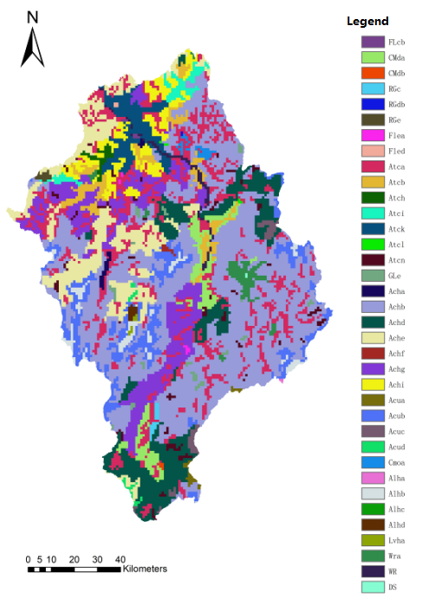
Study area and data
Data preparation
  DEM
    ASTER GDEM
    30m ground resolution
  Soil map
    Soil type map and soil physical property database. The soil type map was from the 1:1 000 000 Harmonized World Soil Database (HWSD)

Slide 8
Method
Flowchart
  Runoff characteristics analysis in the basin
  Analysis of landscape pattern changes
  Watershed runoff modeling
  Impacts assessment of landscape change on surface runoff

Slide 9
Method
SWAT model setup in FRB
Data input & model running
Sensitivity analysis
HRU division
Parameter calibration
Runoff modeling
River network delineation
Results validation
Data prepare

Slide 10
Results and discussion
Runoff variations in FRB
  Runoff variations during three periods
    Increasing during 1990–1999
    Decreasing during 2000–2008
    Fluctuation during 2009–2013
  During three periods, monthly average maximum discharge increases then decrease, and minimum discharge continuous declined.

Slide 11
Results and discussion
Runoff variations in FRB
The moving average of rainfall and runoff fluctuates in the same trend and in the same direction, and R² of both reaches 0.798, indicating that precipitation can significantly affect runoff.
The change rate curve shows that the variation range of runoff is much stronger than that of rainfall. Precipitation is one of the influential factors of runoff, and other factors such as human activities also have great influence.

Slide 12
Results and discussion
Runoff variations in FRB
Runoff is mainly affected by climate change and human activities. By using the mathematical relationship of three periods derived from Double Cumulative Curve Method, the contributions of climate and human activities to surface runoff was calculated in FRB from 1990 to 2013.
Period | Annual rainfall (mm) | Runoff（m³/s） |  |  | Climate Change |  | Human activities
 |  | Observed annual mean runoff | Calculated annual mean runoff | Total changes | Impacted amount (m³/s) | Contribution rate(%) | Impacted amount (m³/s) | Contribution rate (%)
1990-1999 | 1814.90 | 15.57 | - | - | - | - | - | -
2000-2008 | 1667.75 | 12.11 | 14.36 | -2.24 | -1.16 | 33.39% | -2.30 | 66.61%
2009-2013 | 1741.33 | 13.27 | 16.21 | -2.94 | 0.63 | -21.54% | -2.94 | 127.46%

Slide 13
Results and discussion
Runoff results simulated by SWAT model
  The simulated and observed runoff fitted well, and the R² and E_{ns} of the three periods were 0.91, 0.86, 0.92 and 0.89, 0.80 and 0.90, respectively.
  The built SWAT Model is able to generate accurate result of hydrology prediction in FRB.

Slide 14
Results and discussion
Landscape pattern changes in FRB
Year | Area and rate | Rice paddy | Agricultural land | Forest | Grassland | Water | Wetland | Urban | Bare land
1990 | Area/km² | 2877.68 | 1685.42 | 8206.12 | 1360.37 | 202.75 | 20.68 | 211.20 | 172.97
 | Percentage/% | 19.53 | 11.44 | 55.68 | 9.23 | 1.38 | 0.14 | 1.43 | 1.17
2000 | Area/km² | 2166.51 | 1607.66 | 8467.46 | 1574.34 | 295.24 | 33.64 | 362.29 | 353.36
 | Percentage/% | 14.58 | 10.82 | 56.98 | 10.59 | 1.99 | 0.23 | 2.44 | 2.38
2009 | Area/km² | 2249.28 | 1251.28 | 8907.58 | 1341.20 | 172.16 | 37.04 | 518.09 | 272.27
 | Percentage/% | 15.25 | 8.48 | 60.39 | 9.09 | 1.17 | 0.25 | 3.51 | 1.85
1990–2000 | Change rate % | -24.71 | -4.61 | 3.18 | 15.73 | 45.62 | 62.67 | 71.54 | 104.29
2000–2008 | Change rate /% | 3.82 | -22.17 | 5.20 | -14.81 | -41.69 | 10.11 | 43.00 | -22.95
From 1990 to 2008, the area of rice paddy and bare land decreased significantly, while the area of forest, wetland and urban area increased.

Slide 15
Results and discussion
Landscape pattern changes in FRB
2008
 |  | Rice paddy | Agricultural land | Forest | Grassland | Water | Wetland | Urban | Bare land
 | Rice paddy | 1023.02 | 406.87 | 944.95 | 232.79 | 17.65 | 4.85 | 172.42 | 74.84
 |  | 35.55% | 14.14% | 32.84% | 8.09% | 0.61% | 0.17% | 5.99% | 2.60%
 | Agricultural land | 551.33 | 245.12 | 531.67 | 167.32 | 13.36 | 7.13 | 101.39 | 67.93
 |  | 32.72% | 14.55% | 31.55% | 9.93% | 0.79% | 0.42% | 6.02% | 4.03%
 | Forest | 237.82 | 382.42 | 6620.51 | 756.94 | 16.31 | 12.21 | 118.10 | 59.43
 |  | 2.90% | 4.66% | 80.68% | 9.22% | 0.20% | 0.15% | 1.44% | 0.72%
1990 | Grassland | 237.18 | 171.78 | 677.17 | 167.07 | 6.89 | 3.49 | 61.86 | 34.76
 |  | 17.44% | 12.63% | 49.78% | 12.28% | 0.51% | 0.26% | 4.55% | 2.56%
 | Water | 31.57 | 7.19 | 32.60 | 2.77 | 96.05 | 5.01 | 16.96 | 10.59
 |  | 15.57% | 3.55% | 16.08% | 1.37% | 47.37% | 2.47% | 8.36% | 5.22%
 | Wetland | 10.13 | 2.25 | 1.57 | 0.21 | 2.41 | 0.20 | 3.28 | 0.63
 |  | 48.99% | 10.86% | 7.60% | 1.03% | 11.64% | 0.98% | 15.85% | 3.05%
 | Urban | 83.18 | 15.85 | 54.01 | 5.22 | 13.58 | 2.28 | 28.53 | 8.54
 |  | 39.39% | 7.50% | 25.57% | 2.47% | 6.43% | 1.08% | 13.51% | 4.05%
 | Bare land | 73.15 | 18.79 | 35.14 | 7.62 | 5.76 | 1.83 | 15.28 | 15.32
 |  | 42.31% | 10.87% | 20.32% | 4.41% | 3.33% | 1.06% | 8.84% | 8.86%
From 1990 to 2008, a large number of rice paddy, bare land, grassland and water area were transferred to forest and urban area, and some bare land and wetland were transferred to rice paddy.
Landscape types transfer matrix in 1990-2009

Slide 16
Results and discussion
Landscape pattern changes in FRB
Landscape indices change of FRB from 1990 to 2008
Year | NP | PD (n/100ha) | MPS (ha) | FRAC_AM | CONTAG(%) | SHDI | SHEI
1990 | 1047249 | 71.0612 | 1.4072 | 1.3591 | 51.5206 | 1.2942 | 0.589
2000 | 1499697 | 100.9184 | 0.9909 | 1.335 | 45.4509 | 1.3507 | 0.6496
2008 | 729528 | 49.4632 | 2.0217 | 1.3652 | 51.7707 | 1.277 | 0.6141
Patch shapes became complex
Patch connectivity was weak first and then strong
Patch heterogeneity and equilibrium were enhanced
Landscape fragmentation reduced greatly
NP (Number of Patches), PD (Patch Density), MPS (Mean Patch Size), FRAC_AM (Fractal dimension of Area Weighted), CONTAG (contagion index), SHDI (Shannon’s Diversity Index), SHEI (Shannon’s Equilibrium Index)

Slide 17
Results and discussion
Landscape pattern changes in FRB
  Landscape fragmentation
    Rice paddy and grassland were the most fragmented landscapes, of which NP and PD values first increased then decreased, and fragmentation degree first increased then decreased, showing an overall weakening trend.
  Landscape dominance
    Forest was the dominant landscape in this area, and the degree of dominance increased year by year (PLAND: Percentage of Landscape)
  Landscape shape
    The Patch Complexity of urban area increased year by year
  Landscape IJI
    The IJI (Interspersion Juxtaposition Index) of urban area is higher than that of other landscape types, indicating that these two types are adjacent to other types, which denotes that human activities have an important impact on the distribution of landscape types.
Landscape indices change of FRB from 1990 to 2008 on landscape type
Year | Landscape | NP | PD (n/100ha) | PLAND (%) | FRAC_AM | IJI (%)
 | Rice paddy | 300905 | 20.4179 | 19.5265 | 1.3079 | 58.4875
 | Bare land | 192943 | 13.0922 | 11.4364 | 1.2564 | 65.8581
 | Forest | 116245 | 7.8878 | 55.6827 | 1.4477 | 53.6905
1990 | Grassland | 327128 | 22.1973 | 9.2308 | 1.1434 | 60.7551
 | Water | 10330 | 0.7009 | 1.3758 | 1.2635 | 76.2894
 | Wetland | 1497 | 0.1016 | 0.1403 | 1.1421 | 71.3018
 | Urban | 51998 | 3.5283 | 1.4331 | 1.1332 | 84.5781
 | Unused land | 46146 | 3.1312 | 1.1737 | 1.119 | 61.3609
 | Rice paddy | 308133 | 20.735 | 10.8183 | 1.1716 | 72.8939
 | Bare land | 175026 | 11.7779 | 2.4379 | 1.0784 | 90.5337
 | Forest | 88211 | 5.9359 | 56.9796 | 1.4356 | 74.4457
2000 | Grassland | 451998 | 30.4161 | 10.5941 | 1.1309 | 75.2194
 | Water | 3521 | 0.2369 | 0.2264 | 1.1286 | 65.5796
 | Wetland | 236553 | 15.9182 | 14.579 | 1.318 | 67.1805
 | Urban | 51326 | 3.4539 | 1.9867 | 1.2084 | 79.3588
 | Unused land | 184929 | 12.4443 | 2.3779 | 1.0714 | 79.4109
 | Rice paddy | 137983 | 9.3555 | 3.5127 | 1.1106 | 77.7012
 | Bare land | 79153 | 5.3667 | 15.2505 | 1.3781 | 78.2479
 | Forest | 62172 | 4.2154 | 60.3949 | 1.4447 | 66.2811
2008 | Grassland | 189876 | 12.8739 | 8.4839 | 1.1667 | 70.8871
 | Water | 7448 | 0.505 | 0.2512 | 1.1123 | 58.5912
 | Wetland | 204014 | 13.8325 | 9.0935 | 1.1646 | 53.7039
 | Urban | 6014 | 0.4078 | 1.1673 | 1.2598 | 67.5951
 | Unused land | 42868 | 2.9065 | 1.8461 | 1.1432 | 78.1797

Slide 18
Results and discussion
Impacts of landscape change on surface runoff
  The SWAT model was used to simulate the surface runoff of 31 sub-basins, and Spearman Correlation Analysis was used to calculate the correlation between the average annual runoff and landscape indices of 31 sub-basins.
Correlation between landscape indices and annual average runoff in sub-basins
Landscape Indices | 1990–2000 | 2000–2008 | 2008–2013
NP | -0.006 | 0.068 | -0.132
PD | 0.323 | 0.467** | 0.225
MPS | -0.323 | -0.467** | -0.225
FRAC_AM | -0.448* | -0.448* | -0.507**
CONTAG | -0.328 | -0.434* | -0.331
SHDI | 0.398* | 0.428* | 0.335
SHEI | 0.366* | 0.428* | 0.348
**The correlation is significant when the confidence(two-sided) is 0.01. *The correlation is significant when the confidence(two-sided) is 0.05.

Slide 19
Results and discussion
Impacts of landscape change on surface runoff
Correlation between landscape indices and annual average runoff in different landscape types
Landscape types | Landscape indices | 1990–2000 | 2000–2008 | 2008–2013
Agricultural land | PLAND | 0.42* | 0.527** | 0.287
 | NP | 0.028 | 0.137 | -0.142
 | PD | 0.442* | 0.517** | 0.238
 | FRAC_AM | 0.286 | 0.145 | 0.213
 | IJI | 0.465** | -0.134 | -0.231
Rice paddy | PLAND | 0.553** | 0.522** | 0.438*
 | NP | -0.257 | -0.191 | -0.055
 | PD | -0.066 | -0.01 | 0.255
 | FRAC_AM | 0.263 | 0.368* | 0.277
 | IJI | 0.527** | -0.16 | 0.042
Forest | PLAND | -0.535** | -0.516** | -0.516**
 | NP | 0.086 | 0.152 | 0.019
 | PD | 0.246 | 0.437* | 0.296
 | FRAC_AM | -0.438* | -0.435* | -0.485**
 | IJI | 0.41 | 0.205 | 0.118
Grassland | PLAND | 0.034 | 0.154 | -0.292
 | NP | -0.102 | -0.029 | -0.304
 | PD | 0.275 | 0.379* | -0.311
 | FRAC_AM | -0.222 | -0.254 | -0.04
 | IJI | 0.418* | 0.458** | -0.424*
Water | PLAND | 0.62** | 0.497** | 0.417*
 | NP | 0.308 | -0.174 | -0.001
 | PD | 0.545** | 0.091 | 0.295
 | FRAC_AM | 0.518** | 0.598** | 0.394*
 | IJI | 0.397* | 0.368* | 0.5**
Wetland | PLAND | -0.4 | 0.632** | 0.285
 | NP | -0.3 | 0.243 | 0.181
 | PD | -0.1 | 0.379* | 0.253
 | FRAC_AM | -0.7 | 0.497** | 0.442*
 | IJI | -0.6 | -0.26 | 0.459*
Urban | PLAND | 0.469** | 0.508** | 0.594**
 | NP | 0.245 | 0.158 | 0.014
 | PD | 0.538** | 0.597** | 0.543**
 | FRAC_AM | 0.215 | 0.447* | 0.586**
 | IJI | 0.096 | 0.437* | -0.173
Bare land | PLAND | 0.535** | 0.252 | 0.179
 | NP | 0.308 | -0.004 | -0.036
 | PD | 0.478** | 0.279 | 0.187
 | FRAC_AM | 0.554** | 0.137 | 0.079
 | IJI | 0.305 | 0.229 | -0.031
**The correlation is significant when the confidence(two-sided) is 0.01. *The correlation is significant when the confidence(two-sided) is 0.05.

Slide 20
Conclusion
The runoff of FRB showed a downward trend from 1990 to 2013.
On landscape level from 1990 to 2013, NP and PD decreased while MPS and FRAC_AM increased, as well as SHDI and SHEI increased slightly. The PD, SHDI and SHEI showed a significant positive correlation with surface runoff, while MPS and FRAC_AM showed a remarkable negative correlation with surface runoff. The degree of landscape fragmentation decreased, while the shape of patches in the basin became more and more complex, with the uneven distribution of patches was enhanced, which increased the land surface interception and reduces the runoff yield.
On landscape types level, NP and PD of rice paddy and grassland decreased, while the PLAND of forest increased continuously, and the FRAC_AM and IJI of urban area increased. The PLAND of bare land, rice paddy, water and urban area is significantly positively correlated with runoff, while the PLAND and FRAC_AM of forest shows a remarkable negative correlation with runoff. The complexity of patch shape in forest enhances the interception of rainfall and transpiration of plants, which reducing the runoff.

Slide 21
Thank you for your attention!

