Slide 1
5th International Electronic Conference on Water Sciences
16/11/2020 - 30/11/2020
New Assessment of the Analysis of Wastewater Quality on a Wastewater Treatment Plant Using the RAPS Method
Bojan Đurin (Department of Civil Engineering, University North, Varaždin, Croatia)
Nada Glumac (Međimurske Vode, Čakovec, Croatia)
Nikola Sakač (Faculty of Geotechnical Engineering, University of Zagreb, Varaždin, Croatia)
Atena Pezeshki (Department of Water Sciences and Engineering, Ferdowsi University of Mashhad, Mashhad, Iran)
Sara Dadar (Department of Water Sciences and Engineering, Ferdowsi University of Mashhad, Mashhad, Iran)

Slide 2

▓ The Wastewater Treatment Plant (WWTP) of the city of Čakovec, Croatia:

Slide 3
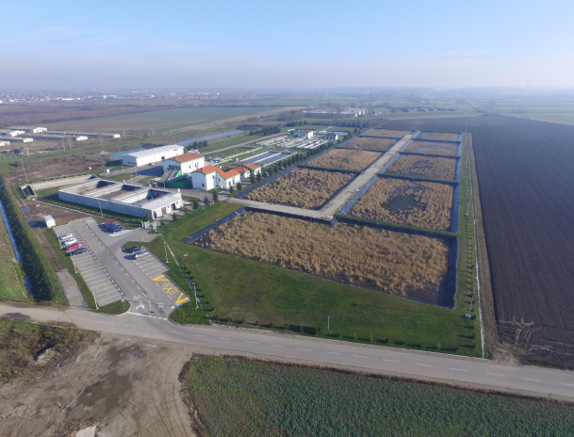
▓ Mixed type (comunal and precipitations), capacity of 91000 ES, mechanical and biological treatment.

Slide 4
▓ RAPS method:
▓ Y_{t} is value of the analyzed member (parameter) of the considered time serie;
is average value of the considered time serie;
S_{y} is standard deviation of the considered time serie;
n is number of members of the considered time serie;
k = 1, 2,..., n is counter during sumation.
▓ The graphical representation of the RAPS method indicates the existence of several subseries that have similar characteristics, a larger number of trends, etc.

Slide 5
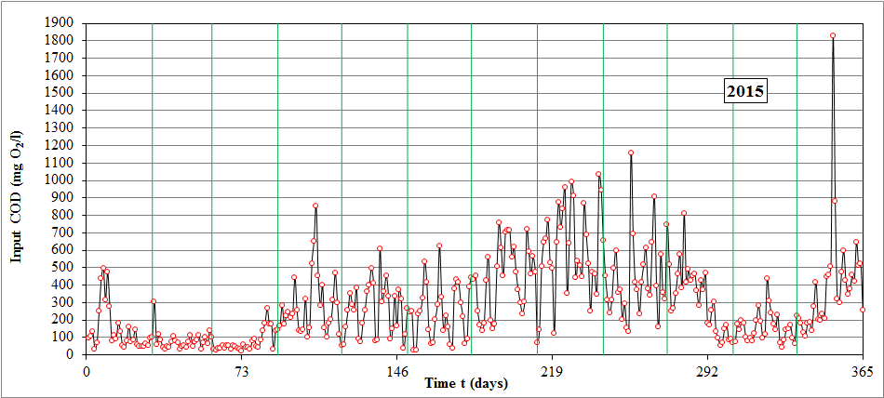
▓ Input time serie:

Slide 6
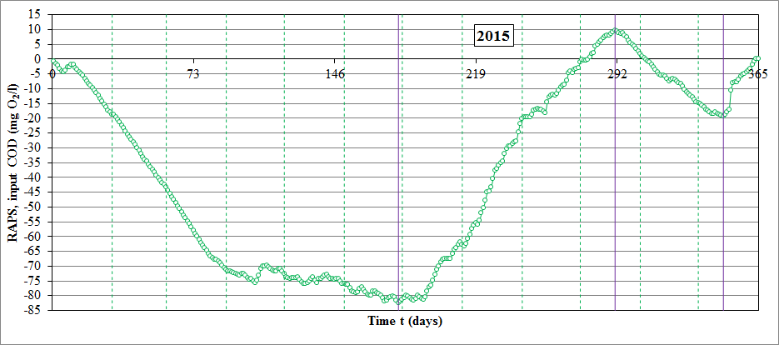

Slide 7
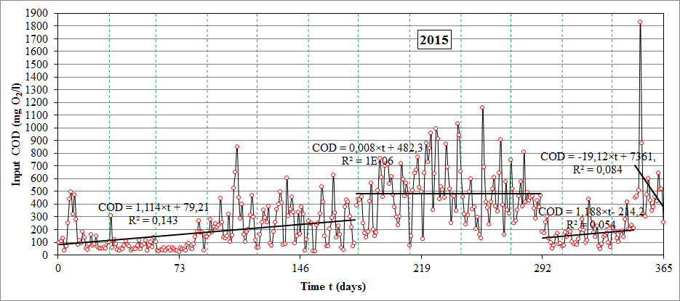

Slide 8
▓ The values of input indicators of wastewater quality for 2015 are in second half of the year above the value of the Maximum allowed value (MAV), which is 700 mg O₂/l for the COD.
▓ Based on the performed analysis, it can be seen that the highest measured value of the coefficient of determination R² of an input serie is equal to 0.1439, while the lowest calculated value of R² is 10⁻⁶ => In both cases, there are insignificant.
▓ Growing trends of all subseries are observed, but given the negligible values of R², this has no argumentative significance.

Slide 9
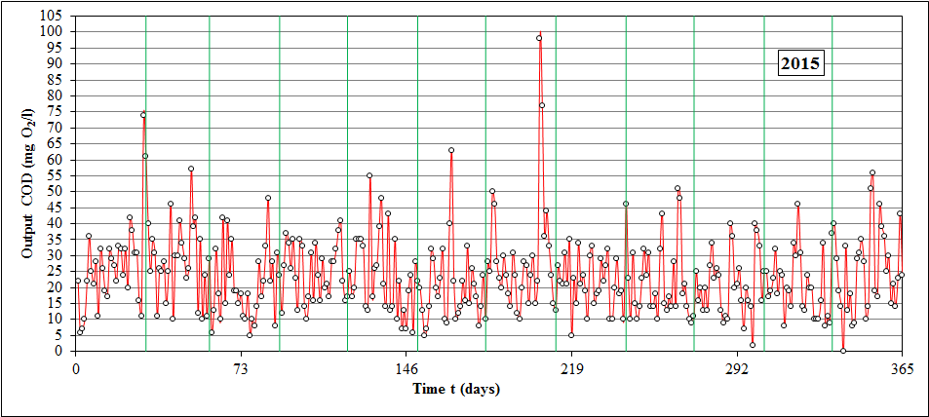
▓ Output time serie:

Slide 10
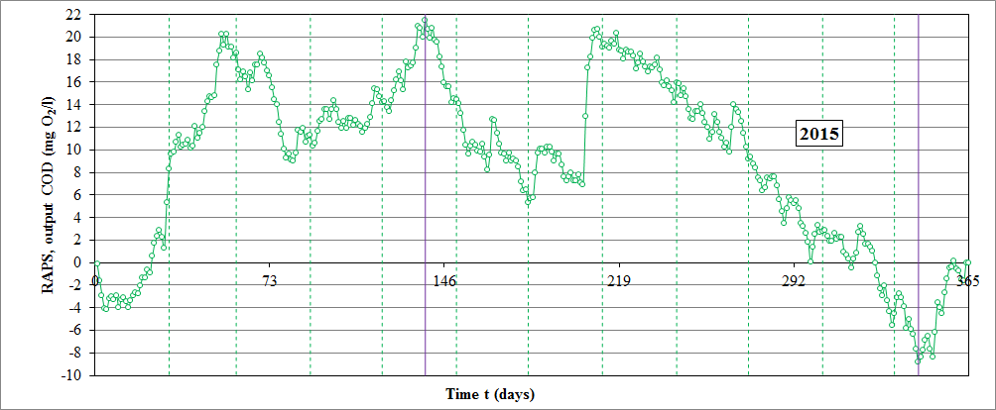

Slide 11
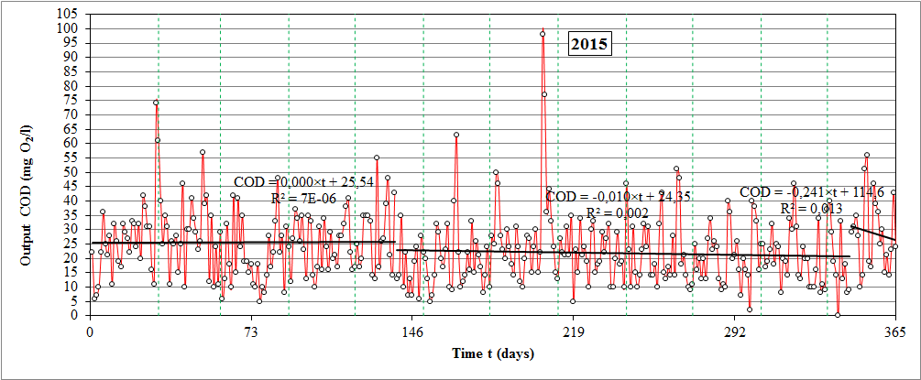

Slide 12
▓ Declining trends of output subseries are observed, but given the negligible values of R², this has no argumentative significance, just as with input subsequences.
▓ Accordingly to the explanations and analysis at the laboratory in WWTP Čakovec, the output values of COD in 2015 did not exceed the permitted limit of 125 mg/l.
▓ Biological treatment efficiencies, expressed as a percentage reduction in COD values deviated in the first quarter of the year is a result of changes in COD inputs (reductions), due to the inflow of large amounts of precipitation.

Slide 13
▓ Equally important is the quality of the sewer system, i.e. its water tightness, especially in those parts where the old concrete sewer is.
▓ All deviations from the efficiency of COD reductions are due to poorly loaded water.
▓ In the conditions of inflow of very dilute wastewater, it is not biologically possible to achieve the required treatment efficiencies.
▓ RAPS has justified purpose of the application!
▓ Further research will include analysis for the longer time period, comparison with the time series of the hydraulical load, precipitation and insolation, as well as extension for the other indicators of the waste water quality.

Slide 14

THANK YOU VERY MUCH!!!

