Slide 1
Growth and silvicultural potential of Lomatia hirsuta forests from stump shoots in the valley of El Manso/ Patagonia/ Argentina
Presentation for the 1st international electronic conference on forests

Slide 2
Structure
Introduction
Material and Methods
Investigation area
Data acquisition
Processing and data analysis
Results
Structures of the stands
Thinning simulation
Growth of the crop trees

Slide 3
Structure
Discussion and Conclusions
Recommendations
Recommendations for the young stands
Recommendations for the intermediate and old stands

Slide 4
Introduction
In the valley of El Manso there are great pure stands of L. hirsuta, which is unusual
The stands originated from stump shoots after forest fires
The wood of L. hirsuta is very attractive because of its colourful appearance and its good workability
There are no references that silviculture is done somewhere with L. hirsuta, the traditional use is as wood pasture (“parquizado”)

Slide 5
Introduction
The objectives were:
Improve the quality wood production evaluating the actual conditions of vigour and quality
Studying the growth of the best trees

Slide 6
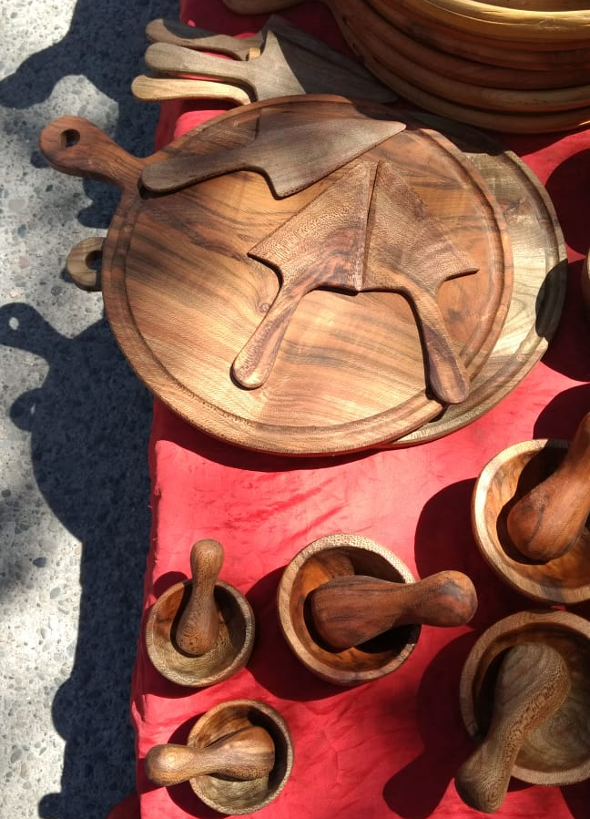
Articles of wood of L. hirsuta offered on a regional market

Slide 7
L. hirsuta stand with the traditional use as wood pasture („parquizado“)

Slide 8
Material and Methods – Study area
Study Area: El Manso Valley in the north-west of the Province of Río Negro (Patagonia, Argentina), near the limit to Chile
Climate: cold temperate, good conditions for tree growth
Annual mean temperature: 9.3 °C; Precipitation: 1,600 mm per year
Soil typ: Andosol (from volcanic ash), very rich soil, cation exchange capacity and water storage capacity are increased by allophane

Slide 9
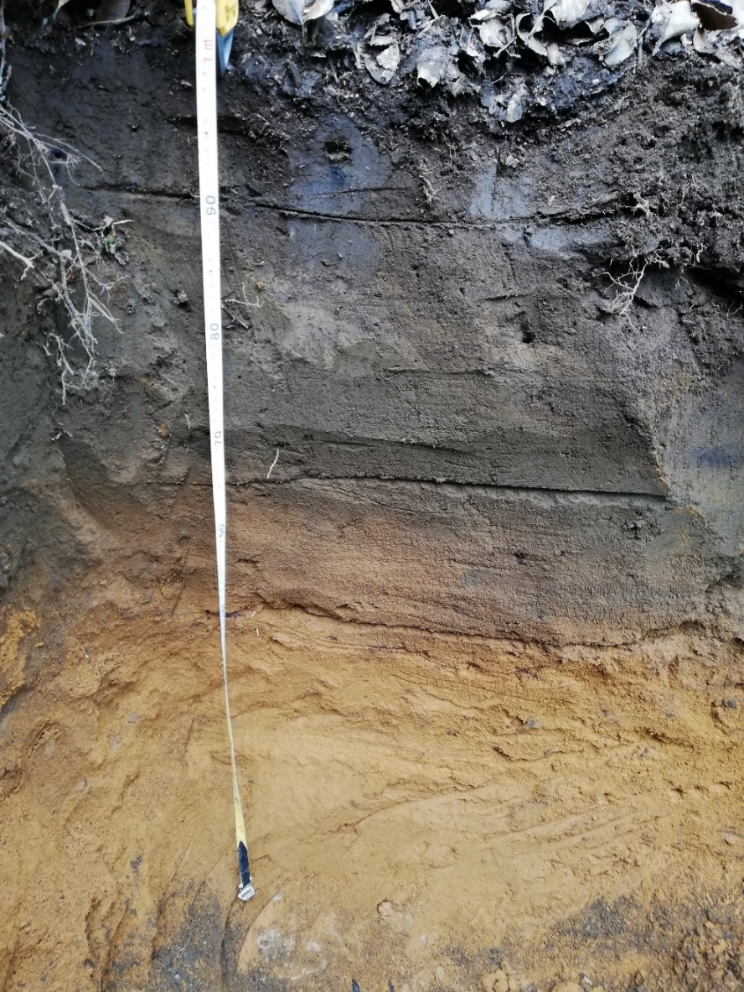
The soil profile in the young stands

Slide 10
Material and Methods – Data acquisition
Four different structures: young, intermediate and old stands and the parquizado
3 parcels per structure (1,000 resp. 300 m²)
Measuring all DBHs and some hights of the stems inside the parcels
Stem description concerning health condition, social position and form
Measuring mid-diameter and length of quality logs
Simulation of a crop tree orientated and a catch-up low thinning
Selection of three trees per structure for trunk analysis

Slide 11
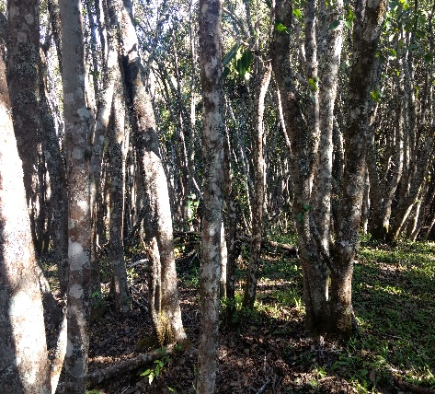
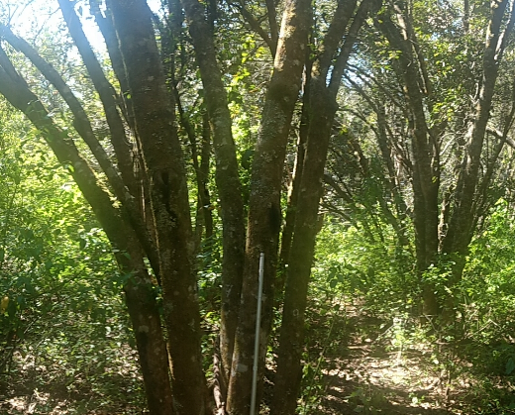
Young Intermediate Old

Slide 12
Measuring quality logs with a Finnish parabolic caliper

Slide 13
Material and Methods – Processing and data analysis
Hypsometric curve and a diameter distribution
Generate total and stem volume equations
Volume of the stands
Competition index (A value) and growth of crop trees analysis
h/d ratio, height, diameter and volume relation to age of crop trees

Slide 14
Results – Structures of the stands
Variables | Young | Intermediate | Old | Parquizado
Number of trees/ha | 2.244 | 1.167 | 600 | 223
Number of stems/ha | 6.278 | 2.180 | 1.157 | 300
Number of stems/tree | 2,9 | 1,9 | 1,9 | 1,3
Mean square diameter [cm] | 10,7 | 18,2 | 24,5 | 26,8
Dominant height [m] | 12,6 | 16,4 | 18,2 | 16,7
Basal area [m²/ha] | 56,1 | 56,9 | 54,4 | 16,9
Total volume [m³ o.b./ha] | 553 | 560 | 536 | 166
Volume of mature stems [m³ o.b./ha] * | 24 | 173 | 249 | 82
* DBH ≥ 20 cm

Slide 15
Diameter distributions of the different structures

Slide 16
Results – Thinning simulation
Number of stems to extract and to remain in the thinning simulation per diameter class

Slide 17
* DBH ≥ 20 cm
Variables | Young |  | Intermediate |  | Old
 | extract | remain | extract | remain | extract | remain
Number of stems/ha | 3.078 | 3.200 | 697 | 1.483 | 450 | 707
Basal area [m²/ha] | 18,3 | 37,8 | 11,0 | 45,9 | 13,6 | 40,8
Total volumen [m³ o.b./ha] | 180 | 374 | 109 | 452 | 134 | 402
Volume of mature stems [m³ o.b./ha] (*) | 5 | 18 | 20 | 154 | 48 | 201
* DBH ≥ 20 cm

Slide 18
Range of products | Young | Intermediate | Old
Firewood from the crowns and thin stems* | 140 | 71 | 69
Badly formed stems | 4 | 13 | 32
Quality wood | - | 3 | 11 (5**)
* DBH ˂ 20 cm; ** correspond to quality logs of fallen trees

Slide 19
Results of trunk analysis

Slide 20
Discussion and conclusions
There is a potential to improve the production of height quality wood in the L. hirsuta stands in the valley of El Manso
But… it is necessary to start the management in the young stage
And this will be a slow and long process, because it is necessary first increase the vitality and stand stability against wind and wet snow in all stages

Slide 21
Recommendations for the young stands
200 crop trees should be selected and favoured trough thinning consequently until maturity
About 150 crop trees should reach a DBH of 40 cm at the age of 70 years

Slide 22
Recommendations for intermediate and old stands
Extraction of fallen and instable trees to capitalize on their wood and to favour the better ones
Create space for natural regeneration or plantings by means of patchy clearances with
L. hirsuta seedlings and other native species to replace stumps and improve the future stand quality
Grazing must be stopped and stumps of cut trees must be killed

Slide 23
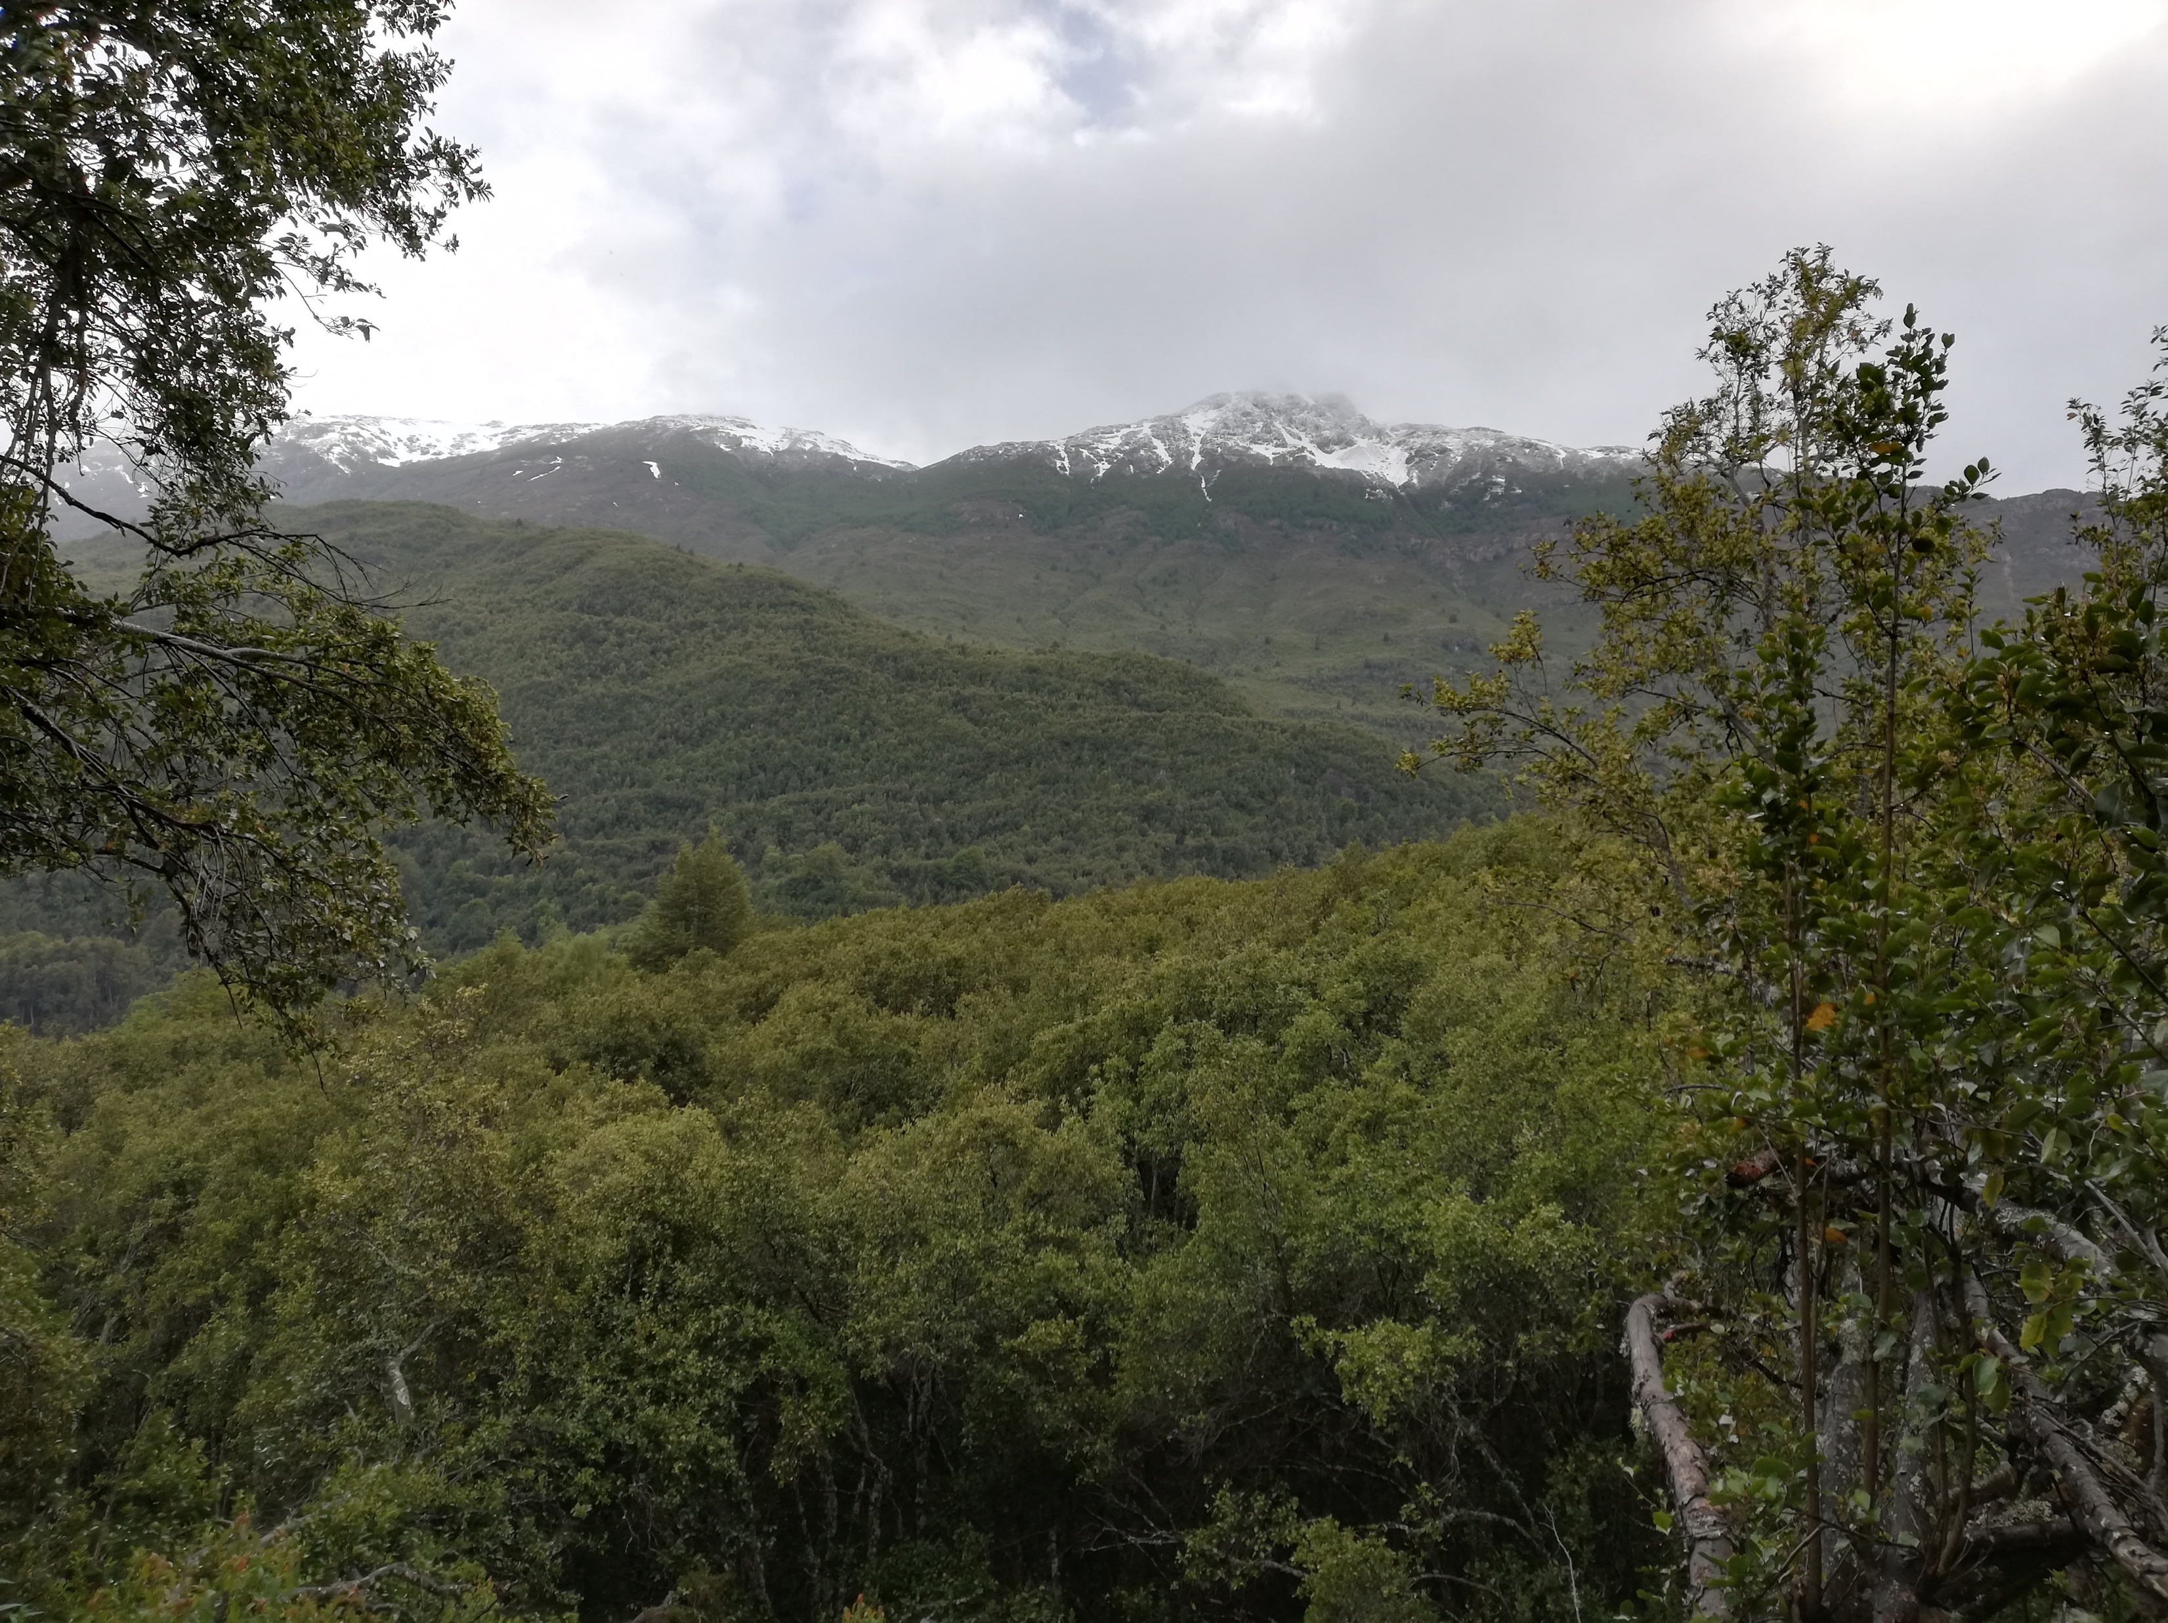
Thank you for your interest

