Slide 1
MANAGEMENT OF CHIPPING OPERATIONS IN POLISH FORESTS
The 1st International Electronic Conference on Forests
Forests for a Better Future: Sustainability, Innovation, Interdisciplinarity
15-30 November 2020
Arkadiusz Gendek¹, Monika Aniszewska¹, Witold Zychowicz¹, Tadeusz Moskalik², Jan Malaťák³, Barbora Tamelová³
¹ Department of Biosystems Engineering, Institute of Mechanical Engineering, Warsaw University of Life Sciences – SGGW, Poland
² Department of Forest Utilization, Institute of Forest Sciences, Warsaw University of Life Sciences – SGGW, Warsaw, Poland
³ Faculty of Engineering, Czech University of Life Sciences Prague, Prague, Czech Republic

Slide 2
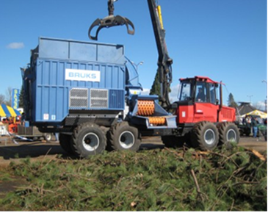
Objective, Materials and Methods
The objective of the study was to determine the basic parameters characterizing woodchipper operations and efficiency in Polish forests.
The machines involved in the study were five Brucks 805 CT chippers, including four units with 18 m³ containers (designated as CH#1–CH#4) mounted on forwarders and one unit without a container (CH#5) mounted on a truck. The chippers were used six days a week in varying terrain conditions. They were part of a fleet owned by one company and managed by the same team.
The examined period of operations was five to seven months, from August–October of one year to February of the following year, depending on the chipper.
The parameters analyzed in this study included: the distance between the stack and chip truck, the distance between the forest site and the overnight chipper location, work shift duration, fuel consumption per shift, the distance traveled by chippers between forest sites during a shift, and the number of site changes per shift (workday).

Slide 3
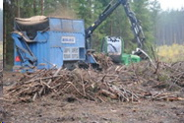
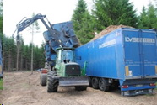
Stack to chip truck distance (km)
RESULTS
Chipper No | Mean | Min | Max
CH#1 | 0.47 | 0.02 | 2.72
CH#2 | 0.28 | 0.02 | 2.87
CH#3 | 0.33 | 0.02 | 5.06
CH#4 | 0.53 | 0.02 | 6.06
CH#5 | - | - | -

Slide 4
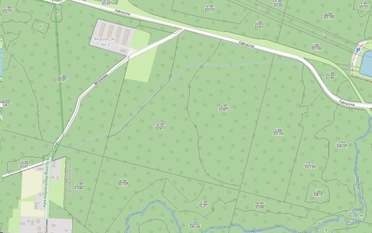
Distance per forest site change during a shift (km)
RESULTS
A
B
Chipper No | Mean | Min | Max
CH#1 | 6.02 | 0.07 | 29.28
CH#2 | 6.53 | 0.06 | 36.30
CH#3 | 4.74 | 0.02 | 34.30
CH#4 | 7.61 | 0.06 | 73.62
CH#5 | 9.48 | 0.00 | 60.52

Slide 5
Forest site to overnight location distance (km)
RESULTS
B
A
Chipper No | Mean | Min | Max
CH#1 | 5.46 | 0.00 | 31.73
CH#2 | 4.20 | 0.02 | 25.57
CH#3 | 5.65 | 0.02 | 33.83
CH#4 | 6.30 | 0.05 | 39.36
CH#5 | 6.01 | 0.06 | 31.52

Slide 6
Overnight location to forest site distance (km)
RESULTS
A
B
Chipper No | Mean | Min | Max
CH#1 | 2.52 | 0.00 | 11.62
CH#2 | 3.30 | 0.02 | 20.43
CH#3 | 3.45 | 0.02 | 31.50
CH#4 | 4.00 | 0.02 | 33.33
CH#5 | 3.43 | 0.02 | 18.08

Slide 7
Number of forest site changes per shift
RESULTS
E
A
D
B
C
Chipper No | Mean | Min | Max
CH#1 | 0.61 | 0.00 | 6
CH#2 | 0.66 | 0.00 | 6
CH#3 | 0.61 | 0.00 | 7
CH#4 | 0.51 | 0.00 | 3
CH#5 | 0.39 | 0.00 | 3

Slide 8
Shift duration (h)
RESULTS
Chipper No | Mean | Min | Max
CH#1 | 12.75 | 0.00 | 20.75
CH#2 | 12.35 | 0.98 | 20.55
CH#3 | 11.84 | 0.00 | 21.53
CH#4 | 13.09 | 0.37 | 23.67
CH#5 | 11.87 | 0.40 | 18.53

Slide 9
Fuel consumption (L/h)
RESULTS
Chipper No | Mean | Min | Max
CH#1 | 17.41 | 1.57 | 38.61
CH#2 | 16.91 | 0.66 | 36.96
CH#3 | 16.25 | 0.00 | 36.05
CH#4 | 16.12 | 0.00 | 44.43
CH#5 | 7.77 | 0.31 | 26.44

Slide 10
CONCLUSIONS
The efficiency of chipper use depends on the organization of chipping operations, and in particular workload per site (the number of site changes per shift), the distribution of work sites and overnight chipper locations (which translates into travel distances during a shift and between shifts), as well as forest site availability to road transport (the distance from the stack of processed forest residues to the chip truck).
◊
The mean distance between the stack and the chip truck ranged from 0.28 km to 0.53 km.
◊
It was found that the forwarder-mounted chippers moved between sites on average once every two days, and the truck-mounted chipper once every 2.5 days.
◊
Mean distances from forest sites to overnight locations were 4.20–6.30 km, those from overnight locations to forest sites were shorter by approx. 50% (2.52–4.0 km).
◊
The recorded shift duration of 12.41 h was slightly longer than the scheduled operator shift time of 12 h.

Slide 11
Thank you for your attention

