Slide 1
TRAINING AND EQUIPPING CHAINSAW OPERATORS AND OCCUPATIONAL SAFETY IN POLISH FORESTS
The 1st International Electronic Conference on Forests
Forests for a Better Future: Sustainability, Innovation, Interdisciplinarity
15-30 November 2020
Arkadiusz Gendek¹, Monika Aniszewska¹, Tomasz Nurek¹, Tadeusz Moskalik²
¹ Department of Biosystems Engineering, Institute of Mechanical Engineering, Warsaw University of Life Sciences – SGGW, Warsaw, Poland
² Department of Forest Utilization, Institute of Forest Sciences, Warsaw University of Life Sciences – SGGW, Warsaw, Poland

Slide 2
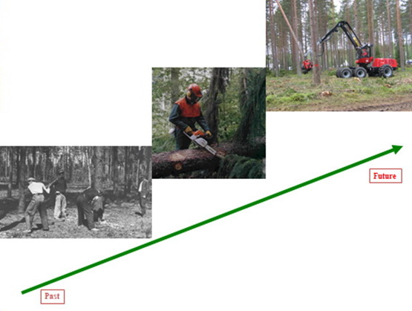
Timber harvesting in Poland

Slide 3
Introduction
The harvesting of timber in Poland is ~42-43 million m³,
82% of it is done with chainsaws and 12% with harvesters,
Chainsaws are the basic tool for felling, delimbing, and wood cross-cutting,
The popularity of chainsaws is determined by their functional features and technical properties, economic and ergonomic ascpects, and universal access to these devices in trade,

Slide 4
Introduction
To ensure work safety, chainsaw operators are required to know how to harvest trees with a chainsaw, including the rules on felling, the operation and maintenance of chainsaws and first aid procedures in case of an accident,
Before being employed in the forest, a logger is required to have completed appropriate training and obtained the petrol chainsaw operator license.

Slide 5
Training of chainsaw operators
The standards of training are set by the Director General of State Forests¹,
Various institutions provide such courses and training, e.g.: universities, business foundations, educational institutions and other business entities,
The scope of training does not always meet the standards,
Not all training providers are concerned with the quality of the knowledge provided, not only theoretical but practical as well.
¹ Instrukcja bezpieczeństwa i higieny pracy przy wykonywaniu podstawowych prac z zakresu gospodarki leśnej (in Polish). 2012. Zarządzenie nr 36 Dyrektora Generalnego Lasów Państwowych z 20 kwietnia 2012. Warszawa. http://www.lasy.gov.pl/pl/pro/publikacje/copy_of_gospodarka-lesna/uzytkowanie/instrukcja-bhp/view

Slide 6
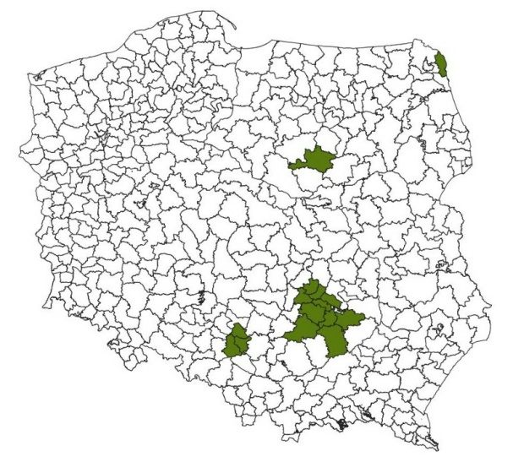
Methodology
A questionnaire survey was conducted to obtain data for the study,
The target study subjects were operators of portable chainsaws, working in wood harvesting in 15 forest districts located in the Regional Directorates of State Forests in Białystok, Katowice, Olsztyn and Radom,
A total of 354 questionnaires were distributed to the chainsaw operators, of which 209 were received.

Slide 7
Self-assessment
Self-assessment of chainsaw operators on a scale of one to ten (1 – low, 10 – high self-assessment)

Slide 8
Self-assessment vs. seniority in the profession
Influence of seniority of chainsaw operators on the self-assessment level with the identification of homogeneous groups (a, b) - ANOVA, Error: MS intergroup = 1.6853, df = 19, at significance level α = 0.05)

Slide 9
Completed course/training
89% of chainsaw operators completed 2-week courses,
7% of them completed 2-3 day courses,
4% completed courses lasted ca. 4 weeks,
A large group of chainsaw operators obtained their skills from a friend or on their own.

Slide 10
Information provided on courses
Did the course provide information on: | Yes | No
 | %
Construction and use of the chainsaw | 97 | 3
Construction and use of the cutting device | 93 | 7
Techniques of felling of easy and difficult trees | 98 | 2
Outfit of a worker | 90 | 10
Work safety on the cuttting area | 94 | 6
Giving first aid | 86 | 14
Risks arising from the work with the chainsaw | 95 | 5
Service and maintenance of the chainsaw | 91 | 9

Slide 11
Safety of work with the chainsaw
A large group of operators is aware of the risk of kickback and consistently use anti-kickback chainsaws for work (38% of chainsaw operators); 13% use them sometimes,
92% of them use wedges to fell thick trees,
41% of them work with an assistant when felling thin trees,
26% bark a stump before the felling,
72% prepare an escape path before the tree felling,

Slide 12
Safety of work with the chainsaw
93% percent of the operators used a safety helmet,
The use of goggles or a visor was declared by 81% of the operators,
Protective gloves were used by 89% of the operators,
83% of the respondents used chainsaw trousers, while 10% used chainsaw chaps on their pants,
52% of the operators used shoes equipped with a protective insole for the toes and ankle.

Slide 13
Accidents at work
25% of the operators were involved in an accident or other injury while performing logging work in the forest,
A large group of respondents stated that the most common cause of accidents was non-compliance with safety rules, lack of personal protective equipment or improper use of working tools,
76% of injuries were not reported to the employer as accidents at work.

Slide 14
Conclusions
Most operators of petrol chainsaws receive the necessary information on chainsaw construction and operation, felling technology, workplace safety or first aid as part of the chainsaw operator’s course. However, a significant group of operators (7%) only completed 2-3 day courses
The lack of the use of personal protective equipment is a worrisome phenomenon. It turns out that only half of the respondents use footwear with a protective insole for their toes and ankles. Failure to use appropriate footwear should be considered a gross violation of health and safety rules

Slide 15
Conclusions
Every fourth chainsaw operator in this study experienced an accident or injuries while working with a chain saw. A very high percentage (76%) of injuries and incidents relating to employee health and safety are not reported as accidents occurring at work
Due to the natural process of forgetting the knowledge gained through learning, continuing education courses and training are recommended, which should be a permanent element of the occupational health and safety system in all companies providing logging services

Slide 16
Full text:
Gendek A., Aniszewska M., Nurek T., Moskalik T. 2018. State of training and equipment of chainsaw operators employed for timber harvesting in Polish forests. Sylwan 162(2): 118-126. doi: https://doi.org/10.26202/sylwan.2017110

