Slide 1
Determination of the Safest Route for Logging Trucks based on Road Types and Conditions
Abdullah E. Akay
Bursa Technical University
Faculty of Forestry
October 2020

Slide 2
BACKGROUND
Hauling of timbers from landing areas to forest depots using logging trucks is an important stage in producing wood-based forest products.
Inadequately planned forest transportation can be the most costly stage of timber production.
The logging truck driving is a dangerous occupation, particularly in Turkey where forests are mostly located in steep slopes.
The safety risk of truck driving mainly depends on the road standards and conditions.
In Turkey, the majority of forest roads (66%) are secondary forest roads with low standards which limits the maneuverability of logging trucks.

Slide 3
BACKGROUND
The forest transportation should be planned by considering not only transportation costs but also safety of truck driving.
To develop an adequate transportation planning, many alternative transportation routes should be evaluated.
Computer-based methods are used to evaluate alternative transportation plans and determine the optimum plan with minimum cost .

Slide 4
OBJECTIVE
In this study, GIS-based network analysis method was used to develop the optimum transportation plans for two scenarios.
  In the first scenario; optimum plan that minimized the total transportation cost was developed.
  In the second scenario; transportation plan that ensured the safest logging truck driving was found.

Slide 5
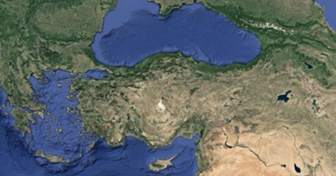
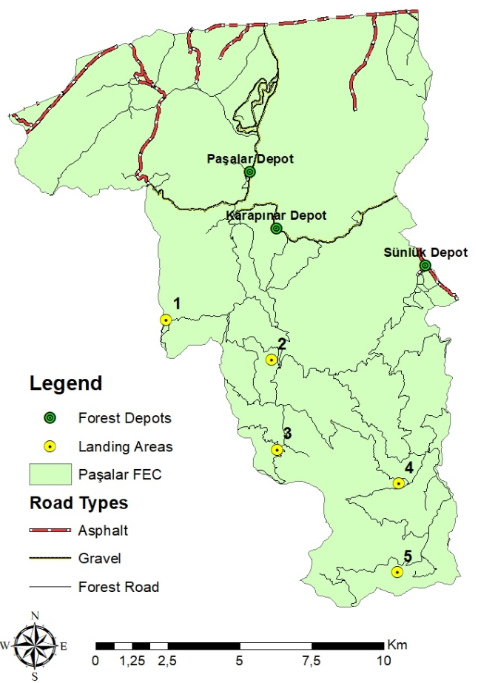
MATERIAL AND METHODS
The study area is Paşalar Forest Enterprise Chief (FEC) located in the border of M.Kemal Paşa Forest Enterprise Directorate (FED) in the city of Bursa in Turkey.
Three forest depots (Paşalar, Karapınar, Sünlük Depots) and five sample landing areas in the FEC were considered in the study.

Slide 6
MATERIAL AND METHODS
Road Network
The road network layer was generated based on the topographic map that was obtained from the FED.
Five parameters (road length, road type, road condition, average vehicle speed, travel time, and road safety score) were assigned to each road section into the Attribute Table.
The road length was calculated by “Calculate Geometry” tool in “Attribute Table”.
The road types (asphalt, gravel, forest road) and road conditions (good, average, poor) were determined based on information obtained from the FED.

Slide 7
MATERIAL AND METHODS
Then, the average vehicle speed was computed based on road types and road conditions.
The travel time of the logging truck for each road section was computed based on road length and vehicle speed:
ti: travel time on road section i (minutes)
li: length of road section i (km)
Vi: vehicle speed on section i (km/hr)
60: coefficient to convert time from hours to minutes
The average logging truck speed (km/hour) for road types and conditions
Road Type | Road Conditions
 | Good | Medium | Poor
Asphalt road | 60 | 50 | 40
Gravel road | 40 | 30 | 20
Forest road | 25 | 20 | 15

Slide 8

MATERIAL AND METHODS
After computing travel time for each road section, transportation cost (€/m3) was computed based on machine rate (€/hr), truck load capacity (m3), and travel time (hr):
Ci: transportation cost (€/m3)
load: load capacity (m3)
MR: machine rate (€/hr)
Within the scope of the study, a logging truck commonly used in the region was taken into consideration.
The load capacity and machine rate of the truck was 15 ton and 9.37 €/hr, respectively.
C_{i}=$\frac{\text{MR}}{\left(\frac{\text{load}}{\text{t}\text{i} }\right)\text{∗}\text{60}}$

Slide 9
MATERIAL AND METHODS
The road safety score was determined by an expert choice approach, depending on road type and road conditions.
The relative safety score of road sections was evaluated based on a numerical scale from 1 to 9.
When the risk was high, the higher score was given to the road sections
Road Type | Road Conditions
 | Good | Medium | Poor
Asphalt road | 1 | 2 | 3
Gravel road | 4 | 5 | 6
Type-B forest road | 7 | 8 | 9

Slide 10
MATERIAL AND METHODS
Network Analysis
“Network Analyst” extension in ArcGIS provides network-based spatial analysis including routing, service area, closest facility, travel directions, and new location-allocation analysis.
Using a sophisticated network model, users can easily build networks based on GIS database.
In this study, “New Closest Facility” method within the “Network Analyst” extension was implemented to explore optimum routing solutions for two scenarios.
In the first scenario, transportation planning with minimum transportation cost was developed.
The transportation cost was assigned to the links that represented the road sections in the network database.

Slide 11
MATERIAL AND METHODS
In the second scenario, transportation planning that ensured the safest logging truck driving was developed.
The safety score was assigned to the links that represented the road sections in the network database.
Finally, both scenarios were compared in terms of total transportation costs and hauling route of forest products from each landing.

Slide 12
RESULTS AND DISCUSSION
In this study, GIS-based network analysis method was used to develop the optimum transportation plans for two scenarios prioritizing minimum transportation cost and the safest transportation.
The results indicated that total transportation cost was 4238.22 € in the first scenario.
It was found that the forest products from one landing (Landing 1) was hauled to Paşalar Depot, from two landings (Landing 2 and 3) to Karapınar Depot, and other two landings (Landing 4 and 5) to Sünlük Depot.

Slide 13
RESULTS AND DISCUSSION
Landings | Depots | Timber Volume (m³) | Unit cost (€/m³) | Transportation Cost (€)
1 | Paşalar | 246 | 0.65 | 160.21
 | Karapınar |  | 0.67 | 164.01
 | Sünlük |  | 1.56 | 383.27
2 | Paşalar | 887 | 0.68 | 601.25
 | Karapınar |  | 0.55 | 487.80
 | Sünlük |  | 0.98 | 867.56
3 | Paşalar | 383 | 0.93 | 357.58
 | Karapınar |  | 0.81 | 308.60
 | Sünlük |  | 1.23 | 472.57
4 | Paşalar | 2407 | 1.38 | 3326.10
 | Karapınar |  | 1.25 | 3018.25
 | Sünlük |  | 1.11 | 2674.71
5 | Paşalar | 415 | 1.87 | 776.12
 | Karapınar |  | 1.74 | 723.04
 | Sünlük |  | 1.46 | 606.90

Slide 14
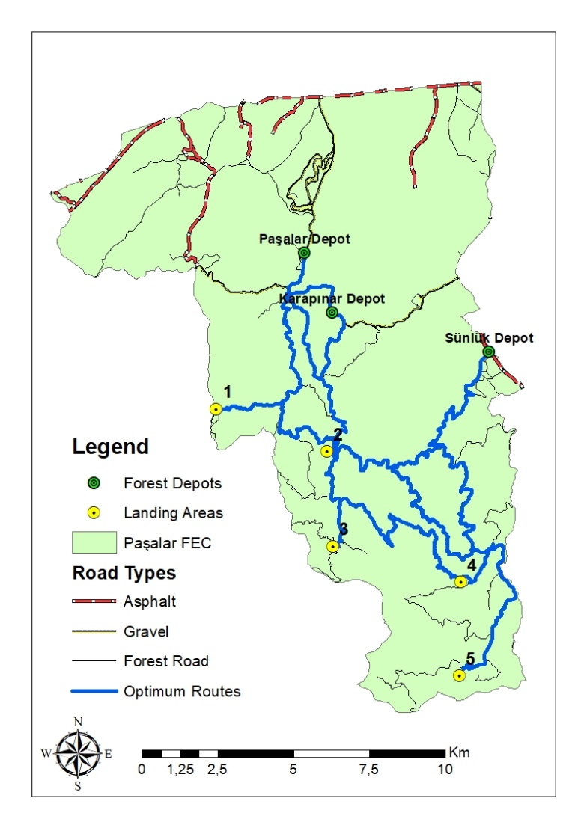
RESULTS AND DISCUSSION

Slide 15
RESULTS AND DISCUSSION
Landings | Depots | Timber Volume (m³) | Safety Scores | Unit cost (€/m³) | Transportation Cost (€)
1 | Paşalar | 246 | 75
 | Karapınar
 |  |  | 53 | 0.69 | 169.58
 | Sünlük
 |  |  | 100
2 | Paşalar | 887 | 76
 | Karapınar |  | 38 | 0.55 | 490.81
 | Sünlük |  | 67
3 | Paşalar | 383 | 115
 | Karapınar |  | 77 | 0.85 | 326.95
 |  |  | 106
 | Sünlük
4 | Paşalar | 2407 | 107
 | Karapınar |  | 69 | 1.25 | 3006.64
 | Sünlük |  | 76
5 | Paşalar | 415 | 133
 | Karapınar |  | 95 | 2.20 | 912.31
 | Sünlük |  | 101

Slide 16
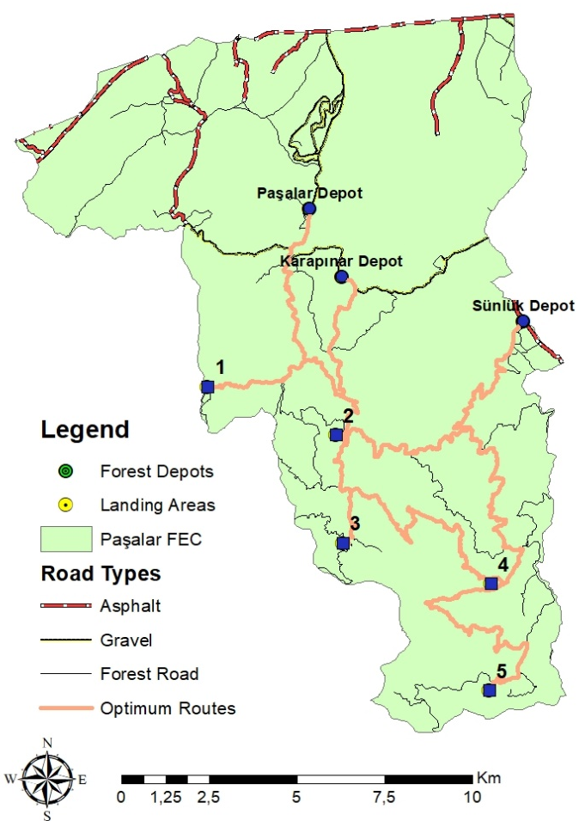
RESULTS AND DISCUSSION

Slide 17
CONCLUSIONS
An application of GIS-based network analysis method was implemented to determine the optimum route for transporting forest products.
The optimum routes were searched for two scenarios including minimum transportation cost and the safest transportation.
The results indicated that total cost of transportation in the first scenario was less than that of the second scenario.
The results suggested that the most important factors affecting the productivity of transportation were the road type, road length, road condition.
In fact, road type and road conditions were also the most important factors on transportation safety.

Slide 18
CONCLUSIONS
In order to ensure safe driving of logging trucks, forest roads should be properly reconstructed and regularly maintained considering the technical and safety requirements.
Although reengineering of the forest roads requires some investment, improved forest roads will provide better access to forest resources for many forestry activities such as reforestation, protection, management, logging operations, and recreations.

Slide 19
Thank you for your attention…

