Slide 1
Tree stems structural diversity of Elephant camp natural forest in Omo Forest Reserve
Oladele Fisayo Falade*¹ and Janet Ugochukwu Iheke²
*¹²Department of Forest Production and Products,
University of Ibadan.
*Correspondence Author’s email: faladedele@yahoo.com,
²Author’s email: ihekejanet27@gmail.com

Slide 2
Introduction
Tree size diversity is an indicator for biodiversity and commercial values of the forest.
Microsite conditions of forest determine the survival and growth of biodiversity.
However, growth of trees enhances their capacity to acquire resources but water availability limits relative growth rate.
Variation in size of trees in a population is caused by different mechanisms (Mendez-Alonzo et al., 2012).

Slide 3
Statement of the problem
However, the contribution of water gradients to tree size hierarchy and segregation is poorly understood.
Therefore, tree species and size diversity of two adjacent forest areas with different water regimes were investigated.

Slide 4
Objective of the study
The objective of the study was to determine the tree stems structural diversity of Elephant Camp natural forest in Omo Forest Reserve. The specific objectives were to:
Investigate tree species and size diversity of the Riparian and Old-growth forests
Quantify diameter distribution of Riparian and Old-growth forests

Slide 5
Justification of the study
Tree size hierarchy in a population is caused by different competition mechanisms and therefore, can identify the process controlling resources utilization in the forest.
Therefore, tree species and size diversity of two adjacent forest areas with different water regimes were investigated.

Slide 6
Materials and methods
The study area
The study was conducted in Elephant Camp Natural Forest Reserve in Southwestern Nigeria.
It is located between Latitude 06°51′00″N to 06°91′00″N; and Longitude 04°22′48″E and 04°32′48″E at altitude 150 above sea level (asl) (Figure 1).
Elephant Camp forest covers approximately 55,000 ha It is one of the remaining protected forests.

Slide 7
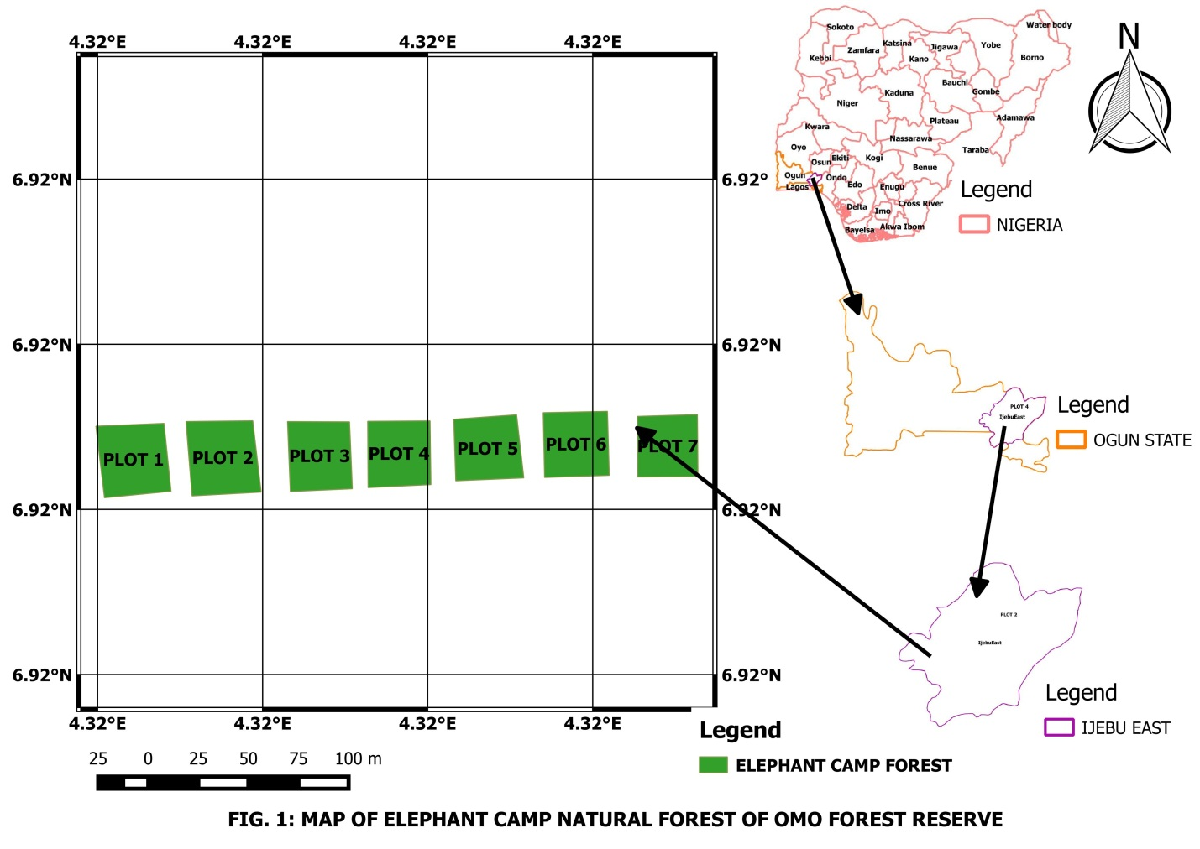

Slide 8
Materials and methods cont.
Sampling methods
Three (3) and four (4) 0.09ha sample plots were established in Riparian Forest (RF) and Old-growth forest (OF) of Elephant camp, respectively.
Tree stems with ≥5cm diameter-at-breast height (Dbh) were identified to species level and enumerated within plots and stem densities was computed.
The diameter-at-breast height (Dbh) was measured with diameter tape.

Slide 9
Data analysis
Species diversity was assessed using Shannon-Weiner (H´) and Simpson indices (1-D´) while
Stem size inequality was assessed using Gini coefficient (GC), Coefficient of Variation (CV), H´ and I-D.
The performance of single 2- and 3-parameter Weibull models were evaluated using Kolmogorov-Smirnov (K-S) Chi-Square (χ²), Root Mean Square Error (RMSE), Bias and Coefficient of determination (R²).

Slide 10
Results
Table 1. indices of tree species diversity in Riparian and Old-growth forest of Elephant camp Natural Forest
Diversity indices | Riparian forest | Old-growth forest
Tree species richness | 27 | 24
Shannon-weiner index | 2.963 | 2.98
Simpson index | 0.937 | 0.939
Margalef index | 5.412 | 5.249
Evennes (H/S) | 0.717 | 0.82
Equitability | 0.899 | 0.937
Sorensen similarity index | 75.0%
Stem density (stem/ha) | 338.89±9.80 | 296.30±8.92

Slide 11
Result cont.
Table 2. Statistics of diameter distributions of Riparian and Old-growth forests of Elephant Camp forest
Forest | Distributions | Α | β | γ | K-S | A-D | RMSE | Bias | R²
Riparian | 2-p Weibull | - | 2.037 | 42.434 | 0.099 | 0.991 | 2.474 | 1.610 | 0.5064
 | 3-p Weibull | 5.508 | 1.565 | 36.472 | 0.073 | 0.463 | 2.359 | 1.551 | 0.4603
Old-growth | 2-p Weibull | - | 2.324 | 47.777 | 0.089 | 0.615 | 1.936 | 1.414 | 0.6651
 | 3-p Weibull | 7.452 | 1.831 | 39.813 | 0.075 | 0.511 | 1.910 | 1.386 | 0.6474

Slide 12
Result cont.
Figure 2. Observed and expected diameter distribution of Riparian forest of Elephant Camp forest in Omo Forest Reserve

Slide 13
Results cont.
Figure 3. Observed and expected Dbh distribution of Old-growth forest of Elephant Camp in Omo Forest Reserve

Slide 14
Conclusion
Stem size distribution of Riparian and Old-growth forests were positively skewed and expressed exponential pattern.
However, the two forest types comprise the same size frequency shape but different proportion of tree sizes and structural diversities which may be caused by water gradients in Elephant Camp natural forest.

