Slide 1
Influence of Ponsse Gazzelle forwarder passes on the soil environment and soil deformation
Msc eng. Dariusz Pszenny Warsaw University of Life Sciences Faculty of forestry, Forest Utilisation department

Slide 2
Aim of the study
Determination of the:
Soil condition of the felling area through measurements during and after the cutting and skidding of wood.
Soil moisture and penetration ressistance changes.
% of soil damage over cut area.
Assesing of rut depth by using UAV photgrammetry and software.

Slide 3
Area of research
Gidle Forest district

Slide 4
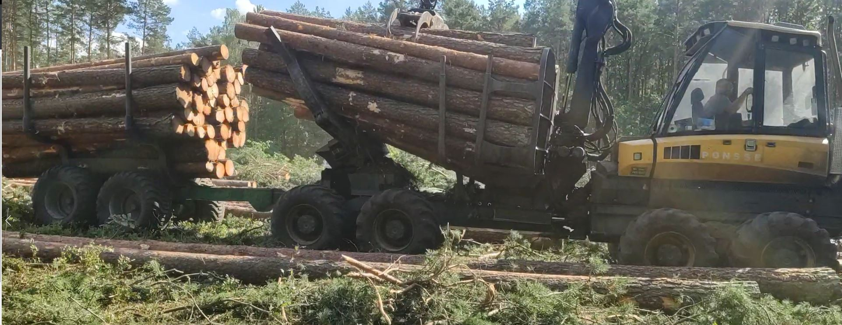
Material and methods

Slide 5
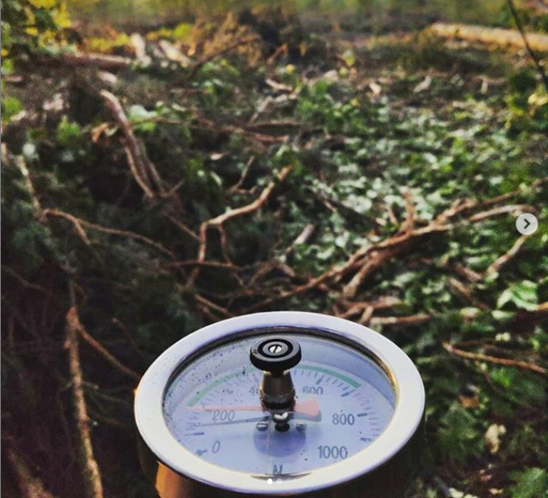
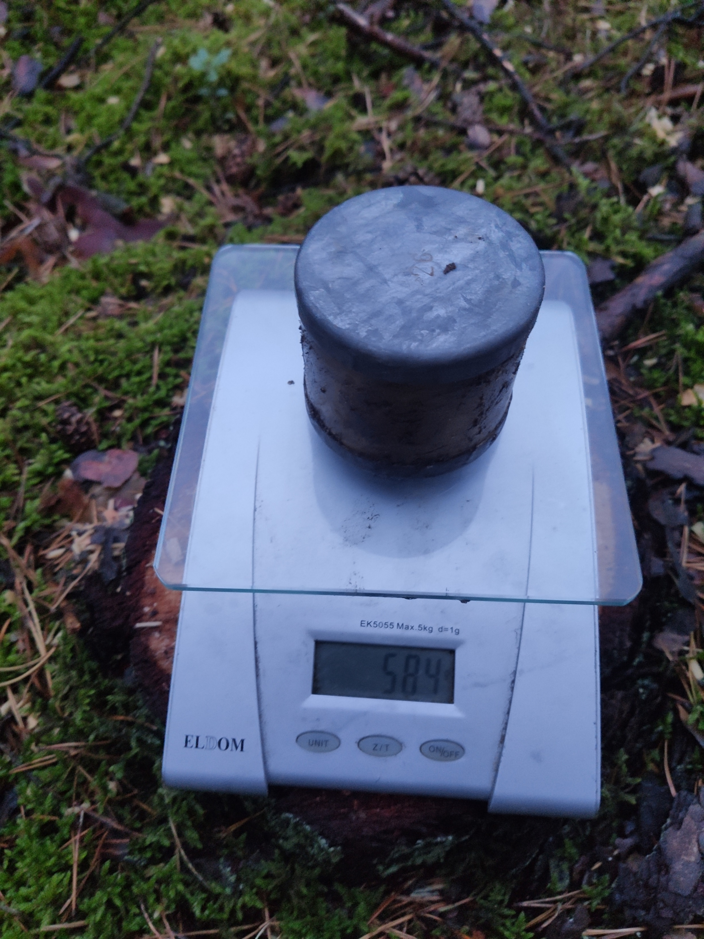
The research was conducted in two stages
Stage one:
Measurements with hand penetrometer
Taking soil samples for examining moisture
UAV flight for data registration
Stage two:
Creation of orthomosaics and digital elevation models using Agisoft metashape software

Slide 6
Material and methods

Slide 7
Material and methods

Slide 8
UAV & flight parameters
DJI Phantom 4 Advanced
20 Mpx camera witch 1 inch CMOS sensor
Photos in 5472x3078 pixels resolution
Flight on 30 meters altitude
Photos overlap indicator 80% (both horizontal and vertical)

Slide 9
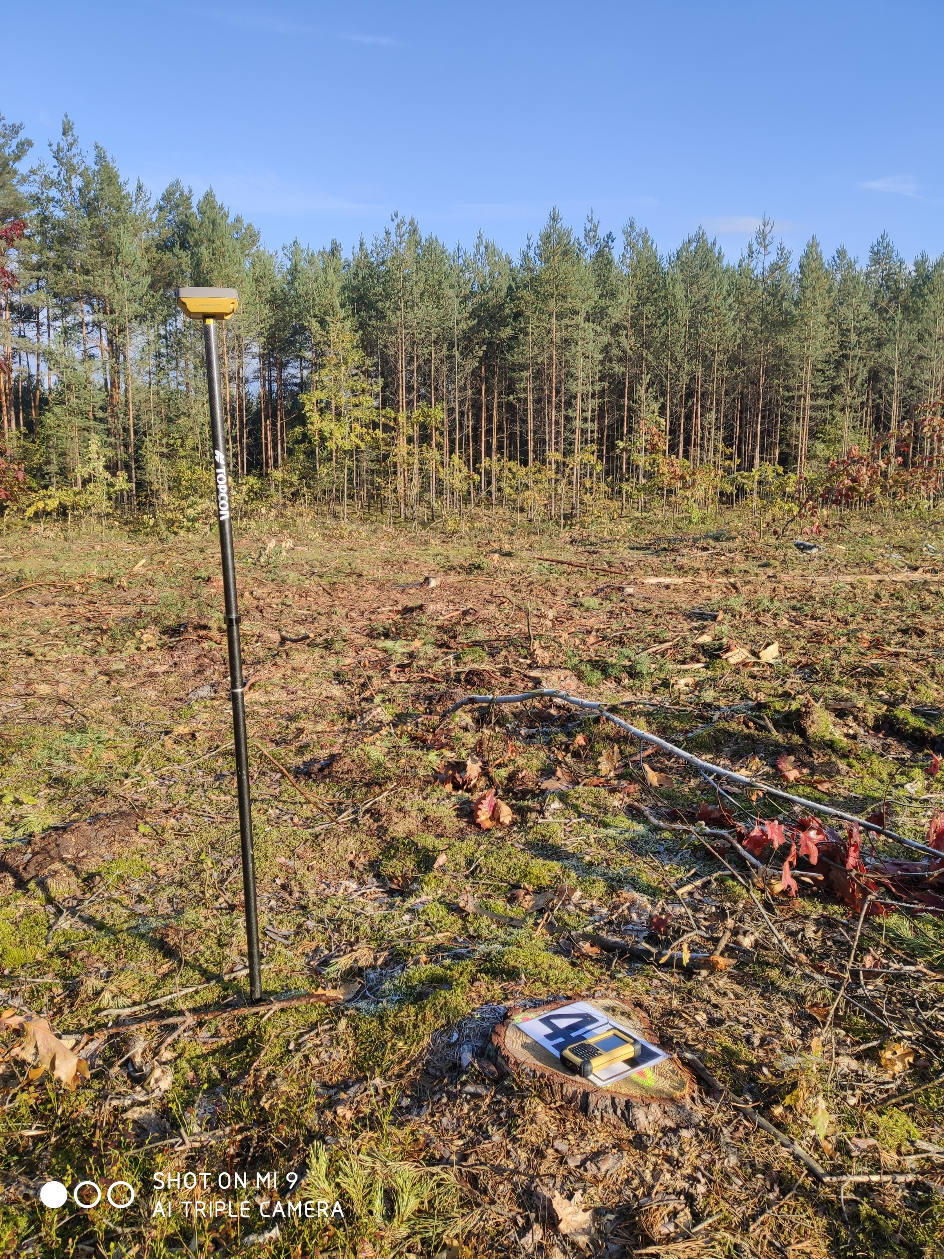
Material and methods

Slide 10
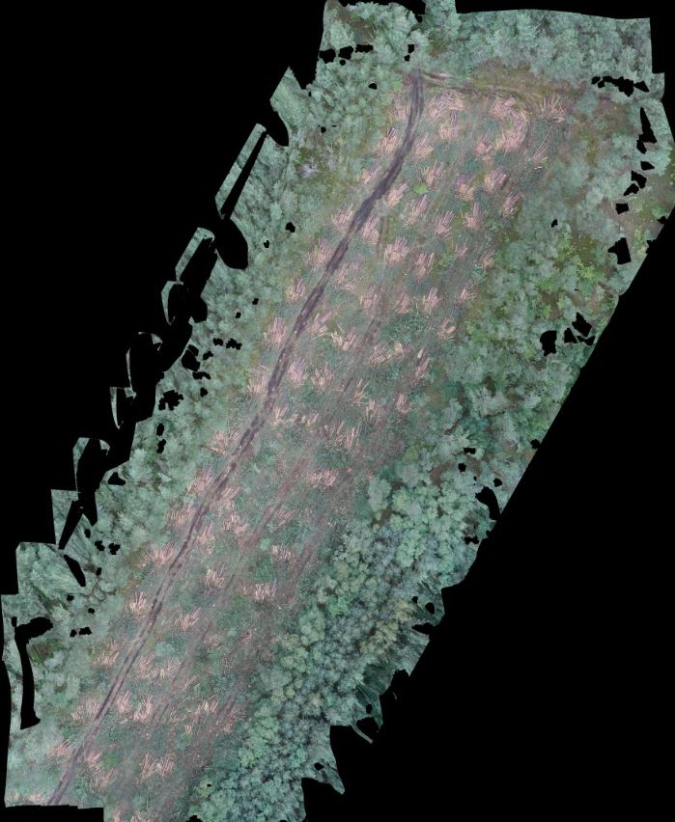
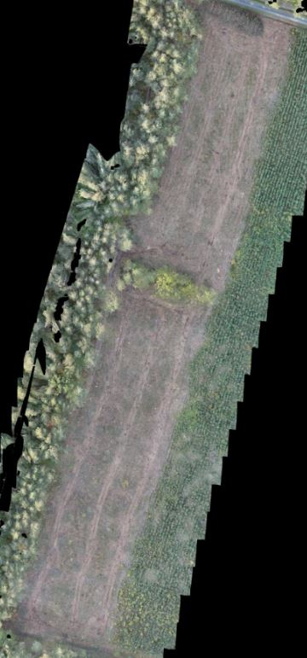
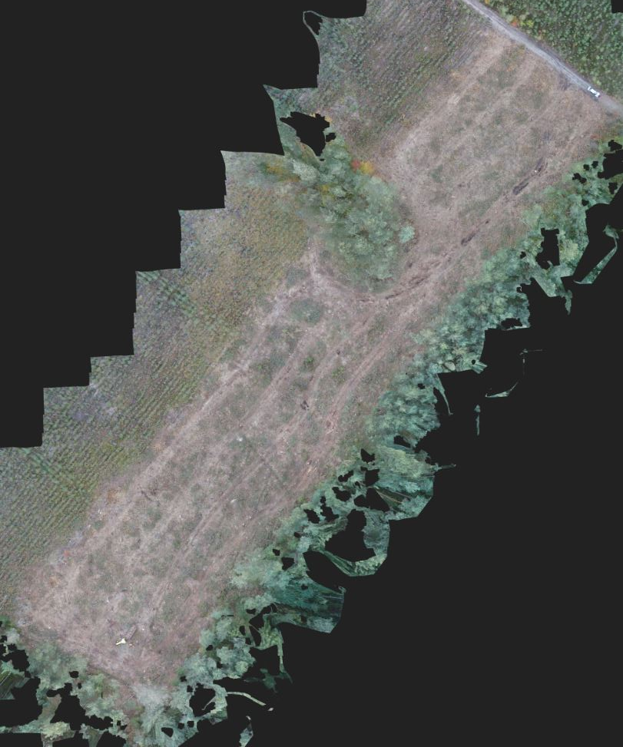
The research covered 4 harvesting sites

Slide 11
Sites specification
Site nr | Habitat type | Site moisture | Soil type
1 | BMW | ++++ | Bgms
2 | BW | +++ | Bgts
3 | BMŚw | ++ | RDB
4 | BŚW | + | Bw
Bśw – fresh coniferous; Bw – moist coniferous; BMśw – fresh mixed coniferous; BMw – moist mixed coniferous.
Bw – podzolic soil Bgms, Bgts – glial-podzolic soil, RDb – rusty podzolic soil

Slide 12
Soil penetration ressistance

Slide 13
Soil penetration ressistance changes
Transect | Placement | Number of passes |  |  |  |  |  | Mean % soil compactness increase after single pass
 |  | 0 | 1 | 5 | 10 | 15 | 20
1 | left rut | 1,25 | 1,85 | 2,43 | 3,17 | 3,42 | 4,29 | 6,70%
2 | left rut | 1,05 | 1,29 | 1,78 | 2,60 | 3,04 | 4,42 | 7,80%
3 | left rut | 1,48 | 1,72 | 2,14 | 2,90 | 4,00 | 6,24 | 6,40%
4 | left rut | 1,25 | 1,85 | 2,43 | 3,17 | 3,42 | 4,29 | 6,70%
1 | middle | 1,00 | 1,49 | 1,77 | 1,89 | 2,00 | 2,08 | 3,90%
2 | middle | 1,04 | 1,07 | 1,45 | 1,75 | 1,87 | 2,45 | 4,60%
3 | middle | 1,20 | 1,18 | 1,60 | 1,96 | 2,28 | 3,29 | 8,48%
4 | middle | 1,00 | 1,49 | 1,77 | 1,89 | 2,00 | 2,08 | 3,90%
1 | right rut | 1,31 | 1,87 | 2,41 | 3,20 | 3,57 | 4,27 | 6,40%
2 | right rut | 1,29 | 1,37 | 1,78 | 2,61 | 2,99 | 4,07 | 6,20%
3 | right rut | 1,45 | 1,66 | 1,96 | 2,81 | 3,84 | 6,27 | 6,63%
4 | right rut | 1,31 | 1,87 | 2,41 | 3,20 | 3,57 | 4,27 | 6,40%
Transect | Placement | Number of passes |  |  |  |  |  | Mean % soil compactness increase after single pass
 |  | 0 | 1 | 5 | 10 | 15 | 20
1 | left rut | 1,66 | 2,52 | 3,41 | 4,97 | 5,38 | 6,40 | 7,40%
2 | left rut | 1,23 | 1,64 | 2,44 | 3,58 | 4,49 | 6,06 | 8,70%
3 | left rut | 1,14 | 1,40 | 1,54 | 1,98 | 2,61 | 3,87 | 8,74%
4 | left rut | 1,66 | 2,52 | 3,41 | 4,97 | 5,38 | 6,40 | 7,40%
1 | middle | 1,39 | 2,16 | 2,39 | 2,72 | 2,92 | 3,06 | 4,20%
2 | middle | 1,27 | 1,39 | 1,93 | 2,32 | 2,62 | 3,61 | 5,60%
3 | middle | 0,92 | 1,01 | 1,16 | 1,30 | 1,49 | 1,87 | 4,77%
4 | middle | 1,39 | 2,16 | 2,39 | 2,72 | 2,92 | 3,06 | 4,20%
1 | right rut | 1,73 | 2,44 | 3,32 | 4,90 | 5,91 | 7,08 | 7,70%
2 | right rut | 1,48 | 1,74 | 2,47 | 3,69 | 4,36 | 5,84 | 7,50%
3 | right rut | 1,18 | 1,35 | 1,46 | 1,89 | 2,51 | 3,90 | 6,83%
4 | right rut | 1,73 | 2,44 | 3,32 | 4,90 | 5,91 | 7,08 | 7,70%
10 cm
20 cm

Slide 14
Soil density changes before & after 20 forwarder passes
Placement | Depth | Transect
 |  | 1 | 2 | 3 | 4
Left Rut | 10 cm | 341.9% | 418.7% | 422,3% | 341.9%
Middle |  | 208.4% | 235.6% | 273,9% | 208.4%
Right Rut |  | 325.9% | 316.0% | 431,4% | 325.9%
Left Rut | 20 cm | 385.4% | 491.9% | 341,2% | 362.7%
Middle |  | 410.5% | 394.3% | 204,6% | 394,3%
Right Rut |  | 219.7% | 283.0% | 329,4% | 313.4%

Slide 15
Moisture changes
 | Transect
Placement | 1 | 2 | 3 | 4
Measure outside skid track (refrence) | 42,2% | 15,5% | 13,7% | 14,9%
Skid track before forwarder passes | 37,3% | 9,0% | 8,6% | 6,0%
Skid track after 20 forwarder passes | 14,6% | 5,8% | 5,8% | 3,9%

Slide 16
UAV based data

Slide 17
Site coverage
Site | 1 | 2 | 3 | 4
Area declared to cut | 1,21 | 1,29 | 1,84 | 1,91
Area measured after cut | 1,35 | 1,23 | 1,75 | 2,04
Difference [Ha] | 0,14 | -0,06 | -0,09 | 0,13
Difference % | 11,13% | -4,56% | -4,66% | 6,70%
Skid trails lenght [km] | 1,35 | 1,23 | 1,69 | 1,38
Skid trails per 1 Ha | 1,00 | 1,00 | 0,97 | 0,67
Skid trails area [ha] | 0,41 | 0,38 | 0,42 | 0,52
% of cut area covered with skid trails | 33,72% | 29,23% | 21,85% | 28,05%
Area with soil damage to the mineral layer [Ha] | 0,053 | 0,007 | 0,05 | 0,055
Converted to % share in the area of the trails area | 10,13% | 1,50% | 7,81% | 10,24%
Converted to % share of measured cut area | 3,92% | 0,57% | 2,85% | 2,70%

Slide 18
Wheel rut depth

Slide 19
Rut depth
Site nr | Habitat type | Site moisture | Soil type
1 | BMW | ++++ | Bgms
2 | BW | +++ | Bgts
3 | BMŚw | ++ | RDB
4 | BŚW | + | Bw

Slide 20
Statistics results
Statistically significant differences in changes of soil penetration ressistance, on both depths (10 & 20 cm), p value = 0.0000
Statistically significant differences in rut depth between anaylyzed cutting areas p value = 0.0000
Moderate corelation (0.44) between rut depth and tested site

Slide 21
Conclusions
Statistically significant differences were found in the changes of soil condensation between the examined surfaces.
Skidding trails covered an average of 28% of the studied cutting areas.
On 2.5% of the tested areas, the mineral layer of the soil was exposed as a result of passing machines.
Statistically significant differences were found in the depth of the created ruts on the examined surfaces.
There is a moderate correlation between the size of the ruts and the cutting area.

Slide 22
Thank you for your attention
In case of any questions please contact me Dariusz.Pszenny@sggw.edu.pl

