Slide 1
The 1st International Electronic Conference on Forests — Forests for a Better Future: Sustainability, Innovation, Interdisciplinarity
Mapping Forest Fire Risk in the Mediterranean forests—A Case Study of SUD-Provence-Alpes-Côte d'Azur region (SE, France)
Abdesslam CHAI-ALLAH & Eric MAILLE
INRAE, UR RECOVER Aix-En-Provence, France
University of Sassari, Italy
November 2020

Slide 2
Introduction
Material and methods
Results and Interpretation
Conclusion

Slide 3
Introduction
A complex ecosystem
An environment under multiple pressures
A key of management and conservation
Area of complex interaction of biological, ecological and anthropogenic processes.
Forest fires appears to be a major problem for the Mediterranean forests
Concentration of populations and economic activities.
The vast majority of Mediterranean fires are of human origin and most of them start in the wildland-urban interfaces (*)
Geographical Information System (GIS) is an important technology that is used in public policy-making for forest and environmental planning and decision-making over a few decades of years.
GIS as a spatially analysis tool has great advantage for forest fire risk management.
* Curt, T.; Fréjaville, T.; Lahaye, S. Modelling the spatial patterns of ignition causes and fire regime features in Southern France: Implications for fire prevention policy. Int. J. Wildland Fire 2016, 25, 785–796. https://doi.org/10.1071/WF15205

Slide 4
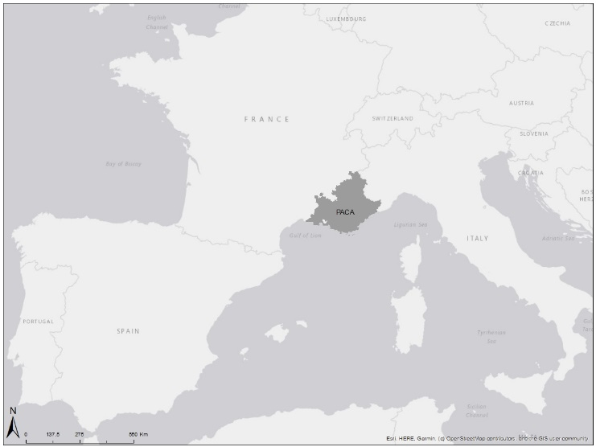
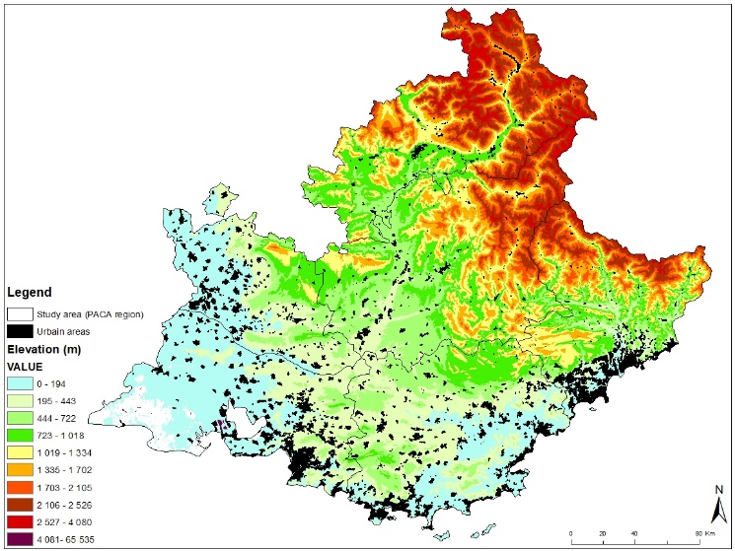
SUD-Provence-Alpes-Côte d'Azur region
Located in the South-East of France
It covers 31 400 Km² between the eastern part of the Rhône Valley and the Italian border, bounded in the South by the Mediterranean Sea
This region has 6 administrative subdivisions

Slide 5
Why SUD-Provence-Alpes-Côte d'Azur region ?
(1/2)
Land cover and Mediterranean climate
The study area has a wide variety of landscapes, from the Alps Mountains to plains and coastal areas
The Alpine region spans high mountain dominated by conifer forests at high elevation and broadleaf forest at low elevation, The Mediterranean region is formed mainly by highly inflammable Mediterranean species (aromatic and resinous species), including a mixture of pines (Pinus halepensis), oaks (Quercus ilex, and Quercus Pubescens) and shrubs (Rosmarinus officinalis, Ulex sp., Lavandula angustifolia, etc.).
The climate is Mediterranean with hot and arid summers and mild winters.

Slide 6
Why SUD-Provence-Alpes-Côte d'Azur region ?
(2/2)
Vulnerability to wildfire and Land-use changes
In the last decade according to the national Prométhée* database in study area, a total of 4398 incidents occurred, including 3779 fire alarms (<1 ha) and 619 fires (>1 ha), affecting a total of 20,570 ha.
Large fires (≥ 100 ha) by departments (Bouches du Rhône (12), Alpes Maritime (8), Alpes de Haute-Provence (5), Var (5), Vaucluse (1), Hautes-Alpes (0)).
* Forest fires database for Mediterranean area in France (Prométhée)

Slide 7
Material and methods
(1/2)
The methodology is based on the concept that the frequency and intensity of fires in the region result from a combination of certain natural conditions and human frequentation (induced hazard).
i) The fire ignition model (induced hazard) calculates the ignition potential based on the presence/absence of causative elements, their types and their proximity, the local ignition load (mainly herbaceous strata),
ii) The fire outbreak model is the phase where the fire remains controllable by artisanal anti-fire infrastructures. The success of this phase is no longer determined only by the herbaceous fuel but also by the presence of shrub fuel,
The modelling framework
iii) The spread potential model estimates, for any point in the territory, the relative probability of a fire spreading. It is a static spatial model of propagation potential and it does not describe the dynamic behavior of fire(*)
* Maillé, E. (2018). Approche multi-échelle de l’exposition des interfaces à l’incendie de forêt : de l’évaluation multicritères locale à un modèle d’aléa subi/induit à l’échelle du massif. Application au feu de Rognac 2016. Convention MEDDE/DGPR/SRNH-IRSTEA, ACTION 502 – RISQUES NATURELS : INCENDIES DE FORET.

Slide 8
Material and methods
(2/2)
To mapping fire risk, it was necessary to obtain data of distinct nature and origin.
Data Description | Source | Format Type
Vegetation type "BD-IFN" | IGN¹ | Raster
Digital Elevation Model with 30-metre spatial resolution | IGN¹ | Raster
Fire data between 2010-2019 | Prométhée²
Wind data | WIND-Ninja³ | Raster
Urban system, roads *, paths *, railways *, power lines *, land uses, administrative divisions "BD-TOPO IGN" | IGN¹ | Vector data (polygon and lines * features)
¹National Geographic Institute (IGN); ²Forest fires database for Mediterranean area in France (Prométhée); ³ _{WIND-Ninja (Forthofer, 2007).}

Slide 9
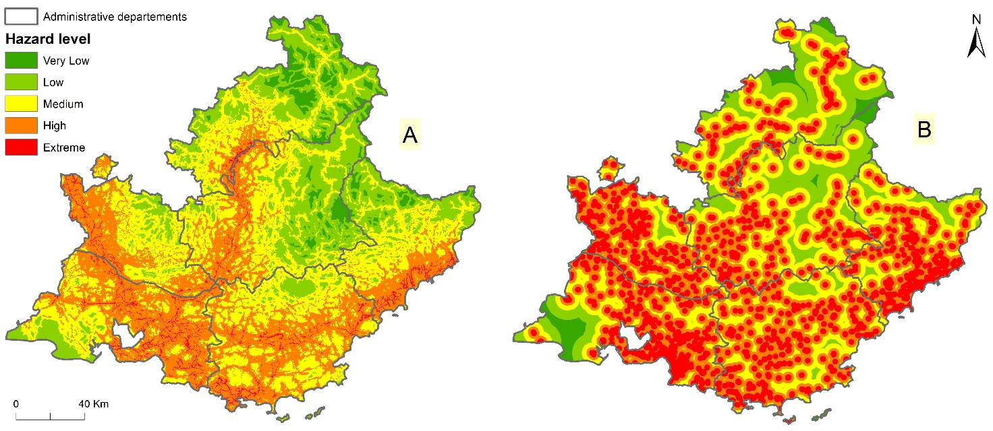
Results and Interpretation
(1/4)
Ignition Risk (Induced Forest Fire Hazard)
The methodology for obtaining the induced hazard for all elements is based on:
Calculation of the Euclidean distance around all elements;
Standardization of values between 1 and 5;
Values were inverted, due to the inverse relationship between hazard and distance;
The statistical data of Prométhée database and our results shows also a clear correlation between the number of fire ignition and the proximity of transport infrastructures and to urban centers.
Ignition Risk maps for each causative element. (A) Transport infrastructures. (B) Population centres and scattered rural buildings.

Slide 10
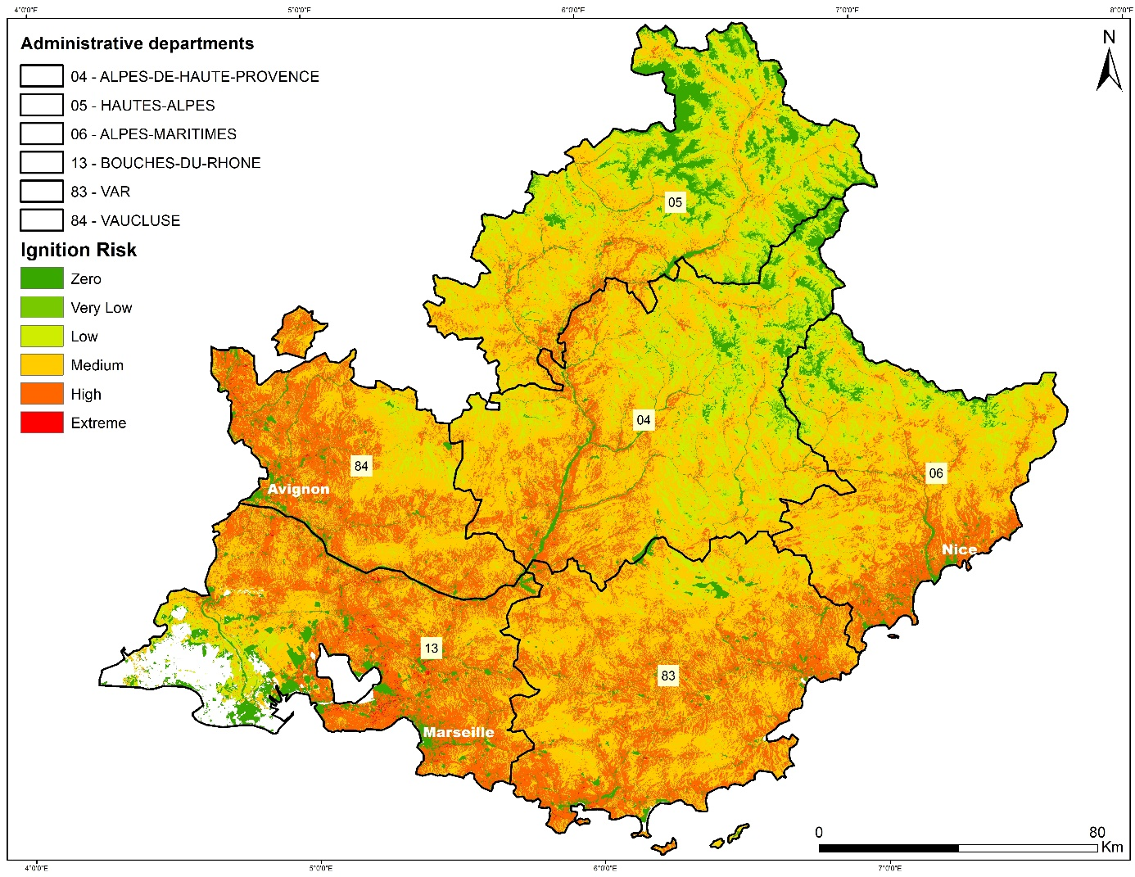
Results and Interpretation
(2/4)
Ignition Risk (Induced Forest Fire Hazard)
The final ignition risk map is in good agreement with all the individual layers considered. The value ranges of the risk were classified in six classes; a class for 0 (null hazard) was included for those areas where vegetation is absent.
The results showed a high level of Ignition Risk in the area near to urban centers and to transport infrastructures. These areas are the zones where a fire is more likely to break out.
Despite the potential for more frequent fire ignitions in greater housing densities, vegetation biomass and continuity decrease and the probability of extinguishing a fire early increase.
Serval studies in the SE France have also shown that the greatest fire risk is associated with isolated, then scattered housing and this risk is decreases with increasing housing density (**).
Ignition Risk map
** Fox, D., Carrega, P., Ren, Y., Caillouet, P., Bouillon, C., and Robert, S.: How wildfire risk is related to urban planning and Fire Weather Index in SE France (1990–2013), Sci. Total Environ., 621, 120–129, https://doi.org/10.1016/j.scitotenv.2017.11.174, 2018.

Slide 11
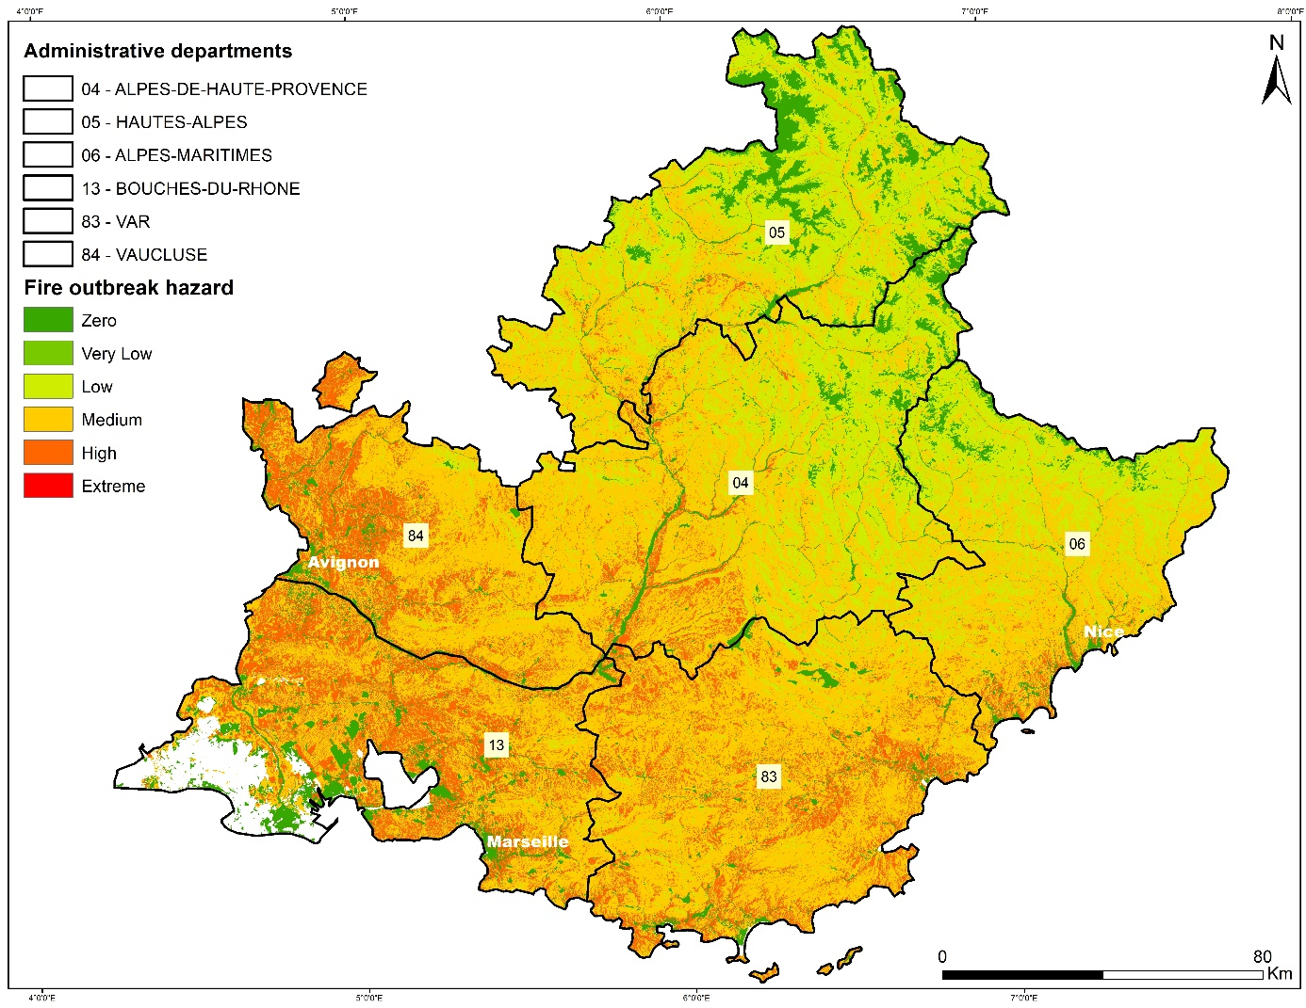
Results and Interpretation
(3/4)
Fire Outbreak
The outbreak hazards are showed to be higher in the South to Southwest areas and lower in the North and Northeast areas.
These differences reflect :
The topography of the study area, with mountainous landscapes and high altitudes in the north and lowland areas in the south, the rugged topography is generally more exposed to direct sunlight (illumination), which leads to drier vegetation,
The exposition to the local wind (Mistral)
The rapid spread of Wildland-Urban Interface WUI in the southern part compared to the northern part of the study area.
Fire Outbreak map

Slide 12
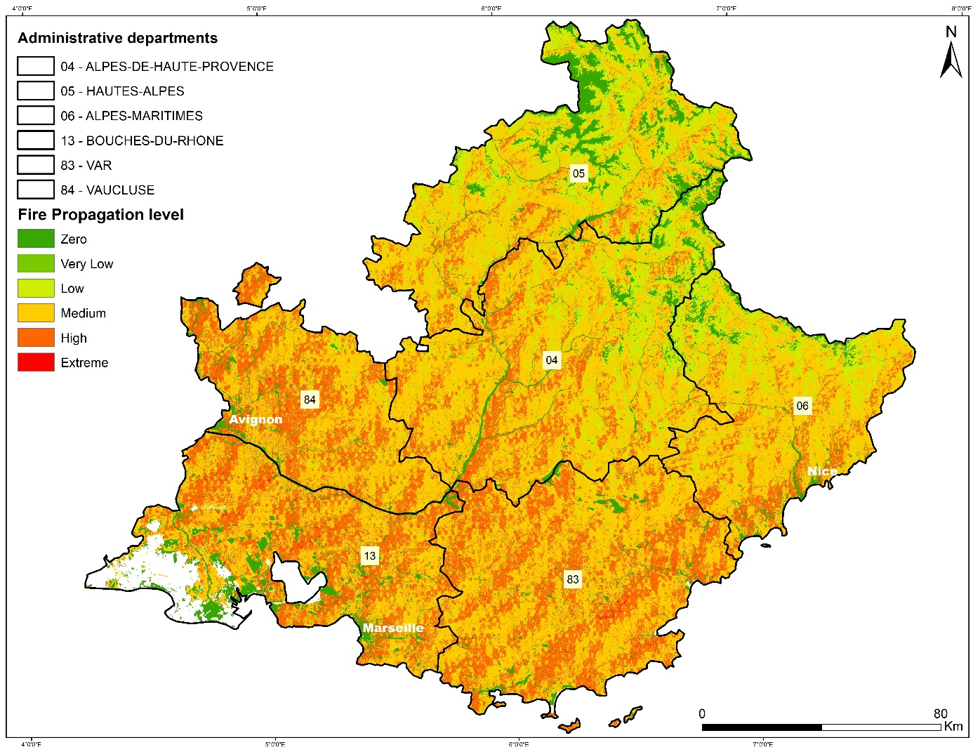
Results and Interpretation
(4/4)
Fire Propagation
The obtained map shows different propagation hazard levels, the areas with higher fire propagation correspond to areas that are greatly affected by (1) Mistral Wind, (2) dominance of deciduous and coniferous forests, and (3) the concentration and intersection of various causative elements relative to humans' activities.
These areas are mainly located in the South and South-West part of the region, which corresponds to three departments (Bouches du Rhône, Vaucluse and Var); although, also around the coastal part of the Alpes Maritime department and the center and South-West part of Alpes de Haute-Provence department.
The areas with medium to low hazard are those located in the North and North-East areas which correspond to the departments of Hautes-Alpes and the mountainous part of both Alpes de Haute-Provence and Alpes Maritime departments.
Fire Propagation map

Slide 13
Conclusion
The simplicity of the proposed modeling framework and the availability of the required data allows its multiple potential applications. First, it could be implemented in a wide range of regions. This may complement the susceptibility relationships derived from local experts’ judgement.
Our results suggested that treatments intended to reduce fire threat around communities should first target sectors of main and scattered settlements, as well as transport infrastructures bordering shrubland and pasture areas, where fires are more likely to ignite and to spread.
The results highlight the importance of considering the actual land-use changes in SE France with the extension of WUI and depth transformations in the rural land-use.
Maps like those produced in the current study and for other Mediterranean region like in Spain by Vallejo-Villalta et al. (2019), Alcasena et al. (2017), and in Greece by Adaktylou et al. (2020), can be useful for civil protection agencies and local land managers.

Slide 14
Thank you for your attention!

Slide 15
References
Adaktylou, N.; Stratoulias, D.; Landenberger, R. Wildfire Risk Assessment Based on Geospatial Open Data: Application on Chios, Greece. ISPRS Int. J. Geo-Inf. 2020, 9, 516. https://doi.org/10.3390/ijgi9090516
Alcasena, F.J.; Salis, M.; Ager, A.A.; Castell, R.; Vega-García, C. Assessing Wildland Fire Risk Transmission to Communities in Northern Spain. Forests 2017, 8, 30. https://doi.org/10.3390/f8020030
Curt, T.; Fréjaville, T.; Lahaye, S. Modelling the spatial patterns of ignition causes and fire regime features in Southern France: Implications for fire prevention policy. Int. J. Wildland Fire 2016, 25, 785–796. https://doi.org/10.1071/WF15205
Fox, D., Carrega, P., Ren, Y., Caillouet, P., Bouillon, C., and Robert, S.: How wildfire risk is related to urban planning and Fire Weather Index in SE France (1990–2013), Sci. Total Environ., 621, 120–129, https://doi.org/10.1016/j.scitotenv.2017.11.174, 2018.
Maillé, E. (2018). Approche multi-échelle de l’exposition des interfaces à l’incendie de forêt : de l’évaluation multicritères locale à un modèle d’aléa subi/induit à l’échelle du massif. Application au feu de Rognac 2016. Convention MEDDE/DGPR/SRNH-IRSTEA, ACTION 502 – RISQUES NATURELS : INCENDIES DE FORET.
Vallejo-Villalta, I.; Rodríguez-Navas, E.; Márquez-Pérez, J. Mapping Forest Fire Risk at a Local Scale—A Case Study in Andalusia (Spain). Environments 2019, 6, 30. https://doi.org/10.3390/environments6030030.
http://www.promethee.com, n.d. Forest Fires Database for Mediterranean Area in France (WWW Document).

