Slide 1
The Interannual and Interdecadal Variability of Soil Moisture and Recent Tornado Activity
(EF2 or greater) in the Central USA.
Lukas J. McGuire
Corey E. Clay
Anthony R. Lupo
Atmospheric Science Program
School of Natural Resources
University of Missouri
Columbia, MO 65211
The 3rd International Electronic Conference on Atmospheric Science

Slide 2
Introduction
Many studies have demonstrated that El Nino and Southern Oscillation (ENSO) have a distinct impact on the occurrence of severe weather and the environment in the eastern two-thirds of the USA.
Typically, La Nina years experience a greater number of tornado events in the central USA. Recent studies have suggested that the real ENSO variability in tornado occurrences shifts where the maxima occur (“Tornado Alley” versus “Dixie Alley”).

Slide 3
Introduction
A previous study of tornado activity over the second half of the 20th century demonstrated that tornado activity was higher in the mid-century than toward the end of the century within the State of Missouri (USA) and neighboring states (Iowa, Kansas, Nebraska).
There has been an increase in the number of tornado cases during first two decades of the 21st century in Missouri. There has been some indication that this may be true in the other three states.

Slide 4
Motivation and Goals
The previous study performed by this research group examined tornado activity in the central United States from 1950 – 2002, thus this study endeavored to extend the time period 2019.
The goal is to determine whether the tornado activity of the most recent years was consistent with that of the previous study. The environment of representative years will be examined as well.
There was a correlation between soil moisture and tornado activity, and this will be explored.

Slide 5
Data Used
The datasets used in this study were the National Centers for Environmental Prediction / National Center for Atmospheric Research (NCEP / NCAR) re-analyses for the study of the environmental conditions
The National Oceanic and Atmospheric Administration (NOAA) Storm Prediction Center (SPC) event archive was used to compile the climatological statistics. EF2 tornadoes or greater were chosen for study since EF0 and EF1

Slide 6
Methods
The study region.

Slide 7
Methods
The tornado counts were broken down by ENSO phase following Lupo et al. (2019 - Atmosphere) for blocking events. ENSO is defined using the JMA definition. The interdecadal variability is assumed to be associated with the Pacific Decadal Oscillation since that will impact ENSO.
Statistical testing was done using standard methods found in Wilks (2006).

Slide 8
Results
An examination of the current two decades demonstrated that the variability with respect to ENSO was similar to that of the Akuyz et al. (2004 – Trans. MO Acad. Sci.) study.
Tornadoes separated by state and ENSO phase (total tornadoes – left, annual mean – right)
State | La Nina (3) | Neutral (8) | El Nino (6) | Total
Missouri | 32 / 10.7 | 91 / 11.4 | 48 / 8.0 | 171 / 10.1
Iowa | 31 / 10.3 | 42 / 5.3 | 28 / 4.7 | 101 / 6.0
Kansas | 42 / 14.0 | 54 / 6.8 | 76 / 12.7 | 172 / 10.1
Nebraska | 17 / 5.7 | 57 / 7.1 | 21 / 3.5 | 95 / 5.6

Slide 9
Results
Adding these events to the 52-year Akyuz et. al. study and decomposing the time series using Fourier analysis shows that the periodicities identified previously are still present.
The x-axis is wave number
and the y-axis is spectral power
(detrended). The blue dashed
line is (p = 0.05).

Slide 10
Results
The variability with respect to the PDO showed that there may be a signal in the southern states (MO, KS) but not in the northern (IA, NE).
Data separated by PDO phase (negative / 1950 – 1976, 1999- present – Positive (1999 – present).
State | 1950 - 1976 | 1977- 1998 | 1999 - present
Missouri | 10.2 | 4.5 | 9.0
Iowa | 12.7 | 8.2 | 5.8
Kansas | 15.3 | 6.3 | 9.2
Nebraska | 7.7 | 6.2 | 5.3
Total | 45.8 | 25.1 | 29.3

Slide 11
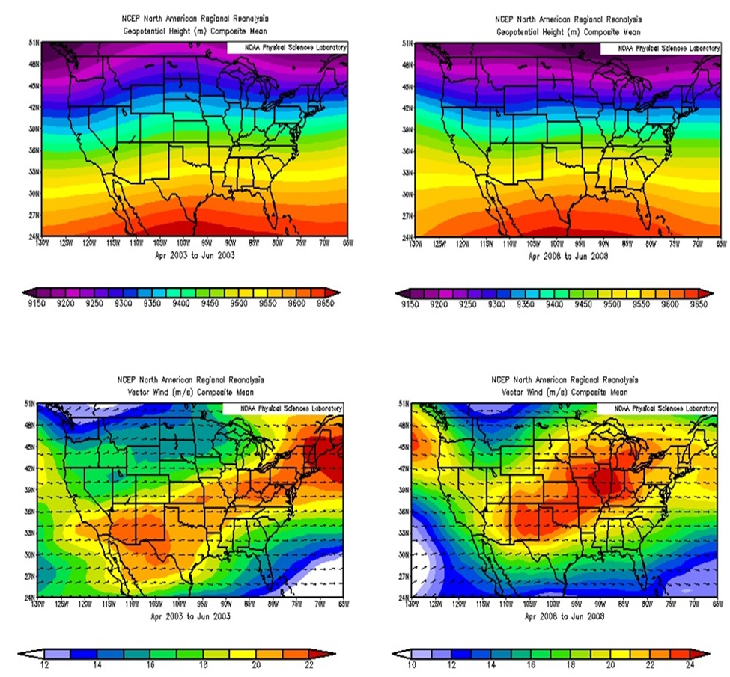
Results
Composite maps for April to June 2003 (El Nino - left) and 2008 (La Nina - right). We show 300 hPa heights (m) (top) and winds (m s⁻¹) (bottom).

Slide 12
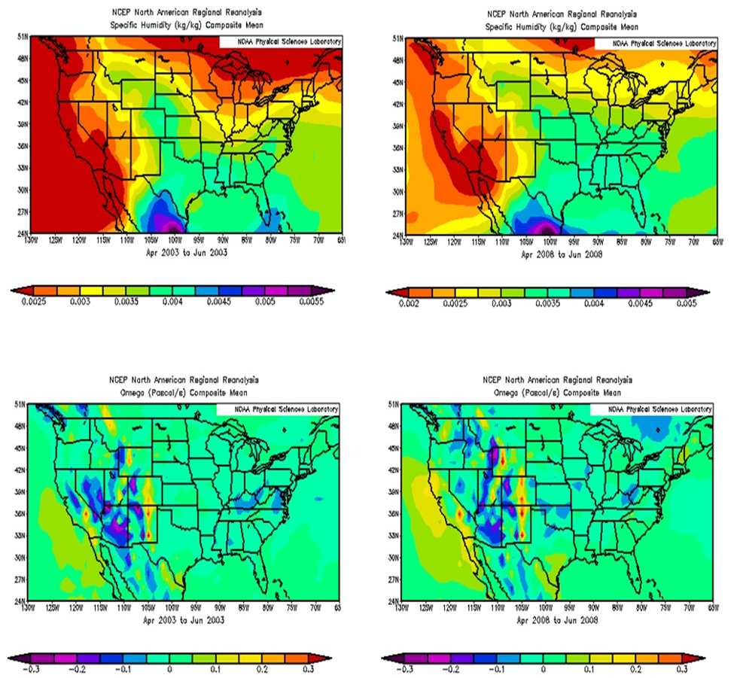
Results
The surface specific humidity (kg kg⁻¹) (top) and 700 hPa Omega (μb s⁻¹) (right).

Slide 13
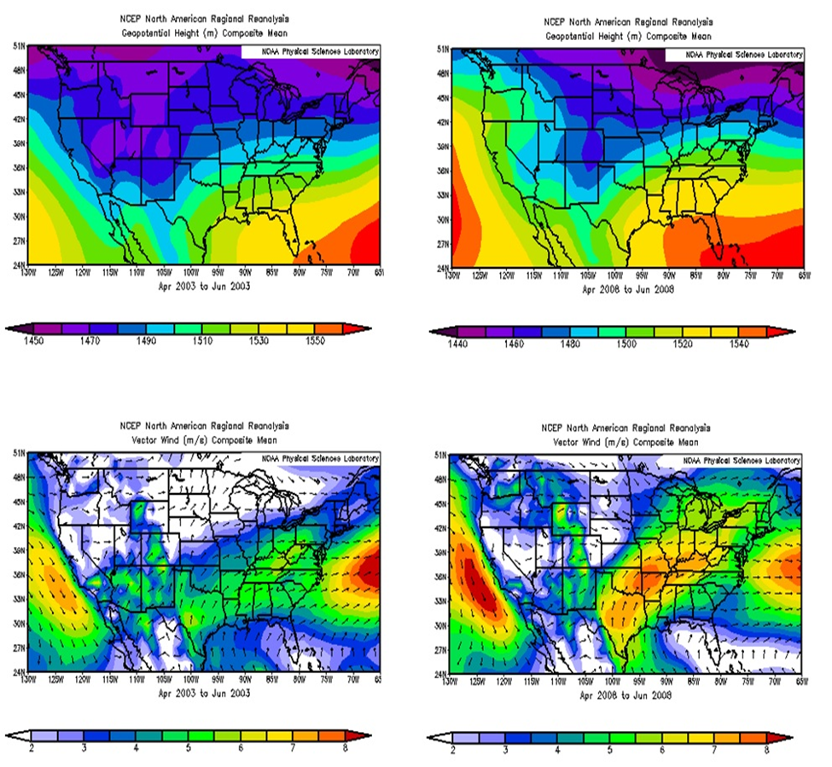
Results
The 850 hPa heights (m) and winds (m s⁻¹)

Slide 14
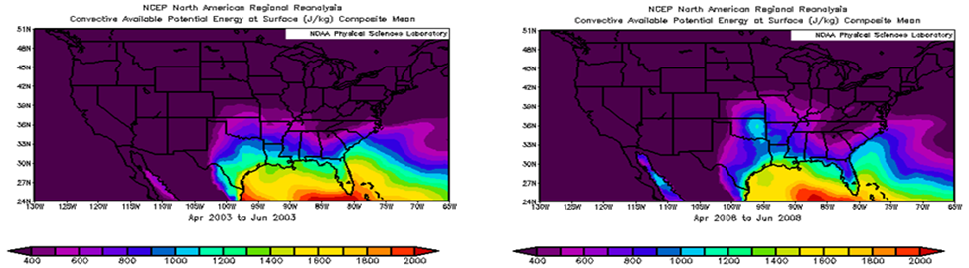
Results
Surface Based CAPE (J kg⁻¹)

Slide 15
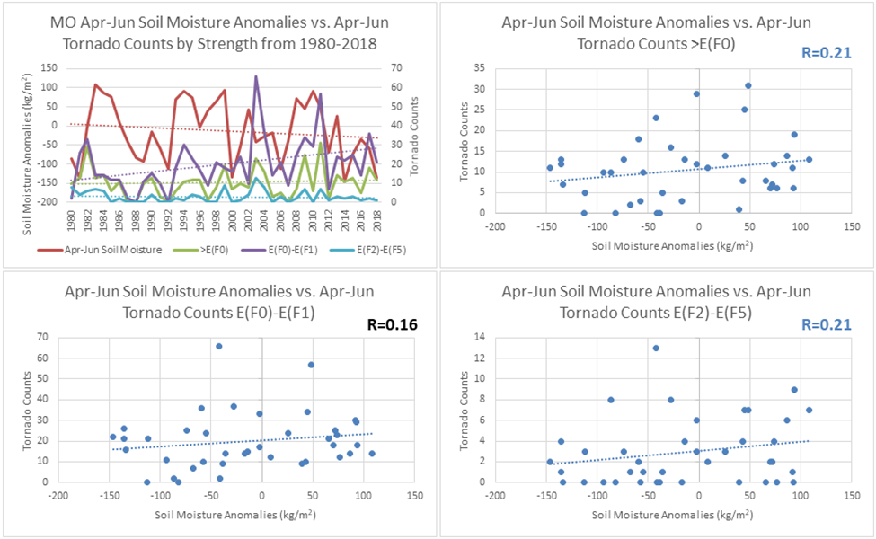
Results
Soil Moisture versus tornado counts for April – June versus in Missouri (p = 0.10 – light blue). Note the significant correlation between EF2 – EF5 events.

Slide 16
Summary and Conclusions
The tornado counts for the central USA were examined from 2003 – 2019 in order to update the Akyuz et al. (2004) study of the tornado climatology (1950 – 2002).
The same pattern of interannual variability was present as in Akyuz et. al. and examining the environments of the primary tornado season (Apr – Jun) shows that La Nina years are more conducive to larger outbreaks (e.g. 2011) over this region.

Slide 17
Summary and Conclusions
Akyuz et al. used a correction factor to remove perceived over-counts of tornadoes occurring before 1977. Thus, the original study showed no interdecadal variability.
The Fourier analysis of ‘corrected’ data here suggests interdecadal variability is present, although it is difficult to extract this because of the perceived over-count. Nonetheless, MO and KS showed interdecadal variability related to the PDO while IA and NE did not.

Slide 18
Summary and Conclusions
Questions?
Comments?
Criticisms?
ljmdyn@mail.missouri.edu ceczpd@mail.missouri.edu lupoa@missouri.edu

