Slide 1
Development of a Line Source Dispersion Model for Gaseous Pollutants by Incorporating Wind Shear near the Ground Under Stable Atmospheric Conditions
Saisantosh Vamshi Harsha Madiraju¹, Ashok Kumar ^{1,}*
College of Engineering, The University of Toledo, Toledo, Ohio, USA 43606
Presented at
The 3rd International Electronic Conference on Atmospheric Sciences

Slide 2
Abstract
Transportation sources are a major contributor to air pollution in urban areas. The role of air quality modelling is vital in the formulation of air pollution control and management strategies. Many models have appeared in the literature to estimate near-field ground level concentrations from mobile sources moving on a highway. However, current models do not account explicitly for the effect of wind shear (magnitude) near the ground while computing the ground level concentrations near highways from mobile sources. This study presents an analytical model based on the solution of the convective-diffusion equation by incorporating the wind shear near the ground for gaseous pollutants. The model input includes emission rate, wind speed, wind direction, turbulence, and terrain features. The dispersion coefficients are based on the near field parameterization. The sensitivity of the model to compute ground level concentrations for different inputs is presented for three different downwind distances. In general, the model shows Type III sensitivity (i.e. the errors in the input will show a corresponding change in the computed ground level concentrations) for most of the input variables. However, the model equations should be re-examined for three input variables (wind velocity at the reference height and two variables related to the vertical spread of the plume) to make sure that that the model is valid for computing ground level concentrations.

Slide 3
Introduction
Classification of air quality models based on various attributes and model categories
Attributes | Model category
Source | Point, line, area, volume, flare
Receptor | Street Canyon, intersection model
Frame | Lagrangian, Eulerian
Dimensionality | Single, double, triple, or multidimensional
Scale | Microscale and mesoscale, small synoptic, large synoptic, planetary
Structure | Analytical, statistical
Approach | Numerical, experimental
Applicability | Simple terrain, complex terrain, rural flat terrain, urban flat terrain, coastal terrain
Complexity | Screen models, refined models

Slide 4
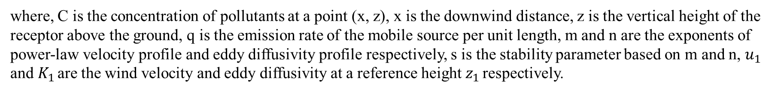

Model Development
The analytical solution of the convective-diffusion equation to calculate the concentration of pollutants at any downwind distance is given by
$C_{\left(x,z\right)}= \frac{q}{u_{1}∗γ\left(s\right)}∗[{\frac{u_{1}}{{\left(m−n+2\right)}^{2}∗K_{1}∗x}]}^{s}∗\exp\left[−u_{1}∗\frac{z^{m−n+2}}{{((m−n+2)}^{2}∗K_{1}∗x)}\right]$
where, C is the concentration of pollutants at a point (x, z), x is the downwind distance, z is the vertical height of the receptor above the ground, q is the emission rate of the mobile source per unit length, m and n are the exponents of power-law velocity profile and eddy diffusivity profile respectively, s is the stability parameter based on m and n, $u_{1}$ and $K_{1}$ are the wind velocity and eddy diffusivity at a reference height $z_{1}$ respectively.

Slide 5

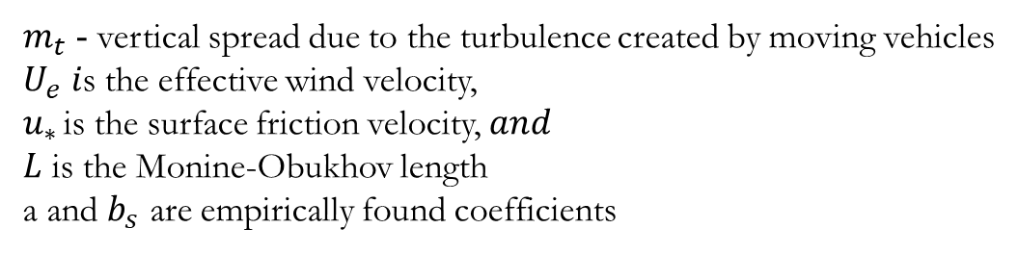
Vertical Dispersion Coefficient
$$σ_{z}=\frac{a{ u}_{∗}x}{U_{e}∗\left(1+b_{s} \frac{u_{∗}}{U_{e}}{\left(\frac{x}{L}\right)}^{\frac{2}{3}}\right)} +m_{t}$$
$m_{t}$ - vertical spread due to the turbulence created by moving vehicles
$U_{e} i$s the effective wind velocity,
$u_{∗ }$is the surface friction velocity, $and$
$L$ is the Monine-Obukhov length
a and $b_{s}$ are empirically found coefficients

Slide 6
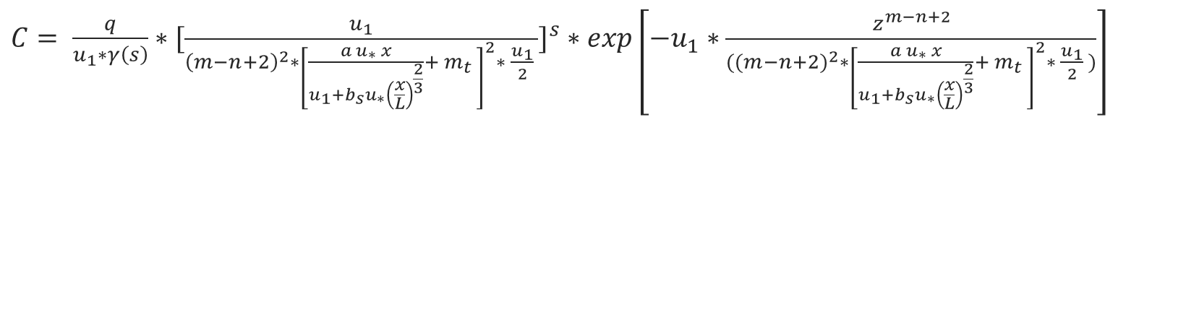
SLINE – Final Equation
$C= \frac{q}{u_{1}∗γ\left(s\right)}∗[{\frac{u_{1}}{{\left(m−n+2\right)}^{2}∗{\left[\frac{a u_{∗} x}{u_{1}+b_{s}u_{∗}{\left(\frac{x}{L}\right)}^{\frac{2}{3}}}+ m_{t} \right]}^{2}∗ \frac{u_{1}}{2} }]}^{s}∗\exp\left[−u_{1}∗\frac{z^{m−n+2}}{{((m−n+2)}^{2}∗{\left[\frac{a u_{∗} x}{u_{1}+b_{s}u_{∗}{\left(\frac{x}{L}\right)}^{\frac{2}{3}}}+ m_{t} \right]}^{2}∗ \frac{u_{1}}{2} )}\right]$

Slide 7
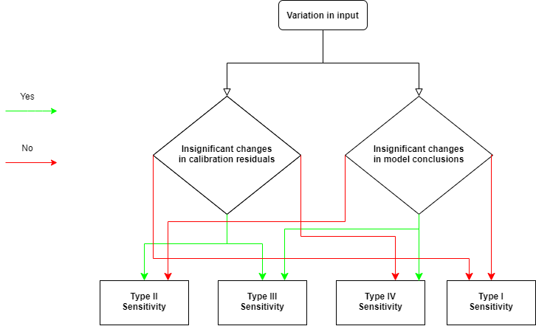
Sensitivity analysis
The categories' sensitivity analysis and output changes
 | Categories | Changes in calibration residuals | Changes in model conclusions
Variation in input parameters | Type I | X | X
 | Type II | ✓ | X
 | Type III | ✓ | ✓
 | Type IV | X | ✓

Slide 8
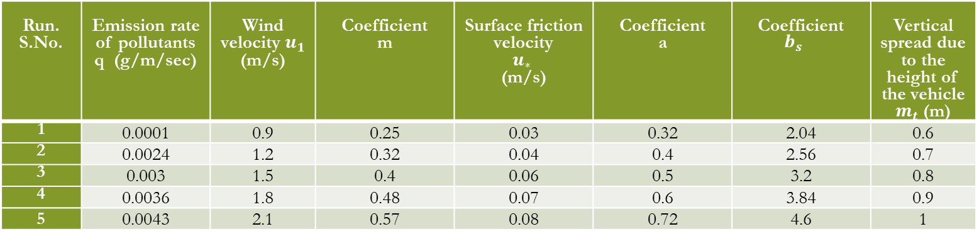
Ranges of the independent input variable used for the sensitivity analysis
Run. S.No. | Emission rate of pollutants q (g/m/sec) | Wind velocity $u_{1}$ (m/s) | Coefficient m | Surface friction velocity $u_{∗ }$ (m/s) | Coefficient a | Coefficient $${b_{s }}_{}$$ | Vertical spread due to the height of the vehicle $m_{t}$ (m)
1 | 0.0001 | 0.9 | 0.25 | 0.03 | 0.32 | 2.04 | 0.6
2 | 0.0024 | 1.2 | 0.32 | 0.04 | 0.4 | 2.56 | 0.7
3 | 0.003 | 1.5 | 0.4 | 0.06 | 0.5 | 3.2 | 0.8
4 | 0.0036 | 1.8 | 0.48 | 0.07 | 0.6 | 3.84 | 0.9
5 | 0.0043 | 2.1 | 0.57 | 0.08 | 0.72 | 4.6 | 1

Slide 9
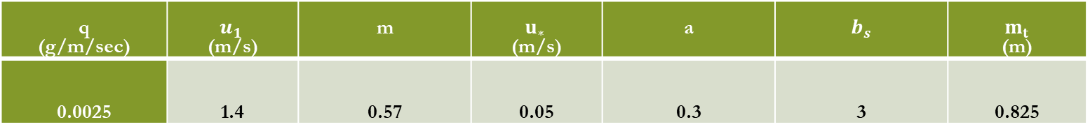
Standard input values considered for sensitivity analysis
q (g/m/sec) | $u_{1 }$ (m/s) | m | $u_{∗ }$ (m/s) | a | $b_{s}$ | $m_{t}$ (m)
0.0025 | 1.4 | 0.57 | 0.05 | 0.3 | 3 | 0.825

Slide 10
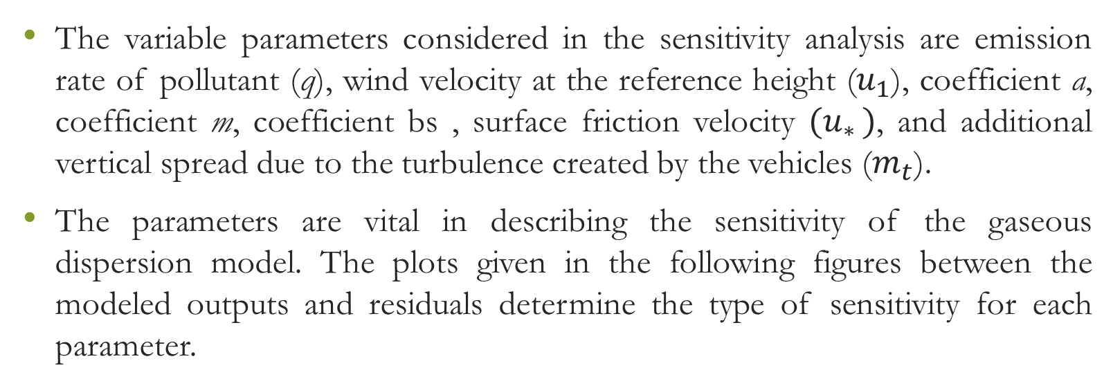
Sensitivity Analysis Results
The variable parameters considered in the sensitivity analysis are emission rate of pollutant (q), wind velocity at the reference height ($u_{1}$), coefficient a, coefficient m, coefficient bs , surface friction velocity ${(u}_{∗ })$, and additional vertical spread due to the turbulence created by the vehicles ($m_{t}$).
The parameters are vital in describing the sensitivity of the gaseous dispersion model. The plots given in the following figures between the modeled outputs and residuals determine the type of sensitivity for each parameter.

Slide 11
At Distance = 10m

Slide 12
At Distance = 50m

Slide 13
At Distance = 250m

Slide 14
At Distance = 10m

Slide 15
At Distance = 50m

Slide 16
At Distance = 250m

Slide 17
At Distance = 10m

Slide 18
At Distance = 50m

Slide 19
At Distance = 250m

Slide 20
At Distance = 10m

Slide 21
At Distance = 50m

Slide 22
At Distance = 250m

Slide 23
At Distance = 10m

Slide 24
At Distance = 50m

Slide 25
At Distance = 250m

Slide 26
At Distance = 10m

Slide 27
At Distance = 50m

Slide 28
At Distance = 250m

Slide 29
At Distance = 10m

Slide 30
At Distance = 50m

Slide 31
At Distance = 250m

Slide 32
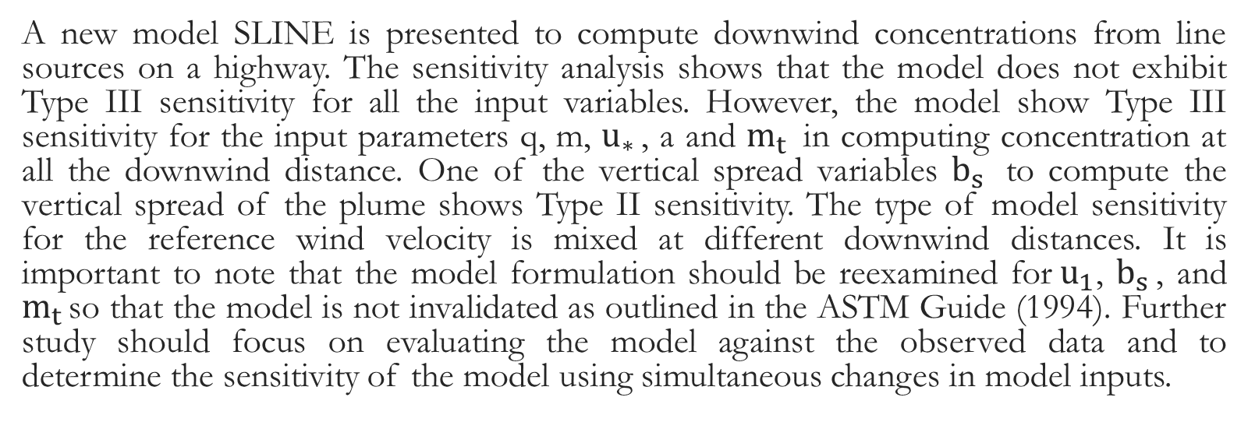
Conclusion
A new model SLINE is presented to compute downwind concentrations from line sources on a highway. The sensitivity analysis shows that the model does not exhibit Type III sensitivity for all the input variables. However, the model show Type III sensitivity for the input parameters q, m, $u_{∗ }$, a and $m_{t }$ in computing concentration at all the downwind distance. One of the vertical spread variables $b_{s }$ to compute the vertical spread of the plume shows Type II sensitivity. The type of model sensitivity for the reference wind velocity is mixed at different downwind distances. It is important to note that the model formulation should be reexamined for${ u}_{1}$, $b_{s }$, and $m_{t }$so that the model is not invalidated as outlined in the ASTM Guide (1994). Further study should focus on evaluating the model against the observed data and to determine the sensitivity of the model using simultaneous changes in model inputs.

Slide 33
References
[1] K. Wark, C. F. Warner, and D. Wayne T, Air pollution: its origin and control. Addison-Wesley, 1998.
[2] “68% of the world population projected to live in urban areas by 2050, says UN | UN DESA | United Nations Department of Economic and Social Affairs,” May 16, 2018. https://www.un.org/development/desa/en/news/population/2018-revision-of-world-urbanization-prospects.html (accessed Nov. 07, 2020).
[3] US EPA, “Smog, Soot, and Other Air Pollution from Transportation,” US EPA, Sep. 10, 2015. https://www.epa.gov/transportation-air-pollution-and-climate-change/smog-soot-and-local-air-pollution (accessed Nov. 07, 2020).
[4] “Guidelines for Developing an Air Quality (Ozone and PM2.5) Forecasting Program, EPA-456/R-03-002 June 2003.”
[5] L. R. Henneman, C. Liu, J. A. Mulholland, and A. G. Russell, “Evaluating the effectiveness of air quality regulations: A review of accountability studies and frameworks,” J. Air Waste Manag. Assoc., vol. 67, no. 2, pp. 144–172, 2017.
[6] K. Karroum et al., “A Review of Air Quality Modeling,” MAPAN, pp. 1–14, 2020.
[7] N. Sharma, K. Chaudhry, and C. C. Rao, “Vehicular pollution prediction modelling: a review of highway dispersion models,” Transp. Rev., vol. 24, no. 4, pp. 409–435, 2004.
[8] R. Cook et al., “Resolving local-scale emissions for modeling air quality near roadways,” J. Air Waste Manag. Assoc., vol. 58, no. 3, pp. 451–461, 2008.
[9] O. G. Sutton, “Micrometeorology: a study of physical processes in the lowest layers of the earth’s atmosphere,” 1953.
[10] J. M. Stockie, “The mathematics of atmospheric dispersion modeling,” Siam Rev., vol. 53, no. 2, pp. 349–372, 2011.
[11] J. R. Zimmerman and R. S. Thompson, User’s guide for HIWAY: a highway air pollution model. US Environmental Protection Agency, Office of Research and Development …, 1975.
[12] D. P. Chock, “A simple line-source model for dispersion near roadways,” Atmospheric Environ. 1967, vol. 12, no. 4, pp. 823–829, 1978.

Slide 34
[13] S. T. Rao and M. T. Keenan, “Suggestions for improvement of the EPA-HIWAY model,” J. Air Pollut. Control Assoc., vol. 30, no. 3, pp. 247–256, 1980.
[14] S. T. Rao, G. Sistla, M. T. Keenan, and J. S. Wilson, “An evaluation of some commonly used highway dispersion models,” J. Air Pollut. Control Assoc., vol. 30, no. 3, pp. 239–246, 1980.
[15] A. Y. Watson, R. R. Bates, and D. Kennedy, “Atmospheric transport and dispersion of air pollutants associated with vehicular emissions,” in Air Pollution, the Automobile, and Public Health, National Academies Press (US), 1988.
[16] D. Heist et al., “Estimating near-road pollutant dispersion: A model inter-comparison,” Transp. Res. Part Transp. Environ., vol. 25, pp. 93–105, 2013.
[17] K. Jones and A. Wilbur, “A User’s Manual for the CALINE-2 Computer Program,” 1976.
[18] P. E. Benson, “Caline 4-A Dispersion Model for Predictiong Air Pollutant Concentrations Near Roadways,” 1984.
[19] P. A. Eckhoff and T. N. Braverman, “Addendum to the User’s Guide to CAL3QHC Version 2.0 (CAL3QHCR User’s Guide,” 1995.
[20] D. Hall, A. Spanton, F. Dunkerley, M. Bennett, and R. Griffiths, A Review of Dispersion Model Inter-comparison Studies Using ISC, R91, AERMOD and ADMS. Environment Agency, 2000.
[21] K. L. Kenty et al., “Application of CALINE4 to roadside NO/NO2 transformations,” Atmos. Environ., vol. 41, no. 20, pp. 4270–4280, 2007.
[22] J. Bluett, G. Kuschel, S. Xie, M. Unwin, and J. Metcalfe, “The development, use and value of a long-term on-road vehicle emission database in New Zealand,” Air Qual. Clim. Change, vol. 47, no. 3, p. 17, 2013.
[23] A. K. Luhar and R. Patil, “A general finite line source model for vehicular pollution prediction,” Atmospheric Environ. 1967, vol. 23, no. 3, pp. 555–562, 1989.
[24] M. Khare and P. Sharma, “Performance evaluation of general finite line source model for Delhi traffic conditions,” Transp. Res. Part Transp. Environ., vol. 4, no. 1, pp. 65–70, 1999.
[25] J. Den Boeft, H. Eerens, W. Den Tonkelaar, and P. Zandveld, “CAR International: A simple model to determine city street air quality,” Sci. Total Environ., vol. 189, pp. 321–326, 1996.

Slide 35
[26] J. Kukkonen, J. Harkonen, J. Walden, A. Karppinen, and K. Lusa, “Validation of the dispersion model CAR-FMI against measurements near a major road,” Int. J. Environ. Pollut., vol. 16, no. 1–6, pp. 137–147, 2001.
[27] S. T. Rao, G. Sistla, R. E. Eskridge, and W. B. Petersen, “Turbulent diffusion behind vehicles: Evaluation of ROADWAY models,” Atmospheric Environ. 1967, vol. 20, no. 6, pp. 1095–1103, Jan. 1986, doi: 10.1016/0004-6981(86)90141-1.
[28] H. Q. Bang, V. H. N. Khue, N. T. Tam, and K. Lasko, “Air pollution emission inventory and air quality modeling for Can Tho City, Mekong Delta, Vietnam,” Air Qual. Atmosphere Health, vol. 11, no. 1, pp. 35–47, Jan. 2018, doi: 10.1007/s11869-017-0512-x.
[29] J. CHRISTOFFER and G. JURKSCH, “The Spatial Distribution of the Average Annual Mean Wind Speed in 10 Meters Height Above Ground of the Federal Republic of Germany as a Contribution to the Utilization of Wind Energy,” Int. J. Sol. Energy, vol. 2, no. 6, pp. 469–476, Jan. 1984, doi: 10.1080/01425918408909944.
[30] S. Gokhale and S. Pandian, “A semi-empirical box modeling approach for predicting the carbon monoxide concentrations at an urban traffic intersection,” Atmos. Environ., vol. 41, no. 36, pp. 7940–7950, Nov. 2007, doi: 10.1016/j.atmosenv.2007.06.065.
[31] C. W. Milando and S. A. Batterman, “Operational evaluation of the RLINE dispersion model for studies of traffic-related air pollutants,” Atmos. Environ., vol. 182, pp. 213–224, Jun. 2018, doi: 10.1016/j.atmosenv.2018.03.030.
[32] G. Bowatte et al., “Traffic related air pollution and development and persistence of asthma and low lung function,” Environ. Int., vol. 113, pp. 170–176, Apr. 2018, doi: 10.1016/j.envint.2018.01.028.
[33] H. Cai and S. Xie, “Traffic-related air pollution modeling during the 2008 Beijing Olympic Games: The effects of an odd-even day traffic restriction scheme,” Sci. Total Environ., vol. 409, no. 10, pp. 1935–1948, Apr. 2011, doi: 10.1016/j.scitotenv.2011.01.025.
[34] D. Liang et al., “Errors associated with the use of roadside monitoring in the estimation of acute traffic pollutant-related health effects,” Environ. Res., vol. 165, pp. 210–219, Aug. 2018, doi: 10.1016/j.envres.2018.04.013.
[35] A. P, O. H, B. Ms, and A.-M. A, “Evaluation of vehicular pollution levels using line source model for hot spots in Muscat, Oman.,” Environ. Sci. Pollut. Res. Int., vol. 27, no. 25, pp. 31184–31201, Jun. 2020, doi: 10.1007/s11356-020-09215-z.
[36] US EPA, “Air Quality Dispersion Modeling - Preferred and Recommended Models,” US EPA, Nov. 02, 2016. https://www.epa.gov/scram/air-quality-dispersion-modeling-preferred-and-recommended-models (accessed Nov. 07, 2020).
[37] K.S. Rao, “Analytical solutions of a gradient-transfer model for plume deposition and sedimentation,” NOAA Tech Mem ERL ARL – 109 Air Resour. Lab. Silver Spring.
[38] P. Nimmatoori and A. Kumar, “Development and evaluation of a ground-level area source analytical dispersion model to predict particulate matter concentration for different particle sizes,” J. Aerosol Sci., vol. 66, pp. 139–149, Dec. 2013, doi: 10.1016/j.jaerosci.2013.08.014.
[39] M. G. Snyder, A. Venkatram, D. K. Heist, S. G. Perry, W. B. Petersen, and V. Isakov, “RLINE: A line source dispersion model for near-surface releases,” Atmos. Environ., vol. 77, pp. 748–756, Oct. 2013, doi: 10.1016/j.atmosenv.2013.05.074.
[40] ASTM Guide, “Standard Guide for Conducting a Sensitivity Analysis for a Ground-Water Flow Model Application,” ASTM Des. 5611-94, 1994.

