Slide 1
7th International Electronic Conference on Sensors and Applications
ADAPTATION AND SELECTION TECHNIQUES BASED ON DEEP LEARNING FOR HUMAN ACTIVITY RECOGNITION USING INERTIAL SENSORS
Manuel Gil-Martín, José Antúnez-Durango and Rubén San-Segundo

Slide 2
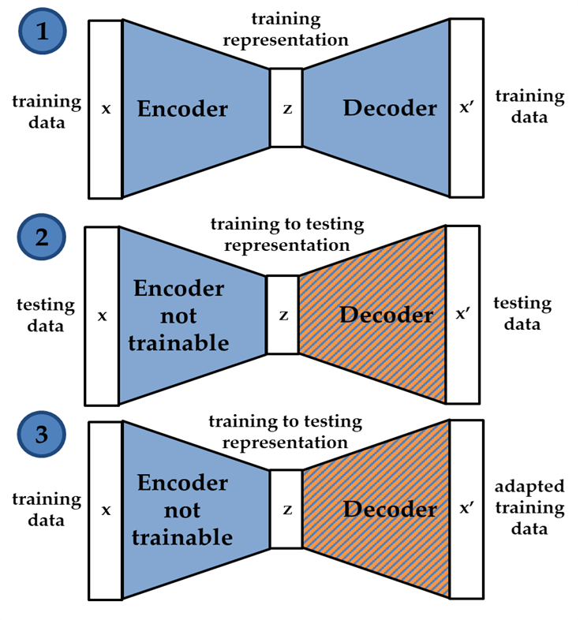
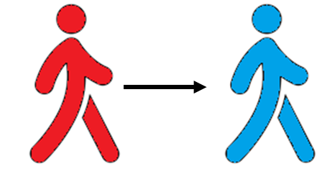
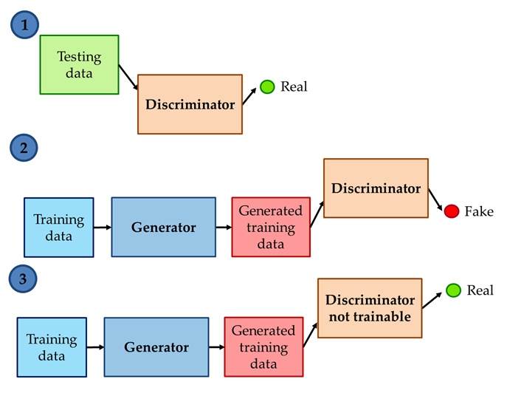
Contents
Introduction
Materials and Methods
Autoencoders
Generative Adversarial Networks
Results
Discussion and conclusions

Slide 3
Introduction
Introduction
Materials and Methods
Results
Discussion and conclusions
Human Activity Recognition (HAR)
Recognize different activities performed by a person
Challenge: training and testing with different subjects (LOSO)
Each user presents unique movement patterns not easily generalizable
This work
Unsupervised learning adaptation techniques for HAR

Slide 4
Dataset description
Introduction
Materials and Methods
Results
Discussion and conclusions
PAMAP2 database
12 physical activities, 9 subjects
3 IMUs in hand, chest and ankle
Accelerometer sampling at 100 Hz
lying
sitting
standing
walking
running
cycling
Nordic
walk
ascending
stairs
descending
stairs
vacuum
cleaning
rope
jumping
ironing

Slide 5
Signal processing
Introduction
Materials and Methods
Results
Discussion and conclusions
Fast Fourier Transform (FFT) of acceleration signals
5.12-second windows separated by 1 second
128 points represent 0-25Hz frequency range

Slide 6
Deep learning architecture baseline
Introduction
Materials and Methods
Results
Discussion and conclusions
Deep learning architecture composed of four convolutional and two max-pooling layers as baseline
Baseline configuration
Dropout layers
ReLU activation function
RMS optimizer

Slide 7
Autoencoders
Introduction
Materials and Methods
Results
Discussion and conclusions
Adaptation process:
Autoencoder trained with training data.
Decoder replaced and encoder not trainable. Decoder is trained with testing data.
Training data could be transformed to the testing domain: adapted training data.
Selection process:
value _{RMS - adapted data} >= µ _{RMS - adapted data} + γ * σ _{RMS - adapted data}

Slide 8
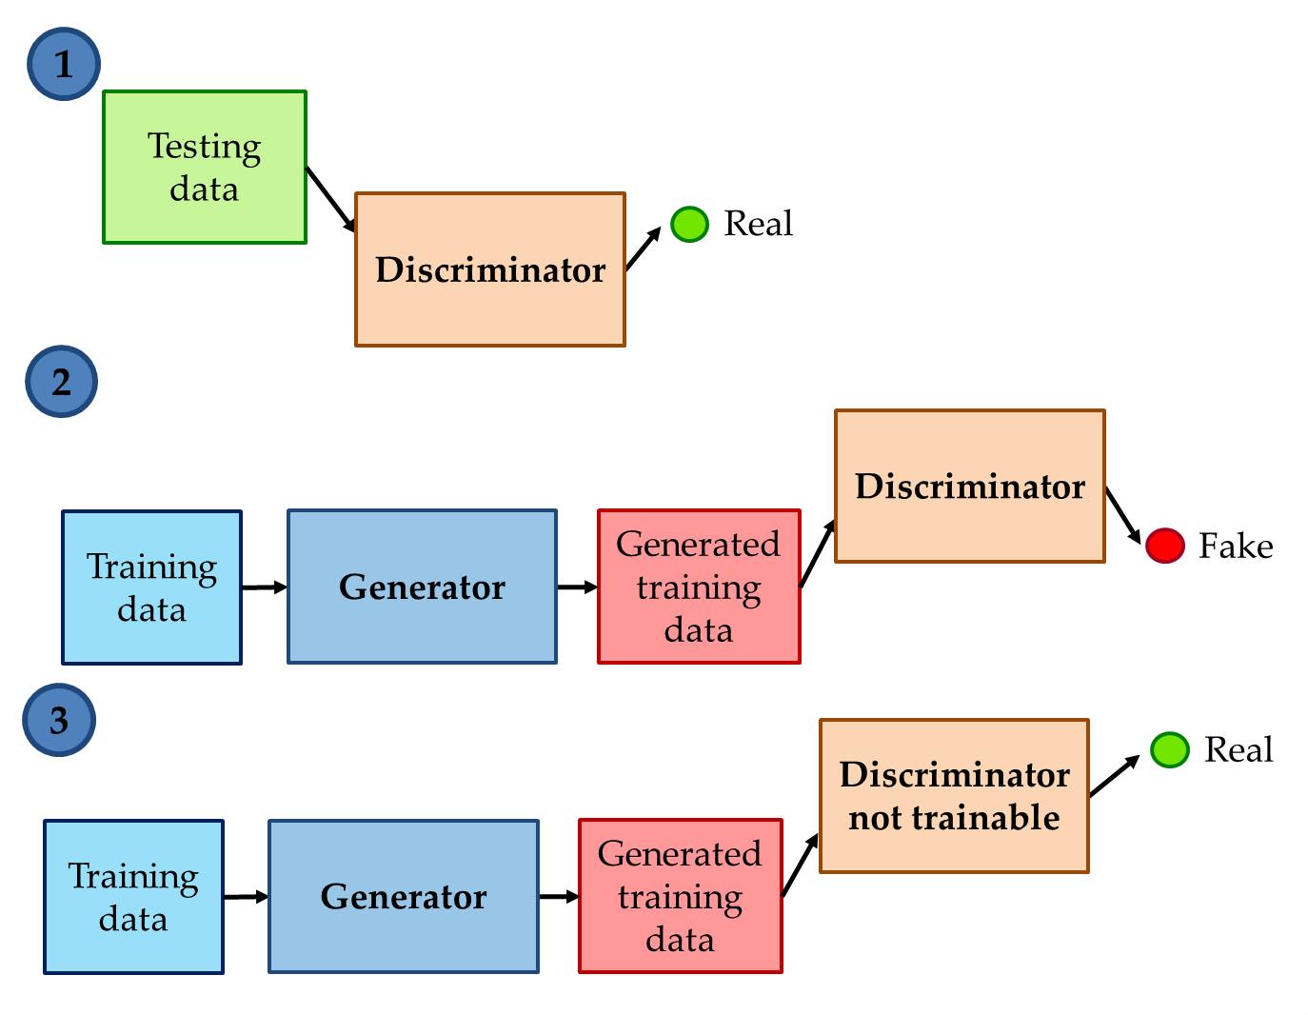
Generative Adversarial Networks (GANs)
Introduction
Materials and Methods
Results
Discussion and conclusions
Adaptation process:
Discriminator is trained with testing data (real).
Random training data (fake) is processed through the generator and its output is processed through the discriminator.
GAN is trained with training data with discriminator not trainable. Generator cheats the discriminator with generated examples similar to testing data.
Selection process with generator:
value _{RMS - adapted data} >= µ _{RMS - adapted data} + γ * σ _{RMS - adapted data}
Selection process with discriminator:
value _{discriminator output} < µ _{discriminator output} - γ * σ _{discriminator output}

Slide 9
Results
Introduction
Materials and Methods
Results
Discussion and conclusions
Activity classification accuracy and confidence intervals.
Significant improvement and deterioration highlighted in green and red, respectively. No color when no statistical difference.
Experiment |  | Subject
 |  | 101 | 102 | 103 | 104 | 105 | 106 | 107 | 108 | 109 | All
Baseline | Acc (%) | 86.34 | 87.93 | 85.91 | 89.76 | 87.69 | 85.15 | 92.04 | 87.61 | 96.88 | 87.85
 | CI (±%) | 1.35 | 1.24 | 1.63 | 1.23 | 1.23 | 1.39 | 1.10 | 1.26 | 4.26 | 0.46
Adapt. Auto. | Acc (%) | 86.26 | 82.88 | 89.23 | 93.35 | 87.36 | 86.23 | 91.91 | 90.62 | 93.75 | 88.36
 | CI (±%) | 1.35 | 1.44 | 1.45 | 1.02 | 1.25 | 1.35 | 1.11 | 1.12 | 5.93 | 0.45
Select. Auto. | Acc (%) | 86.50 | 87.17 | 88.95 | 91.45 | 88.06 | 85.83 | 92.65 | 92.30 | 87.50 | 89.06
 | CI (±%) | 1.34 | 1.28 | 1.47 | 1.14 | 1.22 | 1.37 | 1.06 | 1.02 | 8.10 | 0.44
Select. GAN Gen. | Acc (%) | 85.58 | 85.84 | 90.38 | 90.15 | 88.39 | 88.04 | 92.04 | 91.69 | 98.44 | 88.94
 | CI (±%) | 1.38 | 1.33 | 1.38 | 1.21 | 1.20 | 1.27 | 1.10 | 1.06 | 3.04 | 0.44
Select. GAN Discr. | Acc (%) | 87.46 | 88.99 | 87.57 | 84.45 | 89.75 | 86.79 | 93.08 | 90.62 | 96.88 | 88.68
 | CI (±%) | 1.30 | 1.19 | 1.55 | 1.48 | 1.14 | 1.33 | 1.03 | 1.12 | 4.26 | 0.45

Slide 10
Discussion and conclusions
Introduction
Materials and Methods
Results
Discussion and conclusions
Adaptation for HAR is a very difficult task.
Selection approaches could remove from training data the examples that differ from testing domain and improve the general performance of the system.
Unsupervised learning adaptation approaches could pave the way for future research on domain adaptation in HAR.

Slide 11
7th International Electronic Conference on Sensors and Applications
THANK YOU FOR YOUR ATTENTION
Manuel Gil-Martín, José Antúnez-Durango and Rubén San-Segundo

