Slide 1
Carbon screen-printed electrode coated with poly (Toluidine blue) as an electrochemical sensor for the detection of tyramine
Ms. Lakshmi Devi Chakkarapani
Under guidance of
Dr. Martin Brandl
Donau-Universität Krems
Zentrum für Wasser- und Umweltsensorik
Dr.-Karl-Dorrek-Straße 30
3500 Krems
Österreich

Slide 2
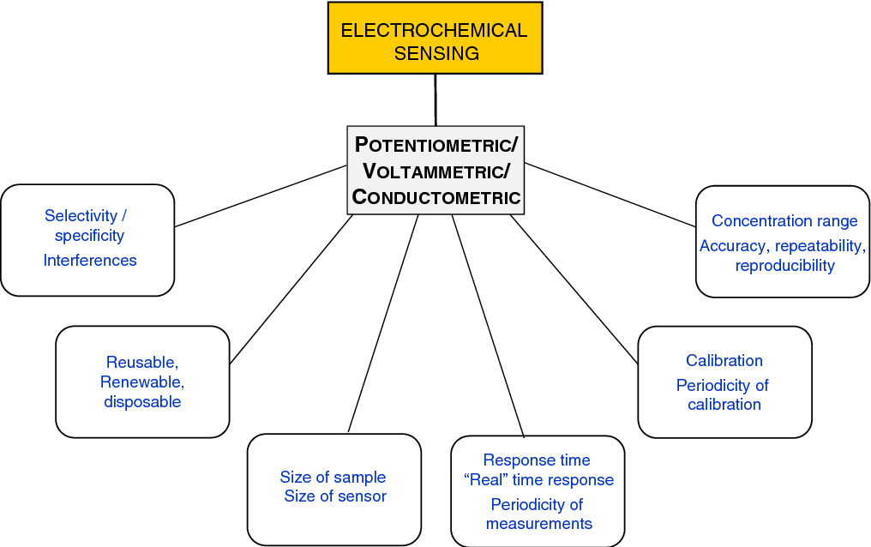
Introduction
Sensor is a device with a transducer which helps to recognize the bioamines and convert the results in the form of signals.
Electrochemical sensors are a class of sensors in which the electrode is the transducer element. These devices are now found in a wide range of commercial applications. These sensors are notable because of several factors: no generation of waste; miniaturization in portable devices; analyses with microvolumes of samples; fast analysis; and low production cost.
Sensor, an eminent tool in electro analysis are small and active that recognized a compound with signal transducer and used for direct measurement of the analyte in the sample matrix.
The sensor device transforms chemical and biochemical activity into an analytically useful signal.
Intensive research for designs electrochemical sensors are capable of providing better analytical characteristics in terms of sensitivity, selectivity, ease of fabrication, utility and low cost.

Slide 3
Bio-amines
A bioamine is a biogenic substance with one or more amine groups which play an important role in human pathology and physiology. For example human brain activity, regulation of body temperature and stomach pH, gastric acid secretion, the immune response and cell growth.
Higher concentration level of bioamines may causes toxic reactions in a human body, which means maintaining controlled level of bioamines are highly important.
The determination of biogenic amines is a time-consuming process that required sample extraction, purification of extracts, and derivatization.
Image 1: shows the structure of the most common biogenic amines

Slide 4
Which foods contain bioamines?
Biogenic amines have been found in a variety of foods, including seafood, fish, meat products, milk products, and some fermented products such as beer and wine.
Biogenic amines in low concentrations are essential for many physiological functions, but when they reach at high concentrations, they may cause some serious health issues. Several symptoms occur following excessive oral intake of biogenic amines, such as headaches, hypo-or hypertension, nausea, cardiac disease and death.

Slide 5
What is the Purpose of developing Chemically modified electrodes
Unmodified electrode surface has no desirable electron transfer reaction occur selected experimental condition. To over come such a obstacle electrode surface modified by different mediator.
Various electrochemical techniques used for electrode surface modification and convert the unmodified surface to active surface.
Electrochemical polymerization, drop casting, dip-coating, deposition spin-coating, and layer by layer coating techniques are used for surface development.
Nanomaterials, graphene, metal oxides, metal complexes, polymers and nano particles act as a mediators over the electrode surface.
These mediators initiates the electron transfer reactions.
Scheme 1.Various electrode materials used for sensor development

Slide 6
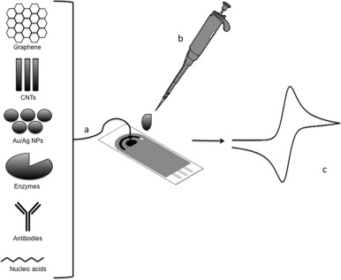
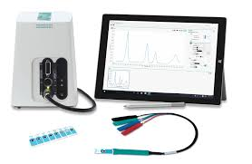
Electrochemical sensor modification
Electrochemical analyses of bioamines were initially analyses using screen-printed electrodes (SPEs) have gone through significant improvements over the past few decades with respect to both their format and their printing materials.
Thus, SPEs have been successfully applied for detection of analytes in a wide range of sample matrixes due to their advantageous material properties, such as disposability, simplicity, and rapid responses.
Image 2: shows the modification of screen printed electrode

Slide 7
Polymerization over screen printed electrode
Figure 1. Cyclic Voltammogram for the electro polymerization of 1 mM Toluidine blue in 0.1 M phosphate buffer solution pH 7.4 at unmodified Carbon screen printed electrodes. Scan rate: 50 mV/s.

Slide 8
Electrochemical oxidation of tyramine by polymer coated screen printed electrode
Figure 2. CVs obtained at (black) carbon screen printed electrode, (red) containing tyramine, (blue) polymer coated screen printed modified, (green) containing 57.76 μM tyramine in 0.1 M PBS pH 7.4 and scan rete 50 mV/s.

Slide 9
Electrochemical additions of tyramine by PTB-Carbon screen printed electrode
Fig.3A shows the CVs responses of PTB-Carbon screen printed electrode on different concentrations of tyramine. Curves b to k represent the presence of tyramine from 3.6 to 57.76 μM at the potential ranging from − 0.7 to 1.0 V in 0.1 M PBS of pH 7.4 at a scan rate of 50 mV/s.
Fig.3B shows the calibration plot of current response vs. concentration of tyramine.
By increasing the concentration of tyramine, the oxidation current also increased linearly and a correlation coefficient was 0.9978.
A
Figure 3. (A) CV response of PTB-Carbon screen printed electrode in the absence (a) and in the presence (b-k) of successive additions of tyramine (3.6 to 57.76 μM) in 0.1 M PBS of pH 7.4 at the scan rate of 50 mV/s. (B) The calibration plot of current response vs. concentration of tyramine.

Slide 10
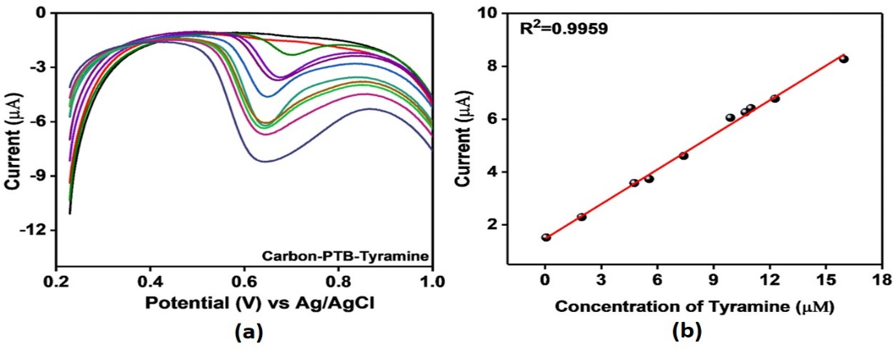
Electrochemical oxidation of tyramine by DPV
Figure 4. (A) DPV response of PTB-Carbon screen printed electrode in presence of tyramine (0.02 to 16 μM) in 0.1 M PBS of pH 7.4 at a scan rate of 50 mV/s. (b) Calibration plot of the current response vs. the concentration of tyramine.

Slide 11
Interference studies

Slide 12
Thank you

