Slide 1
Transfer Printing of Conductive Thin-Films on PDMS with Soluble Substrates for Flexible Biosensors
7th International Electronic Conference on Sensors and Applications
Steffen Hadeler, Sebastian Bengsch, Maren S. Prediger, Marc Christopher Wurz

Slide 2





Introduction
Introduction
State of the art
Manufacturing Process
Methods
Conclusion
Outlook
Institute of Micro Production Technology
PZH - Hannover Centre for Production Technology
Leibniz University Hannover, Lower Saxony, Germany

Slide 3
State of the art I
Introduction
State of the art
Manufacturing Process
Methods
Conclusion
Outlook
Various sensors in medical technology have conductive structures
In this thesis: Focus on electrocorticography (ECOG)
  Invasive,
  Highly sensitive
  Measurement of brain functions
Applications of ECoG:
treatment of diseases like epilepsy
Brain-Computer-Interface

Slide 4
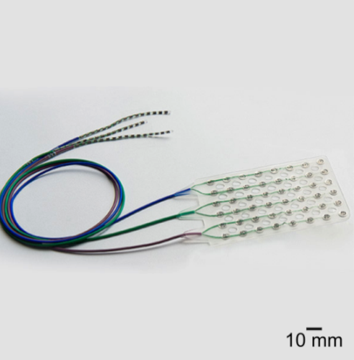
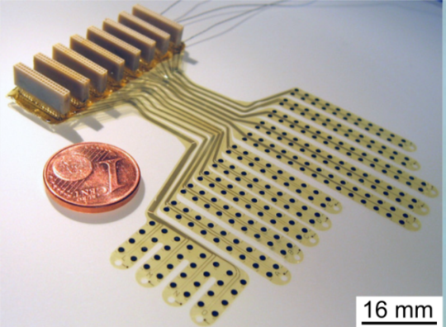
State of the art II
Introduction
State of the art
Manufacturing Process
Methods
Conclusion
Outlook
Commercial ECoG Electrodes
  platinum wire and plates in PDMS
  Advantage: the long-term clinical experience
  Disadvantage: rigidity, limited resolution
Published ECoG Electrodes
  photolithography and physical vapour deposition (PVD)
  on polyimide
  Advantage: high resolution
  Disadvantage: complex production in clean room
[1]
[2]

Slide 5
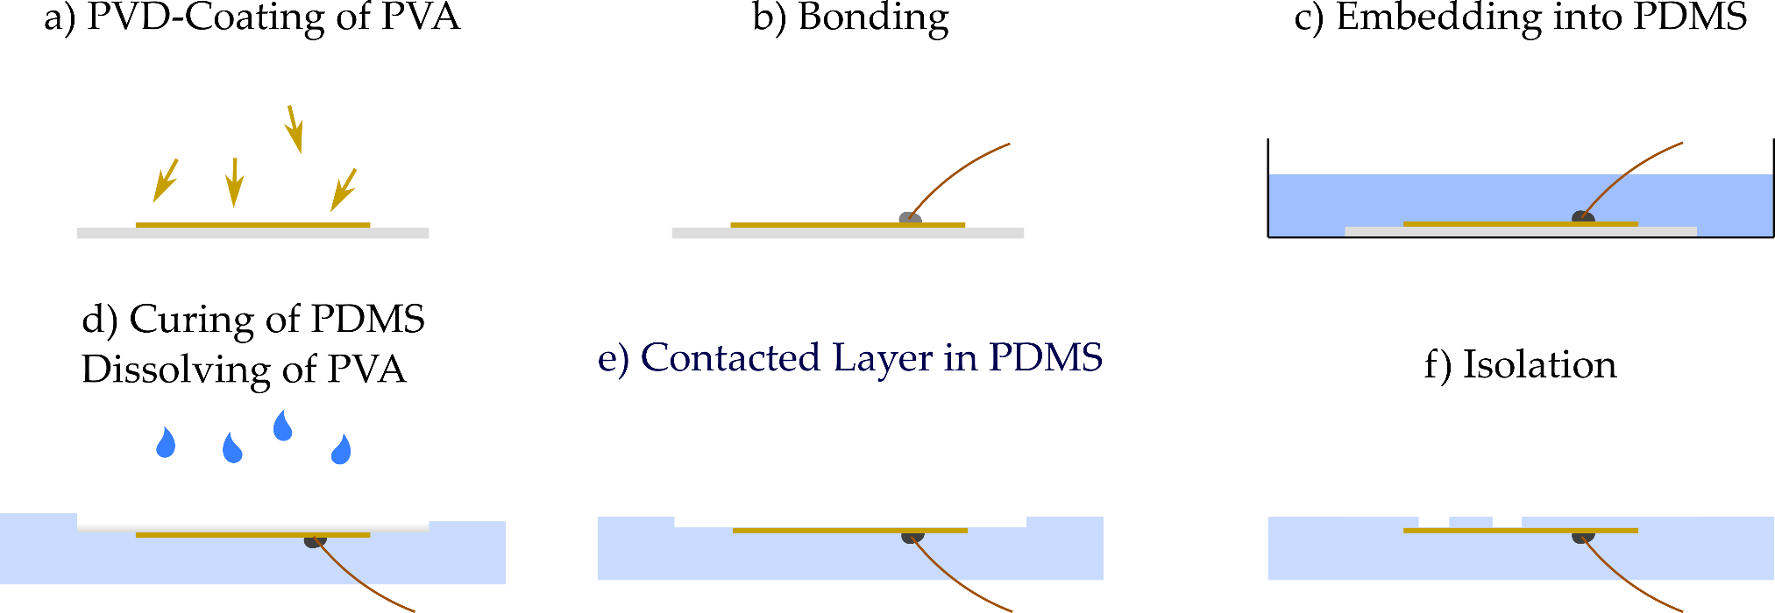
Manufacturing Process
Introduction
State of the art
Manufacturing Process
Methods
Conclusion
Outlook
Combine the advantages of the above methods
  Clinical long-term experience PDMS
  increase resolution
  reduction of electrode spacing

Slide 6
Methods
Introduction
State of the art
Manufacturing Process
Methods
Conclusion
Outlook
Evaluation of the developed manufacturing process
Material characterization
  Adhesion
  Flexibility
Electrical characterization
  Conductivity
  Impedance Measurement
Demonstrator system

Slide 7
Material characterization
Introduction
State of the art
Manufacturing Process
Methods
Conclusion
Outlook
Adhesion
  cross cut test according to DIN EN ISO 2409
  platinum and gold
  Platium poor adhesion
  Gold better adhesion
Flexibility
  Tensile test according to to DIN 53504
  Different layer heights
  Silicatization with NanoFlame

Slide 8
Electrical characterization I
Introduction
State of the art
Manufacturing Process
Methods
Conclusion
Outlook
Conductivity
  Four-point measurement
  Before Transfer (red)
  After Transfer (grey)
  Different layer heights

Slide 9
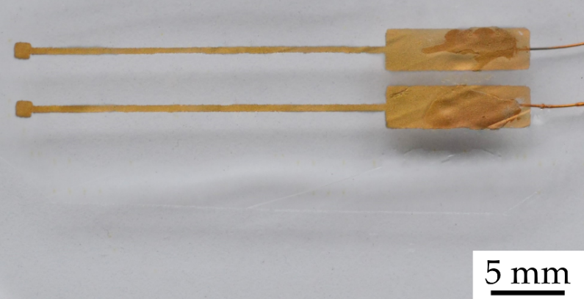
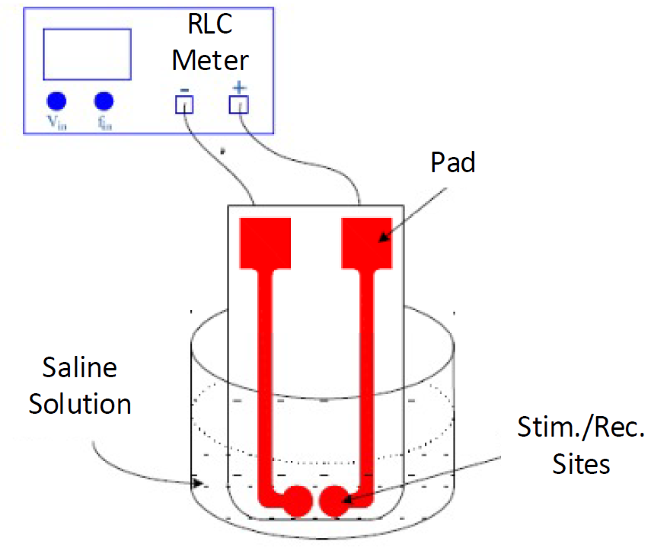
Electrical characterization II
Introduction
State of the art
Manufacturing Process
Methods
Conclusion
Outlook
Electrochemical impedance measurement
  As described in Nahvi et al. [3]
  Sodium chloride solution (9 mg/l)
  LCR meter HM9119
  (Hameg Instruments GmbH)
  Electrode with 2 contacts, 1x1 mm
[3]

Slide 10
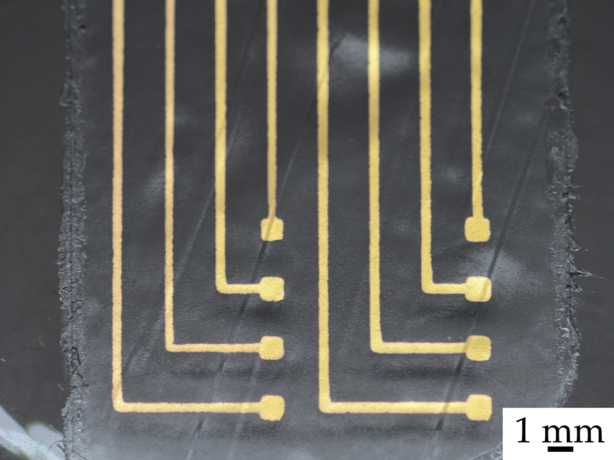
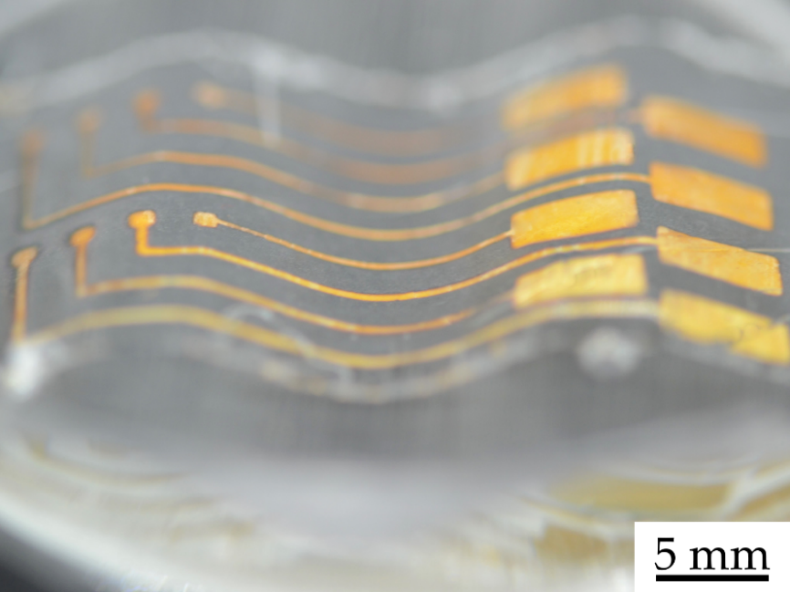
Demonstrator system
Introduction
State of the art
Manufacturing Process
Methods
Conclusion
Outlook
Design of an ECoG electrode array
  8 electrode contacts 1x1 mm²
  Supply lines 0,25 mm isolated with PDMS
Design of a three-dimensional electrode
  Additive production of different casting moulds

Slide 11
Conclusion
Introduction
State of the art
Manufacturing Process
Methods
Conclusion
Outlook
New manufacturing process developed
  High resolution through thin film technology
  Use of PDMS
Various studies for optimization
  Adhesion
  Flexibility
  Conductance
Design of a demonstrator
  two-dimensional
  three-dimensional

Slide 12
Outlook
Introduction
State of the art
Manufacturing Process
Methods
Conclusion
Outlook
Improvement of the PVD process
  higher resolution masking
  More electrode contacts
  Roll-to-roll process
three-dimensional manufacturing
  Better additive manufacturing
  patient individual electrodes
Adaptation for other implants and biosensors

Slide 13
Thank you for your attention hadeler@impt.uni-hannover.de

Slide 14
Sources
[1] PMT Corporation: Cortac Grids & Strips. http://www.pmtcorp.com/cortac.html. Version: 06.05.2019
[2] Rubehn, Birthe ; Bosman, Conrado ; Oostenveld, Robert ; Fries, Pascal ; Stieglitz, Thomas: A MEMS-based flexible multichannel ECoG-electrode array. In: Journal of neural engineering 6 (2009), Nr. 3, S. 036003.
[3] Nahvi, Mohammad S. ; Boroumand, Farhad A. ; Maghami, Mohammad H. ; Sodagar, Amir M. ; Shojaei, Amir ; Mirnajafi-Zadeh, Javad: Design, fabrication, and test of flexible thin-film microelectrode arrays for neural interfaces. 2017 IEEE 30th Canadian Conference on Electrical and Computer Engineering

