Slide 1


Characteristics of wastewater taken from a pool water system: analysis of physicochemical and phytotoxicological parameters in terms of recyclability
Edyta Łaskawiec
Department of Water and Wastewater Engineering
Faculty of Environmental and Power Engineering
Notes:
Note: After adding your pictures, right click on it and “Send To Back”.

Slide 2
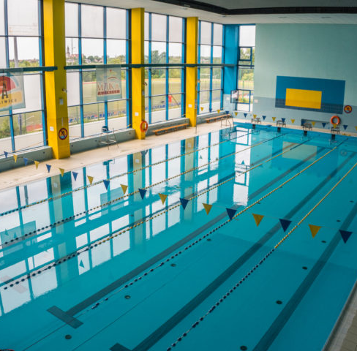
Research problem
The efficiency of the filtration process, including rinsing the deposits, frequency, and intensity, has a significant influence on the quality of the pool water.
In the process of water filtration, the bed is gradually clogged, which means that the suspensions and post-coagulation sediments stick to the grains. As a result, the space between them is gradually filled (the bed's porosity is reduced), and the bed's hydraulic resistance increases. When the filtration resistance reaches the permissible value, the accumulated impurities should be removed from the bed.
Rinsing the filters is essential for their optimal operation, as it cleans the filter material, removes the developing microorganisms, and prepares the filter for further operation.
Notes:
Note: After adding your pictures, right click on it and “Send To Back”.

Slide 3
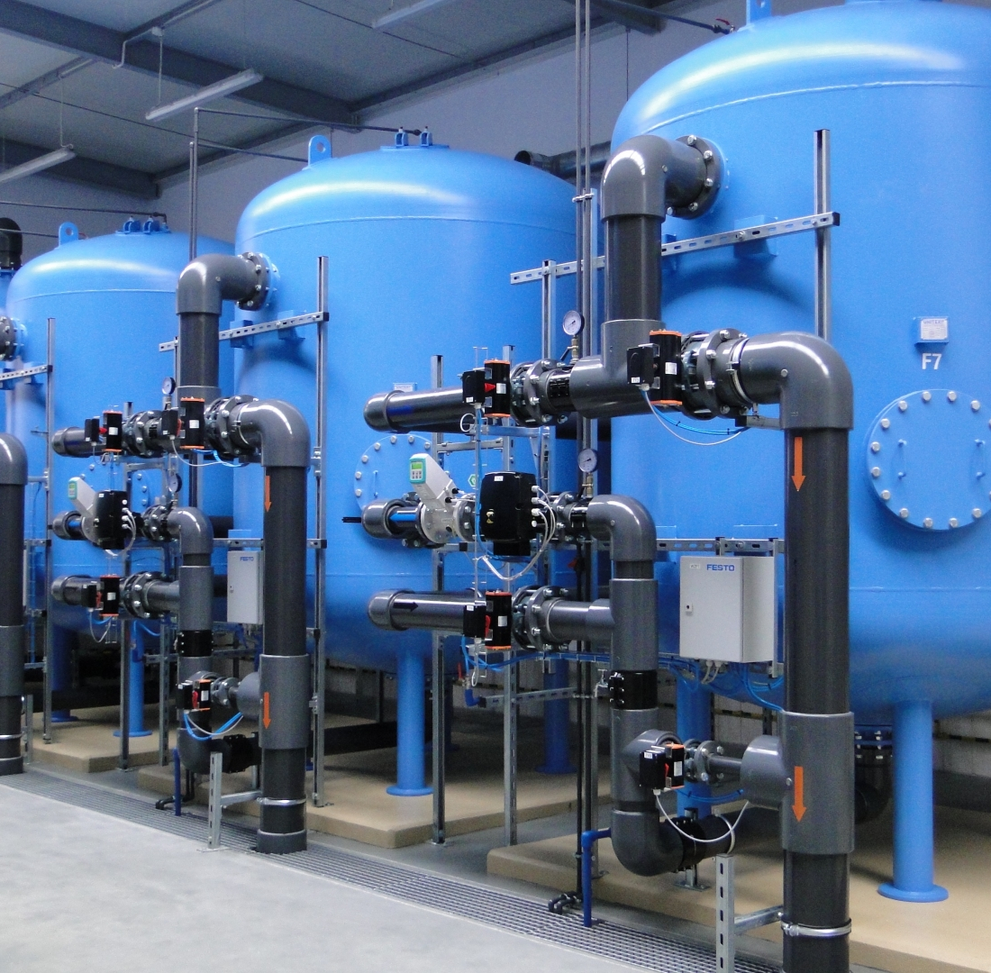
Research problem
The degree of contamination of the washings is observed during the process, and the bed's behavior through special visors is placed in the filter housing.
According to the recommendations, for proper flushing, it is necessary to use 4 to 6 m³ of water for each m² of filter bed. The end of the rinsing process starts a new filtration cycle that lasts until the next rinsing.
Running a swimming pool facility requires a significant water demand for economical, living, and economic purposes. In addition to washing the filters, technological water is used to make up for circulation losses. Monthly water loss in a single basin is about 10% of its capacity (for a swimming pool with an average capacity of 576 m³, it is over 57 m³).
Notes:
Note: After adding your pictures, right click on it and “Send To Back”.

Slide 4
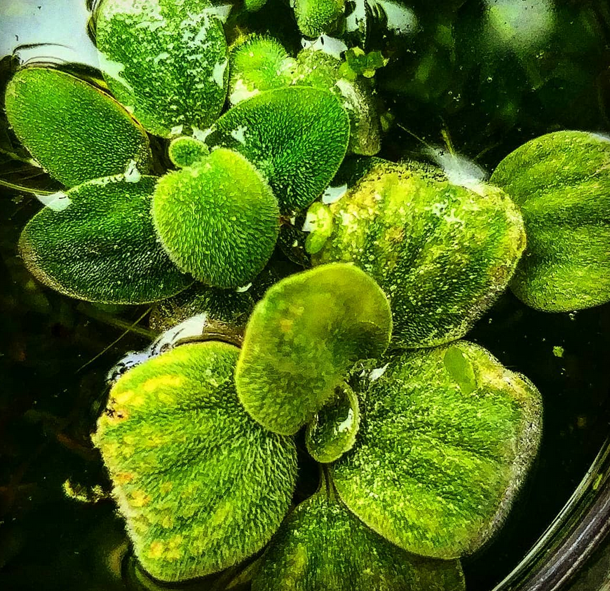
Research goal
The aim of the research was to analyze the possibility of using the washings to maintain greenery during periods of rainfall deficiency, thus limiting the consumption of tap water. As part of the analysis, the physicochemical quality of the collected washings was assessed, enriched with the phytotoxicity assessment.
Notes:
Note: After adding your pictures, right click on it and “Send To Back”.

Slide 5
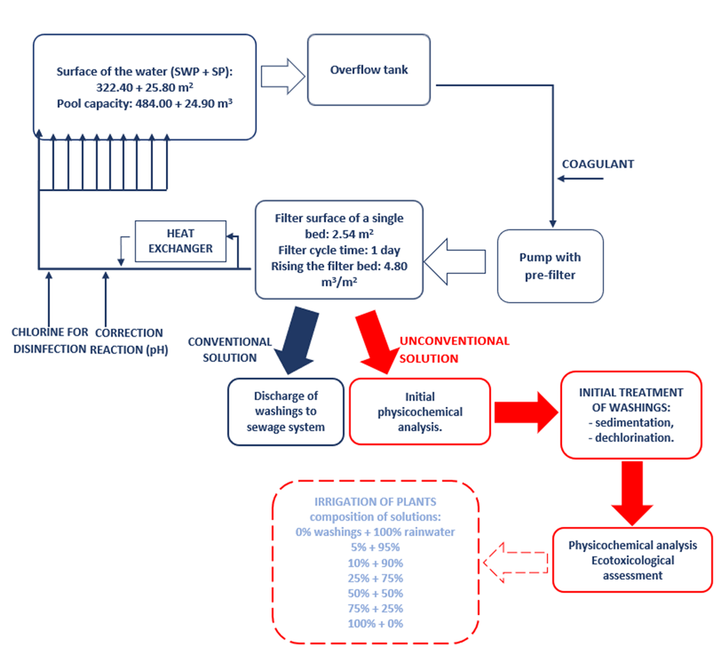
Materials and methods
1) Research material:
Washings from swimming pool water circuits.
The circulating water is purified by a multi-layer filter bed (quartz sand - hydroanthracite).
2) Physicochemical analyzes, inter alia:
Reaction (pH)
Total suspended solids (TSS)
Free chlorine, total chlorine
Total nitrogen
Phenol index
Aluminum
Chlorides
Zinc
Total Organic Carbon
3) Phytotoxicological assessment (next slide)

Slide 6
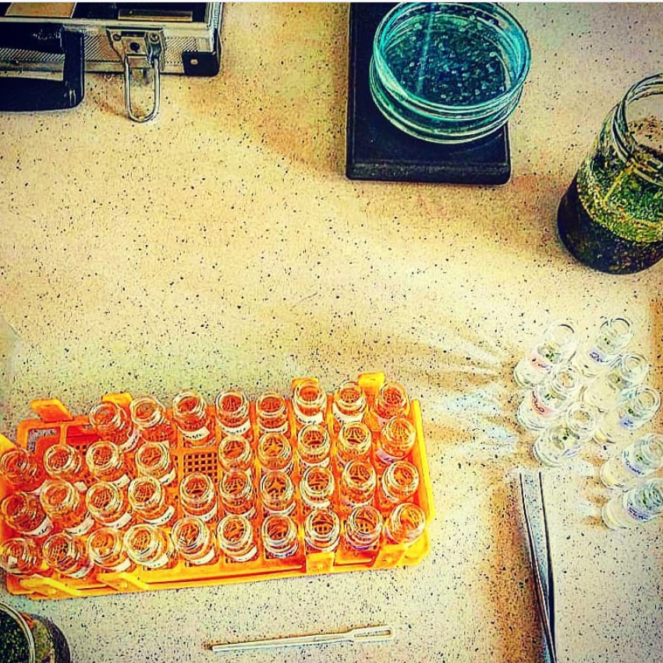
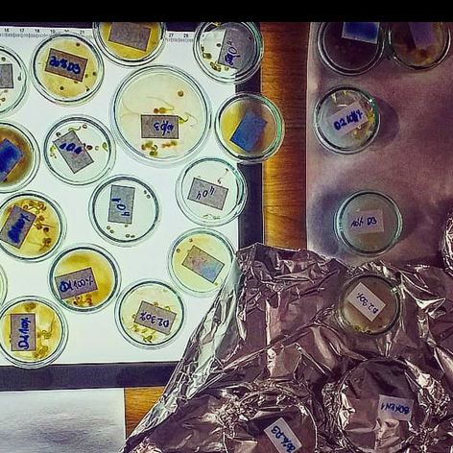
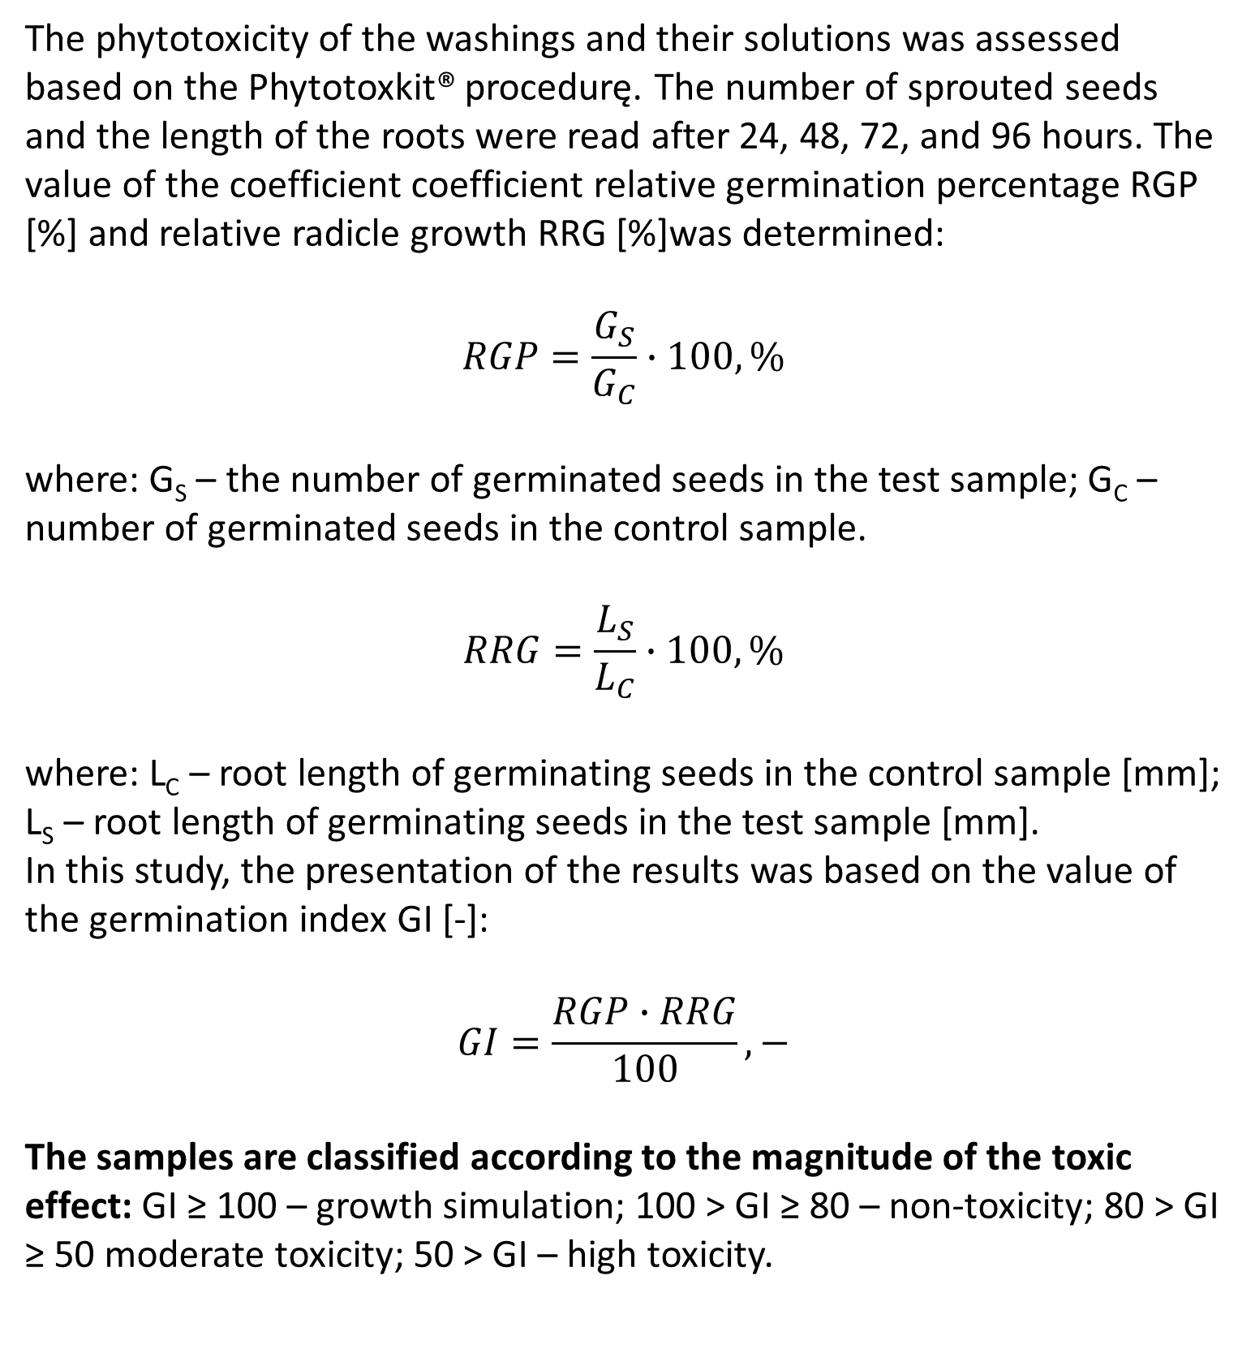
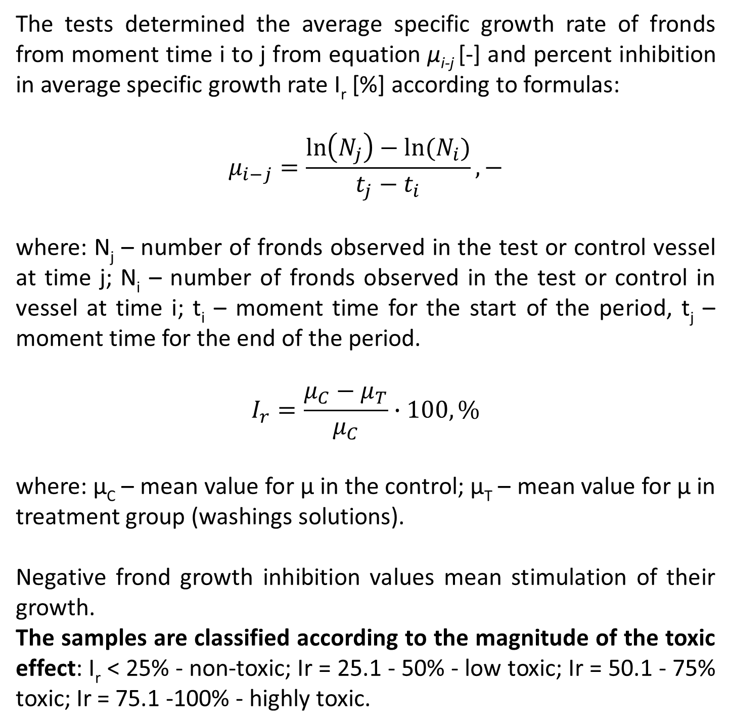
Lemna minor Test
Lepidium sativum/Sinapis alba Test
The tests determined the average specific growth rate of fronds from moment time i to j from equation μ_{i-j} [-] and percent inhibition in average specific growth rate I_{r} [%] according to formulas:
$$μ_{i−j}=\frac{\ln\left(N_{j}\right)−ln⁡(N_{i})}{t_{j}−t_{i}},−$$
where: N_{j} – number of fronds observed in the test or control vessel at time j; N_{i} – number of fronds observed in the test or control in vessel at time i; t_{i} – moment time for the start of the period, t_{j} – moment time for the end of the period.
$$I_{r}=\frac{μ_{C}−μ_{T}}{μ_{C}}∙100,\%$$
where: μ_{C} – mean value for μ in the control; μ_{T} – mean value for μ in treatment group (washings solutions).
Negative frond growth inhibition values mean stimulation of their growth.
The samples are classified according to the magnitude of the toxic effect: I_{r} < 25% - non-toxic; Ir = 25.1 - 50% - low toxic; Ir = 50.1 - 75% toxic; Ir = 75.1 -100% - highly toxic.
The phytotoxicity of the washings and their solutions was assessed based on the Phytotoxkit® procedurę. The number of sprouted seeds and the length of the roots were read after 24, 48, 72, and 96 hours. The value of the coefficient coefficient relative germination percentage RGP [%] and relative radicle growth RRG [%]was determined:
$$RGP=\frac{G_{S}}{G_{C}}∙100,\%$$
where: G_{S} – the number of germinated seeds in the test sample; G_{C} – number of germinated seeds in the control sample.
$$RRG=\frac{L_{S}}{L_{C}}∙100,\%$$
where: L_{C} – root length of germinating seeds in the control sample [mm]; L_{S} – root length of germinating seeds in the test sample [mm].
In this study, the presentation of the results was based on the value of the germination index GI [-]:
$$GI=\frac{RGP∙RRG}{100},−$$
The samples are classified according to the magnitude of the toxic effect: GI ≥ 100 – growth simulation; 100 > GI ≥ 80 – non-toxicity; 80 > GI ≥ 50 moderate toxicity; 50 > GI – high toxicity.

Slide 7

Results
Physicochemical assessment of washings
The raw washings (after sampling) were characterized by a high content of total suspended solids of 142.50 ± 59.10 mg/L . Moreover, an increased concentration of chlorine was noted, which made it impossible to discharge the washings directly into the soil.
The 24-hour sedimentation process in the Imhoff funnel allowed for a significant reduction in the total suspended solids content (32.50 ± 6.80 mg/L). Moreover, a reduction in the concentration of free chlorine (0.05 ± 0.05 mgCl2/L) was obtained (as a result of free dechlorination), which allowed for an ecotoxicological assessment of washings, while limiting the effect of chlorine as the main toxic factor for plants.
Diluting the washings with selected water matrices also allowed reducing the concentration of pollutants in the solutions. It is particularly important to control the concentration of aluminum (the source in the washings are coagulants), which may be a toxic factor for plants (concentration in the raw washings 0.79 ± 0.07 mgAl/L).
Parameter | Share of washings in rainwater (Mean ± SD)
 | Raw washings | 0% | 5% | 10% | 25% | 50% | 75% | 100%
pH, - | 6.97 ± 0.16 | 7.03 ± 0.23 | 7.03 ± 0.23 | 7.05 ± 0.14 | 6.95 ± 0.22 | 7.06 ± 0.13 | 6.99 ± 0.15 | 6.94 ± 0.14
TSS, mg/L | 142.50 ± 59.19 | 14.50 ± 3.27 | 15.33 ± 3.14 | 15.33 ± 2.66 | 16.00 ± 3.03 | 18.00 ± 2.28 | 20.33 ± 3.27 | 32.50 ± 6.80
Free chlorine, mgCl₂/L | 0.72 ± 0.15 | 0.00* ± 0.00 | 0.00 ± 0.00 | 0.00 ± 0.00 | 0.00 ± 0.00 | 0.00 ± 0.00 | 0.00 ± 0.00 | 0.05 ± 0.05
Total chlorine, mgCl₂/L | 1.70 ± 0.23 | 0.00 ± 0.00 | 0.00 ± 0.00 | 0.00 ± 0.00 | 0.00 ± 0.00 | 0.03 ± 0.05 | 0.05 ± 0.09 | 0.11 ± 0.04
Total nitrogen, mgN/L | 7.65 ± 0.61 | 8.42 ± 0.97 | 8.58 ± 0.80 | 8.80 ± 1.12 | 7.79 ± 0.83 | 7.58 ± 0.44 | 7.63 ± 0.45 | 7.60 ± 0.66
Cyanuric acid, mgC₃H₃N₃O₃/L | 3.50 ± 0.40 | 0.00 ± 0.00 | 0.00 ± 0.00 | 0.00 ± 0.00 | 0.00 ± 0.00 | 1.54 ± 0.40 | 1.59 ± 0.39 | 3.30 ± 0.52
Phenol index, mgC₆H₆O/L | 0.42 ± 0.05 | 0.00 ± 0.00 | 0.00 ± 0.00 | 0.00 ± 0.00 | 0.00 ± 0.00 | 0.17 ± 0.04 | 0.24 ± 0.07 | 0.35 ± 0.05
Aluminum, mgAl/L | 0.79 ± 0.07 | 0.00 ± 0.00 | 0.00 ± 0.00 | 0.00 ± 0.00 | 0.00 ± 0.00 | 0.13 ± 0.05 | 0.18 ± 0.04 | 0.78 ± 0.05
Chlorides, mg/L | 187.67 ± 18.58 | 83.00 ± 17.32 | 132.50 ± 17.17 | 134.33 ±17.31 | 142.83 ± 19.69 | 153.00 ± 16.70 | 151.67 ± 20.17 | 182.33 ± 18.14
Zinc, mg/L | 0.00 | 0.76 ± 0.35 | 0.67 ± 0.33 | 0.63 ± 0.31 | 0.61 ± 0.19 | 0.40 ± 0.15 | 0.10 ± 0.12 | 0.00 ± 0.00
TOC, mgC/L | 9.91 ± 1.00 | 0.42 ± 0.66 | 0.56 ± 0.64 | 0.61 ± 0.64 | 0.84 ± 0.82 | 2.12 ± 0.58 | 3.43 ± 1.06 | 9.40 ± 0.98

Slide 8
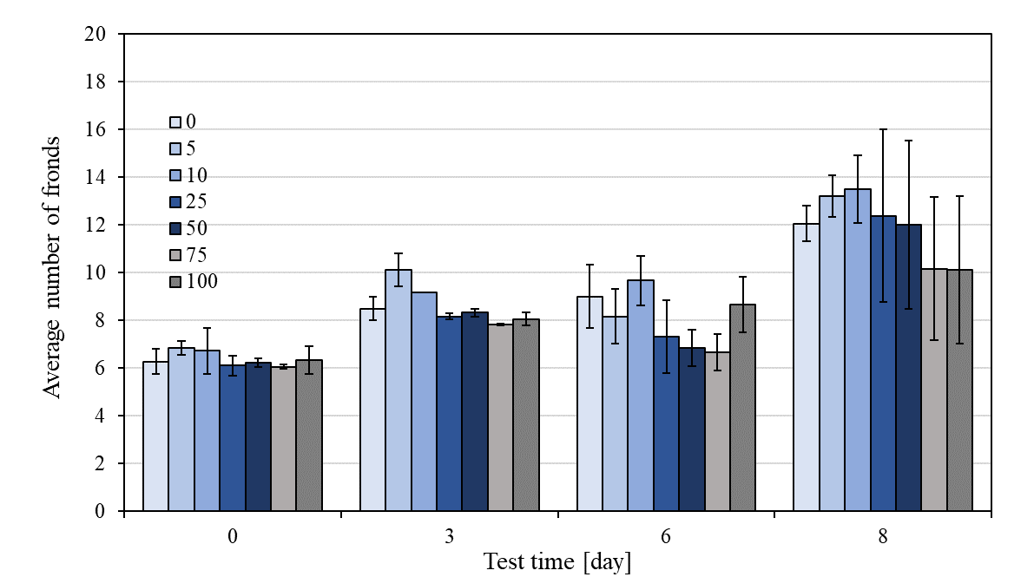
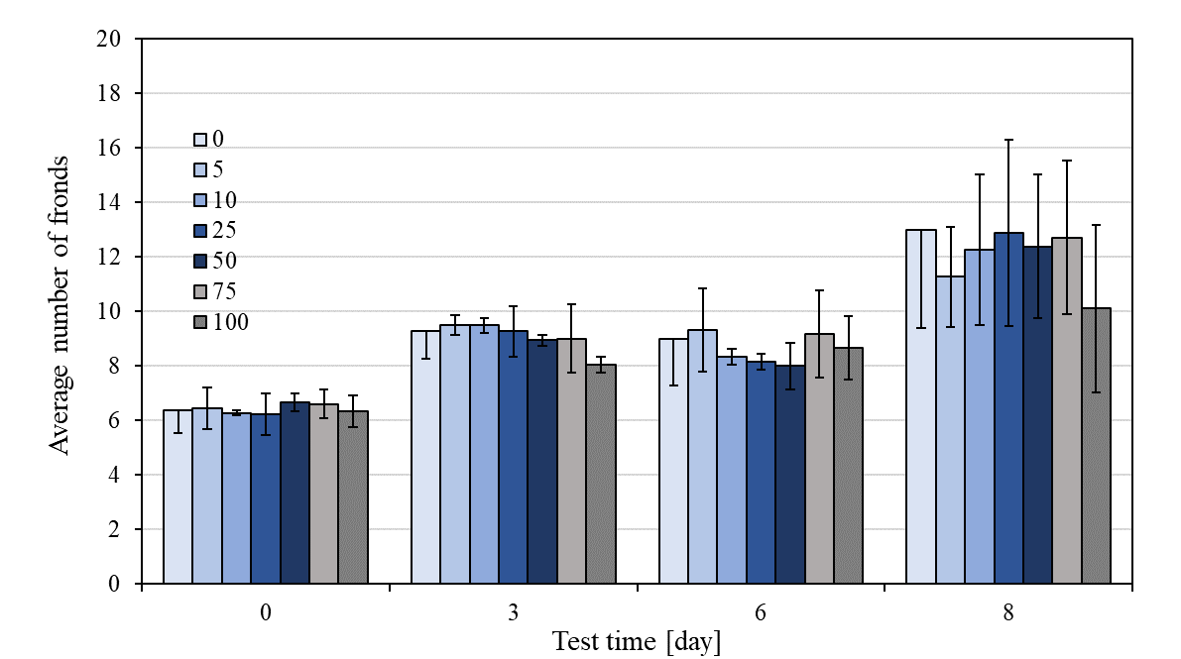
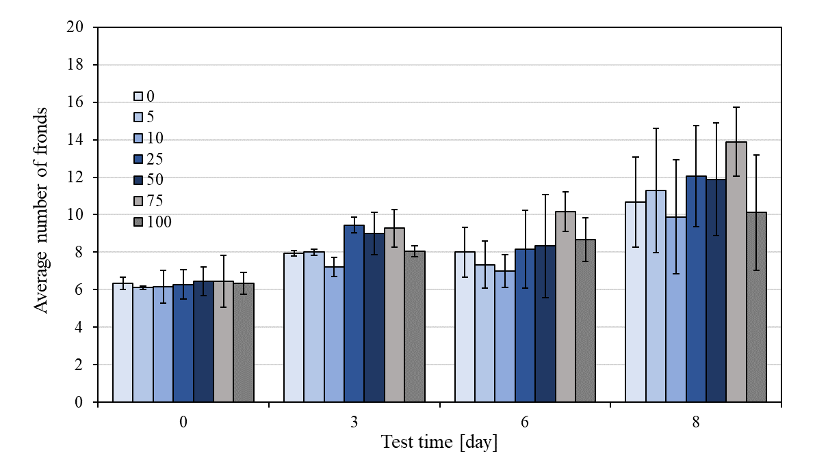
Results
ECOTOXICOLOGICAL assessment of washings: LEMNA MINOR
Characterization of washings toxicity in various water matrices (for selected samples):
no clear inhibitory effect on the growth of fronds was observed in the analyzed samples.
the influence of the variable physicochemical quality of washings on the growth of Lemna minor fronds was noted.
Sample D4 (100% washings solution):
TSS: 38 mg/L
TOC: 29.30 mgC/L
0.75 mgAl/L
Sample D1 (100% washings solution):
TSS: 36 mg/L
TOC: 18.40 mgC/L
0.85 mgAl/L
Sample D8 (100% washings solution):
TSS: 28 mg/L
TOC: 19.88 mgC/L
0.68 mgAl/L

Slide 9
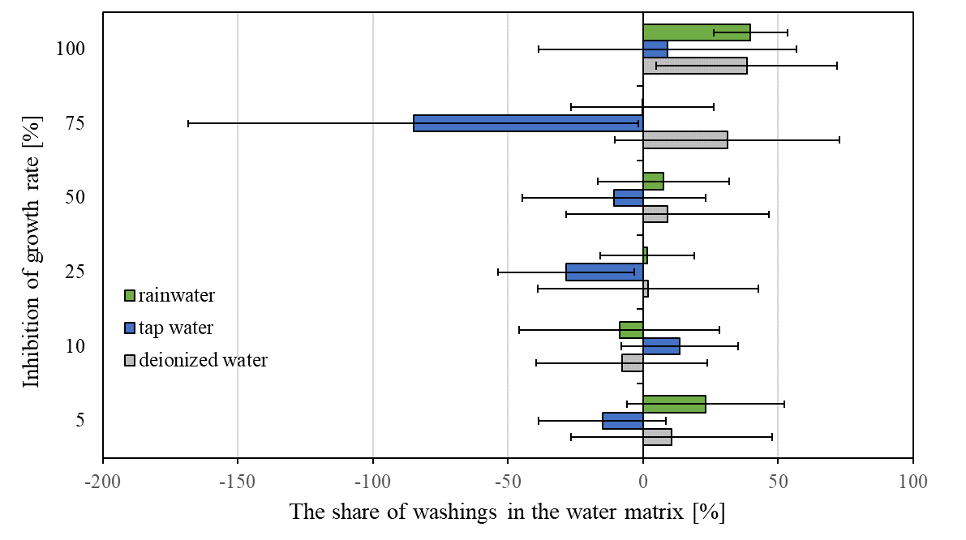
Results
ECOTOXICOLOGICAL assessment of washings: LEMNA MINOR
Characterization of washings toxicity in various water matrices (for all samples):
mean inhibition growth rate ranged from growth stimulation to low toxicity.
the most common growth stimulation was recorded for washings solutions with tap water.

Slide 10
Results
ECOTOXICOLOGICAL assessment of washings: COMPARISON lemna minoR, SINAPIS ALBA, LEPIDIUM SATIVUM
Depending on the concentration and the indicator organism used, either stimulation or inhibition of plant growth was observed. It should be noted that two independent 4-point scales were used for the classification of phytotoxicity.
For Lemna minor, there was low toxicity of the 100% washing solution in all analyzed matrices as well as for 75% washing solution in deionized water (inhibition of frond growth was 39.77 ± 3.71% and 31.18 ± 4.49%).
L. minor frond growth stimulation was noted in samples with 10% washing solution (matrix: deionized water); 5, 25 - 75% washing solution (matrix: tap water), and partially from samples of washing solution with a concentration of 10, 25, 75% (matrix: rainwater).
Matrix | Share of washings in matrix, % | I_{r} Lemna minor (Mean ± SD), % | Toxicity classification | GI Sinapis alba (Mean ± SD), - | Toxicity classification | GI Lepidium sativum (Mean ± SD), - | Toxicity classification
Deionized water | 5 | 10.63 ± 7.27 | Non-toxic | 118.30 ± 10.24 | Growth stimulation (5-57%) | 127.18 ± 8.65 | Growth stimulation (5-75%)
 | 10 | -7.82 ± 3.71 | Growth stimulation | 118.42 ± 11.14 |  | 125.55 ± 11.45
 | 25 | 1.92 ± 4.76 | Non – toxic | 102.52 ± 9.87 |  | 121.04 ± 8.98
 | 50 | 9.04 ± 7.65 | Non -toxic | 114.42 ± 10.68 |  | 142.33 ± 12.33
 | 75 | 31.18 ± 4.49 | Low – toxic | 135.83 ± 12.32 |  | 136.93 ± 12.33
 | 100 | 39.77 ± 3.71 | Low -toxic | 86.62 ± 8.75 | Non-toxic | 90.59 ± 8.88 | Non-toxic

Slide 11
Results
ECOTOXICOLOGICAL assessment of washings: COMPARISON lemna minoR, SINAPIS ALBA, LEPIDIUM SATIVUM
Sinapis alba and Lepidium sativum turned out to be less sensitive to the ingredients contained in the tested washings. None of the tested samples was toxic to plant growth.
Moreover, for tests with L. sativum in washing solution with a concentration range from 5 to 75% (all matrices), stimulation of plant growth was observed.
Matrix | Share of washings in matrix, % | I_{r} Lemna minor (Mean ± SD), % | Toxicity classification | GI Sinapis alba (Mean ± SD), - | Toxicity classification | GI Lepidium sativum (Mean ± SD), - | Toxicity classification
Tap water | 5 | -15.05 ± 3.53 | Growth stimulation | 89.03 ± 9.08 | Non-toxic | 106.55 ± 9.45 | Growth stimulation (5-75%)
 | 10 | 13.58 ± 2.64 | Non – toxic | 89.30 ± 7.89 | Non-toxic | 118.55 ± 10.92
 | 25 | -28.51 ± 5.31 | Growth stimulation | 88.23 ± 7.96 | Non-toxic | 131.36 ± 9.88
 | 50 | -10.70 ± 3.91 | Growth simulation | 128.88 ± 10.67 | Growth stimulation | 119.95 ± 10.28
 | 75 | -85.03 ± 8.21 | Growth stimulation | 108.03 ± 9.87 | Growth stimulation | 126.07 ± 8.28
 | 100 | 39.77 ± 3.71 | Low – toxic | 86.62 ± 8.75 | Non-toxic | 90.59 ± 8.88 | Non-toxic

Slide 12
Results
ECOTOXICOLOGICAL assessment of washings: COMPARISON lemna minoR, SINAPIS ALBA, LEPIDIUM SATIVUM
In short-term tests, it was shown that raw washes (100% solution) can have phytotoxicological potential, which was observed in the 7-day Lemna minor biotest.
No toxic effect was observed in short germination and growth inhibition tests (96 hours), which may be related to both the shorter duration of observation and the lower sensitivity of L. staivum and S. alba to washing components, including aluminum compounds.
Matrix | Share of washings in matrix, % | I_{r} Lemna minor (Mean ± SD), % | Toxicity classification | GI Sinapis alba (Mean ± SD), - | Toxicity classification | GI Lepidium sativum (Mean ± SD), - | Toxicity classification
Rainwater | 5 | 23.12 ± 9.14 | Non/low – toxic | 111.52 ± 8.78 | Growth stimulation | 130.13 ± 10.16 | Growth stimulation (5-75%)
 | 10 | -8.76 ± 7.09 | Growth stimulation | 92.79 ± 6.68 | Non-toxic | 124.97 ± 12.33
 | 25 | 1.60 ± 7.47 | Non – toxic/Growth simulation | 92.41 ± 6.96 | Non-toxic | 136.74 ± 8.23
 | 50 | 7.64 ± 4.28 | Non – toxic | 106.09 ± 7.56 | Growth stimulation | 140.20 ± 5.64 | Non - toxic
 | 75 | -0.20 ± 6.45 | Non – toxic/Growth stimulation | 96.92 ± 8.78 | Non-toxic | 127.89 ± 6.87
 | 100 | 39.77 ± 3.71 | Low – toxic | 86.62 ± 8.75 | Non - toxic | 90.59 ± 8.88

Slide 13
Conclusions
The reuse of wastewater is an important aspect of water supply in areas with water shortages. However, the negative impact that may be associated with the migration of heavy metals, increased soil salinity, or phytotoxic effects should be considered
The use of washings from swimming pool facilities for the maintenance of greenery is an opportunity to reduce the consumption of tap water. Due to the presence of total suspended solids and chlorine remaining after the disinfection process, it is necessary to apply simple measures to improve their quality - sedimentation and de-chlorination.
However, the presence of aluminum with prolonged use of washings can negatively affect both plants and soil. Therefore, the use of washings as the only source of plant nutrition may entail the risk of toxic effects.

Slide 14
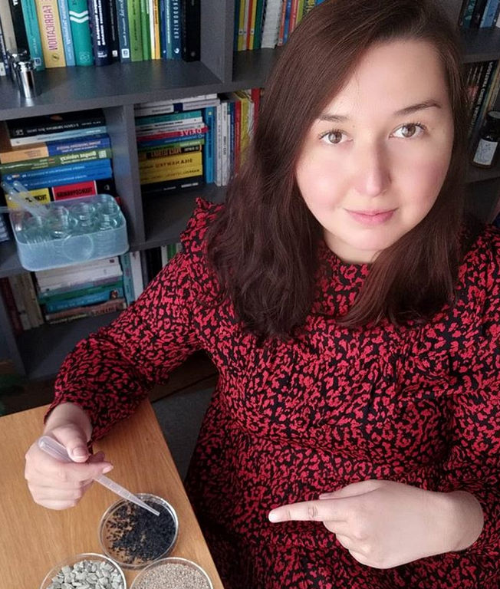


Thank you for your attention!
PhD Edyta Łaskawiec
Department of Water and Wastewater Engineering
Faculty of Environmental and Power Engineering
edyta.laskawiec@gmail.com
https://www.researchgate.net/profile/Edyta_Laskawiec
https://orcid.org/0000-0002-4475-3368
Notes:
Note: After adding your pictures, right click on it and “Send To Back”.

