Slide 1
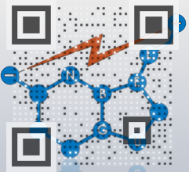

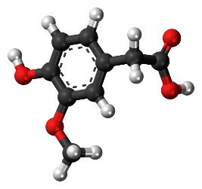
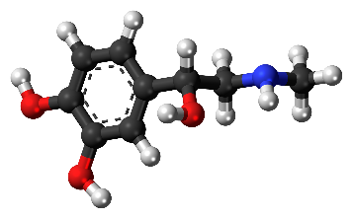
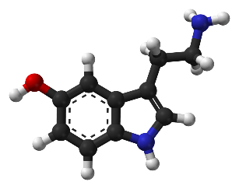
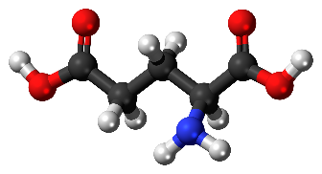



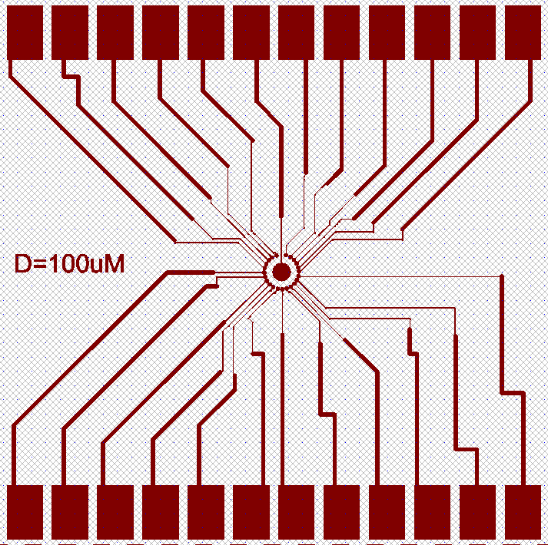
Intelligent Microelectrodes Array for Schizophrenia Treatment Monitoring
Matan Aroosh¹, Rajendra P. Shukla¹, Yuly Bersudsky², Deanna L. Kelly³ and Hadar Ben-Yoav^{1,*}
¹Nanobioelectronics Laboratory (NBEL), Department of Biomedical Engineering,
Ben-Gurion University of the Negev, ²Beer-Sheva Mental Health Center, ³ Maryland Psychiatric Research Center, University of Maryland School of Medicine
* Corresponding author: Dr. Hadar Ben-Yoav. Email: benyoav@bgu.ac.il
Introduction
Schizophrenia Treatment Monitoring Challenges:
Schizophrenia (SCZ) is a mental disorder that affects more than 23 million people worldwide [1].
PANSS and BPRS are mental subjective examinations performed by a psychiatrist with final scores that reflect the patient’s mental condition.
Clozapine (CLZ) is considered the most effective antipsychotic medication for schizophrenia [1]. Despite the superior efficacy of CLZ, it is significantly underutilized due to the unavailable objective tests to measure CLZ efficacy, resulting sub-optimal therapy.
Can you suggest a new treatment efficacy test?
Novel Clozapine efficacy monitoring approach:
Several blood metabolites with electrochemical activity have shown to be related to CLZ treatment efficacy [2];
Clozapine Blood Levels
Treatment
Efficacy
Blood
Test
Predictive Biomarkers!
Mental Stability Status
Clozapine Treatment
Clozapine
Metabolism
Homovanilic Acid
[1],[2],[3]
Higher concentration
Mw: 182.172
Physio. charge: -1
Redox Potential:~0.2[V]
Adrenaline
[2],[4]
Lower concentration
Mw: 183.204
Physio. charge: +1
Redox Potential:~0.7[V]
Serotonin
[5]
Lower concentration
Mw: 176.215
Physio. charge: +1
Redox Potential:~0.4[V]
Glutamate
[6]
Higher concentration
Mw: 147.129
Physio. charge: -1
Redox Potential:~0.5[V]
Electrochemical information
Medically information
* All the standard reduction potentials are vs an Ag/AgCl reference electrode
Difference in the redox-active biomarkers concentrations can lead to clozapine treatment efficacy assessment

Slide 2
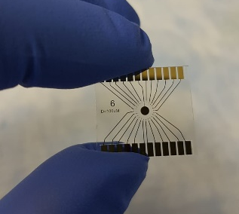
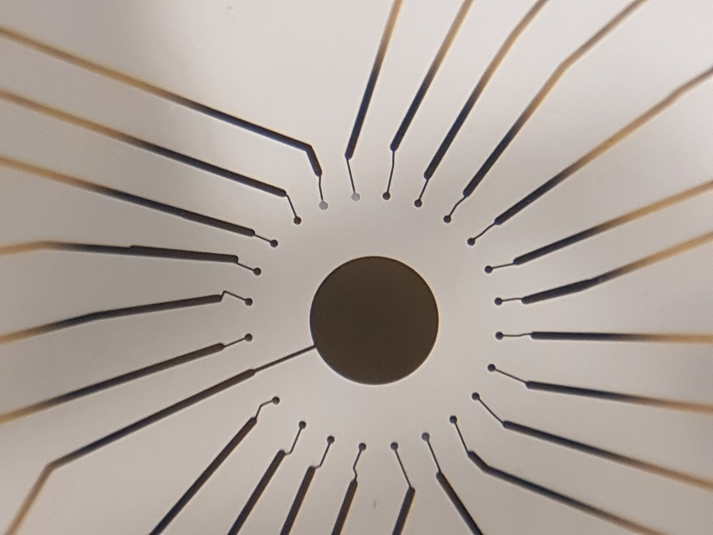
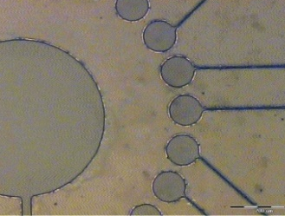

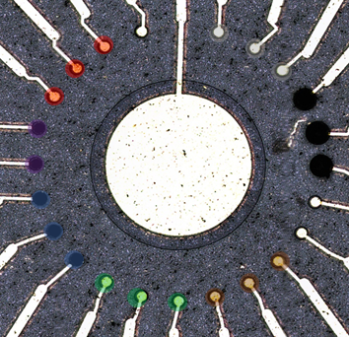


Intelligent Microelectrodes Array for Schizophrenia Treatment Monitoring
Working Hypothesis
Overall Goal:
Investigate electrochemical fingerprints of predictive biomarkers by using an "intelligent" multi-microelectrode array.
Quantify SCZ patient’s treatment efficacy by recording electrochemical signals from capillary blood samples.
Microfabrication and Validation of the Microelectrodes Array:
Microfabrication of Gold Microelectrodes
Electrochemical Validation
AZ 5214 Photolithography
Metal Deposition
Metal Lift-off
Ag\AgCl Deposition
3
Working Electrode
1
2
3
Reference Electrode
AZ5214 Photoresist
Mask
After UV Exposure
10x Magnification
Counter Electrode
Glass wafer
Glass wafer
Glass wafer
6
Theoretical values:
Experimental values:
Au Sputtering
Lift off:
Photoresist Removal
$E_{OCP}=−0.059\log_{10}\left(C\left[M\right]\right)+0.028$
$E_{OCP}=−0.038\log_{10}\left(C\left[M\right]\right)+0.028$
$${ R}^{2}=0.981 , RMSE=2.86×{10}^{−3}$$
4
5
6
Au Electrode pattern
5x Magnification
Glass wafer
Glass wafer
Glass wafer
Homovanilic Acid Detection
Nanomaterial Electrodeposition
Using Bare microelectrode and Chitosan-CNT modified microelectrode to detect homovanilic acid.
A multi-microelectrode array was modified with 6 different electrocatalytic materials [3].
R-GO
Bare
Chitosan
AgCl
Chitosan CNTs
Pt. Black
Counter
Bare
Stable and reproducible electrochemical signal using microelectrode modified with Ag\AgCl as reference electrode
MoS2
WS2
5x Magnification.

Slide 3
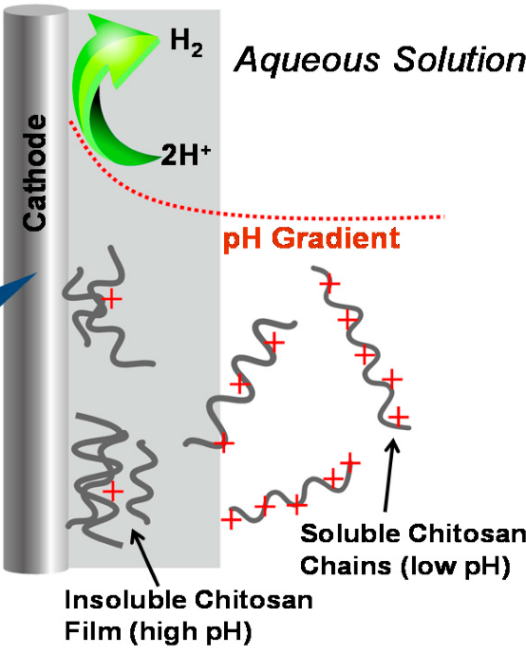
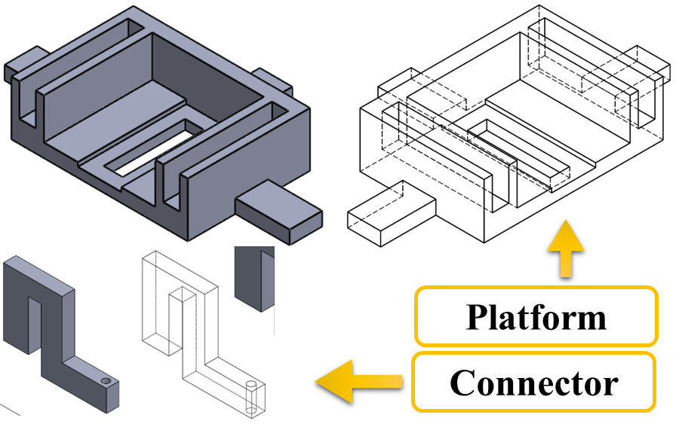
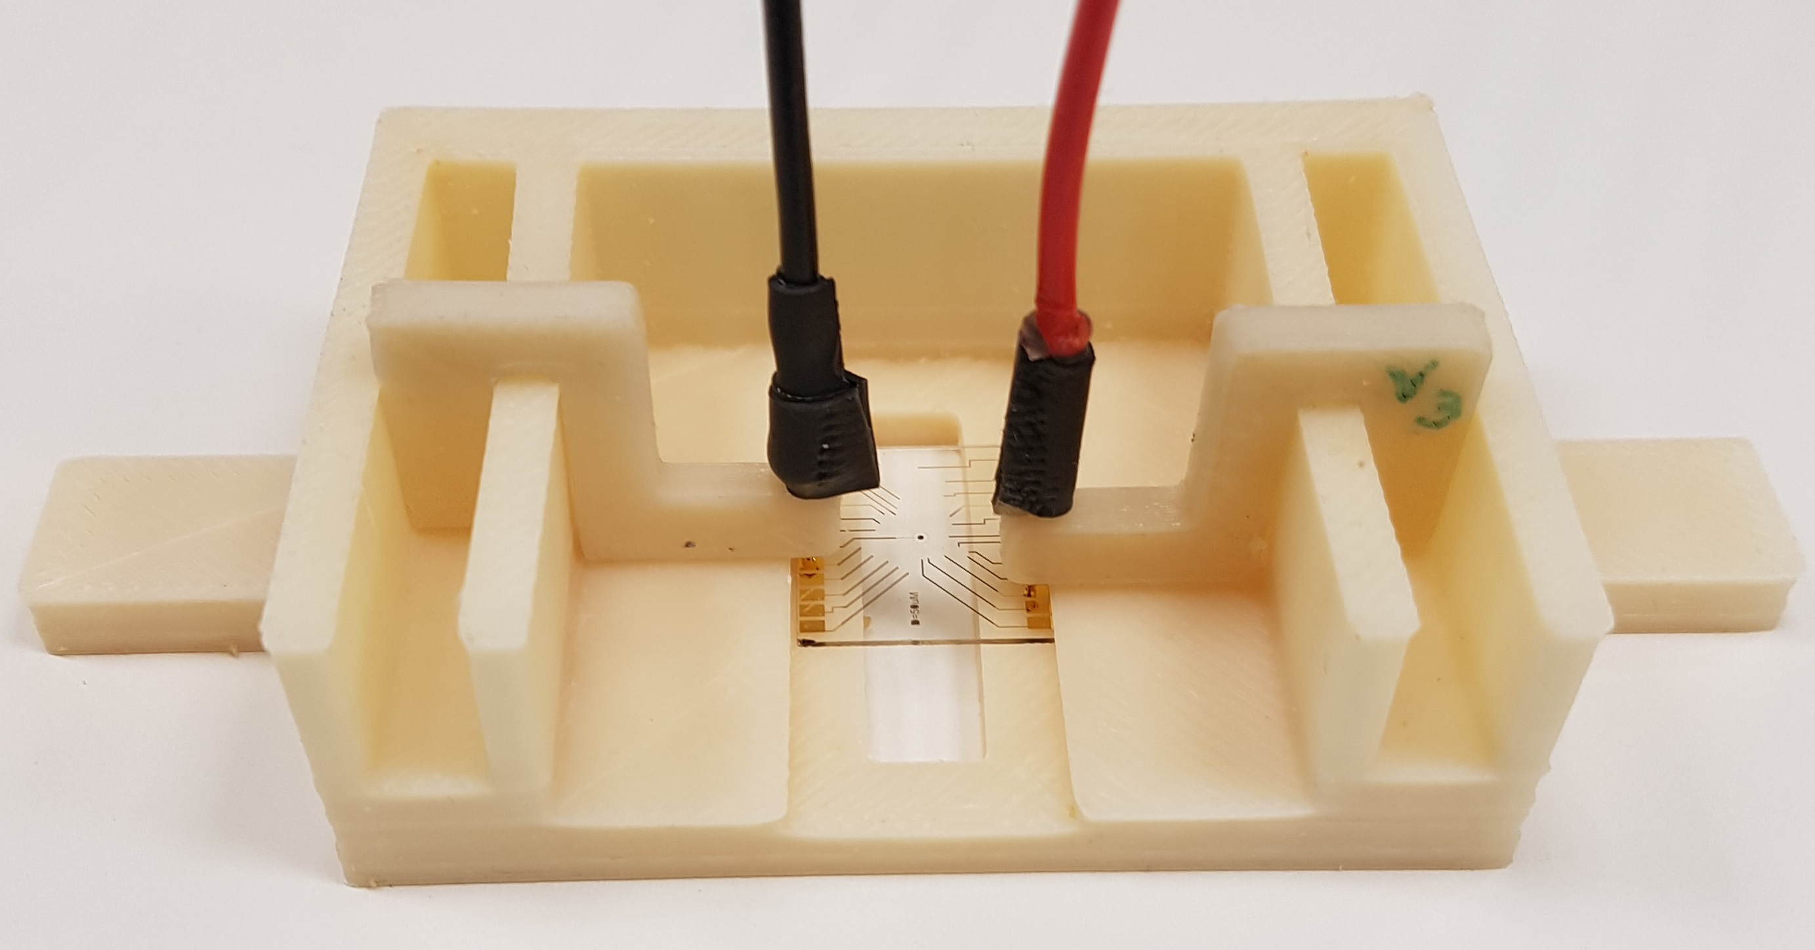
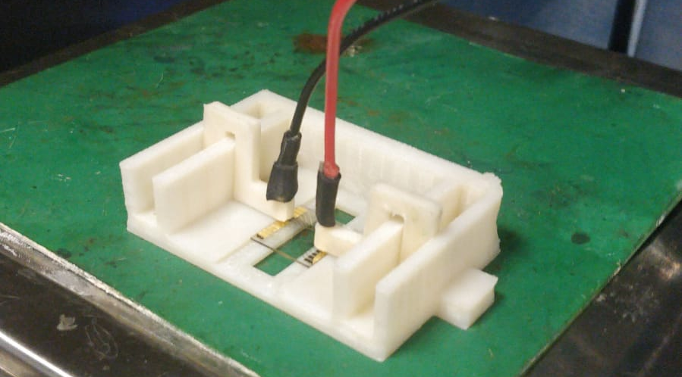
Intelligent Microelectrodes Array for Schizophrenia Treatment Monitoring
Experimental Setup and Results
Chitosan Modification Density Effect on Charged Electroactive Molecules
3D printed Experimental Setup
Chitosan Electrodeposition [4]
Film Thickness Calibration
Easy multiple measurements, and less electrical and mechanical cell failures.
Applying voltage triggers water hydrolysis
Electrode’s interface pH increases
Chitosan polymers change solubility into a hydrogel
Chitosan film is electrodeposited
Chitosan Different Densities:
Same thickness of chitosan yet with different deposition parameters can result in different film’s porosity architecture.
Chitosan is cationic polysaccharide and can affect the mass transfer of positive (Hexaammineruthenium) and negative (Ferricyanide) redox-active molecules.
Molecular properties |  | Ferrocyanide | Hexaammineruthenium | similar wet chitosan thickness (57.6±0.8) was successfully achieved.
Molecular weight / Physiological charge |  | 211.95 / -4 | 197.2 / +2
Applied current | Electrodeposition duration | Mean modified electrode permeability for each molecule |  | Dry Thickness (µm) | Porosity
510 nA | 90s | 1.26 ± 0.02 | 0.429 ± 0.020 | 10.7±0.1 µm | 5.38±0.09
950 nA | 180s | 0.972 ± 0.041 | 0.379 ± 0.025 | 13.2±0.6 µm | 4.36±0.20
T-test Significance (P value) |  | 0.85% | 4.57%
Positively charged chitosan affects differently charged redox-active molecules

Slide 4
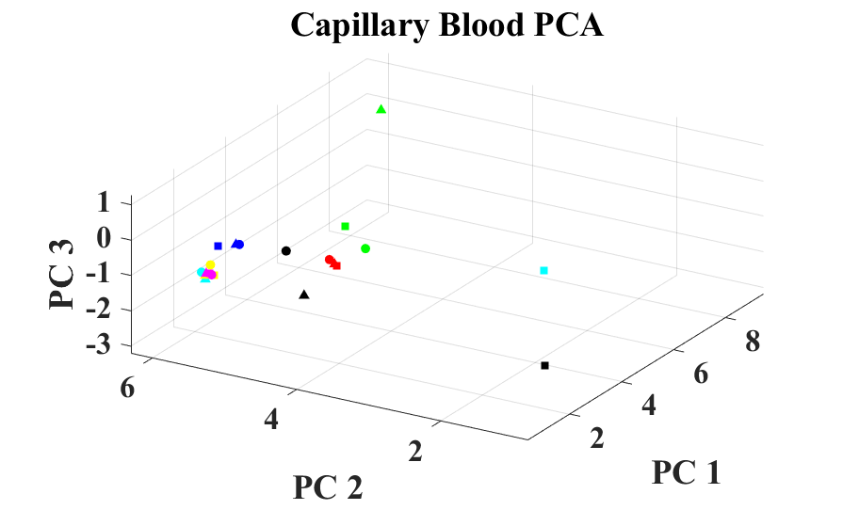
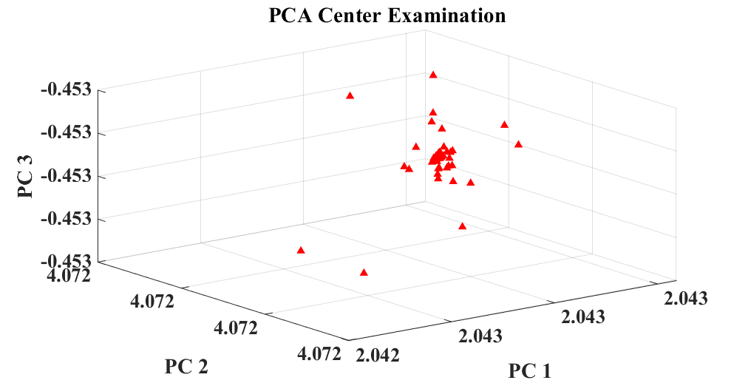
Intelligent Microelectrodes Array for Schizophrenia Treatment Monitoring
Results and Conclusions
Electrochemical signal variability validation on Schizophrenia blood samples
Experimental Information and Signal Processing:
electro-active biomarkers in the blood is influencing the blood’s electrochemical fingerprint.
We using the records of DPV signals from blood samples of 10 different SCZ patients.
Our mission is to understand the electrochemical signal variability from the different modified microelectrode in the array.
In order to do so, we will use principal component analysis (PCA) algorithm to cluster the data based on modification type.
PCA :
Orthogonal linear transformation to new coordinates system based on the data covariance matrix eigenvectors and eigenvalues. The transformation is reducing the problem dimension while preserving the data variability!
Each color represents a different modification. We also discover the reason for each center- The different position in the array! Each modification has repeats in the array (The points shape).
Each Center is 99 points in a very dense data cluster!
Conclusions
References
Microelectrodes were microfabricated and were modified with several modifications.
HVA was successfully detected with the modified microelectrodes.
Chitosan’s different thicknesses affected the electrochemical signal recorded from differently charged molecules.
Principal component analysis showed variable electrochemical signals.
[1] National Institute of Mental Health, '"Schizophrenia-Review", vol. 2016, February. https://www.nimh.nih.gov/health/topics/schizophrenia/index.shtml. [Accessed 10 July 2020].
[2] R. Samanaite, A. Gillespie, K. Sendt, G. McQueen, J.H. MacCabe and A. Egerton, '"Biological Predictors of Clozapine Response: A Systematic Review," Frontiers in Psychiatry,2018, vol. 9, pp. 327-356.
[3] R.P. Shukla and H. Ben-Yoav, "Chitosan-Carbon Nanotube-Modified Microelectrode for In Situ Detection of Blood Levels of the Antipsychotic Clozapine in a Finger-Pricked Sample Volume," Advanced Healthcare Materials, 2019, vol. 9, pp. 1-14.
[4] Kim at el., 2005, “Chitosan to Connect Biology to Electronics”, Polymers, 7(19), 1-49.
Acknowledgement
The authors thank the Nano-Fabrication Center at the Ben-Gurion University of the Negev for their help microfabricating the microelectrodes arrays.

