Slide 1
Analytical scheme for the calibration of magnetic position systems
stefano Lumetti¹, Perla Malagò¹, Dietmar Spitzer², Sigmund Zaruba², Michael Ortner¹
¹ Silicon Austria Labs GmbH
² Infineon Technologies AG

Slide 2
outlook
Magnetic position and orientation systems
Mini-Drive concept
Mini-Drive fabrication
Read-out & field computation
Calibration scheme
Calibration results
Conclusions

Slide 3
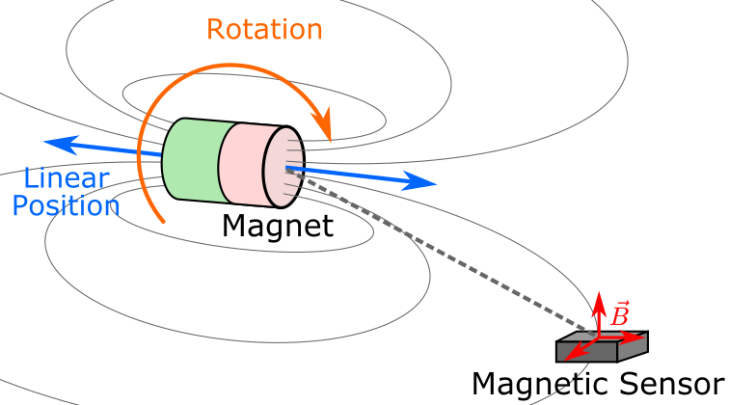
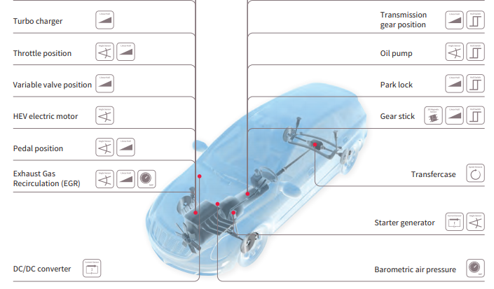
Magnetic position and orientation systems
Magnetic position and orientation detection
Magnetic position and orientation sensing refers to the detection of a relative mechanical motion between a magnet and a magnetic sensor through a magnetic field measurement
Several different implementations are possible, including linear position, rotation but also more complex motion patterns
The advantages of magnetic position sensing include wear-free operation, long lifetimes, robustness in dirty environments, high resolution, cost-efficiency
Nowadays, more than 100 magnetic position and orientation system applications can be found in the automotive sector alone, including gear shift detection, rotating shafts in the gear box, wheel speed sensing, ABS, indication levers, steering wheels, side mirrors, gas and brake pedals
Automotive applications (source: Infineon.com)

Slide 4
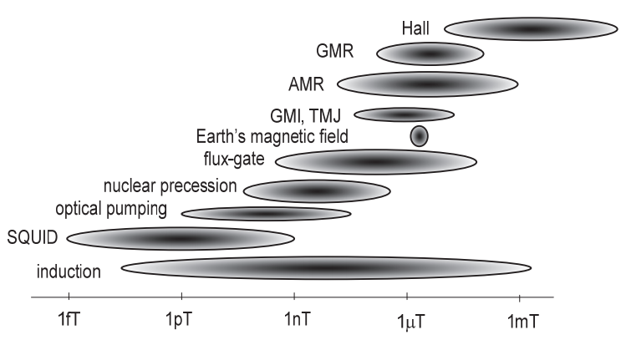
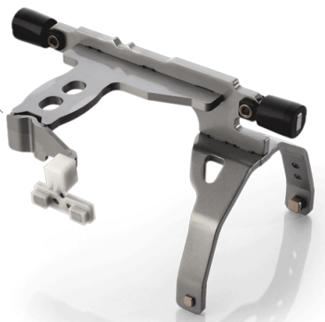
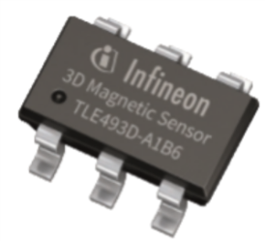
Magnetic position and orientation systems
Multiple established magnetic field sensing technologies exist, each with its advantages and disadvantages
Sensors integrated in industrial applications are typically based on Hall, XMR or fluxgate technology
Magnetic field sensors for 1D, 2D and 3D measurements are available
Magnetic sensor technologies (Janosek, 2017)
2D example: linear position detection in automotive shift forks
The linear motion generates an odd ($B_{odd}$) and an even ($B_{even}$) field component
A linear output is given by $\arctan_{2}\left(B_{even},B_{odd}\right)$, which generates a one-to-one correspondence with the position
3D magnetic field sensor for automotive applications
Magnetic linear position detection in a shift work set-up

Slide 5
Magnetic position and orientation systems
How to design a magnetic position and orientation system?
Constraints
Requirements: motion range, desired resolution
Geometry: where the sensor and the magnet can be placed
Magnetic sensor: detection limit, resolution, noise
Fabrication tolerances: initial construction tolerances, dynamic tolerances during operation
External stray fields
Linearity of the output: which computation is possible (e.g. is a micro-controller available?)
Cost optimization: reduce magnetic material, use cheap sensors
System parameters
Magnet layout (all possible shapes, forms, orientations and positions)
Sensor choice and position
Motivation of our work
Mini-Drive system: detection of the motion of a 3-axis joystick by means of a single magnet and a single sensor
Aim: Cost-efficiency
Cheap fabrication and sensor technology
User-friendly, fast and computationally efficient calibration

Slide 6
Mini-drive concept
Detection of the motion of a 3-axis joystick by using only one sensor and one magnet
full rotation of the joystick lever about its axis
2D tilt motion → only 5 discrete states are detected (i.e. central position and full tilt in four directions)
One-to-one correspondence between mechanical states and sensor output
A magnet is fixed at the end of the lever with a lateral displacement with respect to the rotation axis
The magnetization of the magnet is perpendicular both to the lever axis and to the magnet’s lateral displacement
A 3D Hall magnetic field sensor is placed centrally below
For each tilt state a full rotation of the lever corresponds to a closed loop in the magnetic state space
The magnetic loops are maximally separated from each other thanks to the specific system layout

Slide 7
Mini-drive fabrication
The center-ball defines the center of tilt and allows for full rotation about the lever axis
A cross-shaped cavity in the upper half of the housing limits the possible tilts to four discrete directions only
Center-lock mechanism allowing the lever to recover its zero-tilt position after release
A “hat” presses the center-ball in a circular cavity
Printed springs apply a force on the lateral appendices of the “hat”
A cubical NdFeB magnet is embedded at the bottom of the lever
An Infineon XMC2Go board with a 3D Hall magnetic field sensor is integrated in the system
Sensor features: low power consumption, 12-bit data resolution, range of $±$130 mT
Main geometrical parameters:
Distance from the center of tilt $d_{CoT}$
Airgap $Δ$
Magnet lateral displacement $x_{displ}$
Maximum tilt angle $θ_{max}$

Slide 8
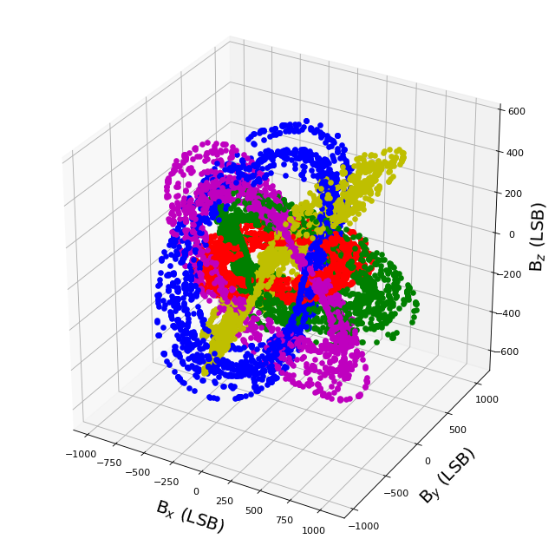
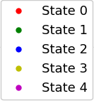
Mini-drive fabrication
The Mini-Drive components are fabricated using a high-resolution industrial 3D printer
Nominal construction parameters:
Tolerances:
$d_{CoT}=$ 6.3 mm
$Δ=$ 3 mm
$x_{displ}=$ 3 mm
$θ_{max}=$ 10°
$δ_{d_{CoT}}=$ 0.3 mm
$δ_{Δ}=$ 0.3 mm
${δ_{x}}_{displ}=$ 0.1 mm
${δ_{θ}}_{max}=$ 0.2°
Fabrication tolerances result in large variations among different devices in the magnetic field space
A calibration of the devices is needed

Slide 9
read-out & field computation
Information about the system state is obtained by solving the so-called inverse problem, i.e. by determining the position of the magnet starting from a magnetic field measurement
Challenges:
Solving the inverse problem within milliseconds to enable real-time measurement
Limited computational resources are typically available (sensor ICs or microcontrollers)
Mini-Drive approach:
Construction of a look-up table (very efficient due to the small state space, i.e. five loops with 36 to 180 rotation states each)
Computation of the inversion by direct comparison between the magnetic field measurement and the look-up table (which takes only few milliseconds on the microcontroller of the Infineon XMC2Go board)
The look-up table is created from 3D analytical solutions for the magnetic field:
The fields are computed using the open-source Magpylib toolbox, based on a Python interface
The analytical solution for cuboid magnets is a closed-form expression and its vectorized implementation can be computed within few milliseconds on standard x86 CPUs
Comparison to FEM computations shows that the error of the Magpylib analytical solution is less than 1%

Slide 10
Calibration scheme
A calibration of the Mini-Drives is necessary to eliminate the influence of the fabrication tolerances
We propose a simple procedure in which the user is asked to provide four well-separated measurement points
For each magnetic loop:
Four consecutive 90° rotations
Each rotation followed by one tilt in all directions
The calibration task consists in fitting the magnetic loops onto the calibration data by variation of the system tolerances
A differential evolution optimizer is combined with an analytical computation of the field of cuboid magnets
A cost function is minimized, defined as the ratio of the distance from the correct loop to the distance from the nearest incorrect loop
The calibration procedure generates a set of tolerances
The tolerances are employed to compute the 5 magnetic loops
A look-up table of arbitrary rotational discretization is created from the calculated loops

Slide 11
Calibration results
Calibration including:
Magnet position (3 DoF)
Magnet magnetization (3 DoF)
Tilt angles (4 DoF)
Sensor position (3 DoF)
Many uncalibrated states lie above the nearest-bad tilt threshold
→ The uncalibrated Mini-Drive would yield incorrect system state output
The calibrated states lie much closer to the correct loops (< 8 mT) than to the wrong ones (> 17 mT)
→ Easy identification of the correct states in the calibrated Mini-Drives
4-point calibration is surprisingly efficient
The best possible result is achieved in most cases
The use of more points for the calibration does not bring any significant improvement

Slide 12
conclusions
Mini-Drive devices
Simple 3-axis joysticks with only one sensor and one magnet
Manufactured via cheap 3D printing
Novel scheme based on analytical methods for the calibration of the Mini-Drives
Calibration based on the analytical solution for the magnetic field
Fast analytical field computation (Magpylib toolbox)
A differential evolution algorithm is applied to solve a multivariate optimization problem that includes multiple relevant fabrication tolerances
User-friendly calibration scheme requiring the measurement of only four points for each tilt
This novel scheme enables to calibrate more than 10 degrees of freedom within few seconds on conventional PCs
Potential for the extension of this method for the design and calibration of other novel and cost-efficient magnetic position systems

Slide 13
Thank you for your attention

