Slide 1
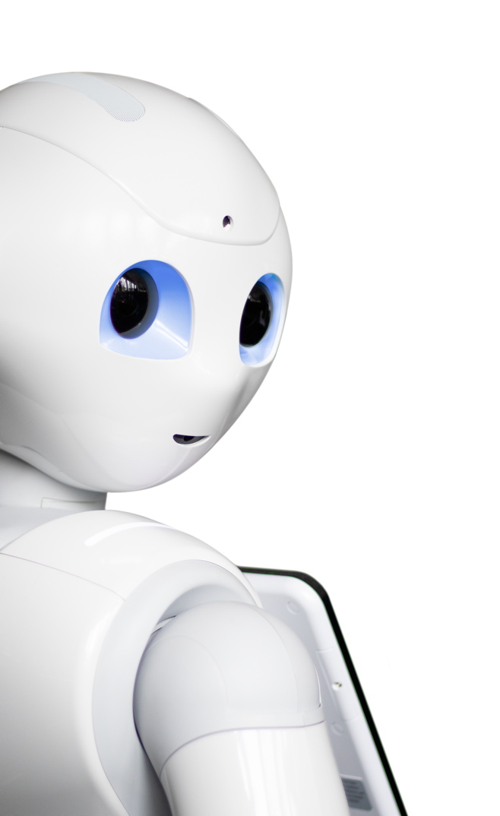
Promoting autonomy in care: Combining sensor technology and social robotics for health monitoring
Caterina Neef and Anja Richert
Cologne Cobots Lab
TH Köln, Cologne, Germany

Slide 2
Motivation
Demographic transition in Germany and around the world
More elderly people in need of care, cared for
At home by relatives and nurses
In nursing homes
Important to support and unburden both elderly and caregivers
One option: use of assistive technologies such as
Social robots for personal interactions
Wearable and non-wearable sensors for health monitoring
Goal: support autonomy of elderly and increase quality of care
Source: German Federal Ministry of Health, July 2020, „Zahlen und Fakten zur Pflegeversicherung“, Link

Slide 3
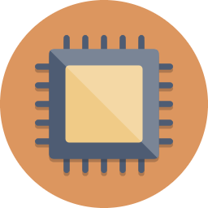
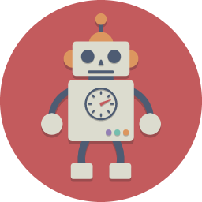
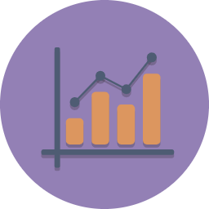
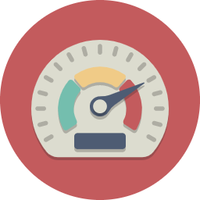
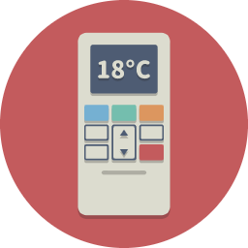
Related Work
Loza-Matovelle et al. 2019¹
Architecture of robot and sensors for elderly care
Boumans 2020²
Use of patient-reported outcome measures with social robot
Yusif et al. 2016³
Largest concern regarding assistive technologies: privacy, trust and added value
→ It is essential to develop technologies together with users
¹ Loza-Matovelle, D.; Verdugo, A.; Zalama, E.; Gómez-García-Bermejo, J. An Architecture for the Integration of Robots and Sensors for the Care of the Elderly in an Ambient Assisted Living Environment. Robotics 2019, 8, 76.
² Boumans, R.; van Meulen, F.; Hindriks, K.; Neerincx, M.; Olde Rikkert, M. A Feasibility Study of a Social Robot Collecting Patient Reported Outcome Measurements from Older Adults. International Journal of Social Robotics 2020, 12, 259–266.
³ Yusif, S.; Soar, J.; Hafeez-Baig, A. Older People, Assistive Technologies, and the Barriers to Adoption: A Systematic Review. International Journal of Medical Informatics 2016, 94, 112–116.

Slide 4
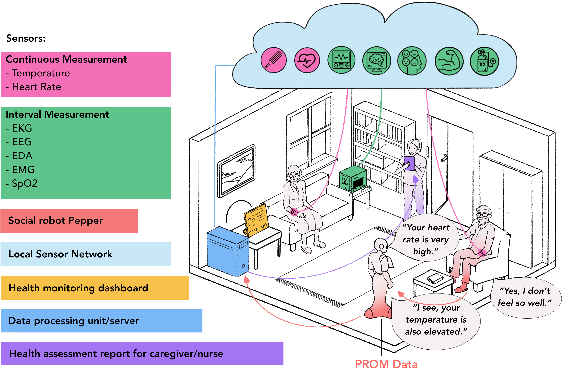
Sensor-robot
ecosystem
Proposed architecture as a
base for the sociotechnical development of an ecosystem comprised of
health care sensors and
a social robot to
promote the autonomy of elderly people in need of care

Slide 5
Sensor-robot
ecosystem
Wrist-worn wearable devices continuously measure skin temperature and heart rate
Stationary sensors acquire EKG, EEG, EDA, EMG, SpO2 in interval measurements
Through conversation with the social robot Pepper (SoftBank Robotics) and use of PROMs, the subjective well-being of the user is determined
Data is visualized in health monitoring dashboard, user/caregiver is notified when data is alarming
Data is collected and processed in data processing unit
Health assessment report is generated for caregiver/nurse
2
4
1
6
5
3

Slide 6
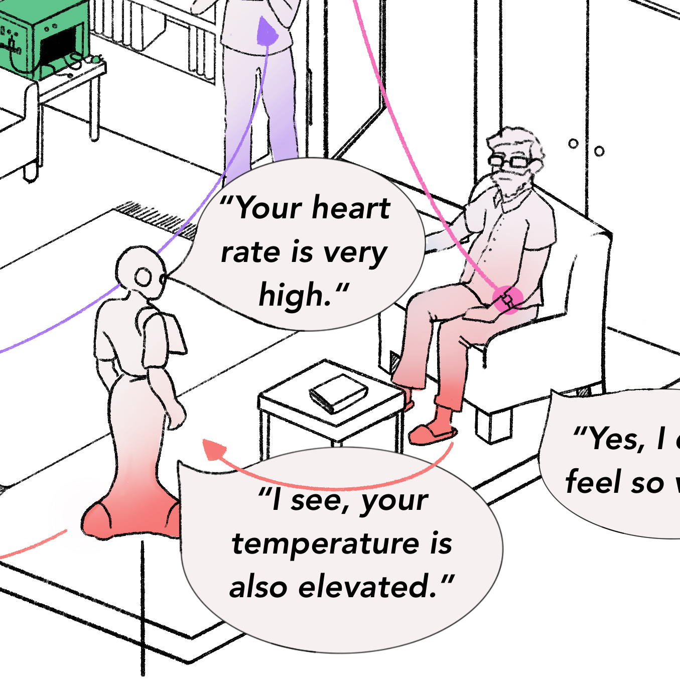
Sensor-robot ecosystem
Subjective
data
Objective
data
PROM data
Use of patient-reported outcome measures (PROMs)
Elderly person answers questions regarding health and well-being in conversation with social robot
Subjective health data is acquired
Health Assessment Report
Combination of objective PROM data and subjective sensor data allows generating a health assessment report for both elderly person and caregiver
Sensor data
Continuous measurement of temperature, heart rate
Interval measurements of EKG, EEG, EDA, EMG, SpO2
Objective health data is acquired

Slide 7
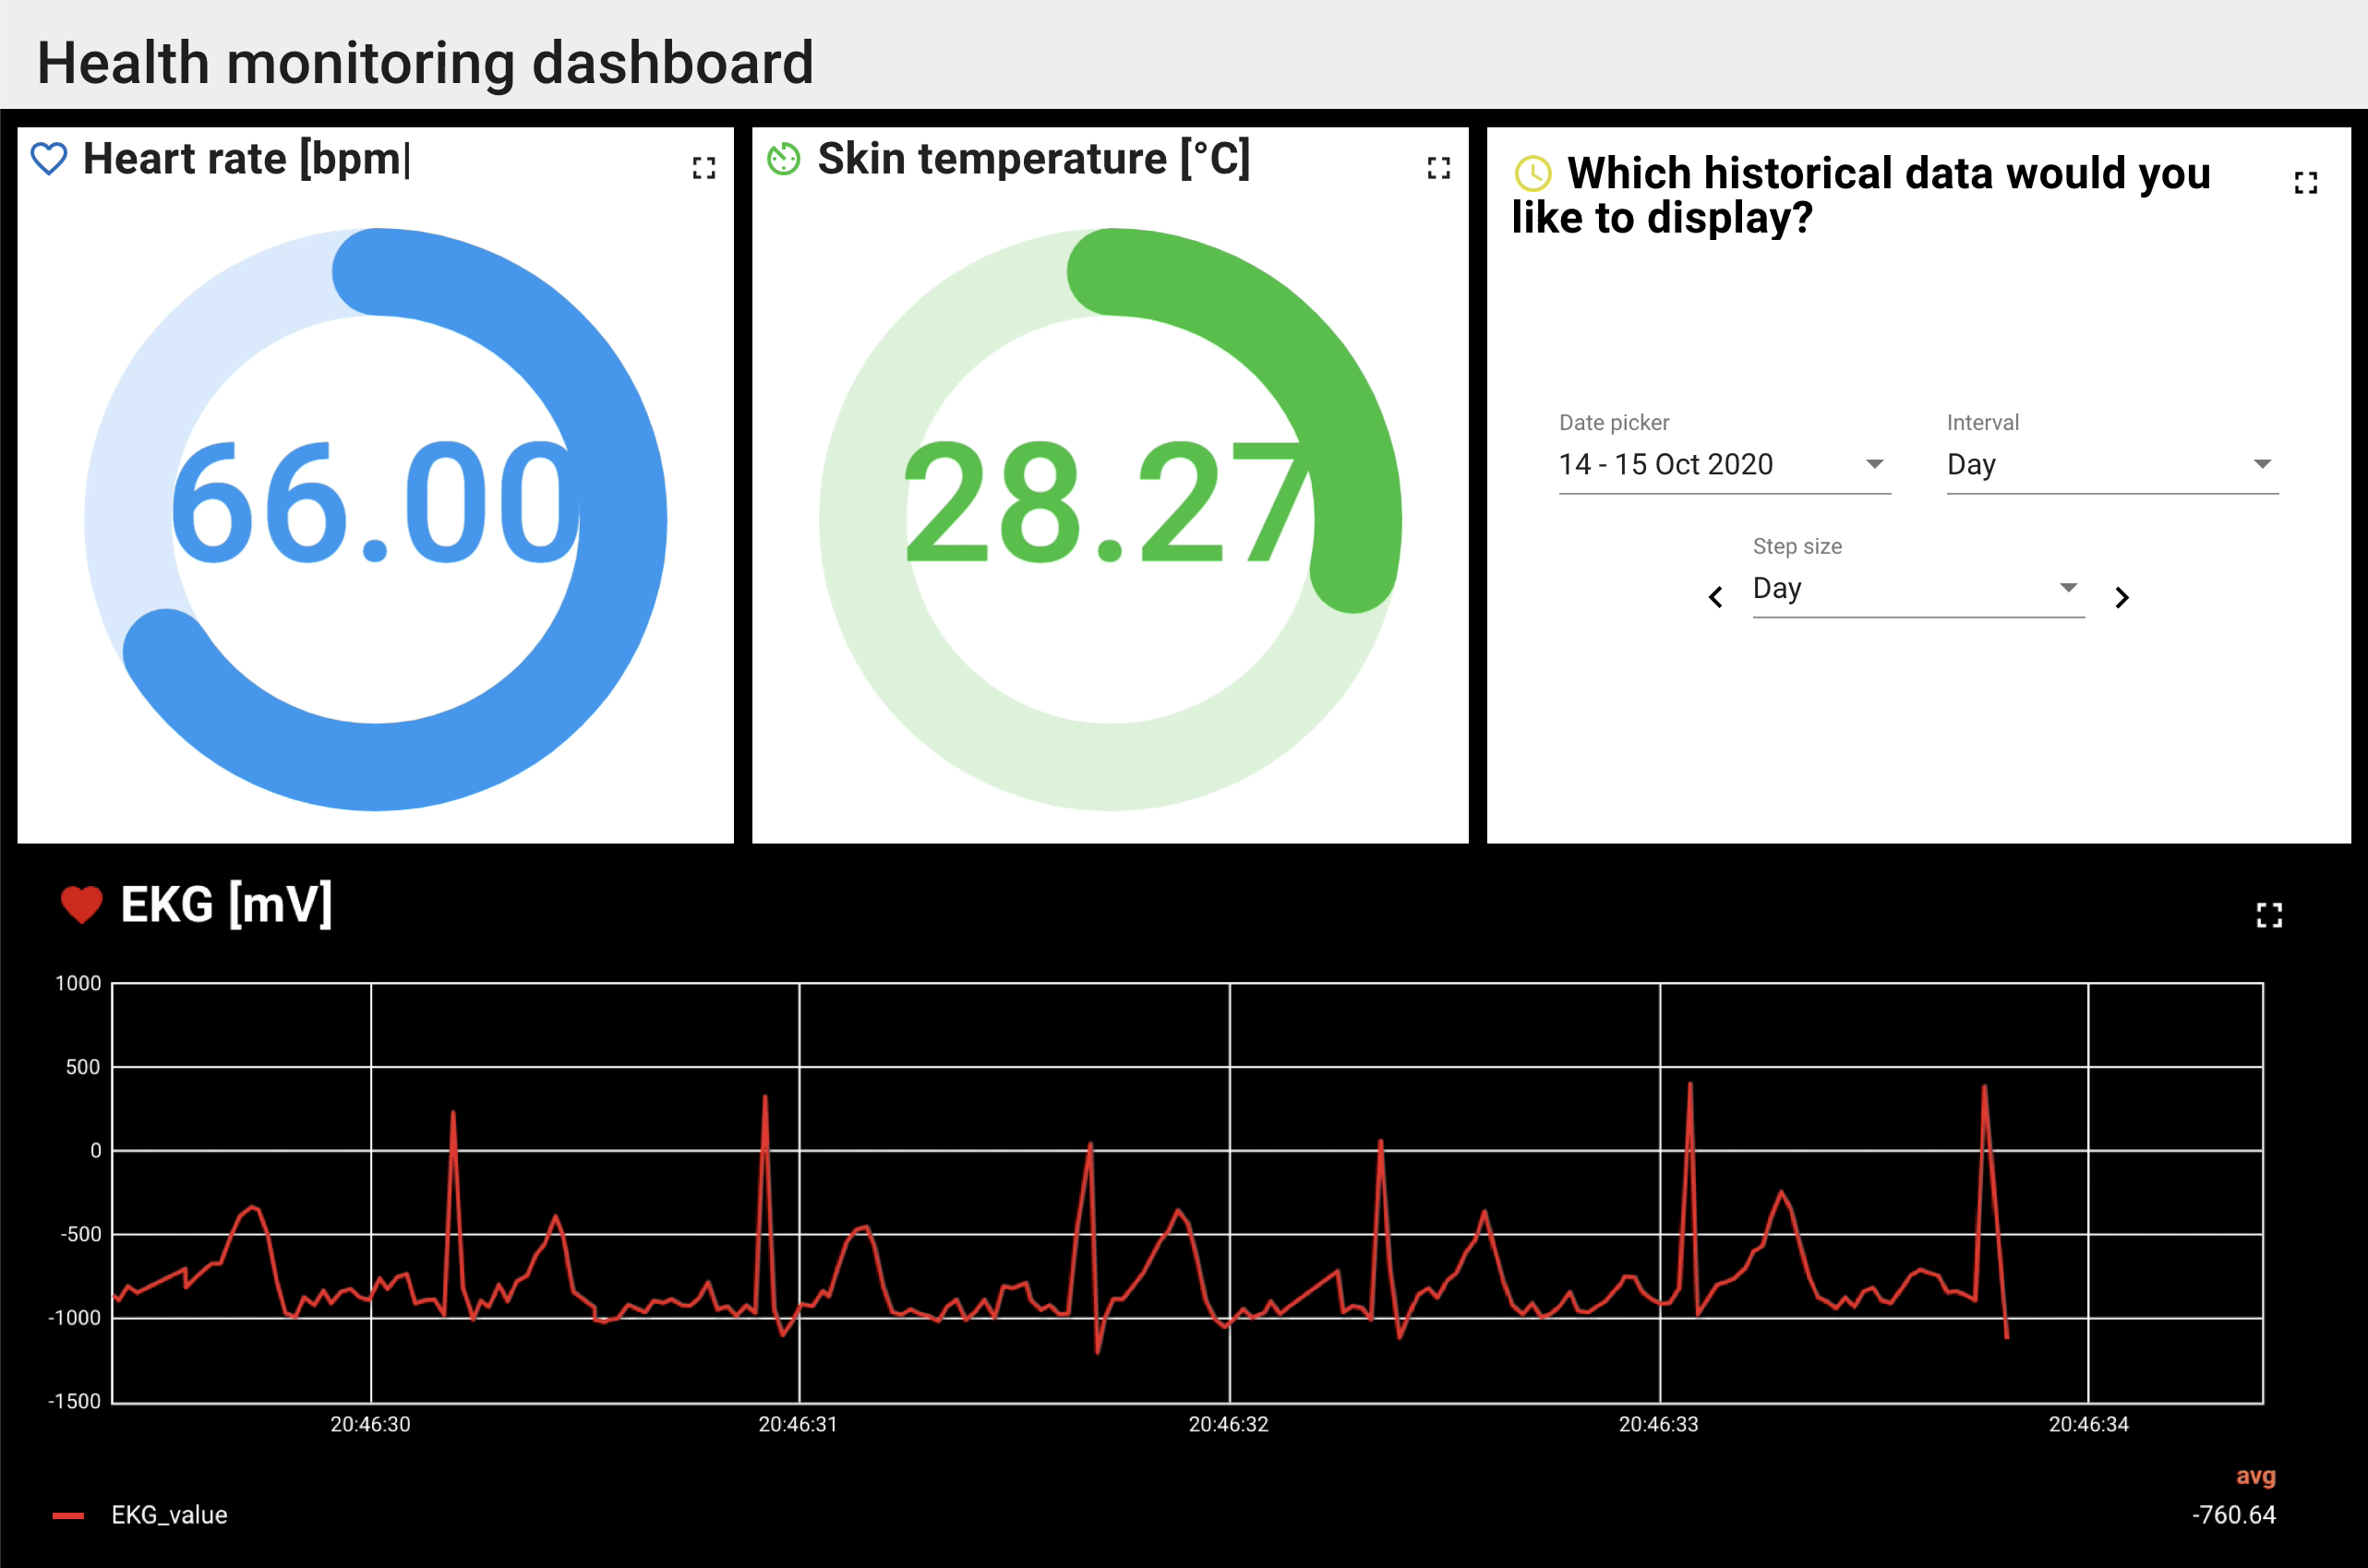
Results
1
1
3
Example of health monitoring dashboard
→ Generated using ThingsBoard¹
Heart rate (optical measurement) and skin temperature are continuously measured using a wrist-worn device and are visualized in real time
EKG is visualized when it is acquired in interval measurements, can be used to determine heart health, can also be sent to nurse/doctor
Historical data can be selected for visualization
→ To visualize data of other sensors, additional widgets can be created and customized
2
¹ thingsboard.io

Slide 8
Discussion and Future Work
Proposed architecture provides basis for integration of sociotechnical perspective into development of sensor-robot ecosystem, by answering the following research questions:
Which are the most important PROMs and sensors to detect specific health and care situations? How individually different is this?
(How) can we combine PROMs and different sensors to increase the quality of care of elderly users in their homes?
In which way, if at all, does this combination reduce the burden of care of both the elderly users and their caregivers (both trained and untrained)?
To which degree can these results be transferred to other age groups and care situations (e.g. nursing homes)?
By integrating users in development of ecosystem, mentioned concerns (privacy, trust, added value of technologies) can be addressed and alleviated
Future work:
Integrate more sensors into ecosystem, e.g. for fall detection, activity monitoring, emotion recognition, on-wrist blood pressure measurement
Test robustness of system through long-term measurements in realistic settings
Investigate how well system works, when only user interacts with it → reduce maintenance and ensure long-term user satisfaction

Slide 9
Questions? Comments?
Please get in touch!
Caterina Neef
caterina.neef@th-koeln.de
Anja Richert
anja.richert@th-koeln.de
Cologne Cobots Lab
TH Köln, Cologne, Germany

