Slide 1


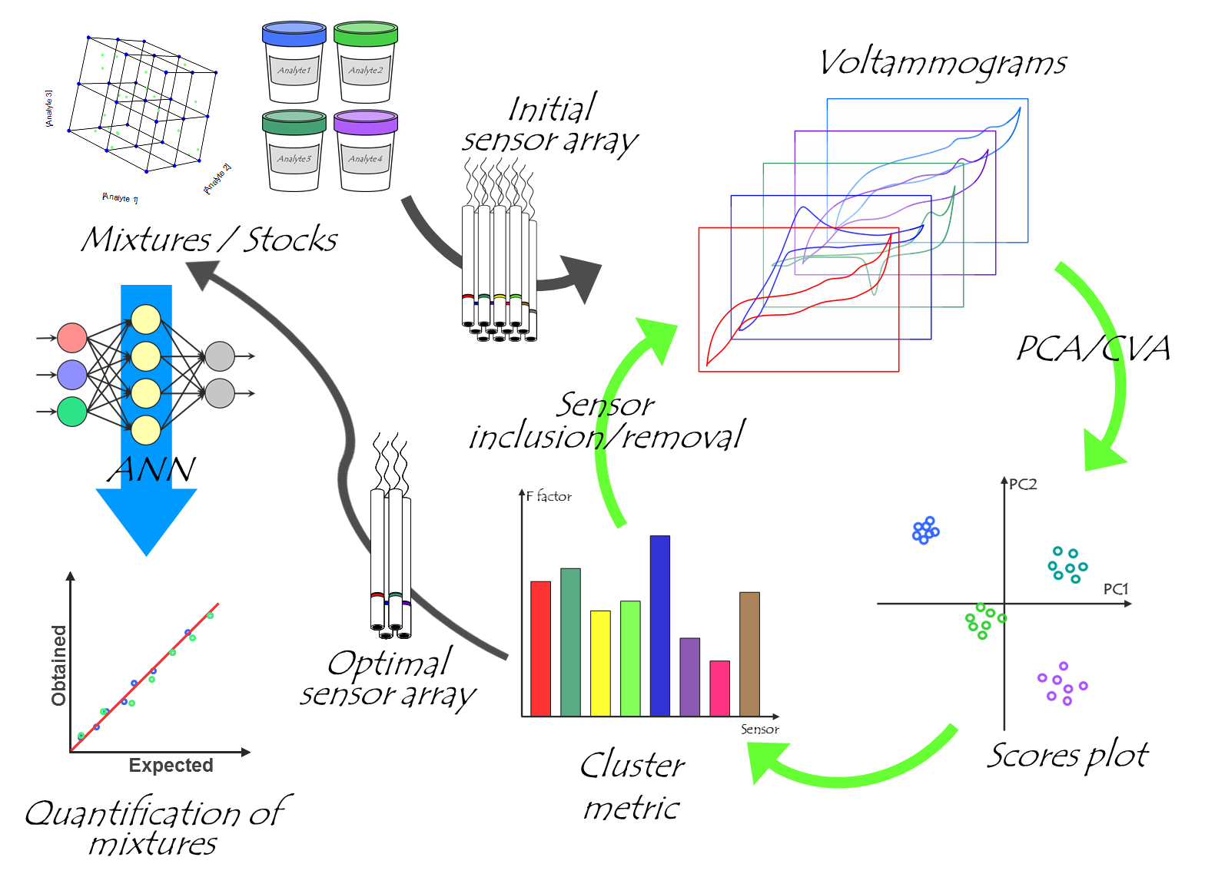
Use of clusterization metrics for optimization of sensors to be used in a voltammetric electronic tongue
Munmi Sarma, Noelia Romero, Xavier Cetó and Manel del Valle
Sensors and Biosensors Group, Department of Chemistry
Universitat Autònoma de Barcelona, Edifici Cn, 08193 Bellaterra, Barcelona, Spain
Abstract: This work focuses on the quantification of paracetamol, ascorbic acid and uric acid mixtures using electronic tongue principle. Five optimal electronic tongue sensors array were selected from a set of eight sensors using principal component analysis (PCA) and canonical variate analysis (CVA) in a combination of some clustering metric (F factor) for a given multianalyte resolution application. PCA and CVA allow to visually compare the performance of the different sensors, while the F factor allows to numerically assess the impact that the inclusion/removal of the different sensors does have in the discrimination ability of the ET towards the compounds of interest. The proposed methodology is based on the electrochemical analysis of a pure stock solution of each of the compounds under study, its posterior analysis by PCA/CVA and the stepwise iterative removal of the sensors that demote the clustering when retained as part of the array. Seven different graphite epoxy resin (GEC) electrodes modified with cobalt (II) phthalocyanine (CoPc), polypyrrole (PPy), Prussian blue (PB), oxide nanoparticles of bismuth (Bi₂O₃), titanium (TiO₂), zinc (ZnO) and tin (SnO₂) in addition to a Pt disc electrode, were used as the initial sensors array for the selection of five optimal sensors. After the optimal selection, the quantitative ANN model was built which successfully predicted the concentration of the three pharmaceutical compounds with a normalized root mean square error (NRMSE) of 0.00378and 0.0368 for the training and test subsets, respectively, and coefficient of correlation R² ≥0.971 in the predicted vs. expected concentrations comparison graph.
Selection of optimum sensors: Optimum sensors for the ET were selected from combined the combination of principal component analysis (PCA) and canonical variate analysis (CVA) with factor [2] calculation. Briefly, stock solutions of each of the analytes were measured with all the considered sensors, obtaining a voltammogram for each of them. Next, those were submitted to PCA/CVA, and the clustering was evaluated by means of the F factor. This was repeated, leaving out of the analysis each of the sensors of the array (one at a time), and the one that leads to the higher improvement is removed. The whole process was repeated until a decrease in the F factor was observed after discarding one of the sensors. Finally, with the selected sensor array, the quantitative application was carried out.
Quantitative model: A tilted factorial design (3³) was used to build the quantitative response model. The model performance was evaluated with an external subset of samples distributed randomly along the experimental domain.
Figure 4: Representative voltammograms obtained for certain arbitrary mixtures of the different APIs (the concentration for each compound is indicated in the legend) with the four-sensor selected array: GECs modified with (A) ZnO, (B) PPy and (C) Prussian Blue, and (D) the metallic Pt electrode.
Sample preparation and electrochemical measurements: All APIs stock solutions were prepared in 0.05 M phosphate buffer at pH 7.0 with 0.1 M KCl as supporting electrolyte. Electrochemical behavior of all the APIs and their mixtures was assessed by recording a complete cyclic voltammogram between − 0.7 V and +1.2 V vs. Ag/AgCl with a step potential of 10 mV and a scan rate of 100 mV·s⁻¹, without the application of any pre-conditioning potential or accumulation time. Furthermore, to avoid any fouling effect or drifts during the measurements, a blank measurement in phosphate buffer was carried out after each measurement .
Figure 5: Modeling ability of the optimized DWT-ANN. Comparison graphs of obtained vs. expected concentrations for (A) paracetamol, (B) ascorbic acid, and (C) uric acid, for both the training (●, solid line) and testing subsets (○, dotted line). The dashed line corresponds to the ideal comparison line (y = x
Figure2: Schematic representation of the methodology followed for the a priori selection of the optimal sensor array .
Compound | Slope | Intercept (μM) | R² | RMSE¹ (μM) | Total NRMSE¹
training subset (n = 27)
Paracetamol | 0.996 ± 0.006 | 0.9 ± 1.9 | 0.9998 | 2.43 | 0.00378
Ascorbic acid | 0.999 ± 0.004 | 1.1 ± 4.6 | 0.9999 | 5.86
Uric acid | 0.996 ± 0.004 | 1.1 ± 1.2 | 0.9999 | 1.64
testing subset (n = 11)
Paracetamol | 1.021 ± 0.134 | 9 ± 36 | 0.971 | 26.4 | 0.0368
Ascorbic acid | 1.017 ± 0.049 | −20 ± 57 | 0.996 | 31.2
Uric acid | 0.999 ± 0.096 | 1 ± 27 | 0.984 | 16.2
Table 1. Results of the fitted regression lines for obtained vs. expected values for the training and testing sets (intervals calculated at 95% confidence level).
Figure 3: (Top) Color map of the variation of the F values after iterative exclusion of the different electrodes (Bottom) Bar plot of the changes of the F values after exclusion of the sensor that leads to the biggest F value at each iteration.
Conclusion: The application of a simple methodology for the selection of the optimal voltammetric sensor array prior to carrying out a quantitative application has been demonstrated with the successful discrimination and quantification of the three different APIs. Nevertheless, despite the good performance shown here, it has to be considered that there are many other clustering indexes, and that those are not universal. Therefore, future work has to focus on the comparison between different indexes and the suitability for different applications.
Figure 1: Voltammograms obtained for the three APIs (250 µM in phosphate buffer) using the GECs modified with (A) SnO₂, (B) Prussian Blue, (C) ZnO, (D) PPy, (E) CoPc, (F) TiO₂ and (G) Bi₂O₃, and (H) the metallic Pt electrode.
Reference: 1. M. Sarma, N. Romero, X. Cetó, M. Del Valle, Sensors (Switzerland) 2020, 20, 1–16
2. P. Ciosek, Z. Brzózka, W. Wróblewski, Sensors Actuators, B Chem. 2004, 103, 76–83.

