Slide 2
Evaluation of Feature Selection Techniques in a Multifrequency Large Amplitude Pulse Voltammetric Electronic Tongue

Slide 3
OUTLINE
1
2
3
4
Introduction
Problem statement
Theoretical background
Materials and Methods
5
6
7
Results
Discussion
Conclusions

Slide 4
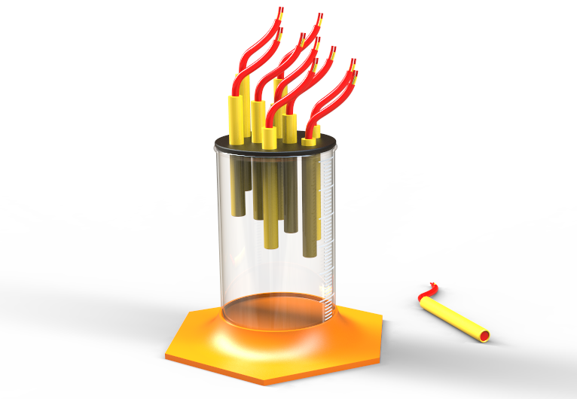
1
Introduction
Electronic tongue sensor array

Slide 5
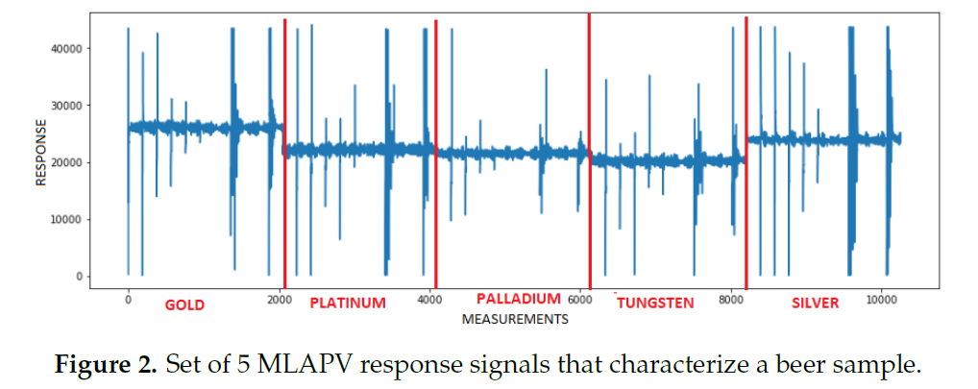
2
Problem statement
High amount of data
Feature Selection
114 x ?
Zhang et al., 2018
114 x 10250

Slide 6
3
Theoretical background
Principal concepts
Electronic tongue
Feature selection
Filter Method
Embedded Method
5 fold cross validation
Hyperparameter tuning
Accuracy as performance measure

Slide 7
4
Materials and methods
MLAPV ELECTRONIC TONGUE DATA SET
Zhang et al., 2018

Slide 8
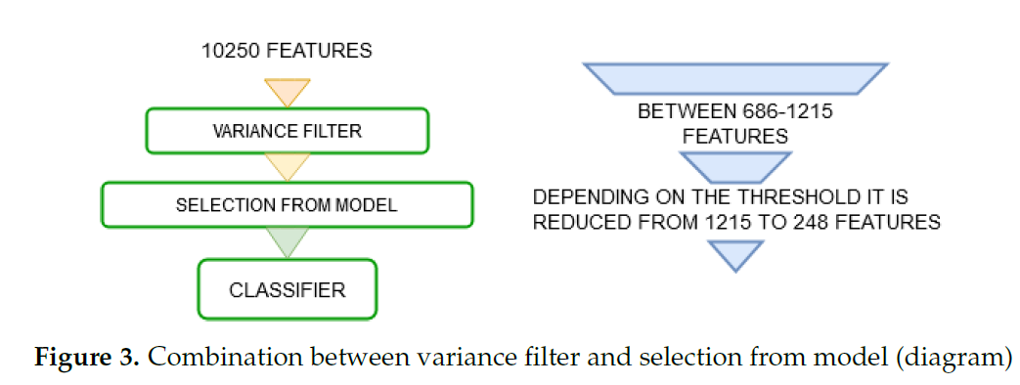
4
Materials and methods
Feature selection

Slide 9
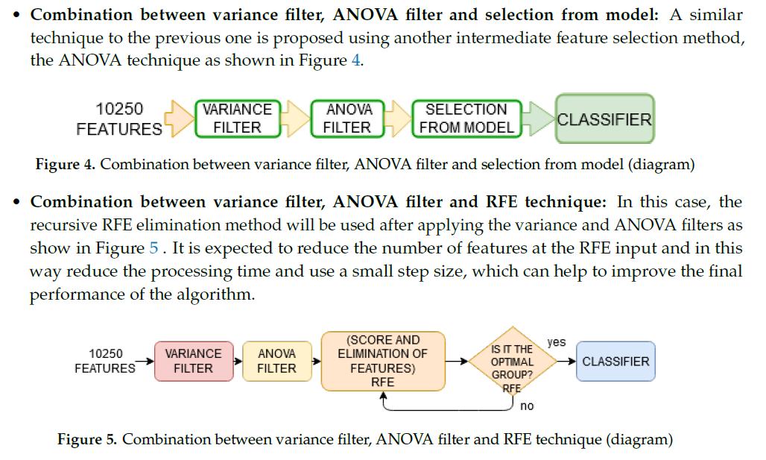
4
Materials and methods
Feature selection

Slide 10
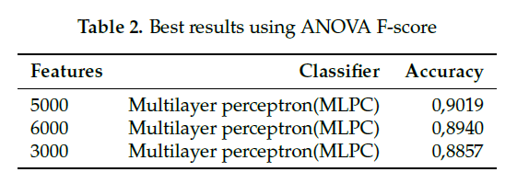
5
Results
Accuracy results

Slide 11
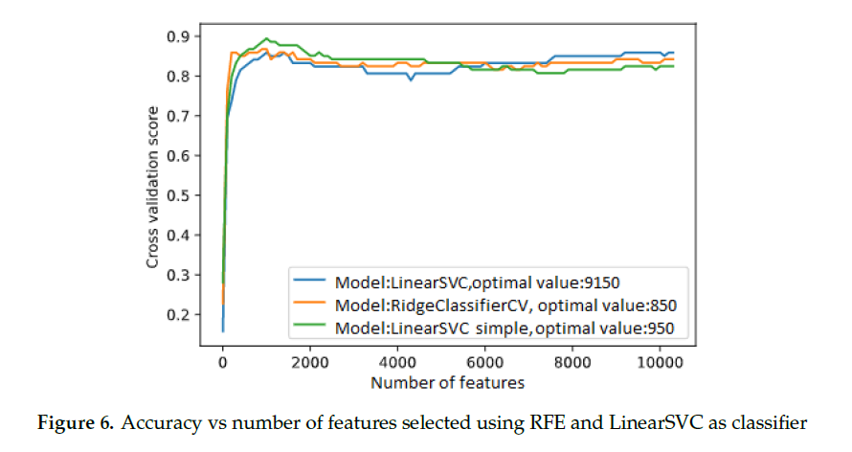
Optimal number of features
5
Results

Slide 12
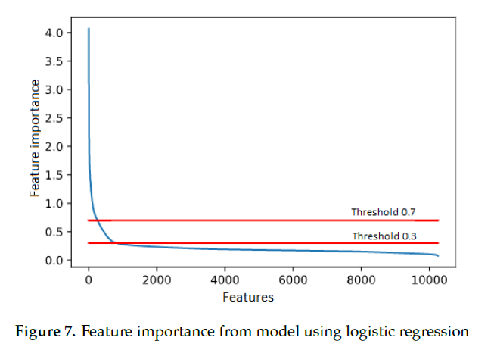
5
Results
Feature importance

Slide 13
5
Results

Slide 14
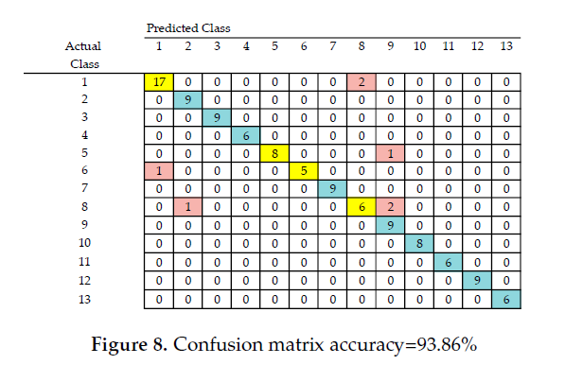
5
Results
Best confusion matrix

Slide 15
5
Results
Combination of variance filter,
ANOVA filter and RFE technique

Slide 16
6
Discussion
The application of the feature selection techniques increases the accuracy of the classification in most cases (initially 81.54% simply using the MLP classifier), as well as reducing the time of algorithm prediction by reducing the number of features in each test instance.
The two best results obtained were 93.86% using the RFE technique and MLP classifier and 92.85% using combination between variance filter, ANOVA filter and selection from model with an MLP classifier.
Although in the first case the accuracy is greater, the time required for the selection of features and training is almost 117 times greater.

Slide 17
7
Conclusions
The use of this type of method is useful to analyze data from sensor arrays, achieving an increase in the accuracy of the classification of up to about 12%, in addition, machine learning models diminish their training and prediction time by reducing the number of features.
It is noteworthy that the use of combined feature selection techniques can achieve high precision, achieve a faster model construction and become very stable, compared to the recursive feature elimination RFE method, which, although it is more precise, the last is slow to select the optimal set of features.
Although the best results are obtained with MLP classifier, several iterations are necessary to obtain the best performance, since the definition of the weights of each feature changes after the construction of each model, therefore, the results vary.

Slide 18
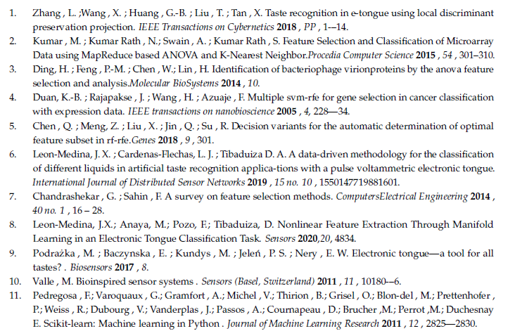
REFERENCES

Slide 19
Thank You
jxleonm@unal.edu.co

