Slide 1
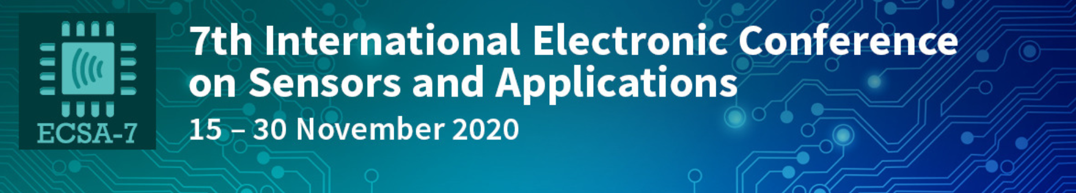


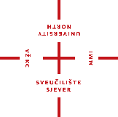

The Influence of Plasticizers On Determination of Cationic Surfactants In Pharmaceutical Disinfectants By Direct Potentiometric Surfactant Sensor
Maja Karnaš ¹, Marija Jozanović ^{2,*}, Bojan Đurin ³, Nikola Sakač ^{4,}*
¹ Faculty of Agrobiotecnical Sciences Osijek, Josip Juraj Strossmayer University of Osijek, Osijek, Croatia; maja.karnas@fazos.hr
² Department of Chemistry, Josip Juraj Strossmayer University of Osijek, Osijek, Croatia; mjozanovic@kemija.unios.hr
³ Department of Civil Engineering, University North, Center Varaždin; Croatia; bdjurin@unin.hr
⁴ Faculty of Geotechnical Engineering, University of Zagreb, Varaždin, Croatia; nsakac@gfv.unizg.hr

Slide 2
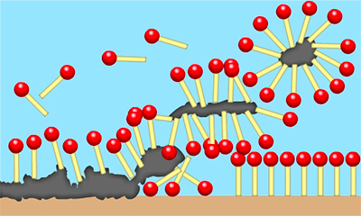
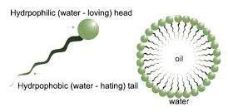
1. Introduction
SURFACTANT = surface active agent
Operating principle
Lower the surface tension
Critical micelle concentration
CMC

Slide 3
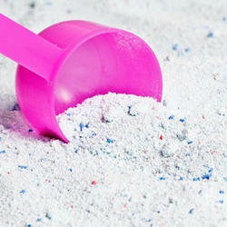

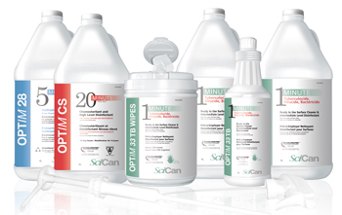

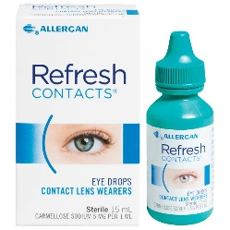
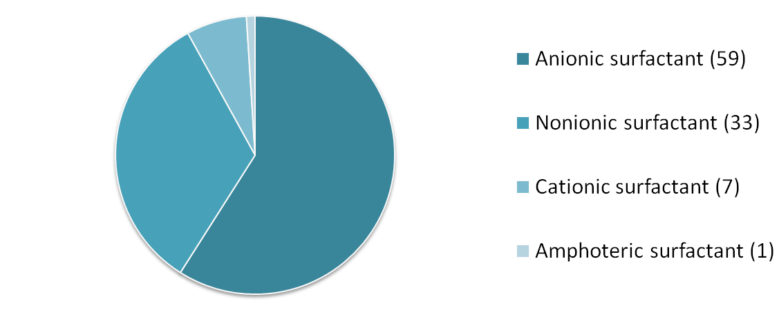
1. Introduction
COMPLEX
MIXTURES
CLASSIFICATION
Anionic surfactants
Global surfactant consumption (%) by surfactant type
Example: Sodium dodecylbenzenesulfonate
Cationic surfactants
  global surfactant market generated revenues of more than US$ 41 billion in 2018
Example: N-Hexadecyltrimethylammonium chloride
Nonionic surfactants
Example: Dodecanol 9-mole ethoxylate
Amphoteric surfactants
Environmental impact
Example: Dodecyldimethylammoniomethane carboxylate

Slide 4
1. Introduction
Cationic surfactants are used in broad spectra of commercial products as preservatives and disinfectants.
Since classical methods for determination of lower surfactant concentrations [1] have many disadvantages, direct potentiometric sensors for surfactants based on ion selective electrodes with liquid membrane type [2][3] offer an elegant, affordable and reliable substitution.

Slide 5
1. Introduction
Liquid membrane type sensing membranes are typically based on high molecular weight PVC mixed with plasticizer and an ionophore.[4]
Even though the plasticizer has a function to soften the matrix and make it more flexible, it also has an influence on the final direct potentiometric sensor response [5] since in influences the membrane polarity, resistance, ion mobility across the membrane. [6][7]

Slide 6
1. Introduction
The typical weight ratio of PVC to plasticizer is 1:2, with up to 1 wt % ionophore:
Higher amounts of plasticizer could be interfering to the measurement. [8]
Ionophore
Plasticizer
PVC

Slide 7
AIM
Previously we synthesized DMI-TPB ion pair, implement it in the PVC-based liquid membrane surfactant sensor and used it for cationic surfactants quantification in real samples. [9]
In this paper we selected four different plasticizers and implement them in the PVC-based sensing membrane with DMI-TPB as an ionophore to observe the plasticizer influence on the response characteristics of the direct potentiometric surfactant sensor and test the selected membrane formulation on commercial pharmaceutical disinfectants.

Slide 8
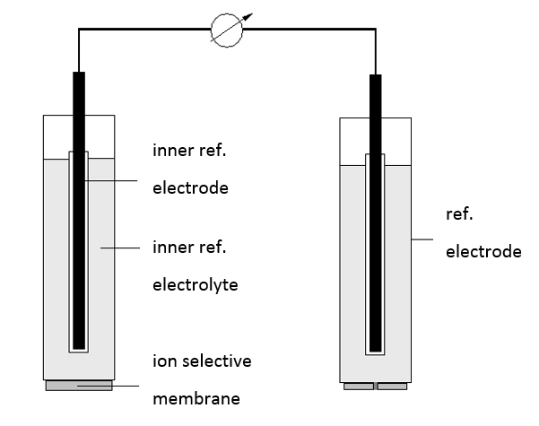
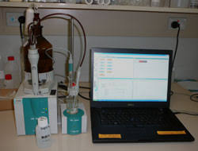
2. Materials and Methods
Surfactant ion selective electrodes (surfactant sensors) are electrochemical sensors able to measure surfactant concentration.
Principle: direct potentiometry
There is a logaritmic dependance between surfactant activity and electrode potential.
Instrumentation:
Working setup

Slide 9
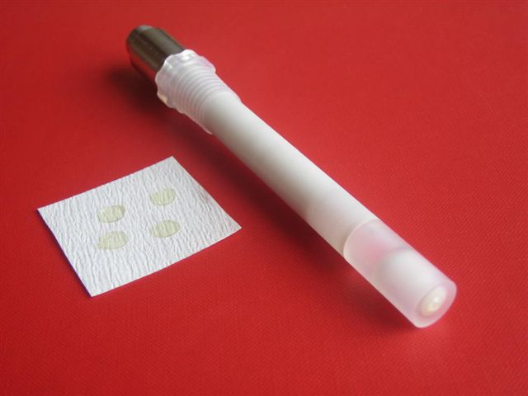
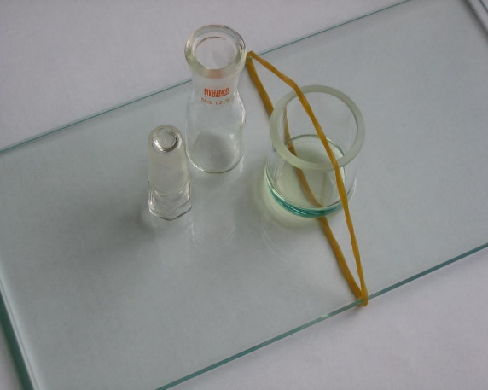
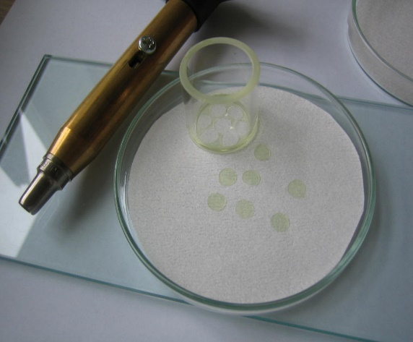
2. Materials and Methods
Surfactant sensor with implemented membrane disc on the bottom of the electrode
PVC liquid membrane preparation:
a) setup, b) cutted membrane discs
CATIONIC SURFACTANTS
cetylpyridinium chloride (CPC)
cetrimonium bromide (CTAB)
PLASTICIZERS
A)
B)
o-nitrophenyl octyl ether (P1)
bis(2-ethylhexyl) phthalate (P2)
bis(2-ethylhexyl) sebacate (P3)
dibutyl sebacate (P4)
ION PAIR
SIX REAL SAMPLES OF PHARMACEUTICAL DISINFECTANTS PROVIDED BY THE LOCAL STORE
1,3-didecyl-2-methylimidazolium-tetraphenylborate (DMI-TPB)

Slide 10
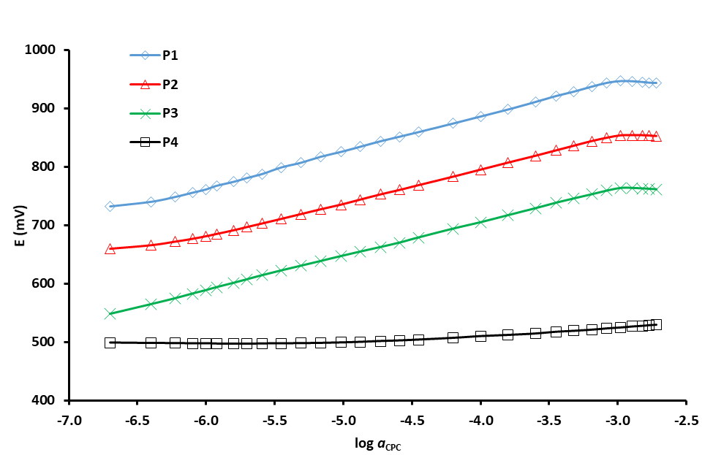
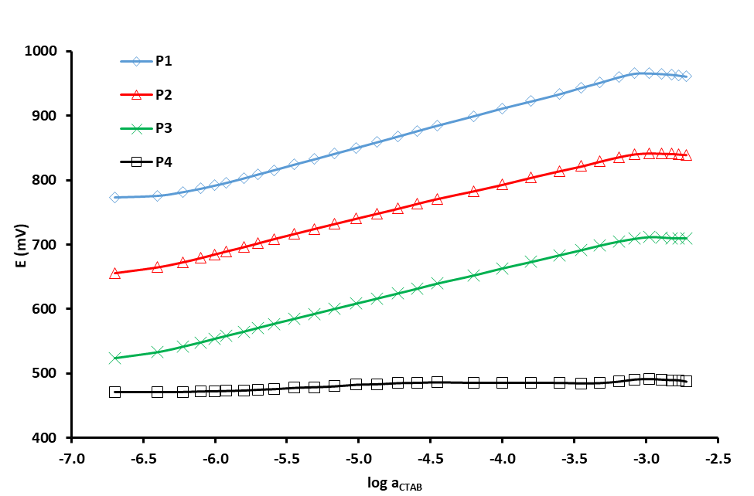
3. Results and Discussion
3.1. Response characterization
CPC
CTAB
Figure 1. Influence of the plasticizer type on the DMI-TPB surfactant sensor response characteristics toward cationic surfactants: a) CPC (left) and b) CTAB (right), in deionized water. Plasticizers, from top to bottom: 2-nitrophenyl octyl ether (P1), bis(2-ethylhexyl) phthalate (P2), bis (2-ethylhexyl) sebacate (P3), and dibutyl sebacate (P4). The curves have been shifted vertically for clarity.

Slide 11
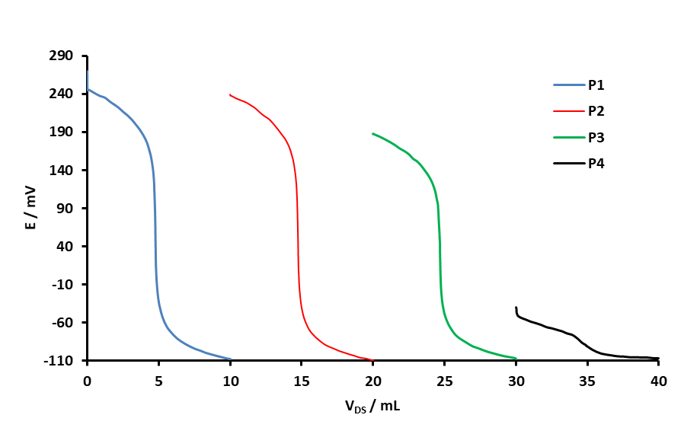
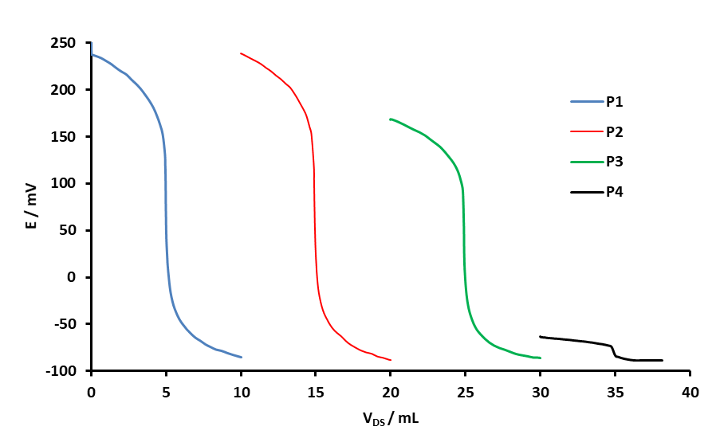
3. Results and Discussion
3.2. Direct potentiometric titrations
CPC
CTAB
Figure 2. Direct potentiometric titration curves for a) CPC (c = 4 × 10⁻³ M) and b) CTAB; with DS (c = 4 × 10⁻³ M) obtained by the use of DMI-TPB sensor and for different plasticizers, from left to right: 2-nitrophenyl octyl ether (P1), bis(2-ethylhexyl) phthalate (P2), bis (2-ethylhexyl) sebacate (P3) and dibutyl sebacate (P4). The curves have been shifted vertically for clarity.

Slide 12
3. Results and Discussion
3.3. Titration of pharmaceutical disinfectants
The DMI-TPB sensor containing plasticizer P1 was selected as an end-point indicator in potentiometric titration of cationic surfactants in six commercial pharmaceutical disinfectants since it presented the best characteristic.
The standard solution of anionic surfactant DS (c = 4 × 10⁻³ M) was used as a titrant. PVC liquid membrane Direct Potentiometric Surfactant Sensor (DPSS) was used as a reference [10].
For determinations in six disinfectant samples, no significant differences were observed between the means of both the DMI-TPB sensor containing plasticizer P1 and the DPSS at the 95% confidence level.
A sufficient well agreement was observed for all results (Table 1).

Slide 13
3. Results and Discussion
3.3. Titration of pharmaceutical disinfectants
Table 1. The results of potentiometric titrations of cationic surfactants in pharmaceutical disinfectants by DS (c = 4 mM) as titrant and a DMI-TPB sensor containing plasticizer P1 as an indicator, in comparison with the results obtained with referent Direct Potentiometric Surfactant Sensor (DPSS).

Slide 14
4. Conclusion
Four different plasticizers were incorporated into the PVC-based liquid membrane surfactant sensors with DMI-TPB as an ionophore.
Membranes were characterized by their response on cationic surfactant CPC and CTAB, and direct potentiometric titrations of CPC and CTAB with anionic surfactant DS as a titrant.
Sensor membrane containing plasticizer 2-nitrophenyl octyl ether (P1) showed the best properties and was used for titration of six pharmaceutical disinfectants obtained from the local store.
The results of showed good agreement with conventional reference direct potentiometric sensor developed previously by the same group.

Slide 15
References
1. Frend, A.J.; Moody, G.J.; Thomas, R.; Birch, B.J. Flow injection analysis with tubular membrane ion-selective electrodes in the presence of anionic surfactants. Analyst 1983, 108, 1357–1364. DOI: 10.1039/AN9830801357
2. Sakač, N.; Jozanović, M.; Karnaš, M.; Sak-Bosnar, M. A New Sensor for Determination of Anionic Surfactants in Detergent Products with Carbon Nanotubes as Solid Contact. J. Surfactants Deterg. 2017, 1–9. DOI: 10.1007/s11743-017-1978-0
3. Sak-Bosnar, M.; Madunić-Čačić, D.; Sakač, N.; Galović, O.; Samardžić, M.; Grabarić, Z. Potentiometric sensor for polyethoxylated nonionic surfactant determination. Electrochim. Acta, 2009, 55, 528–534. DOI: 10.1016/j.electacta.2009.09.010
4. Zareh, M.M. Blank membranes versus ionophore-based membranes for the selective determination of H⁺. Anal. Sci., 2009, 25, 1131–5. DOI: 10.2116/analsci.25.1131
5. Guilbault, J.D.R.T.G.G.; Durst, R.A.; Frant, M.S.; Freiser, H.; Hansen, E.H.; Light, T.S.; Pungor, E.; Rechnitz, G.; Rice, N.M.; Rohm, T.J.; Simon, W. Recommendations for nomenclature of ion-selective electrodes. Pure Appl. Chem., 1976, 48, 127–132.
6. Karnaš, M.; Sakač, N.; Jozanović, M.; Tsakiri, M.; Kopriva, M.; Kovač Andrić, E.; Sak Bosnar, M. The influence of plasticisers on response characteristics of anionic surfactant potentiometric sensor. Int. J. Electrochem. Sci., 2017, 12, 5921 – 5933. DOI: 10.20964/2017.07.16
7. Zahran, E.M.; New, A.; Gavalas, V.; Bachas, L.G. Polymeric plasticizer extends the lifetime of PVC-membrane ion-selective electrodes. Analyst, 2014, 139, 757–63. DOI: 10.1039/c3an01963b
8. Carey, C. Plasticizer Effects in the PVC Membrane of the Dibasic Phosphate Selective Electrode. Chemosensors, 2015, 3, 284–294. DOI: 10.3390/chemosensors3040284
9. Madunić Čačić, D.; Sak-Bosnar, M.; Galović, O.; Sakač, N.; Matešić-Puač, R. Determination of cationic surfactants in pharmaceutical disinfectants using a new sensitive potentiometric sensor. Talanta, 2008, 76, 259–264. DOI: 10.1016/j.talanta.2008.02.023
10. Sakač, N.; Karnaš, M.; Jozanović, M.; Medvidović-Kosanović, M.; Martinez, S.; Macan, J.; Sak-Bosnar, M. Determination of anionic surfactants in real samples using a low-cost and high sensitive solid contact surfactant sensor with MWCNTs as the ion-to-electron transducer. Anal. Methods, 2017, 9, 2305–2314. DOI: 10.1039/C7AY00099E

Slide 16
Thank you for your attention!

