Slide 1
A NIR-spectroscopy-based approach
for detection of fluids
in rectangular glass micro-capillaries
Valentina BELLO and Elisabetta BODO
Laboratory of ElectroOptics
Department of Electrical, Computer and Biomedical Engineering
University of Pavia, Pavia, Italy
(Student Session)

Slide 2
Outline
What is microfluidics?
Goal of the work
Micro-opto-fluidic setup
Theoretical model
Results
Conclusions
Future perspectives: what’s next?
1

Slide 3
What is microfluidics?
Microfluidics is the science of manipulating and controlling fluids, usually in the range of microliters to microliters, in networks of channels with dimensions from tens to hundreds of micrometres.
APPLICATIONS
BIOLOGY
HEALTHCARE
µL VOLUMES
CHEMISTRY
DRUG DISCOVERY
… AND MANY OTHERS!
MICROFLUIDIC CHIP
2
Notes:
Features of rectangular glass micro-capillaries
They offer a flat surface for optical detection. They reduce the optical distortions and scattering typical of round cross-section capillaries. They are low-cost device, commercially available in several formats.
The spectrum of the light reflected from these devices, when illuminated with broadband radiation, is characterized by resonance minima with wavelength position that depends on the geometrical dimensions of the micro-capillary. In previous works, optical resonances in the near infrared region were detected:
by directly monitoring the spectral positions of reflectivity minima#
by monitoring the peaks of reflectivity R(λ) over transmissivity T(λ) (T/R)§
#G. Rigamonti et al., Sensors, 2018 §G. Rigamonti et al., Biomed. Opt. Express, 2017

Slide 4
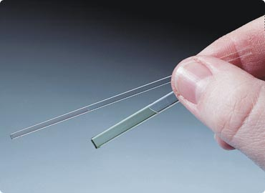
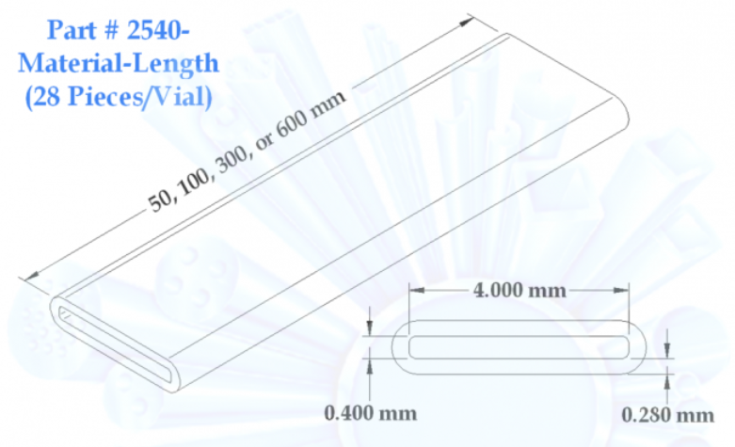
Goal of the work
Rectangular glass micro-capillaries: features
Commercially available low-cost devices.
Reduction of light scattering.
Transparency → optical detection.
Micrometric dimensions → ultra-low volumes of sample.
PERFECT DEVICES
FOR MICRO-OPTO-FLUIDIC SENSING!
In previous works, we exploited micro-capillaries to measure the real part of the refractive index:
spectral reflectometry# (detection of optical resonances)
spectral shift interferometry$
#Rigamonti et al., Biomed. Opt. Express 2017, 8, 4438
$Bello et al., Sensors 2020, 20, 1043
3
Notes:
Features of rectangular glass micro-capillaries
They offer a flat surface for optical detection. They reduce the optical distortions and scattering typical of round cross-section capillaries. They are low-cost device, commercially available in several formats.
The spectrum of the light reflected from these devices, when illuminated with broadband radiation, is characterized by resonance minima with wavelength position that depends on the geometrical dimensions of the micro-capillary. In previous works, optical resonances in the near infrared region were detected:
by directly monitoring the spectral positions of reflectivity minima#
by monitoring the peaks of reflectivity R(λ) over transmissivity T(λ) (T/R)§
#G. Rigamonti et al., Sensors, 2018 §G. Rigamonti et al., Biomed. Opt. Express, 2017

Slide 5
Goal of the work
Rectangular glass micro-capillaries: features
Commercially available low-cost devices.
Reduction of light scattering.
Transparency → optical detection.
Micrometric dimensions → ultra-low volumes of sample.
PERFECT DEVICES
FOR MICRO-OPTO-FLUIDIC SENSING!
BUT refractive index sensing is non-specific!
we exploit micro-capillaries
for recognition of fluids
based on spectroscopy
in the near infrared region
Hence,
in this work
3
Notes:
Features of rectangular glass micro-capillaries
They offer a flat surface for optical detection. They reduce the optical distortions and scattering typical of round cross-section capillaries. They are low-cost device, commercially available in several formats.
The spectrum of the light reflected from these devices, when illuminated with broadband radiation, is characterized by resonance minima with wavelength position that depends on the geometrical dimensions of the micro-capillary. In previous works, optical resonances in the near infrared region were detected:
by directly monitoring the spectral positions of reflectivity minima#
by monitoring the peaks of reflectivity R(λ) over transmissivity T(λ) (T/R)§
#G. Rigamonti et al., Sensors, 2018 §G. Rigamonti et al., Biomed. Opt. Express, 2017

Slide 6
Micro-opto-fluidic setup
TUNGSTEN
LAMP
OSA
Setup for
remote
non-contact
non-invasive sensing
PC
LENS
LENS
t_{f}
d
w
t_{b}
CAPILLARY
CHANNEL
GLASS WALLS
SYRINGE
fluid IN
fluid OUT
MIRROR
electrical connections
multimode optical fibers
4

Slide 7
Theoretical model
effect of absortpion → Beer-Lambert law
T_{air} = P_{out air}(λ)/P_{in}(λ) (with empty channel) T_{sample} = P_{out sample}(λ)/P_{in}(λ) (with fluid in channel)
spectral response: SR(λ) = T_{sample}/T_{air} = P_{out sample}(λ)/P_{out air}(λ) → depends on the absorption features of the sample
incident power P_{in}(λ)
output power P_{out}(λ)
θ₁ = 14°
θ₇
medium 1
air
Model
implemented in
medium 2
θ₂
θ₆
glass
θ₂
θ₆
280 µm
medium 3
fluid
sample
θ₃
θ₃
θ₅
θ₅
400 µm
layered
structure
medium 4
θ₄
θ₄
glass
280 µm
θ₄
θ₄
mirror
5

Slide 8
Results – 1
Experimental spectra, in good agreement with theoretical predictions, allowed to distinguish water from several types of alcohol thanks to their different absorption features.
6

Slide 9
Results – 2
By extending the path length travelled by the light in the channel, spectra of sample can be reconstructed by a higher level of detail.
7

Slide 10
Conclusions
In this work, we have reported a micro-opto-fluidic platform based on rectangular glass micro-capillaries for detection of fluids based on their spectroscopic features.
The micro-capillary is laid onto a bulk mirror and light emitted by a tungsten lamp crosses the channel containing the sample twice.
A theoretical model was implemented in MATLAB® environment.
Experimental results are in good agreement with the theoretical study. In particular, water and three types of alcohol were tested and distinguished thanks to their absorption profiles.
Moreover, by extending the light-path inside the channel, absorption profiles of fluids can be reconstructed with a greater level of detail.
8

Slide 11
Future perspectives: what’s next?
Future work will be devoted to the realization of a more compact setup including a laser diode, a photodetector and a metallization coating instead of the bulky mirror.
Moreover, both sides of the capillary can be coated to obtain a “multiple-bounce” configuration.
The system could be exploited also for the analysis of biological fluids.
in
out
9

Slide 12
THANK YOU FOR
YOUR KIND ATTENTION!
The authors wish to thank
Prof. SABINA MERLO
for her guidance and fruitful suggestions.
Pavia, Lombardy, Italy

