Slide 1
Development of a compact optical measurement system to quantify the optical properties of fluorescently labeled cervical cancer cells
Hun Lee, Ji-hyeon Oh, Se-woon Choe*
Biomedical Imaging, Therapeutics and Sensing Lab.
Department of Medical IT Convergence Engineering
Kumoh National Institute of Technology

Slide 2
Outline
Introduction
Methods
Results and Discussions
Conclusions

Slide 3
1. Introduction
Motivation
Flow cytometry is used for research on various diseases by simultaneously measuring various characteristics of a cell such as the number of cells, the degree of internal composition of the cells, the size of the cells, and the cell cycle.
Flow cytometry is an expensive equipment and requires an operator with expertise for use and maintenance, so when only simple data are needed, such as measuring the number of cells or quantitative analysis of cell growth and inhibition, the use of a flow cytometer requires irrational expense.
Goal
Develop a compact optical signal measurement system that can acquire optical information of cells by using inexpensive LED, photodiode, and 3D printer.
After fluorescence treatment of cervical cancer cells with Calcein-AM and DiD, fluorescence side scatter was measured using various optical filter and confirmed linearity in proportion to the number of cells.

Slide 4
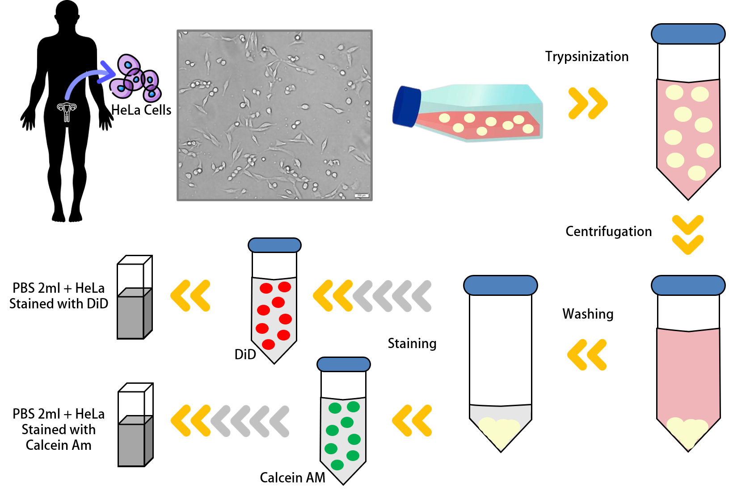
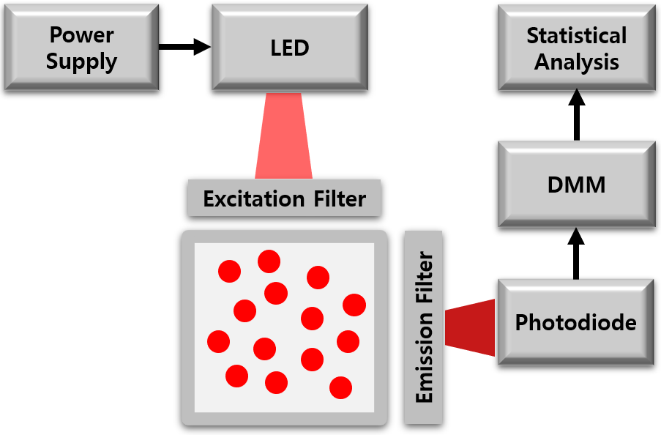
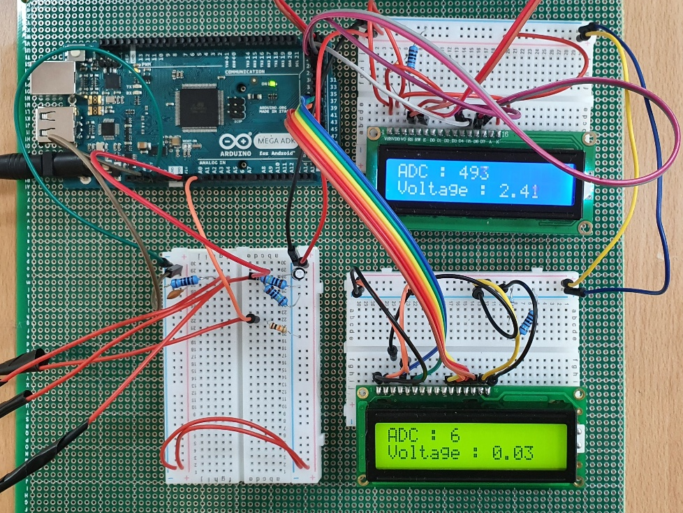
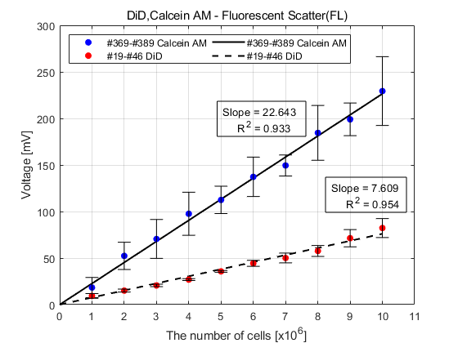
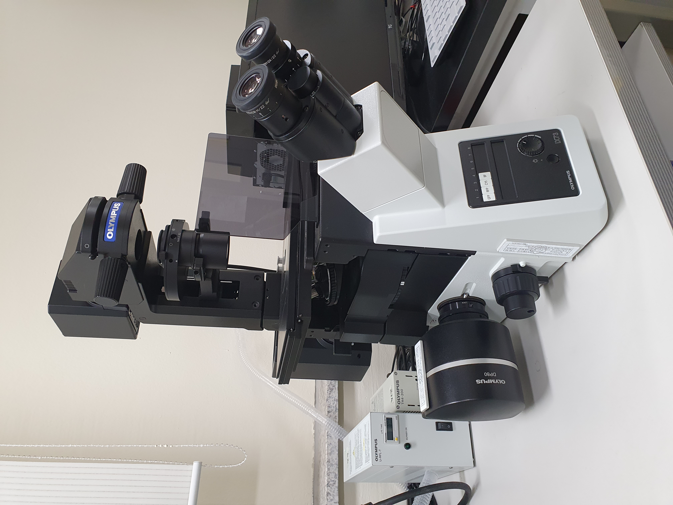
2. Methods
Experimental Process
Module Development
in-vitro Experiment
Characterization
Constant Current Module
Fluorescence Treatment
SSC Measurement
Optical Detection Module
Cell Count
Statistical Analysis

Slide 5
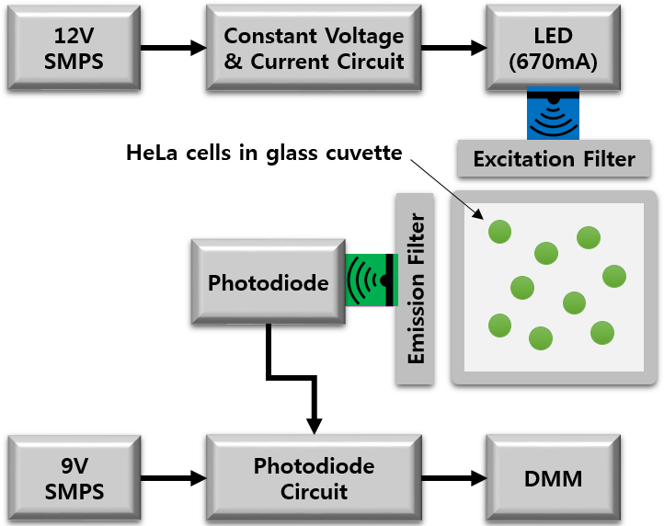
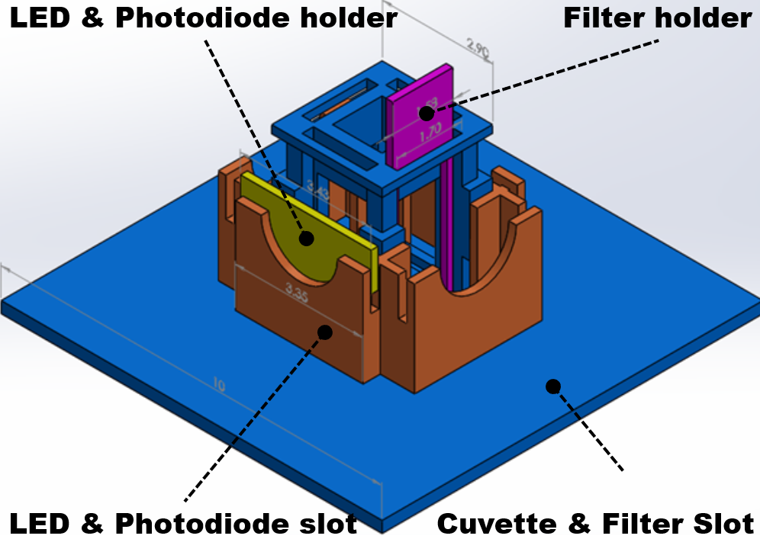
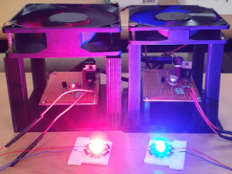
2. Methods
Module Development
Constant current module design (LED)
Switch Mode Power Supply (12V, 1A)
System Cooler (12V, 0.2A)
LED (Photron, 3W, 470nm-Blue, 620nm-Red)
Optical detection module (Photodiode)
Switch Mode Power Supply (9V, 1A)
Photodiode (FDS-1010, Thorlabs, 350-1100nm)
Arduino Mega ADK (Atmega 2560)
Main module(3D printing)
SolidWorks (Dassault Systems, USA)
3D Printer (3DP-310F, Cubicon Inc., Korea)
[Schematic Diagram of the System ]
[3D design]
[Constant Current Module]
[Optical Detection Module]

Slide 6
2. Methods
in-vitro Experiment
Cell information
Human cervical cancer cells (HeLa, Korean Cell Line Bank, Korea)
CO₂ Incubator 72 hours incubation
Excitation / emission wavelength of fluorescent dyes
DiD (644nm / 665nm)
Calcein-AM (495nm / 516nm)
Observing fluorescence and cell count
Inverted fluorescent microscope (IX73, Olympus, Japan)
Using Hemocytometer to count
[Cell Incubation and Fluorescence Treatment]
[Observing Fluorescence and Cell Count]

Slide 7
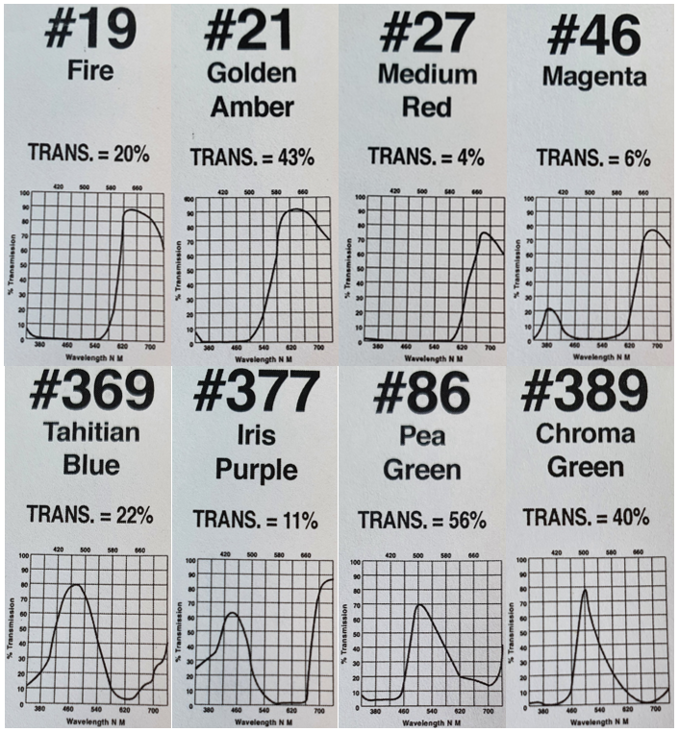
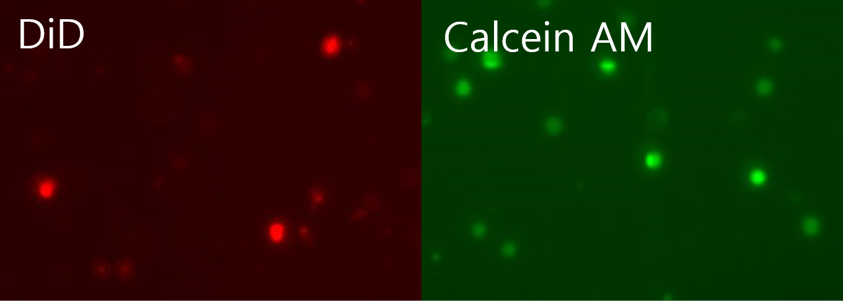
2. Methods
Characterization
SSC measurement and analysis
Fluorescently treated HeLa cell suspension with DiD and Calcein AM 10×10⁶ cells/2ml loaded on the quartz cuvette of the main module
Change the cell concentration and measure SSC (10×10⁶ cells/2ml →1×10⁶ cells/2ml)
Red / Blue LED and optical filter optimization by reflecting the excitation / emission [nm] optical properties of fluorescent dyes.
Confirmation of fluorescence scattering (FL) from the difference in SSC intensity and verification through Hemocytometer
[Method of measuring SSC]
[Characteristics of optical filter]
[HeLa treated with DiD & Calcein AM]

Slide 8
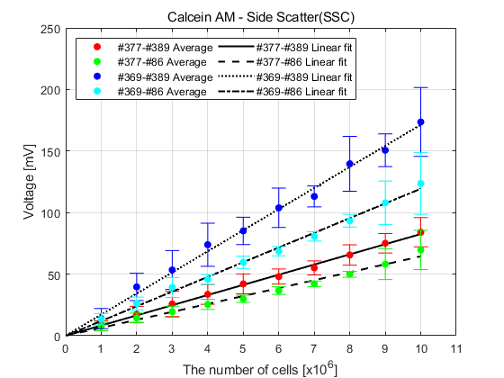
3. Results and Discussions
SSC of the HeLa treated with Calcein-AM

Slide 9
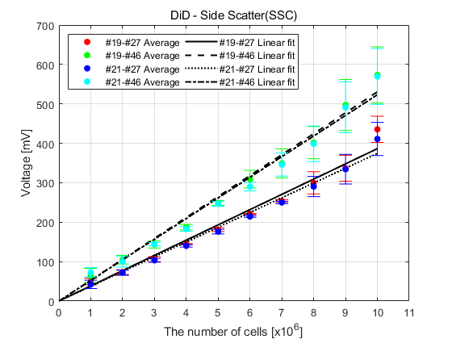
3. Results and Discussions
SSC of the HeLa treated with DiD

Slide 10
3. Results and Discussions
FL of HeLa treated with Calcein-AM vs. DiD

Slide 11
4. Conclusions
In this study, instead of the commercially available expensive flow cytometry system, a small optical signal measurement system using relatively inexpensive LED and photodiode was developed.
As a result of measuring SSC of HeLa treated with Calcein AM and DiD using various filters, high linearity in proportion to the number of cells was confirmed, and an optimized optical filter was able to select
As a result of confirming FL from the difference in SSC intensity between experimental group and the control group, high linearity in proportion to the number of cells was confirmed.
The proposed system enables quantitative comparison of cells and optical characteristics analysis within a relatively fast time with low cost of use.
Since it is easy to replace the LED and optical filter, it is possible to use light sources and filters in various wavelength ranges, and the freedom to select target cells and fluorescent dyes is expanded.
As a follow-up study, a system capable of simultaneous measurement for each cell will be constructed by improving the 3D structure of the main module and the performance of the optical detection module.

Slide 12
Thank You
Q & A

