Slide 1
A.N.Kalashnikov
A.Elyounsi
A.Holloway
Student sensor lab at home: safe repurposing of your gadgets

Slide 2
Outline
Motivation: why repurposing home audio computing equipment
Controlling the equipment
Utilising ground loop isolators
Connecting audio equipment to a custom circuit
Using an external USB audio card
Using Bluetooth audio
Using Arduino
Using custom hardware
Conclusions

Slide 3
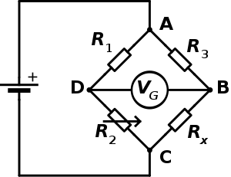
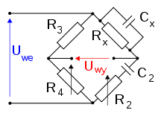
Why repurpose
COVID-19 severely restricted lab use on university campuses
Hands on labs experience is essential for training electrical and electronic engineers
There is no economical way of supplying, maintaining and supervising students at home with a professional measurement equipment
Most of common gadgets that students possess (smartphones, tablets, laptops, PCs) are equipped with decent quality stereo audio
Although audio range is limited to 20 … 20,000 Hz, these frequencies can be used for various sensor experiments, e.g. for Wheatstone and Wein bridges

Slide 4
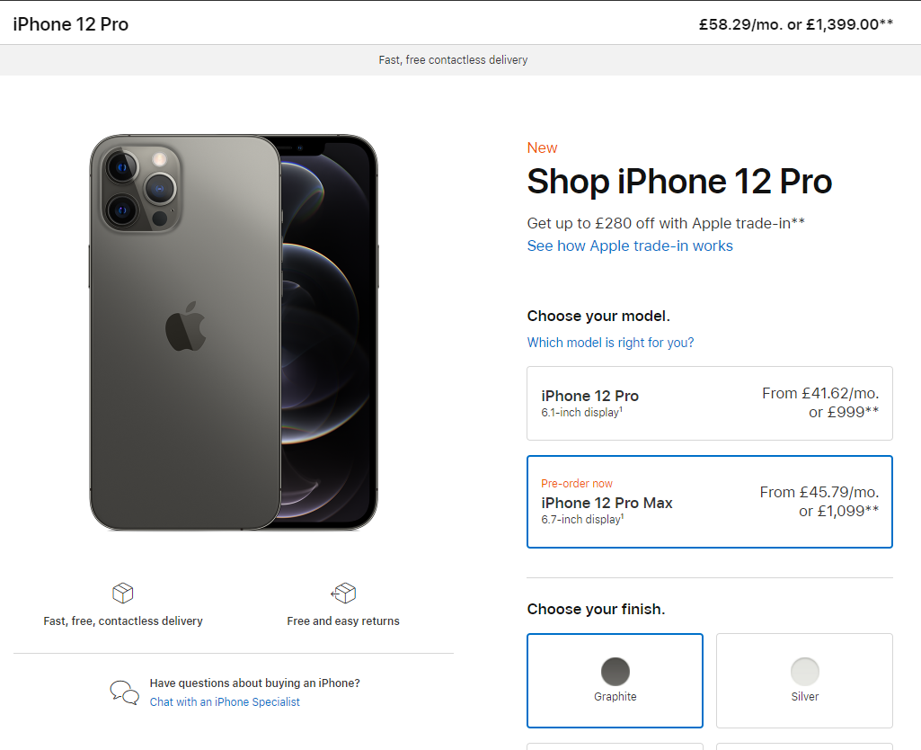
Is it straightforward
Unfortunately not because of the following main reasons
- safety of the learner (students can be very imaginative when using hardware; no university would want to get legally challenged because of H&S issues when operating laboratory instructions at home)
- protection of the expensive gadgets

Slide 5
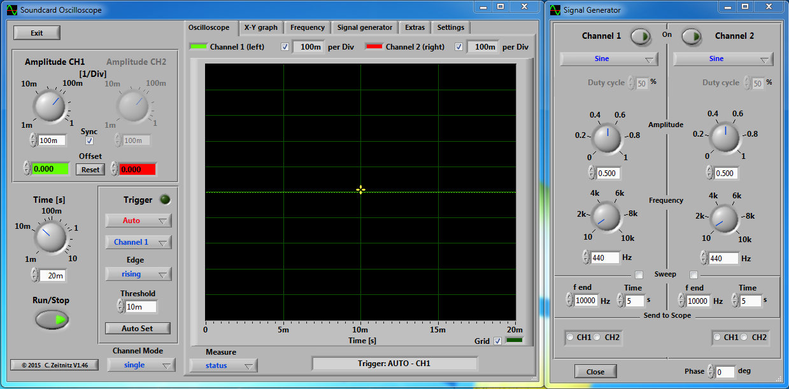
Apps that can be used for measurements (1)
Christian Zeitnitz. Soundcard PC osclloscope. https://www.zeitnitz.eu/scope_en

Slide 6
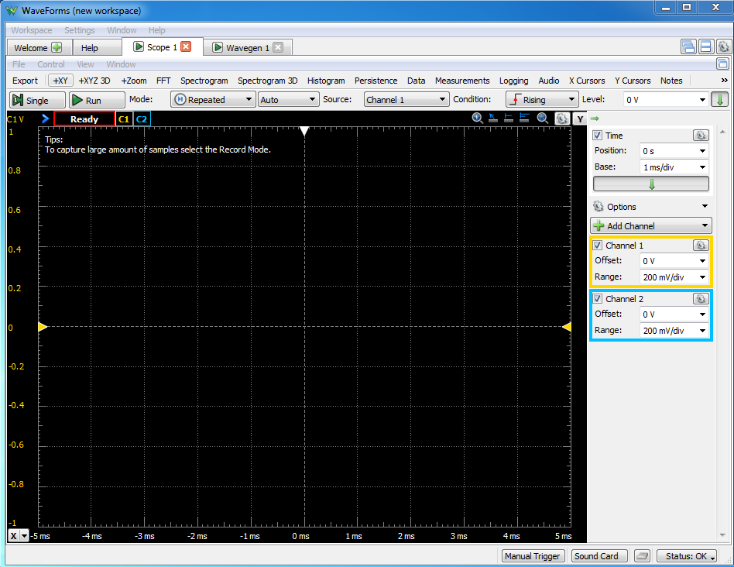
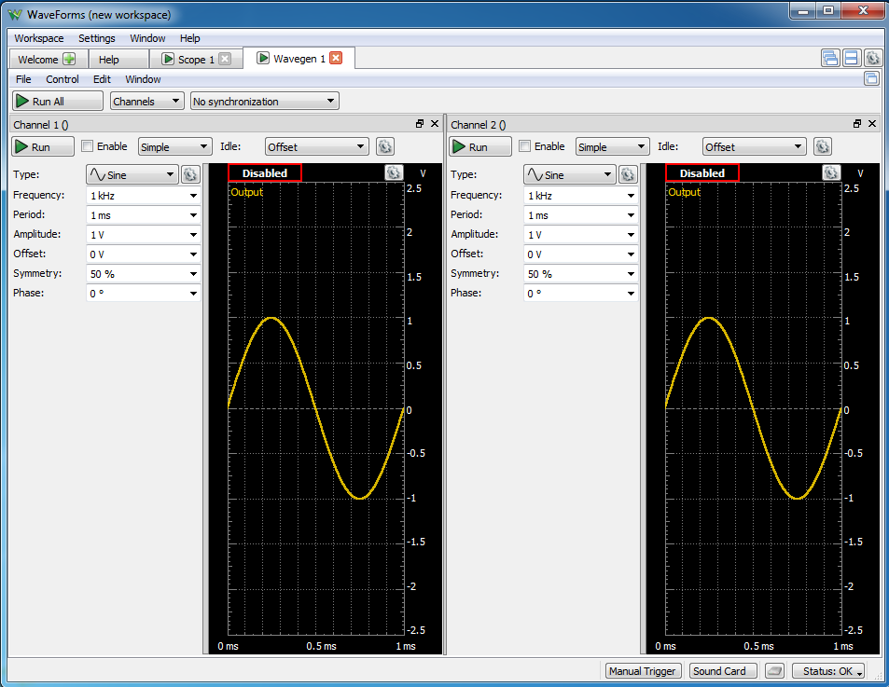
Apps that can be used for measurements (2)
Digilent Waveforms – work with the PC audio inputs and outputs

Slide 7
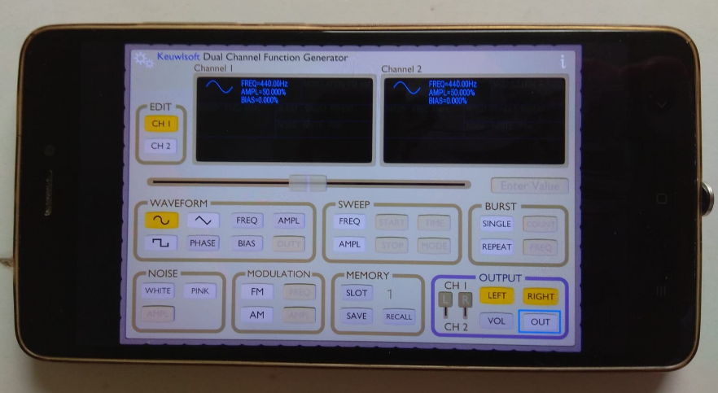
Apps that can be used for measurements (3)
Function generator from KEUWLSOFT for Android. https://www.keuwl.com/FunctionGenerator/

Slide 8
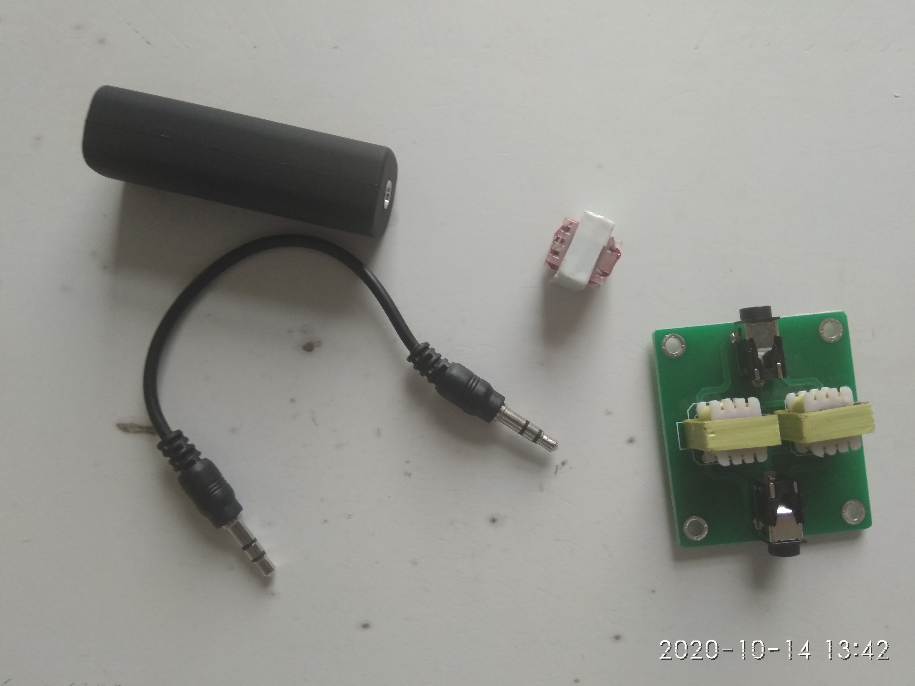
Ground loop isolators
Are used to reduce hum (mains and low frequency noise)
Include transformer in every channel to isolate ground potentials
Block DC with a capacitor (not present on the board)
Up to 1.5 kV isolation stated in some datasheets

Slide 9
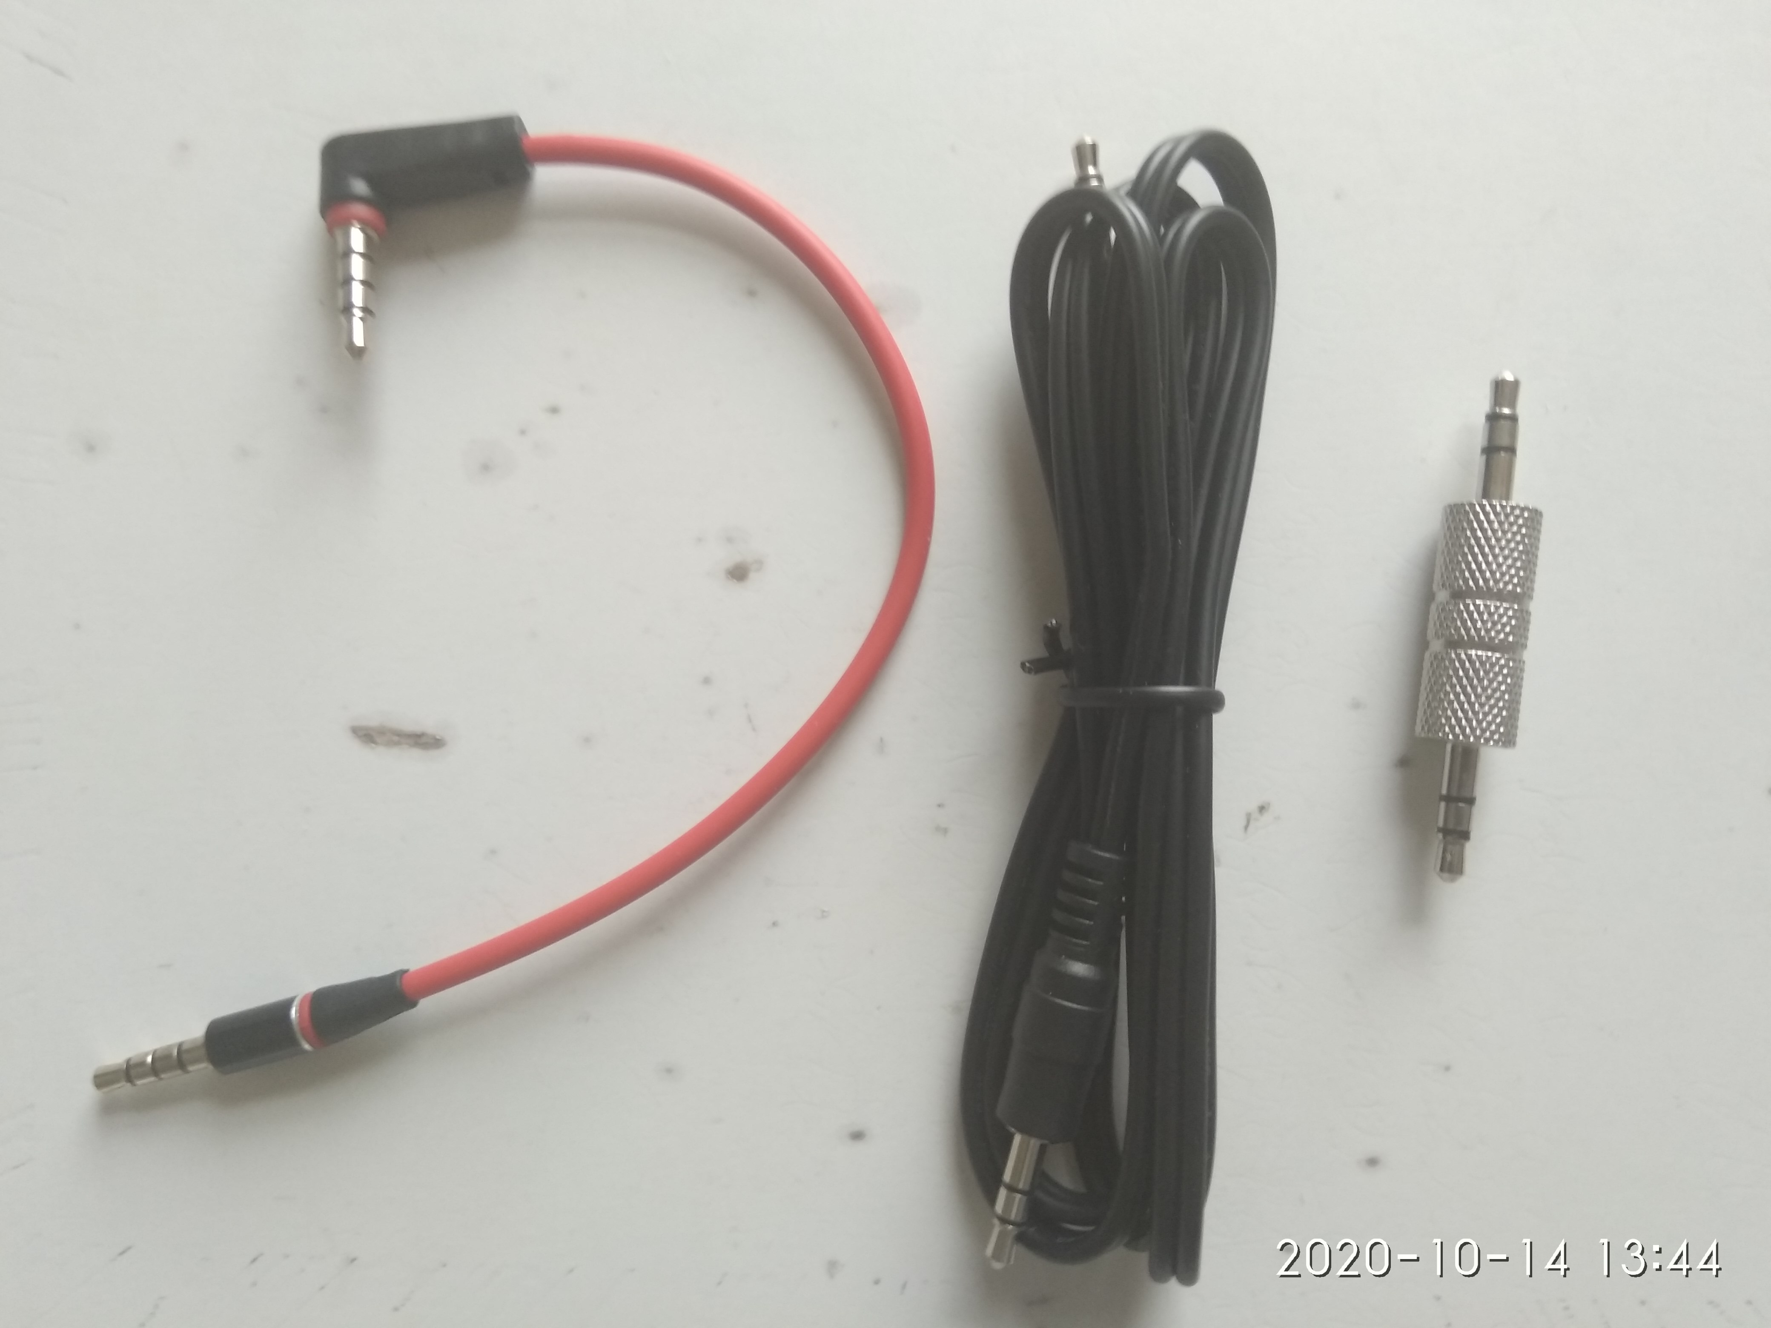
Not all the audio cables were born equal
TS (tip-sleeve, mono) cables are not suitable
! TS may short the stereo outputs !
TRS (tip-ring-sleeve, stereo) are fine
TRRS - (tip-ring-ring-sleeve, full headset – stereo headphones + mono microphone) are fine too

Slide 10
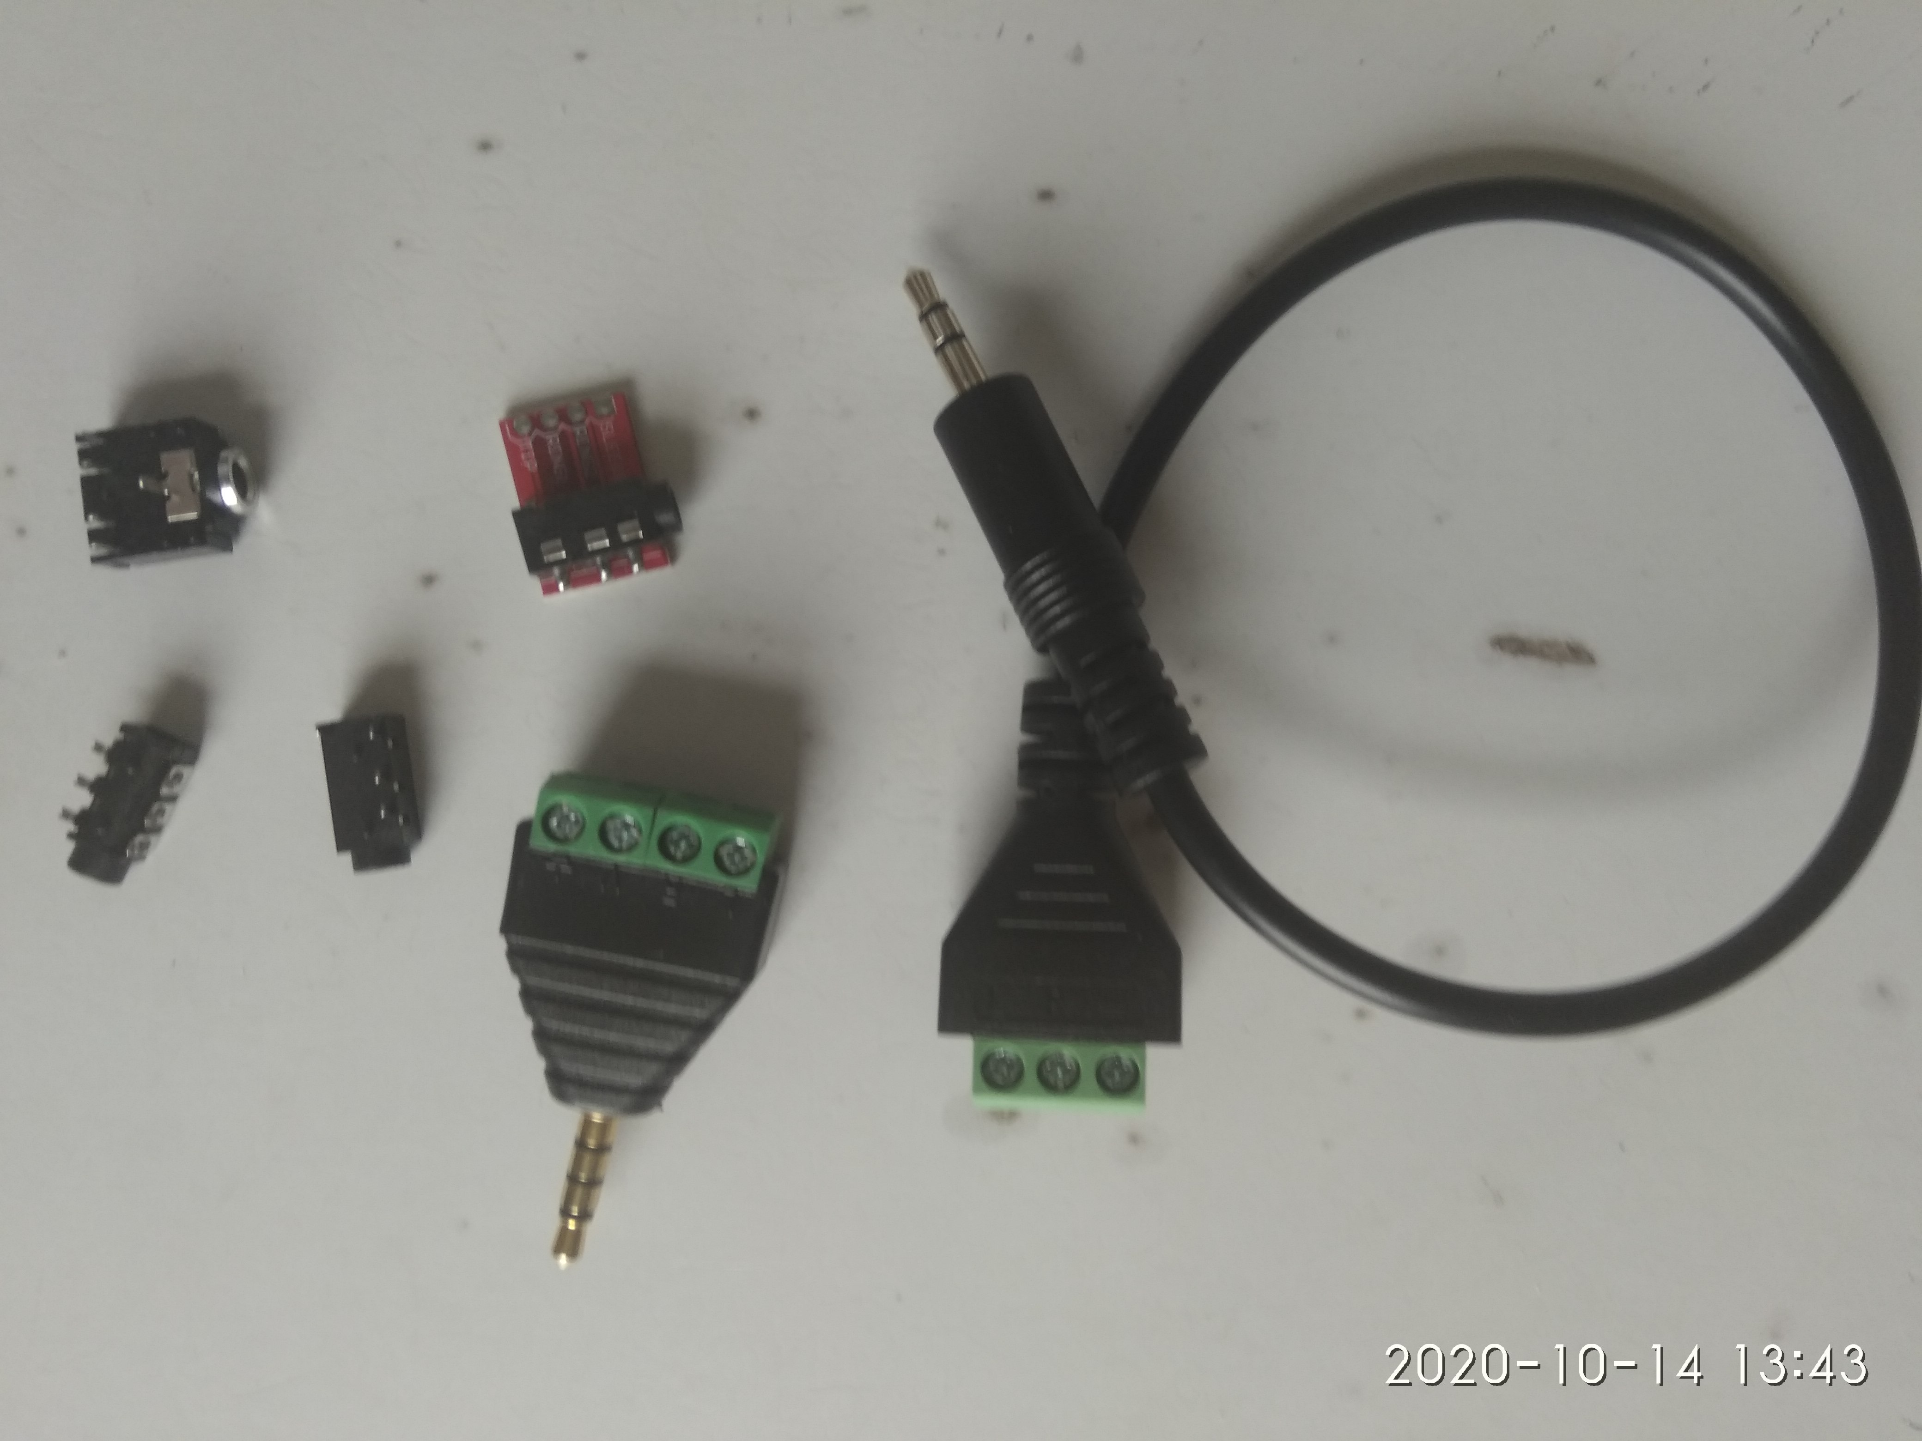
Some audio cable sockets and adapters
Are required to connect the isolated signal to a custom circuit (e.g. a breadboard)
Can be barebone sockets
Can have pin header
Can have screw terminals

Slide 11
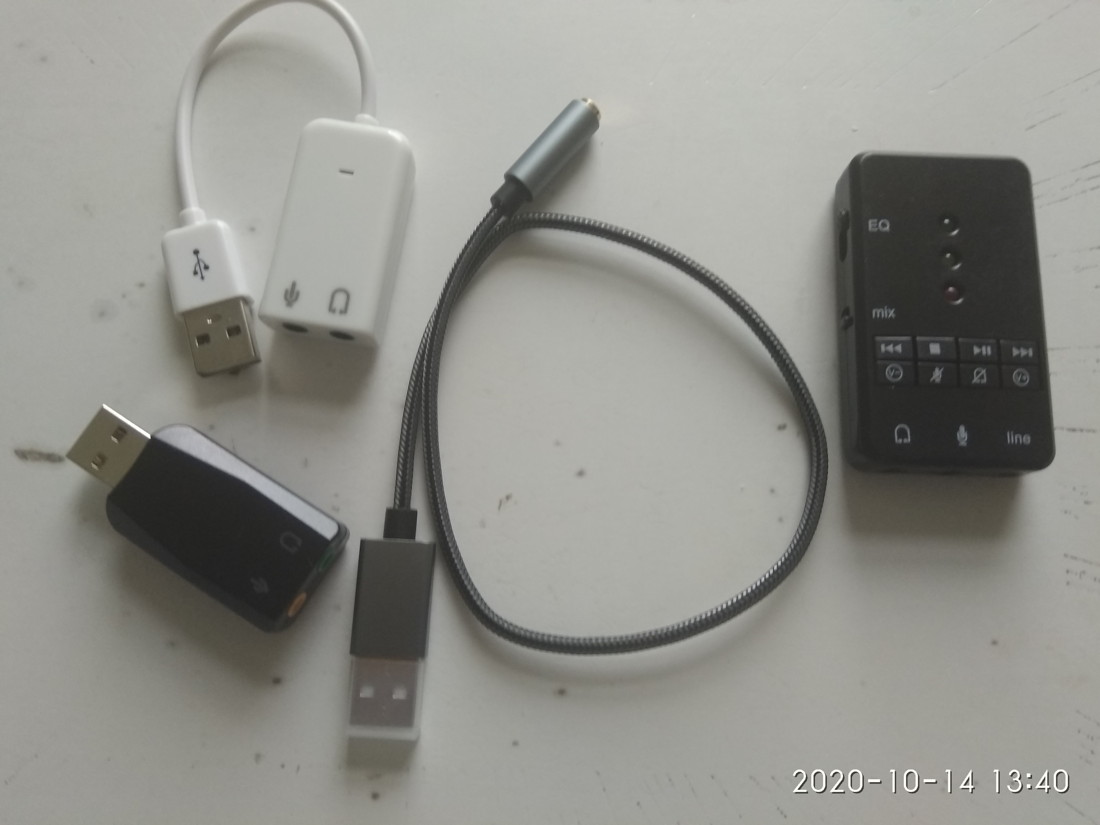
External USB audio cards
Usually have headphone stereo output and mono microphone input with separate sockets
Could be a full single TRRS socket though
Some even have stereo line input
CANNOT BE USED SAFELY W/O USB ISOLATOR

Slide 12
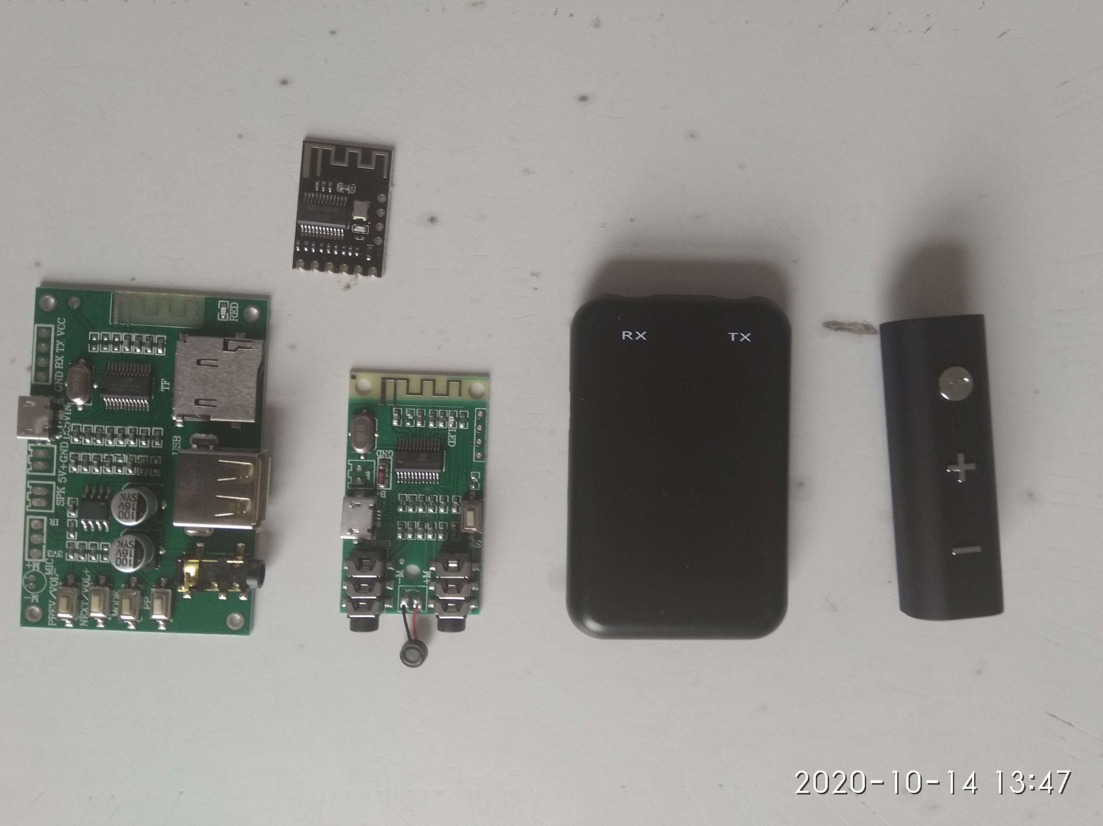
Using Bluetooth audio
Fully wireless
2 channel stereo
A separate transmitter and receiver are required
Some have built in rechargeable batteries
If not, use of power bank is recommended

Slide 13
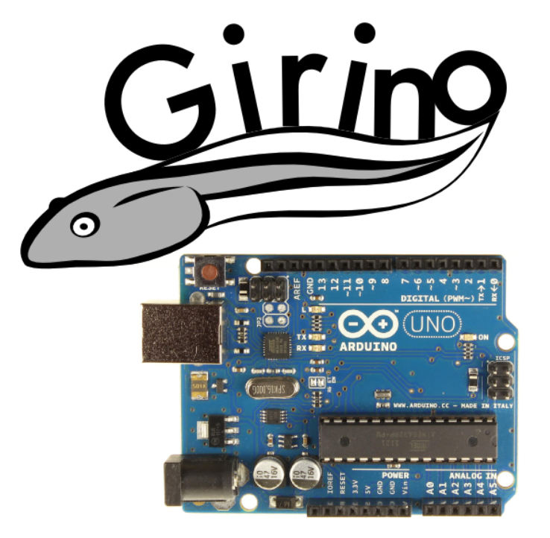
Arduino Uno: Girino + Girinoscope
Firmware for Arduino
1 ch 40 kHz sampling
Must be used with a USB isolator for safety
No generator
PC front end – Girinoscope from Github
Usable but not polished

Slide 14
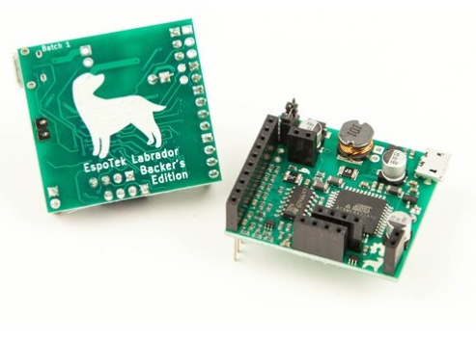
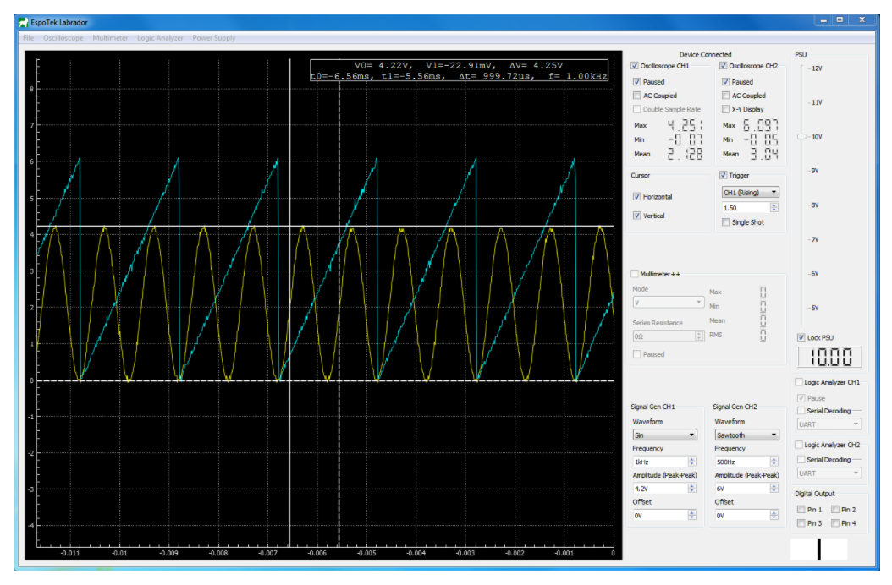
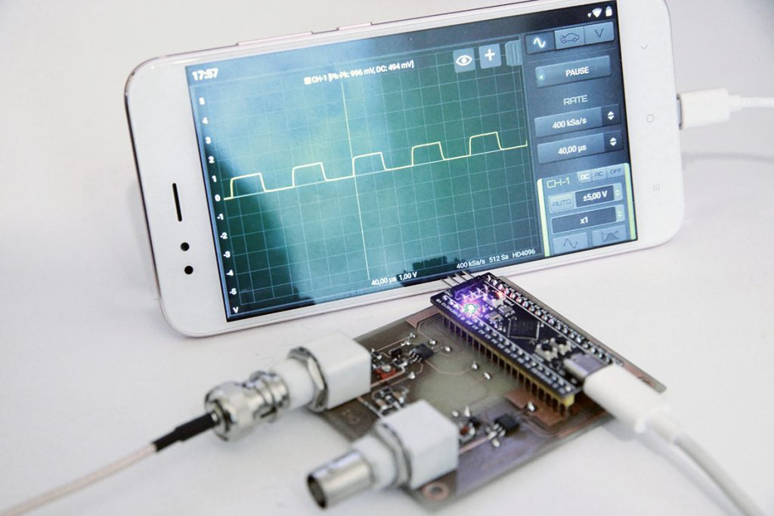
Two more options – USB isolators required !
PC front end
Android front end

Slide 15
Conclusions
It is possible to repurpose standard gadgets using off-the-shelf parts
The easiest option is to use two ground loop isolators with a PC’s audio line input and output
Inexpensive USB audio cards commonly provide only one channel microphone input, and require a USB isolator
Bluetooth modules provide the best isolation but require two devices + two adaptors. For example, an Android phone sending the waveform to a BT receiver driving the circuit, and a BT transmitter acquiring waveforms to be sent to a BT equipped laptop
Low-cost customised or bespoke developments are viable too

