Slide 1
Theoretical elucidation of the formation of γ-butyrolactone from haloacetate
Imane TEMERa,*,Asmaa MOSTEFAIa ,Ali RAHMOUNIa
a Laboratory of modeling and calculation methods- Faculty of Sciences, University Doctor Tahar Moulay de Saida- Saida20000, Algeria
(imane_temer@yahoo.fr)

Slide 2
Experimentally; the production of γ-butyrolactone is done by several chemical routes [1];[2].

Slide 3
the addition of haloacetates to alkenes is an example. We shall compare experimental work [3]
with theoretical work

Slide 4
Global
Reactivity

Slide 5
Global descriptor | A | 1 | 2 | 3
E (u.a) | -117.9228 | -2760.8925 | -649.3706 | -200.5499
E_{HOMO} (u.a) | -0.2599 | -0.3168 | -0.3321 | -0.2918
E_{LUMO} (u.a) | 0.0024 | -0.0528 | -0.0333 | -0.0806
GAP HOMO/ LUMO | 0.2623 | 0.2640 | 0.2988 | 0.2112
ɥ (ev) | -3.5020 | -5.0266 | -4.9694 | -5.0646
η (ev) | 7.1346 | 7.1802 | 8.1274 | 5.7446
ω (ev) | 0.8595 | 1.7595 | 1.5192 | 2.2325
N (ev) | 2.0482 | 0.5004 | 0.0843 | 1.1805

Slide 6
Table shows that
the chemical potential μ of haloacetate 1; 2 and 3 is at an energy level higher than that of the alkene; which implies that the transfer of electrons takes place from the haloacetate to the alkene.
The nucleophilicity index of alkene is significantly higher than that of haloacetate, which means that the alkene is a nucleophile while haloacetate is an electrophile. The same conclusion can be drawn from the electrophile index values.

Slide 7
Local
Reactivity

Slide 8
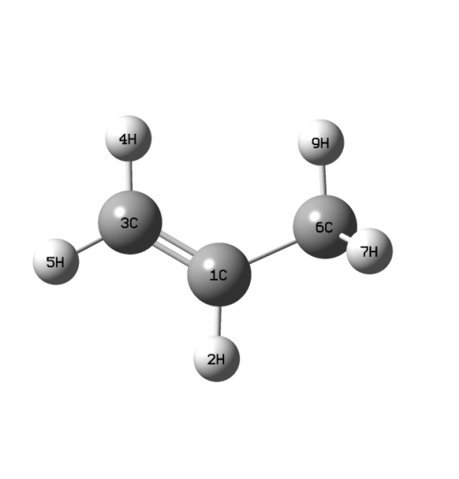
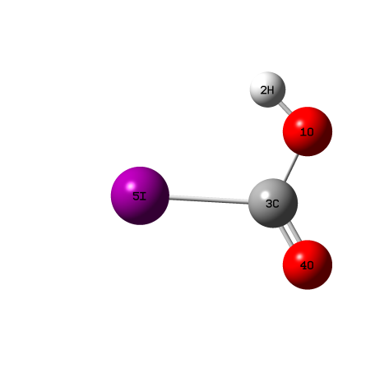
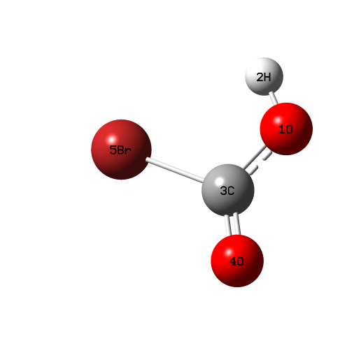
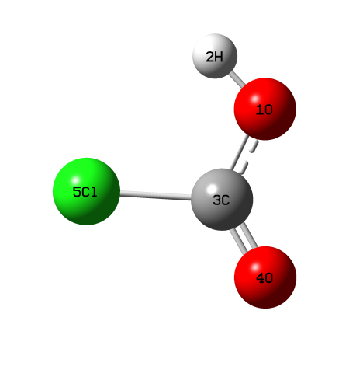
1 2 3
Figure 2: Optimized structure of alkene and haloacetate.

Slide 9
Net charges on the
various sites

Slide 10
site | MPA
compound A
1 C 3 C 6 C | 0.1225 -0.3499 -0.6169
compound 1
1 O 3 C | -0.3439 0.3678
compound 2
1 O 3 C | -0.3445 0.2678
compound 3
1 O 3 C | -0.2846 0.1212

Slide 11
Compound A: Both C₃ and C₆ sites of the C = C bond are rich in electrons (net negative charge). However, the C₁ site is deficient in electrons (positive charge). This suggests that the C₃ and C₆ sites (the carbons of the double bond) are more favored for electrophilic attack. And the C₁ site for nucleophilic attack

Slide 12
Compounds 1; 2 and 3: the O₁ site is rich in electrons (net negative charge). However; the C₃ site is deficient in electrons (positive charge). This suggests that the O₁ site is more favored for an electrophilic attack. And the C₃ site for nucleophilic attack.

Slide 13
Local and dual reactivity descriptors

Slide 14
site | f_{k}⁺ | f_{k}⁻ | ^{w+} | ^{w-}
compound A
1 C 3 C 6 C | -0.4136 -0.1340 0.3127 | 0.1301 0.2684 -0.0153 | -0.3555 -0.1152 0.2688 | 0.1118 0.2307 -0.0132
compound 1
1 O 3 C | -0.0813 0.3715 | 0.1020 0.0025 | -0.1430 0.6537 | 0.1795 0.0044
compound 2
1 O 3 C | -0.5821 0.8911 | 0.1206 -0.0176 | -0.8843 1.3538 | 0.1832 -0.0267
compound 3
1 O 3 C | -0.0571 0.2770 | 0.0898 0.0468 | -0.1275 0.6184 | 0.2005 0.1045

Slide 15
The function of Fukui f_{k}⁻ and ω⁻ provides information on the electrophilic attack. Table indicates the C₃ site (in compound A) and O₁ (in compounds 1, 2 and 3) are more nucleophilic and active towards electrophiles.

Slide 16
The function of Fukui f_{k}⁺ and ω⁺ provides information on nucleophilic attack. The C₁ site (in compound A) and C₃ (in compounds 1; 2 and 3) are more nucleophilic and active with respect to nucleophiles.

Slide 17
The descriptors Δf_{k} and Δω_{k} are capable of simultaneously explaining the electrophilia and the nucleophilia of the given atomic sites.

Slide 18
Compound A | Δf | Δω
1 C 3 C 6 C | -0.5437 -0.4024 0.3280 | -0.4673 -0.3459 0.2820
Compound 1 | Δf | Δω
1 O 3 C | -0.1833 0.3690 | -0.3225 0.6493
Compound 2 | Δf | Δω
1 O 3 C | -0.7027 0.9087 | -1.0675 1.3805
Compound 3 | Δf | Δω
1 O 3 C | -0.1469 0.2302 | -0.3280 0.5339

Slide 19
Prediction of the
reaction mechanism

Slide 20
 | E _{reactif} (a.u) | E _{ts} (a.u) | E _{product} (a.u) | E _{a} (kcal/mol)
TS₁ (1) | -2878.8203 | -2878.7407 | -2878.8463 | 49.9372
TS₂ (2) | -767.2939 | -767.1946 | -767.32883 | 62.3176
TS₃ (3) | -318.4713 | -318.3920 | -318.4995 | 49.7599

Slide 21
The activation energy associated with the formation of gamma-butyrolactone from iodoacetate slightly higher than those associated with the formation of gamma-butyrolactone from bromoacetate and chloroacetate.

Slide 22
The energy profile corresponding to the condensation of the alkene with the haloacetate is shown schematically in next Figures

Slide 23
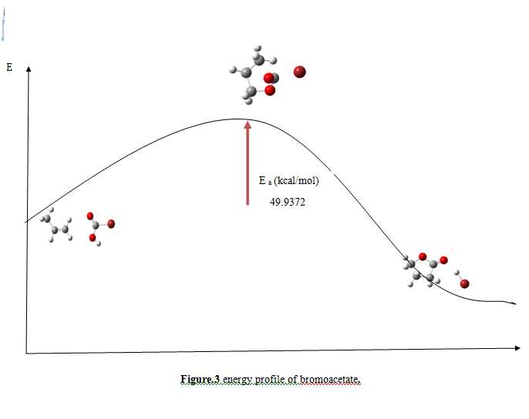

Slide 24
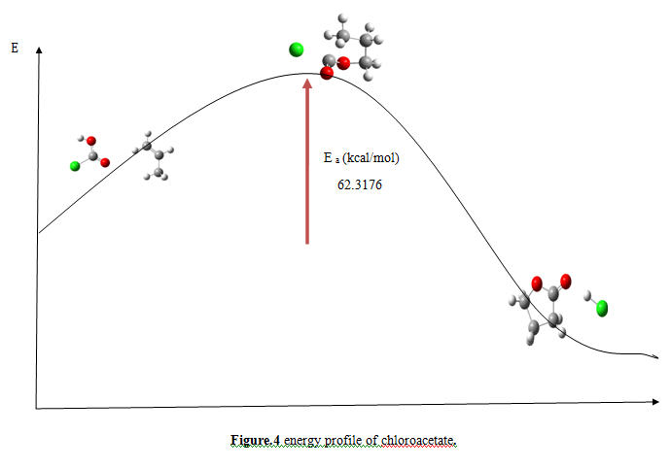

Slide 25
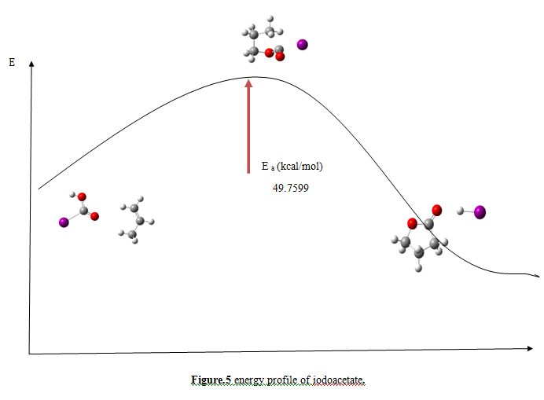

Slide 26
Conclusion

Slide 27
Theoretical calculation by the DFT B3LYP method of the electron density of certain atoms of the reactants; electrophilic and nucleophilic character; the Fukui indices of the addition reaction of alkene with haloacetates; the localization of the transition states, the atomic electronic populations and the reactivity indices calculated by (MPA) allowed us to conclude that:

Slide 28
a good match between theoretical work and experimental work
Good agreement was found between the different theoretical approaches used.
An ionic bond forms between the O₁ atom of haloacetate and the C₁ atom of the alkene.
The formation of γ-butyrolactone from haloacetate is easily done by iodoacetate.

Slide 29
Reference
[1] ALI, Mohd Tajudin Mohd. SYNTHESIS OF (-)-GEISSMAN WAISS LACTONE, cis γ-BUTYROLACTONE DERIVATIVES AND γ-PEPTIDES. 2011. Thèse de doctorat. Universität Regensburg.
[2] Semak, V., Boháč, A., Sališová, M., Addová, G., & Danko, P. (2008). Preparation of α-methyl-γ-butyrolactone: Mechanism of its formation and utilization in 2-methyl-1-tetralone synthesis. Chemical Papers, 62, 275-280.
[3] MAEJIMA, Saki, YAMAGUCHI, Eiji, et ITOH, Akichika. trans-Diastereoselective Syntheses of γ-Lactones by Visible Light-Iodine-Mediated Carboesterification of Alkenes. ACS omega, 2019, vol. 4, no 3, p. 4856-4870.

Slide 30
thank you for your
attention

