Slide 1


In silico evaluation of antimicrobial activity of some thiadiazoles using molecular docking approach
The 24th International Electronic Conference on Synthetic Organic Chemistry
15 Nov - 15 Dec 2020
Amalia Stefaniu^{1*}, Lucia Pintilie¹, Veronica Anastasoaie²
and Eleonora-Mihaela Ungureanu^{2*}
¹ National Institute for Chemical - Pharmaceutical Research and Development – ICCF, 112 Vitan av. 031299 Bucharest, Romania
² Department of Inorganic Chemistry, Physical Chemistry and Electrochemistry, “Politehnica” University of Bucharest, Gheorghe Polizu 1-7, 011061, Sector 1, Bucharest, Romania
* Corresponding authors: email address: astefaniu@gmail.com; em_ungureanu2000@yahoo.com

Slide 2



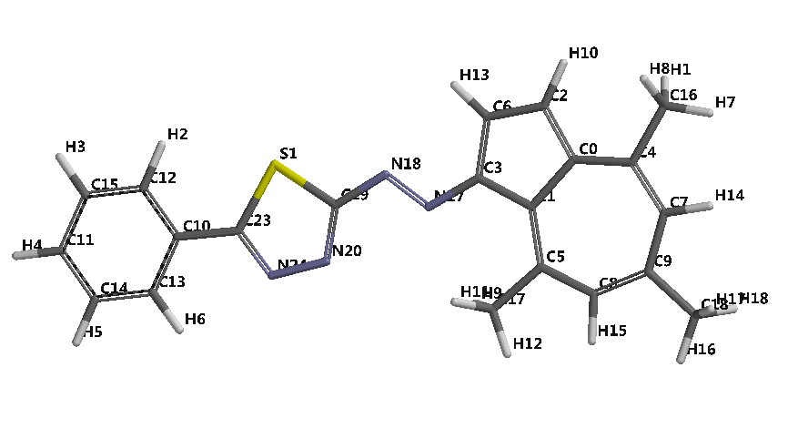
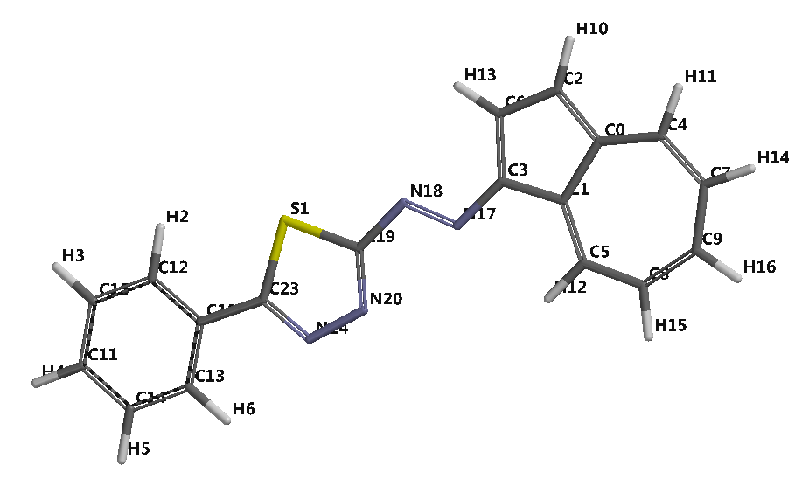
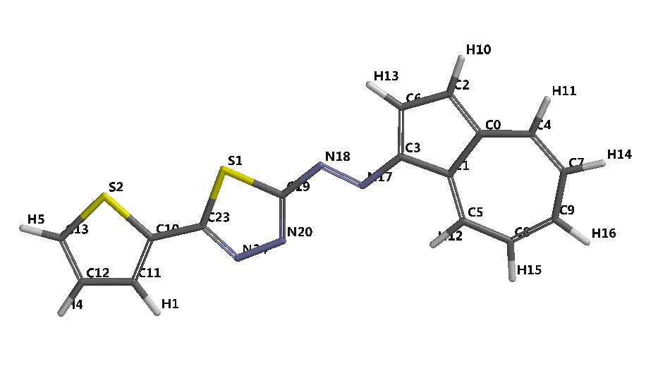
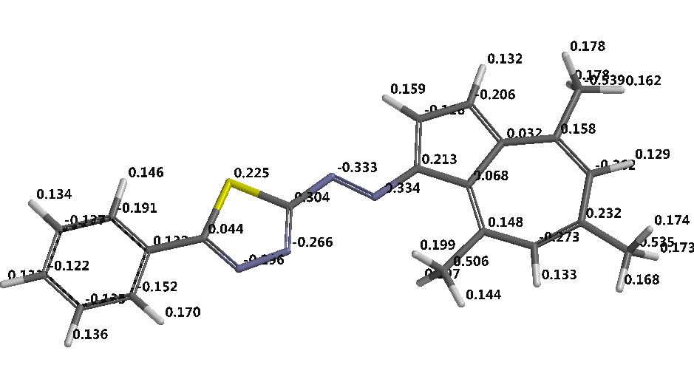
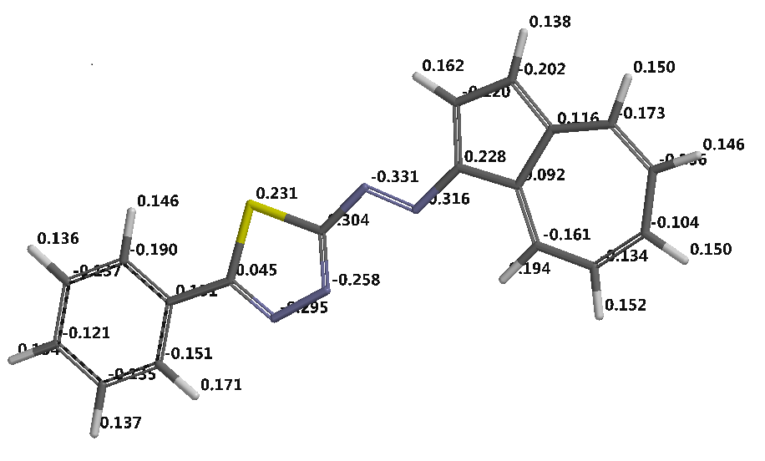
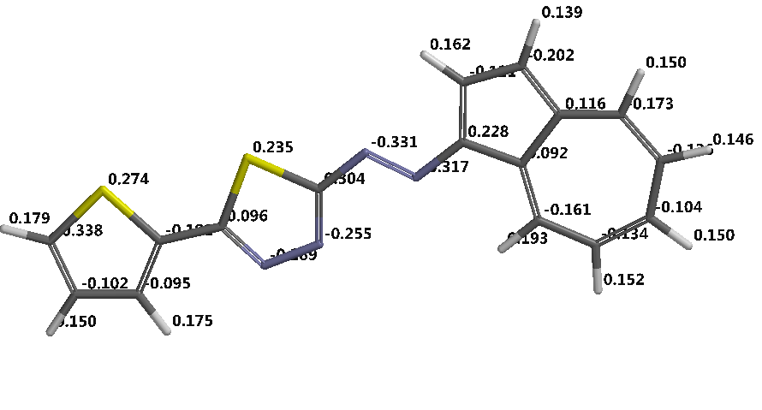
Structures of 1,3,4 – thiadiazoles under investigation
T2
T3
T1
Geometry optimization: energy minimization, MMFF*, with Spartan Software, Wavefunction Inc, Irvine, USA**
* W.J. Hehre, A Guide to Molecular Mechanics and Quantum Chemical Calculations, Wavefunction, Inc., Irvine, CA, 2003
** Y. Shao, L.F. Molnar, Y. Jung, et al., Advances in methods and algorithms in a modern quantum chemistry program package, Phys. Chem. Chem. Phys.2006, 8, 3172-3191
T1
T1
T2

Slide 3
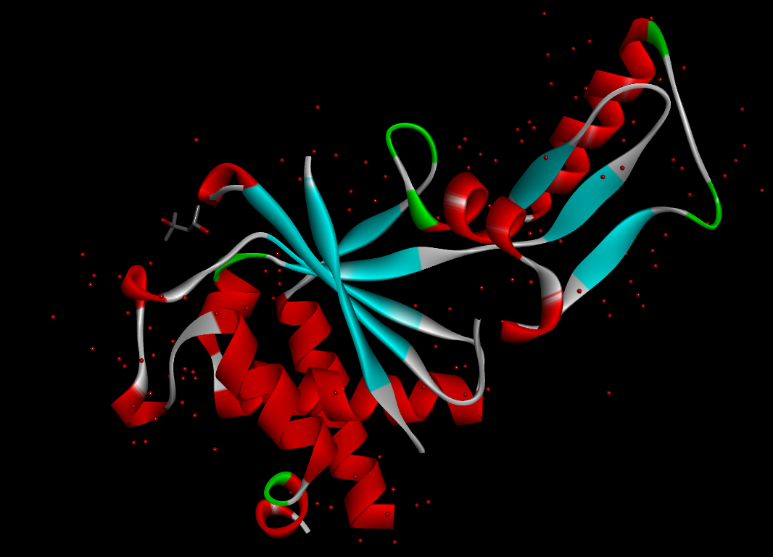
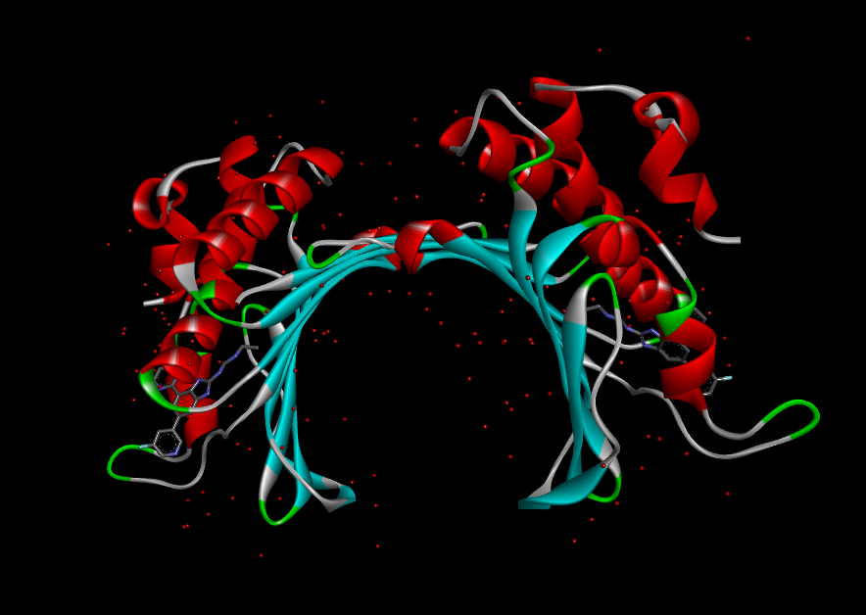
Biological targets from Protein Data Bank
PDB ID : 3M4I [1]
Crystal structure of the second part of the Mycobacterium tuberculosis DNA gyrase reaction core: the TOPRIM domain at 1.95 A resolution
PDB ID : 4P8O [2]
S. aureus gyrase bound to an aminobenzimidazole urea inhibitor
PDB ID : 4RTO [3]
Complex of Escherichia coli DNA Adenine Methyltransferase (DAM) with Sinefungin and with DNA Containing Proximal Pap Regulon Sequence
[1] J. Piton, S. Petrella, M.Delarue, G. Andre-Leroux, V. Jarlier, A. Aubry, C. Mayer, Structural insights into the quinolone resistance mechanism of Mycobacterium tuberculosis DNA gyrase, PLoS One 2010 5, e12245-e12245.
[2] A.L. Grillot, A. Le Tiran, D.Shannon, E. Krueger, et al. Second-Generation Antibacterial Benzimidazole Ureas: Discovery of a Preclinical Candidate with Reduced Metabolic Liability, J. Med. Chem. 2014, 57, 21, 8792–8816.
[3] J.R. Horton, X. Zhang, R.M. Blumenthal, X.Cheng, Structures of Escherichia coli DNA adenine methyltransferase (Dam) in complex with a non-GATC sequence: potential implications for methylation-independent transcriptional repression, Nucleic Acids Research 2015, 43(8), 4296–4308.

Slide 4
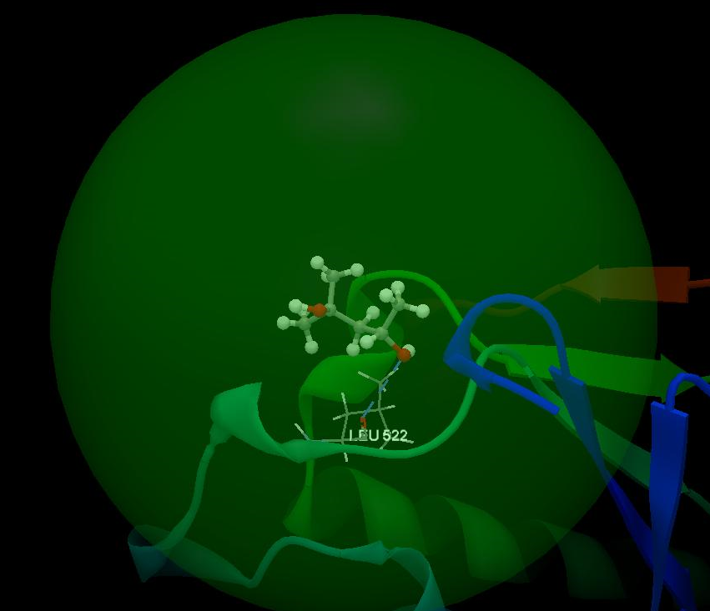
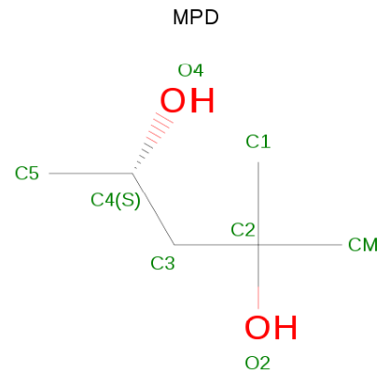
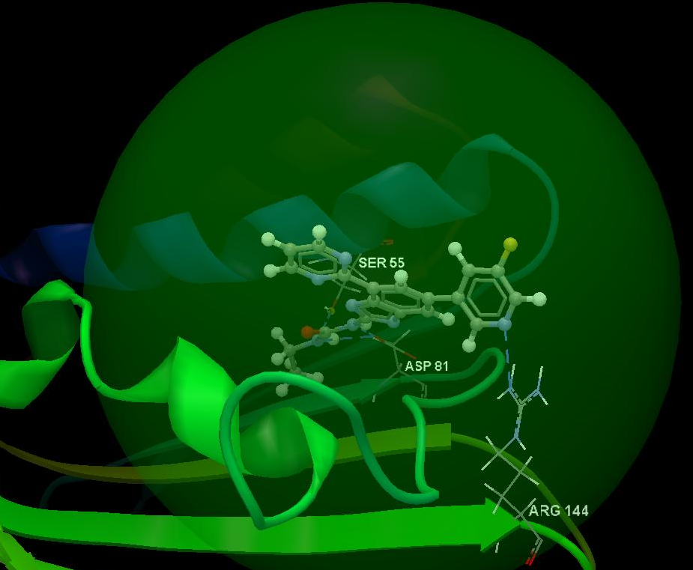
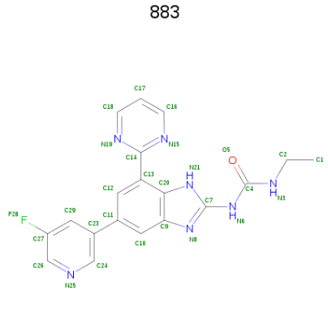
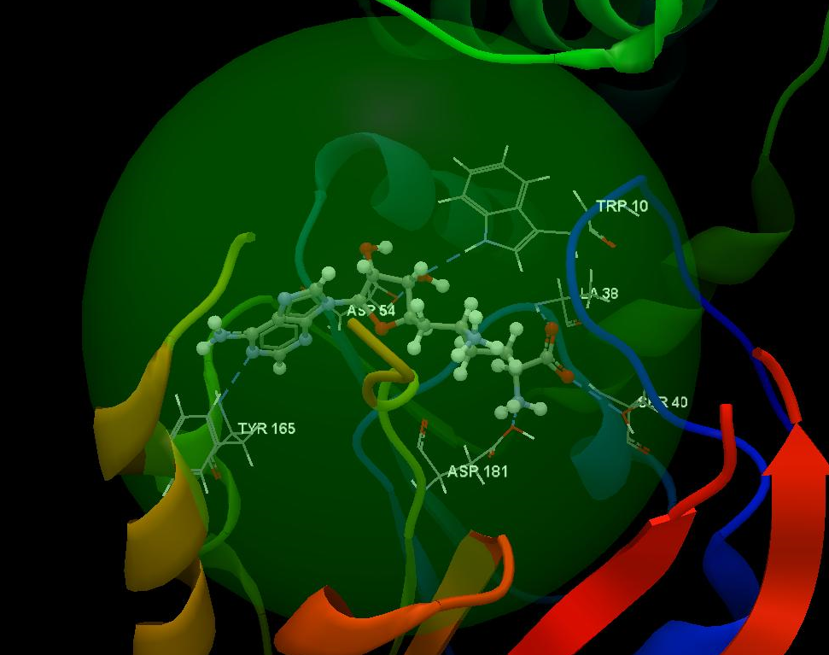
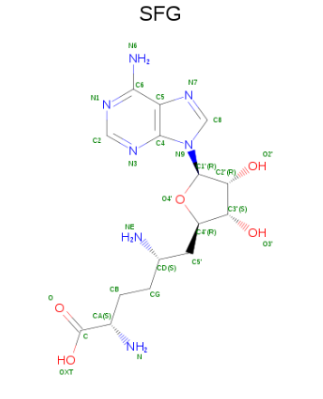
Docking validation of co-crystallized ligands
Interacting group
Ligand interactions (Å)
Score/ RMSD
3M4I
ARG451, HIS525, PRO450, TYR524, HIS560, GLY520, ILE519, LEU522, ARG523
O4(sp³) – O (sp²) LEU522:3.302
25.91
0.86
Ligand (MPD): (4S)-2-methyl-2,4-pentanediol
4P8O
ASN54, VAL52, ILE51, ILE102, VAL79, ILE175, VAL174, THR80, THR173, PRO87, GLY85, ASP81, ARG144, ARG84, GLY83, GLU58, SER55, ILE86
N25(sp²) – N(sp²) ARG144: 2.769
N6(sp²) – O(sp²) ASP81: 2.797
N3(sp²) – O(sp²) ASP81: 2.914
N3(sp²) – O(sp³) SER55: 3.081
70.22
0.08
Ligand (883): 1-ethyl-3-[5-(5-fluoropyridin-3-yl)-7-(pyrimidin-2-yl)-1H-benzimidazol-2-yl]ure
4RTO
ASN56, ILE55, PHE201, GLU163, SER164, GLN205, TYR165, SER168, LEU59, ASP54, PRO183, PHE35, ALA53, PRO182, PRO34, ASP181, GLU33, TYR179, VAL36, TYR184, VAL41, LYS14, SER40, GLY39, GLY13, GLY12, GLY37, ALA38, ALA11, TRP10
N1(sp²) – N(sp²) TYR165: 3.129
O2’(sp³) – O(sp²) ASP54: 2.654
O3’(sp³) – O(sp³) ASP54: 2.567
O3’(sp³) – N(sp²) TRP10: 3.128
O(sp²) – N(sp²) ALA38: 2.834
OXT(sp²) – O(sp³) SER40: 2.980
N(sp³) – O(sp³) ASP181: 2.426
67.74
0.79
Ligand (SFG): (2S,5S)-6-[(2R,3S,4R,5R)-5-(6-aminopurin-9-yl)-3,4-dihydroxy-oxolan-2-yl]-2,5-bis(azanyl)hexanoic acid

Slide 5
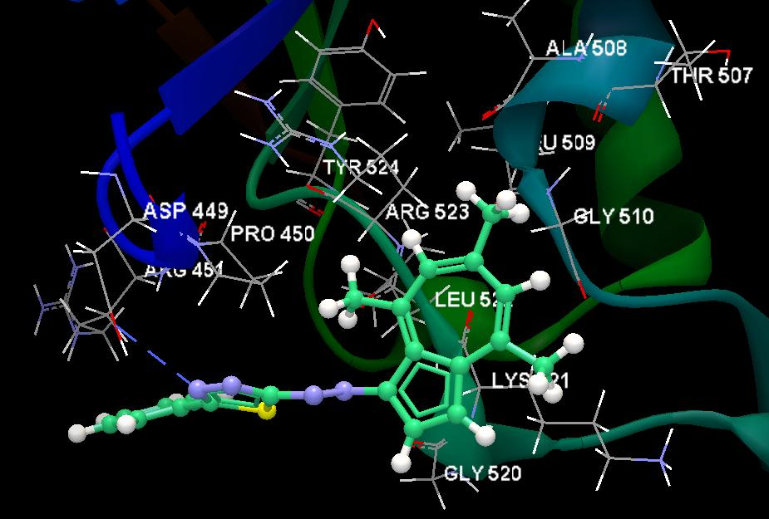
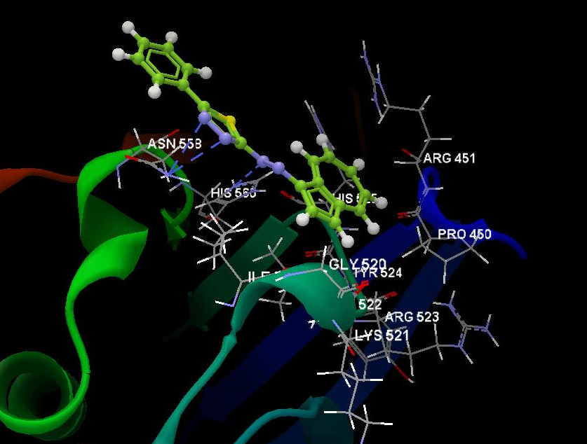
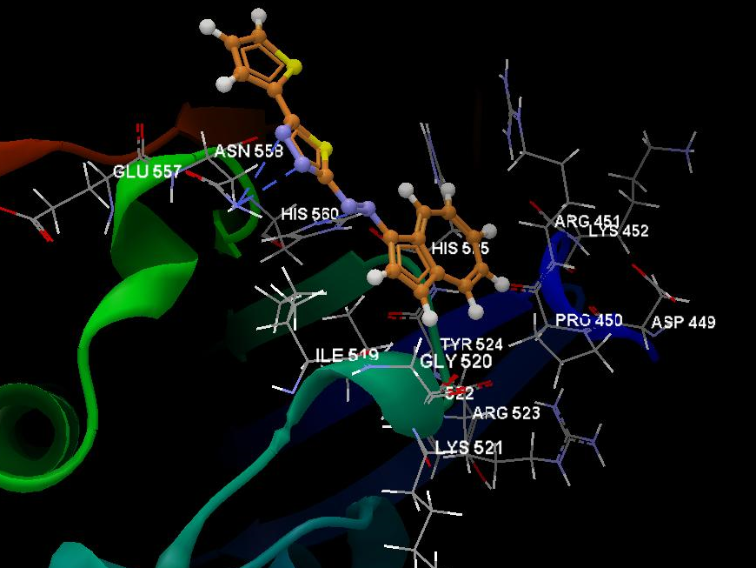
Docking results for 1,3,4 – thiadiazoles against 3M4I (Mycobacterium tuberculosis DNA gyrase)
T1
T2
T3
Interacting group
Interacting group
Interacting group
ASN558, HIS560, ILE519, HIS525, ARG451, PRO450, GLY520, TYR524, LEU522, ARG523, LYS521
GLU557, ASN558, HIS560, ILE519, HIS525, ARG451, LYS452, ASP449, PRO450, TYR524, GLY520, LEU522, ARG523, LYS521
ASP449, ARG451, PRO450, TYR524, ARG523, LEU522, LYS521, GLY520, ALA508, LEU509, GLY510, THR507
Hydrogen bonds:
N18(sp²) – N(sp²) HIS560: 3.057 Å
N20(sp²) - N(sp²) ASN558: 3.126 Å
N24(sp²) – N (sp²) ASN558: 3.103 Å
Hydrogen bonds:
Hydrogen bond:
N24(sp²) – O (sp³) ASP449: 3.247 Å
N17(sp²) – N (sp²) HIS560: 3.187 Å
N20 (sp²) – N(sp²) ASN558: 2.914 Å
N24 (sp²) – N (sp²) ASN558: 3.135 Å
Score: 38.19, RMSD: 0.06
Score:43.19, RMSD: 0.69
Score: 40.95, RMSD: 0.72

Slide 6
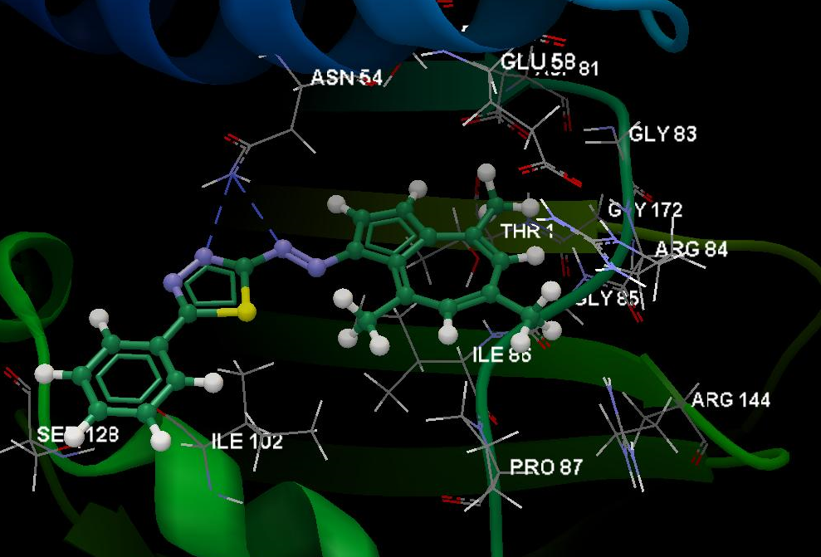
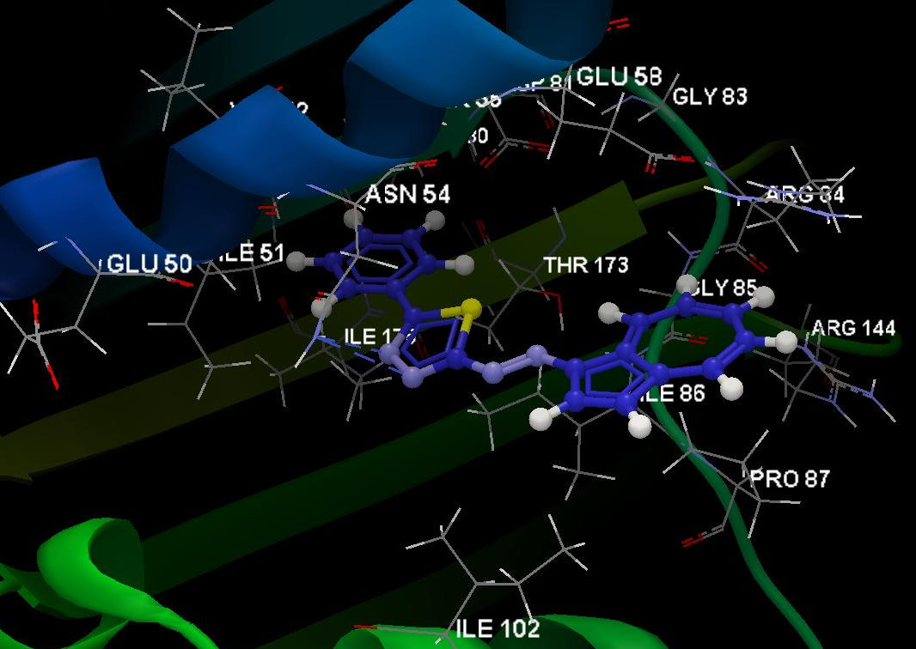
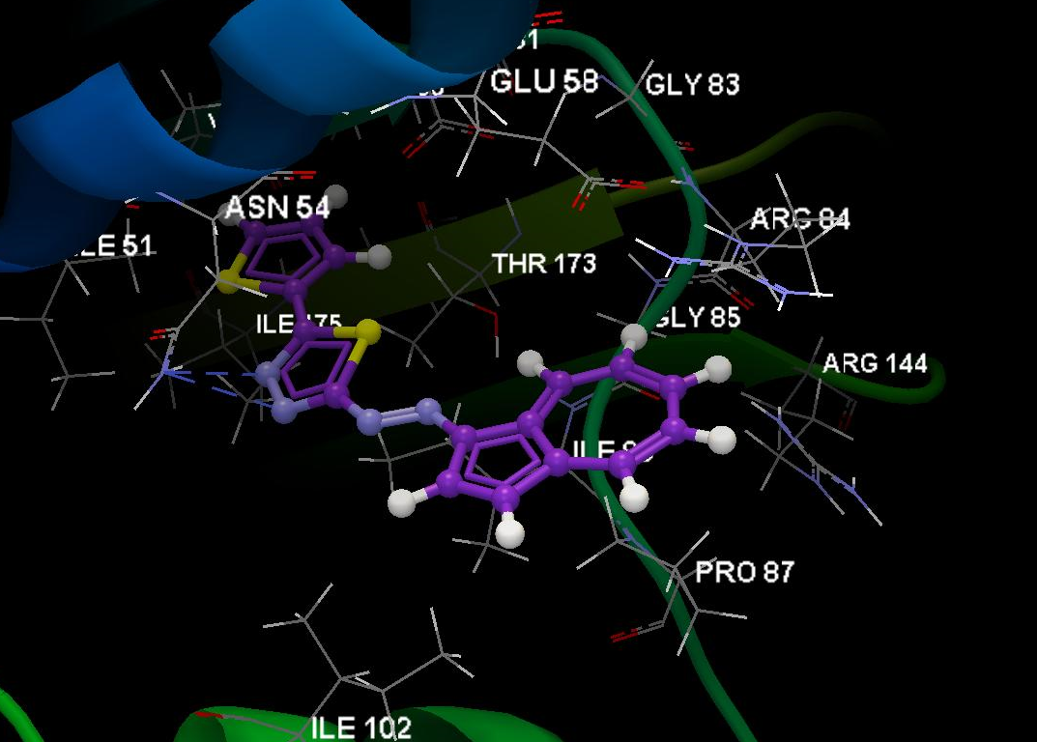
Docking results for 1,3,4 – thiadiazoles against 4P8O
(Staphyloccocus aureus gyrase )
T1
T2
T3
Interacting group
Interacting group
Interacting group
SER55, ASN54, GLU58, ASP81, GLY83, GLY172, ARG84, GLY85, ILE86, PRO87, ARG144, ILE102, SER128, THR173
VAL52, VAL79, ASN54, ILE51, GLU50, SER55, THR80, ASP81, GLU88, GLY83, ARG84, THR173, VAL174, ILE175, GLY85, ARG144, ILE86, PRO87, ILE102
ASP81, GLU58, GLY83, THR80, SER55, VAL79, ASN54, ILE51, ILE175, VAL174, THR173, ARG84, GLY85, ARG144, ILE86, PRO87, ILE102
Hydrogen bond:
N20(sp²) – N(sp²) ASN54: 3.062 Å
N18(sp²) – N(sp²) ASN54: 3.135 Å
Hydrogen bonds:
N24(sp²) – N(sp²) ASN54: 2.790 Å
N20(sp²) – N(sp²) ASN54: 2.944 Å
Hydrogen bonds:
N24(sp²) – N(sp2) ASN54: 2.954 Å
N20(sp²) – N(sp2) ASN54: 2.903 Å
Score: 58.08, RMSD: 0.10
Score: 56.49, RMSD: 0.18
Score: 53.61, RMSD: 0.19

Slide 7
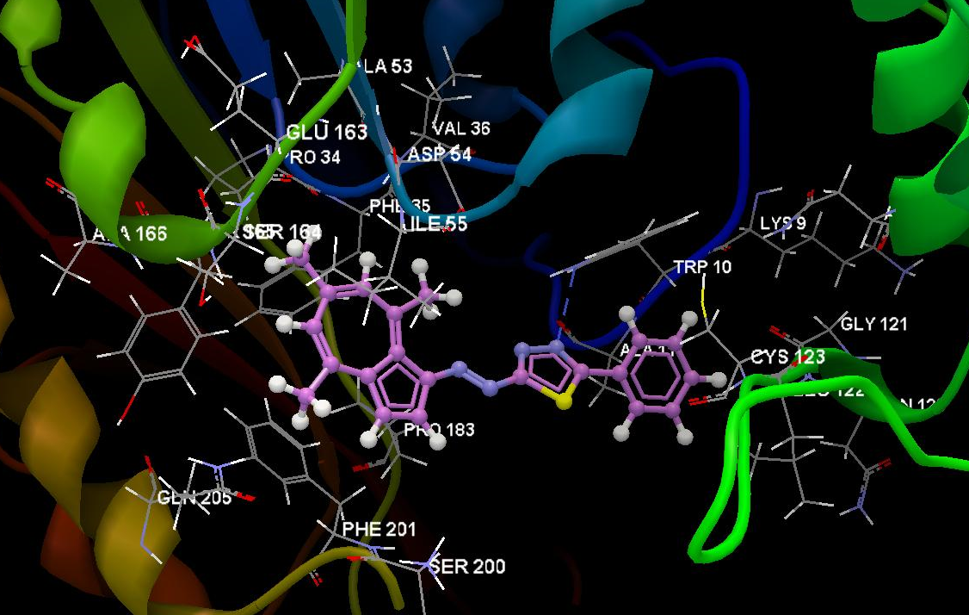
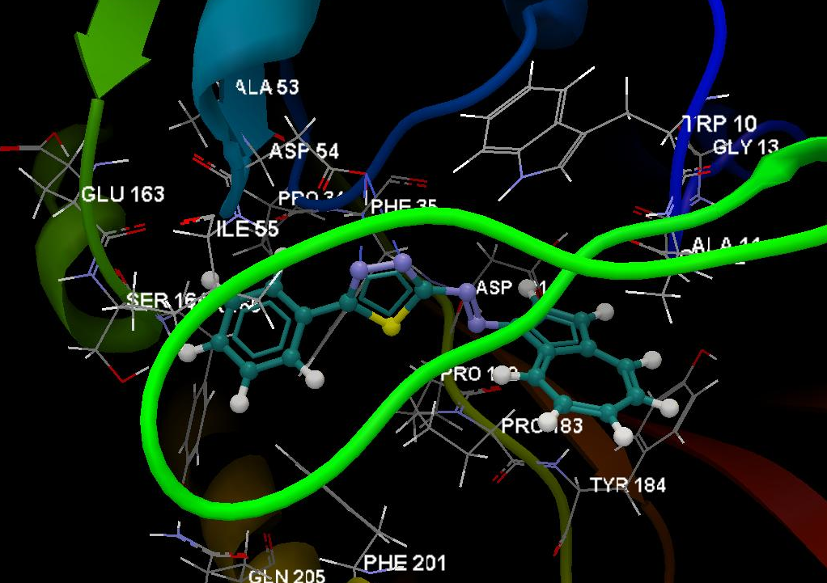
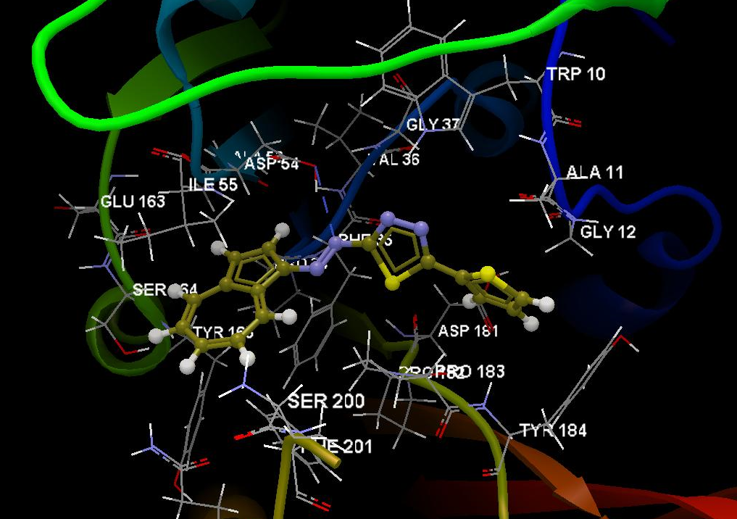
Docking results for 1,3,4 – thiadiazoles against 4RTO
(Escherichia coli DNA Adenine Methyltransferase)
T1
T2
T3
Interacting group
Interacting group
Interacting group
ALA53, VAL36, GLU163, PRO34, ASP54, PHE35, ILE55, SER164, TYR165, ALA166, GLN205, PHE201, SER200, PRO183, ASN120, LEU122, CYS123, ALA11, TRP10, LYS59, ASN115, GLY121
ALA53, ASP54, GLU163, PRO34, PHE35, ILE55, SER164, TYR165, GLN205, PHE201, TYR184, PRO183, PRO182, ASP181, ALA11, GLY12, TRP10, GLY13
TRP10, ALA11, GLY12, GLY37, VAL36, ASP54, ALA53, ILE55, GLU163, SER164, PHE35, PRO34, TYR165, ASP181, PRO183, PRO182, SER200, TYR184, PHE201, GLN205
Hydrogen bonds:
N24(sp²) – O(sp³) ASP54: 3.000 Å
N20(sp²) – O(sp³) ASP54: 2.982 Å
Hydrogen bond:
Hydrogen bond:
N24(sp²) – N(sp²) TRP10: 3.101 Å
N18(sp²) – O(sp³) ASP54: 3.304 Å
Score: 72.21, RMSD: 0.07
Score: 71.15, RMSD: 0.07
Score: 66.42, RMSD: 0.23

Slide 8
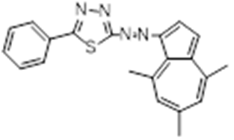
Assessment of oral bioavailability according Lipinski’s rule of Five
Ligand/ protein/ strain | MW (g/mol) | HBD | HBA | LogP | Flexible bonds | Lipinski’s violations
co-crystalized MPDA / 3M4I (M. tuberculosis) | 118.17 | 2 | 2 | 0.27 | 2 | 0
co-crystalized 883 / 4P8O (S.aureus) | 376.37 | 2 | 8 | 1.61 | 4 | 0
co-crystalized SFG / 4RTO (E. coli) | 382.39 | 10 | 12 | -3.22 | 7 | 2
M316 (T1) | 358.46 | 0 | 4 | 5.24 | 3 | 1
M358 (T2) | 326.46 | 0 | 4 | 5.49 | 3 | 1
L2548 (T3) | 322.41 | 0 | 4 | 5.21 | 3 | 1
T1
T2
T3
MW - molecular weight ; HBD - Hydrogen bond donor count; HBA - Hydrogen bond acceptor count; logP - water-octanol partition coefficient
Conclusion:
Log P parameter is larger than 5 for all investigated 1,3,4 – thiadiazoles, these structures being highly lipophilic, with poor aqueous solubility. Values of LogP over 5 suggest poor absorption or permeation. Further optimization of such ligands containing together azulene and thiadiazole moieties, is required in order to increase the hydrophilicity and to favor hydrophilic interactions by means of NH/OH/N/O groups. Thus the propensity/probability to interact with proteins and the ability to become biologically active, can be successfully achieved.
Lipinski's rule of five [4]:
MW < 500 Da
LogP < 5
HBD < 5
HBA < 10
[4] C.A. Lipinski, Lead-and drug-like compounds: the rule-of-five revolution, Drug Discovery Today: Technologies 2004, 1(4), 337-341.

Slide 9
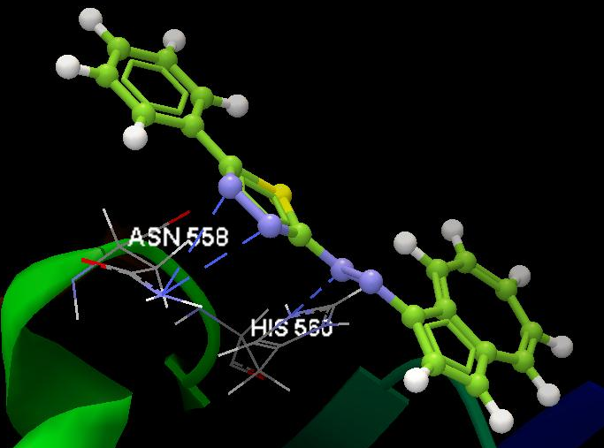
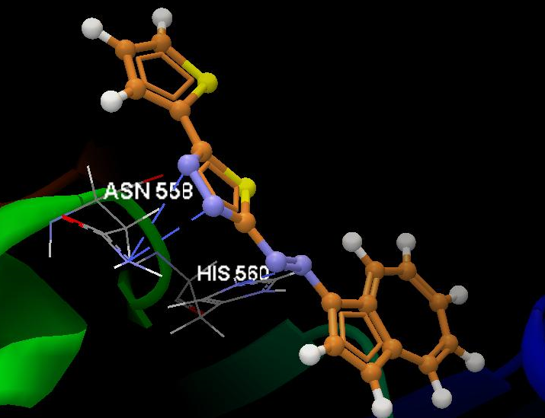
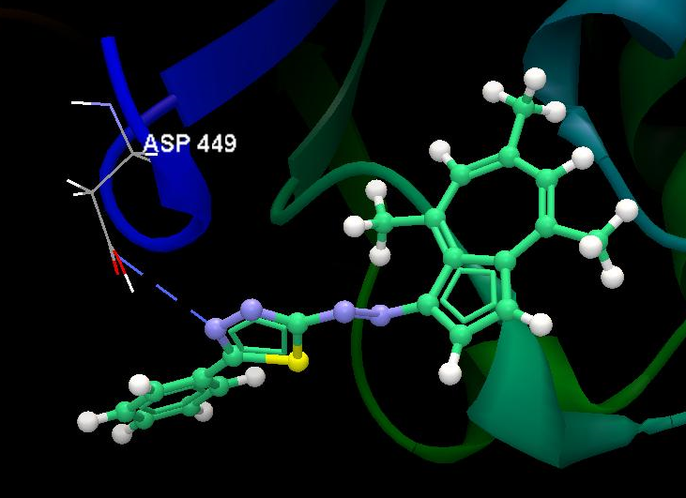
Conclusions and perspectives
Docking conclusions:
a) 3M4I (Mycobacterium tuberculosis DNA gyrase)
All 1,3,4-thiadiazoles exhibit greater docking score than the natural ligand.
T2 and T3 reveals similar scores, by forming 3 hydrogen bonds with the same amino acids residues, with N (sp²) HIS560 and N (sp²) ASN558, respectively, at the two nitrogen atoms of the thiadiazole aromatic ring, that is known as structural motif common in pharmacology [5] and one interaction by the diazo bond that link the thiadiazole with the azulene.
The planar five-member thiadiazole ring acts as an acceptor in the H-bond formation, in the biological media. Some of thiadiazole based structures posses antimicrobial activities, e.g. oxazolidinone analogues possessing 1,3,4 – thiadiazole C-ring, designed as hybrids of linezolid [6, 7].
T1
T2
T3
T1
T2
T3
[5] Y. Hu, C.Y. Li, X.M. Wang, Y.H. Yang, H.L. Zhu, 1,3,4-Thiadiazole: Synthesis, Reactions, and Applications in Medicinal, Agricultural, and Materials Chemistry, Chem. Rev. 2014, 114, 5572−5610.
[6] J. Matysiak, Biological and Pharmacological Activities of 1,3,4-Thiadiazole Based Compounds, Mini Reviews in Med. Chem. 15(9), 2012, 762-775.
[7] .M. Thomasco, R.C.Gadwood, E.A. Weaver, J.M. Ochoada, C.W. Ford, G.E. Zurenko, J.C. Hamel, D. Stapert, J.K. Moerman, R.D. Schaadt, B.H. Yagi, The synthesis and antibacterial activity of 1,3,4-thiadiazole phenyl oxazolidinone analogues, Bioorg. Med. Chem. Lett., 2003, 13, 4196-4196.

Slide 10
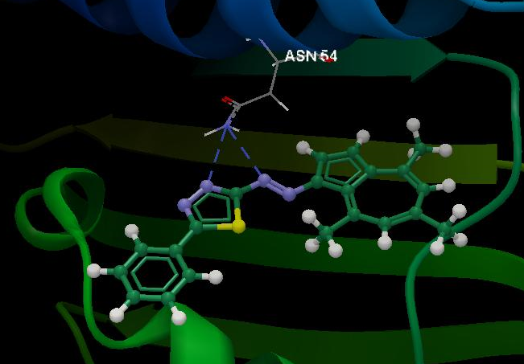
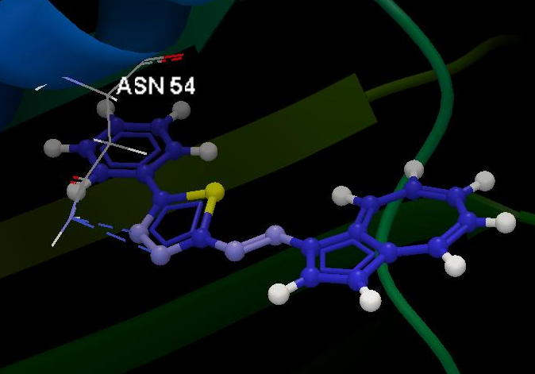
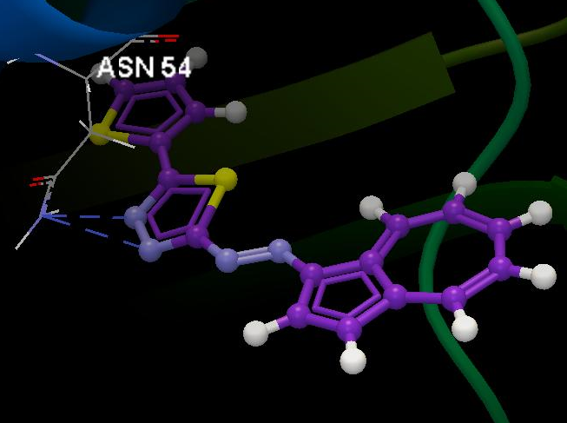
Conclusions and perspectives
Docking conclusions:
b). 4P8O (S. aureus gyrase)
All 1,3,4-thiadiazoles exhibit lower docking score than the natural ligand.
ASN54 amino acid residue is involved by it’s Nsp² in two H-bond forming with T1-T3 ligands. Although present in the interacting surrounding group of co-crystalized ligand and thiadizoles ligands, ASN54 don’t interact by hydrogen bonding with the natural ligand. This compound reveals more interactions (4 H bonding and greater docking score). So, lower, maybe inefficient activity of investigated thiadiazoles against S. aureus gyrase is expected.
T1
T2
T3
T1
T2
T3

Slide 11
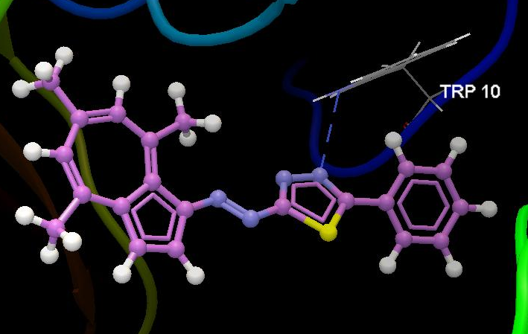
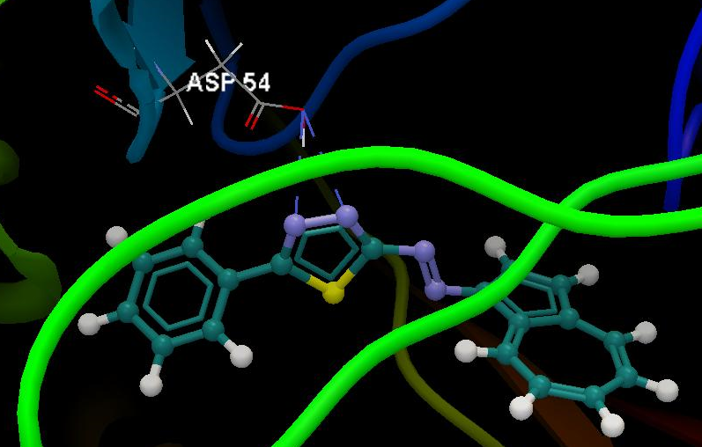
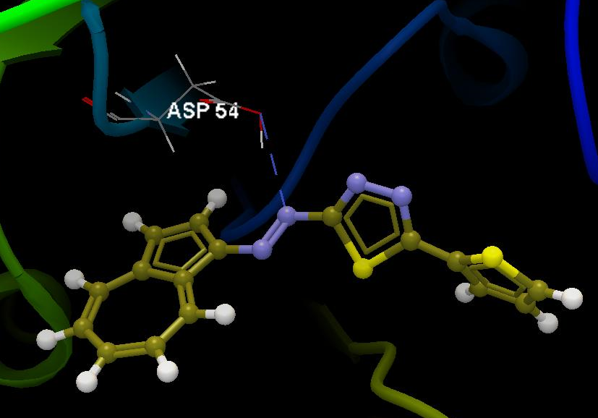
Conclusions and perspectives
Docking conclusions:
c). 4RTO (Escherichia coli DNA Adenine Methyltransferase)
Concerning T1 and T2, the thiadiazole ring is involved in H bonding with different amino acid residues (TRP10 and ASP54, respectively).T3 acts differently, by a nitrogen of the azo bond, that forms Hydrogen bond with ASP54.
T1 and T2 reveals greater docking scores than the natural ligand. The obtained score for T3 is lower. The co-crystallized ligand presents interactions within the active binding site, whiles our investigated thiadiazoles are poorly interacting.
Further analyses are required in order to establish certainly a possible inhibitory action against E. coli and other hybrid optimized structures containing thiadiazole and azulene scaffolds are considered.
T1
T2
T3
T1
T2
T3

