Slide 1
Synthesis and leishmanicidal activity of molecular hybrids 1,2,3-triazole-chalcones
Sofía Vanessa Rodríguez Gutiérrez¹, Olalla Barreiro-Costa², Christian David Alcívar León¹ and Jorge Heredia-Moya^{2,}*
¹ Facultad de Ciencias Químicas, Universidad Central del Ecuador, Quito 170521, Ecuador; vrg101517@gmail.com (S. R.), cdalcivar@uce.edu.ec (C. A.)
² Centro de Investigación Biomédica (CENBIO), Facultad de Ciencias de la Salud Eugenio Espejo, Universidad UTE, Quito 170527, Ecuador; olalla.barreiro@ute.edu.ec (O. B-C.), jorgeh.heredia@ute.edu (J. H-M.)

Slide 2
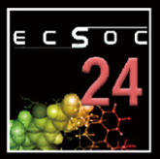
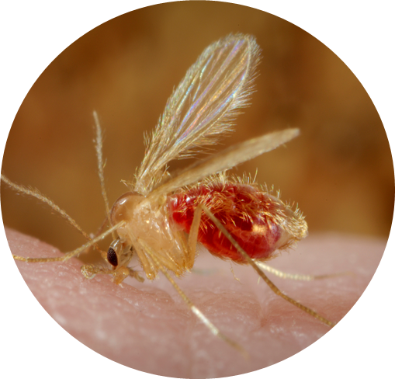
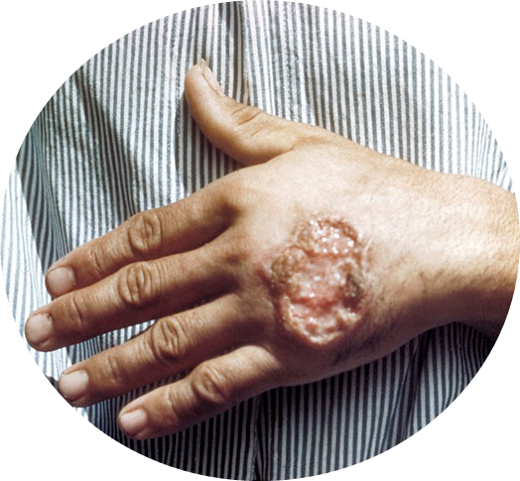
Introduction
Leishmaniasis
Worldwide distribution disease caused by protozoan parasites of the genus Leishmania spp.
The disease may evolve to different clinical forms [2].
Cutaneous
Mucocutaneous
Visceral
No safe and effective vaccine exists against any form of leishmaniasis [3].
The first-line treatment, antimoniate meglumine, has a large number of side effects, high cost, and is developing resistance [4].
Transmitted by the bite of a sandfly of the genus
Phlebotomus (Old World)
Lutzomyia (New World) [1].

Slide 3
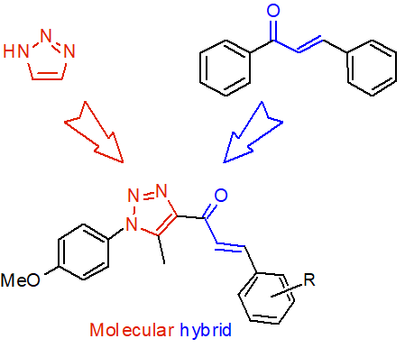
Introduction
Biological activities
Antimicrobial
Analgesics
Anti-inflammatory
Anesthetic
Anticonvulsant
Antineoplastic
Antimalarial
Leishmanicidal
Antiviral
Anticancer [5].
Antibacterial
Antifungal
Anti-inflammatory
Anticancer
Antidepressant
Trypanocidal
Leishmanicidal
Antiviral
Antimalarial
Antioxidant [6-7].

Slide 4
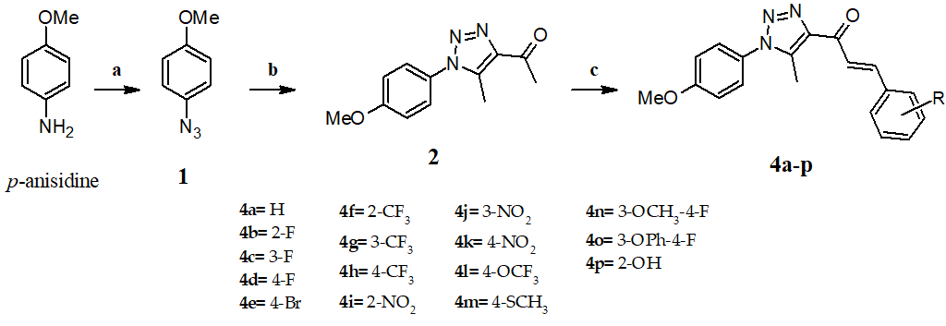
Synthesis
Reagents and conditions: (a) i. KHSO₄, ii. NaNO₂, iii NaN₃, r.t., (b) acetylacetone, K₂CO₃, DMSO, r.t., (c) Benzadehyde 3a-p, KOH, EtOH, 0°C, 2h → rt.

Slide 5
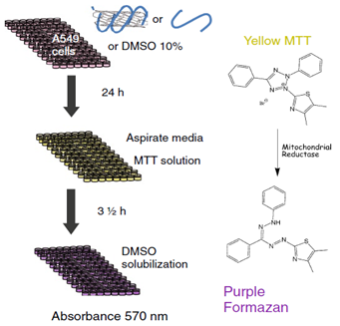
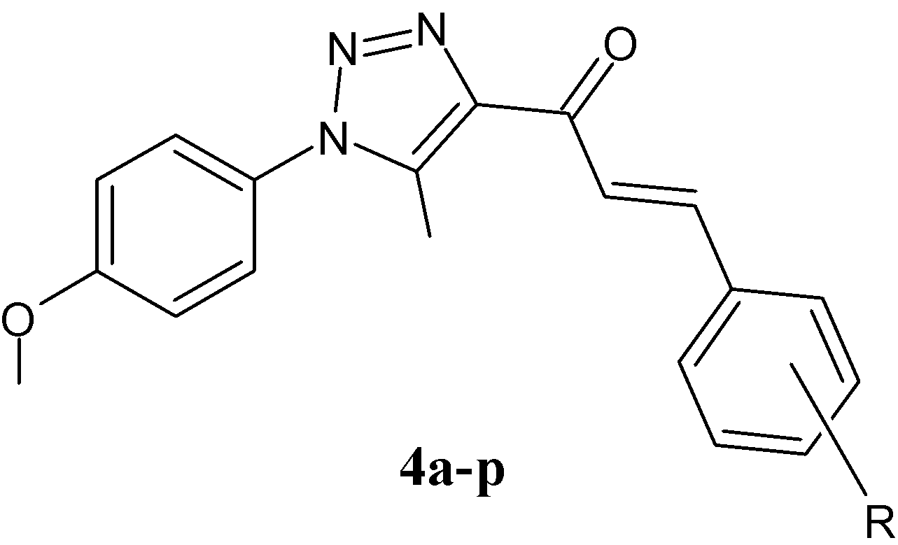
Biological activity
Using the MTT colorimetric assay
1,2,3-Triazole-chalcones
in-vitro against
Leishmania mexicana
RAW 264.7 cells

Slide 6
Results and Discussion
Compound | R | Yield (%)
4a | H | 95.7
4b | 2-F | 73.6
4c | 3-F | 76.7
4d | 4-F | 98.0
4e | 4-Br | 96.4
4f | 2-CF₃ | 97.1
4g | 3-CF₃ | 77.5
4h | 4-CF₃ | 76.8
4i | 2-NO₂ | 33.5
4j | 3-NO₂ | 75.2
4k | 4-NO₂ | 96.7
4l | 4-OCF₃ | 88.3
4m² | 4-SCH₃ | 93.4
4n | 3-OCH₃-4-F | 96.1
4o | 3-OPh-4-F | 99.3
4p² | 2-OH | 99.6

Slide 7
Results and Discussion
Mechanism proposed for the synthesis of hybrids 1,2,3-triazole-chalcone derivatives 4a-p.

Slide 8
Results and Discussion
Leishmanicidal and cytotoxicity activity against L. mexicana and RAW cells, respectively, of compounds 4a-p.
Compound | Leishmanicidal activity IC₅₀ (µM) | RAW cytotoxicity CC₅₀ (µM) | SI index
4a | 15.7 | 20.1 | 1.3
4b | 7.9 | 13.7 | 1.7
4c | 14.4 | 26.2 | 1.8
4d | NA | 44.3 | ND
4e | NA | 22.4 | ND
4f | NA | 23.2 | ND
4g | 3.9 | 11.3 | 2.9
4h | 4.9 | 19.5 | 4.0
4i | NA | 4.6 | ND
4j | 1.0 | 3.6 | 3.7
4k | ND | ND | ND
4l | 27.0 | >100 | >3.7
4m | NA | ND | ND
4n | NA | 16.2 | ND
4o | 29.2 | 1.7 | 0.1
4p | 1.3 | 7.3 | 5.7
Amphotericin B | 0.172 | >5 | ND
Saponin | ND | 0.163* | ND
ND: Not determined, NA: Not active, *: mg/mL.

Slide 9
Conclusions
Compounds showed good leishmanicidal activity in-vitro against promastigotes of Leishmania mexicana, and 9 of the 16 evaluated compounds showed to be active with IC₅₀ in the range 1.0-29.2 µM.
The most active compound was 4j (IC₅₀ = 1.0 µM), however 4p showed the best selective index, and it is 5.7 times more toxic against L. mexicana compared to macrophage cells.
No effect of the substituent could be found in the leishmanicidal activity.

Slide 10
References
1. Arenas, R.; Torres-Guerrero, E.; Quintanilla-Cedillo, M.R.; Ruiz-Esmenjaud, J. Leishmaniasis: A review. F1000 Fac. Rev 2017, 6, 750.
2. Braga, S.S. Multi-target drugs active against leishmaniasis: A paradigm of drug repurposing. Eur. J. Med. Chem. 2019, 183, 111660.
3. Kobets, T.; Grekov, I.; Lipoldova, M. Leishmaniasis: Prevention, Parasite Detection and Treatment. Curr. Med. Chem. 2012, 19, 1443–1474, doi:10.2174/092986712799828300.
4. WHO 63.ª World health assembly. 2010, 17–21.
5. Arlindo Pascual, Z.; Carrera González, S.; Francisco González Matilla, J. Synthesis of Chalcones: Privilegial Structures in the Synthesis of Heterocycles with Biological Activity. Psychol. Lat. Copyr. 2018, Especial, 20–23, doi:10.1016/j.bmc.2007.04.047.
6. Temraz, M.G.; Elzahhar, P.A.; El-Din A. Bekhit, A.; Bekhit, A.A.; Labib, H.F.; Belal, A.S.F. Anti-leishmanial click modifiable thiosemicarbazones: Design, synthesis, biological evaluation and in silico studies. Eur. J. Med. Chem. 2018, 151, 585–600, doi:10.1016/j.ejmech.2018.04.003.
7. Holla, B.S.; Mahalinga, M.; Karthikeyan, M.S.; Poojary, B.; Akberali, P.M.; Kumari, N.S. Synthesis, characterization and antimicrobial activity of some substituted 1,2,3-triazoles. Eur. J. Med. Chem. 2005, 40, 1173–1178, doi:10.1016/j.ejmech.2005.02.013.

