Slide 1
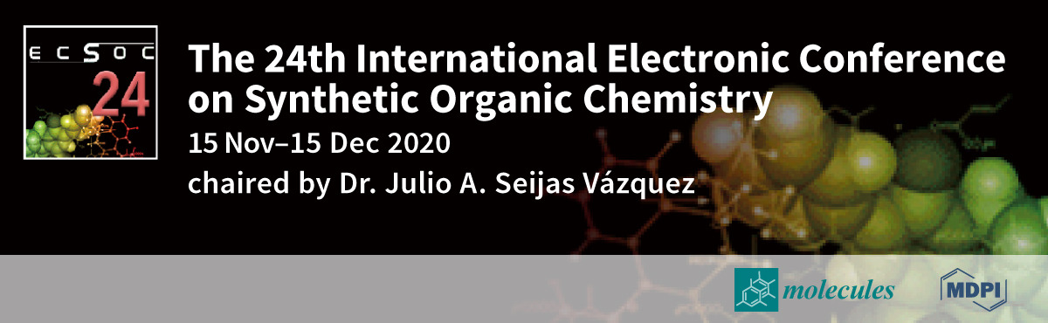
SELECTED THERMODYNAMIC PARAMETERS OF ANTIOXIDANT ACTIVITY OF COUMARIN BASED HETEROCYCLIC COMPOUNDS
Ana Amić¹*, Elena Gotal¹
¹Josip Juraj Strossmayer University of Osijek, Department of Chemistry, Ulica cara Hadrijana 8/A, 31000 Osijek, Croatia
*corresponding author: aamic@kemija.unios.hr

Slide 2
Abstract
Coumarin and coumarin derivatives are bioactive compounds that have an important role in medicinal chemistry, for example in the development of anti-inflammatory, anticancer and antiviral drugs. These compounds are also very powerful antioxidants that successfully scavenge free radicals and prevent or alleviate oxidative stress. The antioxidant potential of selected heterocyclic compounds containing coumarin core was investigated theoretically, the focus of this study was on hydrogen atom transfer mechanism (HAT) and sequential electron transfer followed by proton transfer mechanism (SET-PT). Using MOPAC2012 PM7, reaction enthalpies related to the cleavage of O–H, N–H and C–H bonds via selected mechanisms of free radical scavenging were studied and calculated. The effect of the position of the hydroxyl group, as well as other functional groups, on the antioxidant activity was examined. Based on obtained results, Schiff bases, thiosemicarbazides, oxadiazoles and 4-thiazolidinones containing one or more OH– groups exhibit higher radical scavenging properties.
Keywords: coumarin, antioxidants, PM7, HAT, SET-PT

Slide 3
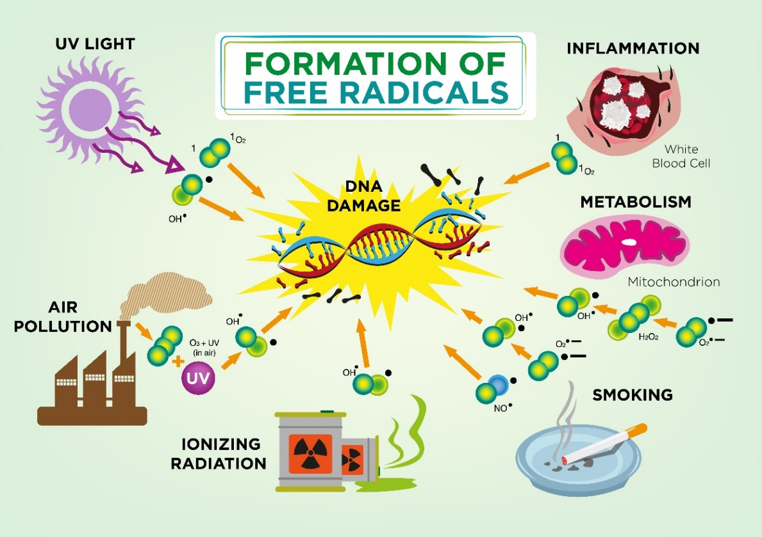
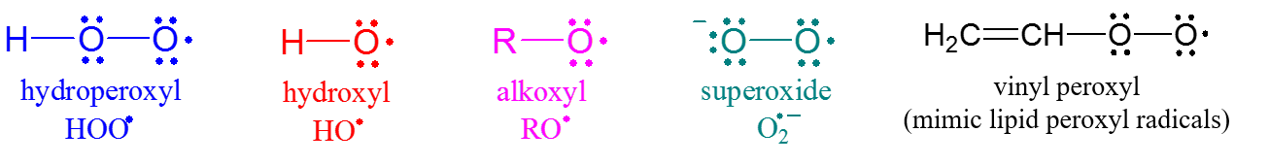
Introduction
Free radicals
Free radicals are constantly produced in our body for specific metabolic purposes (e.g., energy production, regulation of cell growth, defense against pathogens, intercellular signaling, etc.). There are also various exogenous sources of free radicals, for example ionizing radiations, UV light and pollution.
There are many examples of free radicals, some of them are based on oxygen or on nitrogen.
Examples of oxygen centered free radicals

Slide 4
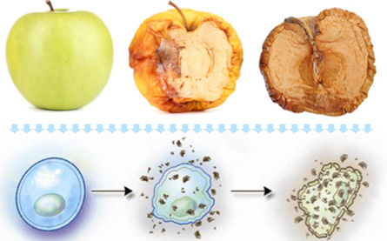
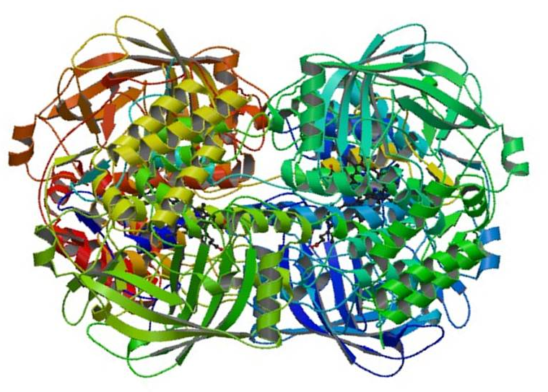
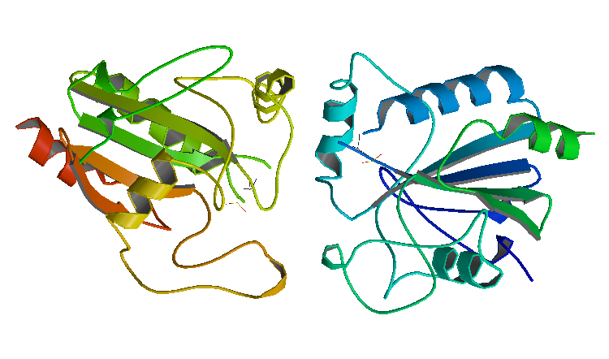
Oxidative stress
Oxidative stress results from an imbalance between production of free radicals and the activity of our own endogenous antioxidant systems, i.e., body defense mechanisms (based on activity of several enzymes, such as catalase and glutathione peroxidase) which regulate overproduction of radicals.
Excess free radicals may attack biological macromolecules giving rise to membrane damage, protein modifications, and DNA damage.
This type of oxidative damage may be involved in pathogenesis of various chronic diseases, e.g., coronary heart diseases and some types of cancer.
To fight oxidative stress, various exogenous antioxidants may be of use.
healthy attacked by oxidative
cell free radicals stress
Catalase
Glutathione peroxidase I

Slide 5
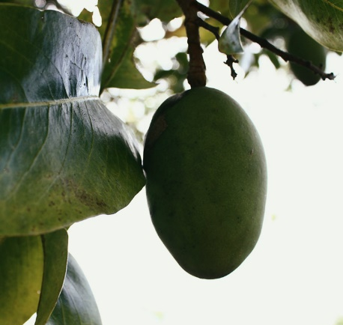
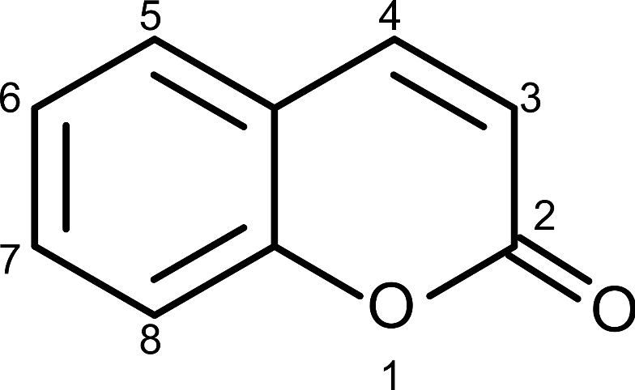
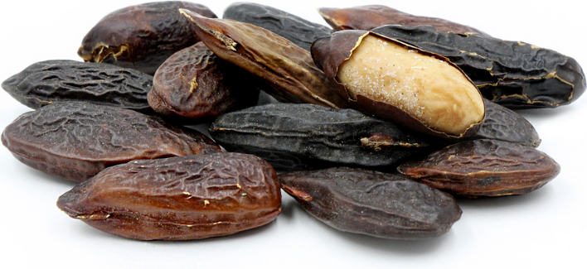
Coumarin and coumarin derivatives
coumarin (2H-1-benzopyran-2-one,
2H-chromen-2-one, 1, 2-benzopyrone)
Dipteryx odorata (Aubl.) Willd.
("cumaru" or "kumaru")
bioactive phytochemicals
important role in the development of anticoagulant, anti-inflammatory, anti-HIV, anticancer and antiviral drugs
hydroxycoumarins – very powerful antioxidants

Slide 6
Computational details
Studied compounds
MOPAC2012TM
51 heterocyclic compounds containing coumarin core
thermodynamics of O–H bond and N–H bonds cleavage
  MOPAC2012TM
  PM7
calculations of enthalpies
reactions in gas phase
mechanisms: hydrogen atom transfer mechanism (HAT) and single electron transfer followed by proton transfer mechanism (SET-PT)
R–
Schiff bases (1-26)
R: 2-F; 3-F; 4-F; 2-Br; 3-Br;
4-Br; 2-Cl; 3-Cl; 2-OH; 3-OH;
4-OH; 2,4-(OH)₂; 2,5-(OH)₂;
2,3-(OH)₂; 3,4-(OH)₂; 3,4-(OH)₂; 2-OCH₃; 3-OCH₃; 4-OCH₃; 3,4,5-(OCH₃)₃; 4-OH,3-OCH₃;
2-OH-5-NO₂; C₆H₅CH=CH; 4-NO₂; 2,5-(OCH₃)₂; 4-(CH₃)₂N

Slide 7
Computational details
Studied compounds
R–
thiosemicarbazides
(27-31)
4-thiazolidinones
(32-36)
R–
R: 4-OCH₃; 4-CH₃;
CH₃, C₂H₅, Phe

Slide 8
Computational details
Studied compounds
oxadiazoles
(37-51)
R–
R: 2-F; 4-F; 2-Br; 4-Br; 2-Cl;
2-OH; 3-OH; 4-OH;
2,5-(OH)₂; 2,3-(OH)₂; 3,4-(OH)₂;
3-OCH₃; 4-OCH₃;
C₆H₅CH=CH; 4-NO₂

Slide 9
Mechanisms od antioxidant activity
HAT:
SET-PT:
Hydrogen atom transfer (HAT)
Hydrogen atom transfer (HAT) mechanism occurs in one step and it involves homolytic bond cleavage.
Because there is no charge separation, this mechanism is preferred in gas phase and non-polar medium.
Bond dissociation enthalpy (BDE)

Slide 10
Single electron tranfer followed by proton transfer (SET-PT)
Single electron transfer followed by proton transfer (SET-PT) mechanism occurs in two step sand it involves heterolytic bond cleavage.
Because there is charge separation, this mechanism is preferred in polar medium.
First step of this mechanism is characterized by ionization potential (IP), and second step is characterized by proton dissociation enthalpy (PDE).
Formulae:
preferred reaction pathway → lowest value of reaction enthalpy

Slide 11
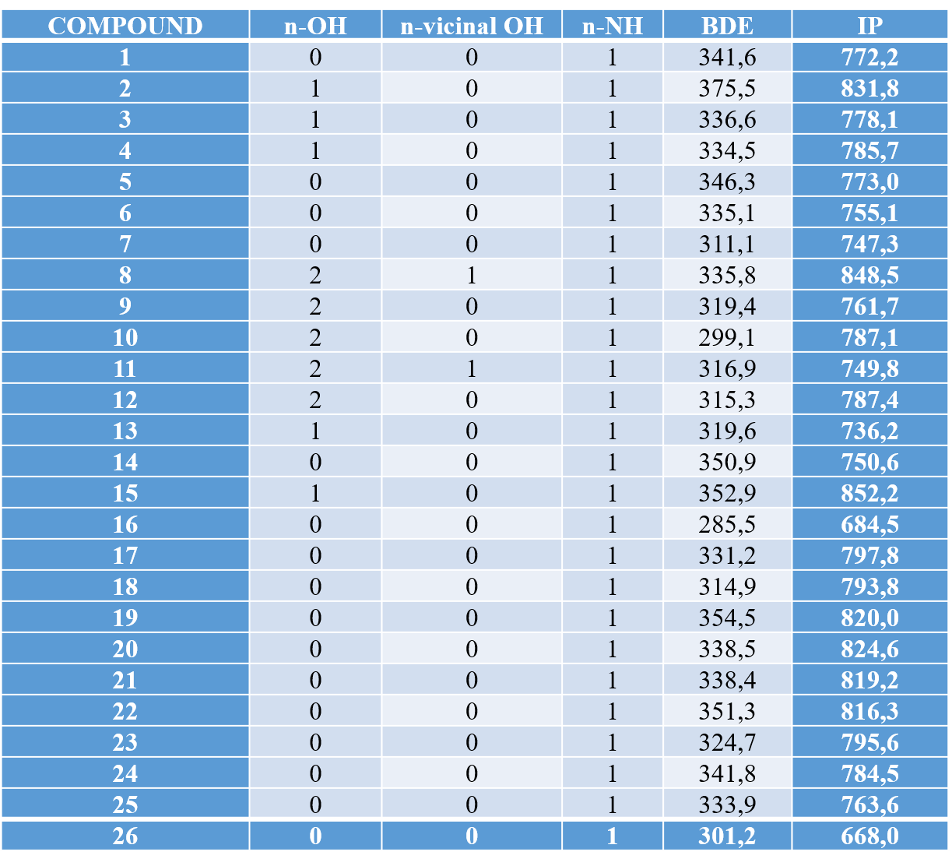
Results and discussion
Table 1. MOPAC PM7 reaction enthalpies (kcal/mol) for HAT and ET-PT for studied Schiff bases.
Results in Table 1. refer to reaction enthalpies for HAT mechanism and first step of ET-PT mechanism for studied Schiff bases.
n-OH refers to number of OH– groups, n-vicinal-OH refers to the number of vicinal OH– groups, and n-NH refers to the number of NH– groups.
Calculated IP values are at least double higher than the BDE values.

Slide 12
Table 2. MOPAC PM7 reaction enthalpies (kcal/mol) for HAT and ET-PT for studied thiosemicarbazides and 4-thiazolidinones.
COMPOUND | n-OH | n-vicinal OH | n-NH | BDE | IP
27 | 0 | 0 | 3 | 291,1 | 766,0
28 | 0 | 0 | 3 | 285,3 | 753,7
29 | 0 | 0 | 3 | 324,2 | 740,2
30 | 0 | 0 | 3 | 275,5 | 753,7
31 | 0 | 0 | 3 | 305,2 | 731,3
32 | 0 | 0 | 1 | 358,4 | 804,3
33 | 0 | 0 | 1 | 314,0 | 761,3
34 | 0 | 0 | 1 | 359,7 | 689,3
35 | 0 | 0 | 1 | 359,3 | 690,4
36 | 0 | 0 | 1 | 358,9 | 668,0

Slide 13
Table 3. MOPAC PM7 reaction enthalpies (kcal/mol) for HAT and ET-PT for studied oxadiazoles.
COMPOUND | n-OH | n-vicinal OH | n-NH | BDE | IP
37 | 0 | 0 | 0 | 294,3 | 782,1
38 | 0 | 0 | 0 | 258,5 | 799,4
39 | 0 | 0 | 0 | 269,5 | 801,3
40 | 0 | 0 | 0 | 300,9 | 801,5
41 | 0 | 0 | 0 | 296,9 | 801,0
42 | 0 | 0 | 0 | 299,5 | 802,0
43 | 0 | 0 | 0 | 254,4 | 807,7
44 | 0 | 0 | 0 | 298,1 | 804,7
45 | 0 | 0 | 0 | 296,8 | 798,7
46 | 0 | 0 | 0 | 293,5 | 797,5
47 | 0 | 0 | 0 | 297,7 | 804,3
48 | 0 | 0 | 0 | 261,7 | 793,9
49 | 0 | 0 | 0 | 299,1 | 796,1
50 | 0 | 0 | 0 | 298,5 | 797,7
51 | 0 | 0 | 0 | 282,3 | 759,0

Slide 14
Some studied compounds have only one OH– group (2-14, 13, 15), some have two (8-12), and some have vicinal OH– groups (8 and 11).
All these compounds are Schiff bases and all show better results of thermodynamic calculations.
Some compounds contain one (1-26, 32-36) or more (27-31) NH– groups, but calculated BDE and IP values for these compounds were not better compared to the ones obtained for Schiff bases.
Some compounds contain OH– and NH– group (Table 4 and 7, compounds 2-4, 8-13, and 15).
These compounds are Schiff bases, the BDE of O–H bond is slightly more favorable compared to the BDE of N–H bond cleavage.
Compounds 37-51 (oxadiazoles) do not have OH– or NH– group, hence for these compounds BDE and IP values for C–H bond was calculated.

Slide 15
Obtained results do not show a better antioxidant potential for oxadiazoles, but they are not “much worse” antioxidants than compounds with OH– and NH– group.
BDE values for Schiff bases were determined to be in the range 285.5-373.5 kcal/mol, BDE values for thiosemicarbazides and 4-thiazolidinones were in the range 275.5-358.9 kcal/mol, and for oxadiazoles in the range 258.5-300.9 kcal/mol.
All obtained results are almost twice higher than results obtained by Mohhajeri et al. (2009).
These results indicate studied compounds as weaker antioxidants.
Their inefficiency may be due to the fact that studied thiosemicarbazides, 4-thiazolidinones and oxadiazoles do not possess OH– group, while five Schiff bases have OH– group, five have two OH– groups, and only two have vicinal OH– groups.

Slide 16
Our study determined following IP values: 684.5-852.2 kcal/mol for Schiff bases, 668.0-804.3 kcal/mol for thiosemicarbazides and 4-thiazolidinones, and 782.1-807.7 kcal/mol for oxadiazoles.
These results are in some cases almost four times higher than results obtained by Mohajeri et al. (2009) and clearly indicates lower antioxidant activity of studied compounds.
Overview of scientific literature related to the experimental determination of antioxidant activity (DPPH essay) also indicates this group of compounds as not significant antioxidants and relates observed antioxidant activity with the number of OH– groups.

Slide 17
Conclusions
• HAT and SET-PT are competitive mechanisms (in our case HAT is preferred)
  SET-PT – preferred in polar medium
  HAT – preferred in non-polar medium
Preliminary results show that studied compounds are not significant antioxidants, due to lack of OH– functional groups.
Future computational study should be conducted on a higher lever of theory, same compounds after deacetylation of OH – groups → should significantly contribute to antioxidant potential because compounds containing one or more OH– groups exhibit higher radical scavenging properties.

