Slide 1
The 24th International Electronic Conference
on Synthetic Organic Chemistry
15 Nov- 15 Dec 2020
The Structural Flexibility of a Cold-, and a Warm
Adapted Enzymes (Endonucleases I)
by Molecular Dynamics Simulation
By :
Djamila Benrezkallah

Slide 2
Working plan
Introduction (Psychrophile Organisms)
Cold Adapted Activity
Case Study of Endonuclease I Enzyme
Molecular Dynamics Simulation Method
Results
Conclusion

Slide 3
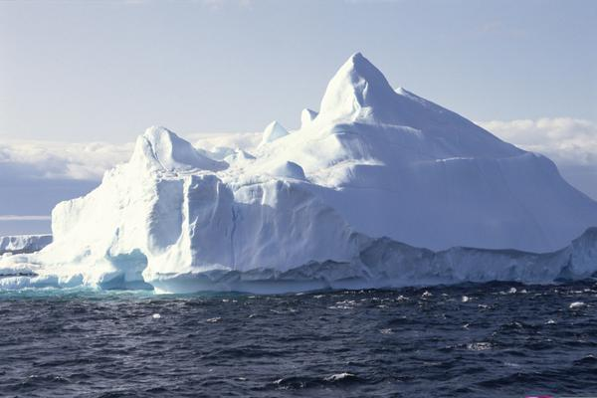
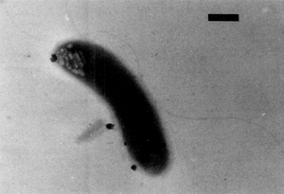
Introduction: Psychrophiles (Cold Loving)
Temp.: Low
Min.: 0°C
Max.: 12°C
Opt.: 4°C
Bactérie Polaromonas Vacuolota
(Habitat: Antarctica)

Slide 4
Applications of Psychrophile Enzymes
Application | Enzyme Psychrophile
Food and agri-Food industry - Feed for improved digestibility and assimilation - Tenderizing meat - Bakery products (dough fermentation) - Elimination of lactose from milk Detergent and cleaning products industry Detergent additives for room temperature washing Environmental biotechnology Bio-remediation, degradation and elimination of xenobiotics and toxic products Biofuel and energy production Production of biodiesel by trans-esterification of vegetable oils and alcohols Pharmaceutical and medical industry Antifungal drugs Antibacterial agents Preparation of antibiotics precursors | Lipase, Protease, Phytase Chitinase β- galactosidase Laccase Lipase, Protease Lipase, Protease, Xylanase Lipase Chitinase Lysozyme Imidase

Slide 5
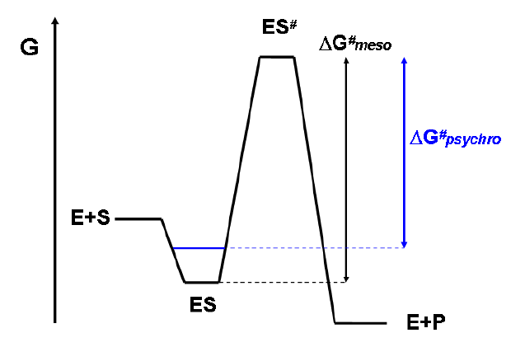
Cold Adapted Activity
To reduce ∆G #
Strategy
Increase Km to maximise reaction rate
Low Affinity for Substrate

Slide 6
Cold adapted Enzyme : Endonucléase I
Estuarine Bacteria : Vibrio Cholérae
Optimal growth ~ 37°C : Mesophile
VcEndA Enzyme
Marine Bacteria : Vibrio Salmonicida
Optimal growth ~ 15°C : Psychrophile
VsEndA Enzyme
Endonuclease is able to cleave DNA as well as RNA at ENDO (non-specific internal) sites

Slide 7
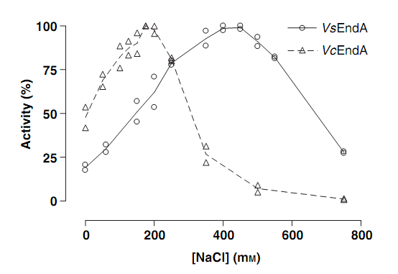
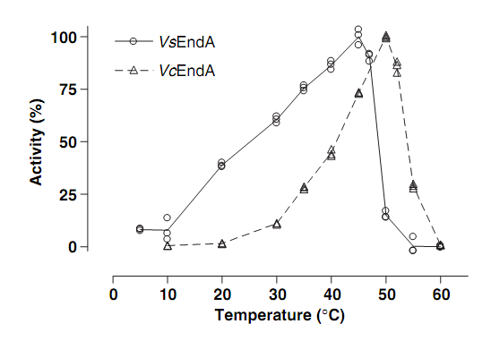
Salt and Temperature dependance of the two enzymes homologous*:
VsEndA (Psychrophile): C=425 mM, T_{opt.} ≈ 45°C
VcEndA (Mesophile): C=175 mM, T_{opt.} ≈ 50°C
*: Altermark, B., Niiranen, L., Willassen, N. P., Smalås, A. O., & Moe, E. (2007). Comparative studies of endonuclease I from cold adapted Vibrio salmonicida and mesophilic Vibrio cholerae. FEBS Journal, 274, 252–263.

Slide 8
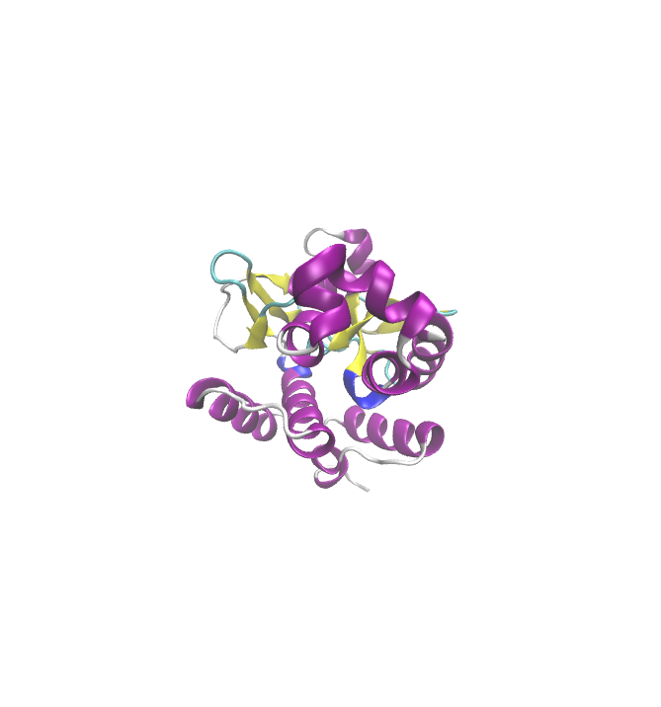
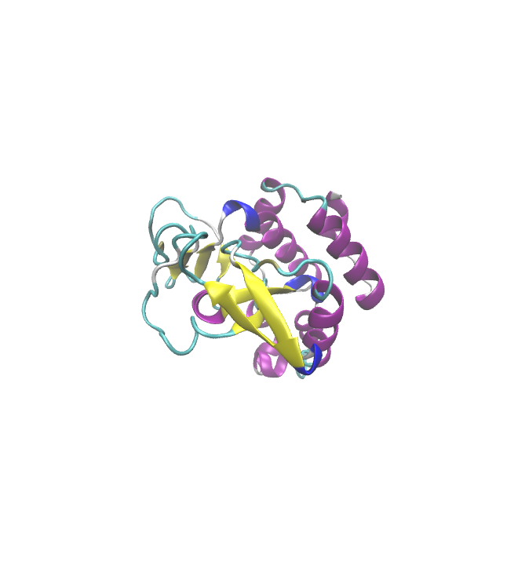
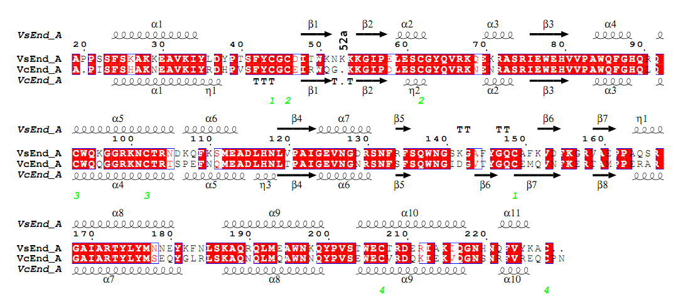
71% identical
protein sequences are
VcEndA
VsEndA

Slide 9
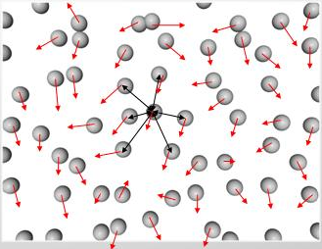
Molecular Dynamics Simulation
Definition: MD is a simulation method which predicts the temporal evolution of a interacting particles system. Their movement obeys the laws of classical mechanics (Newton’s equation of motion):

Slide 10
MD simulations allow the study of complex dynamic processes that occur in biological systems:
Proteins Stability
Conformational Changes
Proteins Folding and Unfolding
Ions Transport in Biological Systems
Molecular recognition: proteins, DNA, membranes, etc.…

Slide 11
Trajectories : Solving Newton’s Motion Equations
Can not be solved analytically for N>3
Finite Difference Method
Integration Algorithm : Velocity Verlet
Knowing the positions and velocities of N particles at time t, the integration of Newton’s equation
of motion gives at t+Δt :

Slide 12
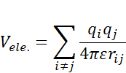
Non Bonding Interactions :
potentiel électrostatique
potentiel de Lennard-Jones

Slide 13
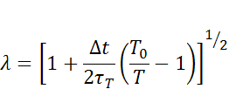
The Isothermal_isobaric Ensemble : NPT
Temperature Control
Principle of Equipartition :
The instantaneous temperature :
Berendsen Thermostat : Applies a multiplicative factor to velocities
To control kinetic energy :
Berendsen Barostat (pressure control): The pressure is modified by adjusting the
box volume. A homothetic factor is applied to adjust the coordinates and the box
volume:

Slide 14
MD Study of the Salt and Temperature Effects of
Homologous Enzymes : Psychrophile (VsEndA), and Mesophile (VcEndA) .
Issues :
Temperature Effect on the Catalytic Activity (Structural Flexibility of the Enzymes).
Which Regions of the Enzymes are directly related to the Temperature Effect ?
Comparison between the two homologous enzymes.
MD Simulations of 10 nanosecondes (t=10 ns), of the two Enzymes
Homologues à T=276,300, 318, et 326 K

Slide 15
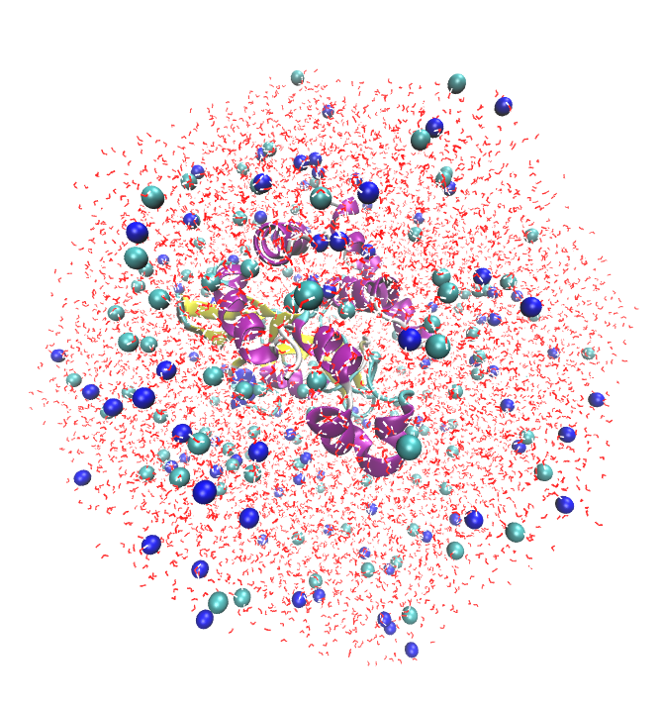
Results
211 residues
8611 water molecules
120 Cl⁻ ions
104 Na⁺ ions
VsEndA

Slide 16
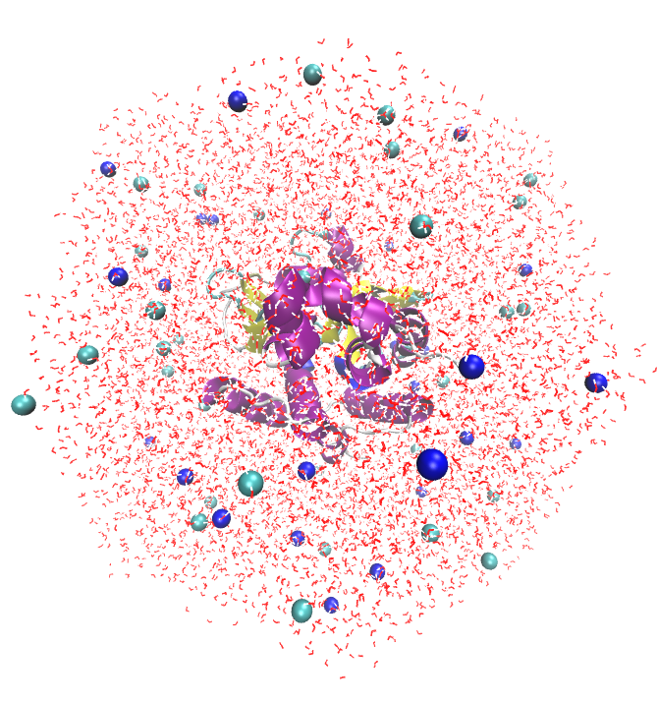
211 residues
8660 water molecules
36 Cl⁻ ions
31 Na⁺ ions
VcEndA

Slide 17
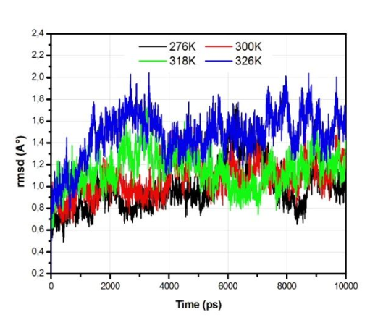
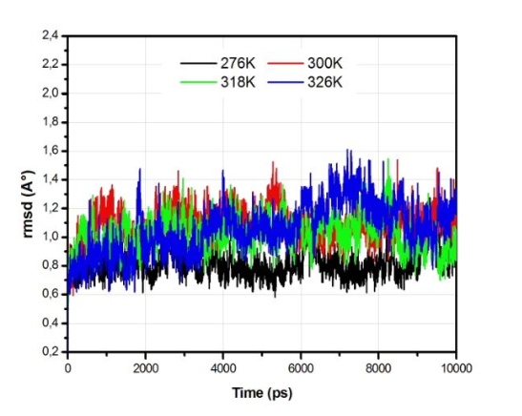
Structural Stability
1- RMSD
VsEndA
VcEndA
Temperature increase affects more VsEndA than VcEndA

Slide 18
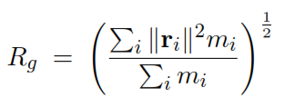
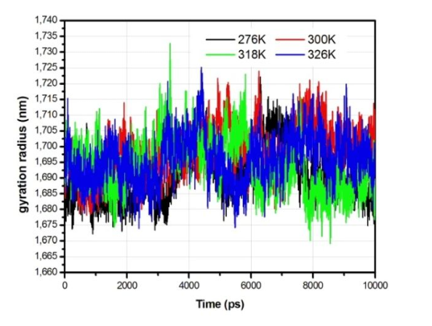
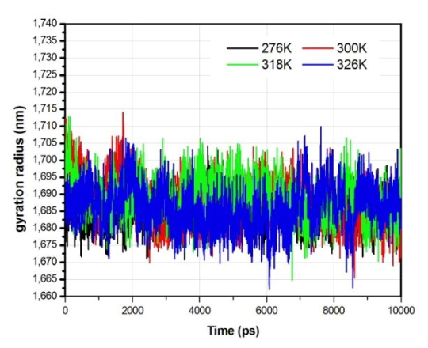
2- Gyration Radius:
VsEndA
VcEndA
A comparable compactness of the two Enzymes

Slide 19
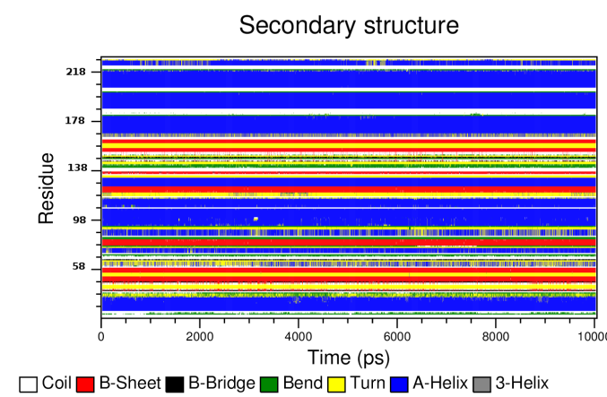
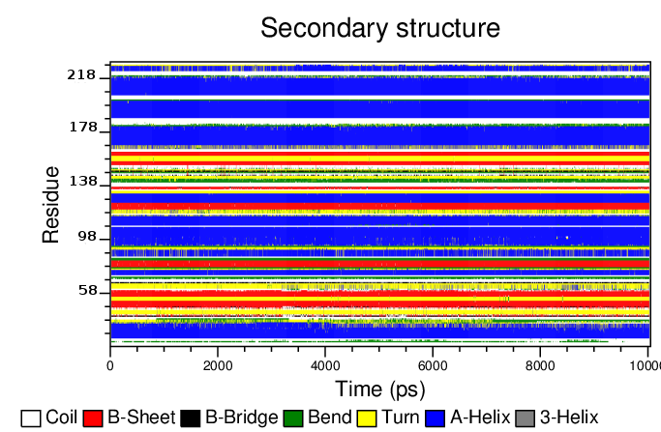
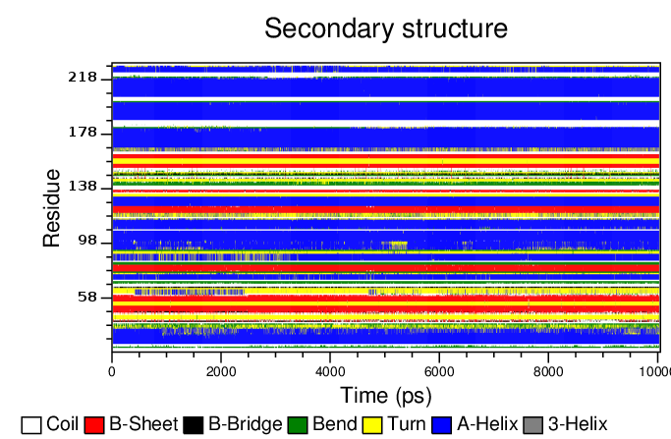
3- Secondary Structures
VsEndA
276K
300K
318K
326K

Slide 20
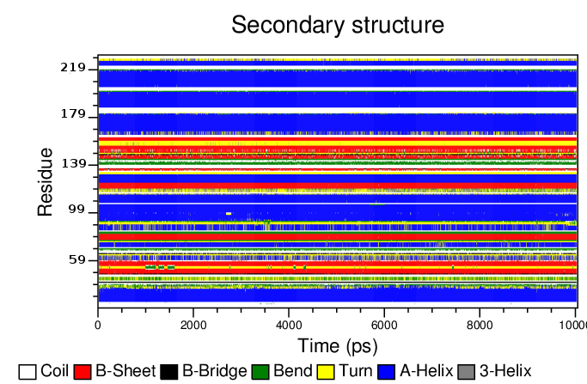
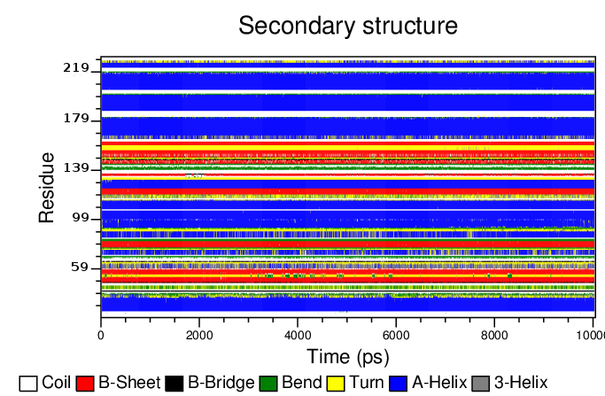
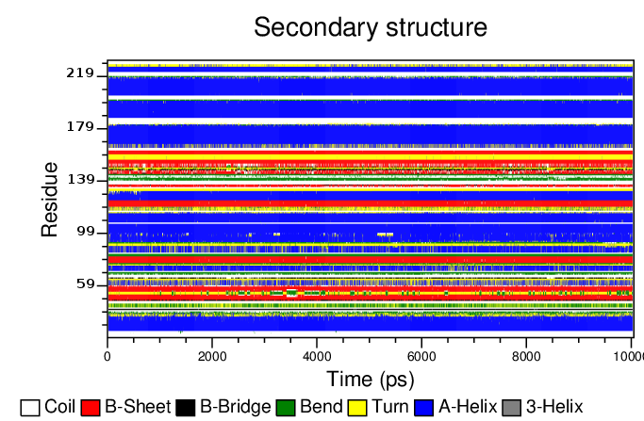
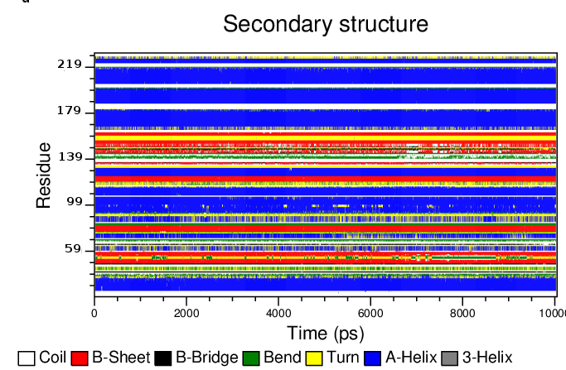
VcEndA
276K
300K
318K
326K

Slide 21
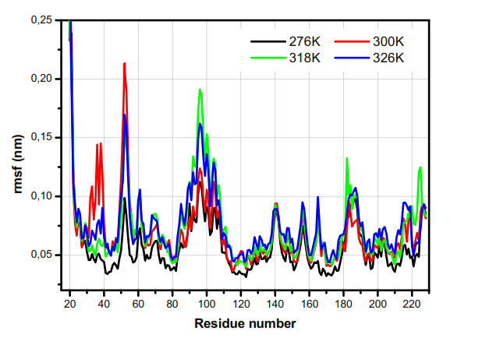
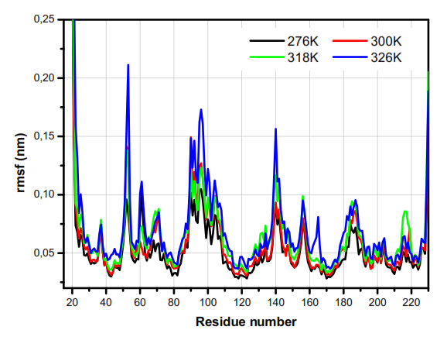
Structural Flexibility:
ASN52
LYS53
LYS96
VsEndA
VcEndA
TYR225
GLN96
GLY140
TYR38
LYS182
LYS182
TYR225

Slide 22
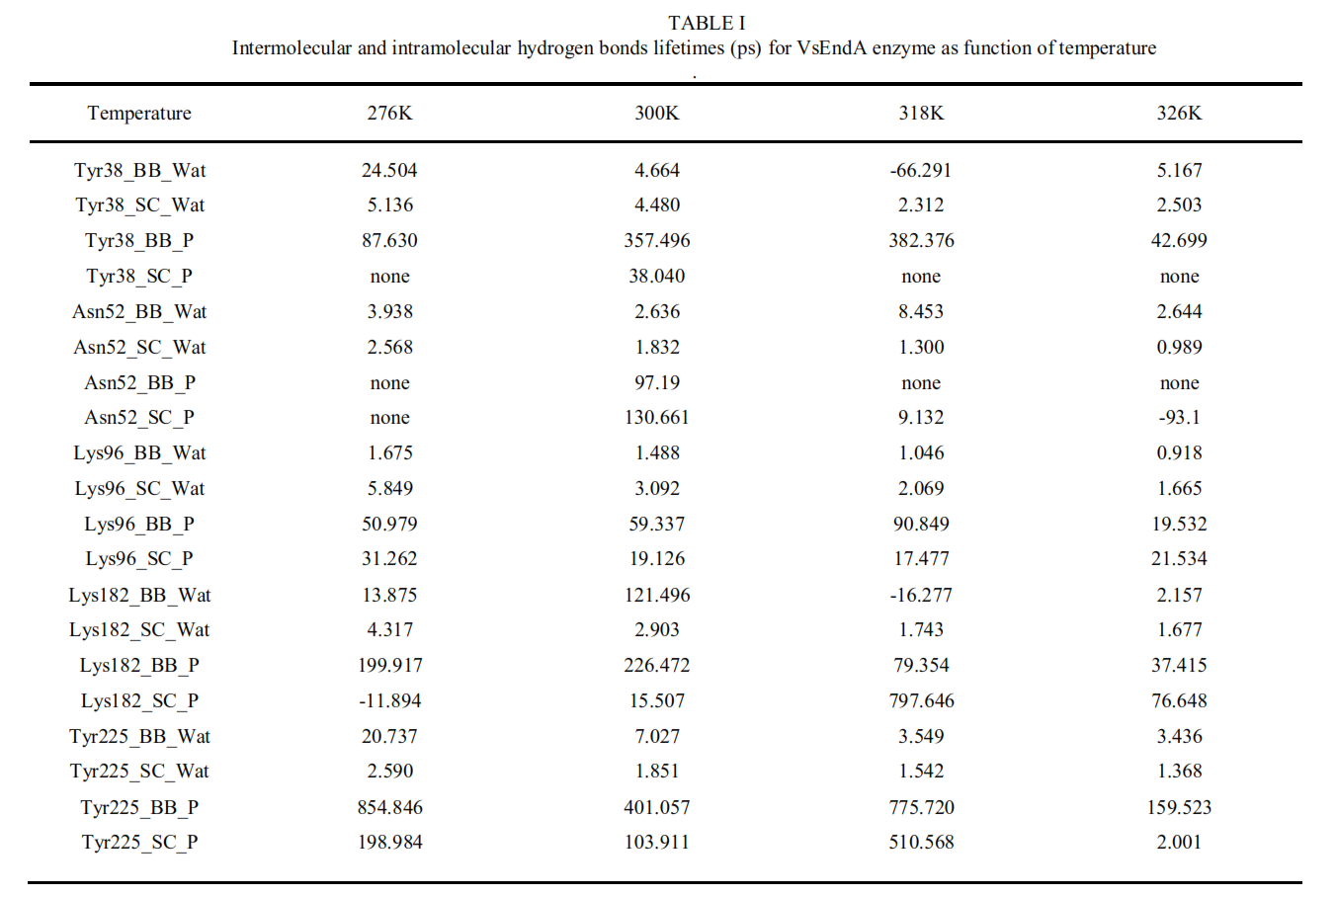
Hydrogen Bonds Lifetimes
(BB: Backbone, SC: Side Chain)

Slide 23
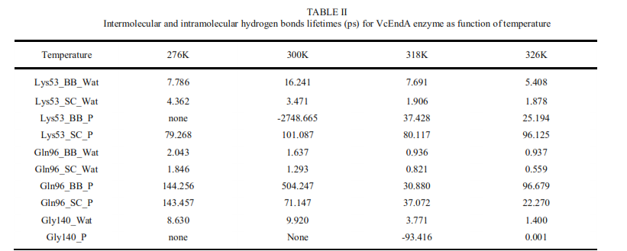
The more flexible residues in the structures of the two enzymes (at the considered
temperatures) show lower Intermolecular and/or Intramolecular Hydrogen bonds
Lifetimes.

Slide 24
Conclusion
Structural analysis : RMSD, Gyration Radius and Secondary Structures of the two enzymes reveal stable trajectories at the temperatures of 276, 300, 318 and 326K.
Temperature effect is different between the two enzymes; the Psychrophile enzyme
shows more mobility at T= 300 and 318 K, whereas the Mesophile enzyme expresses
an important flexibility at 326 K.
The rmsf profile of the two enzymes is similar. the most flexible residues of the two homologs belong to two regions which are identical in the primary structures; residues 52-53 and 96.
The lifetimes of hydrogen bonds of almost all of the most flexible residues of both
Enzymes, correlate well with the RMSF of the considered enzyme.

Slide 25
Acknowledgments
« The Computations were performed on the Al-Farabi
Cluster computer of the Ecole Nationale
Polytechnique Oran – MAURICE AUDIN »

