Slide 1

Linking visual and stress wave grading of beech wood from the log to the sawmill product
Aleš Straže ¹, Denis Plavčak ¹, Ervin Žveplan ¹ and Željko Gorišek ¹
1st International Electronic Conference on Forests, 15–30 November 2020;
1 University of Ljubljana
Biotechnical Faculty
Ljubljana, Slovenia
ales.straze@bf.uni-lj.si

Slide 2
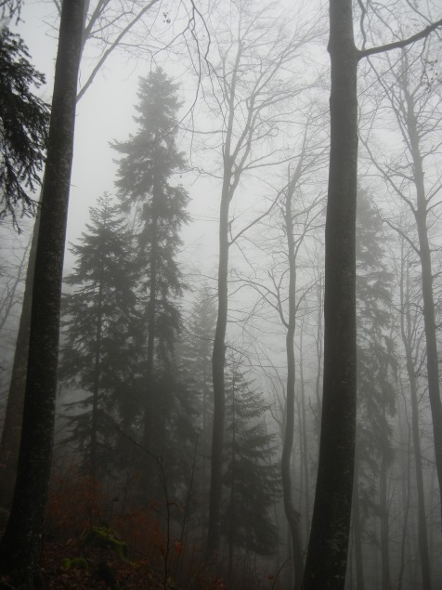
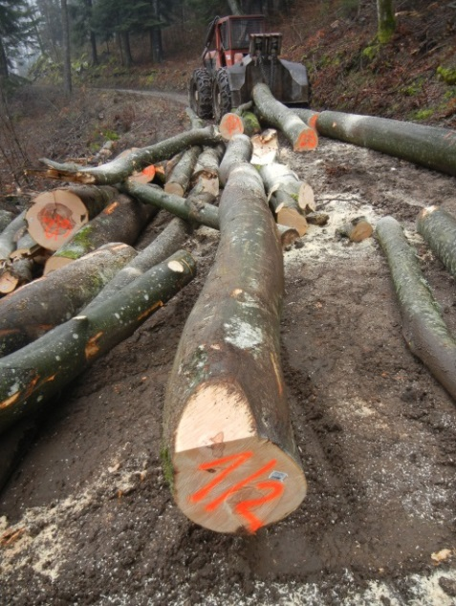
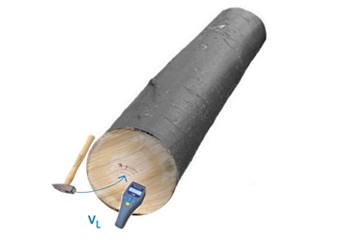
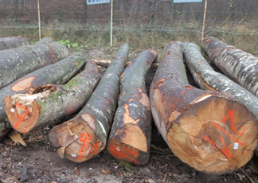

Sampling and visual grading of beech trees and logs
n_{L} = 27
2.5 to 6.5 m
n_{T} = 10,
5 grades
EN 1316-1
EN 1310:
A, B, C, D class
MTG device (Brookhuis, NL)
$$v_{L}=2f_{L}L_{L}$$

Slide 3
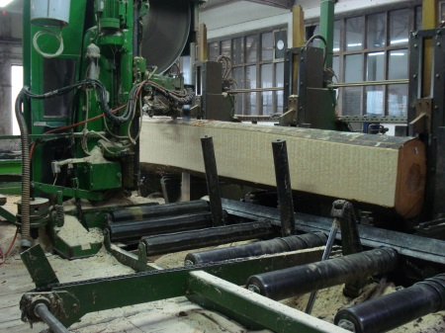
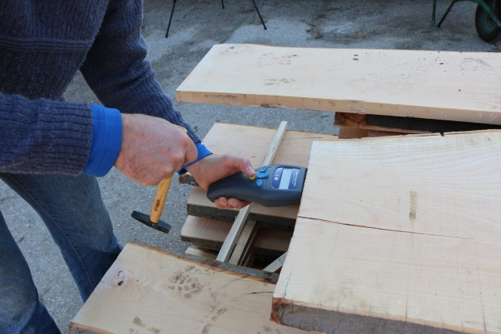
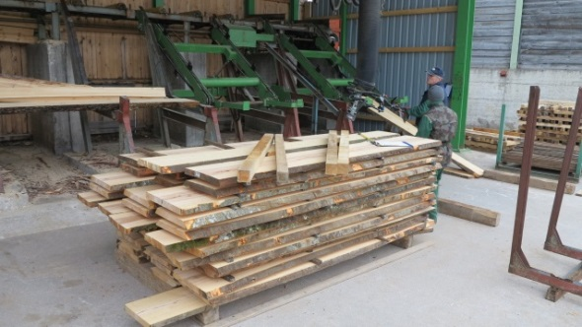

Sampling and production of sawn timber, visual grading and non-destructive testing
n_{B} = 250,
Thickness: 35 mm
Classification of European Organisation of Sawmill Industry (EOS):
EOS-A, EOS-B, EOS-C
MTG device (Brookhuis, NL)
$$v_{B}=2f_{B}L_{B}$$

Slide 4
Linking visual and stress wave grading of logs

Slide 5
Visual grading of sawn wood and dependence on log quality

Slide 6
Visual grading of sawn wood, stress wave velocity and dependence on log quality

Slide 7
Conclusions
The significance of the relationship between the visually assessed beech log quality and stress wave velocity.
Possibility to pre-sort beech logs for better classification and utilization of the sawn timber.
The stress wave velocity in logs is related to the stress wave velocity in boards, which varies considerably, especially with low graded material.
The relationship between sawnwood grade and stress wave velocity is not significant.

