Slide 1
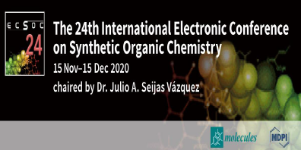
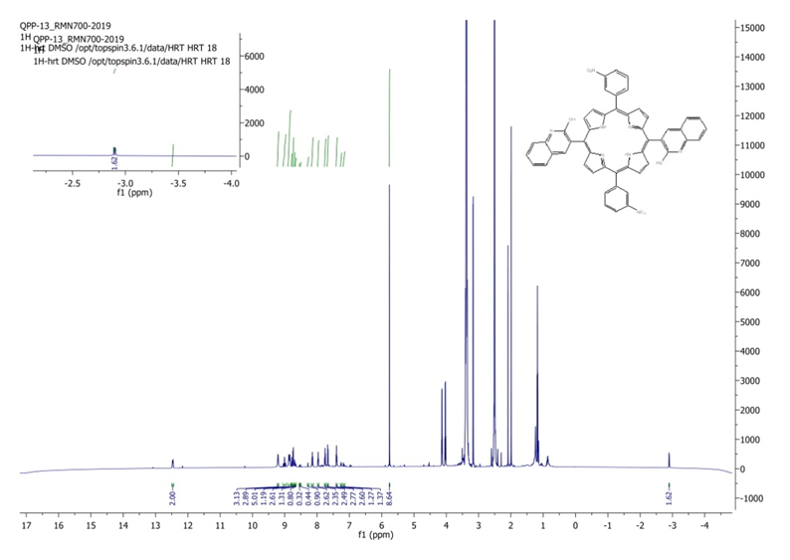
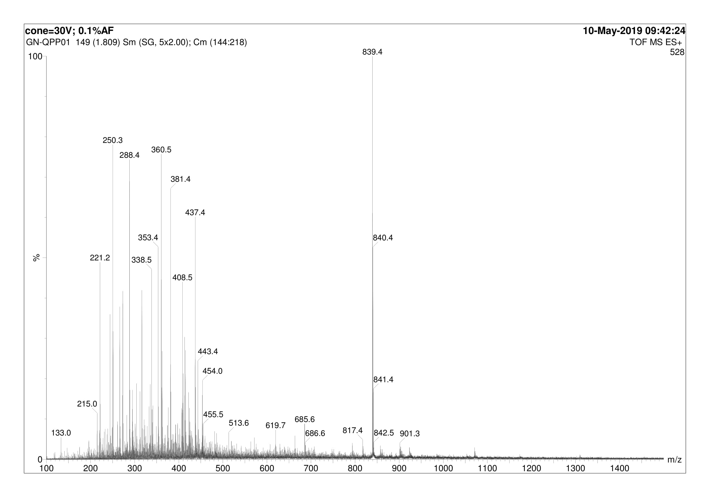
Synthesis of new meso- porphyrins type A2 B2
¹ Unité de Recherche de Chimie de l’Environnement et Moléculaire Structurale CHEMS, Université des Frères Mentouri Constantine 1, 25000 Constantine, Algeria; benosmanekhaled@gmail.com (A.B.); ali.benboudiaf@gmail.com (A.B.)
² Center for Scientific and Technical Research in Physico-Chemical Analysis (CRAPC), 42000 Tipaza, Algeria; Rmaadadi@gmail.com
* Correspondence: Cboukent@gmail.com
Abstract
Abstract: New meso-bis(quinolin-3-yl) porphyrins derivatives were synthetized from quinolin-3-carboxaldehydes derivatives and dipyrromethane in 1:1 ratio in CH₂Cl₂ at room temperature catalyzed by TFA and DDQ. Synthetized porphyrins were obtained with a low yield.
Keywords: Quinoline; porphyrins; dipyrromethane
Introduction
Results and Discussion
The porphyrin core has been a fascinating heterocyclic organic macrocycle as an interesting building unit for the design of new supramolecular assemblies and coordination polymers [1]. The extremely remarkable properties of highly conjugated macrocycles have led to their unique roles in diverse fields ranging from photomedicines [2] to dye sensitized solar cells that are well addressed in recent reviews [3-5]. Substituted nitrogen heterocyclic porphyrins are of particular interest [6]. As they provide sites for metal coordination, hydrogen bonding, alkylation and modulating electronic properties [7]. Several quinoline derivatives have been found to possess useful biological activities such as bactericidal [8], antitumor [9], antimalarial [10], antinflamatory [11]. The benzo and hetero fused quinolines are known to bind to DNA topoisomerase and display cytotoxic and antitumor activities [12].
The synthesis of new macromolecules type trans-A₂B₂ porphyrins possessing aromatic moieties as 2-hydroxy-quinoline and 2-chloro-5,8-dimethoxyquinoline were synthesized within two reaction steps (Scheme 1). In the first step, key precursors, 3-nitrophenyl dipyrromethane and aromatic aldehydes A-1, A-2 were synthesized following literature reported conventional procedure [13], involved the synthesis of trans-A₂B₂-porphyrins via condensation of aryl aldehydes with meso-aryl dipyrromethane in the presence of trifluoroacetic acid (TFA) followed by treatment with 2,3-dichloro-5,6-dicyano-1,4-benzoquinone (DDQ) as an oxidizing agent.
Starting quinoline aldehydes was synthesized by Vilsmeier–Haack cyclization [14] and meso-dipyrromethane by modified procedure literature [15].
The reaction of aldehydes, with dipyrromethane gave rise to the corresponding porphyrin with a low yield of P-1 and trace amount of P-2. Evaluation of reaction was followed by TLC and UV spectrophotometer. The desired A₂B₂-porphyrins, P-1, P-2 were identified by ¹H-NMR and mass spectroscopy.
Figure 1. ¹HNMR spectra of porphyrin P-1
Methods and Materials
Aldehyde (100 mmol) and dipyrromethane (200 mmol) were dissolved in DCM (40 mL) and stirred for 2 mins followed by addition of trifluoroacetic acid (5 μL). The reaction mixture was stirred under nitrogen atmosphere for 4 hrs at room temperature in dark. After that 2,3- dichloro-5,6-dicyano-1,4-benzoquinone (DDQ, 300 mmol) was added and reaction mixture was stirred for another 3 hours under air. Formation of the desired porphyrin was identified by Observation of brown color spot on TLC (in 30% DCM/hexane). The crude reaction mixture was subjected to silica gel column to filter off excess DDQ and other oligomeric products using 100% DCM. Further purification was carried out with a neutral alumina column chromatography and the desired porphyrins (P-1, P-2) were eluted with 20–30% DCM/hexane.
Figure 2. Mass spectroscopy P-2
Scheme 1. Formation of trans-A₂B₂ porphyrins P-1, P-2
Conclusion
In summary, we report the synthesis of trans-A₂B₂ porphyrins can be effectively synthesized from dipyrromethanes and quinoline aldehyde derivatives. Usually, the low yield of this reaction is being studied in order to improve it, as well as the use of other type of aldehydes is being carried out.
References
Dechan, P.; Devi Bajju, G.; Sood, P., Trans A2B2 Porphyrins: Synthesis, Crystal Structure Determinations and Hirshfeld Surface Analysis. ChemistrySelect 2020, 5 (24), 7298-7309.
Tsolekile, N.; Nelana, S.; Oluwafemi, O. S., Porphyrin as diagnostic and therapeutic agent. Molecules 2019, 24 (14), 2669.
Higashino, T.; Imahori, H., Porphyrins as excellent dyes for dye-sensitized solar cells: recent developments and insights. Dalton Transactions 2015, 44 (2), 448-463.
Zhang, J.-X.; Han, F.-M.; Liu, J.-C.; Li, R.-Z.; Jin, N.-Z., Self-assemblies formed by isonicotinic acid analogues axially coordinating with zinc porphyrin via pyridyl unit: synthesis and application in dye sensitized solar cells. Tetrahedron Letters 2016, 57 (17), 1867-1872.
Griffith, M. J.; Sunahara, K.; Wagner, P.; Wagner, K.; Wallace, G. G.; Officer, D. L.; Furube, A.; Katoh, R.; Mori, S.; Mozer, A. J., Porphyrins for dye-sensitised solar cells: new insights into efficiency-determining electron transfer steps. Chemical Communications 2012, 48 (35), 4145-4162.
Gryko, D.; Lindsey, J. S., Rational synthesis of meso-substituted porphyrins bearing one nitrogen heterocyclic group. The Journal of organic chemistry 2000, 65 (7), 2249-2252.
Amaravathi, M.; Babu, M. M.; Chandramouli, G., Synthesis of meso-tetrakis (2-chloroquinolin-3-yl) porphyrins. Arkivoc 2007, 2007, 148-153.
Chu, X.-M.; Wang, C.; Liu, W.; Liang, L.-L.; Gong, K.-K.; Zhao, C.-Y.; Sun, K.-L., Quinoline and quinolone dimers and their biological activities: an overview. European journal of medicinal chemistry 2019, 161, 101-117.
Sukhova, N.; Lidak, M. Y.; Zidermane, A.; Pelevina, I.; Vornina, S., Synthesis, antitumor, and antimicrobial activity of N-substituted nitrofurylvinyl (butadienyl)-4-amino (hydrazino) quinolines. Pharmaceutical Chemistry Journal 1989, 23 (10), 840-843.
Craig, J.; Pearson, D., Potential antimalarials. 7. Tribromomethylquinolines and positive halogen compounds. Journal of medicinal chemistry 1971, 14 (12), 1221-1222.
Dillard, R. D.; Pavey, D. E.; Benslay, D. N., Synthesis and antiinflammatory activity of some 2, 2-dimethyl-1, 2-dihydroquinolines. Journal of medicinal chemistry 1973, 16 (3), 251-253.
Lyon, M. A.; Lawrence, S.; Williams, D. J.; Jackson, Y. A., Synthesis and structure verification of an analogue of kuanoniamine A. Journal of the Chemical Society, Perkin Transactions 1 1999, (4), 437-442.
Littler, B.; Miller, M.; Hung, C.; Wagner, R., O, Shea, DF; Boyle, PD; Lindsey, JS. J. Org. Chem 1999, 64, 1391-1396.
(a). Meth-Cohn, O.; Narine, B.; Tarnowski, B., A versatile new synthesis of quinolines and related fused pyridines, Part 5. The synthesis of 2-chloroquinoline-3-carbaldehydes. Journal of the Chemical Society, Perkin Transactions 1 1981, 1520-1530. (b). Ali, M.; Tasneem, K.; Rajanna, P., An efficient and facile synthesis of 2-chloro-3-formyl quinolines from acetanilides in micellar media by Vilsmeier-Haack cyclisation. Synlett 2001, 2001 (02), 0251-0253.
Tsolekile, N.; Nelana, S.; Oluwafemi, O. S. Molecules. 2019, 24, 2669.
Faugeras, P.-A.; Boëns, B.; Elchinger, P.-H.; Vergnaud, J.; Teste, K.; Zerrouki, R., Synthesis of meso-substituted dipyrromethanes using iodine-catalysis. Tetrahedron Letters 2010, 51 (35), 4630-4632.

