Slide 1
Blood pressure lowering, antidyslipidemic and nitric oxide modulatory effects of methanol extract of Struchium sparganophora leaves on dexamethasone-salt model of hypertension in rats
Abiola Adeosun^{1,2*}, Abdulrahman Aroworamimo¹, Osasenaga Ighodaro¹, Folake Asejeje³, Oluseyi Akinloye²
¹ Department of Biochemistry, Lead City University, Ibadan
² Department of Biochemistry, College of Biosciences, Federal University of Agriculture, Abeokuta
³ Department of Biochemistry, KolaDaisi University, Ibadan, Nigeria
* Corresponding author: adeosun.amuhammad@lcu.edu.ng

Slide 2
Blood pressure lowering, antidyslipidemic and nitric oxide modulatory effects of methanol extract of Struchium sparganophora leaves on dexamethasone-salt model of hypertension in rats

Slide 3
Abstract:
The use of glucocorticoids causes elevation of blood pressure in man and experimental rats. We evaluated the antihypertensive potential of methanol extract of Struchium sparganophora leaves (SPA) on dexamethasone-salt induced hypertension in Rats. Rats were assigned randomly to 6 groups (n=4/group). Group A represented control, while blood pressure (BP) elevation (BP≥140/90) was induced in groups B to F via single subcutaneous administration of dexamethasone at a dose of 2 mg/kg with 4% NaCl substituted as drinking water for five days. Group B-F were treated twice daily for 10 days as follows: B; untreated, C; nifedipine 3 mg/kg, D; nifedipine 3 mg/kg + SPA 300 mg/kg, E; SPA 300 mg/kg and F; SPA 600 mg/kg. BP readings, and Plasma biochemical assays were done using established protocols. SPA at 300 and 600 mg/kg markedly decrease BP (P<0.05) which was increased by dexamethasone-salt in rats. Rats treated with SPA markedly showed increased serum HDL-cholesterol with decreased triglyceride concentration when compared to rats administered dexamethasone-salt only (P<0.05). SPA increases nitric oxide concentration (NO) in a dose-dependent manner in dexamethasone-salt hypertensive rats (P<0.05). This study revealed that SPA might lower blood pressure by increasing NO concentration, and balancing lipid homeostasis in the dexamethasone-salt hypertensive rats.
Keywords: Blood pressure; dexamethasone; dyslipidemia; hypertension; Struchium sparganophora.

Slide 4
Introduction
Hypertension is a persistent disturbance in hemodynamic function characterized by abnormal elevation of systemic blood pressure (James et al., 2014)
The progression of hypertension is multifaceted, and the pathogenesis of above 90% cases of this disease (essential hypertension) is unknown (Chobanian et al., 2003)
Management of hypertension is a crucial challenge to the healthcare system
The condition is often managed or prevented by adequate blood pressure (BP) control through lifestyle modification and by the use of antihypertensive drugs.
These drugs produces severe adverse effects either when used individually or concomitantly with other medications even at prescribed doses (Adeosun et al., 2017)
Hence, the reason for continuous search for more potent antihypertensive therapy with less adversity.

Slide 5
Introduction
The use of medicinal in the management of hypertension is common in developing countries including Nigeria (Oboh et al., 2008).
Various plant species have been explored and said to possess antihypertensive efficacies (e.g Ginger, garlic, barberry e.t.c).
Struchium sparganophora (Linn.) Ktze. (English translated name:water bitter leaf, Yoruba name: Ewuro odo) belongs to the Asteraceae family
It is a shrub commonly found in south western Nigeria. It is a fibrous green leaf consumed as vegetable in Southern Nigeria
Several medicinal uses such as sexually transmitted infections, gastrointestinal disorders, diabetes, and hypertension has been attributed to this green leaf (Oboh, 2006).

Slide 6
Introduction
As a result of increasing use of this plant and due to lack of information on the possible pharmacological mechanisms through which the plant exhibits its antihypertensive claims.
Our study, therefore, focused on blood pressure lowering, antidyslipidemia and nitric oxide modulatory efficacy of methanol extract of the leaves of Struchium sparganophora in Dexamethasone-salt induced hypertensive rats.

Slide 7
Methods
Plant sample preparation
S. sparganophora was were collected from Badeku farm in Ibadan, Oyo State, Nigeria, and it was authenticated and deposited in herbarium with voucher UI 22655.
The leaves were detached from the stems, dried, and milled to a powder. Three hundred gram (300 gram) of the powdered leaf was weighed and extracted with absolute methanol (1:8 g/v). The solvent was evaporated at 40⁰C on a rotary evaporator to obtain the crude methanol extract.

Slide 8
Methods
Assay for active drug content
The active content of nifedipine (Unicure Pharmaceuticals, Nigeria) and dexamethasone (Hubel Tianyao Pharmaceuticals, China) were assayed using standard procedure described in British pharmacopeia, (2009) before use.

Slide 9
Methods
Animal care
Twenty-four adult male rats of Wistar strain with weights between 160-165 grams were purchased from the Department of Anatomy, University of Ibadan. These rats were brought to Lead City University and were kept in clean and well-ventilated plastic cages maintained in 12hours light and dark cycle. The rats were acclimatized for two weeks prior the commencement of the study. Management of the rats was done in accordance to the protocol of the Animal Research Ethics committee of Lead City Ethical Review Board (LCU/ERB) which is in line with the Canadian Council on Animal Care (CCAC) guidelines (CCAC, 2009). The animals were fed pellets throughout the study and were given clean drinking water.

Slide 10
Methods
Experimental design
Rats were assigned randomly to 6 groups (n=4/group). Group A represented control, while blood pressure (BP) elevation (BP≥140/90) was induced in groups B to F via single subcutaneous administration of dexamethasone at a dose of 2 mg/kg with 4% NaCl substituted as drinking water for five days. Group B-F were treated twice daily for 10 days as follows: B; untreated, C; nifedipine 3 mg/kg, D; nifedipine 3 mg/kg + SPA 300 mg/kg, E; SPA 300 mg/kg and F; SPA 600 mg/kg. BP readings, and Plasma biochemical assays were done using established protocols.

Slide 11
Methods
Blood pressure determination
The systolic (SBP) and Diastolic (DBP) blood pressure of the rats were monitored from the hind leg using a noninvasive blood pressure monitoring device (CONTEC 0.8A) with veterinary cuff 3-5 cm (Adeosun et al., 2019).
Blood pressure measurements taken before induction of hypertension (Baseline), prior treatment, and after completing treatment was used for this study.

Slide 12
Methods
Lipid profile determination
After the 10th day of treatment, the rats were fasted 8 hours overnight, and blood samples were collected from each rat into heparinized vials and centrifuged at 3000 rpm for 10 minutes to obtain plasma, which was used for biochemical assays. Total lipid was determined using method of Zollner and Kirsch, (1962), HDL-C was determined with method of Lopez-Virella et al., (1977), Triglyceride was determined with method of Fossati and Prencipe, (1982) and LDL-C was calculated from the obtained lipid parameters using the formula by Friedewald et al., (1972).

Slide 13
Methods
Determination of cholesterol index and atherogenic index
Cholesterol ratio (CR) was calculated with the formula:
$Cholesterol ratio= \frac{TC}{HDL−C}$
Atherogenic index (AI) was calculated using the following formula:
$AI=\frac{TC−HDL−C}{HDL−C}$

Slide 14
Methods
Plasma nitric oxide determination
Nitric oxide was analyzed using the method described by Grisham et al., (1996). Briefly, 200 µL of Griess reagent containing 0.05% N-(1-naphthyl)ethylenediamine dihydrochloride, 0.5% sulfanilic acid and 2.5% phosphoric acid was reacted with the same volume of serum, and color developed was measured at 548 nm. Varying concentration of nitric oxide from sodium nitrite was used as a standard

Slide 15
Methods
Data Analyses
Parameters were calculated as mean ± standard deviation of animals in each group. Two-factor analysis of variance was used to compare changes in blood pressure among groups with time. One-way analysis of variance coupled with Tukey's multiple comparisons test was used to study differences in biochemical parameters among groups. A p-value of less than 0.05 was considered significant.

Slide 16
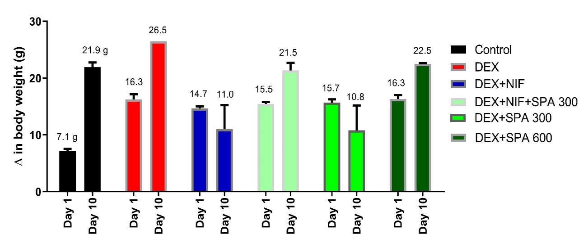
Results
Figure 1: Effect of Struchium sparganophora leaf methanol extract on body weight of Dexamethasone-induced hypertensive rats.

Slide 17
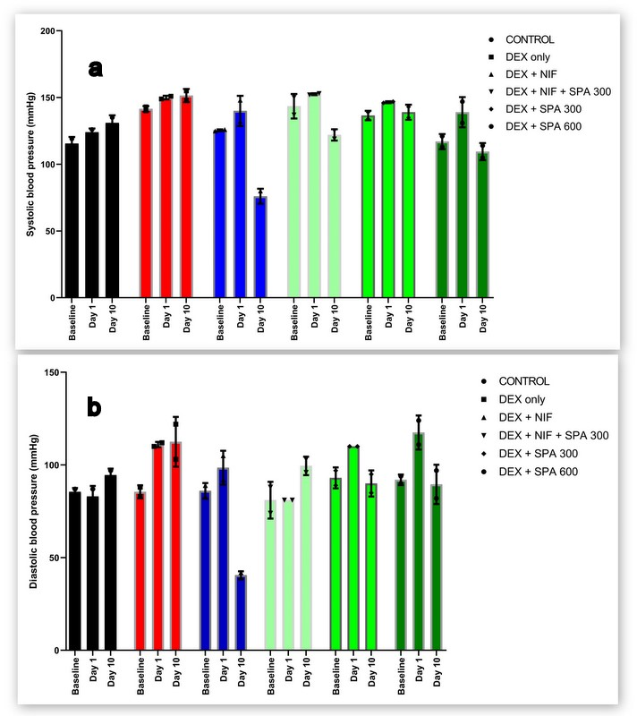
Results
Figure 2: Effect of methanol extract of Struchium sparganophora leaves on (a) systolic and (b) diastolic blood pressure in Dexamethasone induced hypertensive rats

Slide 18
Results
Table 1: Effect of Struchium sparganophora leaf methanol extract on lipid profile in dexamethasone-induced hypertensive rats.
Groups | Total Cholesterol (mg/dL) | HDL-CHOL (mg/dL) | LDL-CHOL (mg/dL) | TRIG (mg/dL) | VLDL (mg/dL)
Control | 40.37±1.20 | 14.22±3.12 | 11.42±0.21 | 153.6±12.09 | 30.60±2.42
DEX | 48.94±3.20 | 9.09±0.31ª | 12.20±0.08 | 143.8±0.43 | 28.76±0.086
DEX + NIF | 46.87±4.43 | 10.71±0.31ª | 10.79±0.00 | 153.4±15.01 | 30.68±3.01
DEX + NIF +SPA 300 | 48.53±1.88 | 12.24±0.21^{b} | 19.78±1.37^{abc} | 84.14±1.65^{abc} | 16.83±0.33^{abc}
DEX + SPA 300 | 46.31±11.13 | 12.60±0.21^{b} | 22.92±0.07^{abc} | 108.9±5.42^{abc} | 21.78±1.08^{abc}
DEX + SPA 600 | 58.62±4.47ª | 12.42±0.00^{b} | 18.72±1.31^{abc} | 103.3±11.15^{abc} | 20.66±2.23^{abc}
Results were expressed as mean ± standard deviation (n=4). ª Significant when compared to control at p < 0.05, ^{b} Significant when compared to dexamethasone p < 0.05, ^{c} Significant when compared to standard drug (Nifedipine) p < 0.05

Slide 19
Results
Table 2: Effect of Struchium sparganophora leaf methanol extract on lipid profile in dexamethasone-induced hypertensive rats.
Groups | Cardiac index | Atherogenic index
Control | 2.84 | 1.84
DEX | 5.38 | 4.39
DEX+NIF | 4.38 | 3.38
DEX+NIF+SPA 300 | 3.96 | 2.96
DEX+SPA 300 | 3.68 | 2.68
DEX+SPA 600 | 4.72 | 3.71

Slide 20
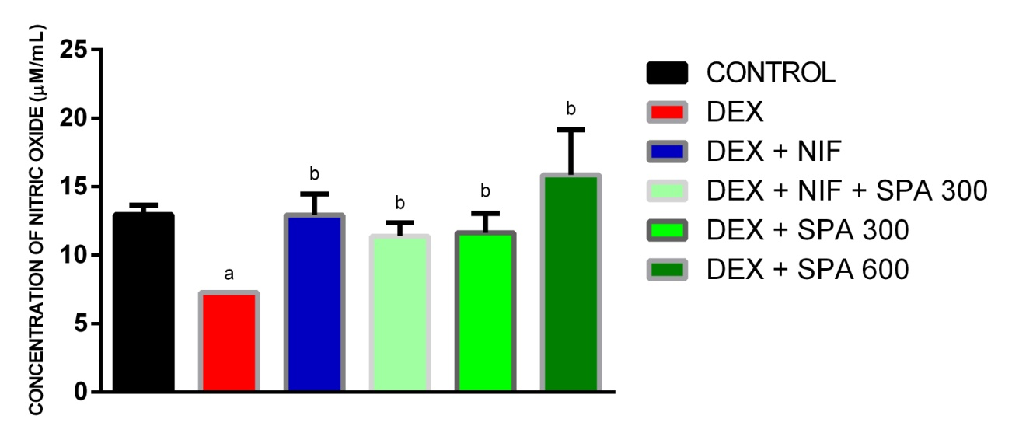
Results
Figure 3: Effect of Struchium sparganophora leaf methanol extract on nitric oxide level in dexamethasone-induced hypertensive rats. ª Significant when compared to control p < 0.05, ^{b} Significant when compared to dexamethasone p < 0.05, ^{c} Significant when compared to standard drug (Nifedipine) p < 0.05

Slide 21
Conclusions
The methanol extract of Struchium sparganophora leaves produced a considerable blood pressure-lowering effect, which could be linked with the extract’s ability to increase plasma nitric oxide concentration, increased HDL-cholesterol concentration, and reduced triglycerides concentration, which their sum effect may help to reduce total peripheral resistance, an essential factor to crucial in controlling high blood pressure.

Slide 22
References
Adeosun AM, Adedapo AD, Adedeji WA. Adverse drug reactions report among hospitalized patients with hypertension in a Nigerian Tertiary Healthcare Centre: a retrospective study. Medicine 2017; 6(2): 276-279.
Adeosun AM, Ighodaro OM, Akinloye OA. New method for determining blood pressure in unanaesthesize rats using non invasive CONTEC 08A device with small cuff: A path to antihypertensive drug development in developing countries. 22nd International Conference on New Horizons in Cardiology and Cardiologists Education 2019: Journal of Heart and Cardiovascular Research; 2019; Berlin: Euroscicon; 2019. p. 43.
Beckett NS, Peters R, Fletcher AE, et al. Treatment of hypertension in patients 80 years of age or older. New England Journal of Medicine 2008; 358(18): 1887-1898.
British Pharmacopoeia. Dexamethasone Sodium Phosphate Injection. Formulated Preparations: Specific Monographs; 2009. p. 8597-8.
British Pharmacopoeia. Nifedipine. Medicinal and Pharmaceutical substances; 2009. p. 4192-5.

Slide 23
References
Chobanian AV, Bakris GL, Black HR, et al. The seventh report of the joint national committee on prevention, detection, evaluation, and treatment of high blood pressure: the JNC 7 report. Jama 2003; 289(19): 2560-2571.
Fossati P, Prencipe L. Serum triglycerides determined colorimetrically with an enzyme that produces hydrogen peroxide Clin Chem 1982; 28: 2077–2080.
Friedewald WT, Levy RI, Fredrickson DS. Estimation of the concentration of low-density lipoprotein cholesterol in plasma, without use of the preparative ultracentrifuge. Clinical chemistry 1972; 18(6): 499-502.
Grisham MB, Johnson GG, Lancaster J. Quantitation of nitrate and nitrite in extracellular fluids. Methods Enzymol 1996; 268(A): 237–246.
Griffin G. Establishing a three Rs programme at the Canadian council on animal care. Alternatives to Laboratory Animals 2009; 37(2_suppl): 63-67.

Slide 24
References
James PA, Oparil S, Carter BL, et al. 2014 Evidence-based guideline for the management of high blood pressure in adults: report from the panel members appointed to the Eighth Joint National Committee (JNC 8). Jama 2014; 311(5): 507-520.
Lopez-Virella MF, Stone P, Ellis S, Colwell JA. Cholesterol determination in high-density lipoproteins separated by three different methods. Clin Chem 1977; 23(5): 882–884.
Oboh G. Nutritive value, antioxidant and antimicrobial properties of Struchium sparganophora leaves. Journal of medicinal food 2006; 9(2): 276-280.
Oboh G, Raddatz H, Henle T. Antioxidant properties of polar and non‐polar extracts of some tropical green leafy vegetables. Journal of the Science of Food and Agriculture 2008; 88(14): 2486-2492.
Zollner N, Kirsch K. Determination of the total lipid concentration in serum. . Zentralblatt für Gesamte Experimental Medizin 1962; 135: 545–549.

Slide 25
Acknowledgments

