Slide 1

UNIVERSITY SIDI MOHAMED BEN ABDELLAH
FACULTY OF SCIENCE
FEZ
CHEMISTRY DEPARTMENT
In vitro antioxidant activity, phytochemical screening and total phenolic and flavonoid contents from the leaves extracts of
Stachys germanica subs cordigera briq
Abdelmoughite Ouakil¹*, Soumaya El ismaili², Hanane El Hajaji¹, Amal Maurady², Ouafaa El Mahdi³,
Brahim El Bali¹ and Mohammed Lachkar¹
¹ Engineering Laboratory of Organometallic, Molecular Materials and Environment, Faculty of Sciences, Sidi Mohammed Ben Abdellah University, 30000 Fez, Morocco;
²Laboratory of Innovative Technologies, Civil Engineering Department, ENSA of Tangier.
³ Multidisciplinary Faculty, Sidi Mohammed Ben Abdellah University, Taza, Morocco
* Corresponding author: mourit11@hotmail.com

Slide 2
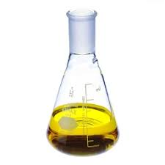
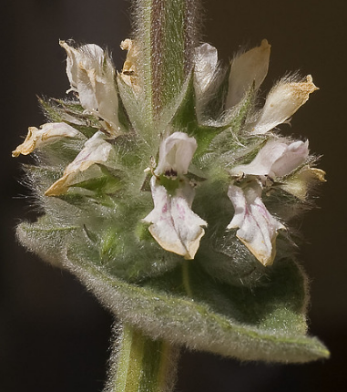
In vitro antioxidant activity, phytochemical screening and total phenolic and flavonoid contents from the leaves extracts of
Stachys germanica subs cordigera briq
Graphical abstract
Total flavonoids and polyphenols
Flavonoids
Extraction
Soxhlet apparatus
polyphenols
Antioxidant
activity
DPPH
Soxhlet apparatus
FRAP
Extraction
Phasphomolebden

Slide 3
Abstract
This study is planned to perform phytochemical screening, evaluate antioxidant activity and assess total phenolics and flavonoids content of methanolic and ethyl acetate extracts from the leaves of Stachys germanica subs cordigera briq. The dried powdered leaves of Stachys germanica subs cordigera briq (80 g) were extracted exhaustively by Soxhlet apparatus with increasing polarity of solvents (hexane, ethyl acetate and methanol). The total phenolic and flavonoid contents in the methanolic and ethyl acetate extracts were determined by using the Folin-Ciocalteu reagent and aluminum chloride method, respectively. The antioxidant activities were examined by three different methods, namely 2,2-diphenyl-1-picrylhydrazyl (DPPH) free radical scavenging activity, reducing power scavenging activity (FRAP) and total antioxidant capacity. Phytochemical analysis of all extracts showed the presence of major classes of phytochemicals such as, flavonoids, tannins and polyphenols. Total phenolic and flavonoid contents results are showed in a large dominance in ethyl acetate extract. In vitro antioxidant activities of both extracts (ethyl acetate and methanol) were significant and ethyl acetate extract showed a higher potency than reference antioxidant Butylated Hydroxy Toluene (BHT) in total antioxidant capacity essay. It can be concluded that the crude extracts from the leaves of Stachys germanica subs cordigera briq. are a potential source of natural antioxidants which can be used in preventing the progression of many diseases.
Keywords: Stachys germanica subsp cordigera briq, phytochemical screening, total phenolics and flavonoids content, antioxidant activity

Slide 4
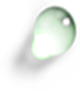


Outline
Introduction
Objectives
Materials and Methods
Plan
Results
Conclusion

Slide 5
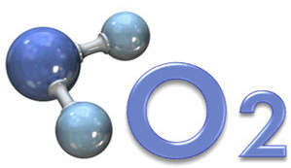

Materials and methods
Introduction
Objectives
Materials Methods
Results
Conclusion
humans, along with many other creatures, need oxygen in the air we breathe to stay alive
highly reactive atom that is capable of becoming part of potentially damaging molecule commonly called ''free radical''

Slide 6

Introduction
Objectives
Materials Methods
Results
Conclusion
The excessive production of these free radicals creates what is known as oxidative stress.
Oxidative stress
Free radicals
Antioxidants

Slide 7
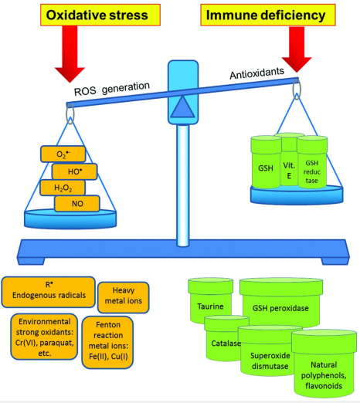
Introduction
Objectives
Materials Methods
Results
Conclusion
Oxidative stress

Slide 8

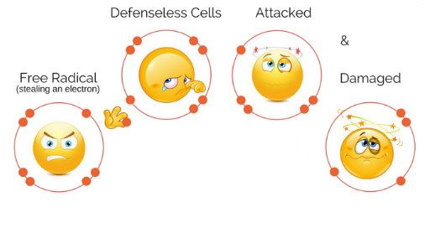
Introduction
Objectives
Materials Methods
Results
Conclusion
Free radicals

Slide 9
Introduction
Objectives
Materials Methods
Results
Conclusion
Free radicals
Free radicals are capable of attaching cells of body, causing them to lose their structure and function.
Although the initial attack cause the free radical to become neutralized, another free radical is formed in this process, causing a chain reaction is occur.
And until subsequent free radicals are deactivated, thousands of free radical reaction can occur within second of initial reaction.
Free radicals have been implicated in the pathogenesis of at least 50 diseases cardiovascular diseases, cancers, neurodegenerative diseases, Alzheimer’s disease inflammatory diseases and other related diseases

Slide 10
Introduction
Objectives
Materials Methods
Results
Conclusion
Free radicals
Hydroperoxyl radical
Superoxide anion radicals
HO₂•
Hydroxyl radicals
O₂‒•
OH•
ROS
H₂O₂
¹O₂
Hydrogen peroxide
HOCl
Singlet oxygen
Hypochlorous acid

Slide 11
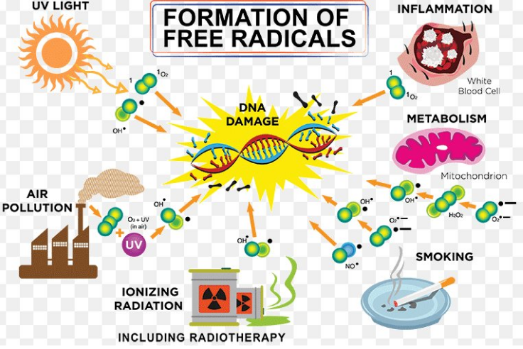
Introduction
Objectives
Materials Methods
Results
Conclusion
Source of free radicals
Free radicals and other ROS are derived either from endogenous metabolic process in the human body (Internal source) or from external sources
Smoking
Mithocondria
Radiation
Phagocytes
Internal sources
External sources
U.V. light
Xantine
oxidase
Air pollution
Exercise
Ischemia &
reperfusion
Inflammation

Slide 12
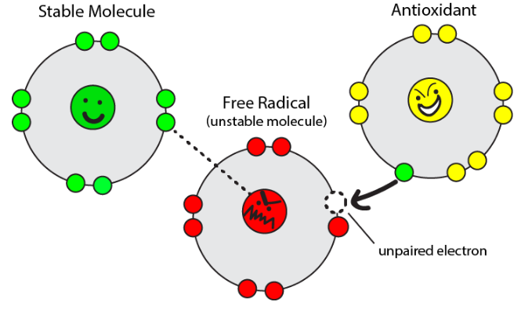
Introduction
Objectives
Materials Methods
Results
Conclusion
Antioxidants
Antioxidants are chemical substances that donate an electron to the free radical and convert it to harmless molecule.

Slide 13
Introduction
Objectifs
Materials Methods
Results
Conclusion
Selection cretiria of antioxidants
Following criteria should be considered while selecting an antioxidant
It should be able to produce desire redox reaction
It should be physiologically and chemically compatible
It should be physiologically inert
It should be non-toxic both in the reduced and oxidized forms
It should be effective in low concentration
It should be provide prolonged stability to the formulation
medicinal plant

Slide 14

Introduction
Objectives
Materials Methods
Results
Conclusion
Natural compounds derived from medicinal plants play a central part in the health care and drug development in classical as well as advanced systems of medicine.
Easy
availability
Medicinal
plants
Cost
effectiveness
negligible
side
effects

Slide 15
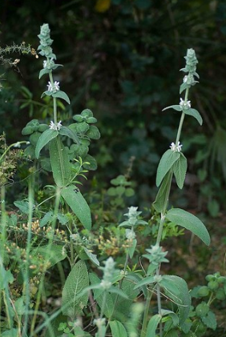
Introduction
Objectives
Materials Methods
Results
Conclusion
Stachys germanica subs cordegira briq
North America
Asia
Europe
Africa
South America
Australia

Slide 16

Introduction
Objectives
Materials Methods
Results
Conclusion
Stomach
Rheumatism
anti-inflammatory
antibacterial
Traditional medicine
Researches
Skin
Vaginal tumors
antianxiety
antioxidant
Asthma
antinephritic
Many Stachys species are used in the preparation of food such as yoghurt or jelly to improve the taste and as flavors and seasoning

Slide 17
Introduction
Objectives
Materials Methods
Results
Conclusion
Aims and Objectives
The present investigation is undertaken by utilizing the plant Stachys germanica subs cordegira briq with following objectives:
Extraction of the leaves with different solvents
Preliminary phytochemical analysis
Determination of total phenolic and flavonoid contents at the different extracts
Evaluation the antioxidant activities

Slide 18
Introduction
Objectives
Materials Methods
Results
Conclusion
Material and methods
1-Collection of material and extraction procedure
Collect material
Evaporate of solvent
Drying
Extraction
Filtration
Talasmtan
One week
80g, Soxhlet
Filter paper
Rotary evaporator

Slide 19
Introduction
Objectives
Materials Methods
Results
Conclusion
2- Phytochemical analysis
Sterols and terpenes: Burchard’s test
Polyphenols: Fecl₃ solution
Flavonoids: cyanidine reaction
Tannins: Stiasny’s test
Alkaloids: Dragendorff’s test

Slide 20
Introduction
Objectives
Materials Methods
Results
Conclusion
3-Total flavonoids content
Total flavonoid content was determined spectrophotometrically by using the AlCl₃ reagent as described by Dewanto et al 2002
250µl of crude extract + 75µl of 5% NaNO₂
6min
Incubation at room temperature
Add 150µl of 10% AlCl₃
5min
Incubation at room temperature
Add 0.5 mL of 1M NaOH
Adjust volume with distilled water to 2.5mL
Absorbance at 510 nm with U.V visible spectrophotometre

Slide 21
Introduction
Objectives
Materials Methods
Results
Conclusion
Total phenolic content
Total phenolic content was determined spectrophotometrically by using Folin-Ciocalteu method as described by El Hajaji et al 2012
100µl Folin-ciocalteu reagent + 1.58mL distilled water + 20µl crude extract
5min
Incubation at room temperature
Add 300µl of Na₂CO₃(25%)
60min
Measuring of TPC at 765nm

Slide 22
Introduction
Objectives
Materials Methods
Results
Conclusion
Antioxidant activities
Antioxidant activities were examined by three different methods namely,
2,2-diphenyl-1-picrylhydrazyl (DPPH) free radical scavenging activity
Reducing power scavenging activity (FRAP)
Total antioxidant capacity.

Slide 23
Introduction
Objectives
Materials Methods
Results
Conclusion
2,2-diphenyl-1-picrylhydrazyl (DPPH) free radical scavenging activity
The leaves extracts of S.germanica subs cordigera briq were tested in their free radical scavenging activity using (DPPH), according to the protocol described by El Hajaji et al 2012.
100µl of extract + 10mL of methanolic solution of DPPH
Incubation at room temperature for 30 min
Record the absorbance at 517 nm
Inhibition ratio : % inhibition = [(A₀ – A₁)/ A₀] × 100
A_{0:} absorbance of control reaction ; A_{1:} absorbance of test compounds
BHT : positive control. The test was carried out in triplicate

Slide 24
Introduction
Objectives
Materials Methods
Results
Conclusion
Reducing power scavenging activity (FRAP)
The reducing power was determined according to the protocol described by El Hajaji et al 2012.
Extract at various conc + 0.2M phosphate buffer (pH 6.6) + (K₃Fe(CN)₆) (1%)
Mix and incubate at 50 ⁰C
in water bath for 20min
Add C₂HCl₃O₂ (10%)
The upper layer mixed with DW and of FeCl3 (1%)
Absorbance at 700nm
Ascorbic acid : standard

Slide 25
Introduction
Objectives
Materials Methods
Results
Conclusion
Total antioxidant capacity.
The total antioxidant capacity of the extracts was evaluated by using the phosphomolybdenum method as montioned by El Hajaji et al 2012
The test is based on the reduction of Mo (VI) to Mo(V) in the extract and subsequent formation of a green phosphate/Mo(V) complex at acid pH.
The absorbance of the solution was measured at 695 nm using a U.V.visible spectrophotometer
The antioxidant capacity of each sample was served as Ascorbic Acid equivalent using the following linear equation in using ascorbic acid as standard: [A= 0.0037C + 0.0343 ; R²=0.991]
A: absorbance at 695 nm ; C: concentration as ascorbic acid equivalent (µg/ml).
The values represent the triplicate analysis.

Slide 26
Introduction
Objectives
Materials Methods
Results
Conclusion
Results
Figure 1. Yields of hexane, ethyl acetate and methanol extracts of Stachys germanica subs cordigera briq.

Slide 27
Introduction
Objectives
Materials Methods
Results
Conclusion
Results
Preliminary phytochemical analysis from the leaves extracts of Stachys germanica subsp cordigera briq showed the presence of major classes of secondary metabolites.
Extracts Metabolites | Hexane | Ethyl acetate | Methanol
Polyphynols Sterols/steroids Terpenes/Terpenoids Tannins Alkaloids Flavonoids | - + + - - - | + - - + - + | + - - - - +
Table. 1 : Results of preliminary phytochemical screening of S.germanica subsp cordigera briq. leaves extracts.

Slide 28
Introduction
Objectives
Materials Methods
Results
Conclusion
Results
Total phenolic contents
Total phenolic content was expressed as GAE using the following linear equation as standard: y= 0.0171x+0.2091, R²=0.975.
Ethyl acetate extract = 23.2 µg/mL GAE ; Methanol extract = 15.7 µg/mL GAE
Fig 2. Total phenolics contents of ethyl acetate and methanol extracts of S. germanica subs cordigera briq.

Slide 29
Introduction
Objectives
Materials Methods
Results
Conclusion
Results
total flavonoids contents
Total flavonoids contents, they are made as quercetin equivalent using also the following linear equation with quercetin as standard: y= 1.657x+0.0317; R²=0.994.
Ethyl acetate extract = 82 µg/ml QE ; Methanol extract =42µg/ml QE.
Fig 3. Total Flavonoid contents of ethyl acetate and methanol extracts of S. germanica subs cordigera briq.

Slide 30
Introduction
Objectives
Materials Methods
Results
Conclusion
Results
DPPH Antioxidant activity
IC₅₀ = 0.5mg/mL
IC₅₀ = 2.9mg/mL
IC₅₀ = 3.5mg/mL
Fig 4. Antioxidant activity of Stachys germanica subs cordigera briq. leaves extracts against DPPH

Slide 31
Introduction
Objectives
Materials Methods
Results
Conclusion
Results
Ferric reducing antioxidant power
Fig 5. Reducing power of of Stachys germanica subs cordigera briq. leaves extracts

Slide 32
Introduction
Objectives
Materials Methods
Results
Conclusion
Results
Total antioxidant capacity
Fig 6. Antioxidant capacity of Stachys germanica subs cordigera briq. leaves extracts

Slide 33
Introduction
Objectives
Materials Methods
Results
Conclusion
Conclusion
Phytochemical screening showed the presence of various classes of bioactive chemical constituents in all extracts of Stachys germanica subs cordigera briq including sterols/steroids, terpenes /terpenoids, polyphenols, tannins and flavonoids.
Total phenolic and flavonoid contents results showed a large dominance in ethyl acetate extract.
The leaves extracts from Stachys germanica subs cordigera briq showed a significant antioxidant activity as well as, ethyl acetate extract exhibited greater antioxidant than BHT as measured by total antioxidant capacity.
These results suggested that the leaves extracts from Stachys germanica subs cordigera briq. can be used as possible in natural antioxidant source. It is then necessary to identify and isolate the compounds that are responsible to these antioxidant activities.

Slide 34


