Slide 1
Short rotation forestry – New approach in biomass production evaluation. An application from NE Romania Iulian Constantin Dănilă Ștefan cel Mare University of Suceava, Faculty of Forestry

Slide 2
Background
Hypothesis
Material
Procedure
Results
Conclusion
The short rotation forestry (SRF) playing an important role in worldwide forest economy: obtaining high biomass production in a short time;
SRF are developing continuously in NE of Romania: with over 800 Ha;
Several studies have been undertaken to identify the high productivity, between different:
hybrid poplar clones;
plant materials;
density;
cycle or rotaion, and
suitable technologies.
For initial studies, biomass production was estimated using the destructive (gravimetric) method.

Slide 3
Background
Hypothesis
Material
Procedure
Results
Conclusion
A precise estimate of biomass is necessary for the sustainable planning of forest resources and for the exchange of energy in ecosystems;
The use of the terrestrial laser scanner (TLS) in biomass estimation brings an important technological leap among indirect (non-destructive) methods;
Measuring the hybrid poplars crops by TLS may have many following aspects, like:
higher accuracy of biomass estimation in SRF;
cost and time effective measurements over the biomass of tree parts;
new and validated allometric equations for SRF in NE Romania;
robust instrument for industry to estimate biomass.
TLS technology is justified when destructive methods become difficult to carry out and allometric equations do not give accurate information.
Notes:
Aims: The main purpose is to estimate the biomass productivity on tree parts in short rotation forestry with TLS technology.
In Romania, TLS technology has never been used in short rotation wood crops, the few cases in forest inventories

Slide 4
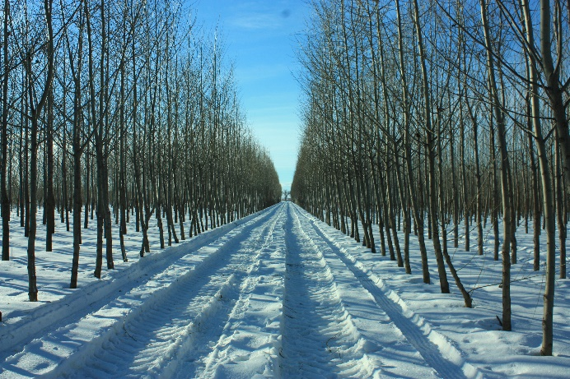
Background
Hypothesis
Material
Procedure
Results
Conclusion
The research was conducted in a hybrid poplar crops in NE Romania (experimental and field crop);
7 different hybrid poplar clones (AF2, AF6, AF8, Monviso, A4A, Pannonia and Max4) under intensive cultivation;
Three different types of planting material (cuttings, rods and seedlings) and different density 3 x 1; 1,16; 1,25; 2 and 2,5 were used;
Biomass was estimated for brunch and trunks after 4 and 7 growing seasons (Mg ha⁻¹), for the first rotation cycle.

Slide 5
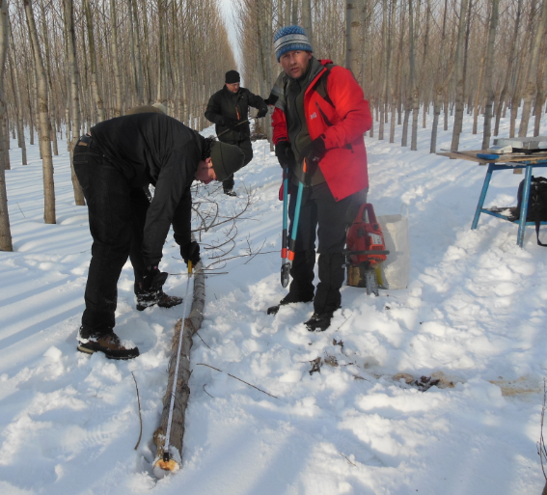
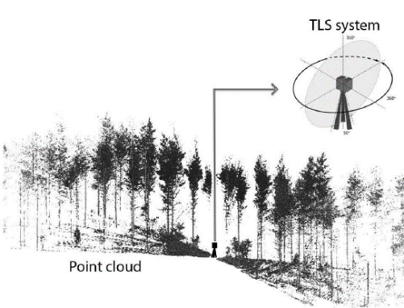
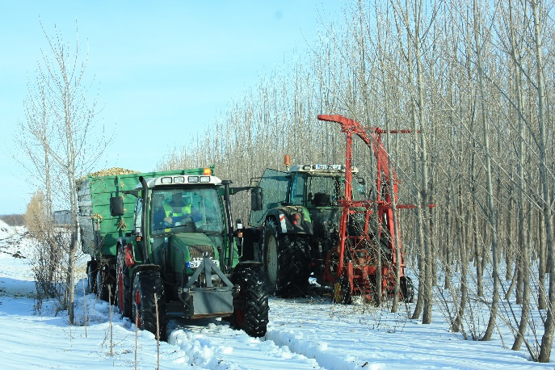
Background
Hypothesis
Material
Procedure
Results
Conclusion
In a second rotation (after 5 years) it will be compared the data obtain form direct and indirect method:
Data will be compare with allometric equation (from the first rotation).
Biomass per different parts of trees: branches and trunk/ steam
Total biomass production
(Mg ha⁻¹)

Slide 6
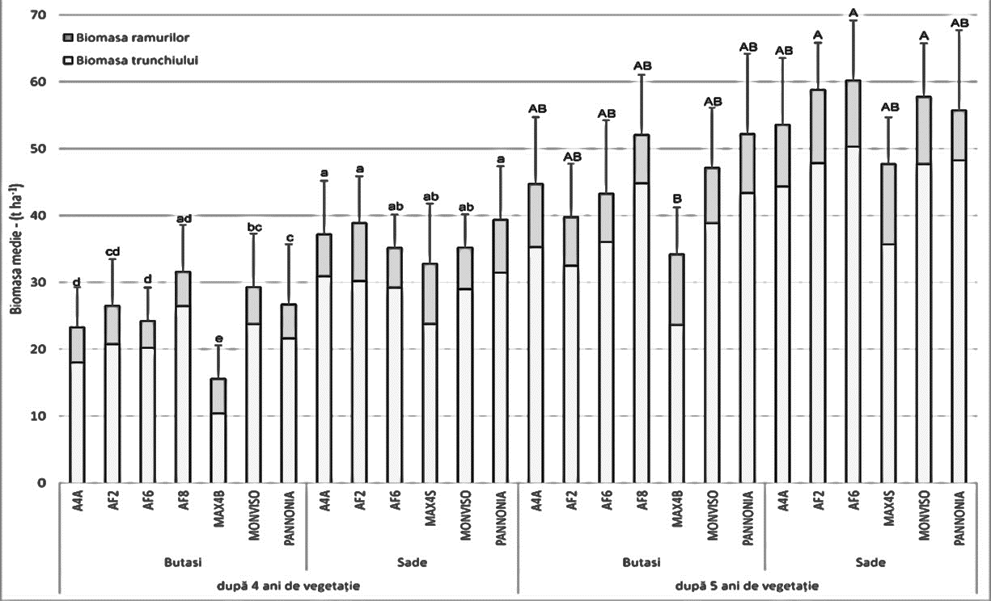
Background
Hypothesis
Material
Procedure
Results
Conclusion
Partial result from the First rotation cycle
(1) what is happening between different types of planting material?
Rods
The biomass difference accumulated by cuttings compared to rods is due primarily to their morphological and physiological characteristics;
Short-rotation crops offer a 30% higher yield in the last growing seasons (after 5 years);
The expansion of the production cycle modifies the proportion between the biomass of the stem and branches for each type of planting material.
Cuttings
Rods
Cuttings
4 years growing
5 years growing
Figure 1. Biomass production per hectar, after different plant material and diferent growing seasons (after 4 and 5 years) – for 3 x 1,25 m (2667 trees ha-) planting density
Table 1. Characteristics of the planting material installed
Planting material | Length (cm) | Thickness (cm) | Weight (g) | Planting depth (cm)
Cuttings | 22 | 1.0 – 1.5 | 29 | 18 - 20
Rods | 180 | 2.0 – 3.0 | 264 | 60 - 70
Seedlings | 60 - 70 | 1 - 2 (close to collar) | 242 | approx. 30 (close to collar)

Slide 7
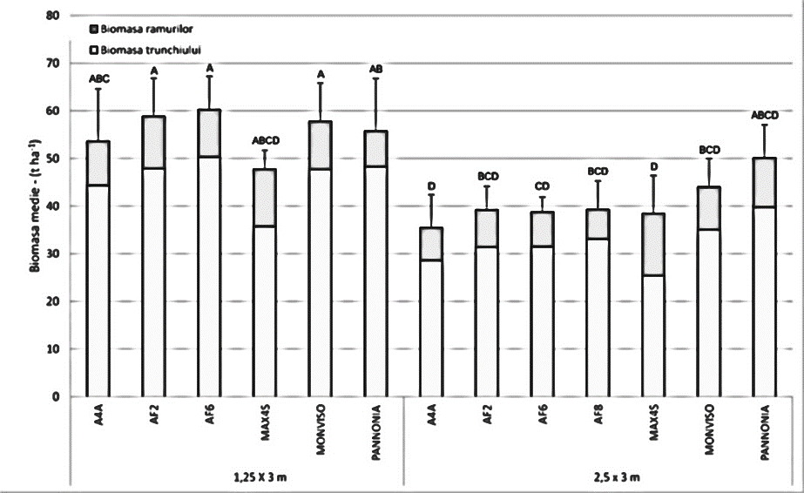
Results – (1) what is happening between different types of planting material?
Background
Hypothesis
Material
Procedure
Results
Conclusion
Partial result from the First rotation cycle
(2) what is happening between different density for rods?
Doubling the planting scheme brings an individual biomass addition of over 60%, but records a reduced yield when it is proportioned per area unit.
Doubling the planting distance has also significantly influenced the proportion between the biomass of the stem and branches and produces a biomass increase at branch level.
2667 trees ha-1
1333 trees ha-1
Figure 2. Biomass production for two different density – 3 x 1,25 m (2667 trees ha-1) and 3 x 2,5 m (1333 trees ha-1)

Slide 8
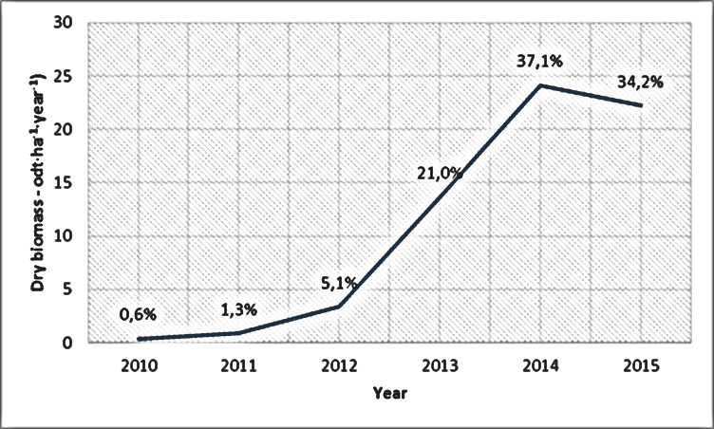
Results – (1) what is happening between different types of planting material?
Background
Hypothesis
Material
Procedure
Results
Conclusion
Partial result from the First rotation cycle
(3) what is happen after 6 years growing season??
After six growing seasons (in 2015), because of very reduced precipitation in the maximum vegetative accumulation period (May - June), this crop has accumulated a biomass of approx. 22,3 odt∙ha⁻¹, that represents approx. 34,2% of the total production;
Figure 4. Annual dry biomass accumulation in 6 vegetation years
In NE of Romania, 3 x 1,25 m (2667 trees ha⁻¹) is recommended to obtain a biomass productivity of 10 odt∙ha⁻¹∙yr⁻¹ after 5 growing seasons
Figure 5. Average individual growt an⁻¹ for different planting densities

Slide 9
Background
Hypothesis
Material
Procedure
Results
Conclusion
We expect.... (?)
Development of calibrated allometric equations in SRF using TLS;
TLS technology gives accurate estimates for DBH, tree height and location, as much as the volume on segments, commercial volume or crown volume can be determined;
The accuracy of these values depends on the original scan data and their co-registration;
AGWB calculated under the terrestrial laser scanner method could improve the company strategies for short periods;
The research will contribute to the development of knowledge in the field of hybrid crops.

Slide 10
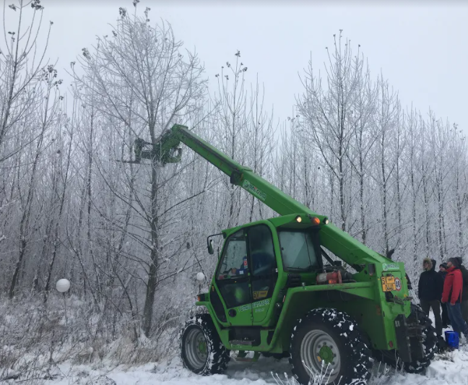
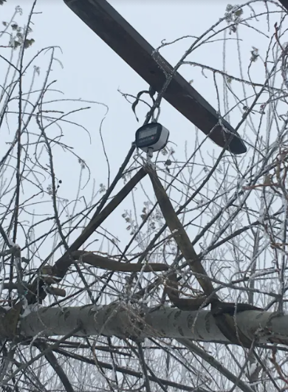
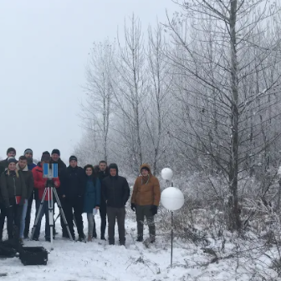
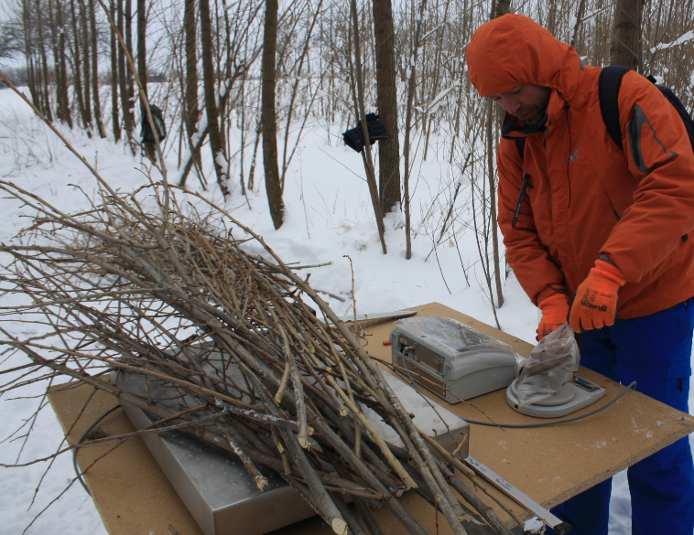
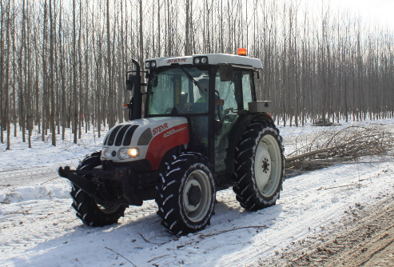
Thank you for your attention!
For more details, please visit:
http://www.silvic.usv.ro/tehnocrops.php
http://www.silvic.usv.ro/forcrops.php
http://www.silvic.usv.ro/forbiome.php
http://www.silvic.usv.ro/stroma.php
This work was supported by a grant of the Romanian Ministry of Education and Research, CNCS - UEFISCDI, project number PN-III-P1-1.1-PD-2019-0388, within PNCDI III
iuliandanila@usm.ro; +40749963403

