Slide 1
1st International Electronic Conference on Food Science and Functional Foods - 2020
Section: Nutraceuticals and Functional Foods
The potential of spent barley as a functional food ingredient: comparison of dietary fiber and bioactivity
Joncer Naibaho¹, Małgorzata Korzeniowska¹, Aneta Wojdyło¹, Adam Figiel¹, Baoru Yang², Oskar Laaksonen², Maike Foste³, Raivo Vilu⁴, Ene Viiard⁴
¹ Wroclaw University of Environmental and Life Sciences, Poland; ² University of Turku, Finland; ³ Fraunhofer Institut Freising, Germany; ⁴ Center of Food Fermentation Technologies, Estonia.

Slide 2
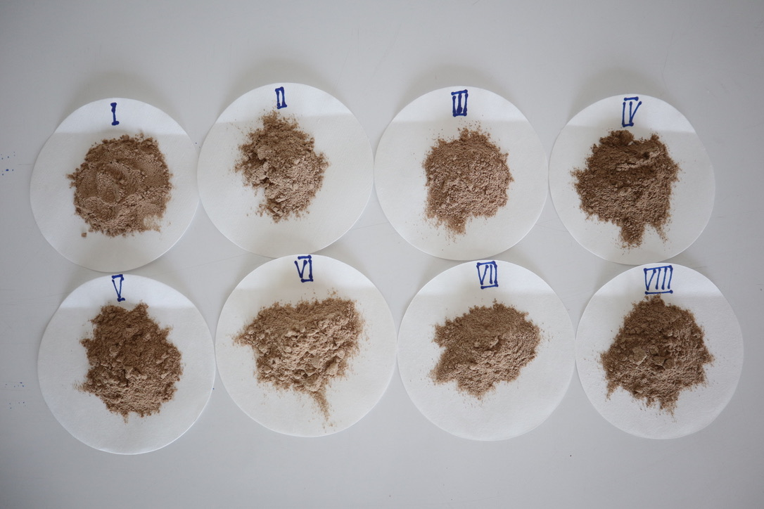
1. Introduction
▷
▷
▷
▷
A waste from brewery industry [1,2]
High dietary fiber, phenolic compounds and protein [2]
Considerable potential to be used for functional food ingredient and nutraceutical [2]
Those properties vary depending on [3,4]:
Brewery spent grain (BSG)
Type of the grain (climate, genetic, growth)
Analysis (extraction methods and solvent used
Brewery industries (procedures)
Research question: different breweries impact the BSG properties

Slide 3
2. Materials and Methods
2.1 Materials
Collection
Drying
Grinding
Storage
8 breweries (Poland, Germany, Estonia)
By convective drying to achieve a stable weight
By a laboratory mill scale and shieved (385 µm)
Sealed in aluminium bags and kept in chiller room
2.2 Analysis
Fiber composition: total, soluble and nonsoluble dietary fiber
Biological activity: TPC, FRAP and ABTS

Slide 4
3. Results and Discussion
Summary:
SDF: 3.98 – 9.66%
Other papers:
SDF: 1.3% [5]
IDF: 36.37 – 43.97 %
TDF: 43.97 - 53.56%
IDF: 58.2% [5]
TDF: 51-53% [6,7]
3.1 Dietary fiber composition of BSG
BSG | Dietary fiber (%)
 | Soluble | Insoluble | Total
I | 3,982 | 41,523 | 45,505
II | 6,039 | 43,095 | 49,134
III | 9,662 | 37,710 | 47,372
IV | 9,588 | 43,972 | 53,560
V | 8,067 | 36,373 | 44,440
VI | 5,944 | 38,027 | 43,971
VII | 7,105 | 43,854 | 50,959
VIII | 7,721 | 40,589 | 48,310
Factors impact fiber composition
Particle size [8]
Source of the grain [3,4]

Slide 5
3.3 Polyphenolic compounds
(a) 320 nm (Phenolic acids)
Flavonols
Phenolic acids
Flavan-3-ols
(b) 280 nm (Flavan-3-ols)

Slide 6
3.3 Polyphenolic compounds…
BSG | Polyphenolic (mg/kg)
 | Flavonols | Phenolic acids | Flavan-3-ols
I | 10,060 | 100,547 | 824,953
II | 13,778 | 96,101 | 886,411
III | 12,693 | 122,532 | 1165,698
IV | 11,918 | 68,969 | 432,775
V | 7,533 | 104,127 | 824,576
VI | 13,557 | 108,239 | 527,065
VII | 9,703 | 115,283 | 529,502
VIII | 3,590 | 65,768 | 362,119
Phenolic in BSG responsible for bioactivity: Hydroxycinnamic acid [9]
Ferulic acid
P-coumaric acid
Caffeic acids
And their derivatives[9]

Slide 7
3.4 Antioxidant activity
AA depends on extraction methods and solvent used [9]
BSG | Antioxidant
 | ABTS* | FRAP**
I | 0,086 | 0,106
II | 0,091 | 0,155
III | 0,154 | 0,253
IV | 0,152 | 0,249
V | 0,105 | 0,204
VI | 0,184 | 0,306
VII | 0,172 | 0,278
VIII | 0,241 | 0,200
Extraction: ultrasound-assisted extraction
Solvent: Methanol 87%
From another papers:
BSG extract has higher AA compared to synthetic antioxidant and almost the same with BHA [10]
*mmol Trolox/100 g dw; **µmol TE/100 g dw

Slide 8
4. Conclusion
As it was expected, the BSG potentially to be used as a functional food ingredients
Different properties were observed: dietary fiber composition, polyphenolic content and antioxidant capacity

Slide 9
References
Garcia-Garcia G, Stone J, Rahimifard S: Opportunities for waste valorisation in the food industry e A case study with four UK food manufacturers. J Clean Prod 2019, 211:1339–1356.
Nigam PS: An overview: Recycling of solid barley waste generated as a by-product in distillery and brewery. Waste Manag 2017, 62:255–261.
Santos M, Jiménez JJ, Bartolomé B, Gómez-Cordovés C, del Nozal MJ: Variability of brewer’s spent grain within a brewery. Food Chemistry 2003, 80:17–21.
Qin F, Johansen AZ, Mussatto SI: Evaluation of different pretreatment strategies for protein extraction from brewer’s spent grains. Industrial Crops and Products 2018, 125:443–453.
Ktenioudaki A, O’Shea N, Gallagher E: Rheological properties of wheat dough supplemented with functional by-products of food processing: Brewer’s spent grain and apple pomace. Journal of Food Engineering 2013, 116:362–368.
Nocente F, Taddei F, Galassi E, Gazza L: Upcycling of brewers’ spent grain by production of dry pasta with higher nutritional potential. LWT 2019, 114:108421.
Stojceska V, Ainsworth P: The effect of different enzymes on the quality of high-fibre enriched brewer’s spent grain breads. Food Chemistry 2008, 110:865–872.
Angioloni A, Collar C: Physicochemical and nutritional properties of reduced-caloric density high-fibre breads. LWT - Food Science and Technology 2011, 44:747–758.
McCarthy AL, O’Callaghan YC, Neugart S, Piggott CO, Connolly A, Jansen MAK, Krumbein A, Schreiner M, FitzGerald RJ, O’Brien NM: The hydroxycinnamic acid content of barley and brewers’ spent grain (BSG) and the potential to incorporate phenolic extracts of BSG as antioxidants into fruit beverages. Food Chemistry 2013, 141:2567–2574.
Barbosa-Pereira L, Bilbao A, Vilches P, Angulo I, LLuis J, Fité B, Paseiro-Losada P, Cruz JM: Brewery waste as a potential source of phenolic compounds: Optimisation of the extraction process and evaluation of antioxidant and antimicrobial activities. Food Chemistry 2014, 145:191–197.

Slide 10
1st International Electronic Conference on Food Science and Functional Foods - 2020
Section: Nutraceuticals and Functional Foods
Thank you …
Joncer Naibaho¹, Małgorzata Korzeniowska¹, Aneta Wojdyło¹, Adam Figiel¹, Baoru Yang², Oskar Laaksonen², Maike Foste³, Raivo Vilu⁴, Ene Viiard⁴
¹ Wroclaw University of Environmental and Life Sciences, Poland; ² University of Turku, Finland; ³ Fraunhofer Institut Freising, Germany; ⁴ Center of Food Fermentation Technologies, Estonia.

