Slide 1
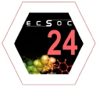
10.3390/ecsoc-24-08502
s-Triazine: A Multidisciplinary and International Journey
Anamika Sharma 1,2 , Zainab Almarhoon, 3Rotimi Sheyi, 1Rakia Abd Alhameed, 3Beatriz
G. de la Torre, Fernando Albericio, Ayman Al-Faham 1 3
1,2
1Peptide Science Laboratory, School of Chemistry and Physics, University of KwaZulu-Natal, Durban 4001, South Africa
2KwaZulu-Natal Research Innovation and Sequencing Platform (KRISP), School of Laboratory Medicine and Medical Sciences, College of Health Sciences, University of
KwaZulu-Natal, Durban 4041, South Africa
3Department of Chemistry, College of Science, King Saud University, P.O. Box 2455, Riyadh 11451, Saudi Arabia
1

Slide 2
Abstract for 24th ECSOC
2,4,6-Trichloro-1,3,5-triazine (TCT) offers unique ability to undergo sequential nucleophilic substitution
reaction using regular nucleophiles (first Cl replacement at 0 ºC, second at rt and third at > 90 ºC) making s-
triazine a privileged scaffold finding application in drug development with an extension towards development
of new materials.
This selective chemical property of TCT fulfills the goal of the chemists to control the organic structures
and make it react in the required condition for achieving each objective. In this regard, orthogonality and
chemoselectivity are two modern organic chemistry concepts which have been exploited in various areas of
research ranging from supramolecular chemistry to organic/bioconjugation chemistry. We have demonstrated
the fusion of these two concepts using TCT as “Orthogonal Chemoselectivity” and defined it as
discrimination between reactive sites in any order. The usage of azide as one of the nucleophiles modulated
the reactivity of s-triazine core for the last Cl replacement. This allowed us to overcome the barrier of higher
temperature (> 90 ºC) for the last Cl replacement which happened at rt taking advantage of side chain of Cys,
Tyr and Lys in biological context.
In this presentation, we revise the chemistry developed in our laboratories to manipulate the TCT core
for application in our medicinal chemistry programs and in bioconjugation.
2

Slide 3
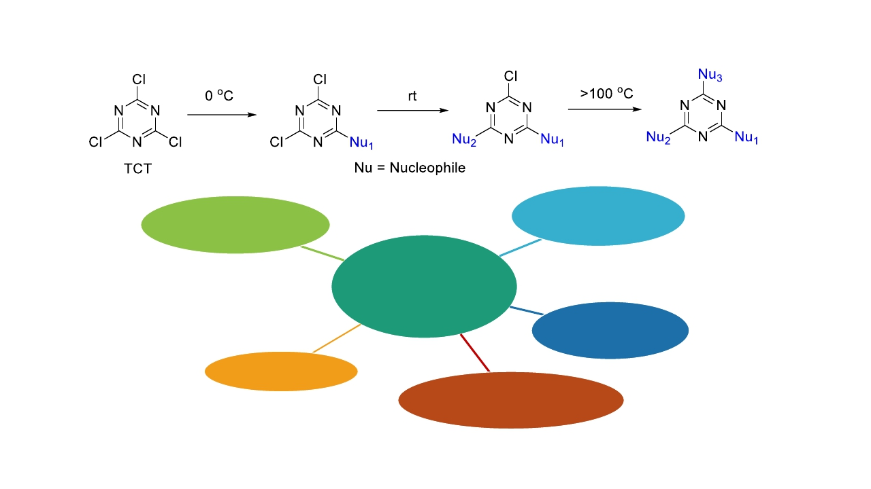
Reactivity of TCT and Applications of their derivatives
Pharmacophore
Drug designing
s-Triazine
A privileged
core
Energetics
Materials
Reagent in Organic
synthesis
E.E. Simanek, H. Abdou, S. Lalwani, J. Lim, M. Mintzer, V.J. Venditto, B. Vittur, Proc. R. Soc. A, 2010, 466, 1445.
P. Leriche, F. Piron, E. Ripaud, P. Frère, M. Allain, J. Roncali, Tetrahedron Lett., 2009, 50, 5673.
3

Slide 4
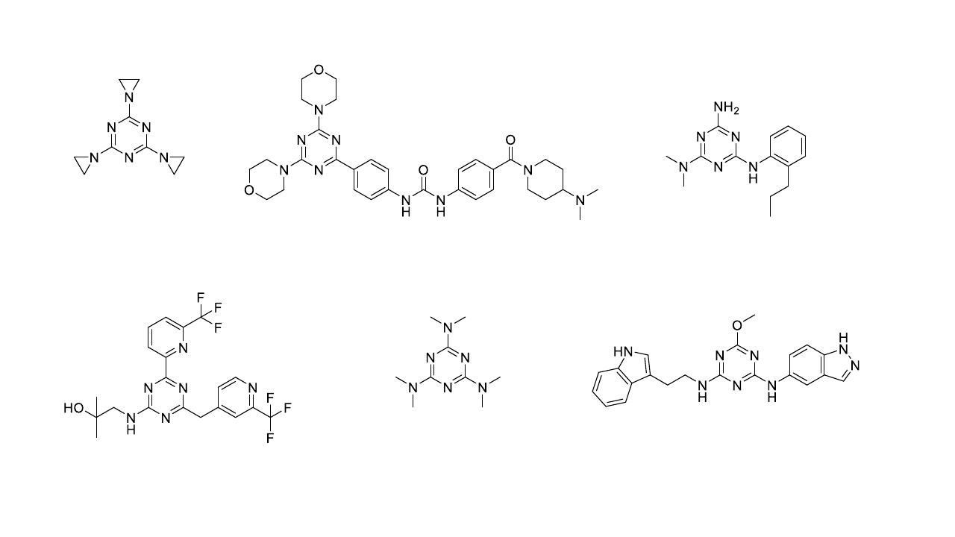
Some Commercial s-Triazine Derivatives in the Drug Market
Tretamine
Cause chromatid aberrations
HL010183
Inhibits proliferation and invasion of Hs578T
triple-negative (TN) breast cancer cells
Gedatolisib
Targets PI3K/mTOR
Altretamine
Alkylating antineoplastic agent
KY-04031
PAK4 inhibitor
Enasidenib
Isocitrate dehydrogenase inhibitor
4

Slide 5
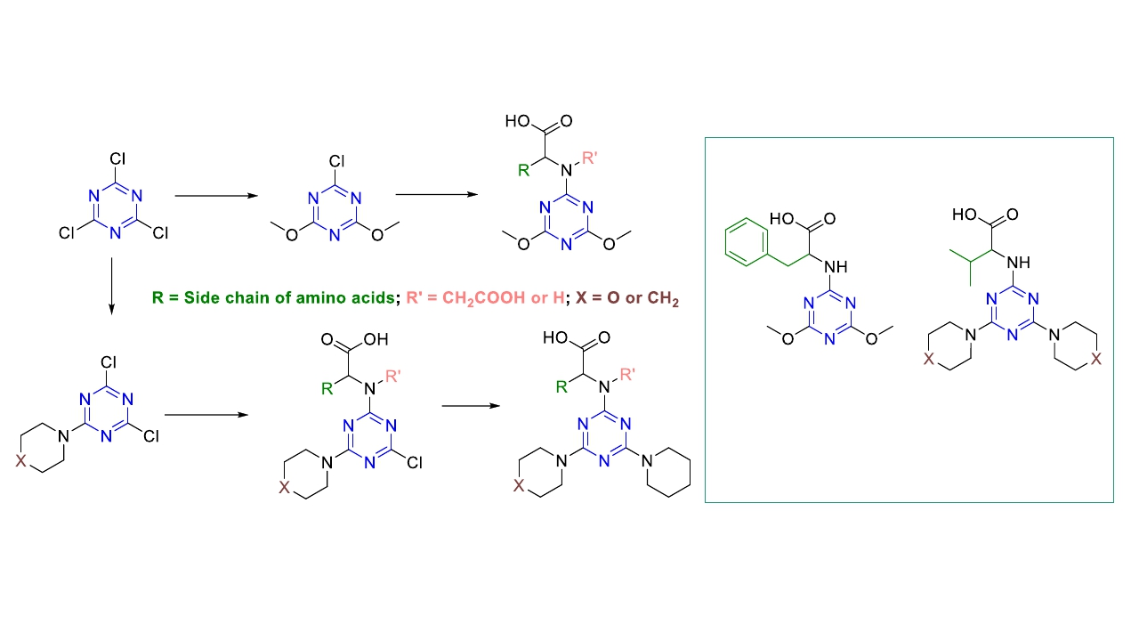
Our Journey with s-Triazine – MAO-A inhibitors
Total 21 derivatives synthesized
Potential MAO-A inhibitors
Comparable to reference Clorgyline
S.N. Khattab, H.H. Khalil, A.A. Bekhit, M.M. El-Rahman, A. El-Faham, F. Albericio, Molecules, 2015, 20, 15976.
5

Slide 6
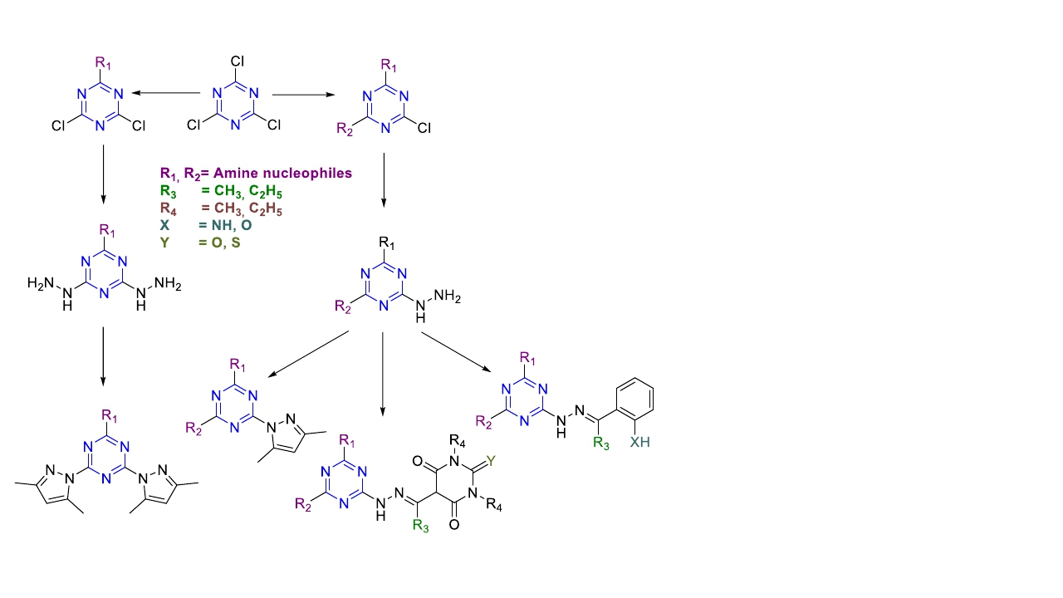
Our Journey with s-Triazine – Antiproliferative/Anticancer agents
1. Synthesized 34 trisubstituted derivatives
2. Tested against cancer cell lines
✓
✓
✓
✓
Lung carcinoma (A549),
Hepatocellular carcinoma (HepG2),
Adenocarcinoma (MCF-7),
Human breast cancer (MCF, MDA-
MB-231),
✓ Human
colorectal
carcinoma
(LoVo, HCT-116),
✓ Human leukemia (K562)
A. El-Faham, S.M. Soliman, H.A. Ghabbour, Y.A. Elnakady, T.A. Mohaya, M.R.H. Siddiqui, F. Albericio, J. Mol. Struct., 2016, 1125, 121.
6
H. Al Rasheed, K. Dahlous, A. Sharma, E. Sholkamy, A. El-Faham, B.G. de la Torre, F. Albericio, ACS Omega, 2020, 5, 15805.

Slide 7
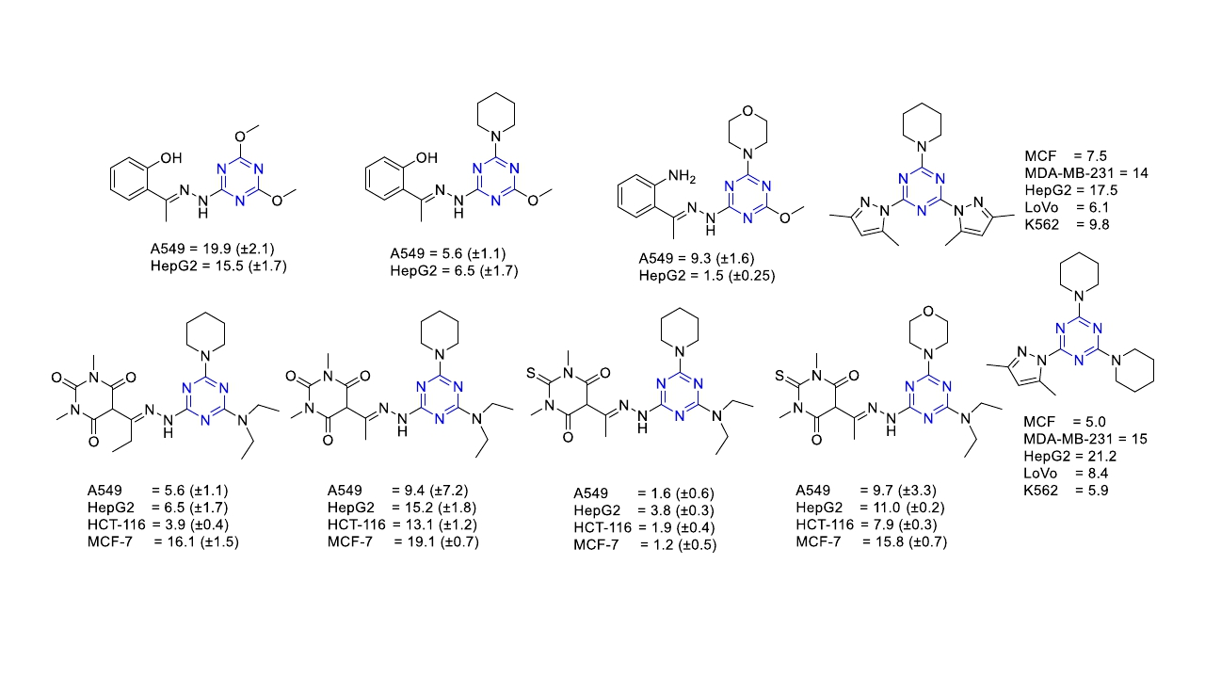
Our Journey with s-Triazine – Antiproliferative/Anticancer Agents
A. El-Faham, S.M. Soliman, H.A. Ghabbour, Y.A. Elnakady, T.A. Mohaya, M.R.H. Siddiqui, F. Albericio, J. Mol. Struct., 2016, 1125, 121.
M. Farooq, A. Sharma, Z. Almarhoon, A. Al-Dhfyan, A. El-Faham, N.A. Taha, M.A.M. Wadaan, B.G. de la Torre, F. Albericio, Bioorg. Chem., 2019, 87, 457.
7
H. Al Rasheed, K. Dahlous, A. Sharma, E. Sholkamy, A. El-Faham, B.G. de la Torre, F. Albericio, ACS Omega, 2020, 5, 15805.

Slide 8
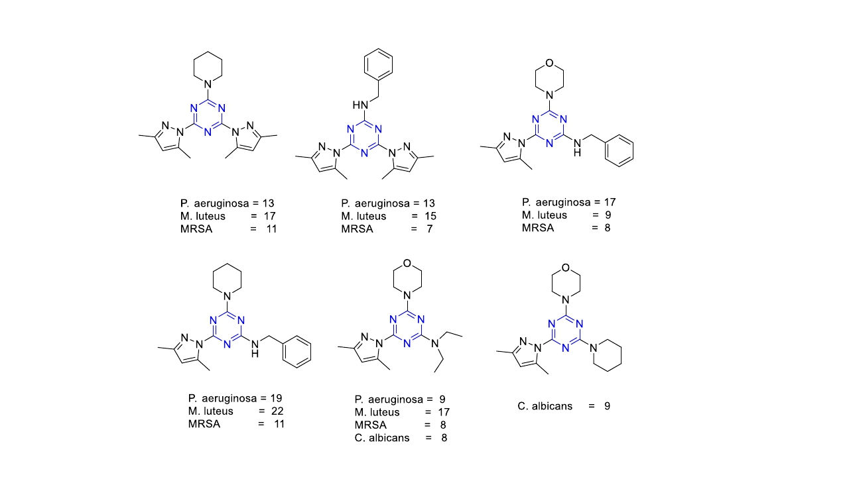
Our Journey with s-Triazine – Antimicrobial Agents
A. Sharma, H. Ghabbour, S.T. Khan, B.G. de la Torre, F. Albericio, A. El-Faham, J. Mol. Struct., 2017, 1145, 244.
8

Slide 9
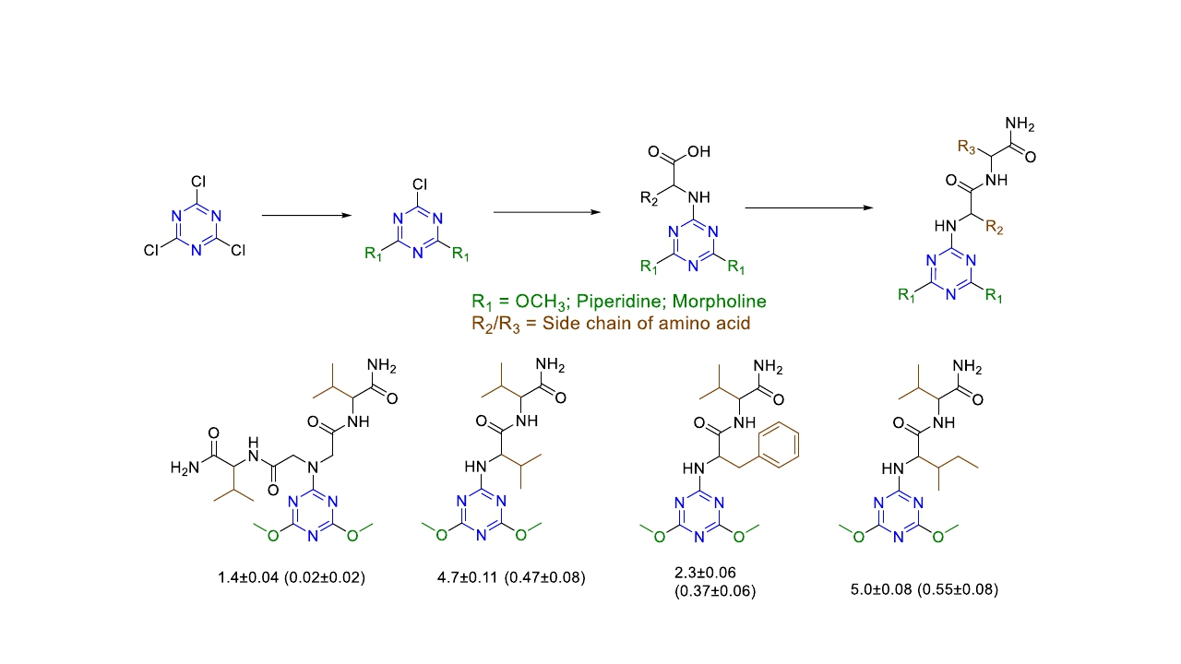
Our Journey with s-Triazine – Antileishmanial Agents
Synthesized total of 20 derivatives
IC50 values for activity = Anti-promastigote (Anti-amastigote)
S.N. Khattab, H.H. Khalil, A.A. Bekhit, M.M.A. El-Rahman, B.G. de la Torre, A. El-Faham, F. Albericio, ChemMedChem, 2018, 13, 725.
9

Slide 10
Conclusion: s-Triazine in Medicinal Chemistry
✓ s-Triazine as a privileged structure.
✓ Amine-bearing s-triazine motif is the “Master Key” as it is integral part of several commercial
drugs.
✓ Piperidine is better compared to morpholine in enhancing the antiproliferative/anticancer activity.
✓ Thiobarbituric analogue with piperidine possess better anticancer activity.
✓ One pyrazole is better than two in addition to benzylamine and piperidine for antimicrobial activity.
✓ Dimethoxy substituent is better than piperidine and morpholine for antileishmanial activity.
✓ Hydrophobic amino acids with amide at C terminal enhances antileishmanial activity.
S.N. Khattab, H.H. Khalil, A.A. Bekhit, M.M. El-Rahman, A. El-Faham, F. Albericio, Molecules, 2015, 20, 15976.
A. El-Faham, S.M. Soliman, H.A. Ghabbour, Y.A. Elnakady, T.A. Mohaya, M.R.H. Siddiqui, F. Albericio, J. Mol. Struct., 2016, 1125, 121.
M. Farooq, A. Sharma, Z. Almarhoon, A. Al-Dhfyan, A. El-Faham, N.A. Taha, M.A.M. Wadaan, B.G. de la Torre, F. Albericio, Bioorg. Chem., 2019, 87, 457.
H. Al Rasheed, K. Dahlous, A. Sharma, E. Sholkamy, A. El-Faham, B.G. de la Torre, F. Albericio, ACS Omega, 2020, 5, 15805.
A. Sharma, H. Ghabbour, S.T. Khan, B.G. de la Torre, F. Albericio, A. El-Faham, J. Mol. Struct., 2017, 1145, 244.
S.N. Khattab, H.H. Khalil, A.A. Bekhit, M.M.A. El-Rahman, B.G. de la Torre, A. El-Faham, F. Albericio, ChemMedChem, 2018, 13, 725.
10

Slide 11
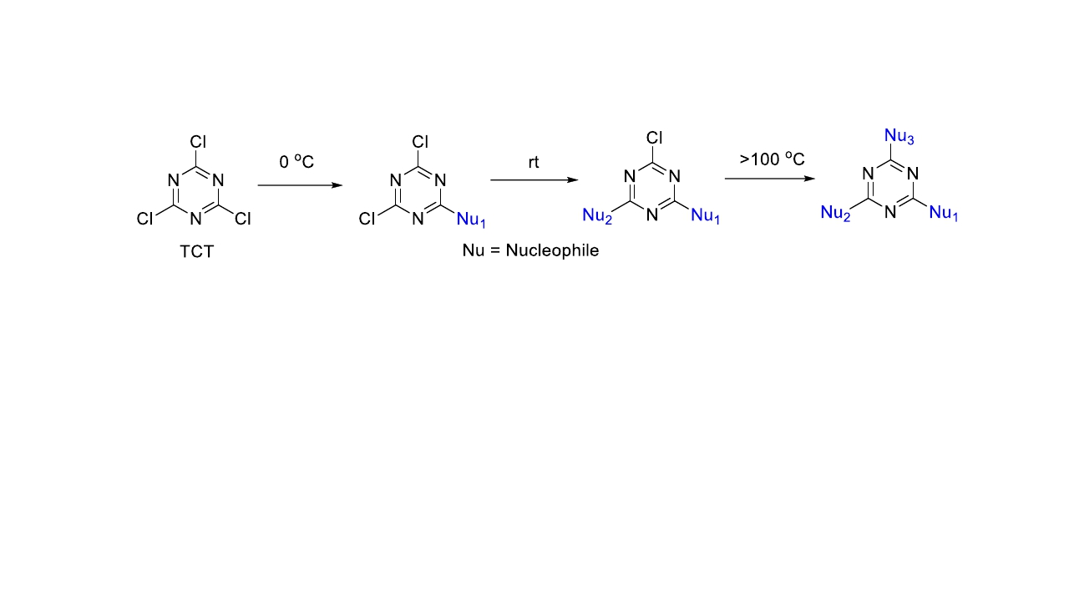
s-Triazine – As a Linker in Bioconjugation
✓ Taking advantage of the three position, and sequential addition of nucleophiles:
➢ s-Triazine can be used in bioconjugation as linker!!!
➢ Exploring orthogonal chemoselectivity in TCT.
11

Slide 12
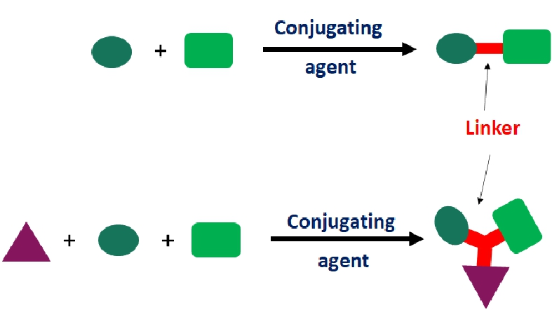
Bioconjugation
• Refers to attachment of one molecule to another (covalent bond) of which one is of biological origin.
• Usually between 2 molecules or 3 molecules.
12

Slide 13
Orthogonality
The idea of orthogonality was first introduced in 1977 by Barany and Merrifield
Demonstrated by Barany and Albericio in 1985 as applied to protecting groups
13

Slide 14
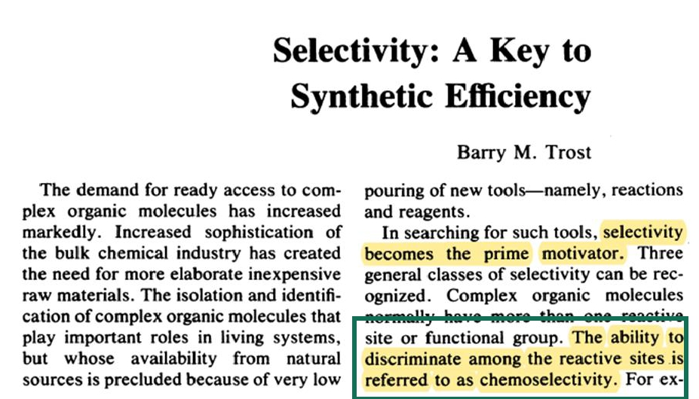
Chemoselectivity
Trost (1983) introduced the concept of chemoselectivity
14

Slide 15
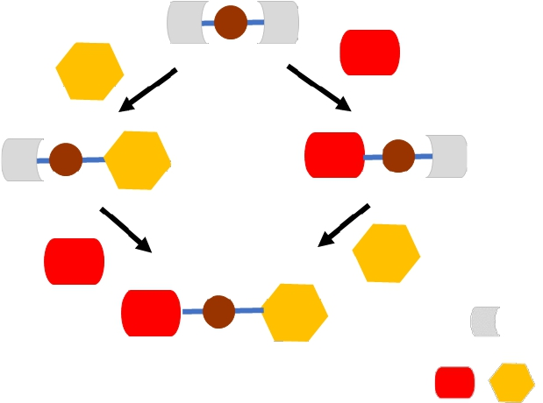
Orthogonal chemoselectivity
Fusion of these concepts as
Bi-orthogonal chemoselectivity
Leaving group
Different nucleophiles15

Slide 16
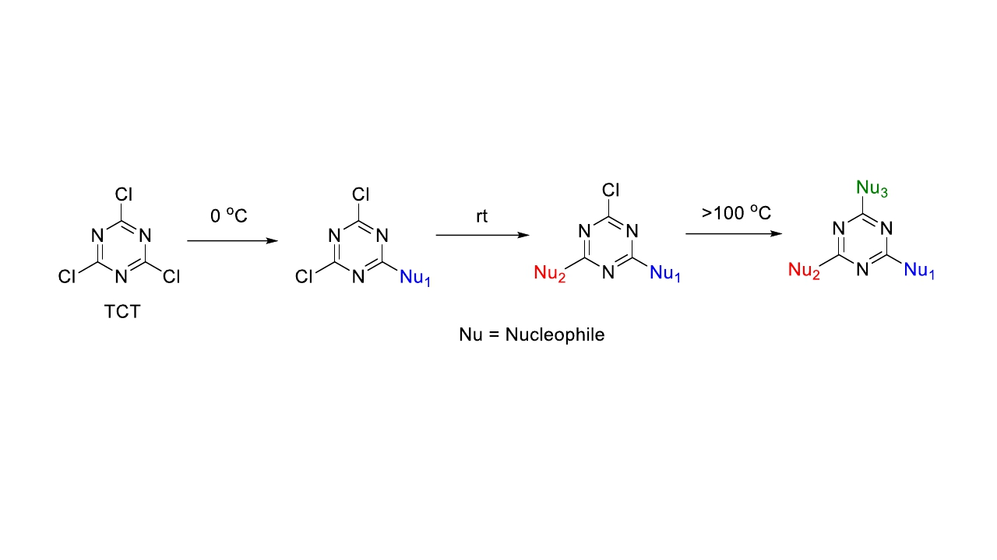
TCT Reactivity
First to demonstrate the orthogonal chemoselectivity* concept onto TCT !!!
Major problem in bioconjugation!!!
High temperature
*Discrimination between reactive sites in any order
16

Slide 17
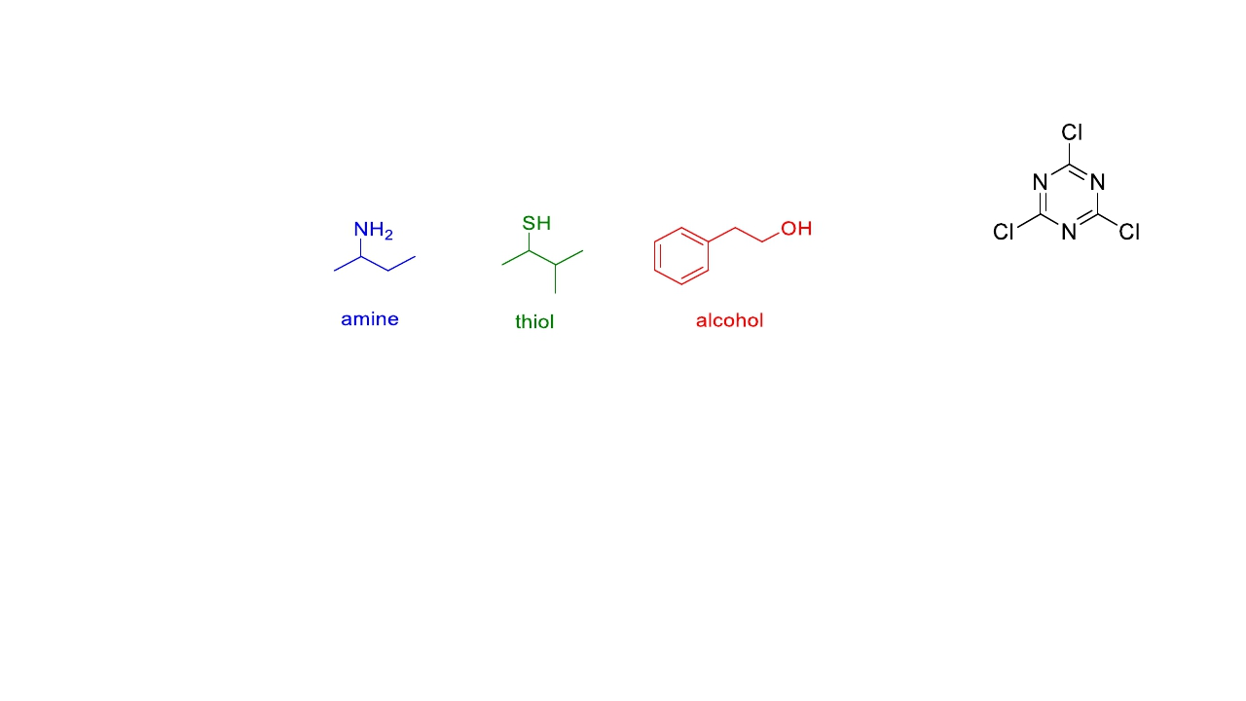
Orthogonal chemoselectivity onto TCT
To prove concept: Following nucleophiles were chosen
TCT
Objectives
1. To study the preferential order of incorporation
2. To demonstrate orthogonal chemoselectivity
A. Sharma, A. El-Faham, B.G. de la Torre, F. Albericio, Front. Chem., 2018, 6, 512.
17

Slide 18
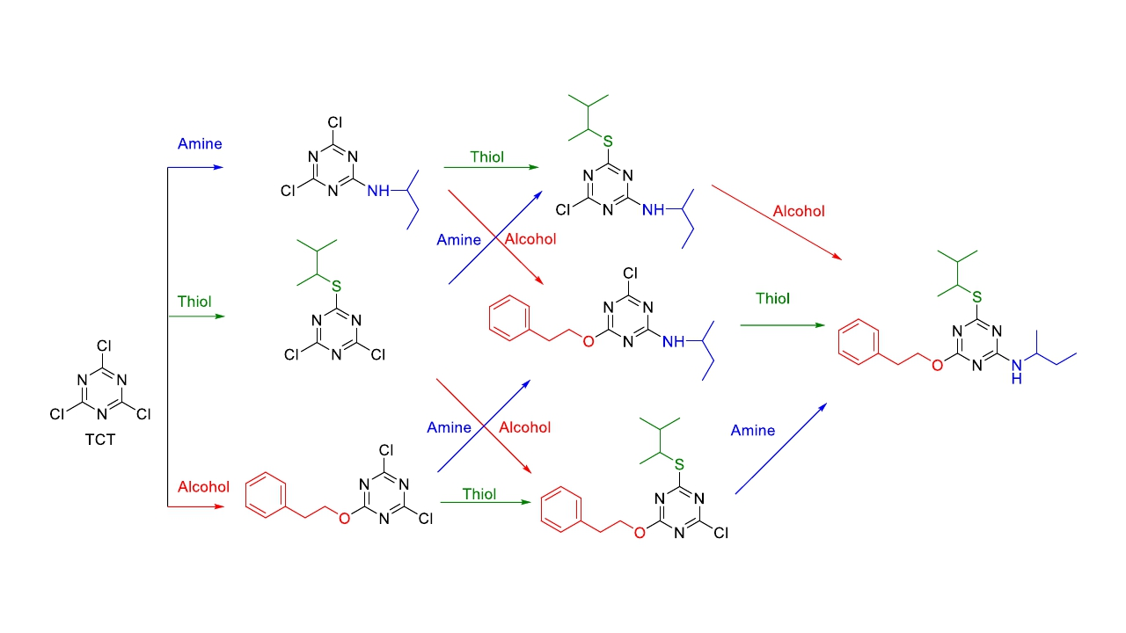
Orthogonal chemoselectivity: Scheme
18

Slide 19
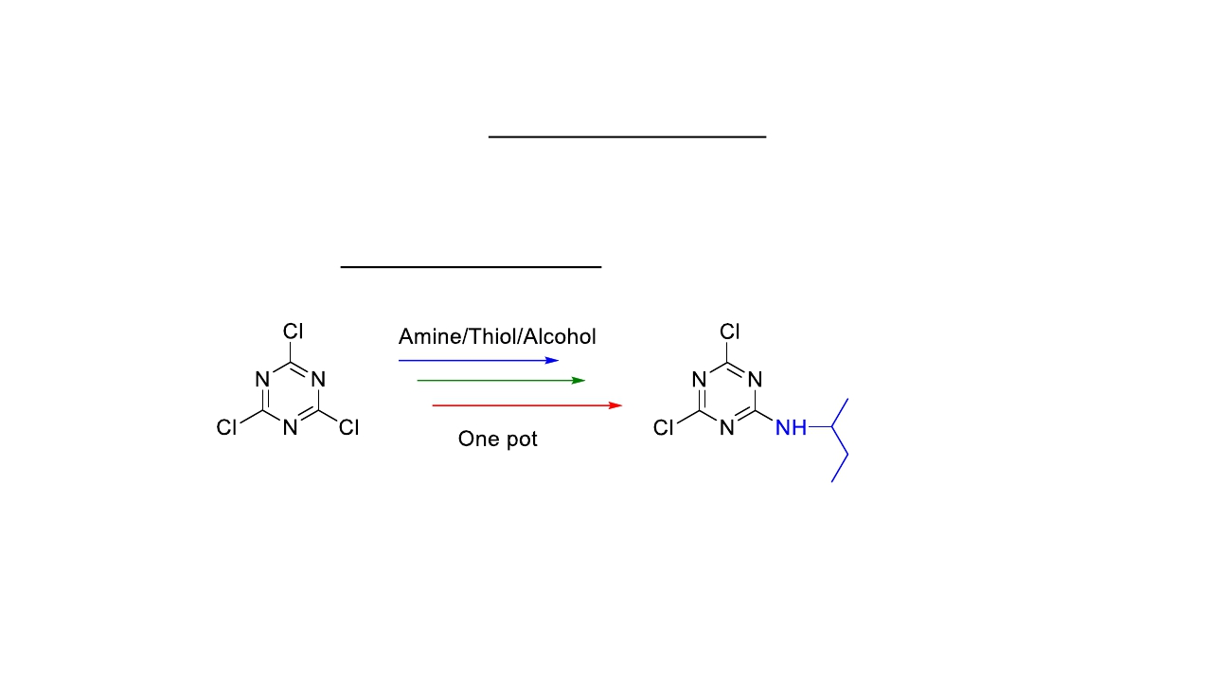
Orthogonal chemoselectivity: Results
1. Preferential order of incorporation: alcohol, thiol and amine
2. Final incorporation at higher temperature (90 °C).
3. Competitive test, only amine is the champion.
4. Once amine is incorporated, only another amine can be introduced.
A. Sharma, A. El-Faham, B.G. de la Torre, F. Albericio, Front. Chem., 2018, 6, 512.
19

Slide 20
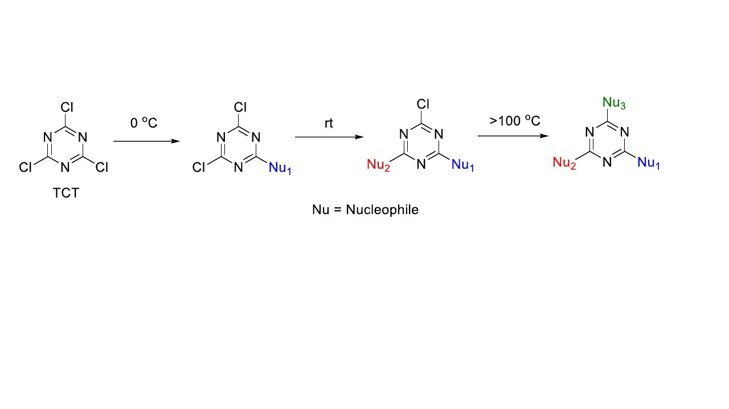
Orthogonal chemoselectivity onto TCT
First to demonstrate the orthogonal chemoselectivity concept onto TCT !!!
Major problem in bioconjugation!!!
High temperature
Objective
Alcohol was replaced by phenol.
20

Slide 21
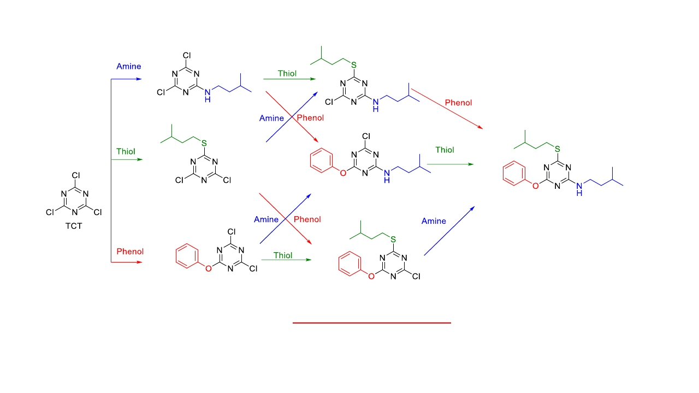
Reactivity of TCT with Phenol as one nucleophile
1. The preferential order of incorporation: phenol, thiol and amine
2. The final incorporation at ambient temperature (35 oC).
R. Sheyi, A. Sharma, A. El-Faham, B.G. de la Torre, F. Albericio, Aust. J. Chem., 2020, 73, 352.
21

Slide 22
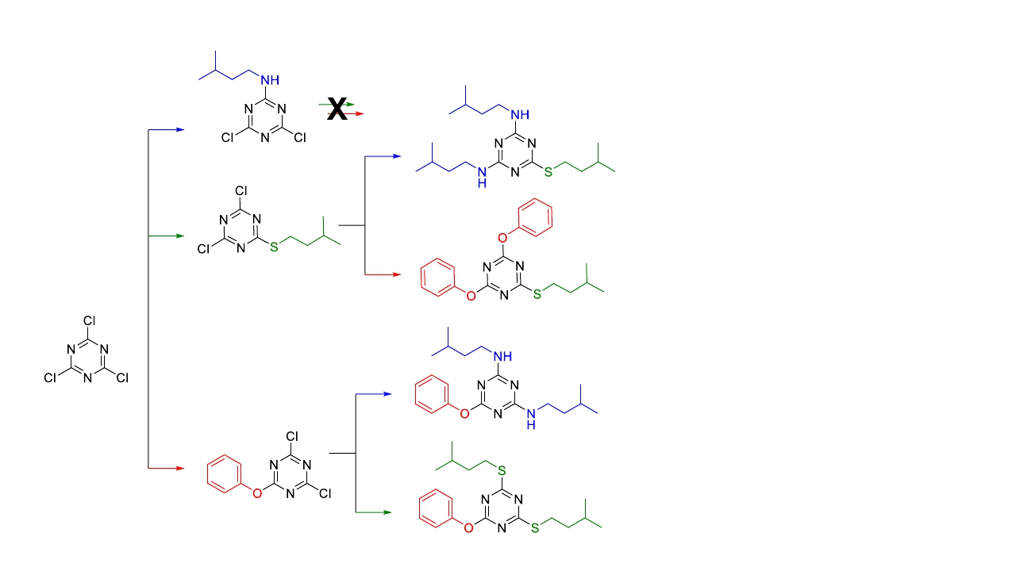
Reactivity of TCT: 1+2 addition (For dendrons synthesis)
Results
1. No nucleophile undergoes
reaction once amine is present
onto TCT.
2. With thiol and phenol at 1st
position onto TCT, 2 eq. of
amine/thiol/phenol reacts at
ambient temperature (35 oC).
R. Sheyi, A. Sharma, A. Kumar, A. El-Faham, B.G. de la Torre, F. Albericio, Arkivoc, 2020. DOI: 10.24820/ark.5550190.p011.245
22

Slide 23
TCT Reactivity and further modulations
Phenol helps to lower the temperature (compatible for bioconjugation), but the preferential order
of incorporation limits its usage to the 1st position.
Azide (N3) as one of the nucleophiles onto TCT as:
✓ Azide is key due is electron withdrawing which enhances reactivity.
Following nucleophiles were chosen
23

Slide 24
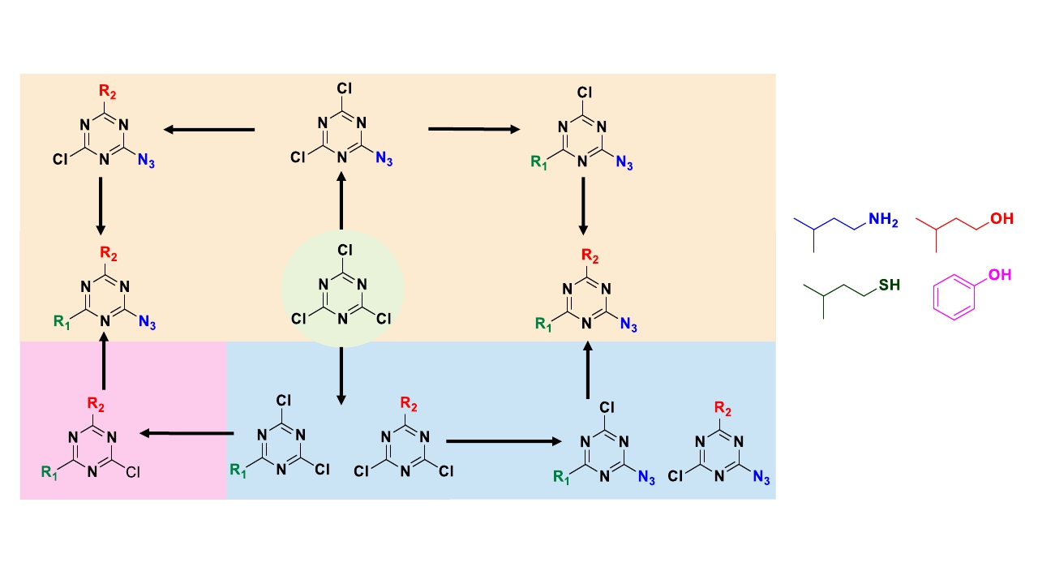
Tri-Orthogonal chemoselectivity onto TCT: Proposed Scheme
R1 and R2; can be any of
First position
Third
position
Second
position
OR
OR
A. Sharma, R. Sheyi, A. Kumar, A. El-Faham, B.G. de la Torre, F. Albericio, Org. Lett., 2019, 21, 7888.
A. Sharma, A. Kumar, A. El-Faham, B.G. de la Torre, F. Albericio, Bioorg. Chem., 2020, 104, 104334.
24

Slide 25
TCT: Azide in first position
1. No proper procedure in literature.
2. Requires inexpensive starting material (TCT), sodium azide and water/acetone as solvent.
3. Reaction temperature controlled well. Its important to avoid di-substitution!!!
4. Reaction optimized well and scaled up to 5 g with around 95% yield.
A. Sharma, R. Sheyi, A. Kumar, A. El-Faham, B.G. de la Torre, F. Albericio, Org. Lett., 2019, 21, 7888.
25

Slide 26
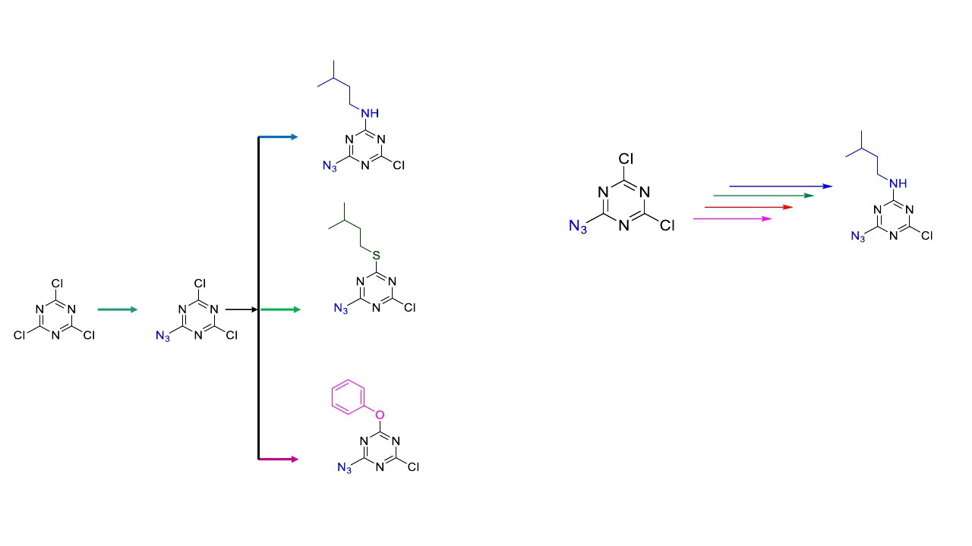
TCT: Azide in first position
Competitive test*
*Reactant with amine/thiol/alcohol/phenol
in one pot in presence of TEA as base
✔
✔
✔
26

Slide 27
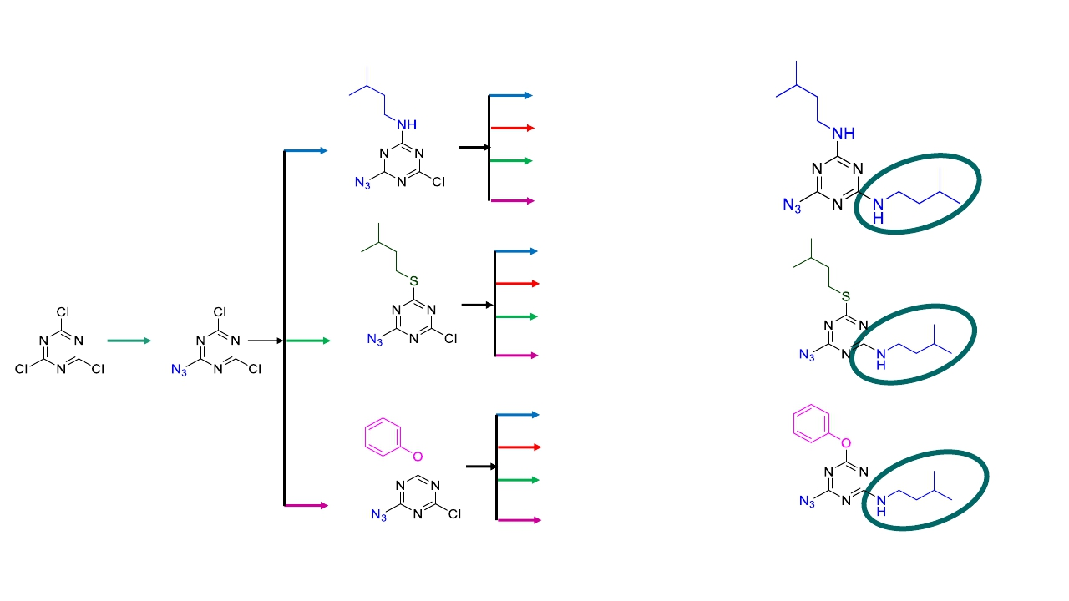
TCT: Azide in first position
Competitive test
✔
X
X
X
✔
X
Once amine;
Nothing else!!!
✔
✔
Once azide;
✔ No alcohol!!!
✔
X
✔
✔
✔
✔
27

Slide 28
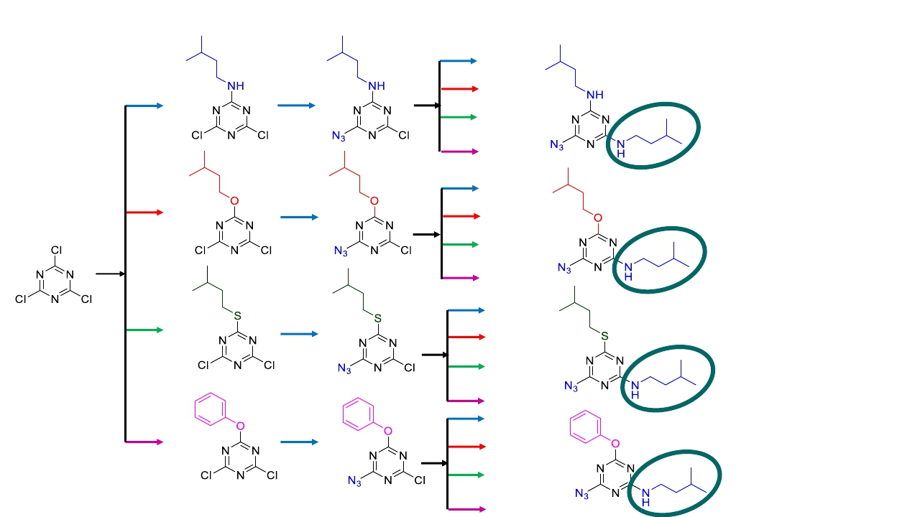
TCT: Azide in second position
✔
X
X
X
✔
X
Competitive test
✔
✔
✔
✔
✔
✔
✔
✔
✔
✔
✔
X
✔
✔
✔
X
✔
✔
28

Slide 29
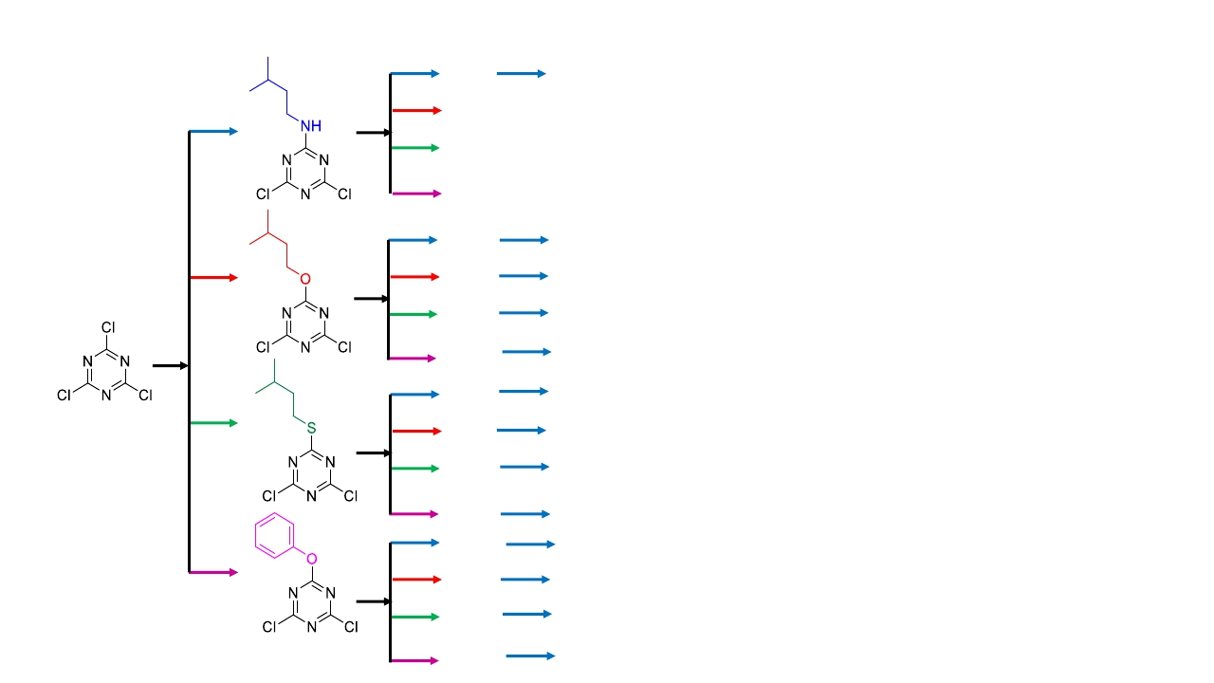
TCT: Azide in third position
✔
X
X
X
✔
✔
✔
✔
✔
✔
✔
✔
✔
✔
✔
X
X
X
X
X
✔
X
✔
✔
✔
X
✔
✔
✔
✔
✔
✔
✔
29

Slide 30
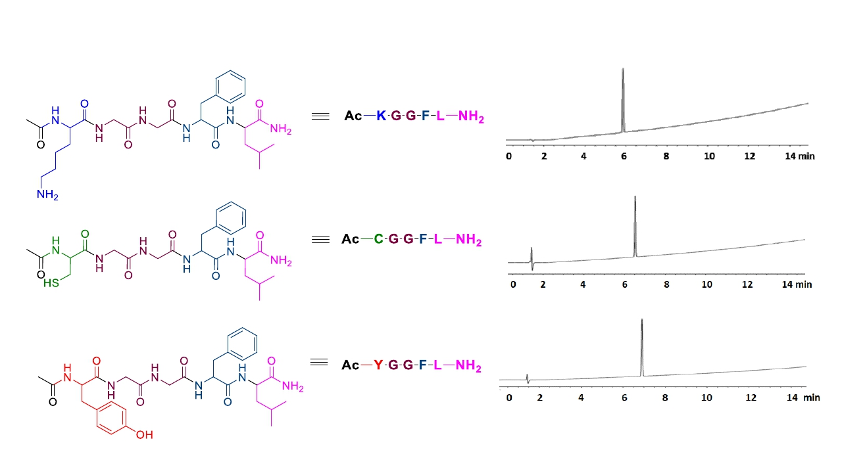
Application using model peptides
SPPS for following peptides bearing Lys, Cys and Tyr amino acids
Lys-peptide
Cys-peptide
Tyr-peptide
A. Sharma, A. Kumar, A. El-Faham, B.G. de la Torre, F. Albericio, Bioorg. Chem., 2020, 104, 104334.
30

Slide 31
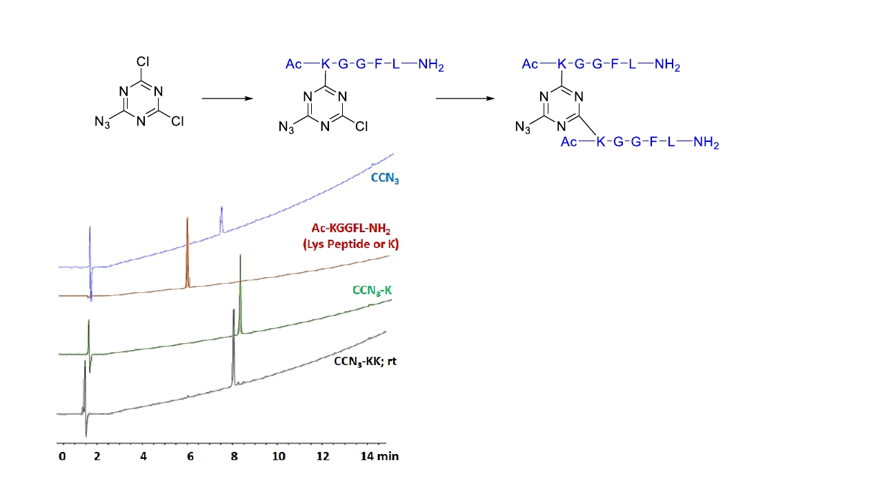
Reaction of CCN3 with Ac-KGGFL-NH2
30 mins, 0 °C
4 days, rt
A. Sharma, A. Kumar, A. El-Faham, B.G. de la Torre, F. Albericio, Bioorg. Chem., 2020, 104, 104334.
31

Slide 32
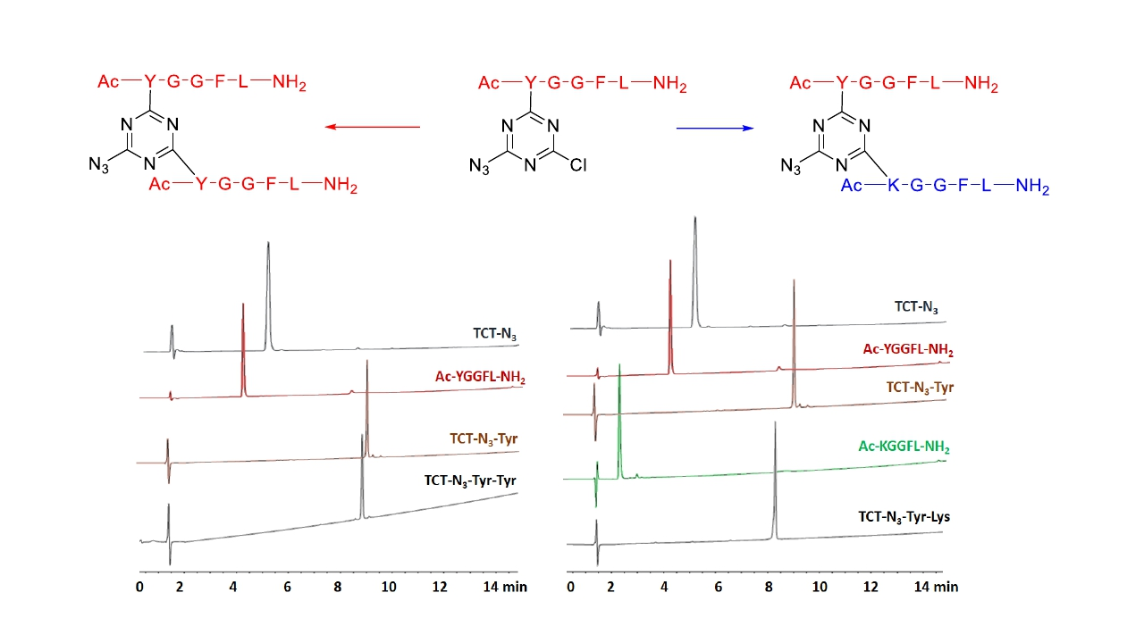
Reaction of CCN3 with Ac-YGGFL-NH2and Ac-KGGFL-NH2
8 h, rt
4 h, rt
A. Sharma, A. Kumar, A. El-Faham, B.G. de la Torre, F. Albericio, Bioorg. Chem., 2020, 104, 104334.
32

Slide 33
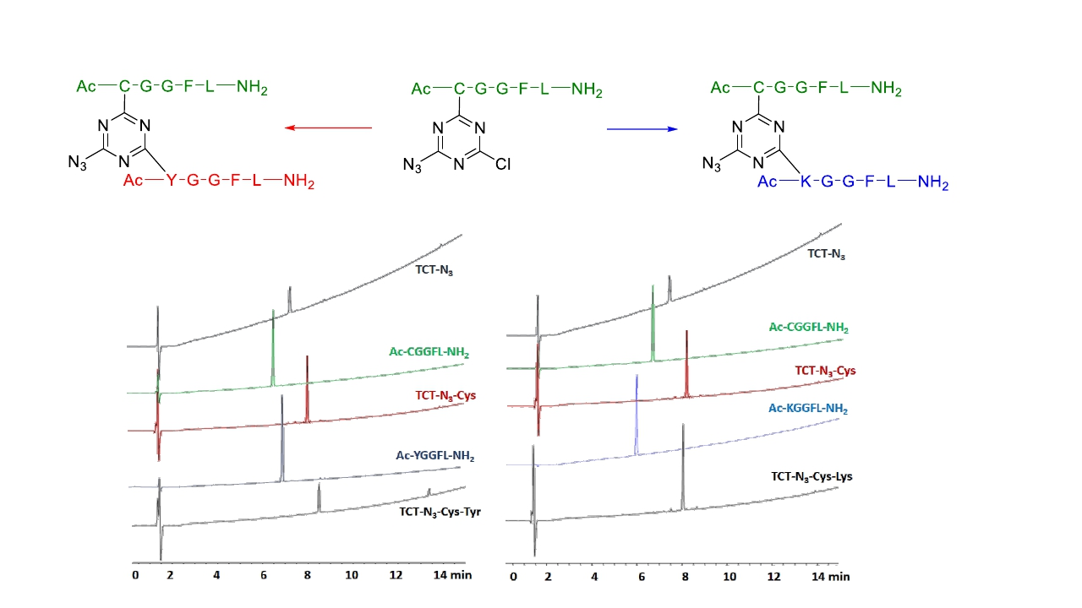
Reaction of TCT-N3-Ac-CGGFL-NH2 with Ac-YGGFL-NH2and Ac-KGGFL-NH2
2 days, rt
2 days, rt
33

Slide 34
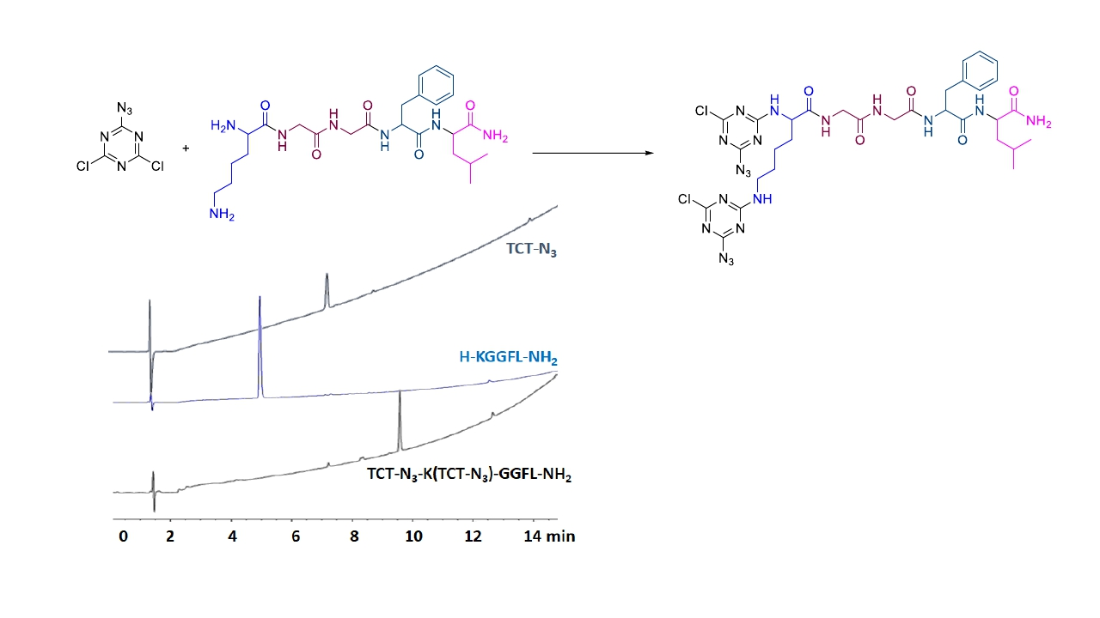
Reaction of TCT-N3with α and ε NH2 of Lys in H-KGGFL-NH2
10 mins, 0 °C
1. The reaction is 5 mins at 0 °C, both
NH2 react.
2. Product confirmed by LCMS
A. Sharma, A. Kumar, A. El-Faham, B.G. de la Torre, F. Albericio, Bioorg. Chem., 2020, 104, 104334.
34

Slide 35
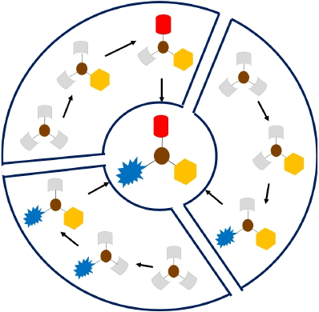
Conclusion: Tri-orthogonal chemoselectivity explained
1. N3, Phenol and Thiol can be substituted in any order.
2. Other combination by 3 different strategies.
3. N3 can be introduced in any position but once N3 is introduced,
OH cannot be incorporated even with higher temperature.
4. N3 placement in either position 1 or 2 facilitates the introduction
of the remaining nucleophiles at room temperature.
5. Competitive tests has been done in all cases and amine always
wins the race.
Amine was best for incorporation in the last position.
A. Sharma, R. Sheyi, A. Kumar, A. El-Faham, B.G. de la Torre, F. Albericio, Org. Lett., 2019, 21, 7888.
A. Sharma, A. Kumar, A. El-Faham, B.G. de la Torre, F. Albericio, Bioorg. Chem., 2020, 104, 104334.
35

Slide 36
Asante
Eshe
Gràcies Medaase
Dankie Gracias
ধন্যবাদ
Obrigado நன்றி धन्यवाद
لايزج اركش
Ngiyabonga
36

