Slide 1
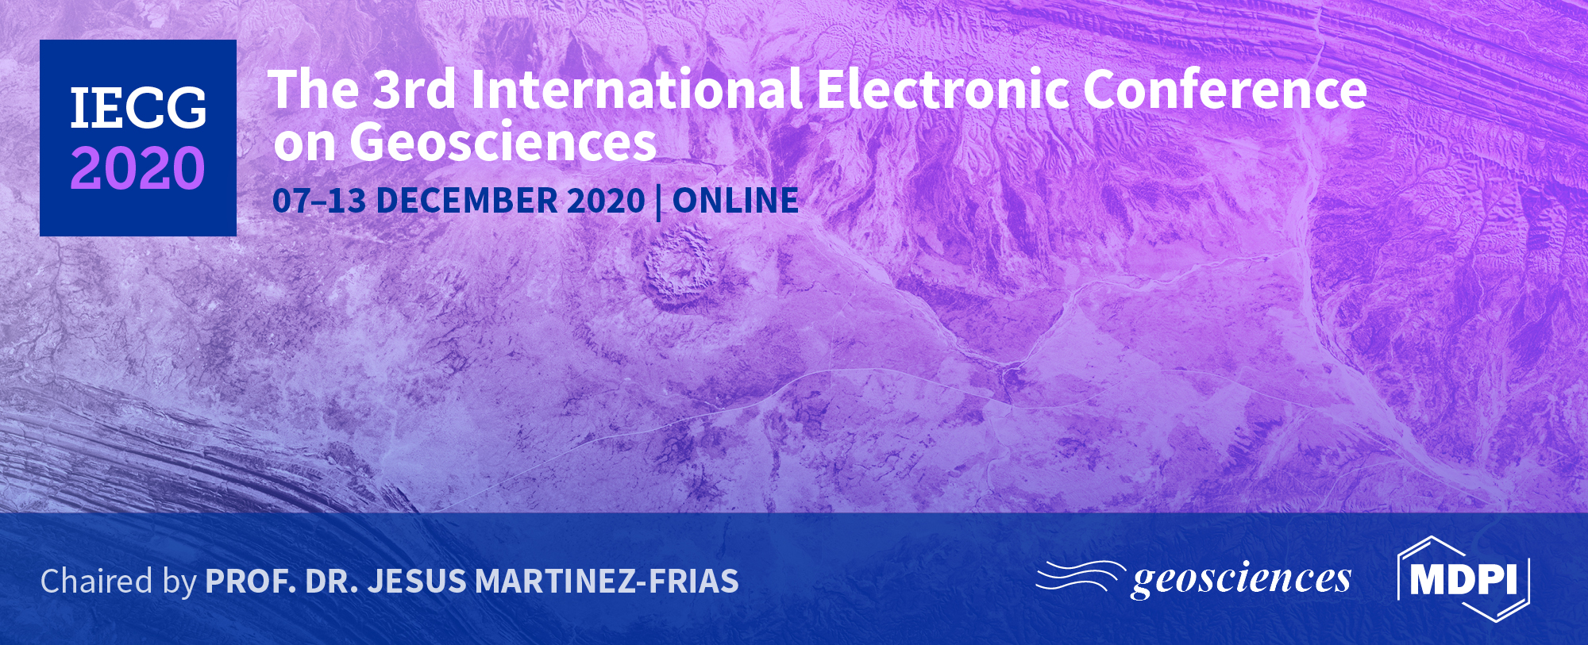
Title of the Presentation
Stjepan Strelec¹, Filip Dodigovic^{1*}, Kristijan Grabar² and Barica Marincic-Kovacev¹
¹ Faculty of Geotechnical Engineering University of Zagreb, Hallerova aleja 7, Varazdin, Croatia
².SPP d.o.o., Koprivnicka ulica 47, Varazdin, Croatia
* Corresponding author: filip.dodigovic@gmail.com

Slide 2
Abstract: Groundwater can be considered as a non-polluting renewable energy source. It can be used as a fluid in the industrial, commercial, and residential building heating and air-conditioning systems. Usually, the water table is deep enough, so the atmospheric conditions have a negligible influence on the water temperature. For that reason, the annual variation in the temperature is minor, therefore, the groundwater can also be considered as a reliable energy source. This paper presents some aspects of the groundwater heat pump (GWHP) wells design and addresses problems that can occur during their exploitation. The heat pump system consists of two types of wells: extraction and recharge well. It is shown that the distance between the two is a crucial parameter that affects the whole system efficiency. An example of wells design for a production hall groundwater heat pump is given. The wells are constructed is in the northern part of Croatia. Geological and hydrogeological conditions at the site are highly favourable regarding the water temperature and soil hydraulic conductivity. Because of the insufficient distance between wells, the thermal breaktrought occurs, i.e. water temperature in the extractionn well rose, which resulted in a lower efficienty of the GWHP system.
Keywords: groundwater heat pump; aquifer;
thermal breakthrough, well design

Slide 3
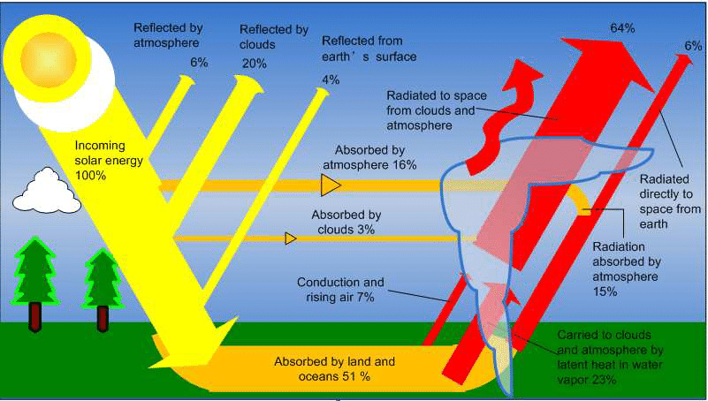
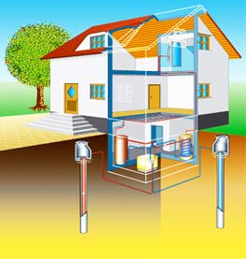
Earth's heat-budget , Heat Pump, Groundwater Heat Pump (GWHP)
Heat can only be transferred from a high temperature region to a lower temperature region in nature. If work is done on a thermodynamic cycle, the cycle can transfer heat in the opposite direction. A system, which transfers heat from a low temperature region to a higher temperature region, is called a heat pump.

Slide 4
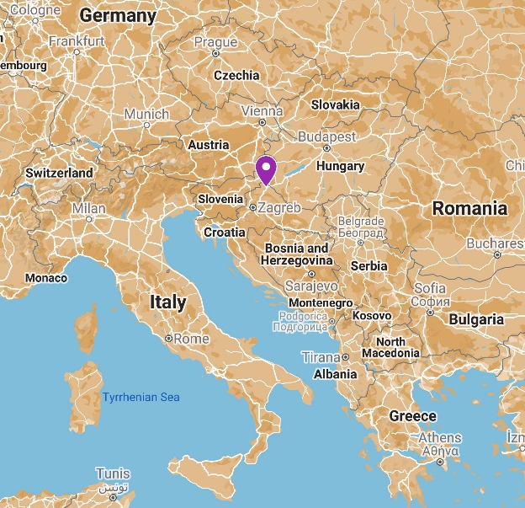
Location
The presented hall was built in the Međimurje County in the northwest part of Croatia (Figure 1). The area is almost completely surrounded by rivers: Mura in the north and east, Drava in the south, and the Šantavec creek, which forms a part of the western border with Slovenia. One of the basic geological characteristics of Međimurje is a ground surface comprised almost exclusively of sedimentary rock of Pleistocene and Holocene origin. The majority of the sediment are actually poorly graduated sand-gravels, comprised mostly of quartz conglomerates (over 90%) and sand, whose light fraction is dominated by quartz (around 50%), with muscovite (around 22%) and feldspar (around 22%) also present.

Slide 5
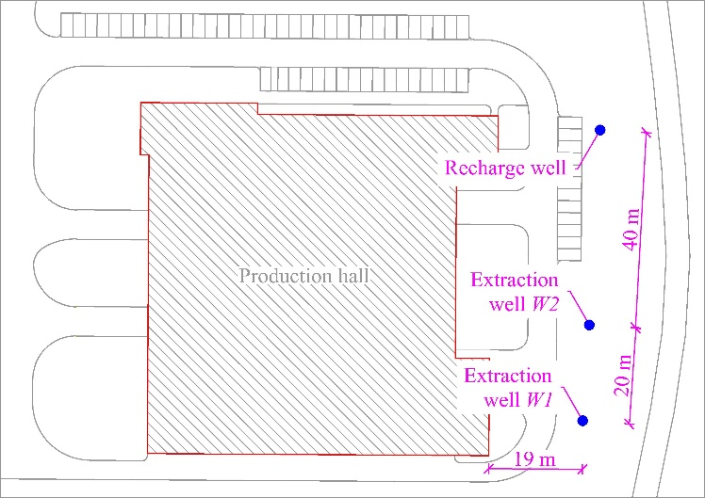
Site layout

Slide 6
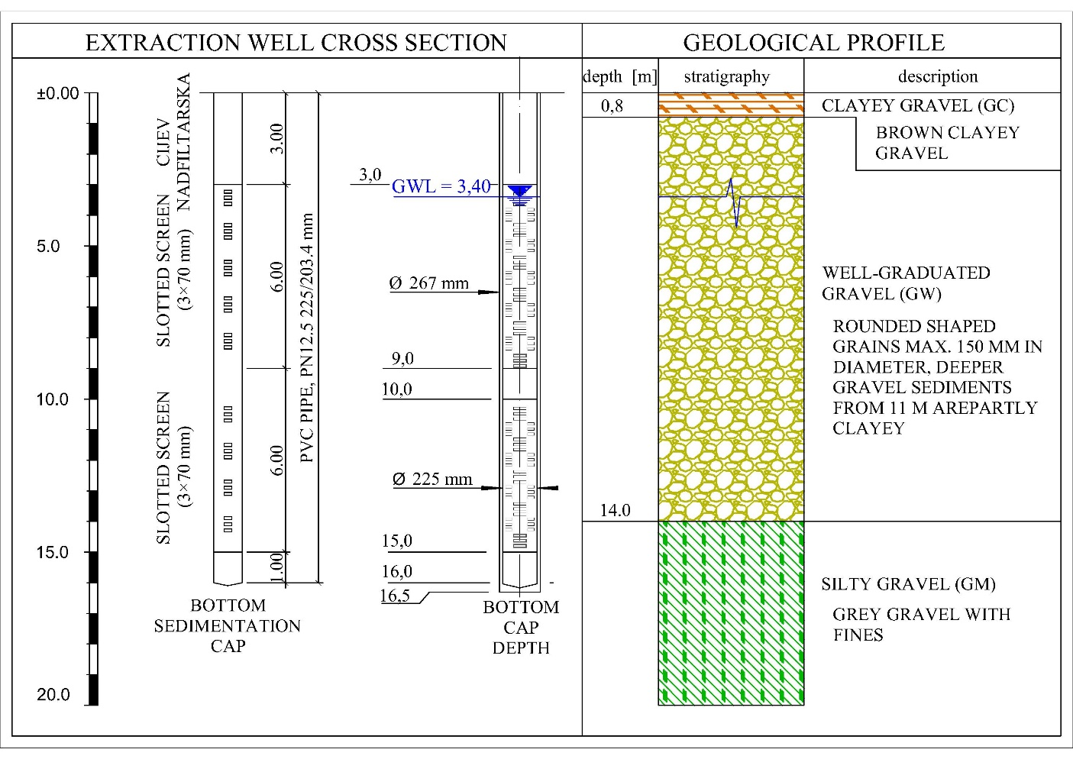
Geological profile, extraction well cross section

Slide 7
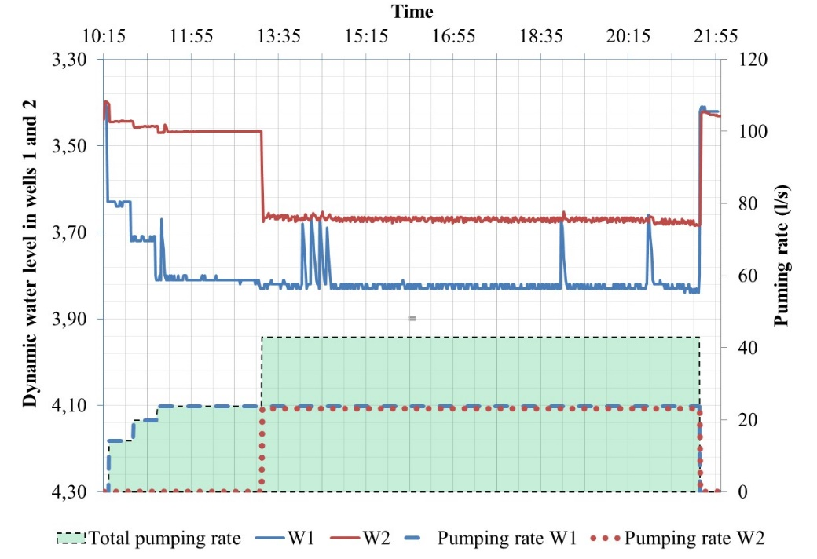
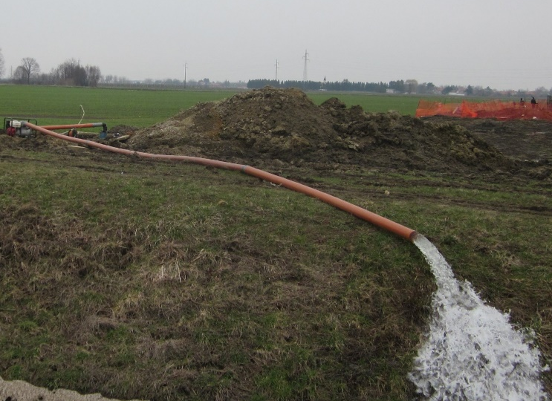
In-situ measurements of aquifer characteristics
A reliable way of determining aquifer parameters is a pumping test, which had two specific goals in this case:
determining aquifer parameters
measuring groundwater lowering as a consequence of pumping, in order to estimate the settlement of the surrounding terrain.

Slide 8
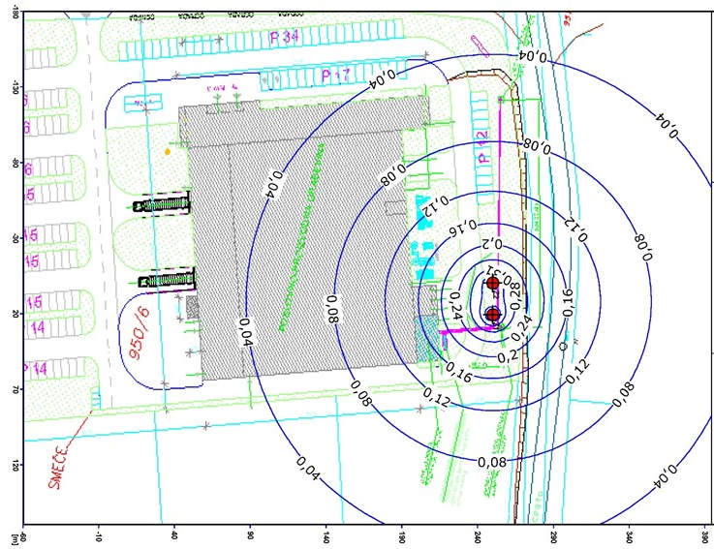
Groundwater lowering as a consequence of pumping
The groundwater lowering caused additional stress in the foundation soil as a consequence of the change in effective stress. The additional stress in this specific case is $∆σ=1.5kN/m^{2}$. Considering the fact that the additional stress caused by construction weight and other external factors was considerably greater, the mentioned influence can be disregarded.

Slide 9
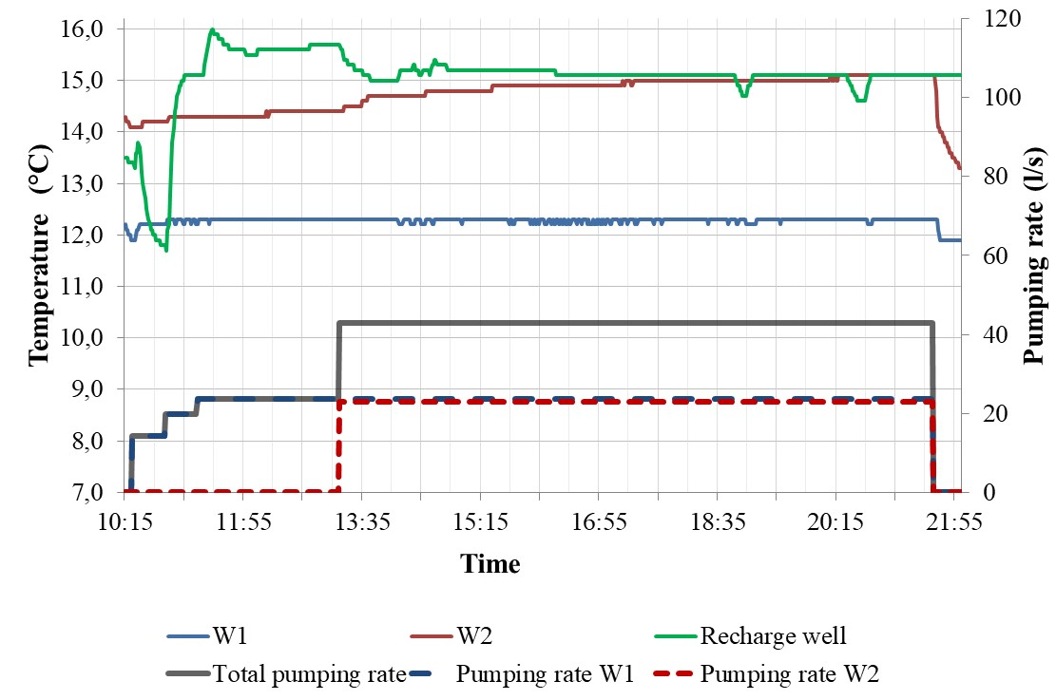
Thermal breaktrought
Water that returns into the ground through the recharge well disturbs the existing condition of the temperature field, and establishes a new, unsteady temperature field, i.e. causes the occurrence of temperature imbalance [16]. When the extraction well is influenced by the temperature imbalance, a change occurs in the temperature of the pumped water - this is called thermal breakthrough.

Slide 10
Conclusions
The groundwater heat pump is an energy-efficient and environmentally friendly building heating and air-conditioning system. One of the major prerequisites effecting the functionality of such a system are the hydrogeological parameters of the aquifer. By analyzing their values an estimate can be given on the feasibility and the efficiency of the GWHP system for a specific case.
The northwest part of Croatia is rich in groundwater; along with favorable hydrogeological conditions, these facts comprise the large potential for GWHP system construction on a larger scale. Design based on quality data can ensure optimal exploitation of groundwater potential, as well as the prevention of possible unwanted side effects during exploitation. Investigation works, including pump tests and drilling, can determine the aquifer hydrogeological characteristics, as well as parameters required for the analysis of the effects of groundwater pumping on terrain settlement.
Design solutions, and consequently the final system efficiency, depend on the scope of investigation works. In order to prevent thermal breakthrough, recharge wells need to be planned at an adequate distance downstream of the extraction wells, taking into account the hydraulic gradient, hydraulic conductivity and other relevant parameters.

