Slide 1
Redox behavior of central-acting opioid Tramadol and its possible role in oxidative stress
Uriel Abe Contardi¹, Mateus Morikawa¹ and Douglas Vieira Thomaz^{2,*}
¹ Federal University of Technology - Paraná;
² Federal University of Goiás
* Correspondence: douglasvthomaz@gmail.com;

Slide 2
Abstract:Tramadol (TRA) is a central acting opioid whose biological activities are achieved by interaction with several bodily receptors such as μ-opioid receptors. Considering that central acting drugs may promote oxidative stress, what could lead up to neurodegeneration, this work reported the investigation of the redox behavior of TRA by electrochemical and semi-empirical quantum chemistry approaches (i.e. voltammetry and extended Hückel method - EHM) in order to study TRA prooxidant features. Electrochemical results showcased that TRA exhibited two anodic peaks, namely: 1a at E_{p1a} ≈ + 0.03 V and 2a at E_{p2a} ≈ + 0.8 V; and a cathodic peak at E_{p1c} ≈ - 0.01 V, whereas the quantum chemistry model suggested that the highest occupied molecular orbital n = 0 (HOMO-0) was associated with the tertiary amine in TRA molecule, while HOMO-1 and the lowest unoccupied molecular orbital n = 0 (LUMO-0) were associated with the aromatic benzene ring. The findings were then use to propose an electrooxidation pathway according to the observations and compared to literature, what further offered hints about TRA prooxidant nature. In conclusion, the work herein reported showcases that voltametric and semi-empirical quantum chemistry approaches can be correlated to investigate the redox behavior of CNS-acting compounds.
Keywords: antioxidant; analgesic; neurodegeneration;
electrochemistry; quantum chemistry.

Slide 3
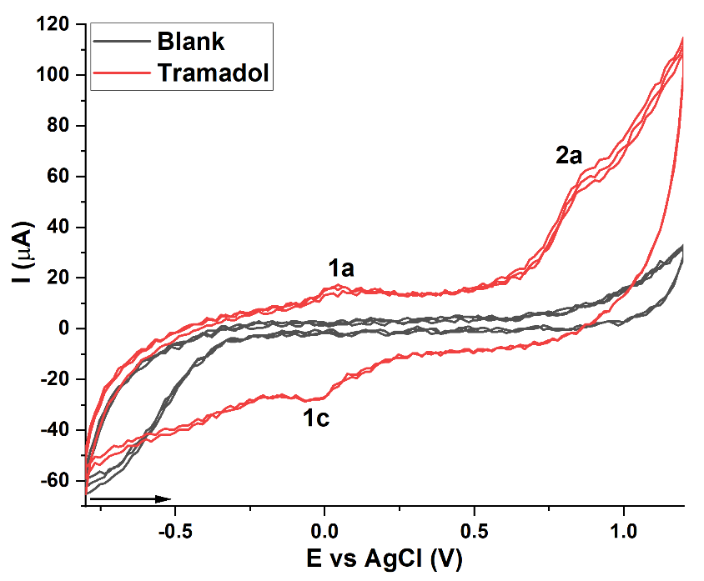
Results and Discussion
In order to primarily evaluate TRA redox behavior at pencil graphite electrode surface, cyclic voltammetries were conducted in triplicates without electrode surface renewal. Results are showcased in figure 1, wherein a blank assay conducted in triplicates with a clean electrode in phosphate buffered saline (PBS) - pH 7.0 is displayed for comparison.
Through cyclic voltammetry, TRA exhibited two anodic peaks, namely: 1a at E_{p1a} ≈ + 0.03 V and 2a at E_{p2a} ≈ + 0.8 V; and a cathodic peak at E_{p1c} ≈ - 0.01 V (Figure 2).
The anodic peaks suggest that electroactive moieties in TRA chemical structure underwent oxidation, while the cathodic peak suggest reduction [1];
Moreover, the faradaic current ratio showcased by peaks 1a and 1c, suggests at least some degree of reversibility, hence normalized I_{pa}/I_{pc} ≈ 1. Peak 2a, however, did not showcase hints of reversibility (Figure 2) [2];
Figure 1. Cyclic voltammogram of TRA. Anodic peaks 1 and 2a suggest the oxidation of TRA at pencil graphite electrode surface, while cathodic peak 1c suggest reduction. The blank assay was performed in 1 ml PBS solution, pH 7.0.

Slide 4
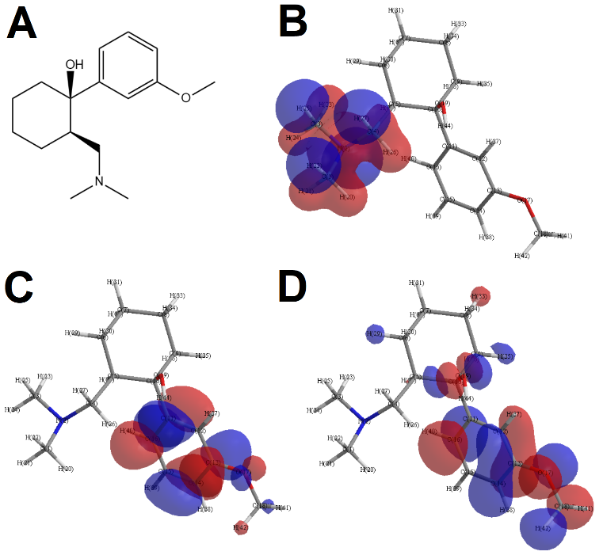
Results and Discussion
After the execution of the electrochemical assay, TRA molecule underwent steric energy minimization and quantum calculations by EHM. Results of the rendered model are showcased in Figure 2 and Table 1.
Results gathered by EHM suggest that HOMO-0 is associated with the tertiary amine in TRA molecule, while HOMO-1 and LUMO-0 are associated with the aromatic benzene ring (Figure 2B,C and D);
An interesting feature was that in HOMO-1, the rendering of the electric orbital also encompassed the methoxyl moiety (Figure 2D);
Considering that smaller energy gap values favor the occurrence of redox processes [3], therefore HOMO-n and LUMO-n can be correlated to the thermodynamic feasibility of oxidation or reduction [4];
Figure 2. TRA molecule (A) and graphical rendering of its HOMO-0 (B), LUMO-0 (C) and HOMO-1 (D). Negative charges are rendered in blue while positive charges are rendered in red.

Slide 5
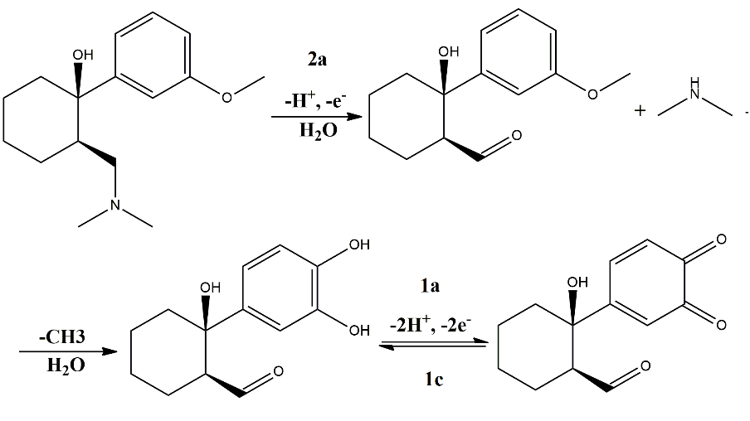
Results and Discussion
After the electrochemical and quantum chemistry investigation of TRA redox processes, the findings of these techniques were correlated to allow us to propose an electrooxidation pathway for this drug. Results are showcased in Figure 3.
Figure 3. Proposed electrooxidation pathway for TRA molecule.
The proposed electrooxidation showcased in figure 3 contemplates the irreversible oxidation of the tertiary amine suggested by HOMO-0 graphical rendering, followed by demethylation and the formation of a catechol-quinone system in the aromatic benzene ring wherein HOMO-1 and LUMO-0 renderings were displayed;
Each electrooxidation step is marked by its particular faradaic signal, i.e. 2a, 1a and 1c;

Slide 6
Results and Discussion
After the electrochemical and quantum chemistry investigation of TRA redox processes, the findings of these techniques were correlated to allow us to propose an electrooxidation pathway for this drug. Results are showcased in Figure 3.
Figure 3. Proposed electrooxidation pathway for TRA molecule.
the oxidation of amines is well reported in literature regarding voltametric investigations, being of ≈ +0.8 V the most common electric potential value associated to this phenomenon [5], what is nonetheless in consonance with our results;
Furthermore, the catechol-quinone system is reported to occur at electric potentials close to the ones herein depicted, and the proposed electrooxidation of TRA follows a similar mechanism to other outreaches in literature [6].

Slide 7
Conclusions
This work reported the investigation of the redox behavior of TRA by electrochemical and semi-empirical quantum chemistry approaches (i.e. voltammetry and EHM). Electrochemical results showcased that TRA exhibited two anodic peaks, namely: 1a at Ep1a ≈ + 0.03 V and 2a at Ep2a ≈ + 0.8 V; and a cathodic peak at Ep1c ≈ - 0.01 V, whereas the quantum chemistry model suggested that HOMO-0 was associated with the tertiary amine in TRA molecule, while HOMO-1 and LUMO-0 were associated with the aromatic benzene ring. The findings were then use to propose an electrooxidation pathway according to the observations and compared to literature, what further offered hints about TRA prooxidant nature. In conclusion, the work herein reported showcases that voltametric and semi-empirical quantum chemistry approaches can be correlated to investigate the redox behavior of CNS-acting compounds.
[1] Thomaz, D.V.; Peixoto, L.F.; de Oliveira, T.S.; Fajemiroye, J.O.; da Silva Neri, H.F.; Xavier, C.H.; Costa, E.A.; Alcantara dos Santos, F.C.; de Souza Gil, E.; Ghedini, P.C. Antioxidant and neuroprotective properties of Eugenia dysenterica leaves. Oxid. Med. Cell. Longev. 2018, 2018, doi:10.1155/2018/8601028.
[2] Thomaz, D.V.; Filho, A.M. de A.; Macedo, I.Y.L.; Rodrigues, E.S.B.; Gil, E. de S. Predictive Modelling to Study the Electrochemical Behaviour of PdO, TiO2 and Perovskite-Type LaFeO3 Modified Carbon Paste Electrodes. Path Sci. 2019, 5, 4001–4007, doi:10.22178/pos.45-3.
[3] Rodrigues, E.S.B.; de Macêdo, I.Y.L.; da Silva Lima, L.L.; Thomaz, D.V.; da Cunha, C.E.P.; de Oliveira, M.T.; Ballaminut, N.; Alecrim, M.F.; de Carvalho, M.F.; Isecke, B.G.; et al. Electrochemical characterization of central action tricyclic drugs by voltammetric techniques and density functional theory calculations. Pharmaceuticals 2019, doi:10.3390/ph12030116.
[4] Thomaz, D.V.; de Oliveira, M.G.; Rodrigues, E.S.B.; da Silva, V.B.; Santos, P.A. Dos Physicochemical investigation of psoralen binding to double stranded dna through electroanalytical and cheminformatic approaches. Pharmaceuticals 2020, doi:10.3390/ph13060108.
References
[5] Thomaz, D.V.; de Oliveira, M.T.; Lobón, G.S.; da Cunha, C.E.P.; Machado, F.B.; Moreno, E.K.G.; Leite, K.C.S.; Ballaminut, N.; Alecrim, M.F.; de Carvalho, M.F.; et al. Development of Laccase-TiO2@carbon paste biosensor for voltammetric determination of paracetamol. Int. J. Electrochem. Sci. 2018, 13, doi:10.20964/2018.11.61.
[6] Zimmermann, S.G.; Schmukat, A.; Schulz, M.; Benner, J.; Gunten, U. Von; Ternes, T.A. Kinetic and mechanistic investigations of the oxidation of tramadol by ferrate and ozone. Environ. Sci. Technol. 2012, doi:10.1021/es203348q

Slide 8
Acknowledgments

