Slide 1
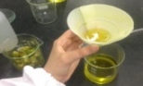
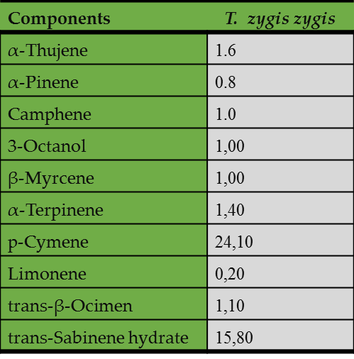
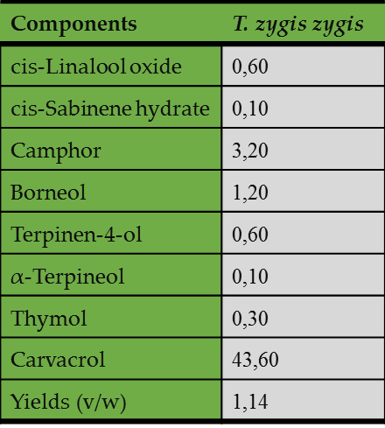
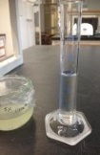
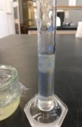
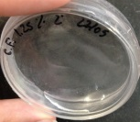
Physical-chemical properties of the phenolic compounds of Humulus lupulus and aromatic plant terpenes; potential for use in a cosmetic formulation
Briolanja dos Santos¹, Olivia Pereira^{1,2}, Luis Pedros³, Maria João Sousa ^{1,2}
¹ Instituto Politécnico de Bragança (IPB);
² Mountain Research Center (CIMO), Bragança Polytechnic Institute, Campus Santa Apolónia, Aparteda 117, 5301-855 Bragança, Portugal. Bragança Polytechnic Institute- Agraria de Bragança Highter School;
³ Centro de Estudos do Ambiente e do Mar (CESAM), Faculdade de Ciências da Universidade de Lisboa, Centro de Biotecnologia Vegetal (CBV), C2, Piso 1, Campo Grande, 1749-016 Lisboa, Portugal.
Introduction
The Hops (Humulus lupulus L.) are known worldwide as an essential flavor in the beer industry. Its compounds have been showing health benefits in terms of phytochemical, pharmacological and biological profiles, due to their antimicrobial, antioxidant, anti-inflammatory and anticancer activities.[1]
Objectives
This study intends to develop a gel formulation incorporating hydroalcoholic extracts of different varieties of hops such as Cascade, Polaris and Spontaneous, from the cones and the vegetative plant parts, in different percentages.
Material and Methods
The essential oil of Thymus zygis was used as a natural conservative and the analysis of the composition was made by GC and GC-MS [2]
Preparation of extracts by solid-liquid extraction with an 80% etanolic solution
-Varieties:Cascade,Polaris, and
-Spontaneous
Determination of physical-chemical parameters and stability and ability to inhibit microbial growth in bacteria and yeast;
Analysis of phenolic compounds by Folin-Ciocalteu.
Results
In hop extracts there was no microbial activity;
The various dilutions of thyme zygis oil at 5% were tested on Escherichia coli bacteria: MIC (minimum inhibitory concentration) was 1/8 and MBC (minimum bactericidal concentration) was 1/16, Staphylococcus aureus: MIC = 1/32 and MBC = 1/64 and Pseudomonas aeruginosa: MIC = 1/2 and MBC = 1/4.
The relative density obtained values ​​of 1 and 0.857;
In the light test there was phase separation in the samples, which may be related to the manufacturing technique of the formulations;
For the yeast Candida albicans, discs of various dilutions of the essential oil of thyme zygis at 5% were placed, the halos went to 1/2 had 0.95cm, 1/4 had 0.6cm, 1/8 had 0.2cm and for 1/16 there was no halo;
Table 1: Yields and percentage composition of the essential oils isolated from the aerial parts of T. zygis zygis collected during Flowering state.
The yield of the essential oil of Thymus zygis zygis, based on the dry mass of the plant, was as follows 1.14%;
GC-MS analysis of the essential oil of T. zygis zygis oil showed the presence of Carvacrol with 43.6%, followed by Cymene 24.10% and trans-Sabinene hydrate 15.8%.
Its total phenolic compounds in the hop varieties are more concentrated in the flowers than in the vegetative parts;
Table 3: For the yeast Candida albicans, disks of various dilutions of the hop varieties (Cascade, Polaris and Spontaneous) of the vegetative and floral parts were placed, the halos were:
Conclusions
Table 2: Total phenol compounds expressed in Gallic acid 1-hydrate, in the different plants extracts
However, this formulations anti aging with phenols from Hop can be development in order to obtain formulations with relevant properties for the consumers and the cosmetic industry.
References
[1] Goes, H., Morais, J. S., Pedro, L., & Sousa, M. J. (2019). Estudo cromatográfico de compostos bioactivos em cultivares e espontâneos de lúpulo. Bragança.
[2] Figueiredo, M. V. B., Martinez, C. R., Burity, H. A., and Chanway, C. P. (2008). Plant growth-promoting rhizobacteria for improving nodulation and nitrogen fixation in the common bean (Phaseolus vulgaris L.). World J. Microbiol. Biotechnol. 24, 1187–1193. doi: 10.1007/s11274-007-9591-4
Acknowledments
The authors thank the Foundation for Science and Technology (FCT, Portugal) and the ERDF under the PT2020 Program for their financial support to CIMO (UID / AGR / 00690/2019).

