Slide 1

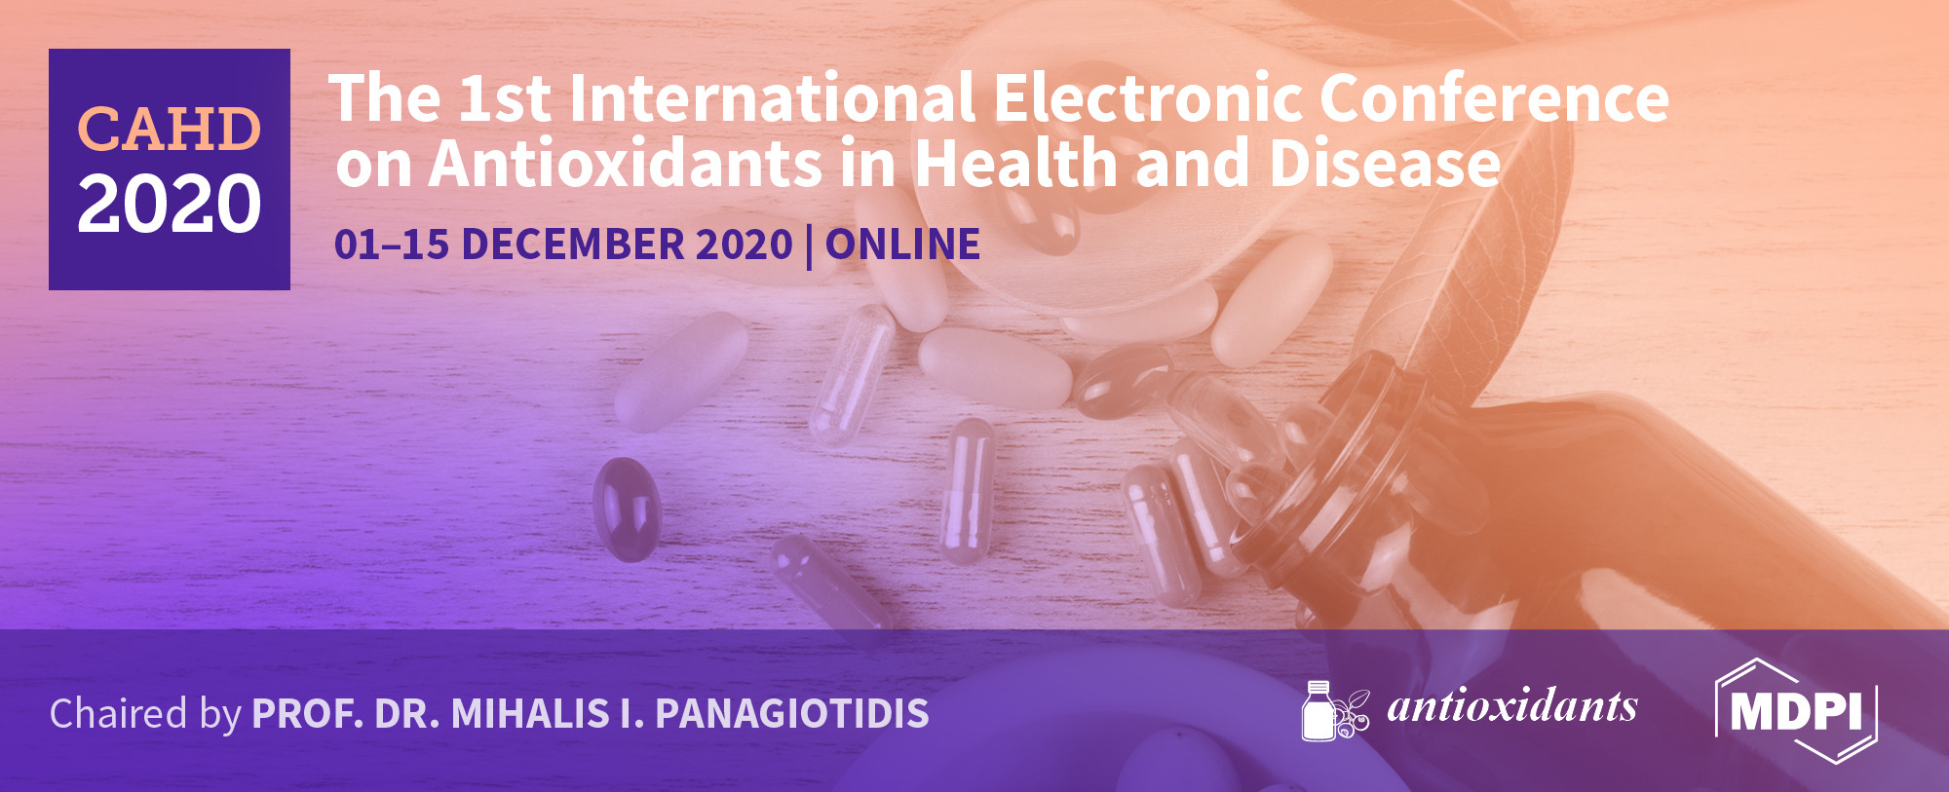

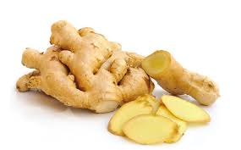
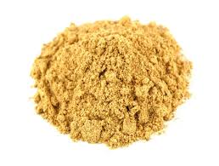
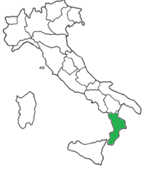
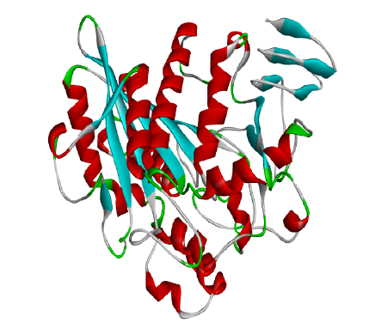
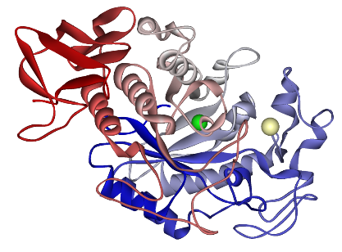
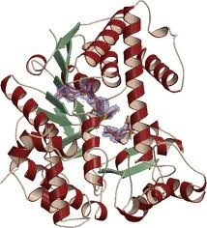
Influence of organic and conventional agricultural practices on chemical profile, in vitro antioxidant and anti-obesity properties of Zingiber officinale Roscoe
Monica Rosa Loizzo^{1,*}, Patrizia Formoso¹, Mariarosaria Leporini¹, Vincenzo Sicari², Tiziana Falco¹, Rosa Tundis¹
¹Department of Pharmacy, Health and Nutritional Sciences, University of Calabria, 87036 Arcavacata di Rende (CS), Italy. (Email: monica_rosa.loizzo@unical.it)
²Department of Agraria, University “Mediterranea” of Reggio Calabria, Salita Melissari, Feo di Vito, Reggio Calabria (RC), 89124, Italy
INTRODUCTION
Spices have been in use for thousands of years in cooking to enhance the sensory quality of food (flavour, colour, pungency, food additive etc.). In recent years, the physiological functionality of food spice, used in traditional cooking, has received much attention due to the increasing interest in human health and has been studied in vitro and in vivo by many research groups.
Zingiber officinale Rosc. (ginger) is a rhizomatous herb belonging to the family Zingiberaceae. The rhizome is extensively used around the world as spice in culinary, beverages and herbal medicinal practices to treat a wide range of diseases such as rheumatic disorders, cold symptoms, fevers, gastrointestinal complications, motion sickness, bronchitis, diabetes, cancer, etc. [1]. Moreover, it was used to treat a wide range of diseases including metabolic syndrome (MetS). MetS is a group of risk factors, including insulin resistance and consequently impaired glucose tolerance, dyslipidaemia, obesity, hypertension and the oxidative stress plays an important role. It is estimated that MetS affects 25% of the population [2]. The efficacy of natural products especially derived from vegetables and spice, largely consumed worldwide, is a topic of great interest not only to cure but also to prevent the onset of the disease.
In this study the influence of organic (OR) and conventional (CONV) agricultural practices on chemical profile and nutraceutical properties of Zingiber officinale Roscoe spice was evaluated.
MATERIALS AND METHODS
Sample and extraction procedure
Commercial dried ginger powders from conventional (CONV) (Z1-Z4) and organic (OR) (Z5) agricultural practices were bought in the market in Cosenza, Calabria (Italy). Ginger powder (5 g) were exhaustively by ultrasound assisted maceration process with ethanol (48h x 3 times). The resultant solutions were dried under reduced temperature and pressure using a rotary evaporator to give extraction yield in the range 0.24-0.85 g for Z4 and Z1, respectively.
Total Phenols, flavonoids and carotenoids content
Total phenols, flavonoids and carotenoids content was determined as previously reported by Leporini et al. [3]
In vitro antioxidant activity
Antioxidant compounds may act in vivo through different mechanisms of action. For this reason, no single method can fully evaluate the antioxidant capacity of food since levels of single antioxidant in food do not necessarily reflect their antioxidant activity. Therefore, to investigate the antioxidant activity of chemicals choosing an adequate assay based on chemicals of interest is critical. In a multi-target approach was used to test the antioxidant activity by using DPPH, ABTS, β-carotene bleaching, and FRAP assays [3]. DPPH and ABTS test are used to evaluate the radical scavenging activity, the β-carotene bleaching assay as a mimetic model of lipid peroxidation in biological membranes while, FRAP test to evaluate the effect on iron, one of the most important ions involved in oxidation process. RACI and GAS approaches were used to evaluate samples with the highest antioxidant potential.
In vitro hypoglycaemic and hypolipidemic effects
The hypolipidemic potential was investigated through inhibition of lipase while, the inhibition of carbohydrate hydrolysing enzymes, α-amylase and α-glucosidase, was used to evaluate the hypoglycaemic activity [3].
(a)
(b)
(c)
RESULTS AND DISCUSSION
Lipase (a), α-Amylase (b) and α-Glucosidase (c)
OR Ginger (Z5) showed the highest TPC and TFC with values of 39.27 and 15.38 mg/g dried weight (DW). Similar values were found for the CONV sample Z3. However, the following rank was found for TCC: Z1>Z5>Z2>Z3>Z4.
TPC, TFC and TCC in ginger samples
Sample from OR agricultural practices resulted the most active in all applied antioxidant test with particular reference to ABTS test where Z5 showed a stronger activity with IC₅₀ value of 0.81 μg/mL in comparison to the positive control ascorbic acid (1.70 μg/mL). The same observation was noted in FRAP assay.
In vitro antioxidant activity of ginger samples
Samples | TPC mg/g DW | TFC mg/g DW | TCC mg/g DW
Z1 | 21.84 ± 1.87^{d} | 8.42 ± 0.98^{c} | 17.05 ± 1.73ª
Z2 | 17.58 ± 1.78e | 6.11 ± 0.79^{d} | 10.30 ± 1.83^{c}
Z3 | 35.66 ± 2.3^{b} | 13.84 ± 1.01^{b} | 6.38 ± 0.74^{d}
Z4 | 22.64 ± 1.93^{c} | 8.36 ± 0.83^{c} | 5.37 ± 0.71e
Z5 | 39.27 ± 2.4ª | 15.38 ± 1.08ª | 14.67 ± 1.56^{b}
Sign. | ** | ** | **
Samples | DPPH IC₅₀ (µg/mL) | ABTS IC₅₀ (µg/mL) | FRAP μMFe (II)/g | β-carotene bleaching test IC₅₀ (µg/mL)
 |  |  |  | t=30min | t=60min
Z1 | 232.27 ± 4.3**** | 3.78 ± 0.9** | 32.71 ± 2.3**** | 54.11 ± 2.0**** | 59.80 ± 3.1****
Z2 | 215.38 ± 4.2**** | 6.28 ± 1.0**** | 47.68 ± 2.9*** | 27.08 ± 1.8**** | 22.92 ± 3.0****
Z3 | 10.79 ± 1.0** | 1.76 ± 0.7 | 102.50 ± 3.9**** | 6.63 ± 0.9*** | 6.81 ± 2.9***
Z4 | 9.80 ± 0.9** | 0.79 ± 0.06 | 91.21 ± 3.5**** | 16.57 ± 1.4**** | 13.95 ± 2.9****
Z5 | 7.91 ± 0.7* | 0.81 ± 0.05 | 100.95 ± 3.9**** | 8.13 ± 1.0**** | 7.80 ± 2.9****
Positive control
Ascorbic acid | 5.01 ± 0.8 | 1.70 ± 0.06
BHT |  |  | 63.2 ± 2.3
Propyl gallate |  |  |  | 0.09 ± 0.04 | 0.09 ± 0.04
RACI and GAS statistical approach confirmed the Z5 highest antioxidant potency followed by the CONV sample Z3.
Data are express as ± S.D. (n= 3). Differences were evaluated by one-way ANOVA followed by a multicomparison Turkey’s **p< 0.05. Means in the same column with different small letters differ significantly (p< 0.05). Sign: significant
Data are express as ± S.D. (n= 3). DPPH Radical Scavenging Activity Assay; Antioxidant Capacity Determined by Radical Cation (ABTS+); Ferric Reducing Antioxidant Power (FRAP). Ascorbic acid. BHT and Propyl gallate were used as positive control in antioxidant tests. Differences within and between groups were evaluated by one-way ANOVA followed by a multicomparison Dunnett’s test (α= 0.05): ****p< 0.0001. ***p< 0.001. **p< 0.01. compared with the positive controls.
RACI and GAS parameters
In vitro hypoglycaemic and hypolipidemic effects
of ginger samples
Moreover, the sample Z5 exhibited a promising lipase inhibitory activity with IC₅₀ value quite similar to the positive control orlistat (IC₅₀ values of 34.48 vs 37.42 mg/mL). Interesting were also, the results obtained for the sample Z4 against α-amylase and α-glucosidase enzymes with values statistically comparable with positive control acarbose.
Samples | α-Amilase IC₅₀ (μg/mL) | α-Glucosidase IC₅₀ (μg/mL) | Lipase IC₅₀ (μg/mL)
Z1 | 66.15 ± 1.4**** | 55.49 ± 1.5**** | 93.46 ± 1.7****
Z2 | 98.16 ± 2.3**** | 72.94 ± 1.8**** | 70.83 ± 1.5****
Z3 | 74.88 ± 1.8**** | 61.31 ± 1.4**** | 32.37 ± 1.4
Z4 | 55.49 ± 1.6** | 43.85 ± 1.3*** | 39.57 ± 1.8*
Z5 | 68.09 ± 1.5**** | 78.76 ± 1.9**** | 34.48 ± 1.9
Positive control
Acarbose | 50.12 ± 1.3 | 35.51 ± 0.9
Orlistat |  |  | 37.42 ± 1.0
CONCLUSION
Data are expressed as means ± S.D. (n= 3). Acarbose used as positive control in α-amylase and α-glucosidase tests. Orlistat used as positive control in lipase test. Differences within and between groups were evaluated by one-way ANOVA followed by a multicomparison Dunnett’s test (α= 0.05): ****p< 0.0001. ***p< 0.001. compared with the positive control.
Collectively, our results demonstrated the impact of agricultural practices on ginger health properties. Moreover ginger may serve as a potential dietary nutraceutical supplement to keep human beings healthy. Furthermore, it holds promise for becoming a natural food additive as an antioxidant agent. However, further in vivo studies will be needed to confirm the potential in humans and prove the safety of the products.
REFERENCES
[1] Afzal M, Al-Hadidi D, Menon M, Pesek J, Dhami MS. Ginger: an ethmomedical, chemical and pharmacological review. Drug Metab Drug Interact 2001;18:159–90.
[2] Rochlani, Y.; Pothineni, N.V.; Kovelamudi, S.; Mehta, J.L. Metabolic syndrome: Pathophysiology, management, and modulation by natural compounds. Ther. Adv. Cardiovasc. Dis. 2017, 11, 215–225.
[3] Leporini, M.; Loizzo, M.R.; Sicari, V.; Pellicanò, T.M.; Reitano, A.; Dugay, A.; Deguin, B.; Tundis, R. Citrus × Clementina Hort. Juice Enriched with Its By-Products (Peels and Leaves): Chemical composition, in vitro bioactivity, and impact of processing. Antioxidants 2020, 9, 298.

